Slide 1
Safety of Hydrogen Powered Industrial Trucks, Lessons Learned and Existing Codes and Standards Gaps
ICHS Conference – Sept 2011
Aaron Harris - aharris@nuvera.com
Notes:
This presentation shows the current status of codes and standards development efforts to date for the industrial truck application. This is not a summary of complete activity but rather an attempt to disseminate information on the current status and solicit input for gaps, potential pitfalls and provide a relative timeline for completion. References between standards are the responsibility of the individual organizations responsible for standards development.

Slide 2
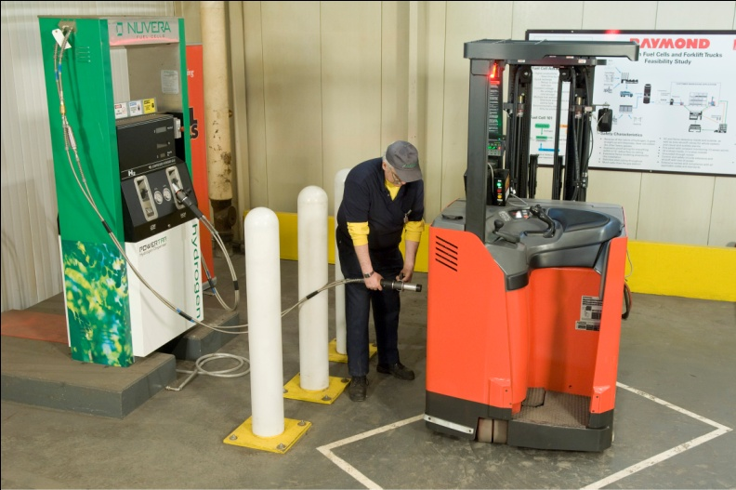
Agenda
Industrial Trucks
- Intro to FC powered Ind. Trucks
Codes and Standards
- Intro to C&S for Ind. Trucks
Safety Challenges
- Fundamental safety aspects
Comparison: Cars and Forklifts
- How do they compare with cars?
Lessons Learned and Gaps
- Where to go from here?
Notes:
The presentation will focus on 5 sections – first introducing the market and it’s applicable codes and standards. Then a short discussion of the fundamental safety aspects for industrial trucks. It is important to compare cars and forklifts as the majority of research has occurred in support of cars. The forklift market is a direct result of this research but there are differences that must be clearly understood. Finally, what are the next steps and challenges to address for industrial trucks? More over how can the evolution of the industrial truck market enable the automotive market.

Slide 3
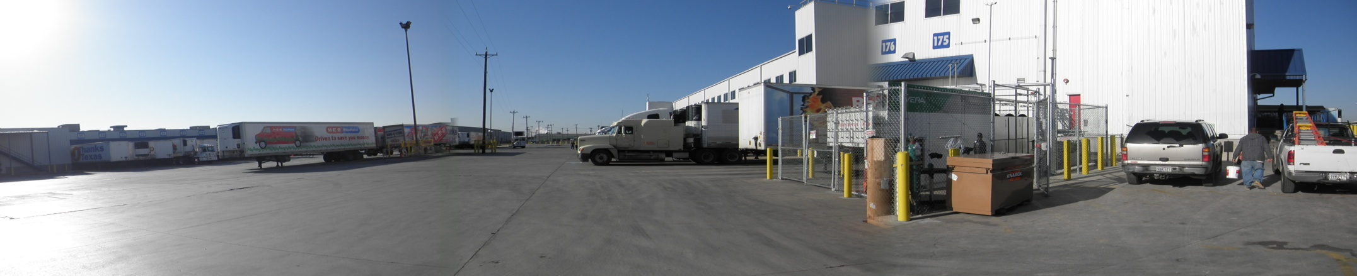
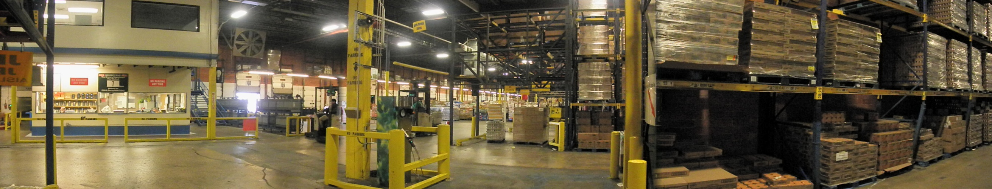
Hydrogen Warehouse
Hydrogen meets the end-user’s goals:
- Increase productivity
- Optimize floor space
- Optimize energy costs
- Improved corporate image
Proven fuel cell advantages:
- Refueling vs. Recharging
- Replace indoor battery charger with outdoor On-Site generation and storage
- On-Site Generation = on-demand generation
- “Green”, Retail brand names associated with national energy/security policies
~1500 vehicles
~300,000 refueling events per year
Notes:
The hydrogen warehouse works on its own. The benefit of ‘niche’ markets is the independence from the broader market. While the industrial truck ‘niche’ helps the long term strategy for automotive it also represents a viable market, one which could sustain fuel cell vehicle adoption without government “push”.
Over the past 5 years industrial trucks surged to the forefront of fuel cell vehicle applications. With more than 1000 vehicles and over 300,000 refueling events, the industrial truck market has entered the ‘early market’ phase of technology introduction. Much of this success is credit to development of light duty passenger vehicle fuel cells and refueling stations. Hydrogen powered industrial trucks are an ideal application for further advancing hydrogen safety, codes and standards. The industrial truck might also serve as a proving ground for components, methods and processes which apply to the broader vehicle market.
Picture – Panoramic shots of the installation at HEB in San Antonio, TX - an ARRA supported site with 50 kg/day on-site generation and 14 reach trucks. Bottom – indoor dispenser

Slide 4
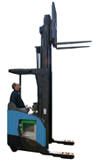
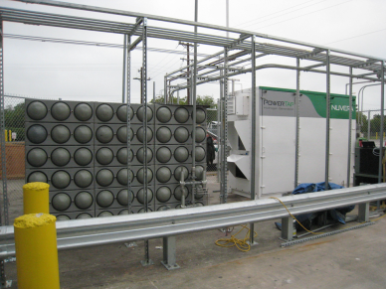
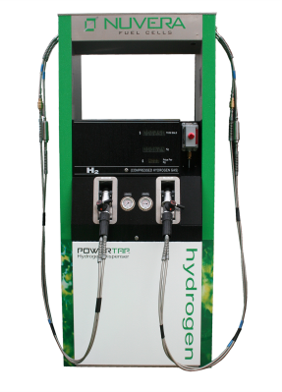
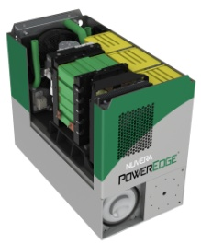
Component Introduction
1
2
3
Onsite Hydrogen Generation
Outdoor Compression and High Pressure Storage
Indoor Dispensing
Battery replacement in existing electric forklifts
4
Notes:
A short list of the components of a hydrogen powered industrial truck application.
Shown are Nuvera’s products:
1 - PowerTap – 50kg/day steam methane reformer with compressor and storage
2 - Hydrogen Dispenser – shown is a dual pressure dispenser however simpler single pressure dispensers are more common
3 – Industrial truck – class 2 “reach truck” commonly used in dry good warehouses, a PowerEdge RL25 module is installed in the vehicle. This is a standard electric industrial truck with the battery replaced and no modifications to the vehicle
4 – PowerEdge RL25 unit; design cutaway showing the fuel cell stack, batteries and one of the two fuel containers

Slide 5
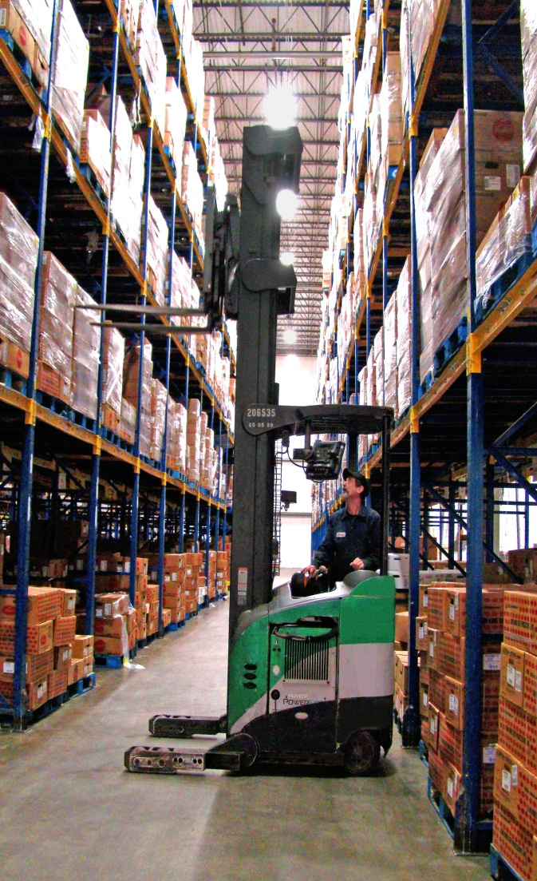
Safety Challenges
Struck By and Crush Hazards
  Tip over
  Regenerative Braking
  Distraction
Flammable Gas Release
  Battery Room vs. On board FC system
  Indoor Fueling
Hot Surfaces
  Exhaust
Release of Hazardous Energy
  High Pressure Gas
  Electric Circuits greater than 50V
Industrial Trucks associated with 57 fatalities in 2009.
Notes:
The industrial truck market present several safety challenges. Many are inherent to the operation of the truck however hydrogen fuel cell systems may positively or negatively impact those hazards.
The most common are “struck by” and crush hazards. While the vehicle is slow it is 3 times heavier than a car and operates in tight spaces.
Tip over – battery acts as counterweight, FC must replace the weight of the battery
Regenerative Braking – FC system must accommodate regenerative braking
Distraction – new technology, additional interfaces
Flammable Gas Release
- Hydrogen already exists in the warehouse from battery charging however this is isolated and controlled. The introduction of FC systems puts the
Hot Surfaces – Exhaust from an electric forklift will be alarming to employees.
Release of Hazardous Energy – stored energy in high pressure gas and electrical components is contained within the system, however the hazards exist particularly for service personnel.
Warehouse operations experienced 57 fatalities in 2009. The vehicles may travel slowly but they are 3 times heavier than a car.
Picture – PowerEdge RL25 unit operating at HEB in San Antonio, TX

Slide 6
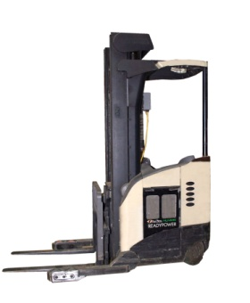
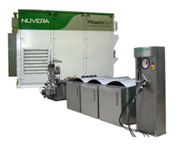
Codes and Standards –Ind. Trucks
Industrial Vehicle
Indoor Dispenser
Vehicle
NFPA 505
UL 2267
UL 583
ITSDF B56.1
Dispenser Component Standards
HGV 4.1 - Dispenser
HGV 4.2 - Hose
HGV 4.4 - Breakaway
HGV 4.5 - Priority and Sequencing
HGV 4.6 - Manual Valves
HGV 4.7 - Automated Valves
Refueling Guidelines
HPIT 2 and SAE J2601-3
Fuel Cell Power System
UL 2267
IEC 62282-4
350 Bar Fueling Receptacle/Nozzle Pair
SAE J2600
Fuel Cell Power System (Battery Replacement)
Generator
NFPA 2
H2 Quality – SAE, ASTM
ISO 16110-1,2
Fuel Cell System Components
Energy Storage – Batteries, Ultra-Caps
Power Conditioning Electronics
Regenerative Braking Dissipation
H2 Detectors/ Proof of Ventilation
Fuel Cell Stack and BOP
Heat Exchangers
Embedded Controls and Software
Tank
Hydrogen Pressure System
SAE J2919
Compression and Storage
NFPA 2
ASME BPVC - storage
HGV 4.8 – compressors
Installation
NFPA 2
NEC
ASME 31.12
HGV 4.10
ISO 20100
Hydrogen Pressure System Components
CSA HPIT 1
- Cylinders, valves, fittings, tubing
Notes:
Published documents are shown in bold, other documents are in various draft stages. This view shows the interaction of the various pieces of a fuel cell forklift operation and codes/standards associated with each piece. Beginning in the lower left the current method of integrating fuel cells with forklifts is to replace the lead/acid battery in a electric forklift with a fuel cell “power pack” which includes the fuel cell, balance of plant and fuel storage. Currently there is a great deal of work surrounding the advantages of using steel containers for fuel storage. The forklift vehcile is designed such that the battery (and the fuel cell replacement) act as the counterbalance for the vehicle. Therefore fuel cell systems which are traditionally designed to conserve weight must meet a minimum weight requirement. This has blossomed to uncover many small difference which exist between forklifts and cars. There are 2 standards efforts underway to define the fuel system and fuel system components for these vehicles. There is an existing UL standard for the “power pack” as a system and there are existing standards for the vehicles. Similarly there are CSA standards in various states of development for hydrogen dispensers. In the forklift application these dispenser would operate inside of the warehouse. Recent code changes have language to address the indoor use of hydrogen dispensers. Finally there is an interaction between vehicle and dispenser during refueling. This is managed in two ways: hardware and guidelines. The hardware used for vehicle to dispenser interface is SAE J2600 – this defines the nozzle and receptacle for the vehicles. The method of refueling, rate of fuel transfer and other key parameters for dispensing are addressed in the fire codes and a proposed standard HPIT2.

Slide 7
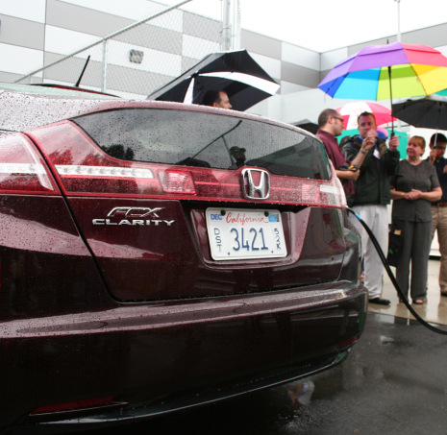
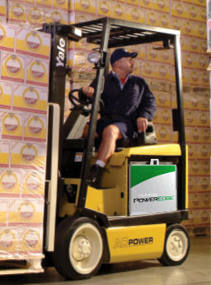
Comparison of Cars and Forklifts
Function | Industrial Truck | Light Duty Vehicle
Storage | 8hr Shift | 300 miles
Power | Peak power | Optimized (idle and peak)
Weight | Heavy is good | Light is good
Hybrid | Replaces battery | Replaces engine
Operational Life | <10yrs | 20yrs
Environment | Indoors (freezers) | Outdoors
User Interface | Separate | Integrated
System Pressure | 250 or 350 bar | 700 bar
Automotive Hydrogen Use
- 70-90 Million new cars/year
- 4-7 kg storage , 300 miles/fill, 1-2 fills/week…
- 8-10 kg per week per vehicle
- 0.5 - 1 kg/day
- 300-500 kg in 25 year life / vehicle
- Current US Vehicle Fleet: 300-400 vehicles
Industrial Truck Hydrogen Use
- 0.2 Million new industrial trucks/year
- 1-2 kg storage, 15-20 fills/week…
- 40 kg per week per vehicle
- 3-4 kg/day
- 4000 – 6000 kg in 10 year life/vehicle
- Current US Vehicle Fleet: 1000+ vehicles
Notes:
Car sales based on monthly averages provided by wall street journal - http://online.wsj.com/mdc/public/page/2_3022-autosales.html
Industrial Truck sales based on ITA North American sales number for 2005-2008.
Other estimates based on information gained through experience and are meant as relative estimates.
The basic idea – cars are the big market but aren’t used as much as industrial trucks.
Hydrogen powered industrial truck fleet is larger and uses much more hydrogen than the current automotive/bus fleet.
Picture – Left: A Honda FCX fuels at Nuvera in Billerica, MA. At right a forklift with at PowerEdge CM25 unit.

Slide 8
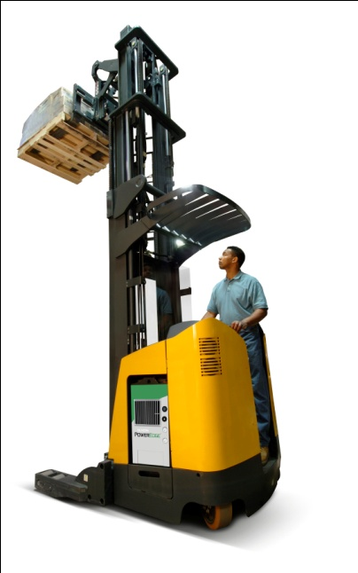

‘Niche’ to ‘Broad’ Market Comparison
Similarities
Engineering Development - fuel cell/battery hybrid vehicle systems, high-pressure hydrogen storage, regenerative braking, “Fuel Cell Range Extenders”
Safety - storage vessel performance, leak detection strategies, impact detection strategies, refueling
Codes and Standards Gaps – end of life control, aftermarket, consumer product vs. industrial use
Differences
Engineering Development - weight, tank size and pressure, power requirements, vehicle integration, indoor fueling
Safety – driver training, regulatory agency
Codes and Standards Gaps – use type 1 tanks, indoor refueling standards
Notes:
The engineering required for system design in both vehicles is very similar. Basic functions of electric vehicles are consistent, when engineering development is shared standards may be shared.
The safety needs are similar for both, leaks are leaks no matter the market, refueling strategies are also closely aligned.
Both applications face similar regulatory issues with regard to the end of life and aftermarket changes.
Where they differ, the two applications are very different. Weight is undesirable in the on-road, where it is required for the industrial truck. Industrial trucks are already electric vehicles and are normally found in caputured fleets.
Safety of the operator is controlled in different ways as well. The agencies that regulate forklfits (OSHA) are very different from cars/trucks/buses (USDOT).
All of the differences also represent areas for codes and standards development. These development efforts are unfortunately not as transferable to the broader market. Therefore the support effort must determine that it is worth the cost to gain the experience.
Pictures – Lower Left – A Fiat Panda which uses a Nuvera fuel cell stack on display at Boston’s Logan airport in 2010. Upper Right – Nuvera PowerEdge RL25 in a class 2 reach truck.

Slide 9
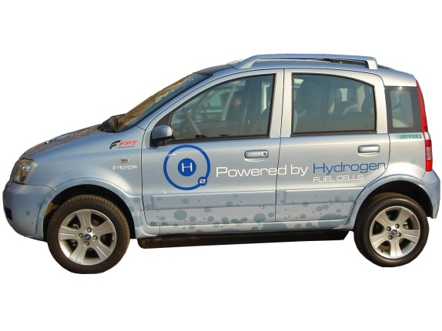
Codes and Standards - Automotive
Automotive
Station
Refueling Guidelines
SAE J2601
Dispenser Component Standards
HGV 4.1 - Dispenser
HGV 4.2 - Hose
HGV 4.4 - Breakaway
HGV 4.5 - Priority and Sequencing
HGV 4.6 - Manual Valves
HGV 4.7 - Automated Valves
Interface Standards
HGV 4.3 – Temperature Comp.
CAFCP Standard
H2 Quality Measurement
Weight and Measures
Tank
Hydrogen Pressure System
SAE J2579
Generator
NFPA 2
H2 Quality – SAE, ASTM
ISO 16110-1,2
Fuel Cell System Components
SAE J2615 – System Performance
SAE J2572 – Fuel Consumption Measurement
SAE J2574 – General Vehicle Safety
SAE J2617 – Stack Performance
SAE J2574 – Design for Recycling PEM stacks
Compression and Storage
NFPA 2
ASME BPVC - storage
HGV 4.8 – compressors
Installation
NFPA 2
NEC
ASME 31.12
HGV 4.10
ISO 20100
Notes:
The reference path for automotive is similar to the industrial trucks. Many more of the documents are published. Also keep in mind that the vehicle standards are FMVSS – Federal Motor Vehicle Safety Standards and are not shown in this slide. Only the fuel cell related standards are listed.

Slide 10
Codes and Standards –Ind. Trucks
Industrial Vehicle
Indoor Dispenser
Vehicle
NFPA 505
UL 2267
UL 583
ITSDF B56.1
Dispenser Component Standards
HGV 4.1 - Dispenser
HGV 4.2 - Hose
HGV 4.4 - Breakaway
HGV 4.5 - Priority and Sequencing
HGV 4.6 - Manual Valves
HGV 4.7 - Automated Valves
Refueling Guidelines
HPIT 2 and SAE J2601-3
Fuel Cell Power System
UL 2267
IEC 62282-4
350 Bar Fueling Receptacle/Nozzle Pair
SAE J2600
Fuel Cell Power System (Battery Replacement)
Generator
NFPA 2
H2 Quality – SAE, ASTM
ISO 16110-1,2
Fuel Cell System Components
Energy Storage – Batteries, Ultra-Caps
Power Conditioning Electronics
Regenerative Braking Dissipation
H2 Detectors/ Proof of Ventilation
Fuel Cell Stack and BOP
Heat Exchangers
Embedded Controls and Software
Tank
Hydrogen Pressure System
SAE J2919
Compression and Storage
NFPA 2
ASME BPVC - storage
HGV 4.8 – compressors
Installation
NFPA 2
NEC
ASME 31.12
HGV 4.10
ISO 20100
Hydrogen Pressure System Components
CSA HPIT 1
- Cylinders, valves, fittings, tubing
Notes:
Reminder of the codes and standards reference paths for industrial trucks.

Slide 11
Lessons Learned and Gaps
No one would want to put a steel tank on a vehicle
  Forklifts use batteries as the counterweight = steel tanks are feasible
  Steel tanks: low tech, low cost, fast fill w/o strict temp compensation
Niche markets will not grow faster than automotive
  200 - Cars
  1500 - Forklifts
  Refueling cycles are not a concern
    Cars = 1800 cycles in 20 years
    Forklift = 10,000 cycles in 10 years
Refueling standards are sufficient for all vehicles
  Indoor Fueling
  Use of the same nozzle/receptacle

Slide 12
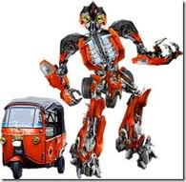


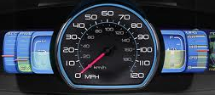
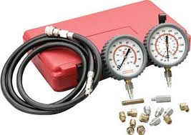
Lessons Learned and Gaps
Conversion Kit
Coordinate standards for “conversion kit” for battery replacement
Drive Off
Refueling “drive off “ prevention
– approx. 1 event per 200,000 fuelings
Regenerative Braking
Regenerative braking requirements
User Interface
Guidance for user interfaces
Leak and Pressure Testing
Consistent approach to leak and pressure testing – assembly and service
Notes:
There are several open technical items for the codes and standards to address.
Conversion Kits refers to codes and standards references which place responsibility on fuel cell replacement system integrators and truck OEMs to communicate to the end user. This process is currently used in the industry for converting a gasoline powered truck into a LPG truck. These references can establish minimum criteria and provide guidance for making adjustments to the vehicle nameplate.
Drive off – refers to an incident where a user drive the vehicle while still connected to the dispenser.
Regenerative Braking – Need to provide guidance for identifying regenerative energy systems and the fuel cell system capability to accept the regenerative energy from the vehicle
User Interface – the slide on safety challenges highlighted the distraction which a user interface could present to the operator.
Leak and Pressure Testing – the current standards do not seem consistent with regard to the test pressure requirement for the vehicle system (test to 100% of the working pressure) and the dispenser target fill pressure (125% of working pressure)

Slide 13


Lessons Learned and Gaps
Counting Fill Cycles
Cyclic fatigue concerns requires close monitoring of fill cycles on each tank
Decommissioning Tanks At End of Life
  Regulation and the aftermarket
Cylinder Handling
Design and manufacture only as good as the installation
Escapee Scenario
Use of SAE J2600 Nozzle/Receptacle for two separately regulated markets
Forklift refueled at retail gas station
Car refueled at warehouse or industrial truck fleet fueling station
Notes:
Counting fill cycles – concerns regarding the cyclic fatigue life of type 1 cylinders lead to a DOE supported test program at Sandia National Labs. This testing will be represented in a standard HPIT 1 which may be available for comment early Oct 2011.
Decommissioning of tanks – this is a lesson learned from NGV activities where tanks are resold after decommissioning. Need guidance, regulation and enforcement,
Cylinder Handling – another lesson learned from NGV activities where tanks failed due to mishandling or improper mounting. Forklifts have poor damping therefore shock and vibration of mounted tanks needs proper guidance
Escapee Scenario – The use of common components in different applications opens the door to using a dispenser beyond its intended purpose.

Slide 14
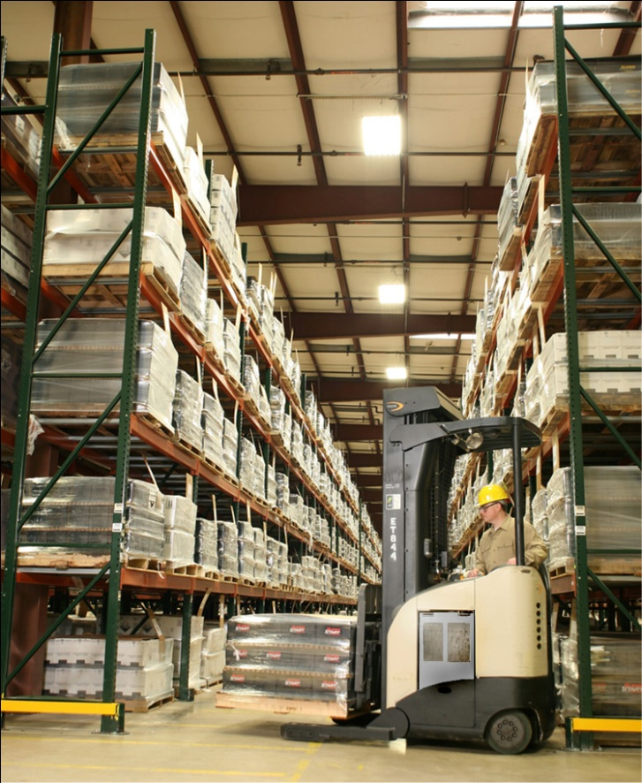
Open Market Items
Codes and Standards Harmony and Implementation
Harmony - UL 583, UL 2267 and NFPA 505
- Implementation – Comprehensive revision to UL2267 to reflect industry standards
- Implementation – Interpretation issues with “new” separation distance tables in NFPA
Government Policy/ Codes and Standards Interaction
- Regulatory Parent Agencies and Involvement
  Industrial Trucks – OSHA – Dept of Labor
  Automotive - FMVSS – Dept of Transportation
Certification and Customer Confidence
Certification path not yet clearly defined
Hurdle for small companies to pursue certification of not yet proven product
Difficult for customers to trust uncertified products
Less diverse customer base (not as many enthusiasts)
- Customers need gentle nudge to field new technology
Notes:
Final notes on the immediate needs for codes and standards.
UL needs to help resolve issues created by conflicting vehicle and battery replacement standards. This effort must also recognize the new designation of CGH type trucks in NFPA 505 (release in 2011)
UL 2267 is not consistent with industry practice and holds too many questions for manufacturers struggling to make both battery replacement and integrated truck designs.
NFPA 2,55 and 52 separation tables represent a new approach to evaluating hazards for fire codes but also need to be made effective for authorities having jurisdictions. Already facing issues relating to interpreting the code and justification for many niche applications.
Code development cannot outpace enforcement. The same active dialog that exists between industry and government regulators for FMVSS must exist with OSHA and truck OEMs for this new type of industrial truck.
Returning to the original reference of the bird in the nest, there is a proverbial chicken and egg situation regarding certification. Warehouse operators/owners are not necessarily new technology enthusiasts. They deal with tight margins and need reliable tools. They are less likely to accept risk of OSHA fines for using uncertified equipment and less likely to trust reliability in uncertified equipment. At the same time OEMs are not experienced in certification and the certification path remains uncleardue to the lack of harmony in the existing standards. Initial attempts at certification may prove fruitless if regulations change, resulting in the loss of captial in the cash-strapped phase for a company moving from demonstration to deployment.
Picture – Nuvera/East Penn developed ReadyPower module in use at East Penn MFG Topton,PA warehouse.

Slide 15


F U E L C E L L S
EXPERIENCE
The Future of Energy
®
Notes:
Nuvera – Sintesi concept car, 4 wheel mounted electric motors to maximize performance.

