Slide 1
TPR-XAFS study for hydrogen recombination reaction of platinum metal nanoparticle catalysts
Daiju Matsumura, Takuya Tsuji, Yasuo Nishihata
Japan Atomic Energy Agency
Masashi Taniguchi
Daihatsu Motor Co., Ltd.
Hirohisa Tanaka
Kwansei Gakuin University
1
Notes:
The title of my presentation is “TPR-XAFS study for hydrogen recombination reaction of platinum metal nanoparticle catalysts”.
Here are collaborators of this presentation.

Slide 2
Background
Hydrogen generation at nuclear power plant
○Radiolytic decomposition of water
○Reduction reaction of water molecules on a surface of zirconium alloy cladding of a fuel rod
Severe accident at Fukushima nuclear power plant: Hydrogen explosion
Hydrogen management system using external electric power could not work due to shut down of all outside electric supplies
Needs of catalyst without electric power supply for hydrogen management
Passive Autocatalytic Recombiner (PAR)
Hydrogen recombination reaction (Water formation reaction)
H₂ + 1/2O₂ = H₂O
Precious metal nanoparticle such as Pd and Pt are used
2
Notes:
First, I want to talk about background of this experiment.
Hydrogen gas management is big issue to maintain safe operation of nuclear power plants.
Some paths of hydrogen gas generation are assumed such as radiolytic decomposition of water and reduction reaction of water molecules on a surface of zirconium alloy.
In the case of the severe accident at Fukushima nuclear power plant, hydrogen management system which needs external electric power could not work because all outside electric supplies had shut down.
An alternative hydrogen management system which does not rely upon external electric power is required.
Hydrogen recombination reaction, which is the same with water formation reaction between hydrogen and oxygen gases, is a promising candidate to reduce hydrogen gas.
Precious metal nanoparticles such as Pd and Pt are used as catalysts of the hydrogen recombination reaction.
This reaction itself is exothermic and passive, so that it does not need external power supply.
From such merits of the reaction, the development of the catalytic hydrogen management system, called as passive autocatalytic recombiner (PAR), is greatly hoped.

Slide 3
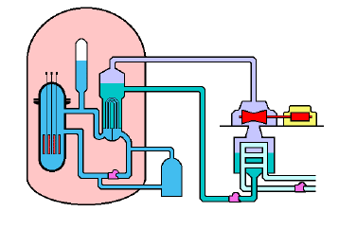
Hydrogen recombination catalysts
① Exhaust gas line
② Power plant building
③ Containment building
Containment building
②
③
Condenser
①
Reactor vessel
③ In containment building, CO generation is assumed in severe accident
→ CO poisoning effect of hydrogen recombination reaction should be studied
→ Structural change of Pt nanoparticles during catalytic reaction is studied by in situ and time-resolved X-ray Absorption Fine Structure (XAFS)
3
Notes:
Hydrogen recombination catalysts, water formation catalyst can be used at some positions in nuclear power plant.
One is exhaust gas line in power plant such as at condenser.
Another position is inner side of nuclear power plant building.
Then, most important and challenging position is inner side of containment building.
In containment building, CO generation is assumed in the case of severe accident via molten corium concrete interaction.
CO is famous gas for having poisoning effect on metal nanoparticle catalyst, so CO poisoning effect on hydrogen recombination reaction should be studied.
We have observed the structural change of Pt metal nanoparticles during catalytic reaction by using XAFS technique.
From next slide, I will explain the details of experiment.

Slide 4
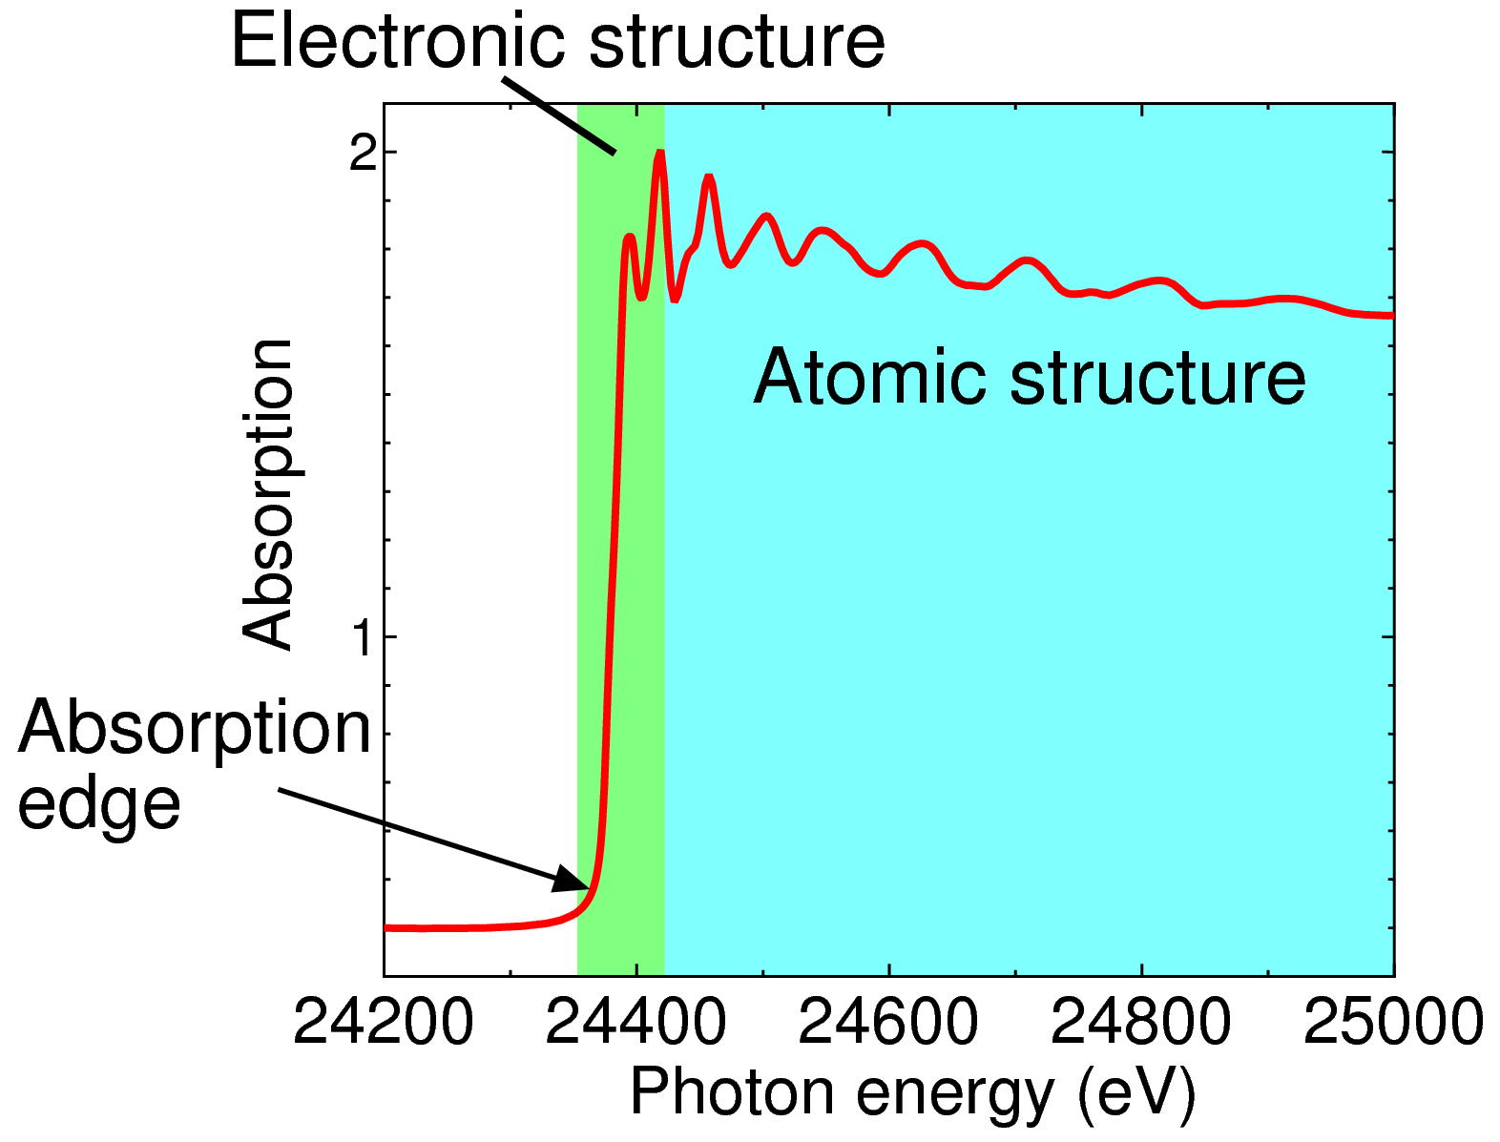
Method: XAFS （X-ray Absorption Fine Structure）
Principle
hν
hν
Interference of scattered photoelectron waves from neighbor atoms
e⁻
e⁻
Fine structure in absorption spectroscopy
Isolated atom
With neighbor atoms
XAFS spectroscopy
Feature
・ Element selectivity
・ Local sensitivity
→ Good for low amount additives, amorphous, and catalyst
4
Notes:
We used X-ray absorption fine structure, XAFS technique for in situ observation of electronic and atomic structure of catalysts.
This figure shows the simple picture of the basis of XAFS technique.
Incident X-ray is absorbed by the target atom, then photoelectron wave is created from the inner shell.
The photoelectron wave propagates to the surrounding atom and scattered by this atom.
The scattered photoelectron makes interference of photoelectron waves and changes absorption coefficient.
This is the example of XAFS spectroscopy.
When the photon energy of incident X-ray exceeds the binding energy of the inner shell electron, the electron can be excited and make a photoelectron wave.
As a result of electron excitation, the absorption intensity abruptly increases at the position of the electron binding energy.
This sharp increase energy of absorption is called absorption edge.
XAFS is usually divided into two regions.
One is located at the near position of the absorption edge and this region is largely influenced by the electronic structure of the sample.
Another region is the extended region from the absorption edge, and this oscillation is the result of local atomic structure.
XAFS spectroscopy includes both of electronic information and structural information.
XAFS technique has two features, element selectivity and local sensitivity.
These features means that XAFS technique is good for studying low amount additives, amorphous, and catalyst.

Slide 5
Dispersive optics
Inner shell spectroscopy
Conventional XAFS
Monochromator
White X ray
Sample
Motion of monochromator
Accurate XAFS
Dispersive XAFS
White X ray
Polychromator
Position sensitive detector
No mechanical motion
Sample
SPring-8 (Japan), beamline BL14B1
Fast and Stable XAFS
→ Time-resolved XAFS in real-time mode
5
Notes:
In this study, we used dispersive XAFS optics in order to obtain time-resolved XAFS spectra.
Let me introduce the details of the dispersive XAFS system.
In the case of conventional XAFS, we need to move the monochromator formed by the two flat crystals,
in order to change the energy of the incident X-ray.
However, in the case of dispersive XAFS, a curved crystal, called polychromator, is used to produce the wide band energy of X-ray.
Wide white X-ray is induced onto polychromator at different angle which is dependent on emerged X-ray energy.
X-ray with wide band of energy is once focused at the sample position, then re-dispersed.
By using the position sensitive detector, we can observe the XAFS spectra without mechanical motion process.
This character is very useful for the fast and stable XAFS observation, then we adopted this optics for the in situ and time-resolved XAFS spectroscopy.

Slide 6
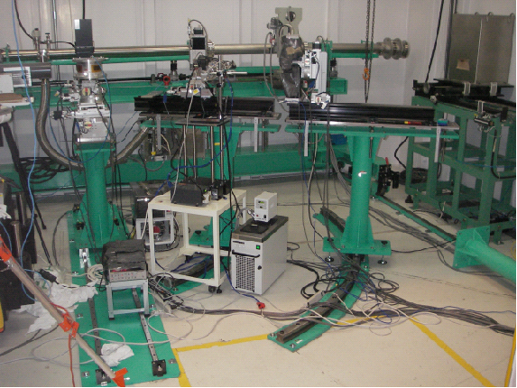
SPring-8 BL14B1
Heater
Sample holder
Polychromator
CCD camera
Stand
R1000 rail
R2000 rail
6
Notes:
Here is a picture of the dispersive XAFS system.
Polychromator and detector are arranged to the theta-2theta positions.
Depending on the absorption atom, we select the theta position of the polychromator and the 2theta position of sample and detector.

Slide 7
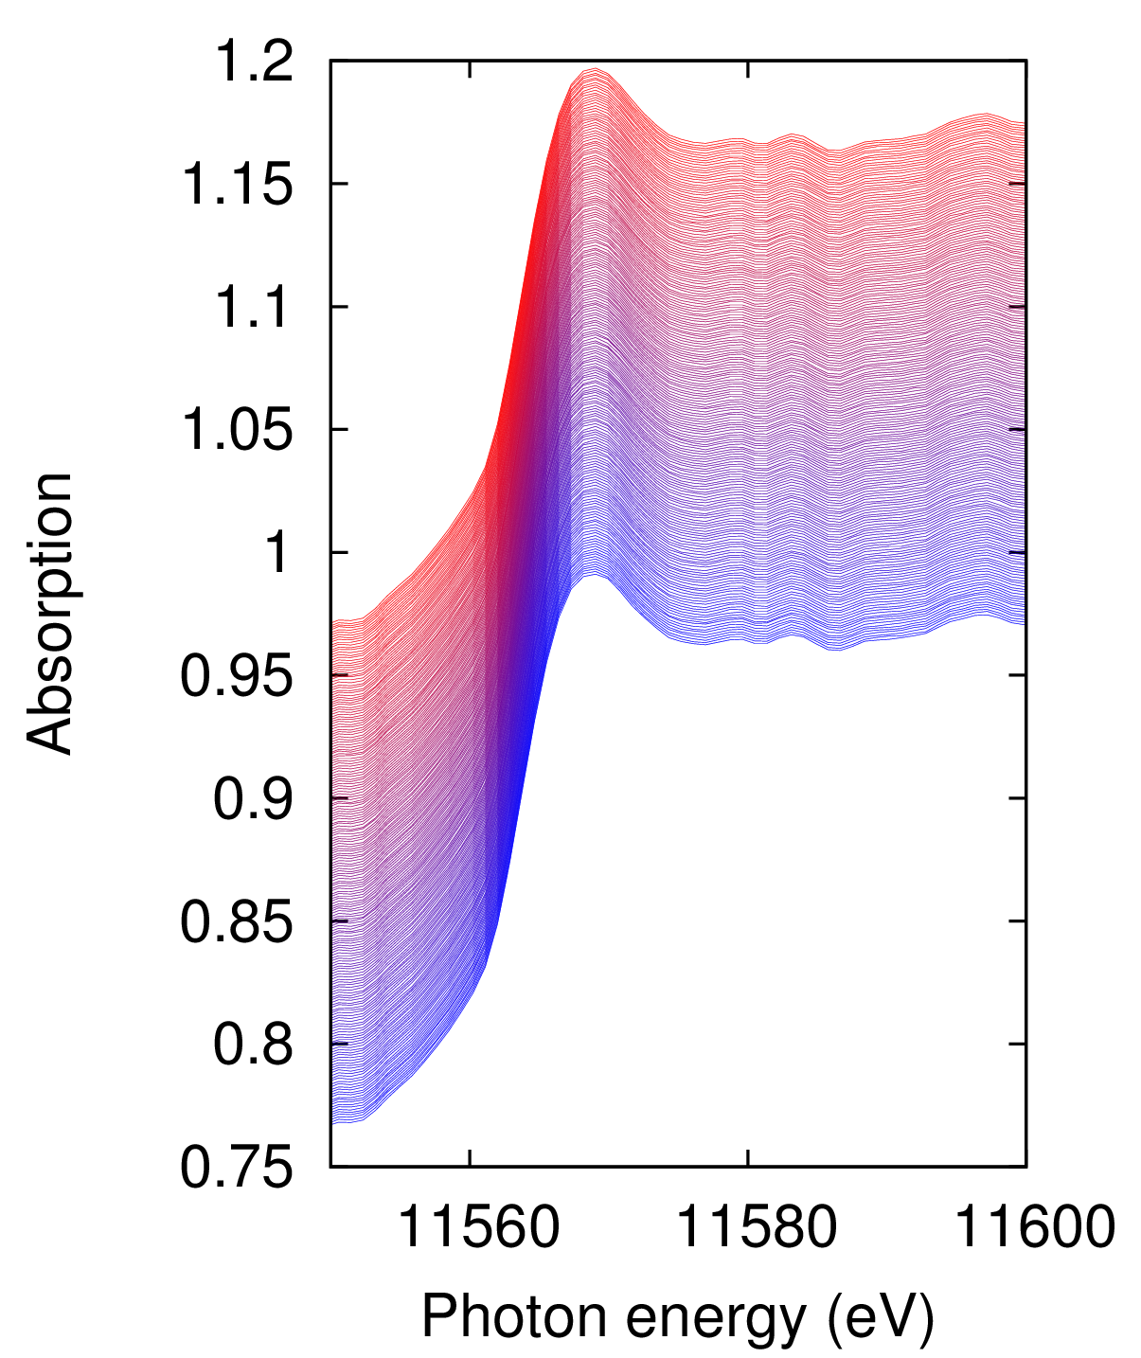
Time-resolved XAFS for Pt
Dispersive optics
Si(111), Bragg configuration
Pt L₃-edge
SPring-8 BL14B1
2 Hz observation
Room temperature
Time
Pt(4 wt%)/Al₂O₃
For passive autocatalytic recombiner (PAR) catalyst.
Change of spectra during hydrogen recombination reaction (water formation reaction)
7
Notes:
From here, I want to talk about XAFS results of Pt nanoparticles for hydrogen recombination reaction catalyst.
Here shows the Pt L3-edge XAFS spectra during hydrogen recombination reaction, water formation reaction proceeds.
The sample is Pt(4wt%)/Al2O3 and the spectra were taken at 2 Hz rate at room temperature.
We can understand that the time-resolved spectra show very smooth shape and the spectra shows only small change during reaction proceeds.

Slide 8
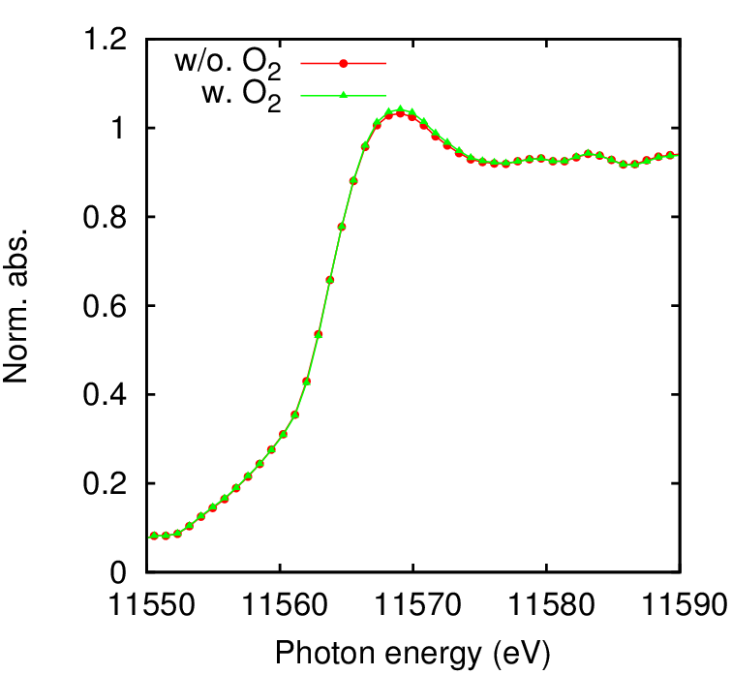
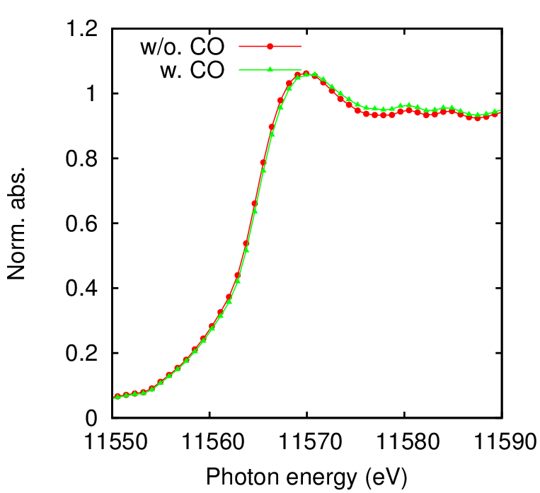
XAFS change
SPring-8 BL14B1 Dispersive optics,
Pt L₃-edge
Pt(4 wt%)/Al₂O₃ room temperature
Without O₂
With O₂
Without CO
With CO
Increase of peak intensity
High energy shift
Surface oxidation and CO adsorption can be detected
8
Notes:
The change of Pt L3-edge XAFS spectra of Pt nanoparticle catalyst is clearly seen in these figures.
Left figure is the comparison between the clean surface of Pt nanoparticle and oxygen adsorbed Pt nanoparticles.
The small change of peak intensity is observed due to the oxygen adsorption on the surface of Pt metal nanoparticles.
On the other hand, right figure indicates the change of Pt L3-edge XAFS spectra by CO dosing.
You can see the shift of peak position to the higher energy side by CO adsorption on the surface of Pt nanoparticles.
These figures indicates that we can decide the surface adsorption species by the analysis of peak intensity for oxygen adsorption and peak position for CO adsorption.

Slide 9
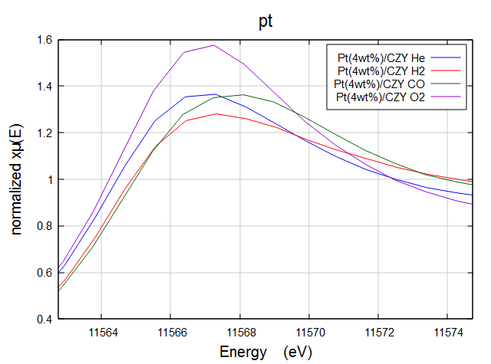
Surface adsorption species
・Conventional XAFS
・Expansion of peak of Pt L₃-edge XAFS
O₂
Clean
CO
H₂
Peak structure of XAFS depends on adsorption species
→ decomposition of O, CO and H
9
Notes:
Besides the adsorption of oxygen and CO, hydrogen adsorption on Pt surface is important issues.
This figure shows the change of XAFS spectra of Pt nanoparticles taken by conventional XAFS technique.
Here shows the adsorption of 3 types of species, that is, oxygen, CO and hydrogen.
As the last slide shows, oxygen adsorption on the surface of Pt nanoparticles increases the peak intensity.
And the CO adsorption on the Pt nanoparticle surface change the peak position to the higher energy side.
While, the hydrogen adsorption on the surface of Pt nanoparticle, two changes are observed in the red line.
One is the decrease of the peak intensity, and another is the increase of absorption at the higher energy side by 8 eV.
This figure indicates that the peak structure of XAFS spectra depends on the adsorption species.
And we can distinguish the adsorption species of oxygen, CO and hydrogen.

Slide 10
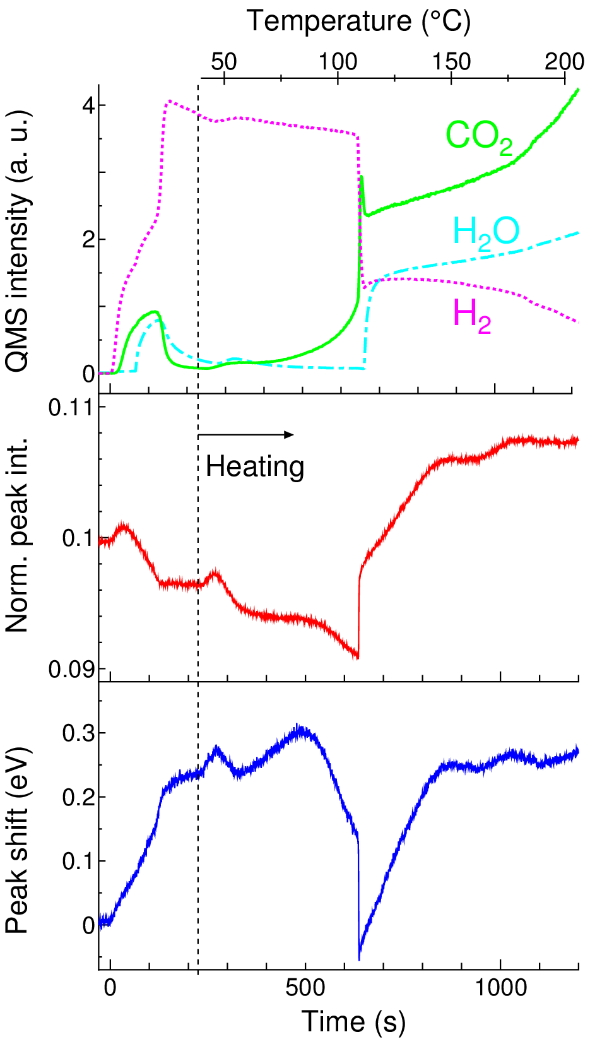
TPR-XAFS
Gas flow start
Simultaneous observation of temperature-programmed reaction (TPR) and XAFS
“TPR-XAFS”
○Pt(4 wt%)/Al₂O₃
○Gas flow starts at 0 s
Gas： H₂(4%)+O₂(10%)+CO(1%)
○After 200 s, heating starts
Rate： 10 K/min
○Time-resolved XAFS
Rate： 2 Hz
○Peak intensity
Pt surface oxidation
○Peak shift
CO adsorption & Pt oxidation
10
Notes:
Here is the result of simultaneous observation of temperature-programmed reaction, TPR, and XAFS, named “TPR-XAFS” technique.
Top figure is the result of temperature-programmed reaction, TPR, showing gas composition.
Middle and bottom figure are the results of XAFS spectra.
The sample is Pt 4 wt% nanoparticle catalyst on the alumina support.
The mixture gas of hydrogen, oxygen and CO were flowed at 0 second of the figure.
And following from the dashed line the temperature is increased at the constant rate of 10 K/min.
XAFS spectra were observed continuously at a rate of 2 Hz.
The change of peak intensity is displayed in red line, indicating the Pt surface oxidation.
And the peak position is displayed in blue line, indicating mainly CO adsorption.

Slide 11
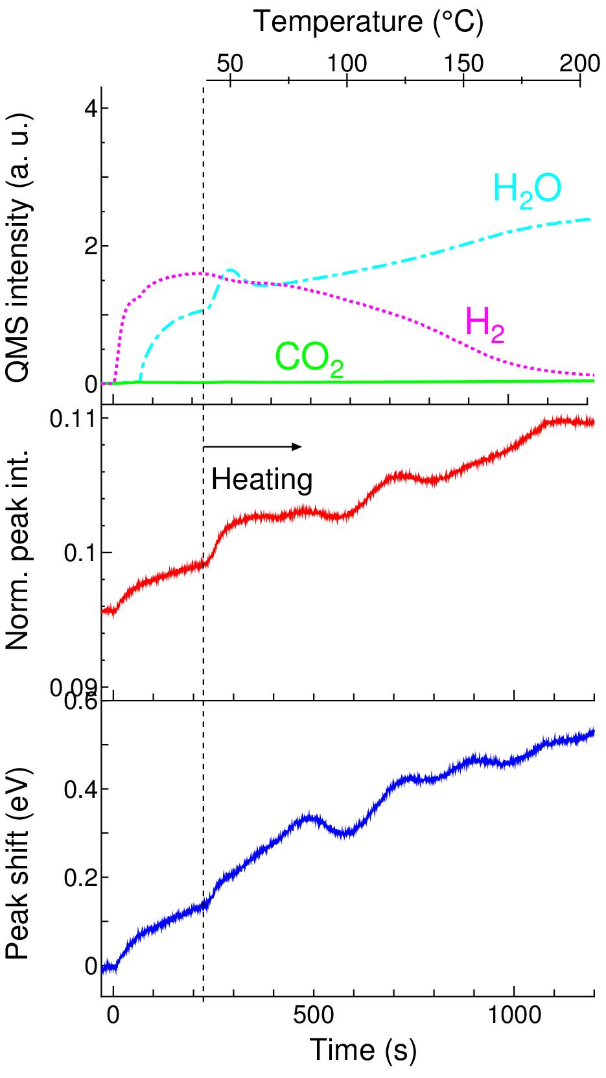
TPR-XAFS
Pt(4wt%)/Al₂O₃、 H₂/O₂ = 4%/10%
Without CO
With CO
CO adsorption blocks surface oxidation
Surface oxidation and CO burning
Water formation after CO decomposition
11
Notes:
This slide shows the effect of CO on the hydrogen recombination reaction of Pt metal nanoparticles.
Left figure shows the case of only hydrogen and oxygen flows.
While, CO is added in right figure.
For the case of without CO, the water molecule is formed from the room temperature, and as the temperature increases, the hydrogen gases are gradually decreased and the water molecules are more formed.
On the other hand, when CO is added in the system, the water molecule is not formed at room temperature.
But sudden increase of water molecule and CO2 is observed at around 120 C, indicating sudden oxidation reaction of hydrogen and CO occurred.
And at the same time and same temperature, sharp increase of peak intensity and sharp decrease of peak position are observed.
This indicates that, the surface of Pt nanoparticle is covered by CO molecules at room temperature, but CO is abruptly oxidized at temperature of 120 C and surface of Pt is covered by oxide at the same time.
Due to the change of surface structure of Pt metal nanoparticles, water molecules and CO2 are formed by catalytic oxidation reaction of hydrogen and CO.

Slide 12
Reaction model
Hydrogen recombination reaction (water formation reaction) proceeds after Pt surface oxidation
H₂
＋H₂ & O₂
O₂
H₂O
Pt
Pt
Al₂O₃
Al₂O₃
With CO
H₂
O₂
H₂
H₂O
CO₂
CO
＋Heat
CO
CO
Pt
Pt
R. T.
>120 °C
12
Notes:
Here shows the simple picture for reaction model.
When the hydrogen recombination reaction, water formation reaction proceeds, the surface of Pt nanoparticle catalyst is covered by Pt oxide.
But when the CO is present, the surface of Pt nanoparticle is covered by CO molecular and the creation of oxide layer is hindered.
Over 120 C, CO is suddenly oxidized to CO2, and at the same time, the surface of Pt nanoparticle is covered by Pt oxide and water formation reaction proceeds.

Slide 13
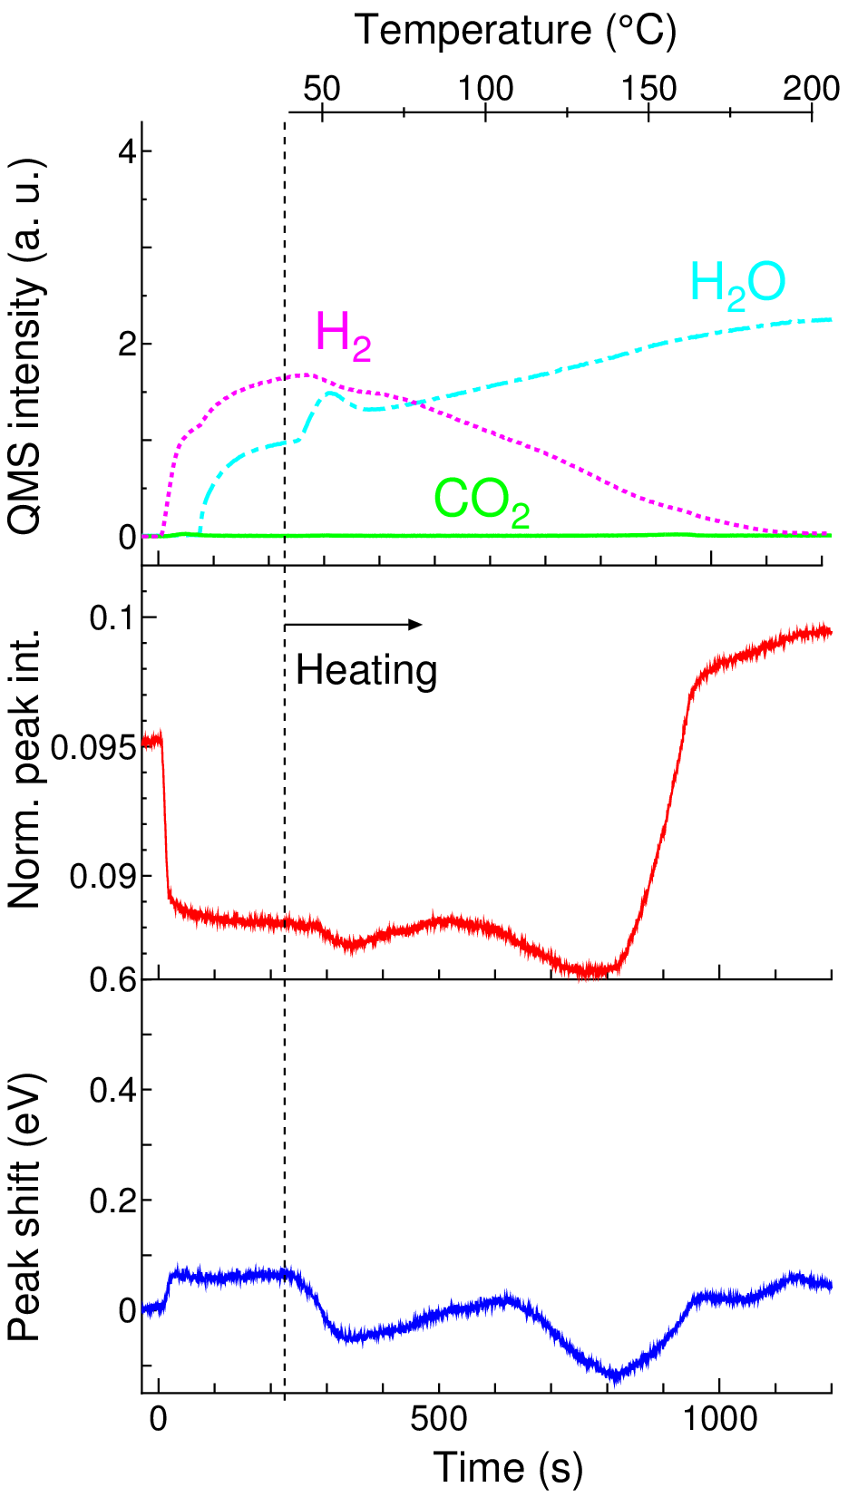
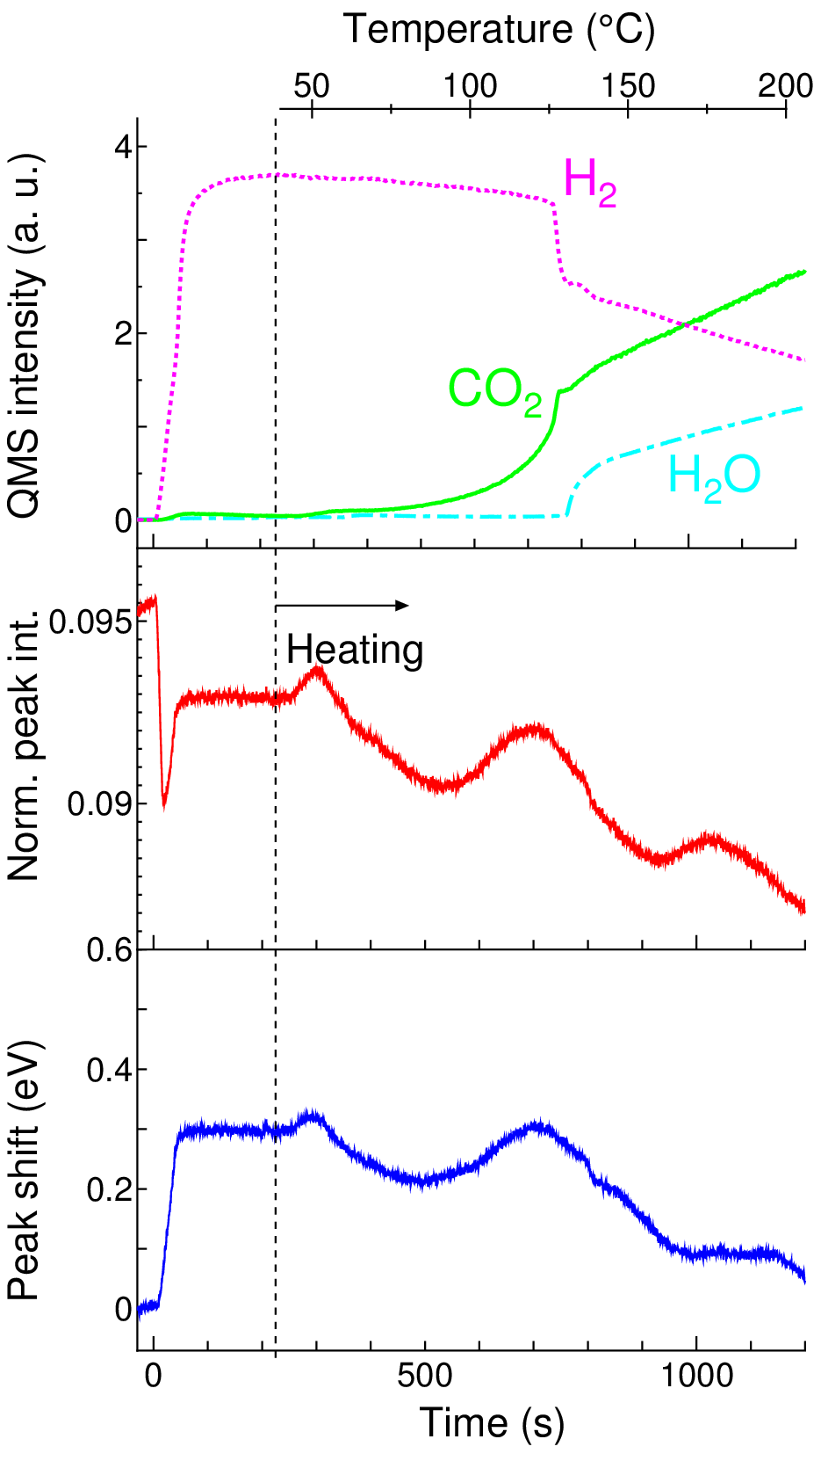
TPR-XAFS: Low O₂ condition
Pt(4wt%)/Al₂O₃、 H₂/O₂ = 4%/2%
Without CO
With CO
Hydrogen adsorption
CO adsorption
13
Notes:
This is the result of the case of low oxygen condition.
In this case, the ratio of hydrogen and oxygen is 4 by 2, meaning stoichiometric case.
The peak intensity is largely decreased when the mixture gas of hydrogen and oxygen flows.
This decrease of peak intensity is originated to the hydrogen surface adsorption on Pt nanoparticle.
This is comparable with the case of oxygen rich condition where the surface of Pt nanoparticle is covered by oxide layer
While in the case of CO is included, the large positive shift of peak position is observed, indicating the surface of Pt nanoparticle is covered by CO.

Slide 14
Reaction model: Low O₂ condition
Pt surface is covered by hydrogen atoms in low oxygen condition
O₂
H
H
＋H₂ & O₂
H
H
Pt
Pt
H₂O
Al₂O₃
Al₂O₃
H₂
With CO
H₂
O₂
H₂O
CO
＋Heat
CO
CO₂
CO
CO
Pt
Pt
R. T.
>120 °C
14
Notes:
Again show the reaction model of low oxygen concentration case.
Hydrogen molecules dissociatively adsorbed on the surface of Pt nanoparticle catalyst.
After the hydrogen adsorption, the oxygen reacts with the hydrogen atoms.
This is comparable with the case of high oxygen concentration case where the water formation reaction is operated on the oxide surface.
CO poisoning effect is similar.
The surface is covered by molecularly adsorbed CO at room temperature and hydrogen recombination reaction is hindered.

Slide 15
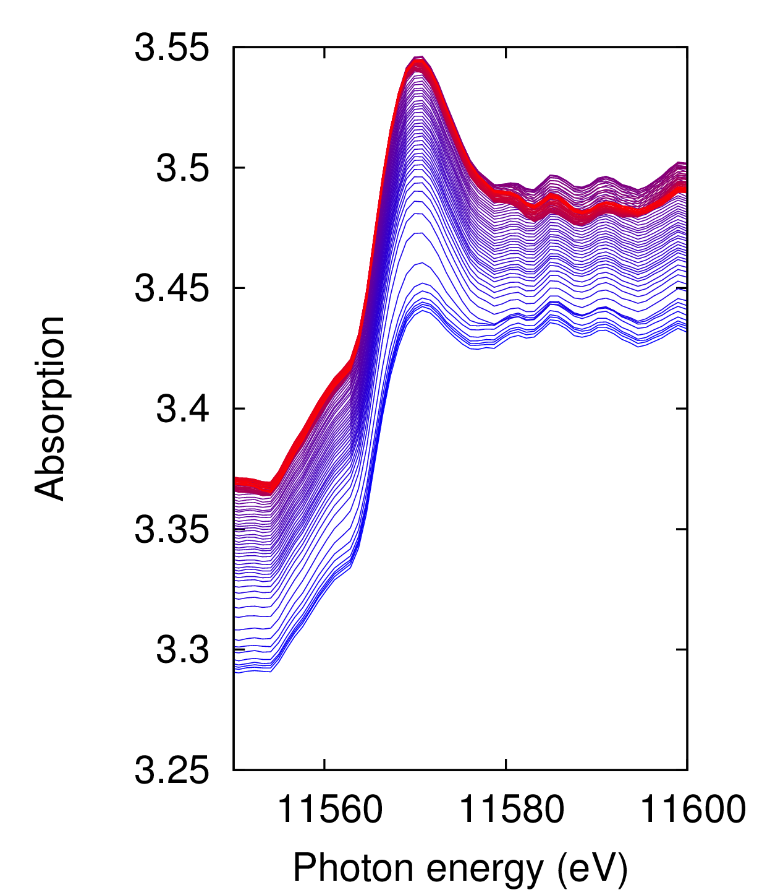
Pt/CeZrYO_{x}
SPring-8 BL14B1
Dispersive optics
Pt L₃-edge
Pt(4wt%)/CeZrYO_{x}
Sampling rate：
0.2 Hz
Gas flow：
H₂(4%)+O₂(10%)
Heating rate：
10 K/min
Observation for heavy support sample is difficult
15
Notes:
In order to overcome the CO poisoning effect, the complex oxide of Ce, Zr and Y are used as a support of Pt nanoparticles.
This figure shows the change of Pt L3-edge XAFS spectra during hydrogen recombination reaction, water formation reaction proceeds.
You can see the spectra are changed during the reaction, but the quality of data is not good as you can see the background wave.
This quality of XAFS data are originated to the X-ray absorption amount of sample.
In this sample, relatively heavy atoms such as Ce and Zr are used as support materials.
Heavy atoms absorbed X-rays much and then Pt absorption intensity is decreased.
This is the reason why the quality of these data set are not good.
But still you can see the change of peak intensity during reaction proceeds.

Slide 16
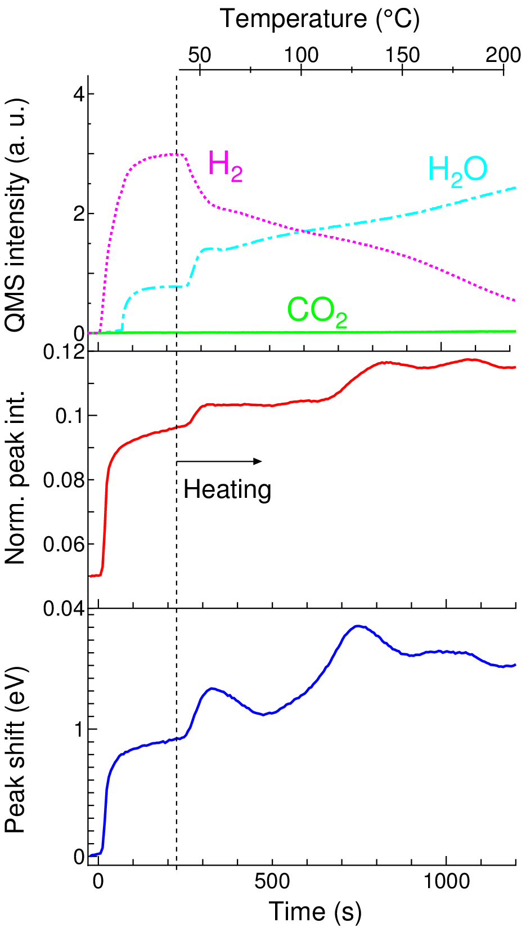
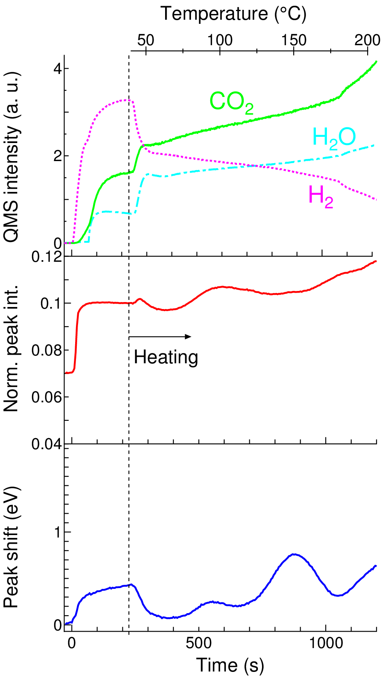
TPR-XAFS: CZY
Pt(4wt%)/CZY、 H₂/O₂ = 4%/10%
Without CO
With CO
ｖ
ｖ
Oxide layer creation even with CO
16
Notes:
We can still analyze the XAFS data set to get the information of the structure of the surface for Pt metal nanoparticle catalyst.
Gas intensity shows that water molecules are formed from room temperature even in the case of addition of CO molecules.
In the case of the Pt nanoparticle on the Ce, Zr and Y complex oxides, the sweep increase of the peak intensity right after the mixture gas are flowed in both of only hydrogen and oxygen dosed case and CO gas addition case.
This indicates that the surface oxide layer is created at room temperature right after mixture gas dosing even in the presence of CO gas.
And water molecules are formed via the surface oxide layer in both cases as gas intensity shows.

Slide 17
Reaction model: Al₂O₃ & CZY
Pt surface oxide layer is created even at room temperature for CZY support.
O₂
H₂
＋H₂ & O₂ & CO
R. T.
CO
CO
CO
Pt
Al₂O₃
Pt
CO₂
H₂
O₂
Pt
H₂O
CZY
17
Notes:
Here summarized the reaction model on Pt nanoparticle as the hydrogen recombination reaction catalyst.
Passive autocatalytic recombiner is required to work at room temperature even in the condition of the presence of CO.
For alumina supports, the surface of Pt nanoparticle is covered by CO at room temperature and the oxide layer does not formed.
But for the case of Ce, Zr and Y complex oxide support, the surface oxide layer is created from room temperature, and water formation reaction proceed even if CO molecules exist.

Slide 18
Summary
We have developed TPR-XAFS technique for real-time observation of hydrogen recombination reaction
Platinum metal nanoparticles are useful for catalysts of hydrogen recombination reaction
CZY support is effective for hydrogen recombination reaction against CO poisoning
18
Notes:
Let me conclude my talk with this summary.
We have developed TPR-XAFS technique for real-time observation of hydrogen recombination reaction.
Platinum metal nanoparticles are useful for catalysts of hydrogen recombination reaction.
CZY support is effective for hydrogen recombination reaction against CO poisoning.
Thank you for your attentions.

