Slide 1
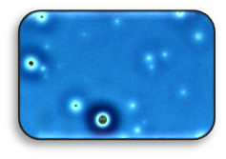
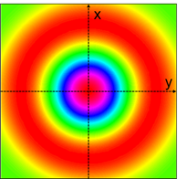
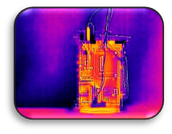
Behavior of Polymers in High Pressure Hydrogen, Helium, and Argon as applicable to Hydrogen infrastructure
International Conference on Hydrogen Safety,
Hamburg, Germany Sept.11-13, 2017
Nalini Menon, SNL
April Nissen, SNL
Jeff Campbell, SNL
Dr. Alan Kruizenga
Dr. Bernice Mills, SNL
Dr. Chris San Marchi (presenter)
Kevin Simmons, PNNL (PM)
Dr. Barton Smith, ORNL
Dr. Amit Naskar ORNL
Dr. Jong Keum, ORNL
Mike Veenstra (Ford)
SAND2017-9743 C
Sandia National Laboratories is a multimission laboratory managed and operated by National Technology and Engineering Solutions of Sandia, LLC., a wholly owned subsidiary of Honeywell International, Inc., for the U.S. Department of Energy’s National Nuclear Security Administration under contract DE-NA-0003525.

Slide 2
Collaborative Activities

Slide 3
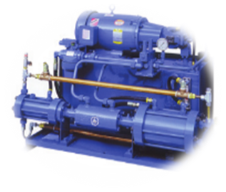
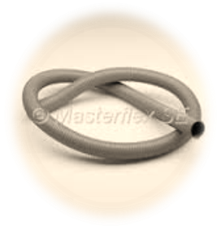
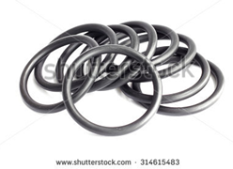
Polymers in Hydrogen Environments: Current Applications
Polymers are used extensively in the hydrogen systems
Distribution and Delivery (Piping and Pipelines)
Fueling Stations
Vehicle Fuel Systems
Component designs such as tanks, pipeline liners, hoses, valves, O-rings, gaskets, regulators, pistons, and other fittings are made of polymers
Conditions of ambient temperature (-40˚C to +85˚C) and high pressure (0.1 to 100 MPa) with rapid transitions in temperature and pressure are possible during service
Elastomers
EPDM, NBR/HNBR
Levapren, Silicone, Viton, Neoprene
Thermoplastics
HDPE, Polybutene, Nylon, PEEK, PEKK, PET, PEI, PVDF, Teflon, PCTFE, POM
Thermosetting polymers
Epoxy, PI, NBR, Polyurethane

Slide 4
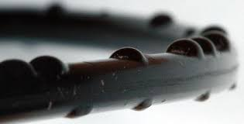
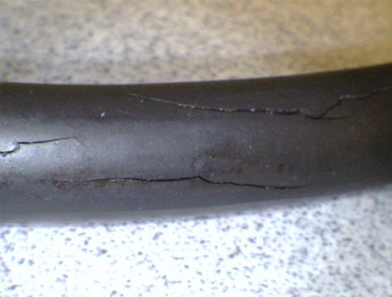
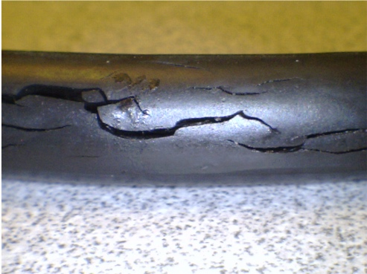
Polymers in Hydrogen Environments: Gap Analysis for Characterization and Testing
High-pressure hydrogen and related transport properties: assessment of plasticization through mechanical properties
Effect of high pressure hydrogen on fracture and fatigue
Friction and wear characterization, methods, and test facilities
Cumulative damage in elastomers due to combined effects of temperature and pressure cycles (RGD): metrics for assessing damage and development of damage-resistant materials
Low-pressure hydrogen transport data (permeation) through epoxies and composites used in hydrogen infrastructure
Effects of volatiles from polymers in the hydrogen stream

Slide 5
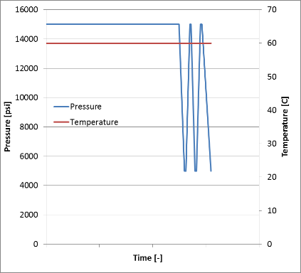
Pressure cycling of polymers under HP hydrogen, argon, and helium
Polymer
Construction of one-of-a-kind high-pressure hydrogen cycling manifold
Controlled decompression rate at controlled temperature
Understand damage accumulation due to cycling and effects of rapid gas decompression
Materials characterization
Mitigation of failure modes through materials design
Isolate the effect of purge gas during experimental setup from hydrogen effects on polymer properties
H₂

Slide 6
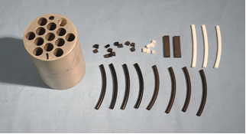
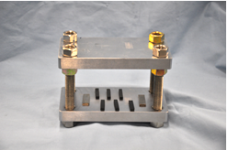
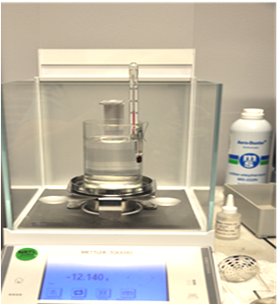
High-pressure testing: materials and exposure
Polymers tested:
PTFE, Nylon-11, POM, EPDM, NBR, Viton A, HDPE
O-rings and sheets of all polymers used
Static exposure at temperature of 20°C
All specimens were 3 mm thick regardless of other dimensions
No pre-treatment before exposure; except for thermoplastics
Specimens of PTFE and HDPE were annealed
removal residual thermal stresses
Experiment 1: Helium gas at 100 MPa for 40.5 hrs followed by hydrogen at 100 MPa for 168 hrs
Experiment 2: Helium gas at 100 MPa for 40.5 hrs*
Experiment 3: Argon gas at 100 MPa for 108 hrs followed by hydrogen at 100 MPa for 168 hrs
* = Data from this experiment is shown minimally in this presentation because the effect of helium on polymers was negligible
Sample holder with O ring specimens
Compression set test for elastomers
Density measurements set-up

Slide 7
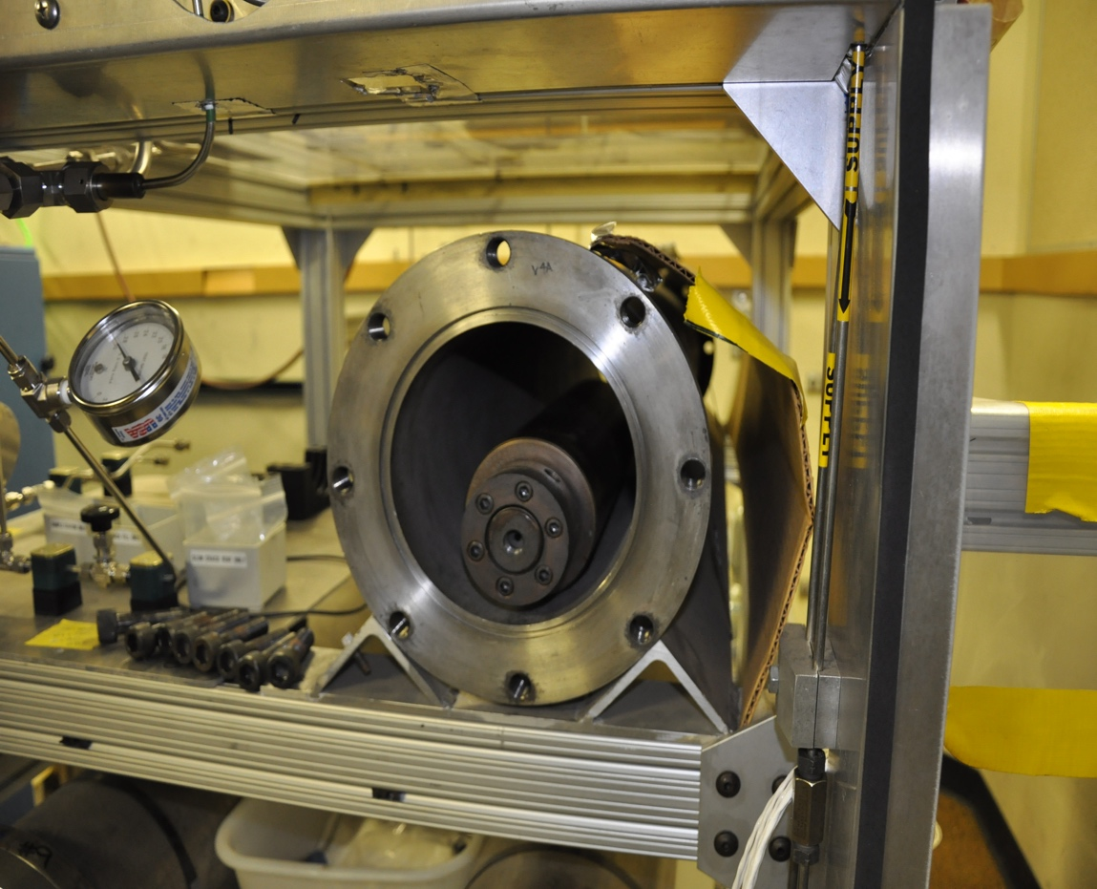
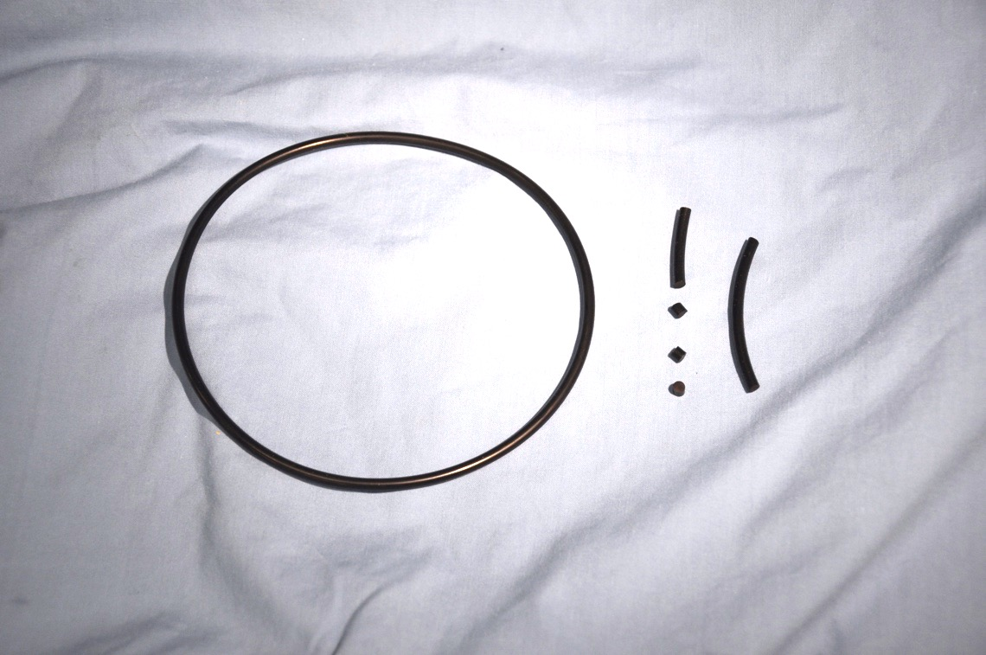
Characterization and methods
Pressure vessel in secondary containment
Elastomers
Viton A
Buna N
Mass loss & Spectroscopy
Specific volume changes
Thermoplastics
HDPE
PTFE
Spectroscopy
Compression Set
Specific volume changes
T_{g} and Modulus
Microstructure
T_{g} and Modulus
Microstructure
Buna N O-ring and test specimens

Slide 8
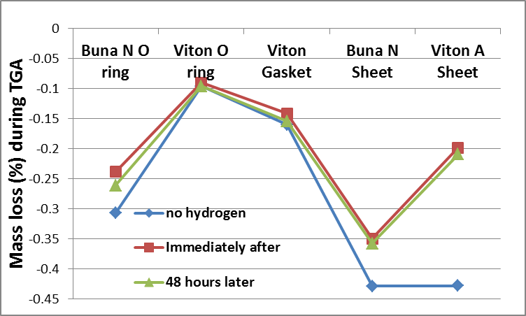
Mass loss from Buna N and Viton A after He/H₂ exposure
Mass loss not sensitive to time after exposure
Greater mass loss prior to exposure
Were volatiles driven out with hydrogen decompression?

Slide 9
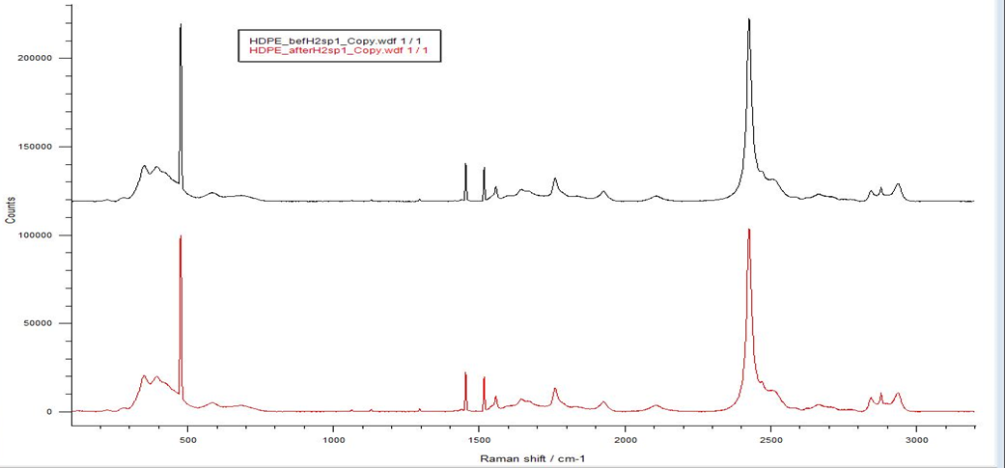
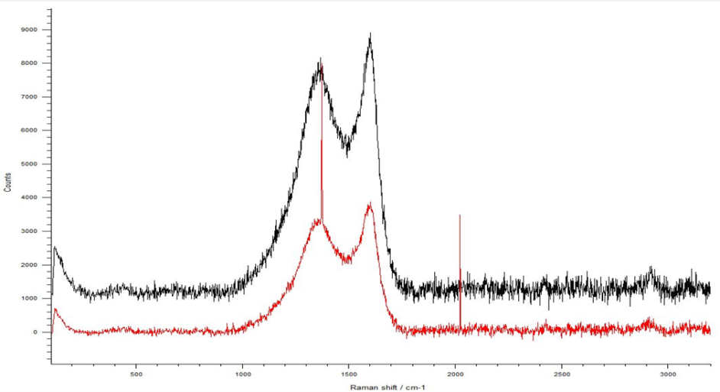
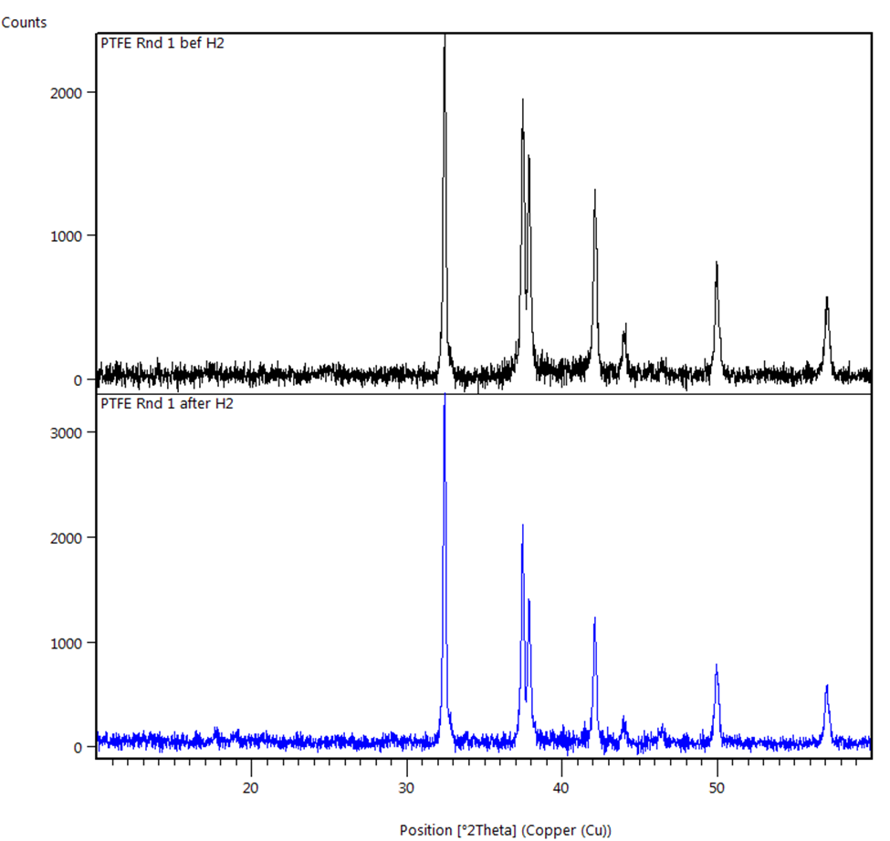
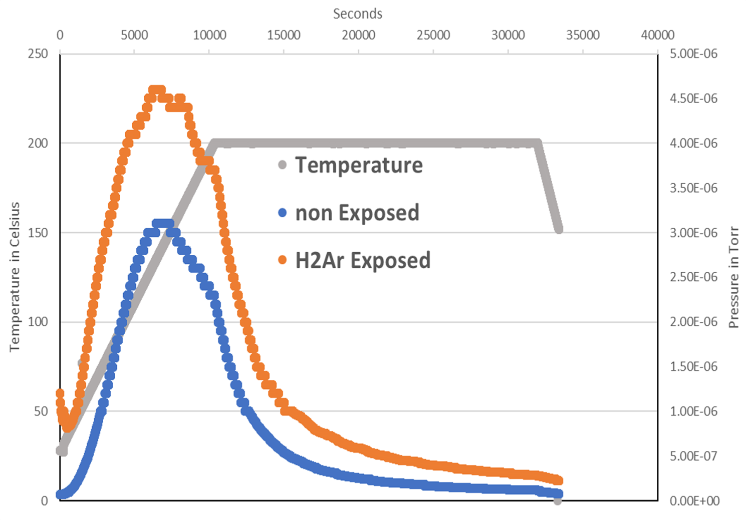
Spectroscopy shows no structural changes in polymeric materials after high-pressure exposure
Raman spectroscopy
HDPE before H₂
Buna N before (black) and after (red) H₂
HDPE after H₂
X-ray
diffraction
PTFE before H₂
EPDM before H₂
Data suggests additional volatiles after Ar/H2 exposure
PTFE after H₂
EPDM after H₂
Thermal desorption spectroscopy

Slide 10
Storage modulus and T_{g} measurements
 | Before exposure |  | After Ar / H₂ exposure |  | After He / H₂ exposure
Polymer properties | T_{g} (˚C) | Storage Modulus (MPa) | T_{g} (˚C) | Storage Modulus (MPa) | T_{g} (˚C) | Storage Modulus (MPa)
Buna N | -36 | 3.9 ± 0.0 | -43 | 3.9 ± 0.2 | -39 | 3.1 ± 0.0
Viton A | -11 | 4.6 ± 0.4 | -11 | 2.7 ± 0.3 | -12 | 3.3 ± 0.1
EPDM | -48 | 4.1 ± 0.4 | -49 | 3.6 ± 0.2 | Not tested | Not tested
PTFE | 32 | 225 ± 1 | 31 | 266 ± 0 | 27 | 234 ± 4
HDPE | -110 | 848 ± 7 | Not tested | Not tested | -111 | 913 ± 25
POM | -65 | 1695 ± 5 | -65 | 1664 ± 9 | Not tested | Not tested
Nylon 11 | 70 | 1118 ± 92 | 67 | 1189 ± 11 | Not tested | Not tested

Slide 11
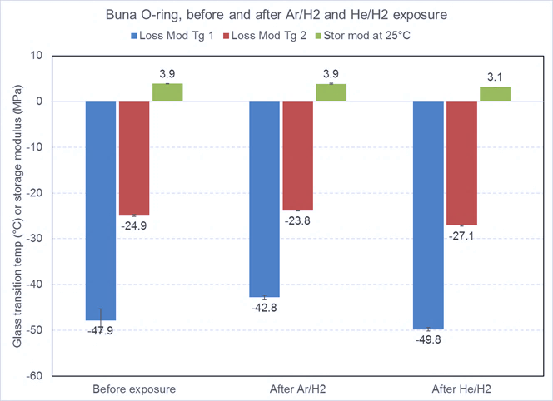
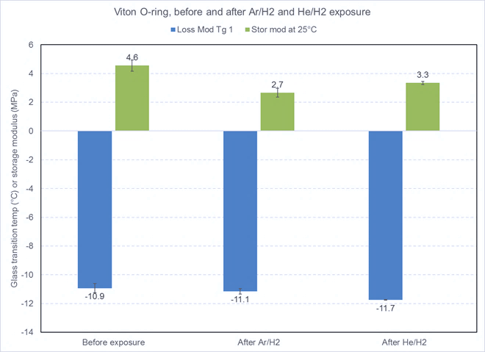
Storage modulus changes for elastomers
Buna N
Viton A
Before
exposure
Ar / H₂
exposure
He / H₂
exposure
Before
exposure
Ar / H₂
exposure
He / H₂
exposure
Polymer | Ar / H₂ exposure | He / H₂ exposure
Buna N | No change | 20% decrease
Viton A | 41% decrease | 28% decrease
test conditions
0.1% strain
1 Hz
5°C/minute

Slide 12
Storage modulus changes for PTFE
18% increase
4% increase
Before
exposure
Ar / H₂
exposure
He / H₂
exposure
test conditions
0.1% strain
1 Hz
5°C/minute

Slide 13
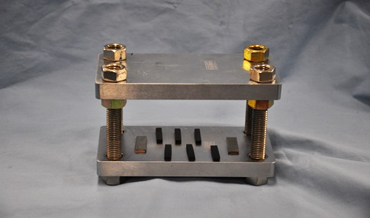
Compression set of elastomers
Polymer | Before exposure | Ar / H₂ exposure | He / H₂ exposure
Buna N | 14% | 22% | 15%
Viton A | 5% | 28% | 9%
EPDM | 7% | 8% | Did not test
Viton A shows large increase (5.3x) in compression set in Ar/H₂ compared to Buna N (1.6x) and EPDM (1.2x)
Compression Set Jig

Slide 14
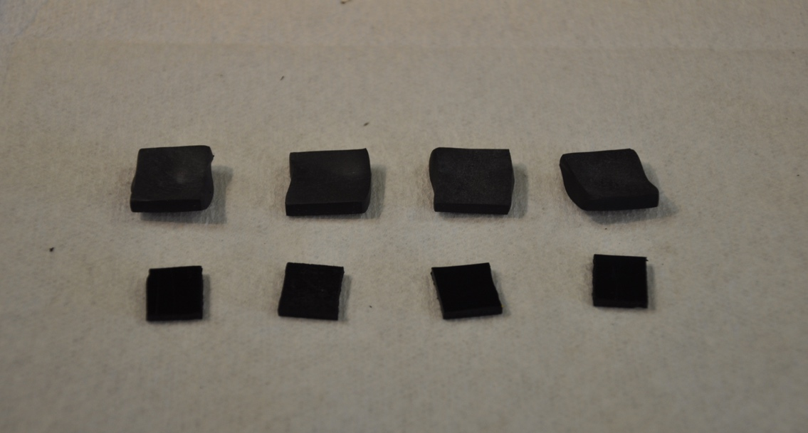
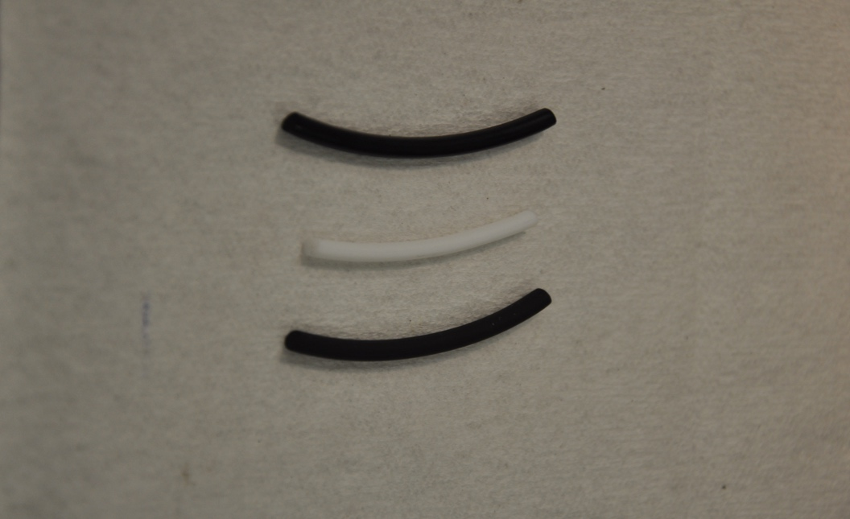
Swelling in elastomers and thermoplastics
Elastomer
Viton A
Buna N
Specific volume changes
Thermoplastic
Polymer | Ar / H₂ exposure | He / H₂ exposure
Buna N | 14% | 74%
Viton A | 34% | 34%
EPDM | 2% | TBD
Nylon 11 | 0% | TBD
PTFE | -4% | 0%
POM | 0% | TBD
All numbers shown are the percent increase in dimensions for specimens immediately after removal from the pressure vessel. All the polymers with the exception of Viton A returned to original dimensions. Viton A retained 10% swell
Notes:
Swelling seen, no RGD due to less cycles, sample dimensions. Viton retains 43% more over Buna N immediately and 41% after 48 hours
Loss in storage modulus is around 54% in Viton, 41% Buna N
Explain why comp set went up for Viton so dramatically.
Viton: saturated fluoroelastomer, slight crosslinking with Bis AF or peroxide, degree of crosslinking matters and controls free volume – lots of free volume here, P is 3.5, D is 1.9 and S is 19, permeability is high and so is solubility. Retains large amounts of Hydrogen with decent recovery. Hydrogen effects – can occupy free volume, cause voids around filler particles, can undergo RGD, lower initial tensile/tear strength, lower Young’s modulus at 100%elongation compared to Buna N and so can be more prone to RGD over Buna, increased compression set due to retention of hydrogen and increase in hardness. 43% more hydrogen retained than Buna N. Min. Service temp: -29C, max service temp: 204C.
Buna N: unsaturated non fluoroelastomer, highly crosslinked with unsaturation (crosslinking prevents slippage of chains), P is 5, D is 4.3 and S is 11.4, low free volume, does not retain lot of hydrogen, high initial tear strength and tensile strength (almost double that of Viton) and higher Youngs Modulus at 100% elongation, permeability is very high and solubility is lower than Viton. Hydrogen effects – No voids around matrix or filler, less prone to RGD, does not allow hydrogen penetration much, quick recovery. Min service temp: -54C, Max service temp: 135C

Slide 15
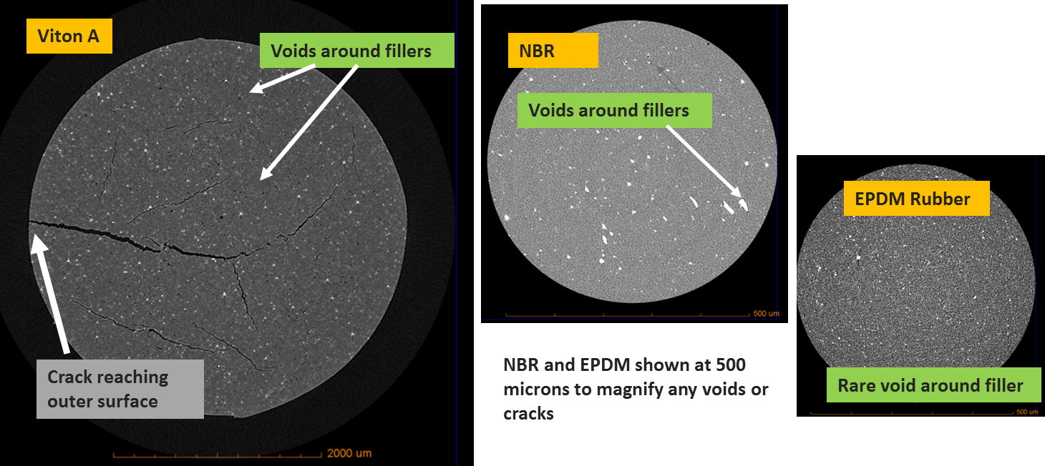
Micro-CT reveals voids and cracks in elastomers after Ar/H₂ exposure
NBR and EPDM at higher magnification show voids around fillers

Slide 16
Micro-CT reveals damage in Buna N after Ar/H₂ exposure
Several types of damage are evident in Buna N
Voids around filler particles
Voids in the matrix
blisters
Damage not observed in Buna N after He/H2 exposure

Slide 17
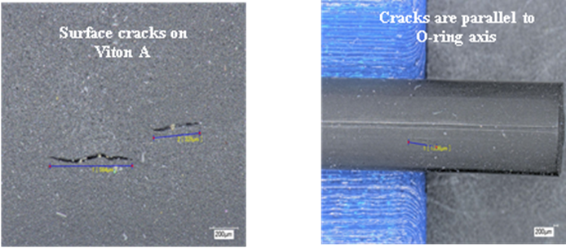
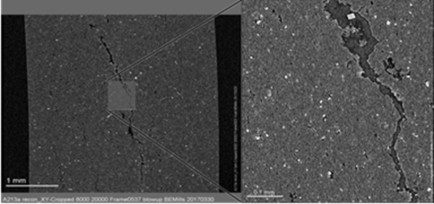
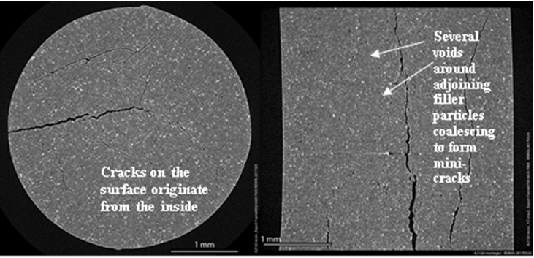
Formation of voids and cracks in Viton A
Cracks parallel to O-ring axis on the surface after Ar/H₂ exposure
Large cracks extend from smaller cracks after Ar/H₂ exposure
Voids appear to nucleate around filler particles and coalesce to form microcracks in Viton A after Ar/H₂ exposure
Some voids at fillers after He/H₂ exposure

Slide 18
Summary
Polymer property | Maximum Effects seen in gas environments
 | Argon/Hydrogen | Helium/Hydrogen
Swelling | 74% volume increase 100% recovery in 48 hrs for Buna N | 36% volume increase 90% recovery in 48 hrs for Viton A
Storage Modulus | 41% decrease for Viton A | 20% decrease for Buna N
Compression set (Elastomers only) | 5 times increase for Viton A | 1.6 times increase for Viton A
Damage evolution | Severe damage in Viton A; significant damage in Buna N and EPDM | Voids around some fillers in Viton A; Buna N and EPDM unaffected
CHOICE OF PURGE GAS/LEAK DETECTION GAS PRIOR TO CYCLING | GOOD FOR THERMOPLASTICS; NOT FOR ELASTOMERS | GOOD FOR ELASTOMERS AND THERMOPLASTICS

Slide 19
The observed behaviors can be rationalized based on the basic character of the gases and the materials
Structural changes in the polymers were not observed, therefore behaviors appear to be governed by damage evolution and accumulation
Damage appears to evolve from formation of voids around fillers within the polymer
Presumably due to precipitation of dissolved gases when the overpressure is removed (i.e. during decompression)
Damage coalesces into micro-cracks in advanced stages of damage evolution
Damage evolution should depend on the materials microstructure as well as on the character of the gases
Atomic size: Ar > H₂ > He
Diffusivity: He > H₂ > Ar
Solubility: Ar > H₂ > He

Slide 20
Conclusions
Ar/H₂ exposure appears to result in more damage than He/H₂ exposure
Slow diffusion of Ar, combined with greater solubility results in void formation during decompression
In contrast, He moves rapidly and has comparatively lower solubility, resulting in less damage
Viton A displays more damage than Buna N or EPDM
More highly cross-linked microstructure for Buna N can resist damage easier than saturated less crosslinked micro-structure of Viton A
The presence of fillers and the strength of the bond between the filler and the polymer matrix will likely also affect damage evolution
Other polymer behaviors such as increase in compression set for elastomers and increase in stiffness for thermoplastics can also be explained by the evolution or lack of damage

Slide 21
Future steps: Addressing knowledge gaps for polymers in H₂
Pressure cycling of polymers at high pressure with the goal of characterizing damage accumulation and understanding mechanisms of failure (RGD)
Materials design to mitigate effects of pressure cycling on polymeric materials for use in hydrogen technologies

Slide 22
Thank you for your attention. Questions?

Slide 23
Technical Back-Up Slides

Slide 24
Permeability characteristics (H₂ transport)
Polymer | Permeability coefficient (10⁻⁹ mol H₂/m·s·MPa) | Diffusivity coefficient (10⁻¹⁰ m²/s) | Solubility coefficient (mol H₂/m³·MPa)
Perbunan (Buna N) | 5.1 | 4.2 | 12
FKM (Viton A) | 3.5 | 1.9 | 19
EPDM | 17 | 5.0 | 33
Nylon 11 | 0.4 | 0.65 | 6.2
PTFE | 3.2 | - | -
HDPE | 0.82 | 1.9 | 4.3
POM = No data for behavior in hydrogen in literature (Source: SAND2013-8904, Literature review by Sandia National Laboratories, Livermore CA)

