Slide 1
EXPLOSION AND FIRE RISK ANALYSES OF MARITIME FUEL CELL ROOMS WITH HYDROGEN
Presented at the International Conference of Hydrogen Safety, Hamburg 11-13 September 2017.
Huser, A., Jambut, R., Helland, S., Rivedal, N.H., Tronstad, T., and Haugom, G.P.

Slide 2
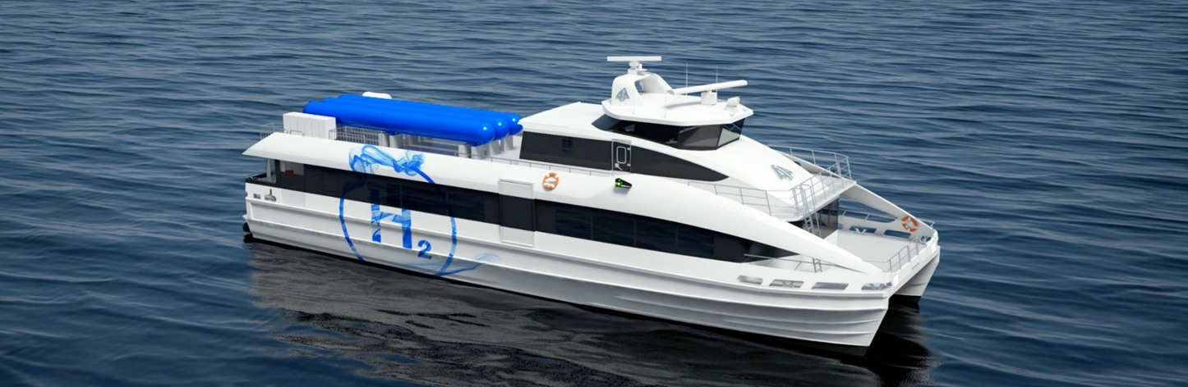
Content
Introduction
Maritime use of hydrogen
Design process maritime hydrogen
Example maritime fuel cell room Explosion Risk Analysis
Conclusions
Brødrene Aa high speed passenger ferry concept. Hydrogen Pilot in the Green Coastal Programme

Slide 3

How can hydrogen replace fossil fuels fast enough?
Fossil fuels
-Can cause permanent damage
-But generates revenue to invest in clean energies
Renewables
-Large scale wind and solar
-Transported and stored as hydrogen
-Hydrogen can replace fossil fuels

Slide 4
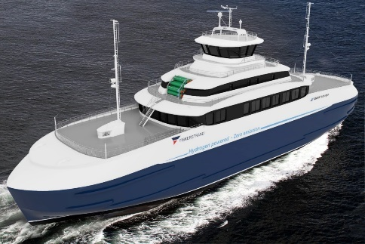
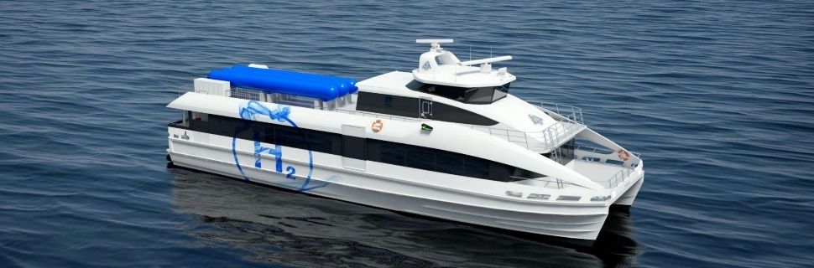
Background – market maritime sector
The shipping industry is under increasing pressure wrt environmental issues
Challenges with all alternative fuels
H2 can become a vital green fuel for maritime applications
  Sometimes the only alternative for zero emission
  Can become a very popular solution for shipping in cities and coastal shipping
  Large interest from the Norwegian Parliament and industry
Activities in Norway are first movers for maritime zero emission technologies
Hjelmeland – Nesvik – Skipavik
Fiskerstrand Brødrene Aa Road Authorities
Notes:
Climate and local emissions

Slide 5
Maritime Use of Hydrogen

Slide 6
Why hydrogen at sea?
-No CO2
-Technologies exists
-Low noise and vibration
-Low maintenance
-Longer reach
-Low filling time
-First movers can get large rewards
-Norway has surplus clean hydropower
-Poor infrastructure
-Commercially unproven
-More Safety systems
-Large volume storage
-Stability can be an issue
-Harder to get approval

Slide 7
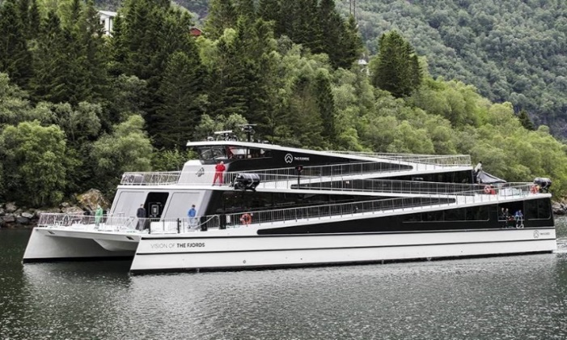

Status and motivation
Norwegian government: All ferries to be with zero emission within 2030.
There are gaps in the rules and regulations
  Storage of hydrogen on board
  DNV GL classrules for fuelcells need updates
International IMO rules points at a Technology Qualification (TQ) process
Existing rules requires detailed explosion analyses and QRAs
  To show that design is as safe as conventional systems
We need an efficient approach to show that fuelcell and storage rooms are safe
When enough experience is gained we want to update rules and regulations

Slide 8
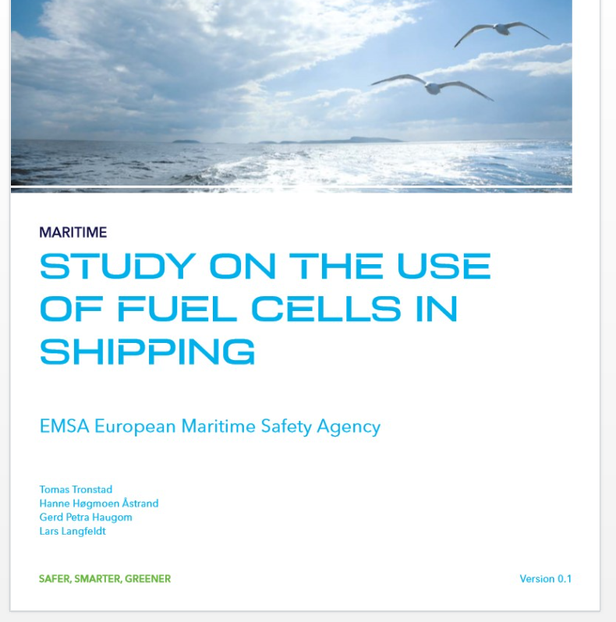
Study by DNVGL about maritime fuel cells
Gives status
Possible ways foreward

Slide 9
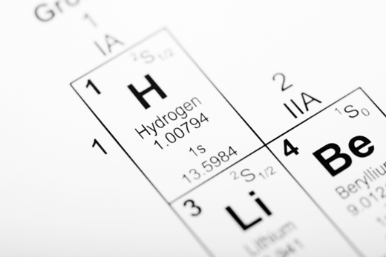


Maritime Hydrogen Safety JDP invitation
DNV GL want to initiate a Maritime Hydrogen Safety JDP (Joint Development Project)
This will provide important quality input to national, class and IMO requirements, and improve application of hydrogen at sea
The JDP invites participants from the entire value chain
  Key players have already shown great interest
  You are invited to participate

Slide 10

There will be a set of benefits for the JDP participants
Regulators and approval bodies will improve their knowledge base and build confidence on how maritime hydrogen systems can be safe and reliable. What are reasonable requirements to manage the hydrogen risks?
Ship owners will build competence and position themselves in the forefront regarding utilization, development and operation of safe hydrogen systems
Vendors and yards need to build competence to understand the specifics for safety of maritime hydrogen related systems
Buyers of transportation services will build competence and position themselves in the forefront as a driving force behind a safe green shift
All project participants are motivated by taking a leadership in safe green shipping
The project results will increase market penetration of maritime hydrogen solutions and position the partners in the marketplace

Slide 11

Results and deliverables from JDP
Apply DNVGLs Technology Qualification process
  Includes a explosion risk analysis
Input to update of requirements and rules – analyses, testing, operating
Training documents and operational guidance
Results dissemination to IMO, authorities and industry

Slide 12
Design process maritime hydrogen

Slide 13




Technology Qualification Process
Approval of Preliminary Design
Project
Milestones
DNV GL TQ process
deliverables
Step 1
Define Approval Basis
Stakeholder Requirements, RCS..
Technology Categorisation
TA
Consolidated summary of approval basis
Step 2
Threat Assessment
QRA, Explosion Risk Analysis
Qualification Plan
Required testing/qualification activities
Input to approval conditions for preliminary design.
- HazId report.
TQP
Step 3
Execute Qualification Plan
Testing and further analyses
Performance Assessment
TQ?
Compliant?
If Yes; Normal operation can start
Yes
No
Technology
Deployment
New
Technology
Qualified
Fall-back
Further assessments/
re-design required
Notes:
Gul sirkel – sirkler inn del av TQ prosessen som trengs før approval of preliminary design.
How to ensure that the process covers all the required input and steps to successfully achieve approval???
Definition of the approval basis, RCS, class rules etc., other stakeholder criteria – by all relevant stakeholders
Categorisation of technology based on maturity & application area=> “Consolidated summary of approval basis”
Threat assessment, at minimum: HAZID according to circ 1455, RA & Assess Explosion consequences according to IGF.
Result – basis for preliminary approval with possible conditions
Ready to start final design stage and final approval stage & integrate required testing.

Slide 14
Compliance vs cost driven approach
Compliance
-Follow rules
-Standard solutions
-OK for proven technology
Cost driven
-Risk based design
-optimi-
zations
-Best for new technologies

Slide 15
Probabilistic vs deterministic approach
Probabilistic
Risk = consequence * probability
Higher complexity
Deterministic
Consequence analysis
Not cost efficient
Worst credible Event
Solutions can be inconsistent
Efficient process
Acceptance criteria
Consider all scenarios
Find risk drivers and put money where needed

Slide 16
Risk based design process
HAZID
Hazard Identification
Blast workshop
Identify possible solutions
Qualitative
Quantitative Risk Analysis
ERA/FRA
Explosion and Fire risk analysis
Assess and compare solutions quantitatively
QRA
Consider all risks

Slide 17
Accident development and mitigations
Leak
Pipe in pipe
Gas dispersion
Ventilation
Ignition
EX equipment
Explosion
Escalation
Small ESD segments
Gas detection
Ignition control
Deluge
Inert gas
Structure strength
Vent panels
Escalation
Fire
Inert gas
PFP
Deluge
Structure strength
Fire fighting

Slide 18
Optimize safety and cost – prevent as early as possible in chain of events
Room design and architecture
Process and ESD segments, ventilation
Wall strength, explosion venting, inerting, deluge
Safe and cost optimal solution

Slide 19
Cloud types
Lean
  Small leak rates, short duration
  Only small part of cloud is flammable
  Can be accepted if shown to give small enough clouds
Ideal
  Medium leak rates
  Flammable most of the leak
  Must be avoided
Rich
  Large leak rates
  Is flammable when building up and down
  Must be avoided

Slide 20
Design cycles
Design workshop
HAZID
Explosion Risk Analysis
Basecase design
Sensitivities
Safety systems
Designs
Cost of design changes

Slide 21
Risk based design approach
Break down and organize consequences and frequencies – Examination
Simulate critical events with CFD
Simulate all events – Risk Analysis
Point at risk drivers – Diagnosis
Suggest design improvements
Find solutions together with operator

Slide 22
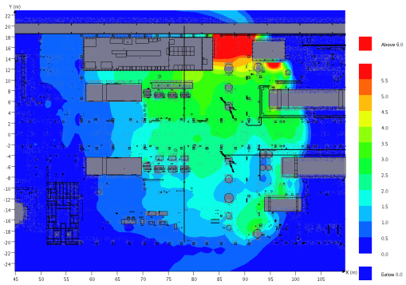
Explosion Risk Analysis (ERA) approach
CONCEQUENCE ANALYSIS WITH FLACS
FREQUENCY AND SYSTEM ANALYSIS
Response surfaces
Leak frequency
Flow conditions and ESD segments
Ventilation
Gas detection
Ignition sources
CFD Converting geometry
CFD Ventilation
CFD Dispersion
Risk analysis:
DNV program EXPRESS
Response surfaces
JIP Ignition model
Monte Carlo simulations
CFD Explosion
Improve
design
Design effects and recommendations
Explosion DAL
Notes:
STEPS IN EXPLOSION ANALYSIS:
Geometry converted from CAD files to relevant Explosion modelling software. We use the CFD software FLACS, and the program include a convertion sub-program. Following conversion, a verfication process includes plotting all areas and verify the plots with layout drawings, CAD models or someone who knows the design, or, if it is an existing installation, the verfication process may include offshore site. Small piece congestion is hard to verify, but a main contributor to the explosion pressures, as small piepes genereate turbulence when gas combustion hits the geometry elements. Hence, the congestion of small piping and equipment is read from the geometry, and compared to similar installations in the DNV geometry reference database, and, if necessary, additional small pieces and piping is randomly added to the geometry in selected modules to obtain realistic congestion factors. If the verification process shows that geometry elements is missing in the converted CAD geometry, or if no CAD geometry exists, the objects are included by hand modelling.
Ventilation steady state ventilation simulation is performed for typically 8 different wind directions, to find the air flow through the module and ACH (air change per hour) from natural ventilation. A interpolation of the results finds the ventilation conditions with different wind speeds. Ventilation plots uncover stagnant zones, tunnel effect zones, objects that obstruct the air flow and prevent effective ventilation etc. The results from ventilation simulations can be further used to determine the WCI conditions (when combined with weather statistics). The results can also be used to determine critical leak rates in different areas that produce flammable clouds close to stoichiometric as ratio between air flow and leak rate makes flammable mixing of gas.
Dispersion Dispersion simulations are performed with assumptions and conditions drawn from leak frequency analysis (using possible leak points), process conditions, inventory and segmentation (simulating leaks from segments containing high mass of flammable gas or volatile condensate), and leak rates and wind conditions drawn from ventilation simulations to set up a set of simulations that give sufficent information to describe the possible dispersion scenarios. The size of the flammable clouds is found from the simulations, and interpolation is applied to find cloud sizes for different wind speeds and leak rates than what simulated. Gas plots show the dispersion of the gas and uncover important effects on the build up of clouds, including entrappment of gas, exposure and performance of gas detector layout, spreading of gas through grating, stairways or openings to areas considered non-hazardous, or exposing ignition sources etc
Explosion simulations Ignition of a set of flammable clouds is simulated, using cloud locations, cloud shapes and cloud sizes from dispersion simulations, and also alternating different ignition points. Explosion panel pressures and pressure impulses and durations are monitored on blast walls, main structure, large equipment and safety critical objects such as control rooms and escape facitities. Drag forces is monitored on piping, instrumentation and smaller geometry elements, and the results combined to understand and describe the expected explosion loads on different targets following selected leak scenarios.
Probabilistic analysis: combining the results from ventilation, dispersion and explosion simulation with wind rose, leak frequencies, process conditions, gas detectors, ignition sources, ESD system to produce pressure exceedence curves and DAL pressures for selected targets. For areas with explosion risk in unacceptable or ALARP region, design improvement or other risk reducing measures may be proposed, and implemented in the model as sensitivity to quantfy the effect of the mitigating measures on the explosion risk

Slide 23
Example maritime fuel cell room

Slide 24
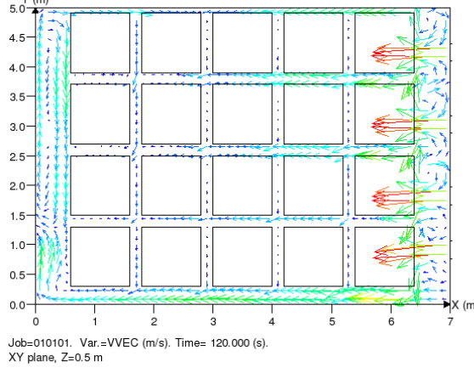
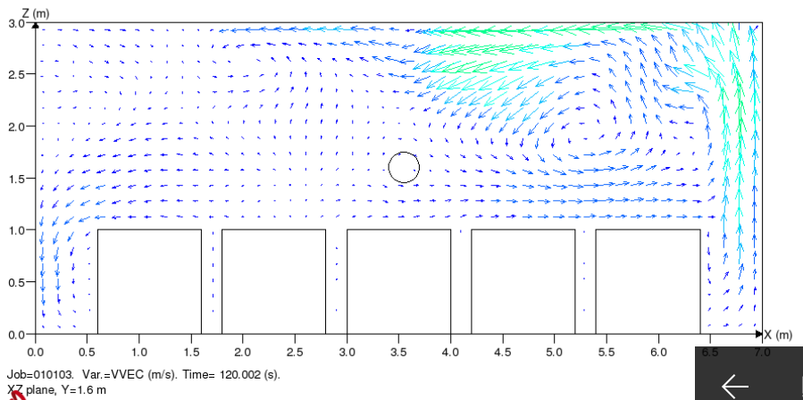
Ventilation example
Horizontal cut
Vertical cut

Slide 25
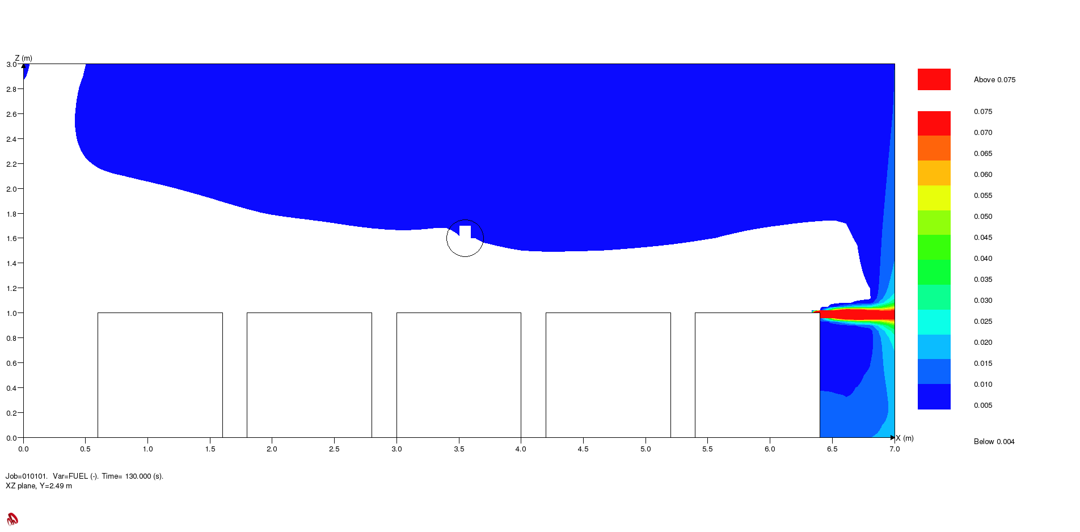
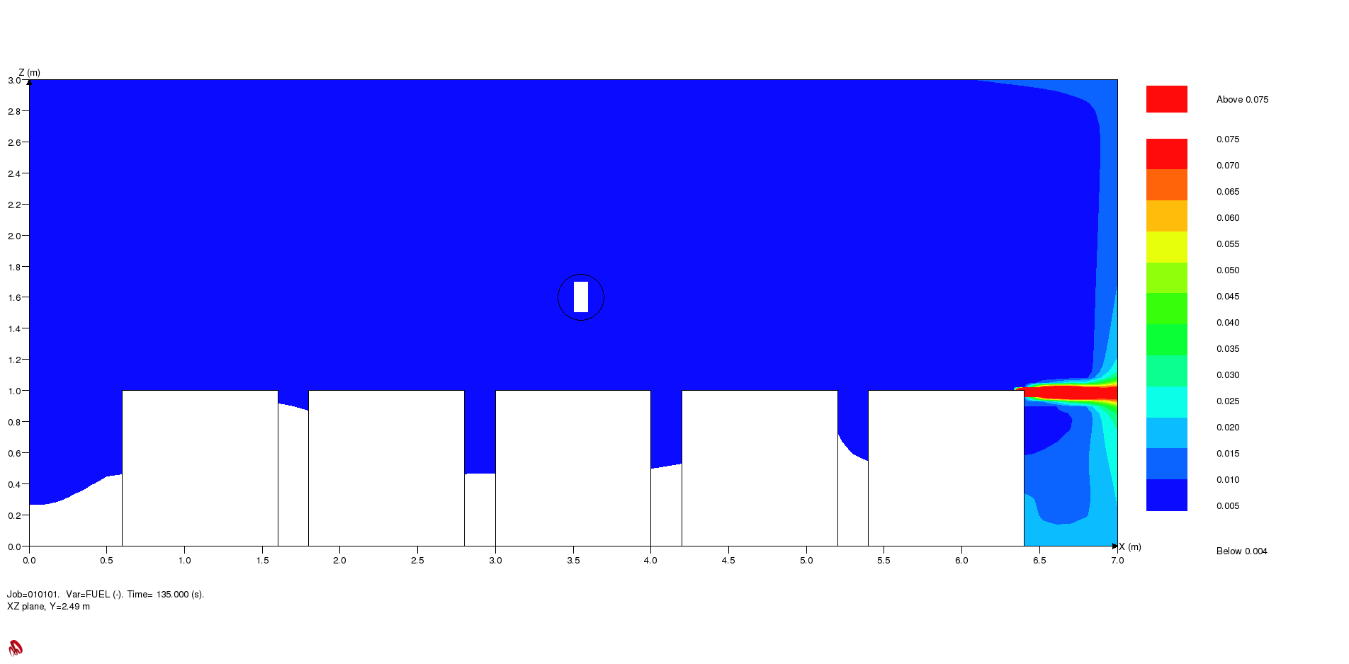
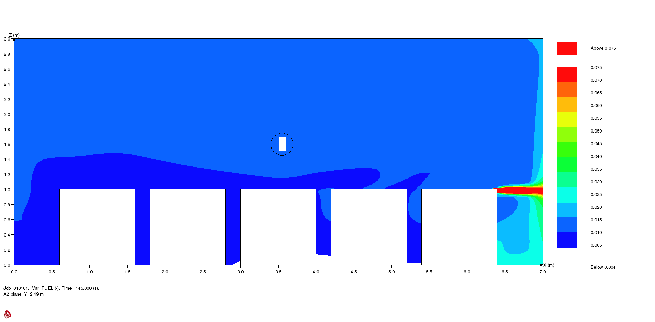
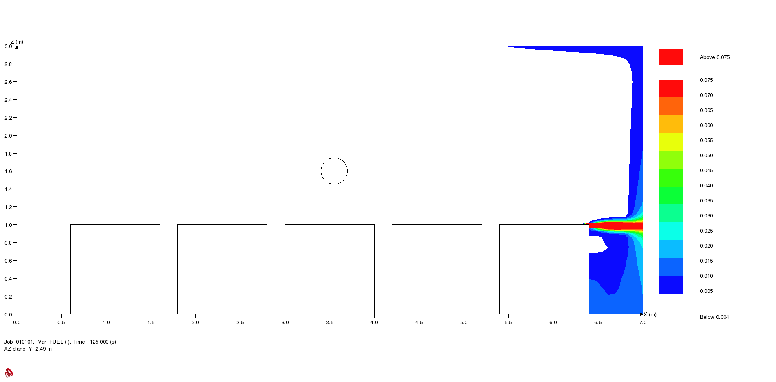
Gas leak dispersion example

Slide 26
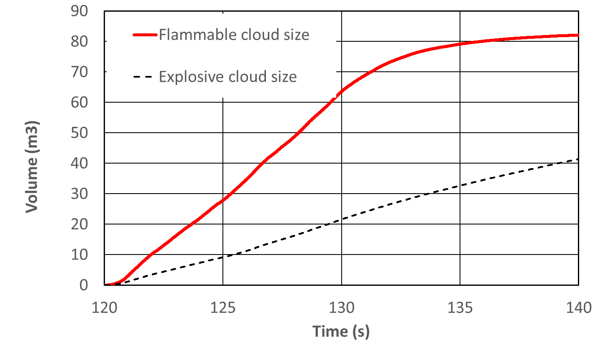
Gas cloud sizes

Slide 27
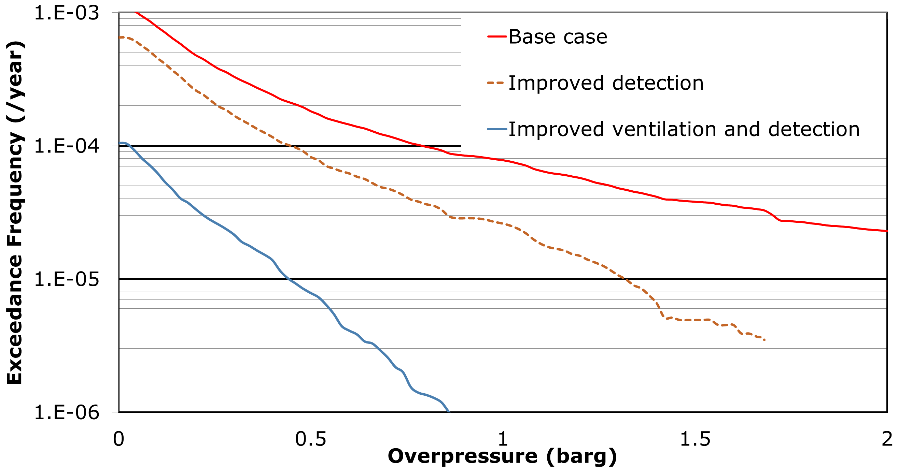
Compare risks: Pressure exceedance curves

Slide 28
Conclusions
An Explosion and Fire Risk Analysis for maritime rooms is presented
Such method is also part of a Technology Qualification process and required to get approval
Investigate and apply measures that stop the event as early as possible in the accident chain of events until acceptable risk is achieved
-Meaning may need more safety measures than in normal ships to show equivalence
Risk based approach can be used to reduce number of design cycles
A JDP is proposed. Improvement areas are to test out safety systems with experiments
When systems are tested and validated, prescriptive maritime rules can be written.

Slide 29
Thank you

