Slide 1




Hydrogen dispersion in a closed environment
M. De Stefano ^{a,b}, X. ROCOURT^{b} , I. Sochet^{b}, N. DAUDEYª
ª EDF SEPTEN– Villeurbanne, France, nicolas.daudey@edf.fr.
^{b} INSA Centre Val de Loire, PRISME EA 4229, Bourges, France, maria.de_stefano@insa-cvl.fr, xavier.rocourt@insa-cvl.fr, isabelle.sochet@insa-cvl.fr.
International Conference of Hydrogen Safety
September, 11-13 2017 - Hamburg Germany

Slide 2
Introduction
One of the most frequent accident scenarios at nuclear power plants is the following:
Fuel leakage and formation of a cloud H₂ / air
It’s of fundamental importance a good understanding of the dispersion and stratification of a hydrogen leak.
The cloud encounters a source of ignition
Explosion
What are the consequences of the explosion?
What are the effects of the gradient concentration and of the obstruction on overpressure?

Slide 3
Introduction
Over the past decade, many studies have been devoted to the dispersion of hydrogen in an enclosed space, experimentally and numerically through CFD codes.
References | Size Enclosure | Releasing Gas | Vent | Release position | Objectives
Lacome et al. (2007) | 80 m³ | Helium | Small opening | Bottom | Dispersion in different release conditions (flow rate, velocity and volume injected)
Gupta et al. (2009) | 41 m³ | Helium | Upper and lower vent | Bottom | Dispersion in different release conditions (flow rate, velocity and volume injected)
Danisenko et al. (2009) | 4 m³ | Hydrogen | Unventilated | Bottom | Dispersion in different confined space and different release conditions
 | 25 m³ | Hydrogen | Upper and lower vent | Bottom
 | 9 m³ | Helium | Unventilated | Side
Pitts el al. (2012) | 1.7 m³ | Helium | Three vents | Bottom, Upper and side | Effects of the location of the leak and location of the vent
Cariteau et al. (2012) | 1.1 m³ | Helium | Small opening | Bottom | Dispersion in different release conditions (flow rate, velocity and volume injected)

Slide 4
Introduction
The objectives of this work are:
Study hydrogen stratification in a closed unventilated enclosure during release depending upon flow rate and leak position (upper and side).
Study diffusion mechanisms when release stops.
Study the influence of obstacles on the dispersion.
Identify the more dangerous cases in terms of concentration gradient and flammable volume in order to study the explosion

Slide 5
Outline
Experimental setup
  Instrumentation
  Test Scenarios
Experimental results
  Dependence of flow rate and of the release position
  Dependence of the presence of obstacles
Conclusions
Perspectives

Slide 6
Experimental setup

Slide 7
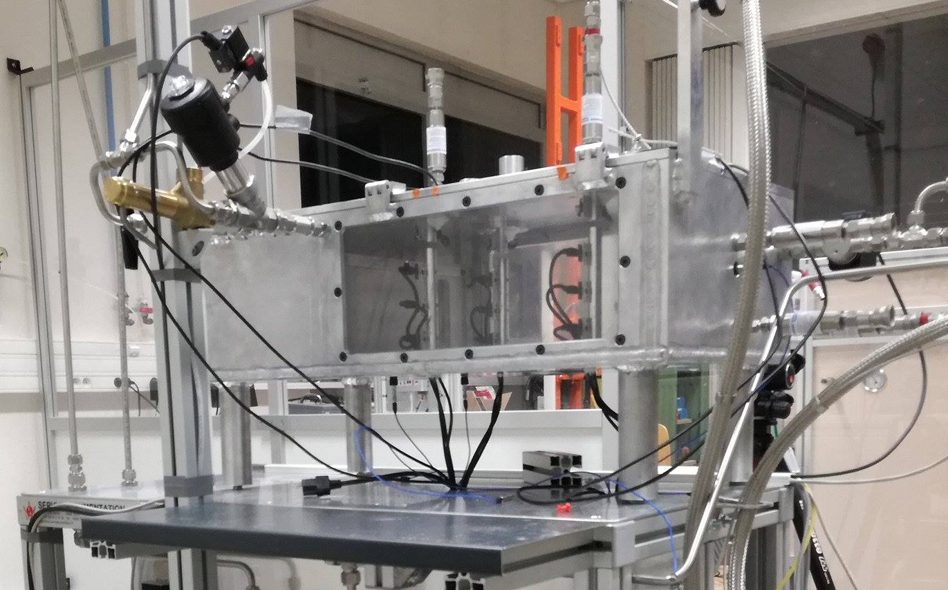
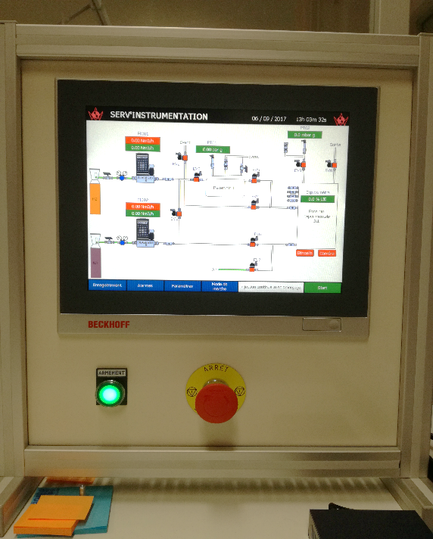
  Instrumentation
Characteristics of the enclosure
Geometry: aluminum rectangle parallelepiped with 2 faces in polycarbonate
Size: W 0.33 m x L 0.47 m x H 0.20 m
Internal volume: 0.031 m³
Experimental enclosure
Injection source
Releasing gas: Hydrogen
Geometry: circular
Internal diameter: 4 mm
Releasing flow rate: from 0.1 to 6 Nm³·h⁻¹
Injected Volume : 5 % of the enclosure volume
Human-machine interface systems

Slide 8
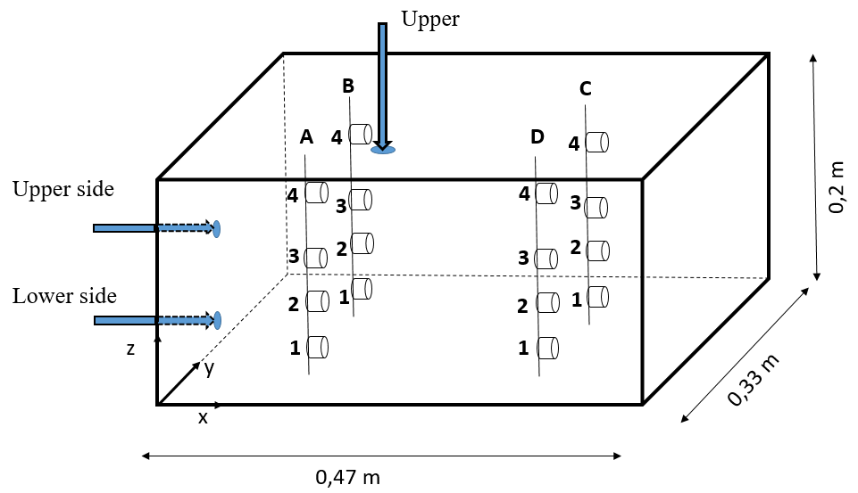
  Instrumentation
Measurement devices
Catharometer Xen-TCG 3880 from Xensor Integration, accuracy around 0.1% on hydrogen volume fraction.
Upper
Positions of the concentration sensors.
Rod | Position | x (m) | y (m) | z (m)
A | 1 | 0.13 | 0.07 | 0.04
 | 2 | 0.13 | 0.07 | 0.08
 | 3 | 0.13 | 0.07 | 0.12
 | 4 | 0.13 | 0.07 | 0.18
B | 1 | 0.13 | 0.24 | 0.04
 | 2 | 0.13 | 0.24 | 0.08
 | 3 | 0.13 | 0.24 | 0.12
 | 4 | 0.13 | 0.24 | 0.18
C | 1 | 0.38 | 0.24 | 0.04
 | 2 | 0.38 | 0.24 | 0.08
 | 3 | 0.38 | 0.24 | 0.12
 | 4 | 0.38 | 0.24 | 0.18
D | 1 | 0.38 | 0.07 | 0.04
 | 2 | 0.38 | 0.07 | 0.08
 | 3 | 0.38 | 0.07 | 0.12
 | 4 | 0.38 | 0.07 | 0.18
Upper side
0,20 m
Lower side
0,33 m
0,47 m
Experimental enclosure scheme and sensor positions.

Slide 9
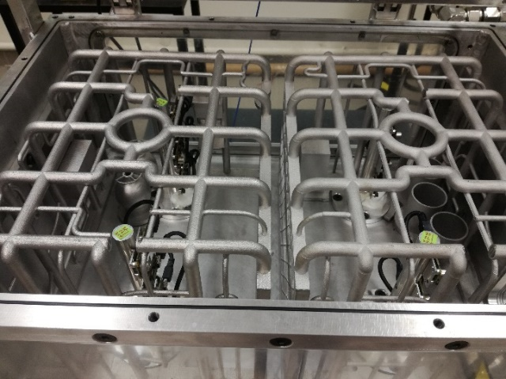
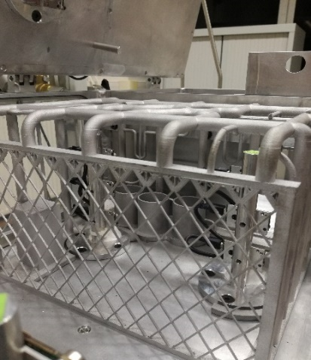
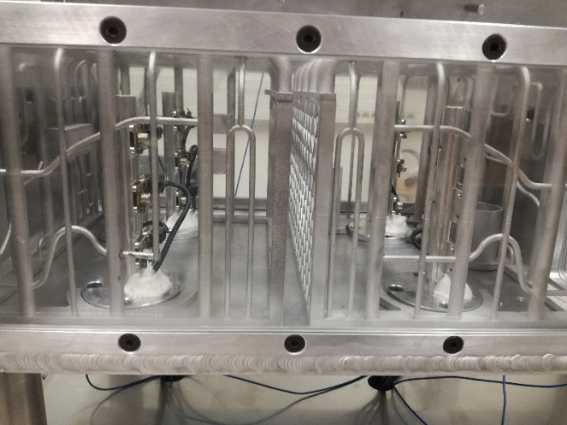
  Instrumentation
The reproduction of the obstacles of a room of a nuclear facility is made to the 1/15 scale in aluminum.
Obstacles

Slide 10
  Test Scenarios
The concentration of hydrogen was measured for a period of 180 seconds.
Configuration without ventilation, at ambient conditions of temperature and pressure.
All tests are performed in the empty enclosure and in the enclosure with the obstacles.
Upper
Reference Position | Upper | Upper side | Lower side
x [m] | 0.17 | 0 | 0
y [m] | 0.165 | 0.165 | 0.165
z [m] | 0.2 | 0.13 | 0.01
Release direction | -z | x | x
0,20 m
Upper side
Reference Flow | Q₁ | Q₂ | Q₃
Volumetric flow rate [Nm³·h⁻¹] | 5.4 | 1.8 | 0.1
Release duration [s] | 1 | 3 | 46
Re | 4500 | 1500 | 83
Lower side
0,33 m
0,47 m

Slide 11
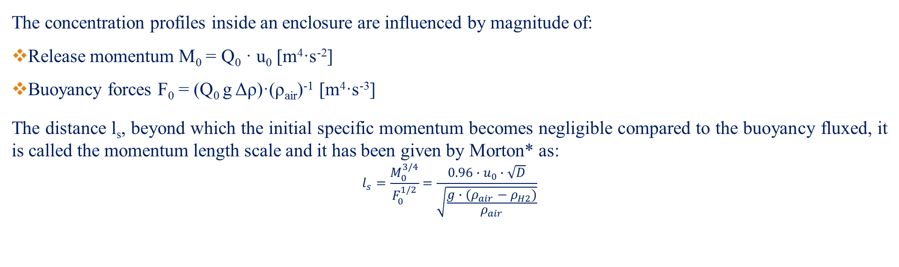
  Test Scenarios
The concentration profiles inside an enclosure are influenced by magnitude of:
Release momentum M₀ = Q₀ · u₀ [m⁴·s⁻²]
Buoyancy forces F₀ = (Q₀ g Δρ)·(ρ_{air})⁻¹ [m⁴·s⁻³]
The distance l_{s}, beyond which the initial specific momentum becomes negligible compared to the buoyancy fluxed, it is called the momentum length scale and it has been given by Morton* as:
$$l_{s}=\frac{M_{0}^{3/4}}{F_{0}^{1/2}}=\frac{0.96∙u_{0}∙\sqrt{D}}{\sqrt{\frac{g∙(ρ_{air}−ρ_{H2})}{ρ_{air}}}}$$
Where u₀ - exit velocity, m·s⁻²; D - diameter of the leak, m; g - acceleration of gravity, m·s⁻² ; ρ_{air} - density of air, kg·m⁻³; ρ_{H2} - density of hydrogen, kg·m⁻³.
Reference Flow | Q₁ | Q₂ | Q₃
Volumetric flow rate [Nm³·h⁻¹] | 5.4 | 1.8 | 0.1
Release duration [s] | 1 | 3 | 46
Ri | 1.27·10⁻⁶ | 1.14·10⁻⁵ | 3.70·10⁻³
l_{s} [m] | 2.41 | 0.8 | 0.045
< 0,47
* Morton, B.R., Forced plumes, J. Fluid Mech., 5 (1959), pp 151-163.

Slide 12
  Test Scenarios
Each case was repeated 5 times and for each sensor we have compared:
the maximum concentration,
ten different concentrations (t = 1 s, 2 s, 3 s, 4 s, 5 s, 10 s, 20 s, 40 s, 50 s, 80 s)
the slopes, in two different time intervals Δt₁ = (40 s - 20 s) and Δt₂ = (90 s - 60 s), of the concentration curves.
The tests are comparable to each other and it is possible to average the 5 tests in order to analyze the results.

Slide 13
Experimental results

Slide 14
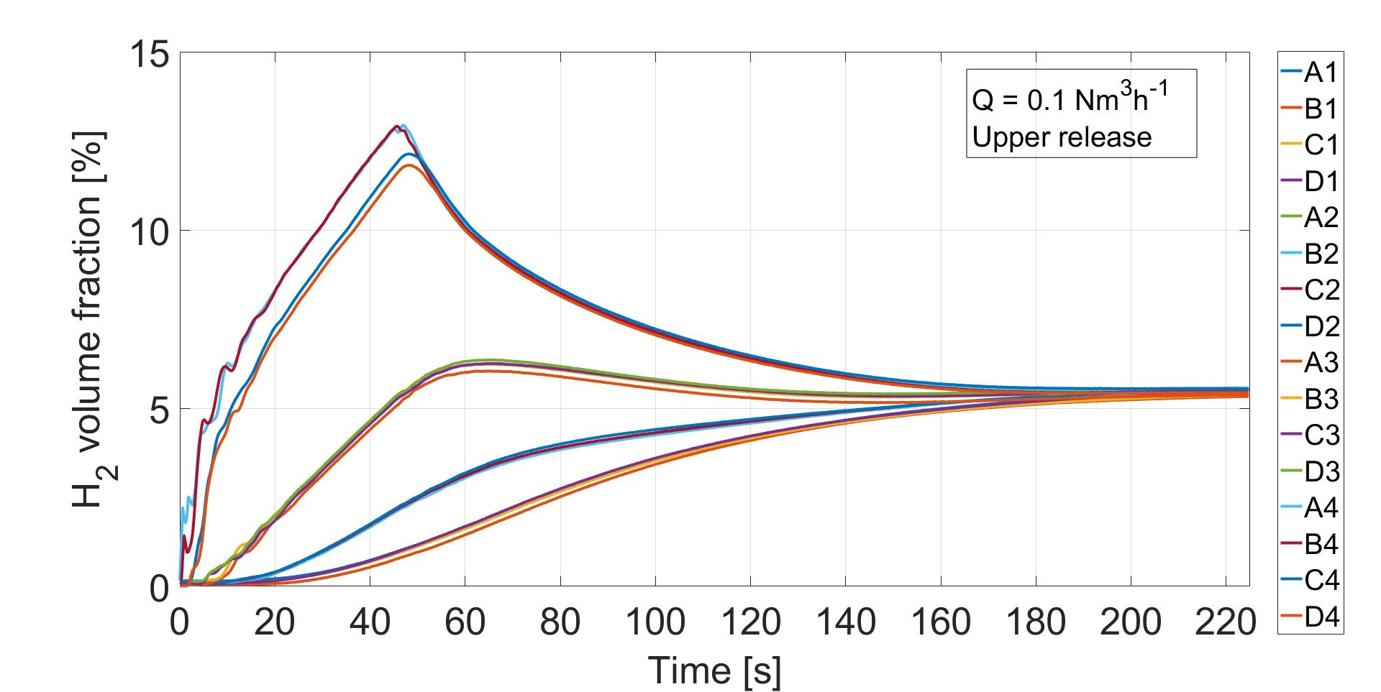
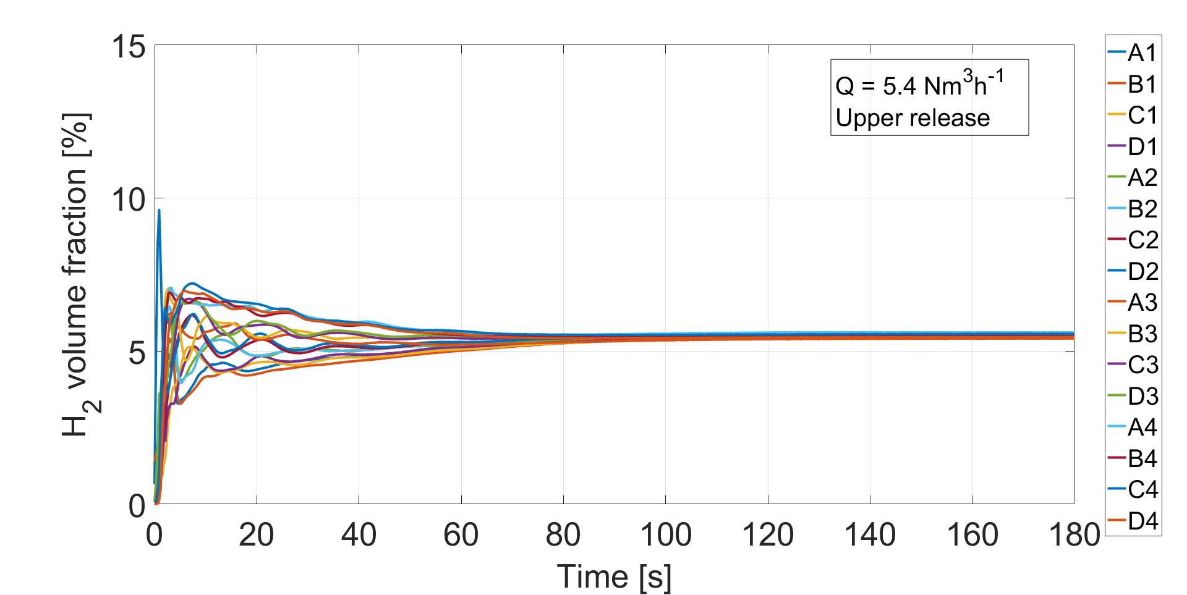
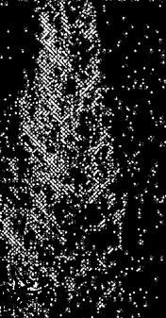
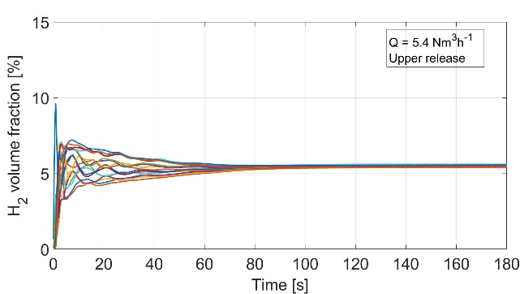
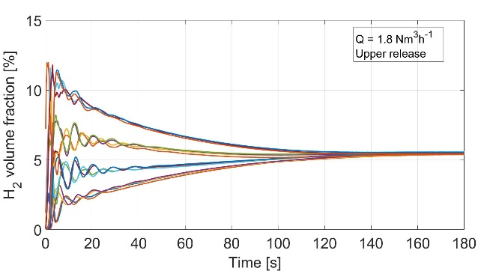
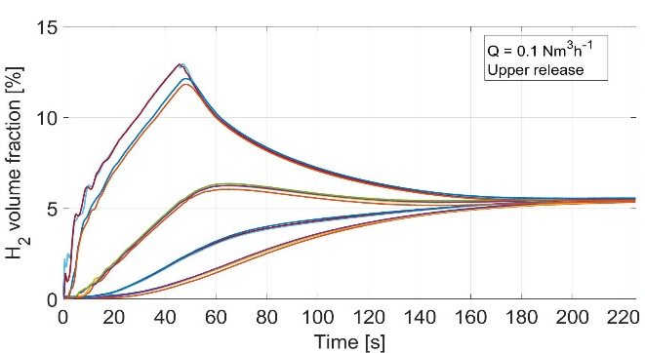
  Dependence of flow rate and of the release position
Turbulent Flow
Δt= 60 s
t = 1 s
c_{max}= 7.5 %
Δc= 7 % -> 3 %
0.2 m
0.08 m
Volume fraction of hydrogen in function of time during the injection and dispersion phases for the 16 sensors, and images obtained at t = 1 s - Leakage from the top - flow rates: a) Q ₁ = 5.4 Nm ³·h ⁻¹, b) Q ₂ = 1.8 Nm ³·h ⁻¹ and c) Q ₃ = 0.1 Nm ³·h ⁻¹.

Slide 15
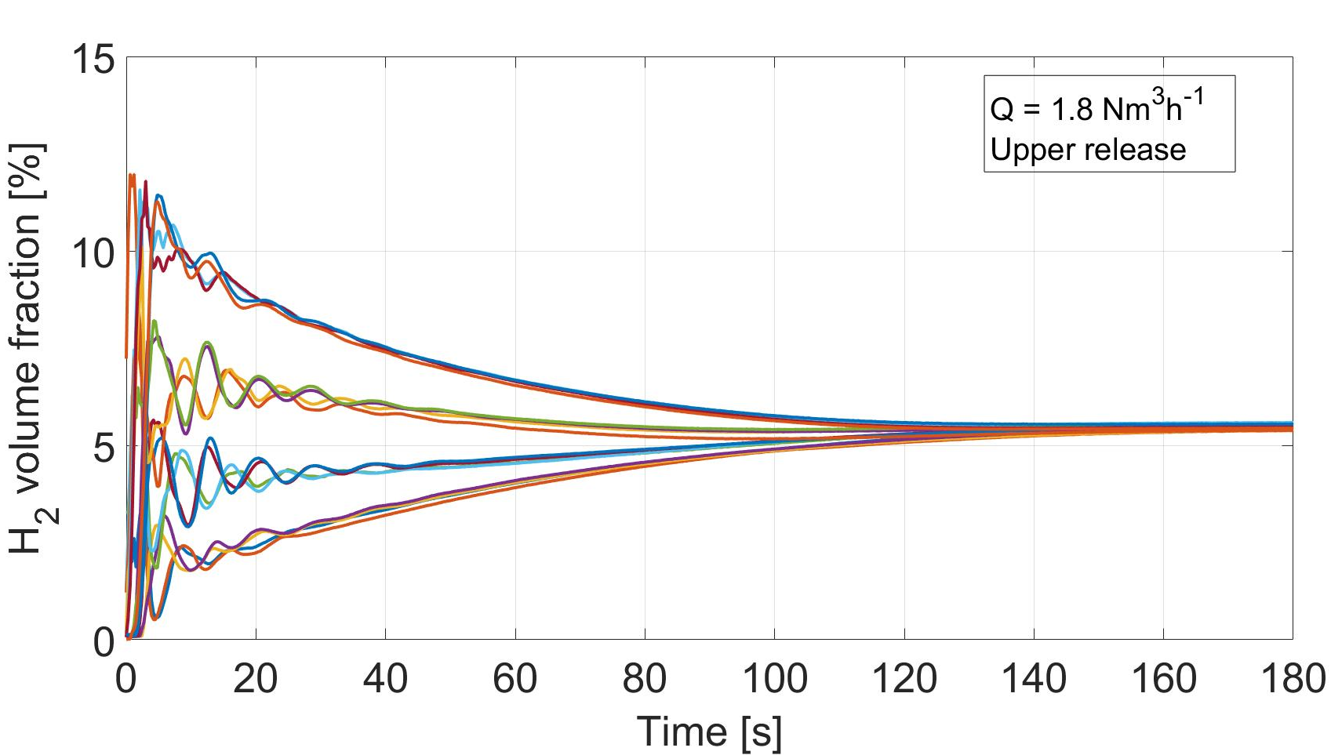
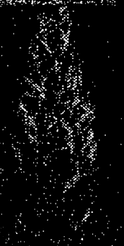
  Dependence of flow rate and of the release position
Transient Flow
Δt= 120 s
t = 1 s
c_{max}= 11.5 %
Δc= 11 % -> 6 %
0.2 m
0.08 m
Volume fraction of hydrogen in function of time during the injection and dispersion phases for the 16 sensors, and images obtained at t = 1 s - Leakage from the top - flow rates: a) Q ₁ = 5.4 Nm ³·h ⁻¹, b) Q ₂ = 1.8 Nm ³·h ⁻¹ and c) Q ₃ = 0.1 Nm ³·h ⁻¹.

Slide 16

  Dependence of flow rate and of the release position
Laminar Flow
Δt= 140 s
c_{max}= 12.5 %
t = 1 s
Δc= 12 % -> 7 %
0.05 m
0.2 m
0.08 m
Volume fraction of hydrogen in function of time during the injection and dispersion phases for the 16 sensors, and images obtained at t = 1 s - Leakage from the top - flow rates: a) Q ₁ = 5.4 Nm ³·h ⁻¹, b) Q ₂ = 1.8 Nm ³·h ⁻¹ and c) Q ₃ = 0.1 Nm ³·h ⁻¹.

Slide 17
  Dependence of flow rate and of the release position
By analysing the concentration curves as a function of time, we can maintain that:
For all tests the variations in the volume fraction of hydrogen are much greater in the vertical plane than in the horizontal plane.
If the flow rate decreases there is an increase in maximum concentrations, concentration gradients and homogenization time.
 | Turbulent flow | Transient flow | Laminar flow
Maximum concentration | 7.5 % | 11.5 % | 12.5%
Homogenization time | 60 s | 120 s | 140 s
Gradient concentration at t=20 s | 3 % | 6 % | 7 %

Slide 18
  Dependence of flow rate and of the release position
The comparison is carried out on two characteristics:
the maximum concentration;
the time to reach the homogeneous concentration after the end of the injection;
The comparison of the three characteristics is done as a function of z.
The average of the sensors placed at the same high z was made.

Slide 19
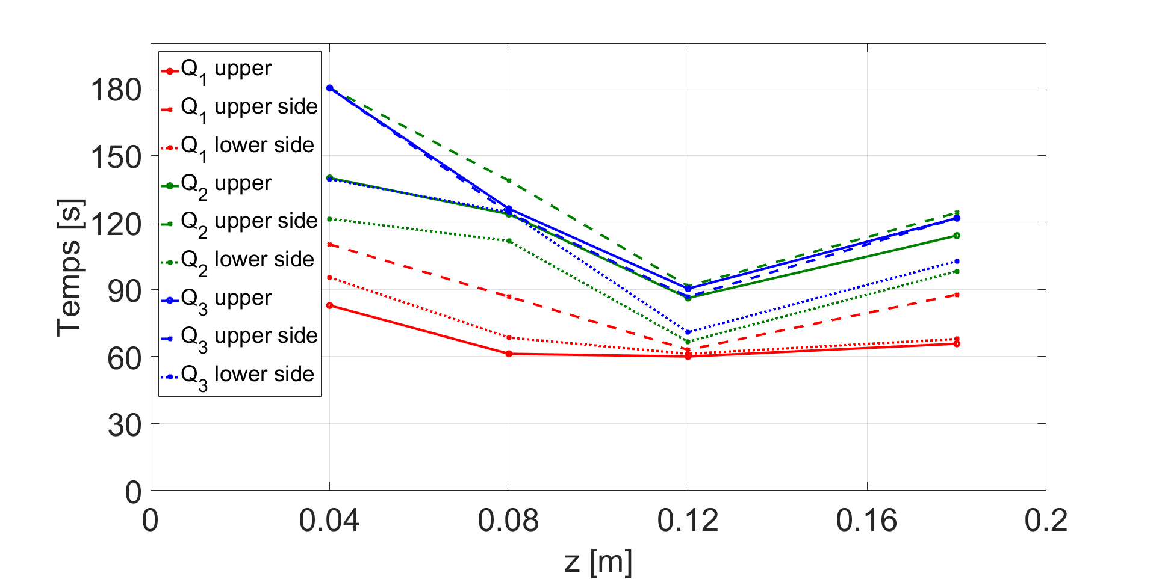
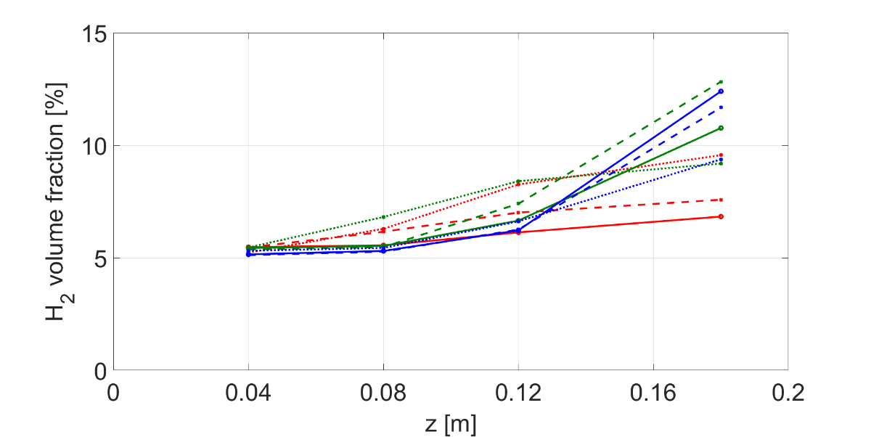
  Dependence of flow rate and of the release position
Maximum hydrogen volume fraction versus height z for 3 injection positions (upper, upper side, lower side) and the 3 study flows (Q_{1,} Q_{2,} Q₃).
The maximum concentration increases with the height.
For z = 0.18 m the concentrations, for the three flow rates, for the lower side position are comparable.

Slide 20
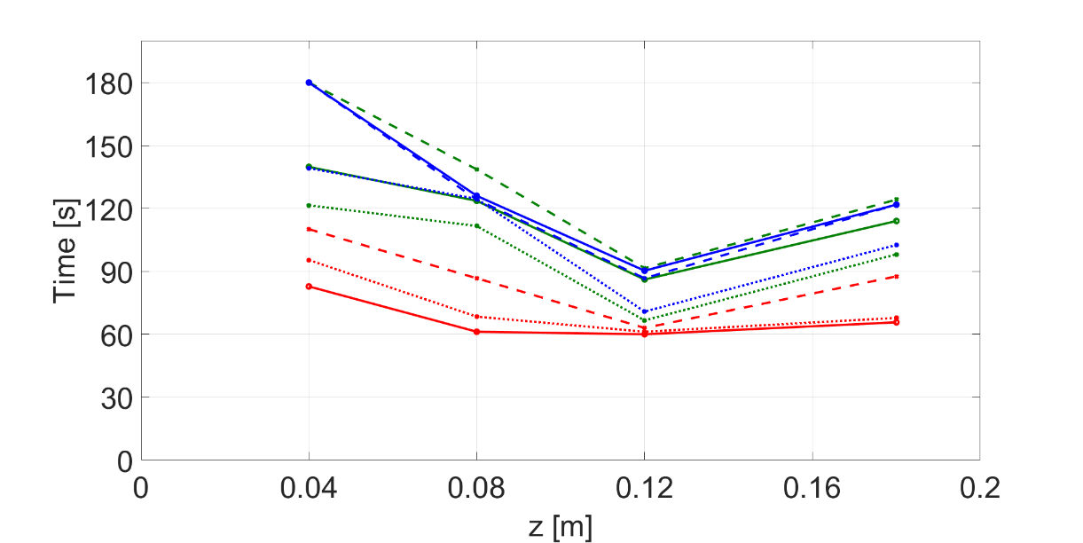
  Dependence of flow rate and of the release position
Time to reach the homogeneous concentration inside the enclosure after the end of the injection as a function of the height for the 3 injection positions (upper, upper side, lower side) and the 3 study flows (Q_{1,} Q_{2,} Q₃).
For z = 0.04 m the maximum homogenization time is obtained for all the cases.
The time increases if the flow rate decrease.

Slide 21
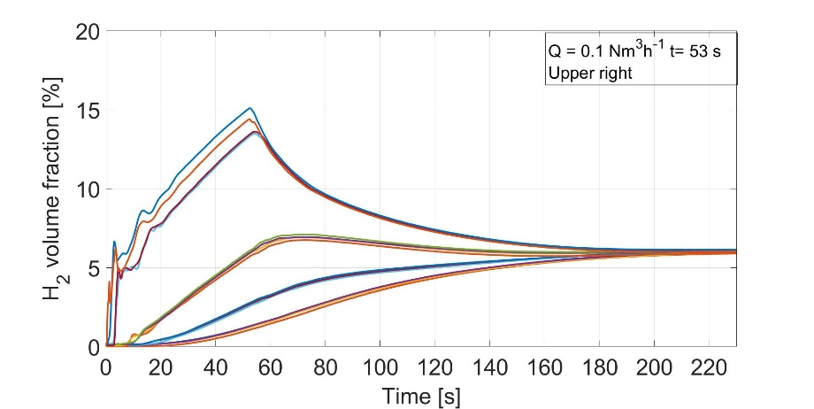
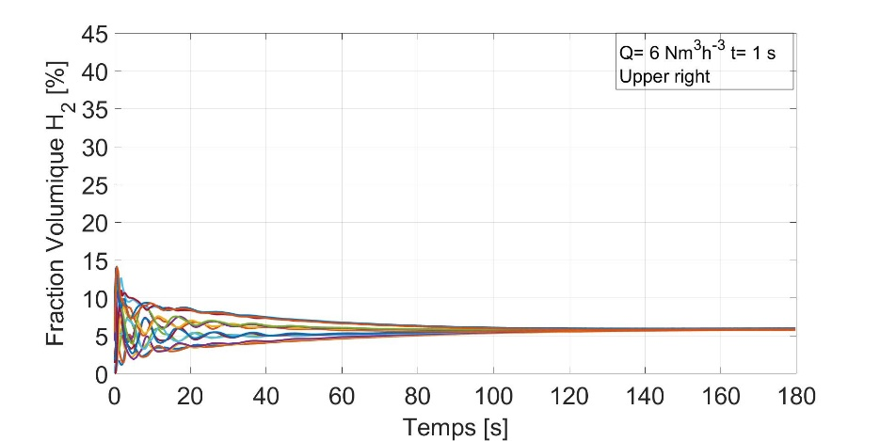


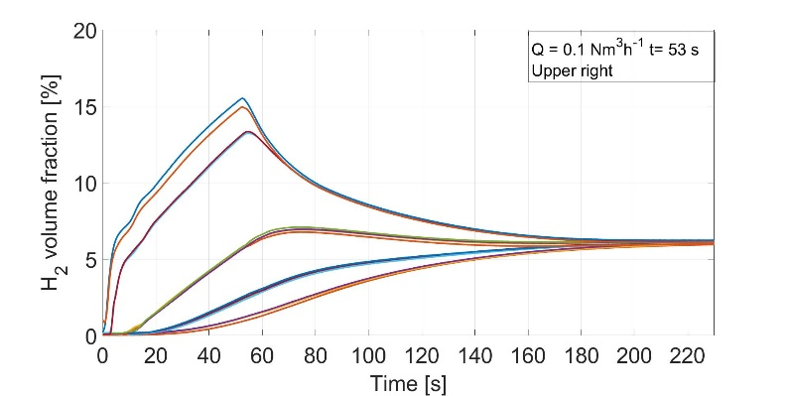
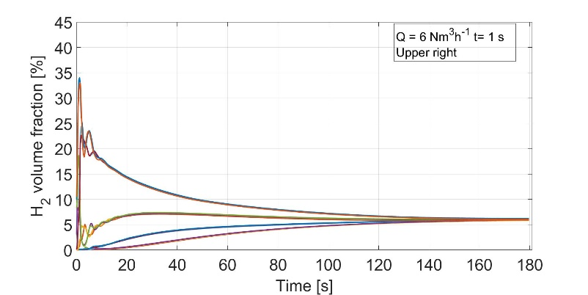
  Dependence of the presence of obstacles
Without Obstacles
Laminar Flow
Turbulent Flow
C_{max}= 15.08
Δt=95 s
Δc [%]= 13.5 -> 7.5
C_{max}= 14.15
Δc [%]= 14 -> 5
Δt=130 s
With Obstacles
Laminar Flow
Turbulent Flow
C_{max}= 15.51
Δt=125 s
Δc [%]= 14 -> 7.5
C_{max}= 34.01
Δc [%]= 34 -> 15
Δt=130 s
Volume fraction of hydrogen in function of time during the injection and dispersion phases for the 16 sensors- Leakage from the top - flow rates:
a) Q = 5.4 Nm ³·h ⁻¹, b) Q = 0.1 Nm ³·h ⁻¹ without and with obstacles.

Slide 22
  Dependence of the presence of obstacles
By analysing the concentration curves as a function of time, it can be concluded that:
The dispersion mechanism in case of turbulent flow changes when the jet encounters the obstacle.
If the flow is laminar the dispersion doesn’t change.
 | Turbulent flow |  | Laminar flow
 | Empty | With Obstacles | Empty | With Obstacles
Maximum concentration | 14.1% | 34 % | 15.1 % | 15.5%
Homogenization time | 95 s | 125 s | 130 s | 130 s
Gradient concentration at t=20 s | 5 % | 15 % | 7.5% | 7.5%

Slide 23
Conclusion
Dependence on the flow rate
-Turbulent flow
-Transition flow
-Laminar flow
Dependence on the release position
-Upper
-Upper side
-Lower side
Presence of obstacle
-Empty enclosure
-Enclosure with obstacles
12 test cases of HYDROGEN dispersion have been studied in an enclosure of 0.031 m³.
The most dangerous cases in term of concentration gradient and maximum concentration are:
the laminar flow with upper release if the enclosure is empty
the turbulent flow if the jet encounters the obstacle.
 | Turbulent flow | Transient flow | Laminar flow
Maximum concentration | 7.5 % | 11.5 % | 12.5%
Homogenization time | 60 s | 120 s | 140 s
Gradient concentration at t=20 s | 3 % | 6 % | 7 %
 | Turbulent flow |  | Laminar flow
 | Empty | With Obstacles | Empty | With Obstacles
Maximum concentration | 14.1% | 34 % | 15.1 % | 15.5%
Homogenization time | 95 s | 125 s | 130 s | 130 s
Gradient concentration at t=20 s | 5 % | 15 % | 7.5% | 7.5%

Slide 24
Perspectives
The presented results are a part of a larger work
The next steps are the following:
Additional test cases to study the effects of flow and leakage orientations with obstacles.
Validation of the calculations carried out with the FLACS CFD code.
Explosion tests for the most dangerous cases in term of flammability.

Slide 25

maria.de_stefano@insa-cvl.fr

Slide 26
Background-Oriented Schlieren
The BOS (Background-Oriented Schlieren) technique is an optical method that determines the instantaneous density field from the analysis of the deflection of light rays. This is due to the optical index gradients of the observed flow.
This method consists in :
Recording a patterned image placed behind the enclosure;
Recording during the release, the refractive index is change
Subtraction of the background image;
The result is a visualization of density gradient.
Sketch of optical arrangement for line-mode Synthetic Schlieren

Slide 27
Consistency of the results
Each case was repeated 5 times and for each sensor we have compared:
the maximum concentration,
ten different concentrations (t = 1 s, 2 s, 3 s, 4 s, 5 s, 10 s, 20 s, 40 s, 50 s, 80 s)
the slopes, in two different time intervals Δt₁ = (40 s - 20 s) and Δt₂ = (90 s - 60 s), of the concentration curves.
The tests are comparable to each other and it is possible to average the 5 tests in order to analyze the results.

Slide 28
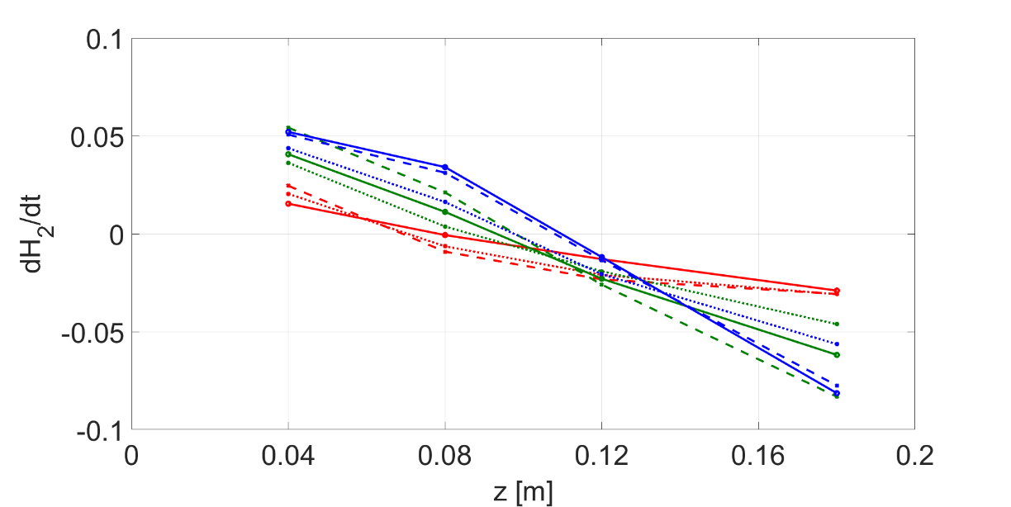
  Dependence of flow rate and of the release position
Slopes of the volumetric fraction of hydrogen after the end of the injection in the time interval Δt = (40 s - 20 s) as a function of the height z for the 3 injection positions (upper, upper side, lower side) and the 3 study flows (Q_{1,} Q_{2,} Q₃).
The slope sign changes as a function of the height.
The slope increases in absolute value if the flow rate decrease.

