Slide 1
Component Availability Effects
Pressure Relief Valves Used at Hydrogen Fueling Stations
ICHS 2017, Hamburg, Germany
Moussin Daboya-Toure, Project Engineer, Air Liquide
Robert Burgess, Senior Engineer, NREL
Aaron Harris, Hydrogen Technical Director, Air Liquide

Slide 2
OVERVIEW
Guidelines in sizing and selecting pressure safety valves (PSVs)
Guidelines in sizing vent stacks
Available PSVs impact on vent stacks
Current high pressure safety valves availability landscape for hydrogen fueling stations and associated challenges

Slide 3
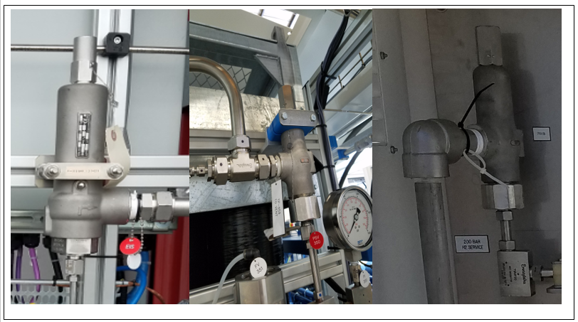
SIZING PRESSURE SAFETY VALVE (PSV)
Identify equipment and process lines to be protected
Determine expected flow rate, allowable overpressure and backpressure if unknown
Define and Identify design scenarios
Thermal Expansion
or
Fire

Slide 4
Thermal Expansion Scenario per API 520:
Identify discharge flow behavior
$$P_{Cf}=P_{1}∗{(\frac{2}{k+1})}^{\frac{k}{(k−1)}}$$
$P_{Cf} \text{−} \text{critical} \text{flow} \text{nozzle} \text{absolute} \text{pressure}$(kPa)
$P_{1}\text{−}$ reliving upstream absolute pressure (kPa)
$P_{2}$ - absolute back pressure (kPa)
$k \text{−}$gas or vapor specific heats ratio (Cp/Cv)
A - required effective discharge (${mm}^{2}$)
W - required flow capacity through the PSV (kg/hr)
C - function of the ideal gas specific heats ratio (k)
$k_{d}$- unit less discharge coefficient (0.8)
$k_{b}$ - unit less capacity correction factor due to backpressure (1 )
$k_{c}$ - unit less combination correction factor (1)
M - gas or vapor molecular weight (kg/kg-mole)
T - relieving temperature of the inlet gas or vapor ($\text{K})$
$F_{2}$- unit less coefficient of subcritical flow
Z - unit less compressibility factor at the relieving inlet conditions
Critical flow behavior
if $P_{Cf}$ $≥$PSV downstream nozzle pressure
Calculate PSV required effective discharge area
$A=$ $\frac{W}{C∗k_{d}∗P_{1}∗k_{b}∗k_{c}}∗\sqrt{\frac{T∗Z}{M}}$
Subcritical flow behavior
if $P_{Cf}$ $<$PSV downstream nozzle pressure
Calculate PSV required effective discharge area
$A=$ $\frac{W}{F_{2}∗k_{d}∗k_{c}}∗\sqrt{\frac{T∗Z}{M∗P_{1}∗(P_{1}−P_{2})}}$
API 520

Slide 5
Fire Scenario per CGA S-1.3
Calculate PSV effective discharge area
$$A_{prd}=\frac{2225.46∗S∗A∗k^{2}∗\sqrt{M}}{C∗k_{d}∗P}$$
$A_{prd}$- required effective discharge flow area of the PSV (${cm}^{2}$)
S - safeguarding factor
A - container outer surface area ($m^{2}$)
$k$- gas or vapor specific heats ratio (Cp/Cv)
C - function of the ideal gas specific heats ratio (k)
$k_{d}$- unit less discharge coefficient (0.8)
M - gas or vapor molecular weight (kg/kg-mole)
P - maximum allowable absolute pressure of the container (kPa)
CGA S-1.3

Slide 6
SELECTING PRESSURE SAFETY VALVE
Compare the required effective area for the thermal expansion and fire scenario cases and choose the larger effective area. This is the required effective area for the worse case scenario
Compare the required effective area against available PSV manufacturer effective area values
Select the available PSV with an actual effective area at least as large as the calculated required effective area to meet the worse case scenario
Ensure selected available PSV relief capacity is greater or equal to calculated required flow from the design worse case scenario

Slide 7
Required vs. Market Available PSVs Areas
Equipment PSV | Supply Storage | Suction Compressor | MP Storage | HP Compressor | HP Storage | HP Dispenser
Set Pressure-kPa | 25,000 | 25,000 | 53,600 | 95,000 | 95,000 | 87,500
$A_{Required thermal expansion .case.}$-${mm}^{2}$ | 0.79 | 2.75 | 0.74 | 0.42 | 0.42 | 0.45
$A_{Required fire case}$ - ${mm}^{2}$ | 14.13 | 4.50 | 0.69 | 0.004 | 0.58 | 0.004
$A_{Market Available}$ - ${mm}^{2}$ | 31.92 | 31.92 | 31.92 | 31.92 | 31.92 | 31.92
${Flow}_{Required}$- $\frac{{Nm}^{3}}{hr}$ | 404.6 | 2,599.8 | 762.1 | 710.9 | 710.9 | 710.9
${Flow}_{Market Available}$- $\frac{{Nm}^{3}}{hr}$ | 16,292.3 | 16,292.3 | 34,876.02 | 61,756.2 | 61,756.2 | 56,880.7

Slide 8
SIZING STATION VENT STACK PER API 521
Need to determine:
expected gas flow rate for the design worse case (number of PSVs lifting)
maximum heat load associated with worse case release ($Q_{h}$)
minimum distance (D) from the flame epicenter to each thermal radiation threshold safe location (personnel-$D_{H}$, equipment-$D_{I}$, & public area-$D_{L})$
anticipated flame length ($L)$ with no wind conditions
anticipated offset flame axes (horizontal - $I_{x}$ and vertical- $I_{y}$) under wind conditions
Define site vent stack height and location

Slide 9
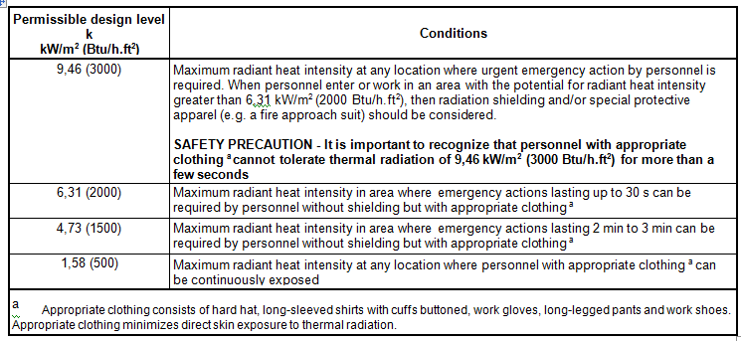
Heat Load and Minimum safe thermal radiation distances per API 521
Released heat load ($Q_{h}$)
$$Q_{h}=LHV∗Q$$
Minimum safe thermal threshold distances
$D=\sqrt{\frac{τ∗F∗Q_{h}}{4∗π∗K}}$ ($D_{L}$, $D_{H}$, $D_{I}$)
$Q_{h}$- maximum heat released (kW)
LHV - lower heating value of the fluid ($\frac{kWh}{{Nm}^{3}}$)
$Q$ - maximum worse releases scenario flowrate ($\frac{{Nm}^{3}}{hr}$)
D - minimum distance from the epicenter of the flame to the thermal radiation threshold safe location (m)
F - unit less fraction of heat radiated (11.1%)
K - radiant threshold heat intensity ($\frac{kW}{m^{2}}$)
$τ$- unit less fraction of the radiated heat transmitted through the atmosphere (1)
API 521

Slide 10
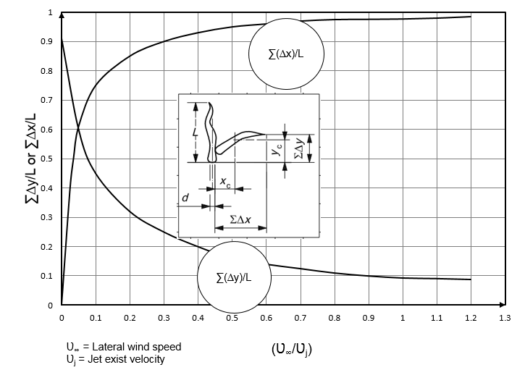
Release Flame Length and Tilt flame offset distances due to wind per API 521
Flame Length with no wind
$$L={10}^{(0.444∗\log\left(Q_{h}−0.876\right))}$$
Tilt flame offset distances due to wind to equipment
$I_{x}=0.5∗L∗\sum{\frac{∆x}{L}}$
$I_{y}=0.5∗L∗\sum{\frac{∆y}{L}}$
$L$- flame length (m)
$\sum{\frac{∆x}{L}}$- unit less horizontal wind distortion effect factor
$\sum{\frac{∆y}{L}}$- unit less vertical wind distortion effect factor
$Q_{h}$ - maximum heat released (kW)
$I_{x}$ - horizontal tilt flame offset distance to equipment due to 9m/s wind velocity (m)
$I_{y}$ - vertical tilt flame offset distance to equipment due to 9m/s wind velocity (m)
API 521

Slide 11
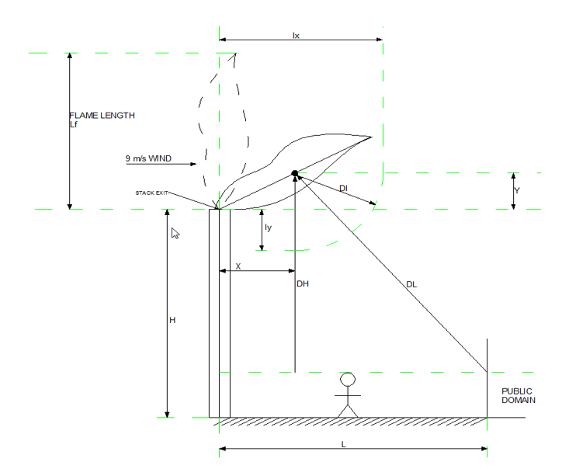
AVAILABLE PSVs IMPACT ON VENT STACK
Vent Stack Parameters | Required PSV | Available PSV
Vent Stack Diameter - mm | 52.5 | 52.5
Flow Rate ($Q$) - ${Nm}^{3}$/hr | 2,599.80 | 16,292.3
Heat Released ($Q_{h}$) - kW | 7,797 | 51,732
Thermal Radiation ($D_{L}$) - m | 6.6 | 16.9
Thermal Radiation ($D_{H}$) - m | 3.7 | 9.6
Thermal Radiation ($D_{I}$) - m | 2.6 | 6.8
Flame Length ($L$) - m | 7.1 | 16.5
Vertical Offset to Equip. ($I_{y}$) -m | 2.0 | 3.9
Horizon. Offset to Equip.($I_{x}$) m | 3.4 | 7.9
Vent Height to Personnel (H) -m | 4.3 | 8.4
Vent Stack to Public (L) - m | 8.0 | 23.6
Vertical Offset Dist. (Y) - m | 1.3 | 3.0
Horizontal Offset Dist. (X) - m | 3.4 | 7.9
GT-PR-PIP-005

Slide 12
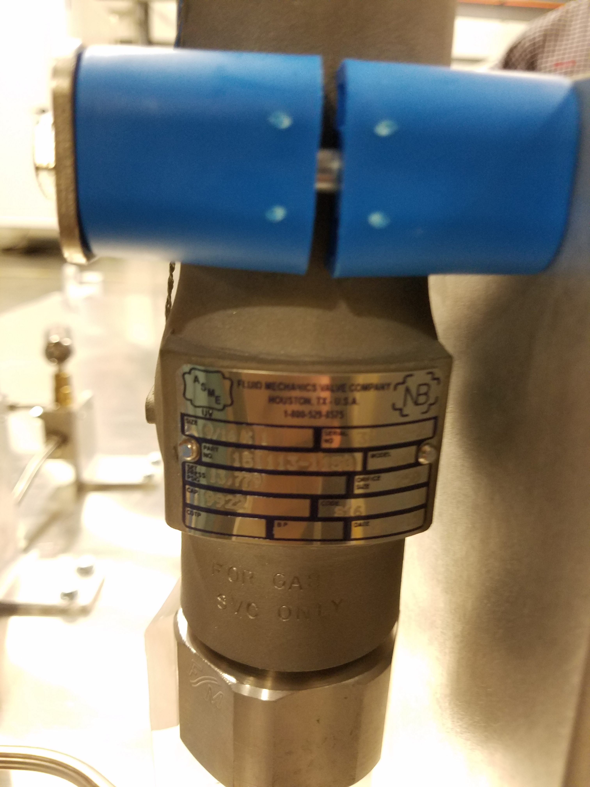
HIGH PRESSURE SAFETY VALVES LANDSCAPE
Limited in the choice of devices with National Board certification
Considered as custom products or special order
High cost
Bigger orifice sizes compared to what is desired or required

Slide 13
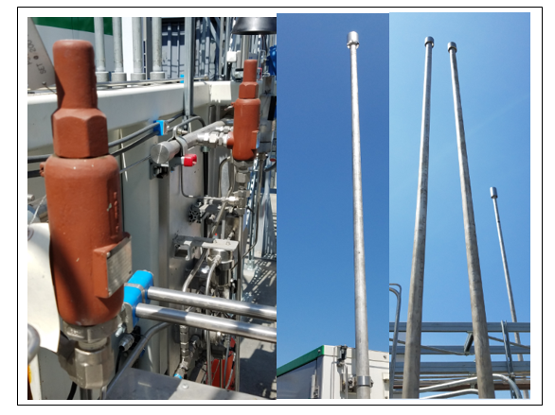
SUMMARY
PSVs and Vent stacks design guidelines
Results of required PSVs from established code & standards (CGA S-1.3 & API 520)
Required PSVs compared to market available PSVs
Results of required vent stacks from established code & and standard (CGA G-5.5 & API 521)
Oversized (bigger orifice size)market available PSVs impact on the site vent stacks
Safety concerns
High procurement cost
High installation cost (10-30 % more)
Require more installation space
Challenges with permits approval

Slide 14
RECOMMENDATIONS
Incentives to help increase supply chain product offering of certified smaller orifice size PSVs for high pressure hydrogen applications
Improvement on documentations sharing and approval process
Improvement on approval and required testing lead time (National Board or American Society of Mechanical Engineers)

Slide 15
ACKNOWLEDGEMENTS
The authors would like to thank US Department of Energy (US DOE) and National Renewable Energy Laboratory (NREL). In addition, the authors would like to acknowledge Charles James, DOE Technology manager in DOE Office of Fuel Cell Technology

Slide 16
QUESTIONS?

Slide 17
Thank You.

Slide 18
REFERENCES
ASME Section VIII Division 1 – Safety Relief Valves Design
CGA S-1.3-2008 – Pressure Relief Device Standards-Part 3-Stationary Storage Containers for Compressed Gases
NFPA 2 2016 – Hydrogen Technologies Code
CGA G-5.5 – Hydrogen Vent Systems
API 520 2014 – Sizing, Selection, and Installation of Pressure Relieving Devices
API 521 2014 – Guide for Pressure Relieving and Depressurizing Systems
NIST 12, Thermodynamic and transport properties of pure fluids, NIST Standard Reference database 12, version 5 (2000)
ASME B31.12 –Hydrogen Piping and Pipelines
ISO4126-1 – Safety Devices for Protection against Excessive Pressure
Harris, A. & Marchi, C. S. Investigation of the hydrogen release incident at the AC Transit Emeryville Facility. SAND2012–8642 (Sandia National Laboratories, Livermore, CA, 2012)
http://www.tchouvelev.org/Documents/UpdatedDocs/Real_ideal_gas.pdf
GT-PR-PIP-005 – Hydrogen Venting to Atmosphere (Internal Document)

