Slide 1
Non-adiabatic blowdown model: a complimentary tool for the safety design of tank-TPRD system
7th International Conference on Hydrogen Safety
Hamburg, Germany, 11-13 September 2017
M. Dadashzadeh, D. Makarov, V. Molkov
Hydrogen Safety Engineering and Research Centre

Slide 2
Onboard storage
Optimizing tank-TPRD system performance
Objectives:
Reduce TPRD diameter to avoid:
  Large flame length of hydrogen jet fire
  Pressure peaking phenomena to prevent civil structure demolition
Exclude tank rupture during blowdown in a fire when TPRD orifice size is small

Slide 3
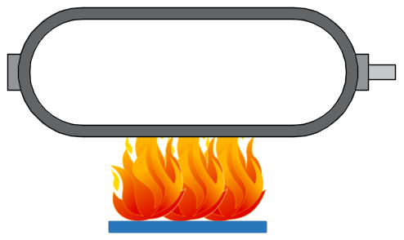
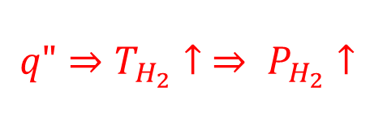
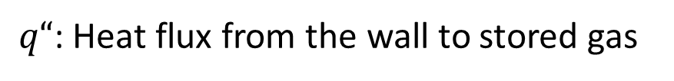
Ulster model
Problem formulation: tank in a fire
$$q"⇒T_{H_{2}}↑ ⇒ P_{H_{2}}↑$$
TPRD
q"
$q“$: Heat flux from the wall to stored gas
Phenomena (heating only):
Heat transfer from the fire through the wall to stored gas
Temperature and pressure of gas increase
Load-bearing thickness of the wall increases from inside
Material decomposition wave propagates from outside
Rupture: load-bearing thickness “meets” decomposition wave

Slide 4
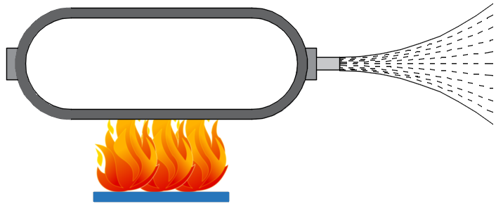
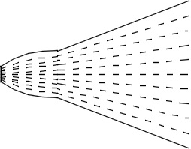
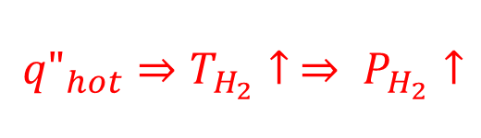
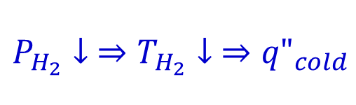
Ulster model
Problem formulation: tank in a fire with TPRD
TPRD activated
$${q"}_{hot}⇒T_{H_{2}}↑ ⇒ P_{H_{2}}↑$$
$$P_{H_{2}}↓ ⇒T_{H_{2}}↓ ⇒{q"}_{cold}$$
Additional phenomena (cooling due to TPRD activation):
Pressure and temperature decrease
Wall load-bearing thickness decreases
Heat transfer from cooled gas to the wall (cold wave)
Wall decomposition wave may slow down or even stops
Rupture is delayed or prevented

Slide 5
Ulster model
Equations, input, output
Formulation
TPRD-tank system | Equation | Reference
Gas | Energy conservation equation Real gas EOS (Abel-Noble) | Molkov et al., 2009 Johnson, 2005
Notional nozzle | Under-expanded jet theory | Molkov et al., 2009
Tank | 1D unsteady heat transfer equation Nu correlations for convective heat transfer Enthalpy change during decomposition* | Patankar, 1980 Woodfield, 2008 Voller, 1985
Input
Tank and hydrogen properties; external heat flux; TPRD diameter and initiating time
Output
Gas pressure and temperature; tank wall temperature; time to rupture or blowdown time
Wall material decomposition is not considered at the current stage of this study but it is under investigation for the further development of the model

Slide 6
Ulster model validation
Pressure: adiabatic vs non-adiabatic model
Test by KIT: 19 L Type IV tank; Helium; Pressure 70 MPa
TPRD diameter 1 mm
Theory by Ulster
Tank material parameters: Acosta et al., 2014; Welch et al., 2017

Slide 7
Ulster model validation
Temperature: adiabatic vs non-adiabatic model
Test by KIT: 19 L Type IV tank; Helium; Pressure 70 MPa
TPRD diameter 1 mm
Theory by Ulster
Tank material parameters: Acosta et al., 2014; Welch et al., 2017

Slide 8
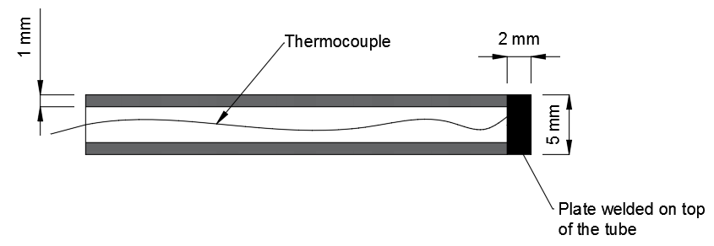
Ulster model validation
Temperature: thermocouple response delay
Thermocouple shielded with magnesium oxide and thin steel shell: KIT, 2017
Top metal plate is steel 1.4571: KIT, 2017
Lump heat transfer model, considering the metal plate is thermally thin
Nu correlations for convective heat transfer: Incropera et al., 1985
Metal plate properties: www.engineeringtoolbox.com

Slide 9
Ulster model validation
Temperature: adiabatic vs non-adiabatic model
Test by KIT: 19 L Type IV tank; Helium; Pressure 70 MPa
TPRD diameter 1 mm
Theory by Ulster
Tank material parameters: Acosta et al., 2014; Welch et al., 2017

Slide 10
Concluding remarks
A model for design of inherently safer system TPRD-storage tank is formulated.
The model is validated against non-adiabatic blowdown (KIT test).
  Satisfactory agreement for dynamic pressure/temperature
The model validation against temperature and pressure rise in a tank in a fire (KIT test) is under development
The model can be applied for hydrogen safety engineering of a system TPRD-storage tank

Slide 11
Thank you for your attention!

