Slide 1
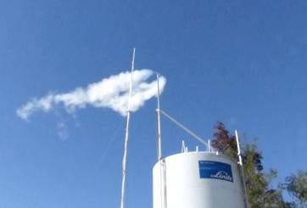


Empirical Profiling of Cold Hydrogen Plumes
Formed From Venting of LH2 Storage Vessels
W. Buttner¹, M. Ciotti², C. Rivkin¹
K. Schmitt^{1,*}, H. Wright^{1,*}, K. Hartmann^{1,*}, E. Weidner³
¹ National Renewable Energy Laboratory, Golden, CO USA
² Linde Group, Murray Hill, NJ USA
³ Joint Research Centre, Petten, NL
* Interns, Colorado School of Mines, Golden, CO, USA
Presented to
International Conference on Hydrogen Safety
Hamburg, Germany
September 11-13, 2017

Slide 2
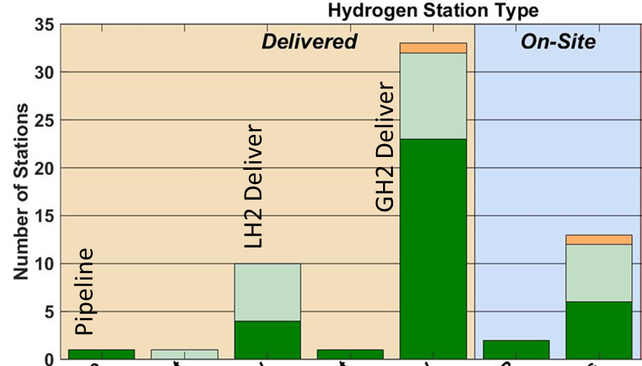
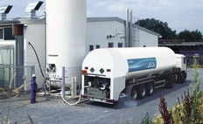
Brief Overview of LH2 Storage and Commercial Use
Commercial Hydrogen Fueling Stations
Predominately GH2 with delivery by tube trailers, but capacity limitations
LH2 on-site storage increasing (higher density ➔ greater on-site capacity)
Features of LH2
Industrial on-site storage and use is common
LH2 produced remotely and transported by tanker for on-site transfer and storage
Issues and concerns with LH2 at HFS
Regulations preclude many urban facilities
  NFPA 2 prescribes set back of 22.9 m (75 feet)
  Mitigation strategies could ease requirements
  Need for field data and models on dispersion
LH2 Delivery (tanker trailer)
Current separation distances exclude LH2 storage at many urban H2 fueling stations

Slide 3

Project Background
Concerns expressed by the NFPA 2 H2 Storage Task Group
Will the H2 plume drop below the vent stack release point?
What will the cold H2 do to atmospheric gases (O2 and N2)?
Will the chilled air produced from contact with the cold H2 gas impact dispersion?
Will the H2 become entrained in any liquid oxygen or nitrogen produced from the cold H2?
How significant is wind speed in impacting the H2 plume?
Will there be significant ground level H2 concentrations?
Can existing dispersion models account for the actual physical phenomenon occurring during a H2 venting event?
Does the visible vapor correlate to hydrogen levels in the air?
Hydrogen dispersion uncertainty impedes scientific-based requirements and mitigation strategies.
The NREL H2 Plume Analyzer was developed in response to NFPA 2 Storage Task Group concerns

Slide 4
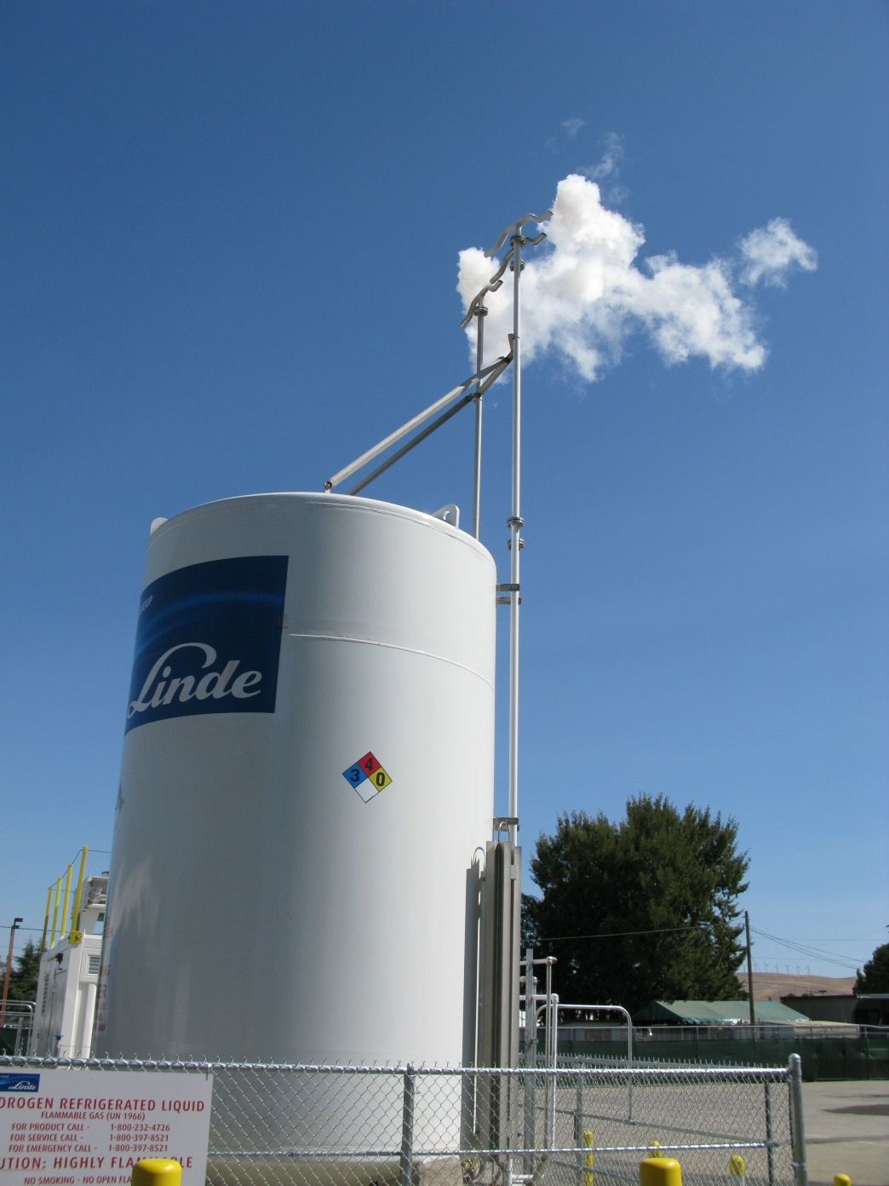
Project Background—LH2 Delivery and Venting
LH2 Delivery and Transfer
LH2 Venting is a routine part of LH2 Delivery
  Nominal amount and duration 50 to 75 Kg in hour
  ~ 8 ft³ (>200 L) per sec of H2 at STP
Opportunity to measure temporal and spatial H2 dispersion
Cold H2 Plume Behavior
Little or no information on H₂ dispersion was available
  Perceptions and opinions existed
Analyzer with flexible design and deployment capability
  Sensing locations, time and spatial resolution
  Sensors for H₂ plus O₂, T, RH
  Limited Budget (NREL Sensor Lab AOP)
  Prototype Analyzer developed and deployed (results follow)
    Point sensors: Low cost, mature, flexible, profile and monitor capability,
    versus:
    Remote Detection: Less mature, more costly, detection limit concerns
`

Slide 5
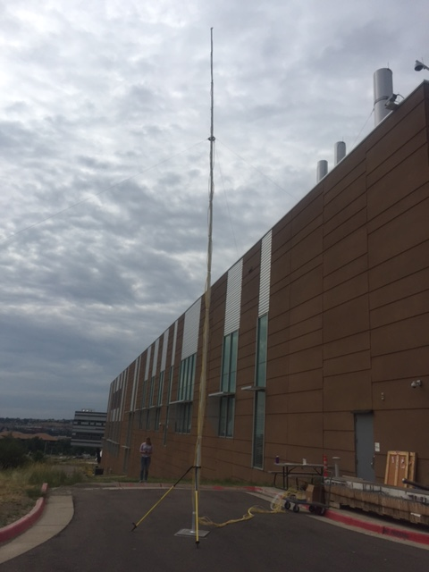
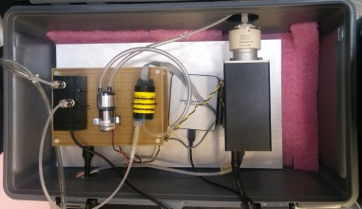
Prototype Hydrogen Plume Analyzer
Integrated System
Support Structure (assembled) extended to 35 ft
Analyzer Box (with sensors) deployed outside classified zone and interfaced to a computer
Umbilical (Support Structure to Analyzer Box)
  Thermocouples interface to remote logger
  Pneumatic line interfaced to O₂ and H₂ sensors through multi-port valve
    Multiplex analyses from 10 positions
The Analyzer Box with (L to R) TC sensor (in a custom-built holder), pump, O₂ Sensor, DAQ interface, and multi-port valve.

Slide 6
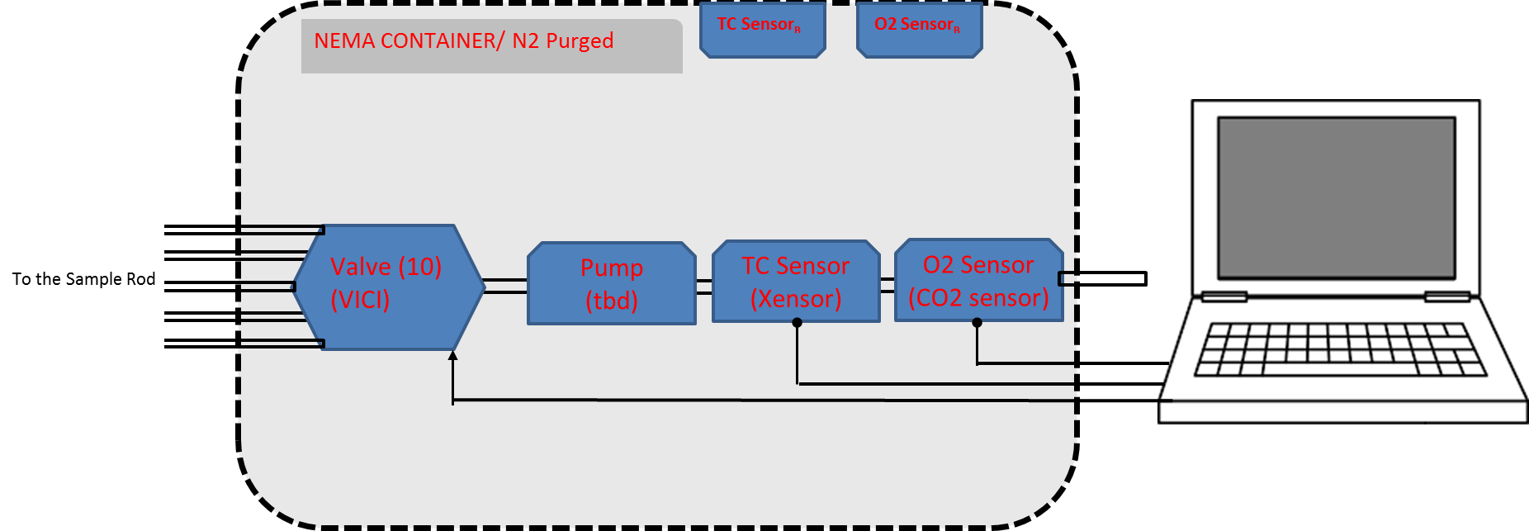
NREL Sensor Laboratory
The Analyzer Box –Design and Limitation
15 foot (can be increased)
pneumatic line to pole
Analyzer Box
  Multiple Sensors mounted at base of pole
  Computer control and DAQ (LabVIEW)
Pneumatic system
  10-position multiport valve (VICI)
  Pump (Flow rate = 1000 sccm ➔~0.1 g H2/min if pure)
  Pneumatic tube: 1/16” ID (purge time < 1s)
  Interface to support structure (pole)
Sensor Selection
  Thermo-conductivity sensors (remote)
    t₉₀ < 300 ms, 0 to 10 vol% H₂
  O2 Sensors (remote)
    “Response Time < 1 sec”, 0 to 25 vol% O₂
  Thermocouples (8 points) (In-situ)
  Multiplexing of sample positions
  Sequential analysis of gas sample (t_{r} = 100s)
Computer Control and Logging
NOTE: This configuration was for the PROTOTYPE Cold Hydrogen Plume Analyzer

Slide 7
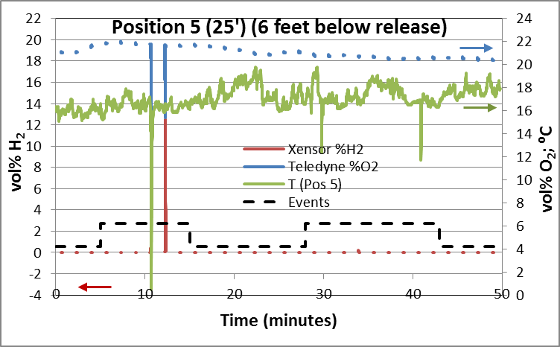
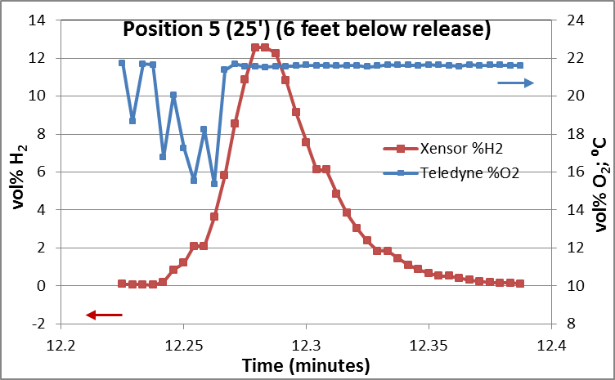
Details on field test data (October 2016)
Events (Planned Venting): A: Storage Tank Vent (SP: 5-10 horizontal feet) B: Truck Tank Vent (SP: 20 - 30 horizontal feet);
Thermocouple (—) in ⁰C, logged continuously 1 pt/s, for 8 channels ; Right “Y axis”
O2 sensor (“●”), logged continuously 4 pt/sec for 10 sec sequentially at each of 10 positions (Right “Y axis”)
H2 sensor (“●”), logged continuously 4 pt/sec for 10 sec sequentially at each of 10 positions (Left “Y axis”)
A
B
Expanded view of one cycle
(H2 and O2 sensor)

Slide 8
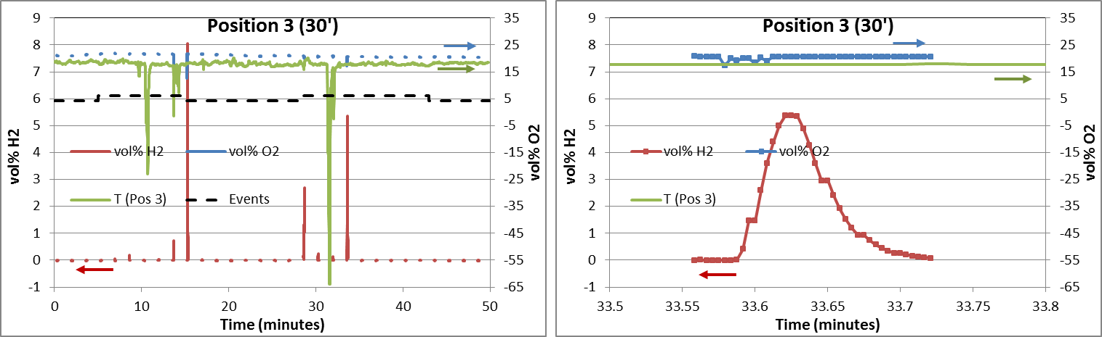
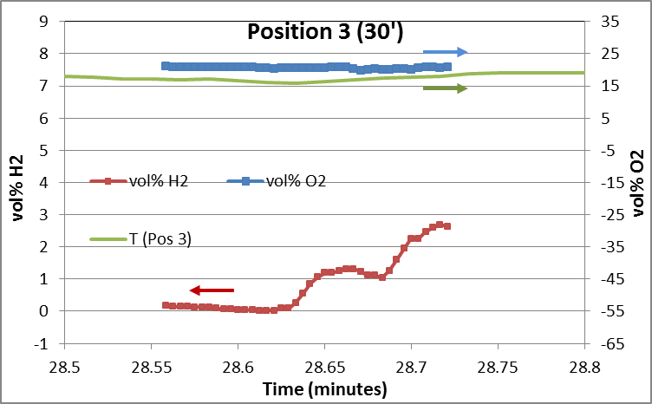
Field Data from the Hydrogen Plume Analyzer
Hydrogen was observed for every SP
O2 measurements did not correlate to H2
T (in-situ TC) remained near ambient
  Low fast T transients were observed

Slide 9
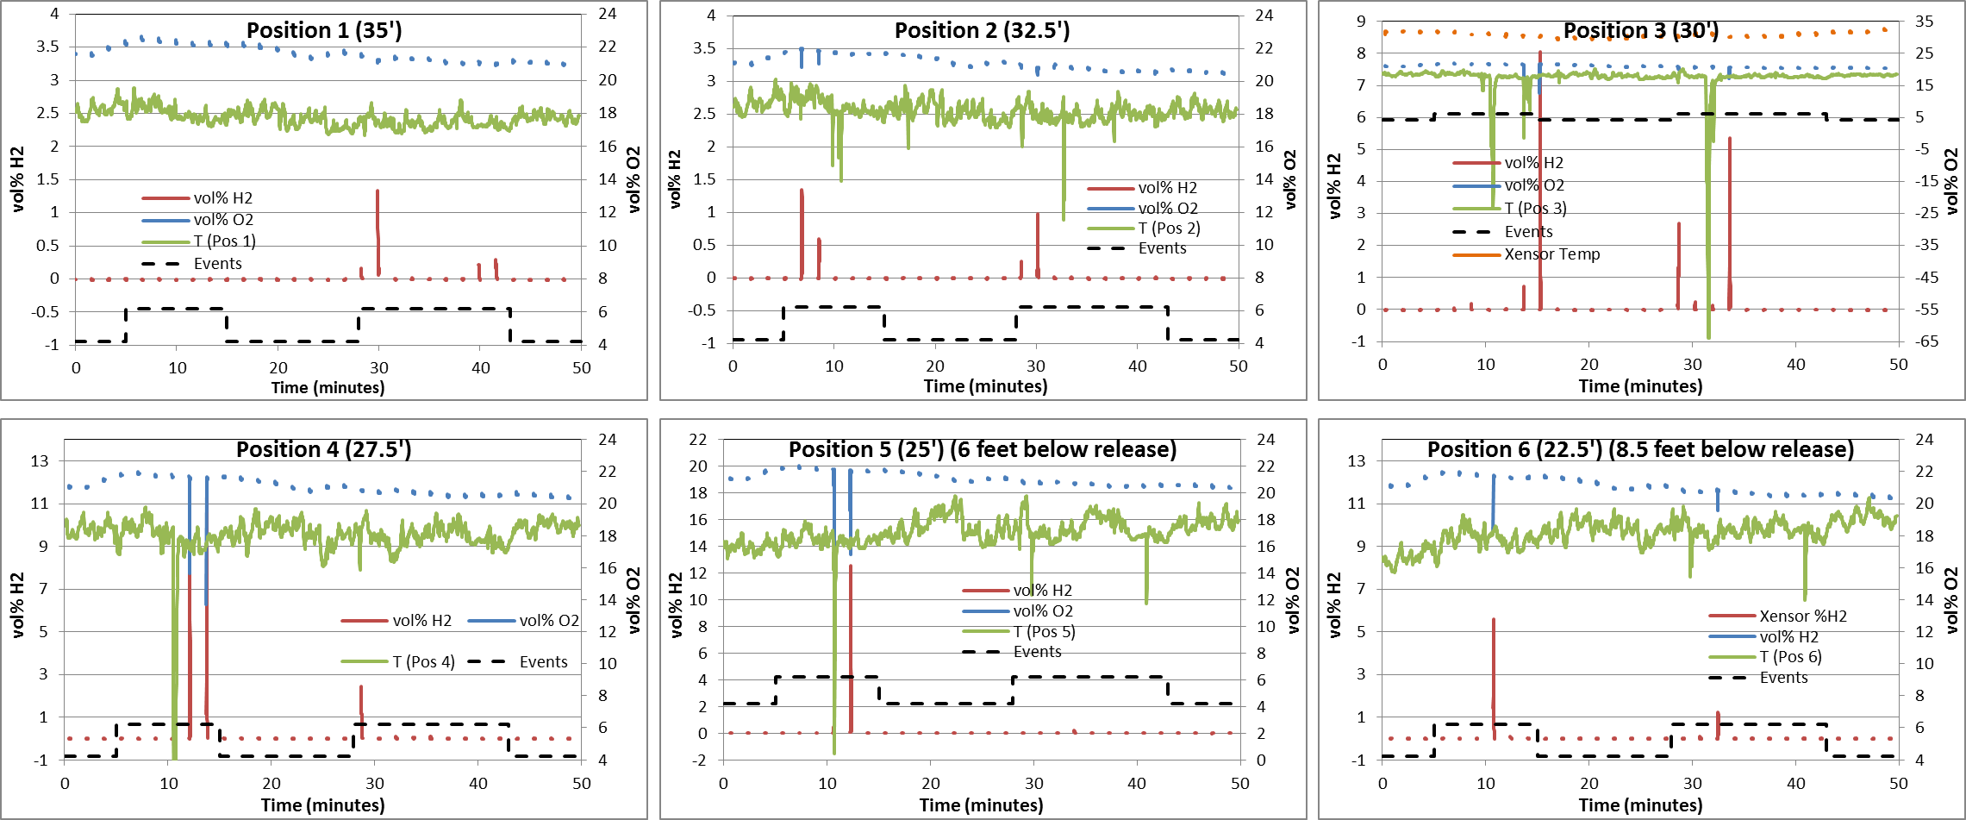
Field Data and Results--FINDINGS
Prototype Hydrogen Plume Analyzer performed as designed
Buoyancy does not necessarily dominate the hydrogen dispersion process
  vol% H₂ > LFL was observed below the release point (8.5 feet)
  Ground level personal monitors detected hydrogen
vol% O₂ fluctuations had a inconsistent correlation to vol% H₂
T measurements remained near ambient except for transient pulses
  Poor correlation to Vol% H₂
The vapor cloud did not strongly correlate to vol% H₂

Slide 10

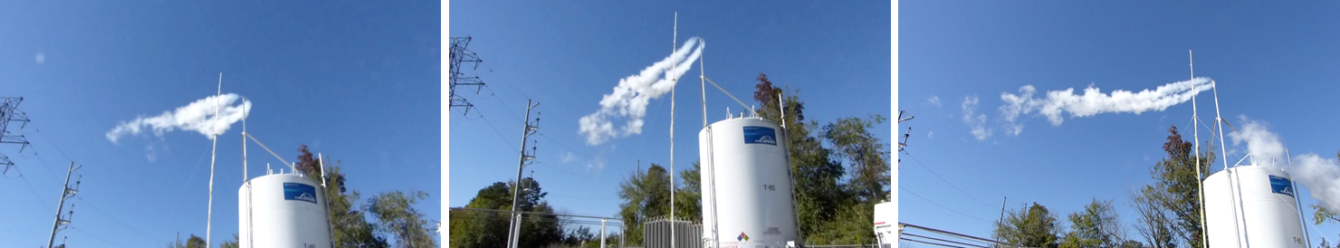
Outcome of Field Demonstration
(NFPA 2 Storage Task Group Meeting)
Vent Stack Design Recommendations Field measurements of outdoor LH2 releases with the Analyzer supported the recommendation that the hydrogen vent stacks ought to be directed up and away from ground level (NFPA 2)
(Schematic Drawing)
Common LH2 vent stack design
(~ 3 inch diameter vent line)

Slide 11
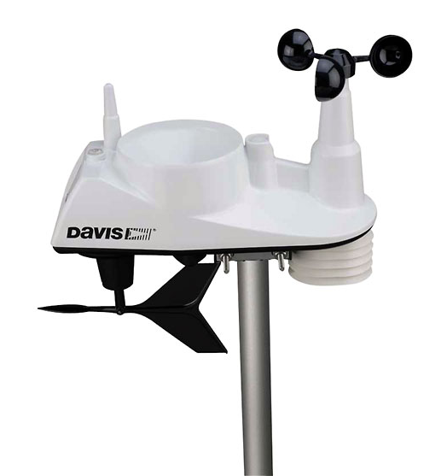
H2 Cold Plume Release Analysis
(Design and Application Embellishments)
Identification of Modifications and Embellishments
Dedicated sensors for each sample point
  (ELIMINATE multiplexing sample points )
In-situ sensors (where conditions permit)
Weather sensors (wind speed and direction RH)
Additional deployments under various ambients (T, wind, RH)
The Analyzer is amenable for profiling and monitoring either GH2 and LH2 facilities
The Analyzer can form the basis for Hydrogen Wide Area Monitoring (HyWAM) in support of H₂@Scale
Wind speed and direction sensor
(not used in the Oct 2015 deployment)
The NREL Hydrogen Plume Analyzer can be the basis for Hydrogen Wide Area Monitoring

Slide 12
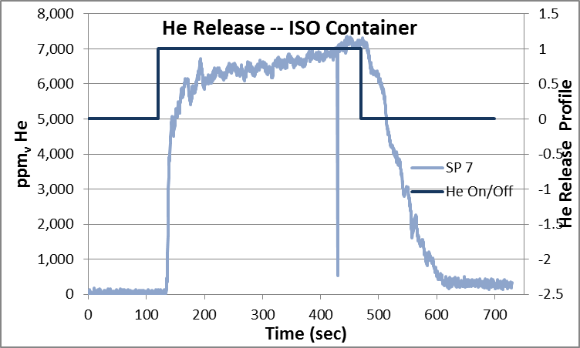
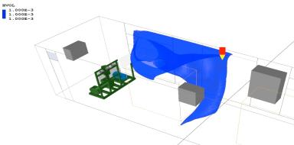


OUTCOMES of the Field Demonstration—Expanded Applications
Hydrogen Wide Area Monitoring (Hy-WAM)
Verification of CFD model for indoor H2 releases (On-going)
Goal: Sensor Placement Guidance (Identified as a GAP for Hydrogen Sensors)
CFD modelling completed by A. V. Tchouvelev & Associates Inc. and by JRC
Empirical verification using H2 Plume Analyzer with helium as a hydrogen surrogate
Profile and Monitoring Outdoor H2 Facilities (Planned)
Amenable to LH2 and GH2 facilities
In support of the science of hydrogen safety
H₂ sensors are mandated by NFPA 2 and IFC, but without guidance on deployment.
Understanding hydrogen plume behavior will guide sensor placement for optimized safety.
A Sensor Placement Guidance Document will be developed as a Technical Annex in NFPA 2.

Slide 13


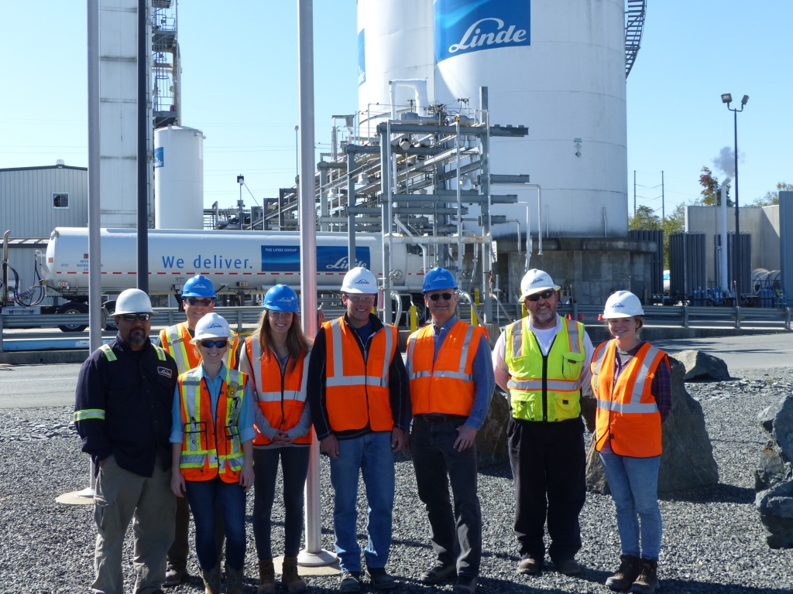
Acknowledgements
The NREL Sensor Laboratory is supported by DOE-EERE Fuel Cell Technologies Office, SCS Sub-Program Will James, Program Manager , Laura Hill, Project Manager
The Colorado School of Mines Interns (past and present)
The Linde Group for Site Access during the field test.
The NFPA 2 Hydrogen Storage Task Group for input and feedback
The Linde Facility, Midland, NC (October 25, 2016)
QUESTIONS or COMMENTS?

