Slide 2
Analysis of out-of-spec events during refueling of on‑board hydrogen tanks
Nerea de Miguel, Beatriz Acosta, Pietro Moretto, Frederik Harskamp
Tuesday 12th September, International Conference on Hydrogen Safety,
September, 11-13 2017 - Hamburg (Germany)

Slide 3
OUTLINE
ISO/TS 19880-1:2016 Gaseous hydrogen - Fueling stations: General requirements.
SAE J2601. Fueling protocols for light duty gaseous hydrogen surface vehicles.
OUT-OF-SPEC events: Abnormal scenarios that could happen during hydrogen refueling.
EXPERIMENTAL
RESULTS
CONCLUSIONS
Notes:
1. Compressed Hydrogen Storage System, CHSS: One or more of fully wrapped composite tanks (type 3 or type 4).
2. Thermally Activated Pressure Relief Device (TPRD) + Temperature and Pressure sensors.
3. Fuel line connected to the nozzle and to an Infrared Data Association, IrDA, communication system. The SAE J2799:2014 communication hardware and software can be used for this purpose.
4. Hose with the right length and the breakaway.
5. The metering system (Mass flow meter).
6. The temperature and pressure sensors (display).
7. The dispenser and the dispenser control.
8. The cooling block.
9. The Ambient temperature sensor.

Slide 4
ISO/TS 19880-1:2016 Gaseous hydrogen - Fueling stations - Part 1: General
It stablishes the minimum design characteristics for the safe performance of the fuelling stations that dispense gaseous hydrogen to light duty land vehicles.
A risk assessment was performed intended to study the safety between the fuelling station and vehicle interface.
Measures for the avoidance of different identified hazards (e.g. overpassing maximum allowed T & P) are included.
Schematic of station dispenser with FCEV CHSS (from ISO/TS 19880-1:2016)
Schneider, J., Dang-Nhu, G., Hart, N., Groth, K., ISO 19880-1, Hydrogen Fueling Station and Vehicle Interface Safety, Technical Report (ICHS 2015 # 116)
Notes:
Any other protocols should be approved and validated to confirm compatibility and robustness

Slide 5
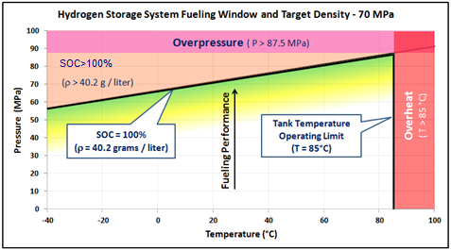
SAE J2601 Fueling protocols for light duty gaseous hydrogen surface vehicles. Boundary conditions.
According to ISO 19880-1, stations should use approved and validated fueling protocols such as SAE J2601
The State of Charge (SOC) is used to control the filling. At the end of the filling the SOC should be as close as possible to 100% without surpassing the maximum allowed T (+85 °C) and P (1.25*NWP).
SAEJ2601 Normal H70 fueling window
Notes:
7. GENERAL PROCESS REQUIREMENTS FOR HYDROGEN FUELING
This section is intended to cover the general hydrogen fueling process requirements and does not contain all the detailed requirements for the dispenser and station. Each fueling protocol may have additional requirements and process limits which are discussed in subsequent sections.
7.1 CHSS Storage Limits
This standard applies to fueling light duty HSV with compressed hydrogen storage system capacity from 2 to 10 kg for 70 MPa and 2.4 to 6.0 kg for 35 MPa. See Table 4 for a breakdown of storage categories.
7.2 Temperature Process Requirements
7.2.1 Fuel Delivery Temperature Sensor
The temperature sensor measuring the fuel delivery temperature shall be located upstream of and as close as possible to the dispenser hose break-away. The flow length between sensor and hose break-away shall be no greater than 1 meter.
7.2.2 Ambient Temperature
Fueling shall only occur when the ambient temperature is greater than or equal to -40 °C (-40 °F) and less than or equal to 50 °C (122 °F). The sensor used to measure the ambient temperature shall be protected from environmental conditions that may affect its accuracy.
7.2.3 Fuel Delivery Temperature
The fuel delivery (Tfuel) temperature shall always be greater than or equal to -40 °C.
7.2.4 Vehicle CHSS Gas Temperature
For communications fuelings, the station should not fuel or terminate vehicle fueling as soon as possible but within five seconds if the CHSS gas temperature signal is greater than 85°C.
7.3 Pressure Process Requirements
7.3.1 Initial Pressure
The initial CHSS pressure measured during startup will be used as P0 in applying the Look-up table. If the measured initial CHSS pressure is less than 0.5 MPa or greater than the pressure class nominal working pressure (35 MPa or 70 MPa), then the station shall terminate the fueling procedure as soon as possible but within five seconds.
7.3.2 Station Pressure Sensor
The sensor measuring the station pressure shall be located upstream of and as close as possible to the dispenser hose break-away. The flow length between sensor and hose break-away shall be no greater than 1 meter.
7.3.3 Operating Pressure
For communications fuelings, the station should not fuel or terminate fueling as soon as possible but within five seconds if the CHSS pressure is greater than or equal to 125% NWP.
7.4 Other Process Requirements
7.4.1 State Of Charge
In communication fueling, the station should terminate fueling as soon as possible but within 5 second if the SOC is greater than or equal to 100%. The station may use SOCvehicle or SOCstation (more conservative value) based on the station dispenser fueling methodology.
7.4.2 Flow Rate
Fueling protocols shall be designed to not exceed a maximum flow rate of 60g/s. After the initial connection sequence, the station shall terminate fueling as soon as possible but within 5 second if the measured maximum flow rate of the hydrogen gas exceeds 60 g/s.
7.4.3 Maximum Hydrogen Mass during Startup
The total mass of hydrogen transferred to the vehicle during startup shall be less than 200g.
7.4.4 Tolerances
Stations dispensers shall consider appropriate tolerances in their protocol implementation methodology to ensure a fueling is performed safely and accurately. Vehicles that communicate to the station should consider appropriate tolerances for their signals.

Slide 6
SAE J2601 Fueling protocols for light duty gaseous hydrogen surface vehicles. Refueling protocols.
The refueling is categorized:
1. Pressure class: H35, H70.
2. Fuel delivery temperature: T40, T30, T20
3. The CHSS capacity: 2-4, 4-7, 7-10 kg.
With or without communication
Through look up tables or with a MC method formula based approach.
Table D25 - H70-T40 4-7KG Non-communications
Impact of hydrogen SAE J2601 fueling methods on fueling time of light-duty fuel cell electric vehicles, Int J Hydrogen Energy 2017; 42(26): 16675-16685.

Slide 7
OUT-OF-SPEC events: Abnormal scenarios that could happen during a hydrogen refueling
Studied scenarios when refueling hydrogen CHSSs using the SAE J2601 look up tables.
Choosing a wrong look up table e.g. the PLC fails:
Wrong inputs on the look up tables e.g. the PLC fails or there is an operator's mistake.
Technical failures e.g. deviation of the ambient temperature sensor/s or a failure of the pre-cooling system.
Some out-of-spec events have already been performed on a type 4 tank
In the present work single and combined out-of-spec events have been performed on a type 3 tank
Schneider, J. M., Dang-Nhu, G. and Hart, N., Hydrogen Fueling Station and FCEV Fueling Safety Specification: TS ISO 19880-1, 21st World Hydrogen Energy Conference 2016, Zaragoza, Spain.
Notes:
These out-of-spec events could lead to dangerous situations where the temperature and pressure safety boundaries are surpassed. In the following, three possible events have been studied:
The scenario (1) considers a wrong chosen CHSS capacity. When the tank being filled is smaller than the targeted one and at an ambient temperature above 10°C, the APRR given in some of the look up tables of the SAE J2601 will be higher than what it should be, which could result in an over‑temperature inside the tank.
The next situation considered (2) is when the chosen pre-cooling category on the look up tables is for colder gas than the one on the dispenser (so the filling is done faster). It can also happen that the supplied hydrogen is warmer than the expected temperature window of the station because the cooling system failed. These scenarios could eventually lead also to an over‑temperature inside the tank.
The case (3) is the other way around, when the chosen pre-cooling category on the look up tables is for warmer gas than the actual pre-cooling capacity of the station (so the filling is done slower). Similarly, when the supplied hydrogen is colder than the expected temperature window of the station. These assumptions could result in an overfilling of the tank (SOC > 100%).
In the scenario (4), the chosen pressure class is wrong; the station fills a 35 MPa tank with a 70 MPa target. The filling speed will be similar or even lower and the target pressure will be higher, resulting in an overpressure (and consequently overfill) inside the tank. However, as it is going to be discussed in the next chapter, this situation is avoided by designing the station dispensers with different separate nozzles [14] for each NWP system.
The next situations considered are when the ambient temperature sensor fails or when the input of the ambient temperature on the look up tables is wrong. In scenario (5), the ambient temperature is higher than the targeted one. The final pressure will be lower but the filling is going to be done at a much higher speed which could lead to an over-temperature inside the tank.
On the contrary, in scenario (6) the ambient temperature is lower than the targeted one and the tank could result more filled than how it should be.
In the SAE J2601 protocols, the pressurization rate does not depend on the initial pressure. As reflected in scenario (7), at very low ambient temperatures and when the real initial pressure inside the tank is higher than the targeted one, the final pressure is going to be significantly higher and this could lead to an overfilling of the tank.
Combinations of these events could also happen in a refueling station.
To avoid these scenarios appropriate measures (and countermeasures) are taken into account in the design of the refueling stations.

Slide 8
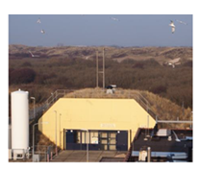
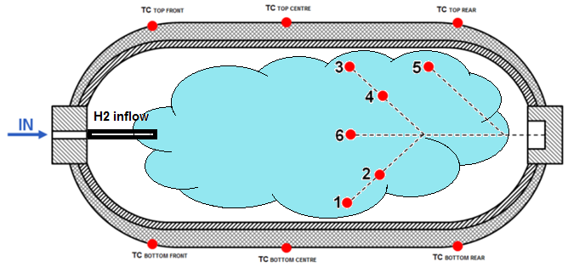
EXPERIMENTAL: Test tank and instrumentation
70 MPa NWP and 40 L Volume Type 3 tank
The tests have been performed at the JRC's GasTeF facility
The tank has been instrumented with Temperature & Pressure sensors.
The temperature of the fuel entering the tank, has been measured at a position simulates the breakaway temperature.
The measured gas temperature and pressure has been used to determination of the hydrogen gas densities by using the standard equation developed by NIST.
Hydrogen test tank with the temperature measurement points
Revised standardized equation for hydrogen gas densities for fuel consumption applications. J Res Natl Inst Stand Technol. 2008; 113(6):341e50.
Notes:
As in our previous work [13], the standard equation developed by NIST [19] has been used for the determination of the hydrogen gas densities. The gas density inside the tank has been calculated making use of the average gas temperature (average of sensors 1, 2, 3, 4 and 6). Recorded data of gas temperature and pressure, with a time interval of 1 second, has been used as input in the NIST equation. With the density of the gas inside the tank, the SOC has been monitored along the filling.

Slide 9
Single out-of-spec scenarios: 14 cases studied
Wrong look up table:
2-4 kg tank filled with 7-10 kg table (T_{Amb} of 50 °C) → Over T?
T20 pre-cooling with a T40 table (T_{Amb} = 20 °C & 50 °C) → Over T?
T40 pre-cooling with a T20 table (T_{Amb} = 20 °C & -40 °C) → Over filling?
Wrong inputs on look up tables:
T_{Amb} of 50°C with ‑40°C input → Over T?
T_{Amb} of -40°C with 50°C input → Over filling?
P₀ of 30 MPa with input of 0.5 MPa (T_{Amb} of -30 °C) → Over filling?
Technical failure:
No cooling with a T40 table (T_{Amb} = 20 °C & 50 °C) → Over T?
Cooling below ‑40°C with a T20 table (T_{Amb} of 20 °C & ‑40°C) → Over filling?
T_{Amb} of 20°C with 10°C reading→ Over T?
T_{Amb} of 20°C with 30°C input → Over filling?
Table D25 H70-T40 4-7KG
Table D19 H70-T40 2-4kg
Notes:
Wrong selection of the CHSS capacity
Wrong selection of pre-cooling category
Failure of the cooling system
Wrong selection of the Ambient temperature
Wrong selection of Initial Pressure

Slide 10
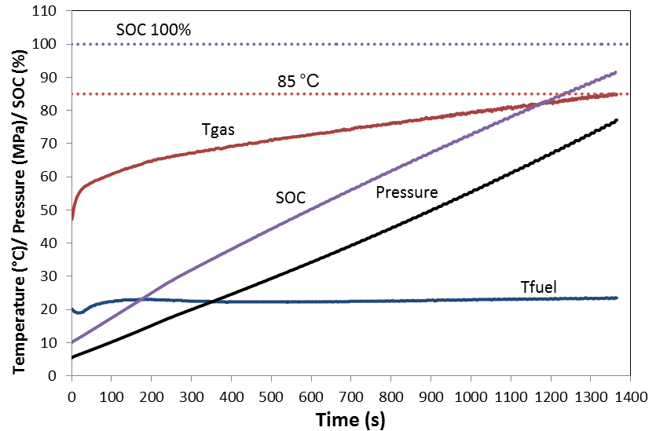
RESULTS: Single out-of-spec event
Technical failure: No cooling with a T40 table (T_{Amb} = 50 °C)
From the 14 single scenarios in the type 3 tank, the highest temperature inside the tank 84.9°C.

Slide 11
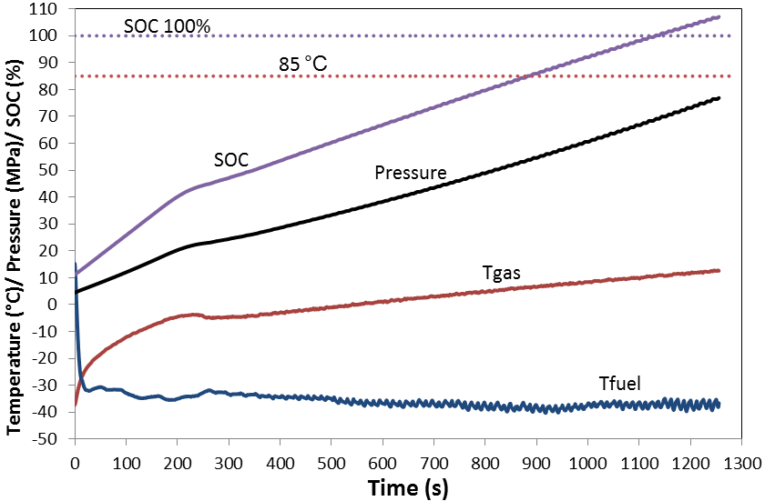
RESULTS: Single out-of-spec event
Wrong input on the look up tables: T_{Amb} of -40°C with 50°C input
Table D19 - H70-T40 2-4kg Non-Communications
The highest SOC at the end of the filling 107.1%.
At low T_{Amb}, a failure of the cooling system and a wrong input of P₀ lead also to overfilling on a type 3 tanks.

Slide 12
Combined out-of-spec scenarios: 10 cases studied
Wrong look up table:
2-4 kg tank and T20 pre-cooling with a 7-10 kg & T40 table (T_{Amb} of 20°C & 50°C) → Over T?
Wrong look up table & technical failure:
2-4 kg tank with a 7-10 kg table & T_{Amb} of 50°C with 40°C reading → Over T?
T40 pre-cooling on a T20 station & T_{Amb} of 20°C with 10°C reading → Over T?
T20 pre-cooling on a T40 station & T_{Amb} of 20°C with 30°C reading → Over filling?
Wrong look up table & wrong inputs on look up table:
2-4 kg tank with 7-10 kg table & T_{Amb} of 50°C with -40°C input → Over T?
T40 pre-cooling on a T20 station & T_{Amb} of 50°C with -40°C input → Over T?
T20 pre-cooling on a T40 station & T_{Amb} of ‑40°C with 50°C input → Over filling?
Wrong inputs on look up table & technical failure:
No cooling with a T40 table & T_{amb} of 50°C with -40°C input → Over T?
Cooling below ‑40°C with a T20 table & T_{Amb} of ‑40°C with 50°C input → Over filling?

Slide 13
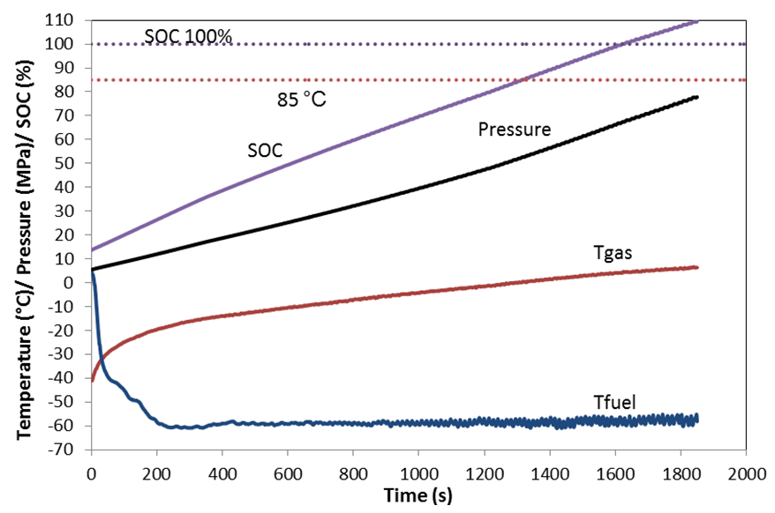
RESULTS: Combined out-of-spec events
Technical failure: Cooling below ‑40°C with a T20 table
Wrong input on the look up tables: T_{Amb} of -40°C with 50°C input
The highest SOC on the type 3 tank at the end of the filling 109.5%.

Slide 14
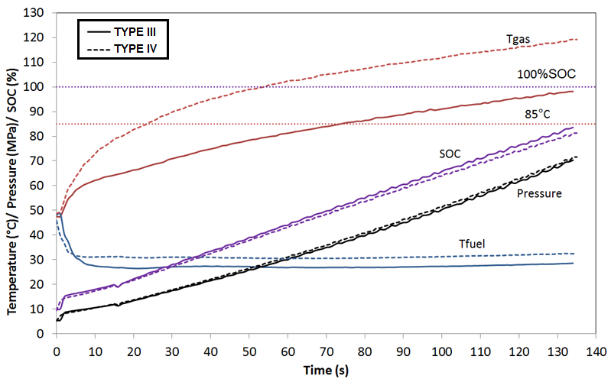
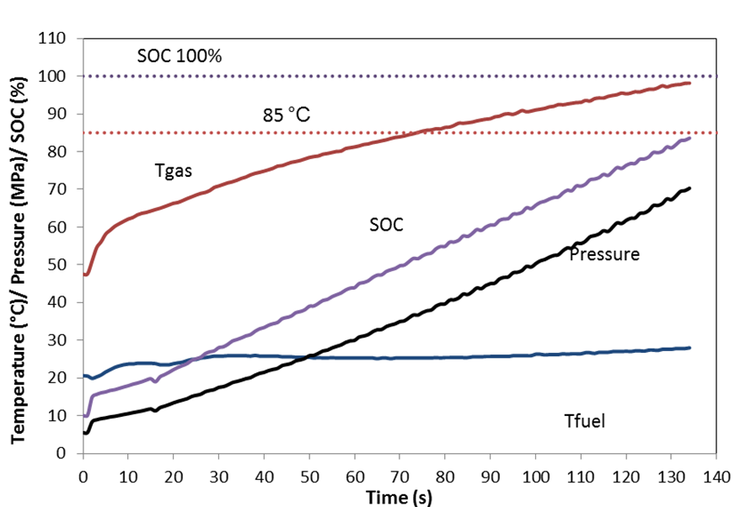
RESULTS: Combined out-of-spec events
Technical failure: No cooling with a T40 table
Wrong input on the look up tables: T_{Amb} of 50°C with -40°C input
The highest temperature inside the type 3 tank 98.1°C.
On an equivalent type 4 tank, the gas temperature at the end of the filling reached the 118.4°C.
Notes:
As soon as the filling finishes the temperature inside the tank lowers down
, the exposure time of the tank materials to this temperature was short and the temperature at the hydrogen tank wall (in between the liner and the composite) remained below the 85°C threshold [11]
makes the filling fastest

Slide 15
SUMMARY AND CONCLUSIONS
During the refuelling of the type 3 tank, the +85°C maximum allowed temperature has not been surpassed in any of the single out-of-spec events considered. The closest to the boundary happened due to a failure of the cooling system at a very warm environmental temperature of 50°C.
Under low environmental conditions, certain out-of-spec events resulted in over-filling the type 3 tank. Cooling down the gas below its temperature range, a wrong input of the environmental temperature or initial pressure on the look up tables and a combination of these events and/or other events resulted in surpassing the 100% SOC. The maximum measured SOC was close to 110%.
At high environmental conditions and on a combination of unlucky events (an unnoticed stop of the gas cooling combined with a wrong input of the environmental temperature on the look up tables), the +85°C limit was surpassed. In a type 3 tank, this boundary was exceeded by 13°C whereas on a type 4 it was by >30°C.
It is important that the refueling stations include the fault detection and managements procedures as recommended in the ISO/TS 19880-1:2016.
The SAE J2601:2016 look-up tables have a quite wide range of safety margin.
Notes:
I will put it at the end and just leave it there for the

Slide 16
Thanks
Any questions?
You can find me at nerea.de-miguel-echevarria@ec.europa.eu

