Slide 1
Pressure effects of an ignited release from onboard storage in a garage with a single vent
Brennan, S. , Hussein, H. G., Makarov, D., Shentsov V., Molkov, V
International Conference on Hydrogen Safety
Hamburg, September 11-13, 2017

Slide 2
Overview
Background and previous work
Problem description
Methodology
  CFD (ignited and unignited scenarios)
  Analytical model (unignited)
Pressure dynamics – key finding
Release behaviour
Conclusions and future work

Slide 3

Background - context
Ignited release from on-board storage in a garage
Onboard hydrogen typically stored as high pressure compressed gas (350 bar upwards)
Tanks fitted with TPRD through which release may occur
Indoor storage scenarios relevant for practical applications e.g. garages, maintenance shops, tunnels etc.
Previous work highlighted safety issue when an unscheduled unignited release occurs through a TPRD in an enclosure
Notes:
700 Bar for small vehicle.
TPRD= thermal pressure relief devices.
Practical applications
Safety issue in previous work

Slide 4
Background – pressure peaking
Ignited release from on-board storage in a garage
Previous work highlighted “pressure peaking phenomena”
Release in an enclosure with minimum ventilation and a leak rate which is ensures no air ingress
Overpressure can destroy the structure in a matter of seconds
Previously only UNIGNITED scenarios considered
Need exists to understand the behaviour of an INGNITED release storage
H₂ only!
Mass flow rate 390 g/s (H₂: 350 bar, 5.08 mm orifice).
10-20 KPa – safety limit for structures
Notes:
Mentioning (10-20)kPa for destroying building structures.

Slide 5
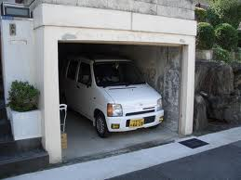
Problem description
Ignited release from on-board storage in a garage
Small typical garage, one vent, release from a H₂ tank
Consider both unignited & ignited cases
Typical onboard hydrogen storage tank 700 bar
Through a 3.34 mm diameter orifice TPRD
Mass flow rate of 0.2993 kg/s constant
Garage is small : L 4.5 m, W 2.6 m, H 2.6 m
Release vertically upward in the centre, 0.5 m above floor
Single vent: W 0.35 m, H 0.55 m
  Note: this vent area is typical of e.g.
  a window and should be “safe” in the
  case of an unignited release
Is this safe for ignited H₂ release?
Notes:
Showing vent and release nozzle in next slide.

Slide 6
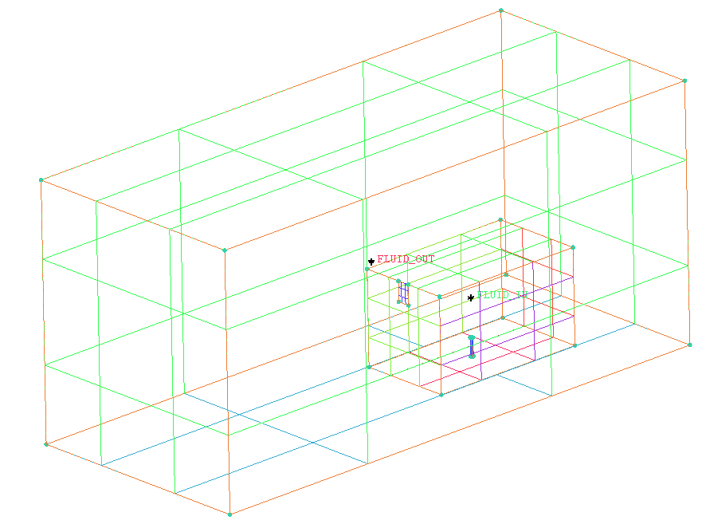
Modelling approach
CFD geometry and mesh
FLUENT, domain L 15.5 m, W 6.6 m, H 7 m
Notional nozzle for under expanded jets = 0.0564 m
(Molkov et al. 2009*)
351,152 hexahedral cells, 0.05 cm rectangular nozzle exit
Valve opening time of 0.01 s
Wall not meshed but thickness accounted
for calculating conduction heat transfer.
Garage floor, walls and roof are concrete
with thickness 0.15 m, front wall is an
aluminium wall with a thickness 0.02 m.
  Specific details in the paper
Vent
Nozzle
Notes:
Pointing to vent and release point.
Aluminium and concrete were used.

Slide 7
Modelling approach
CFD unignited and ignited
Pressure based solver
RNG k-ε RANS
PISO for pressure velocity coupling
Eddy dissipation concept (EDC) used in the ignited case
Ignition modelled as a spark via a “patched” temperature
Simulations:
  Unignited release
  Ignited release
  Range of CFL values considered to gauge sensitivity as simulations highly computationally intensive

Slide 8
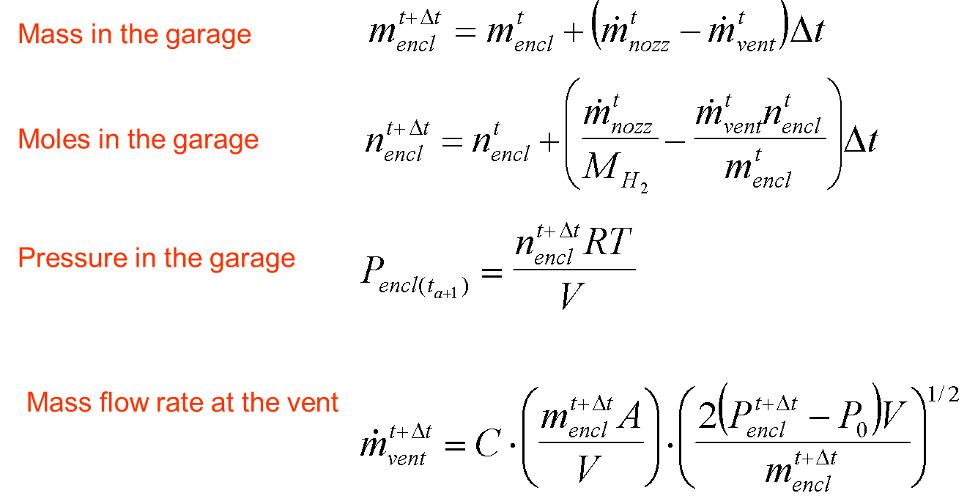
Modelling approach
Analytical
Presented in previous work used here to support CFD
Average M
density
Velocity at the vent

Slide 9
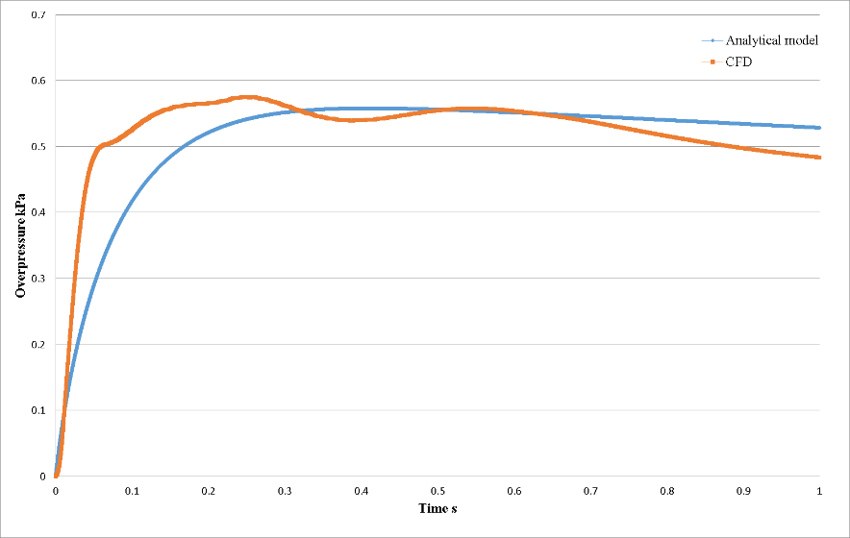
Pressure dynamics: Unignited release
CFD and analytical models
Mass flow rate 299 g/s (H₂: 700 bar, 3.34 mm orifice).
Note “safe” pressure in unignited case
Notes:
The differences are due to:
Modelling heat transfer
Accounting for ventilating different gas types while analytical model considered the gas ventilation is homogeneous (well distributed).

Slide 10
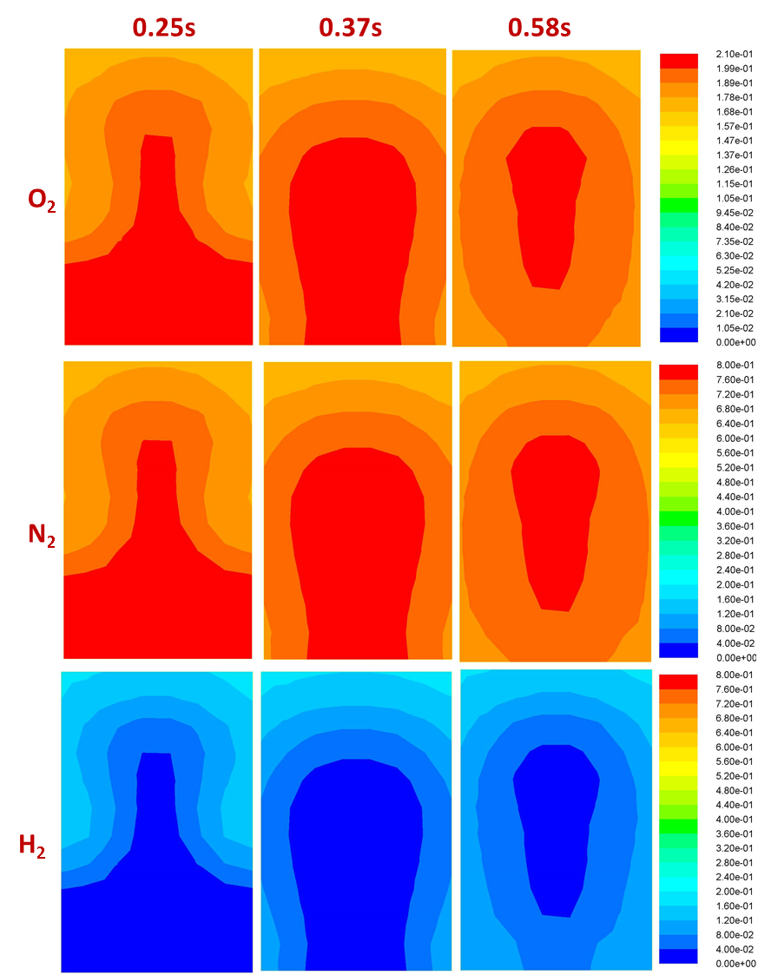
Pressure dynamics: Unignited release
CFD and analytical models
Difference between analytical and CFD results
Mass flow rate 299 g/s
H₂: 700 bar, 3.34 mm orifice
Contours of oxygen, nitrogen and hydrogen mole fraction in the vent area at 0.25s, 0.37s, and 0.58s for the unignited release
Notes:
Explaining the vent occupied with hydrogen more than before and after the dip.

Slide 11
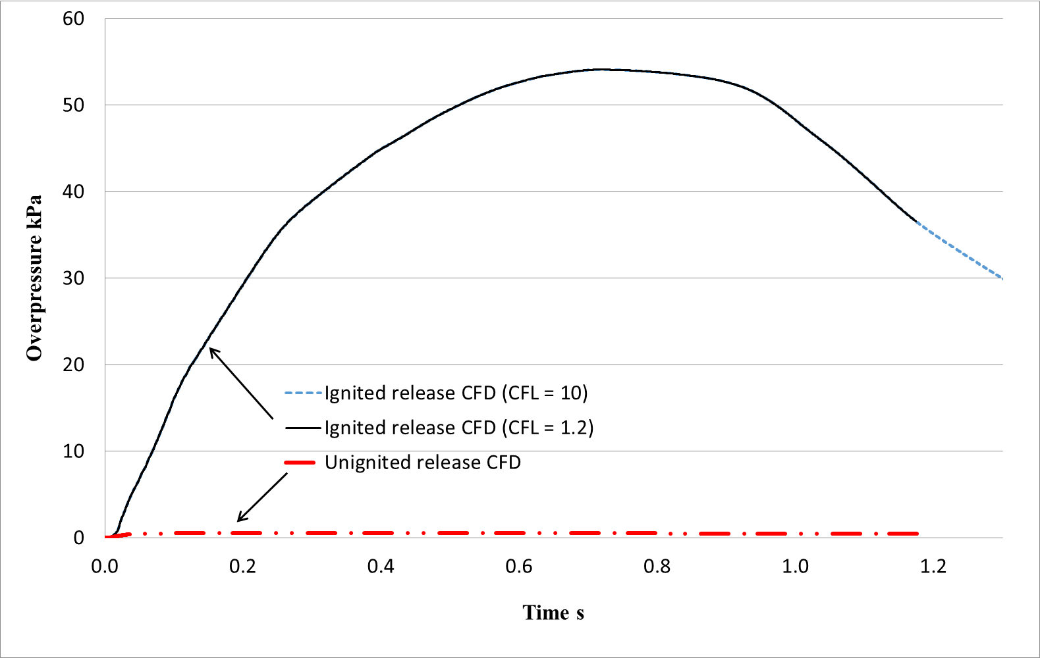
Pressure dynamics from CFD
Ignited AND unignited
10-20 KPa – safety limit for structures
Notes:
Change this to new figure in the paper.
This is key finding.

Slide 12
Unignited case

Slide 13
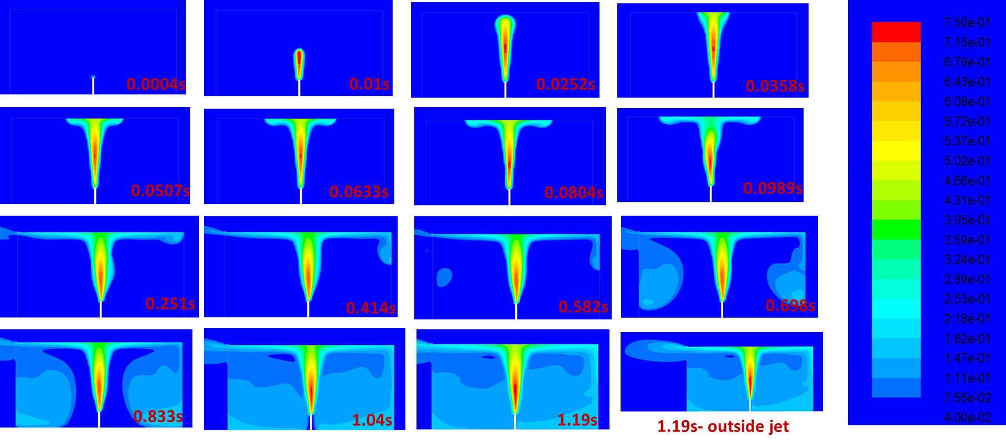
Flammable atmosphere development
Unignited release
Contours of hydrogen mole fraction (4% - 75%) first 1.19 s of release
Mass flow rate 299 g/s , H₂: 700 bar, 3.34 mm orifice
Notes:
The garage will be engulfed with hydrogen in just 1s.
Out side jet as well, which is around 2 m.

Slide 14
Oxygen depletion
Unignited release
Contours of oxygen mole fraction ( 0% - 19%) First 1.19s of the release
Mass flow rate 299 g/s , H₂: 700 bar, 3.34 mm orifice
Notes:
Oxygen depletion and make safety hazard

Slide 15
Ignited case

Slide 16
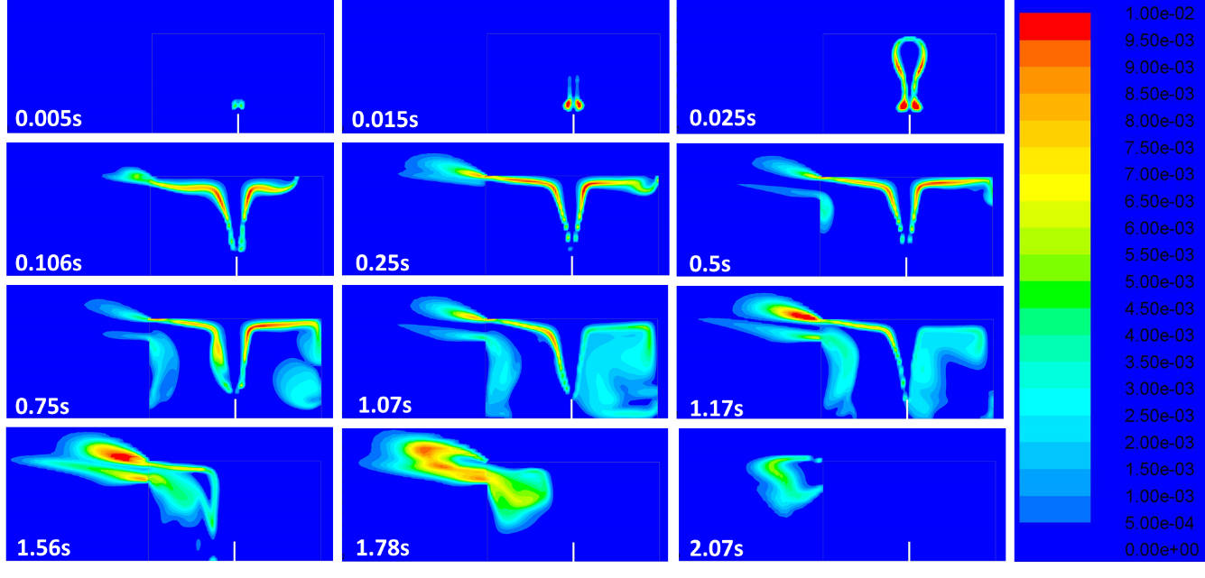
Flame development
Ignited release - Hydroxyl mole fraction (OH)
Mass flow rate 299 g/s , H₂: 700 bar, 3.34 mm orifice
Notes:
Most of enclosure will be covered with flame in just 1s.
In 2s the garage will run out of oxygen and flame will continue outside.

Slide 17
Ignited release – Hydroxyl mole fraction
Horizontal & vertical planes through midpoint of the vent
Mass flow rate 299 g/s
H₂: 700 bar 3.34 mm orifice
Notes:
How the flame was split in two.

Slide 18
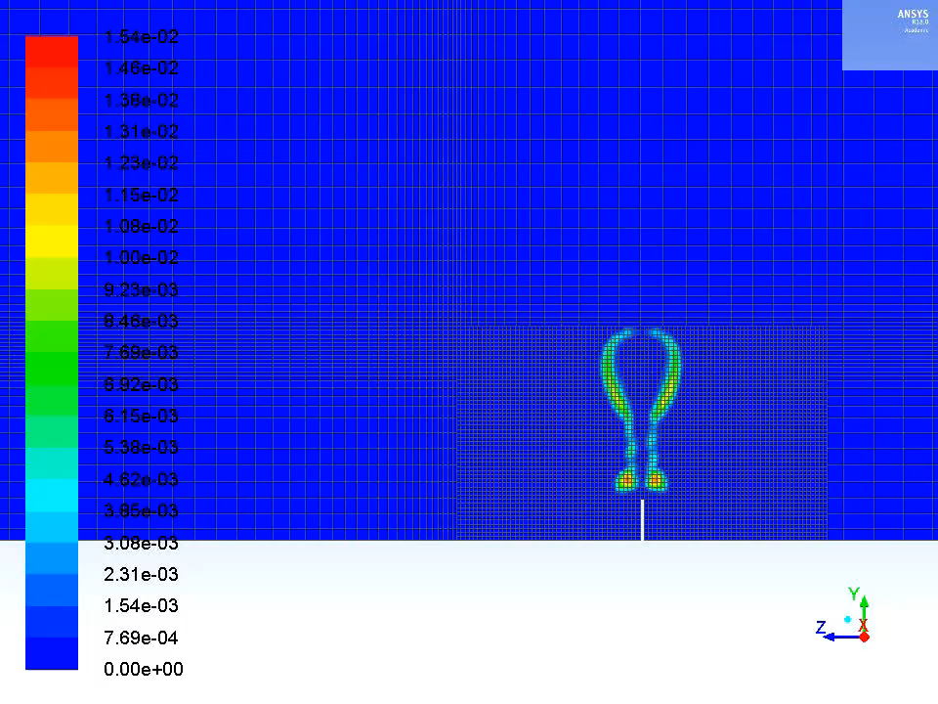
Ignited release – Hydroxyl mole fraction
Evolution of hydrogen jet fire for the first 1.3 s
Notes:
Flame probation inside the enclosure.

Slide 19
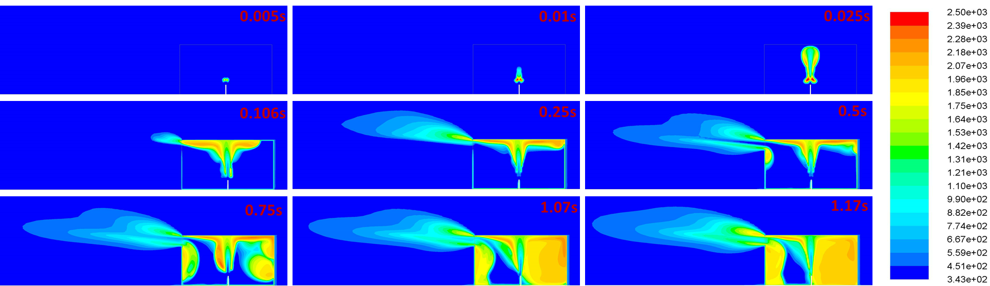
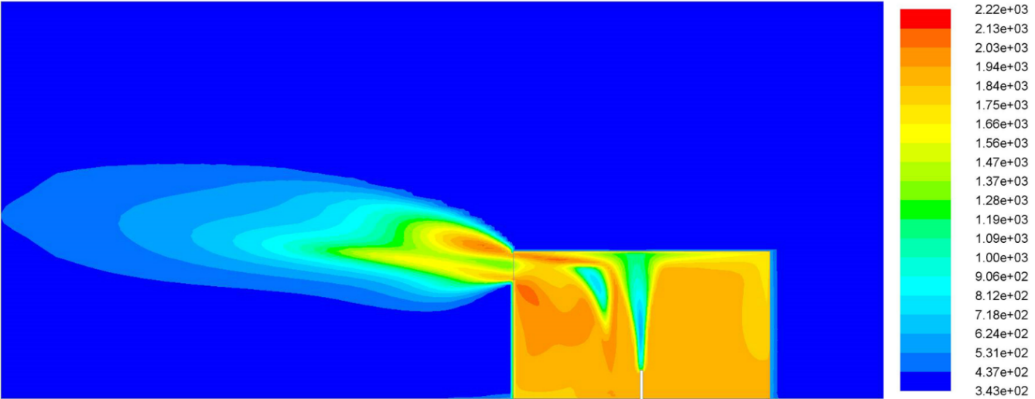
Thermal effects – ignited release
“No harm” distance of 70ºC for first 1.17s of release
“No harm” distance of 70ºC at 1.56s of the ignited release = point of maximum external flame length
Notes:
Real safety concern
9 m away from the vent in just 1.56s.

Slide 20
Conclusions
And recommendations for future work
Unignited and ignited releases from onboard hydrogen storage at 700 bar through 3.34 mm diameter orifice in a small garage have been compared.
Predicted overpressure for an unignited release is ~ 0.55 kPa (“safe”)
  However, the garage is engulfed by a flammable atmosphere in < 1s and the oxygen is depleted to dangerous levels within this time.
Overpressure predicted for the ignited release is two orders of magnitude greater > 55kPA in less than 1s, causing destruction of the structure and raising safety concerns regarding TPRDs
  Thermal effects resulting from the release are predicted to extend almost 9m from the jet in 1.5s.
Further studies are required to investigate the pressure peaking phenomenon for ignited releases in order that safety recommendations can be made.

Slide 21
Any questions?
24

