Slide 1
STRUCTURAL RESPONSE FOR VENTED HYDROGEN DEFLAGRATION:
Coupling CFD and FE Tools
Gordon Atanga, Sunil Lakshmipathy, Trygve Skjold, Helene Hisken and Arve grønsund Hanssen

Slide 2
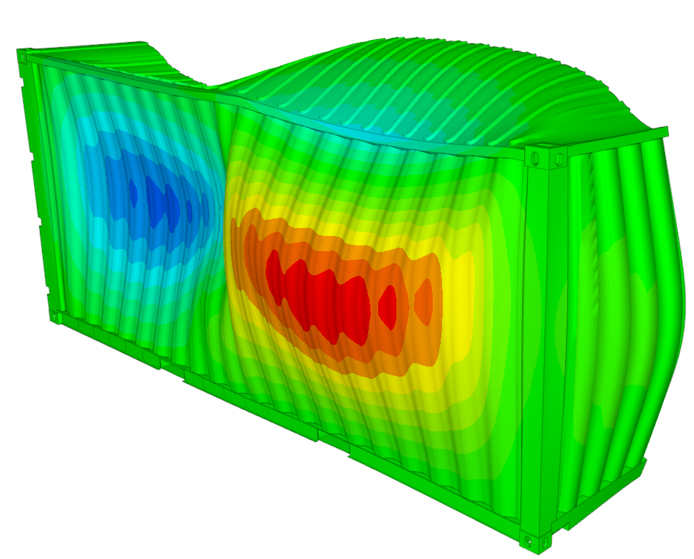
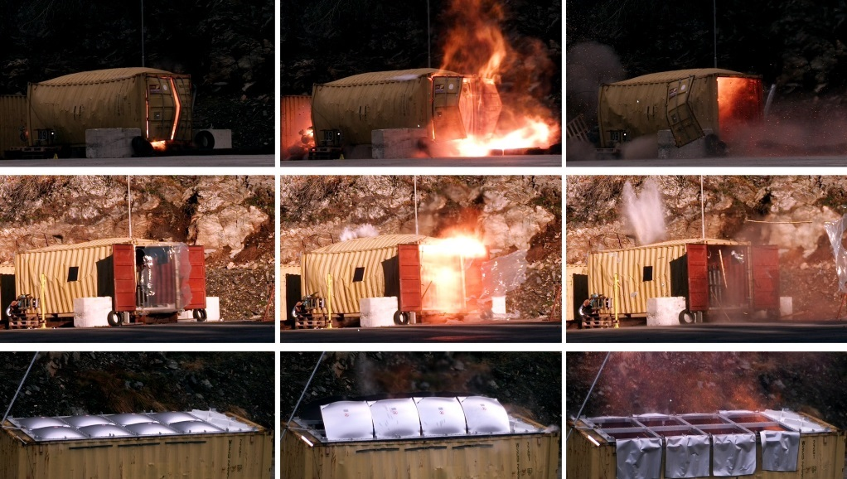
Outline
Introductions
Experimental configuration
Numerical Models
CFD Model
FE model
Results and discussions
Concluding Remarks
Perspective

Slide 3
Introduction
It is common practice in industry to install refuelling stations, fuel cell backup systems, electrolysers and other equipment for hydrogen energy applications in containers or smaller enclosures.
Explosions and fires represent an inherent hazard in such systems.
Explosion venting is often used to reduce the risk of accidental hydrogen deflagrations to a tolerable level.
The design of venting devices suitable for industrial applications requires a good estimation of the structural response of enclosures during vented hydrogen deflagrations
Here, we presents a methodology for a one-to-one coupling of explosion loads, taken from either experiments or computational fluid dynamics (CFD) simulations, to a finite element (FE) model, to investigate the structural response caused by hydrogen deflagration.
The coupling methodology used in this study was first proposed and demonstrated for an offshore process module by Salaün et al. [1].
This would allow researchers and engineers to estimate the structural response of enclosures during vented hydrogen deflagrations, and hence to design venting devices suitable for industrial applications.
Notes:
Slide lists the main motivation and objectives of the HySEA project

Slide 4
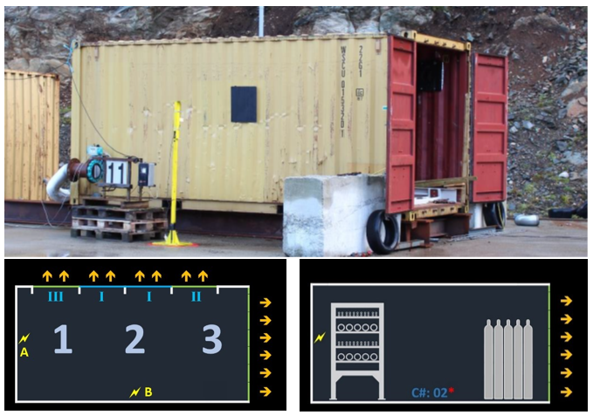
Experimental setup: 20-foot ISO container
displacement sensors
Obstacles
Roof/Door venting
Obstacles
Ignition locations
More details on they HySEA phase 1 tests in ICHS Paper 223 – Vented deflagrations session

Slide 5
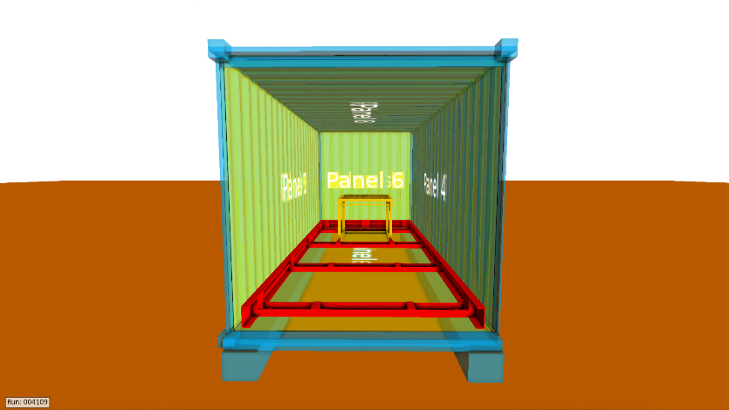
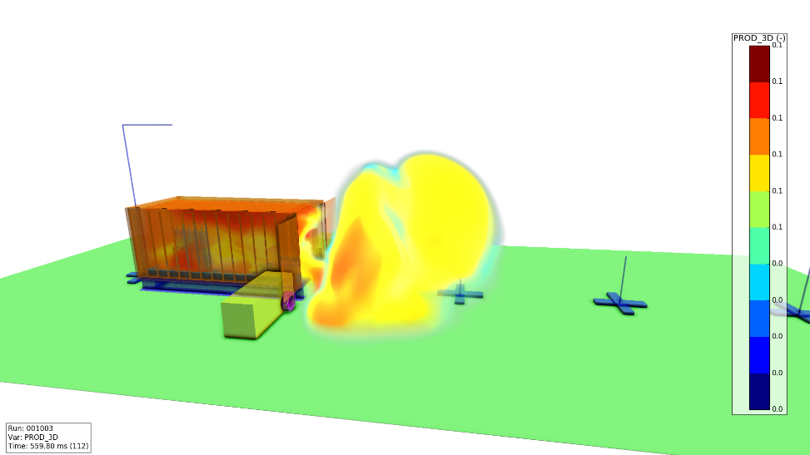
CFD model: FLACS Solver
Sidewall
FLACS™ is a finite volume CFD tool widely used to simulate industrial accident dispersion, fires and explosions.
based on a structured Cartesian mesh
belongs to the porosity/distributed resistance (PDR) family of CFD solvers.
Uses two-equation Reynolds-averaged Navier Stokes (RANS) turbulence models coupled with a premixed combustion model to simulate turbulent reacting flows.
For the 20-ft HySEA container model
The computational domain is 30m × 12.5m × 9m, mesh sizes 0.1 m and plane wave boundary conditions.
The explosion loads on the walls and roof are captured with pressure panels.
The full scale tests of 20-ft containers subjected to internal hydrogen-air deflagration is considered.
Notes:
It is a finite volume based CFD solver which uses a structured mesh to discretize the computational domain. Special attribute of the solver is that it used the PDR method to represent the geometry in the flow solver

Slide 6
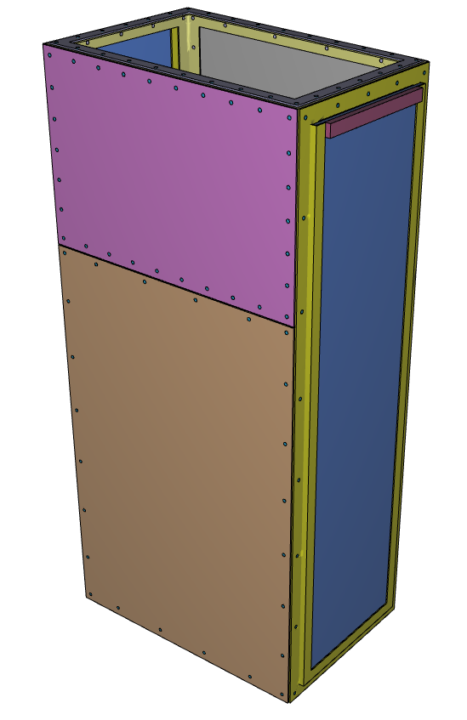
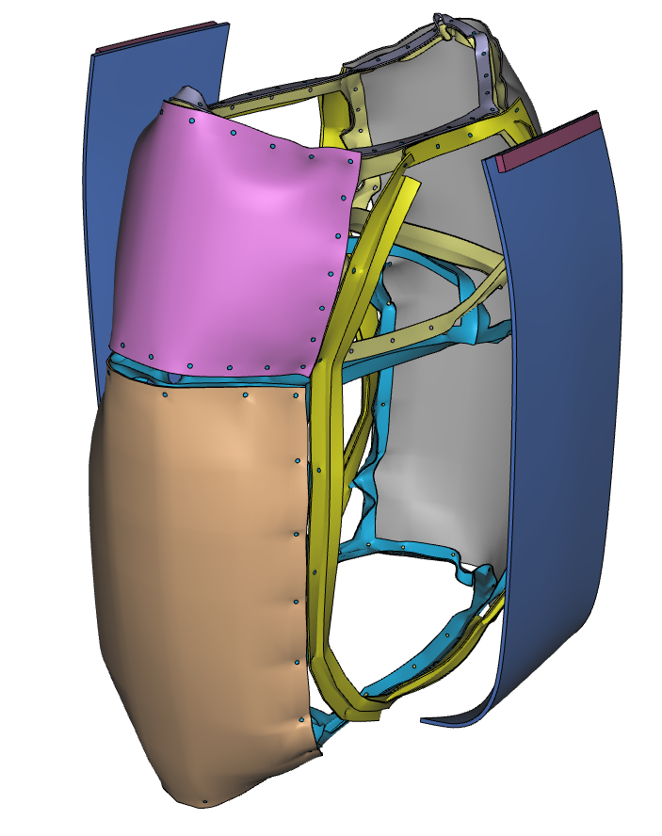
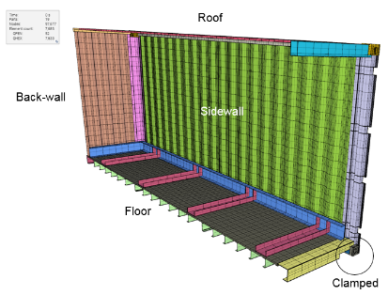
FE model: IMPETUS Afea solver
The IMPETUS Afea Solver is a system for non-linear explicit finite element analysis (NLFEA).
developed to predict large deformations of components exposed to extreme loads.
higher-order solid element technology and explicit time integration
GPU adaptation for enhanced computational speed
The formulation is purely Lagrangian.
For the 20-ft HySEA container model
Half a model is used due to symmetry.
the corner posts are clamped.
Open doors.
The model consists of quadratic hexa-elements.
The corrugated panels were 2 mm thick.
The steel parts of the container are modelled as 335 steel using a model from IMPETUS material library
Notes:
A brief overview of the FE solver

Slide 7
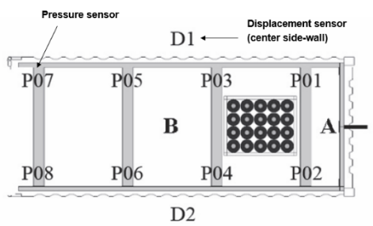
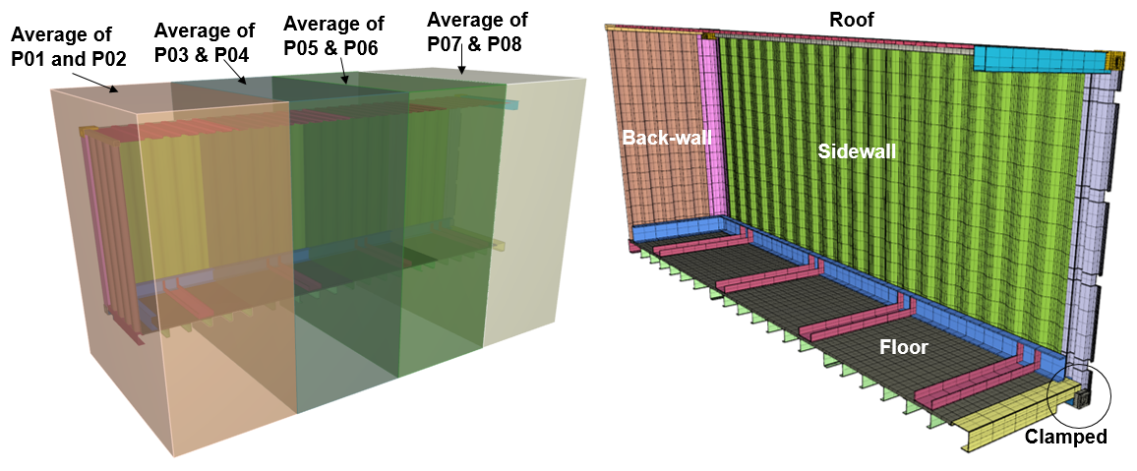
CFD/FE model
Sidewall
The FE models applies the full spatial mapping of transient overpressures from measurements or FLACS simulations, captured by displacement sensors (side walls) or pressure panels (back-wall, side-wall, floor and roof).
Data from the eight internal pressure sensors are averaged in pairs.
The methodology entails a one-to-one CFD-NLFEA job solution scheme.

Slide 8
1a: Venting through the doors
Configuration | Test | A_{v} (m²) | [H₂] | P_{red, av} (bar) | P_{red, max} (bar)
Frame only, doors open | 01 | 5.64 | 15 | 0.018 | 0.025
 | 02 |  |  | 0.015 | 0.029
 | 05 |  |  | 0.025 | 0.046
Bottle basket (1), doors open | 03 |  |  | 0.038 | 0.072
 | 04 |  |  | 0.035 | 0.054
 | 06 |  |  | 0.031 | 0.046
 | 10 |  | 18 | 0.100 | 0.124
 | 07 |  | 21 | 0.147 | 0.184
 | 08 |  | 24 | 0.407 | 0.457
Bottle basket (1), doors closed | 09* | 5.64* | 24 | 1.228 | 1.368
Pipe rack (1), doors open | 11 | 5.64 | 15 | 0.037 | 0.049
 | 12 |  | 18 | 0.092 | 0.110
 | 13 |  | 21 | 0.238 | 0.269
Pipe rack (1), bottle basket (3), doors open | 14* |  | 21 | 0.604 | 0.636

Slide 9
1b: Venting through the roof
Configuration | Test | A_{v} (m²) | [H₂] (vol.%) | P_{red, av} (bar) | P_{red, max} (bar)
Frame only, open | 25 | 4 | 21 | 0.155 | 0.180
 | 21 | 6 |  | 0.092 | 0.122
 | 16 | 8 |  | 0.130 | 0.214
Pipe rack (2), open | 24 | 4 | 21 | 0.151 | 0.170
 | 22 | 6 |  | 0.129 | 0.164
 | 17 | 8 |  | 0.124 | 0.132
 | 29 | 4 | 24 | 0.261 | 0.336
 | 23 | 6 |  | 0.182 | 0.216
 | 19 | 8 |  | 0.167 | 0.213
 | 34* | 8 | 42 | 0.806 | 1.095
Frame only, panels | 32 | 4 | 21 | 0.201 | 0.241
 | 26 | 6 |  | 0.221 | 0.274
 | 15 | 8 |  | 0.161 | 0.176
Pipe rack (2), panels | 33 | 4 | 21 | 0.245 | 0.277
 | 31 | 6 |  | 0.235 | 0.266
 | 27 |  |  | 0.264 | 0.322
 | 30 | 8 |  | 0.199 | 0.229
 | 18 |  |  | 0.225 | 0.247
 | 28* | 6 | 24 | 0.442 | 0.763
 | 20* | 8 |  | 0.311 | 0.366

Slide 10
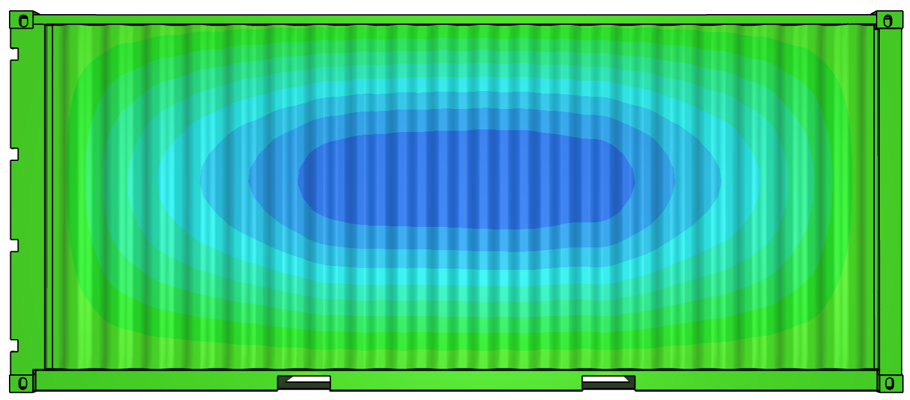
Results: Test with no obstacle
The simulation gives 17 mm as max displacement amplitude.
Test 1 gives 20 mm.
Test 2 gives 20 mm.
Test 5 gives 42 mm
Pressure-time curves from FLACS
Displacement measurement
Displacement-time curve of central side-wall from IMPETUS
The maximum displacement predicted by the FE solver is comparable to the measurements

Slide 11
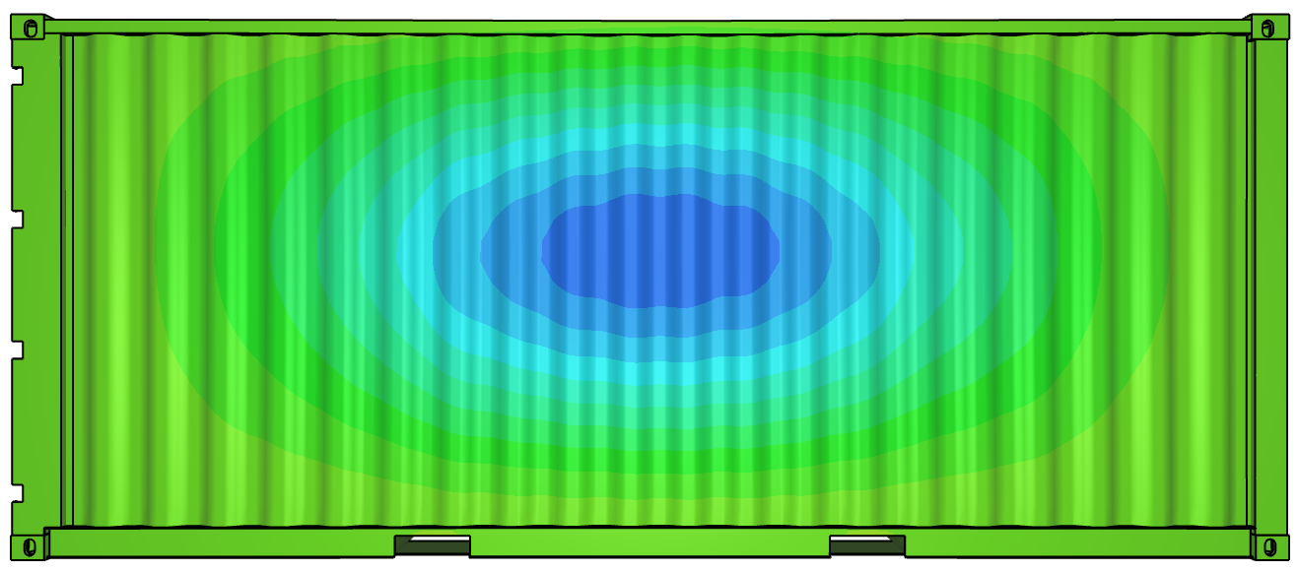
Results: Test with obstacle
Pressure-time curves from FLACS
Displacement-time curve of central side-wall from IMPETUS
Displacement measurement
The simulation gives 73 mm as max displacement amplitude.
Test 3 gives 105 mm.
Test 4 gives 75 mm.
Test 6 gives 36 mm
Congestion results in more violent explosion.
Significant spread in the experimental results, possibly caused by permanent deformation of the steel structure of the container

Slide 12
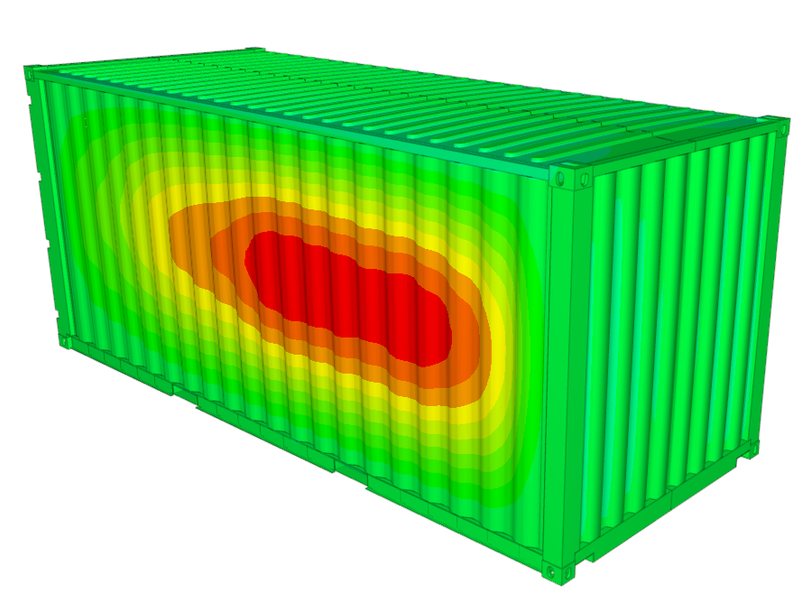
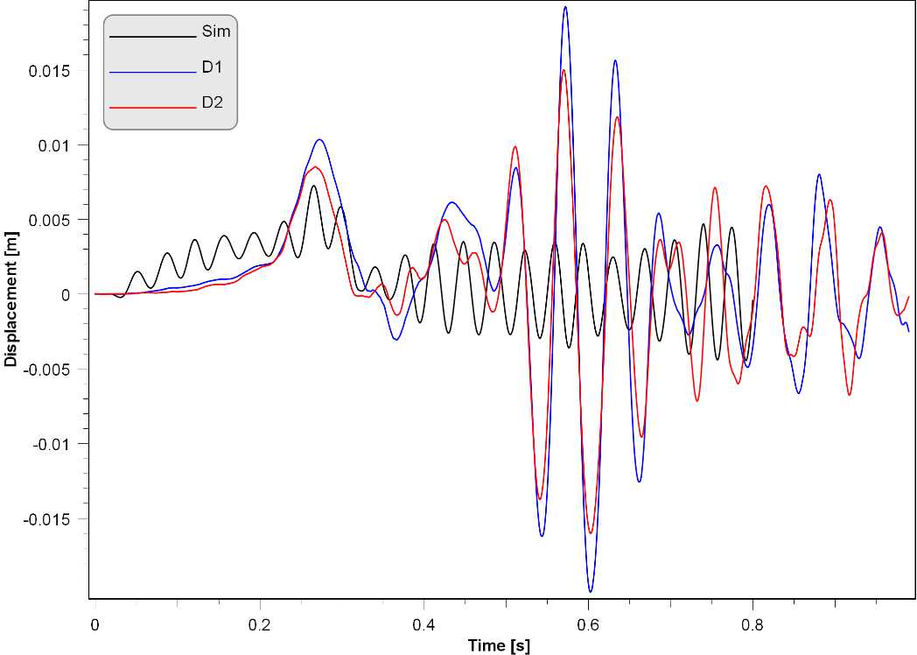
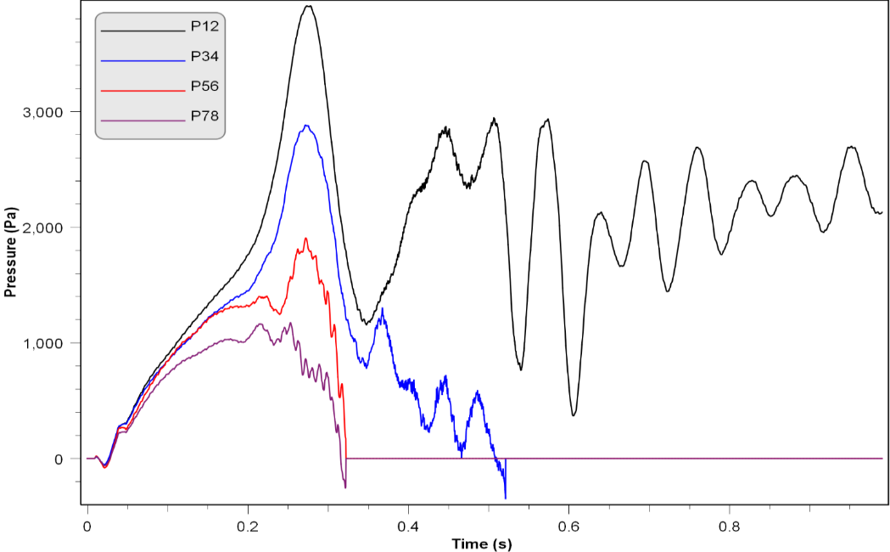
Results: Test 1 (5.64 m² door venting, 15 vol. % H₂ – empty)
dmax_exp_min (m) | dmax_exp_max (m) | dmax_sim (m)
0.016 | 0.020 | 0.007
We use max displacement of the center of side wall and compare model with tests.
Pressure-time input
Measured pressure-time histories are directly applied as input to the FE model
The maximum displacement predicted by the FE solver is 7 mm, which is significantly lower than the measured values of 20 mm, 20 mm, & 42 mm (repeated tests 1, 2 & 5)

Slide 13
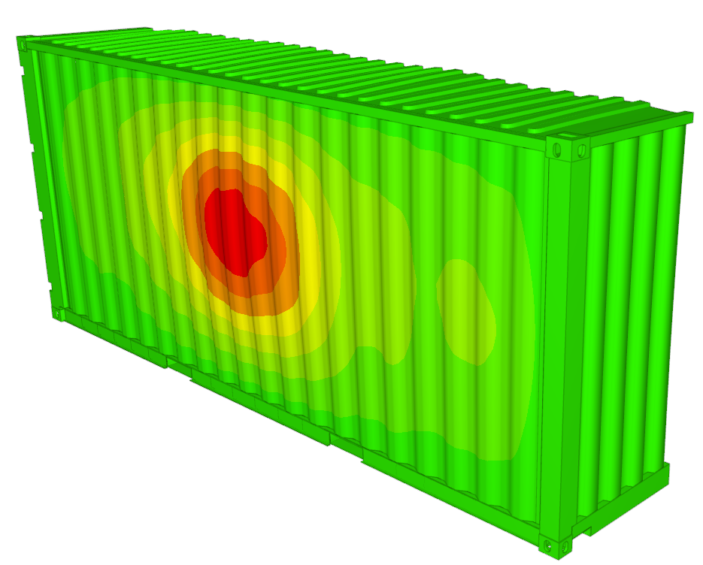
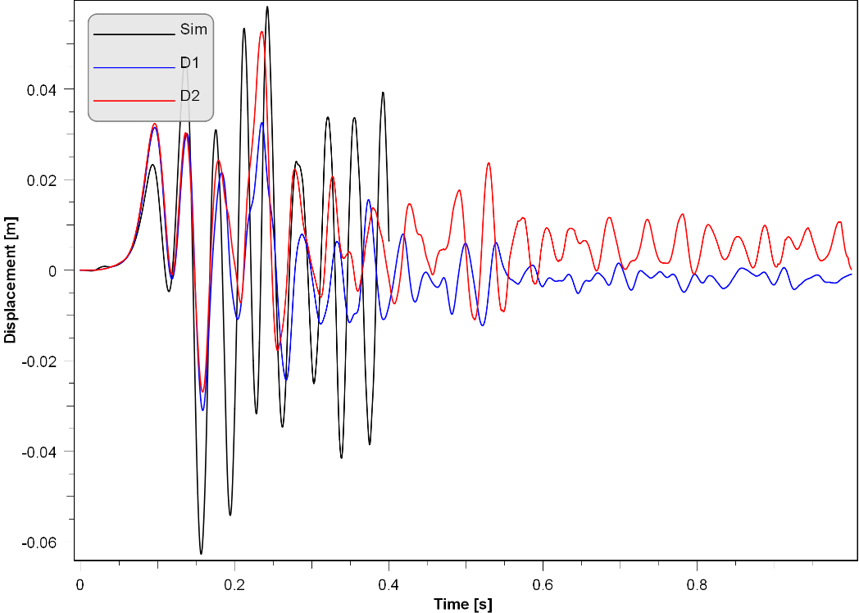
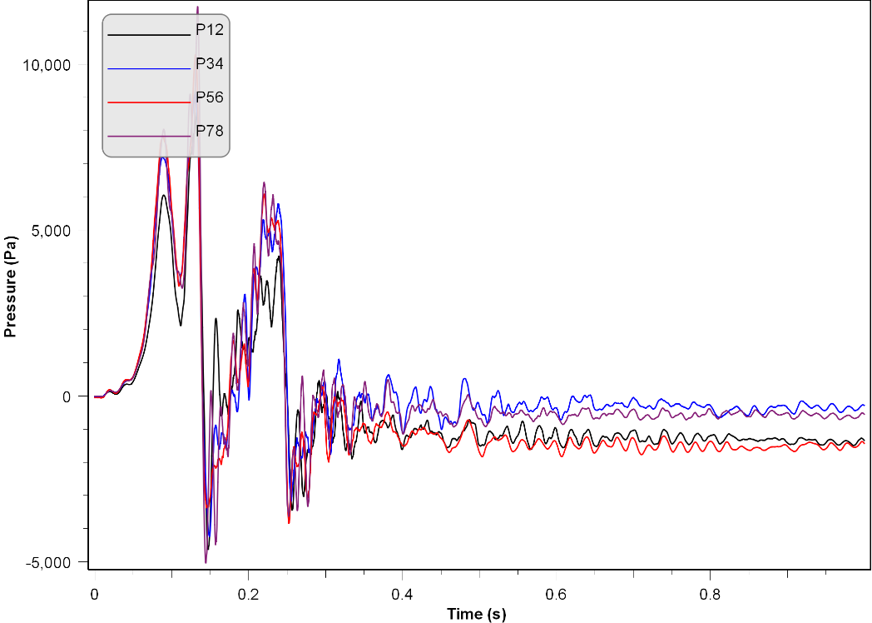
Results: Test 21 (6 m² roof venting, 21 vol. % H₂ – empty)
dmax_exp_min (m) | dmax_exp_max (m) | dmax_sim (m)
0.031 | 0.053 | 0.063
We use max displacement of the center of side wall and compare model with tests.
Pressure-time input
Measured pressure-time histories are directly applied as input to the FE model
The maximum displacement predicted by the FE solver is 63 mm, which is comparable to the maximum measured value of 53 mm (Test 21)

Slide 14
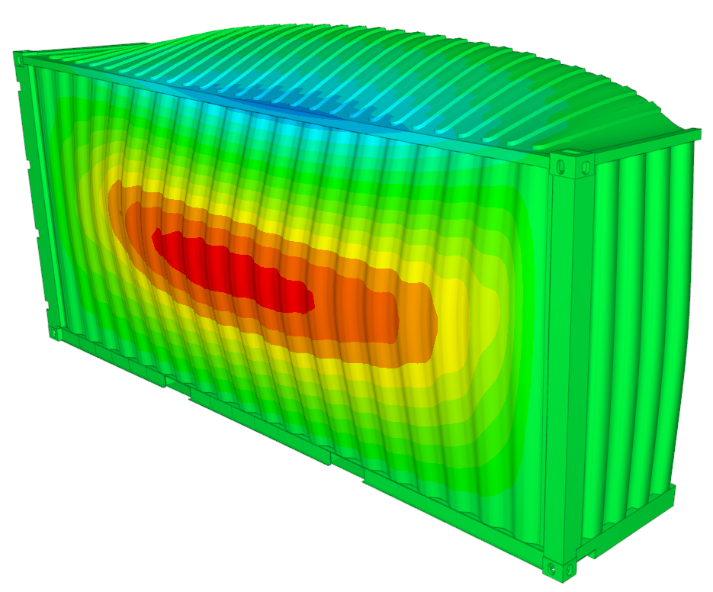
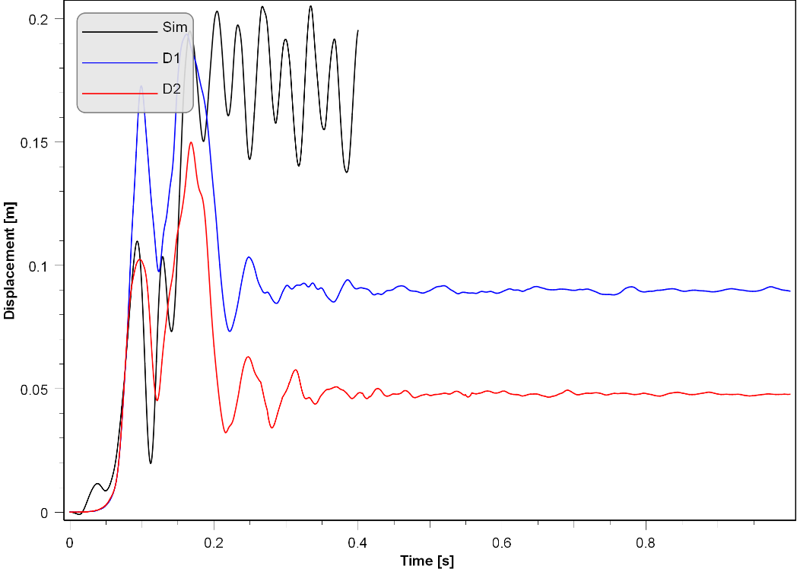
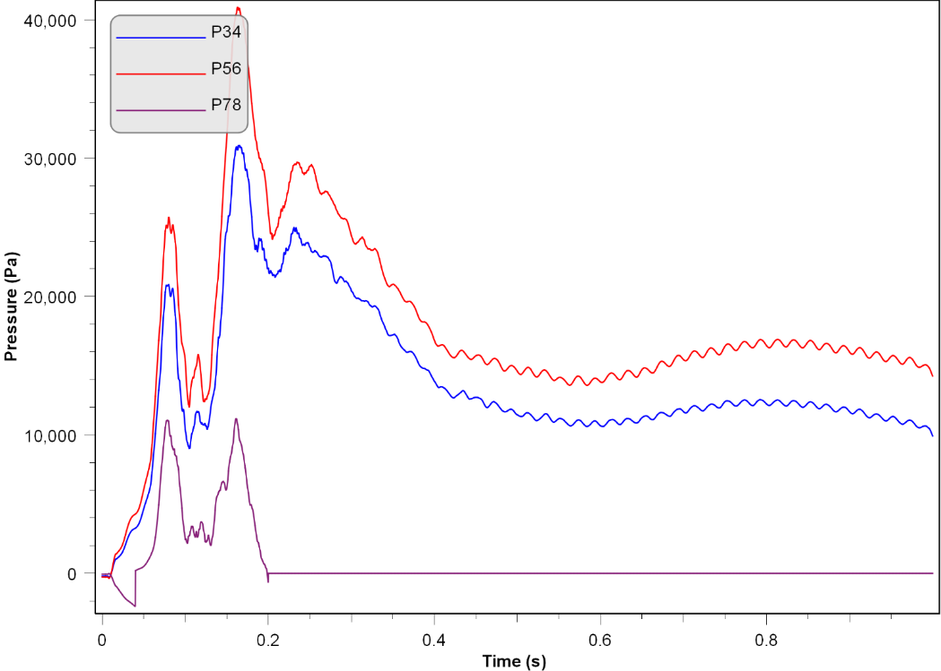
Results: Test 29 (4 m² roof venting, 24 vol. % H₂ - Pipes)
dmax_exp_min (m) | dmax_exp_max (m) | dmax_sim (m)
0.150 | 0.194 | 0.205
We use max displacement of the center of side wall and compare model with tests.
Pressure-time input
The FM model predicts a maximum deflection of 205 mm, which compares reasonably well with the measured value of 194 mm (Test 29)
Displacement contours show a wider deformation zone compared to test 21

Slide 15
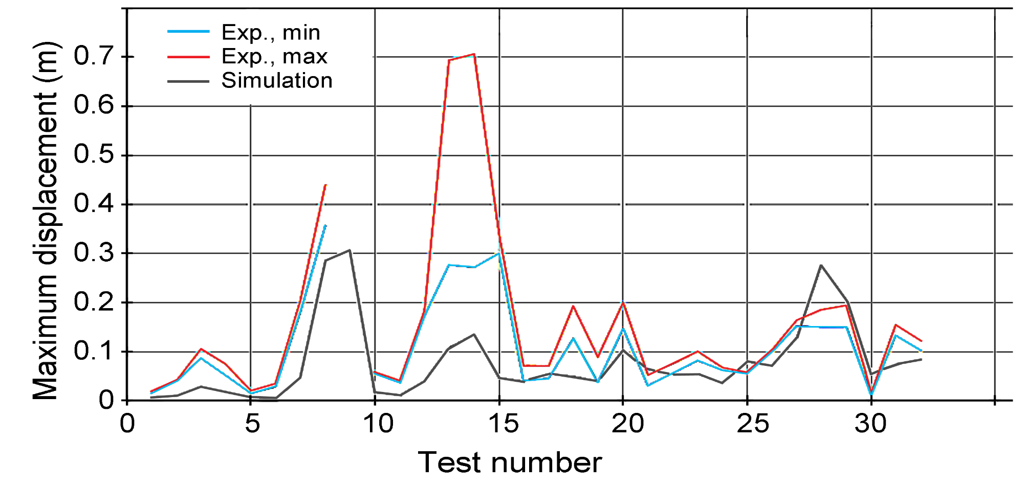
Results: Summary of all tests
Door venting
Roof venting
The model predictions are consistently low compared to the tests, especially for the tests with door venting (Test 1 – 14)

Slide 16
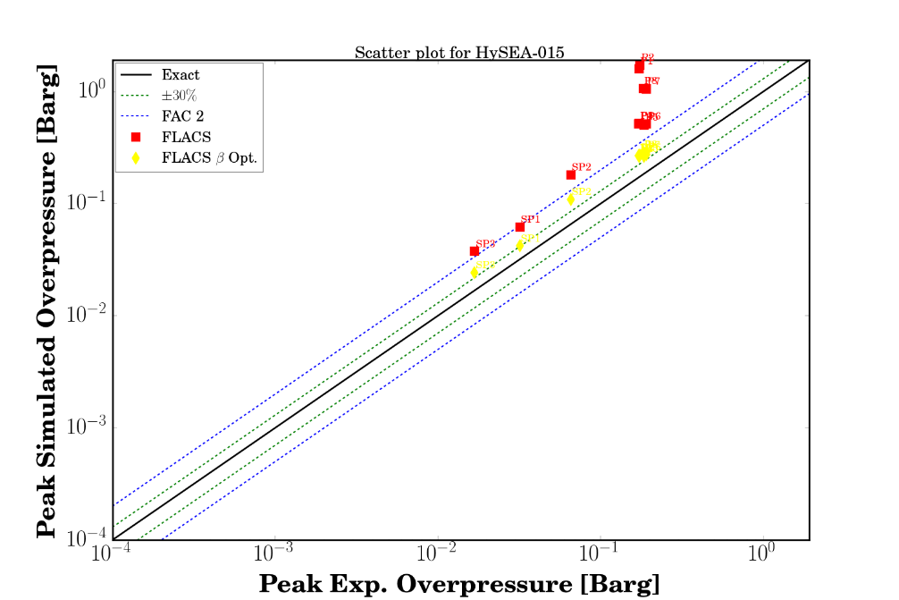
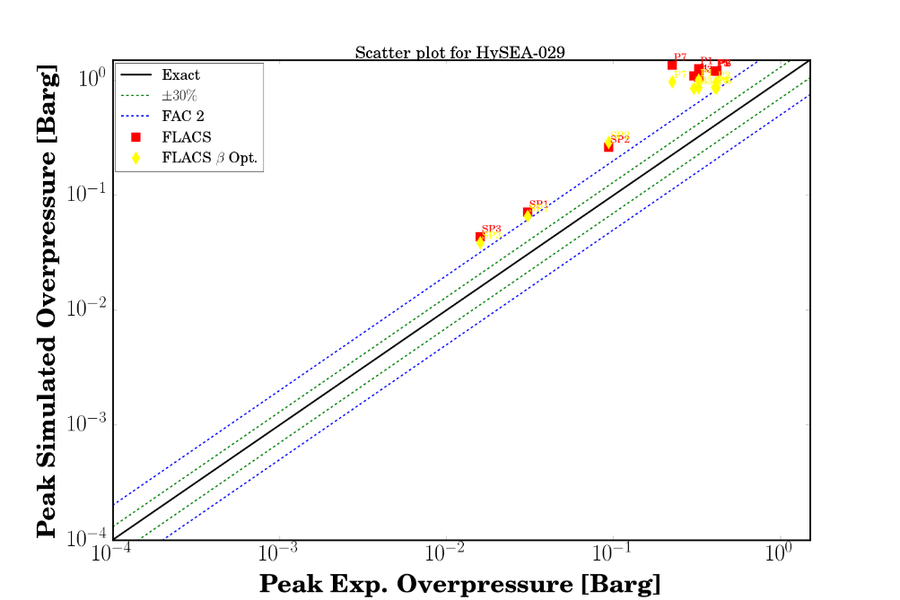
Perspective: Predictions from CFD data
CFD simulations of tests 15 and 29 with FLACS v10.5, as well as an in-house development version of FLACS (FLACS β).
Both versions of FLACS tend to predict conservative values for the maximum overpressures in enclosures with obstacles (test 29) and without obstacles (test 15). FLACS β results are better compared with standard FLACS.
As part of future work in the HySEA project, similar pressure-time data will be used as input to the IMPETUS Afea FE simulator to estimate the structural response of the container.

Slide 17
Concluding Remarks
A 20-ft container model has been built within the HySEA project to predict structural response
The combined model predictions are in reasonable agreement with measurements, except for scenarios where the explosion vessels were severely damaged. The following may have contributed to some of the observed deviations:
The uncertainties associated with material properties,
The mapping of discrete pressure data to surfaces,
The permanent deformation of structures,
Cyclic plastic deformation and reloading of the materials,
The formation of local buckling & development of kinematic hardening of the material,
That some of the pressure sensors quite quickly report zero pressure or “no signal”,
This demonstrates that the proposed methodology is viable, provided it can be demonstrated that CFD tools are able to simulate vented hydrogen-air deflagrations in complex geometries with sufficient accuracy.
Future work in the HySEA project will focus on,
Improving and validating the models for explosions in FLACS-Hydrogen,
Refining the integration between the CFD tool and the FE solver.
Measurement of the material properties for the ISO containers to improve FE model
Deriving pressure-impulse (P-I) diagrams for containers.

Slide 18
HySEA CONSORTIUM

Slide 19
ACKNOWLEDGEMENTS
The HySEA project received funding from the Fuel Cells and Hydrogen 2 Joint Undertaking (FCH 2 JU) under grant agreement No. 671461.
This Joint Undertaking received support from the European Union’s Horizon 2020 research and innovation programme and United Kingdom, Italy, Belgium and Norway.

