Slide 1


Hydrogen Safety Sensor
Performance and Use Gap Analysis
W. Buttner¹, E. Weidner², R. Burgess¹, H. Wright^{1,*}, R. Rivkin¹, R. Ortez-Cebolla², C. Bonato², P. Moretto², L. Hill³, W. James³
¹ National Renewable Energy Laboratory, Golden, CO, USA
² Joint Research Centre, Petten, NL
³ Department of Energy, EERE, Washington, DC, USA
* Intern, Colorado School of Mines, Golden, CO, USA
Presented to
International Conference on Hydrogen Safety
Hamburg, Germany
September 11-13, 2017

Slide 2


Overview of Talk
Clarify “What is a sensor”?
Overview of the NREL and JRC Sensor Laboratories
Recent Improvements in sensor performance
Gaps in Sensor Performance
On-going and Proposed Research activity of the sensor laboratories (addressing the gaps)
“Gaps” in addressing the gaps

Slide 3
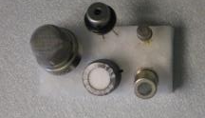
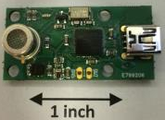
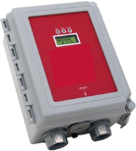
What is a sensor?
Every sensor platform is good, but none will work for every application.
The Sensing Element will control (and limit) Sensor and Analyzer performance.
vs.
vs.
Sensing Element (<$100)
(analog signal)
Sensor ($100 to $500)
(vol% H2)
Analyzer (>$500)
(Control Functions)

Slide 4
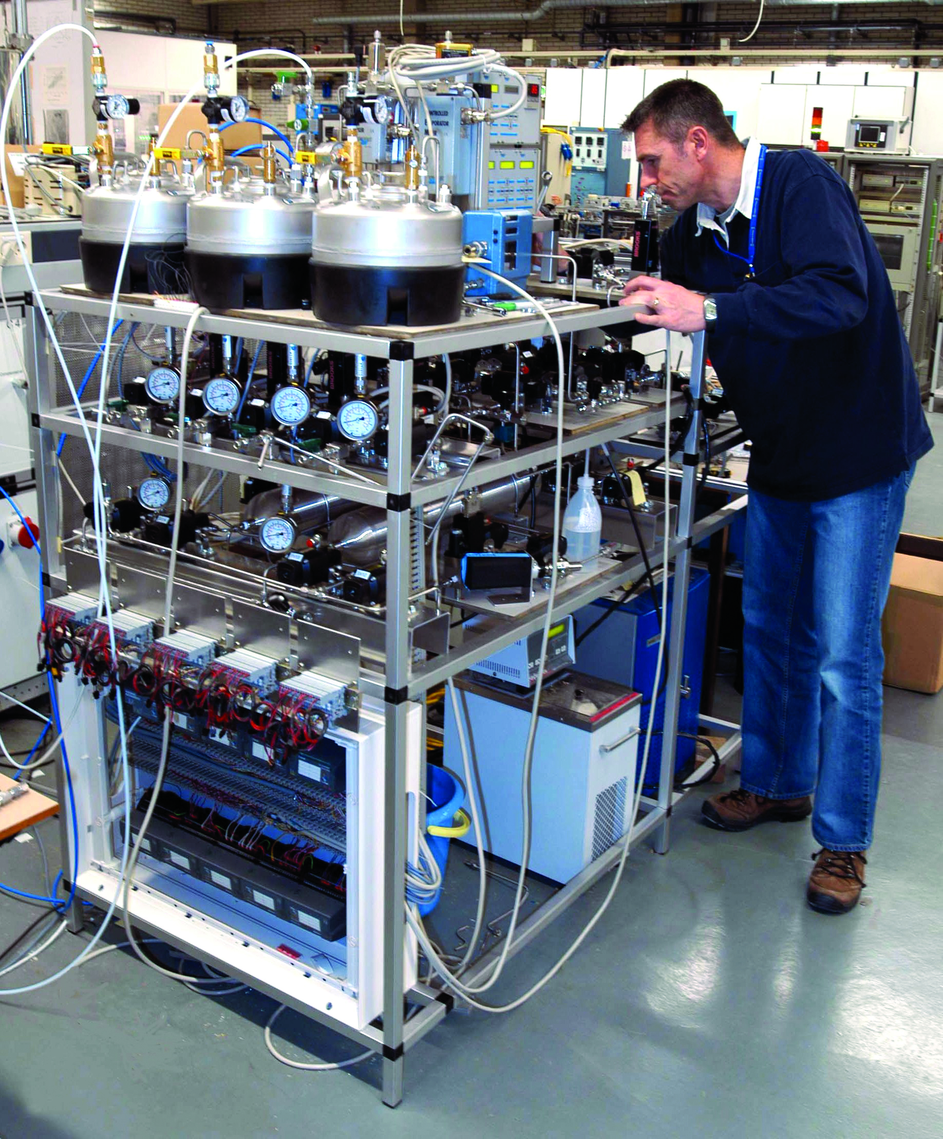
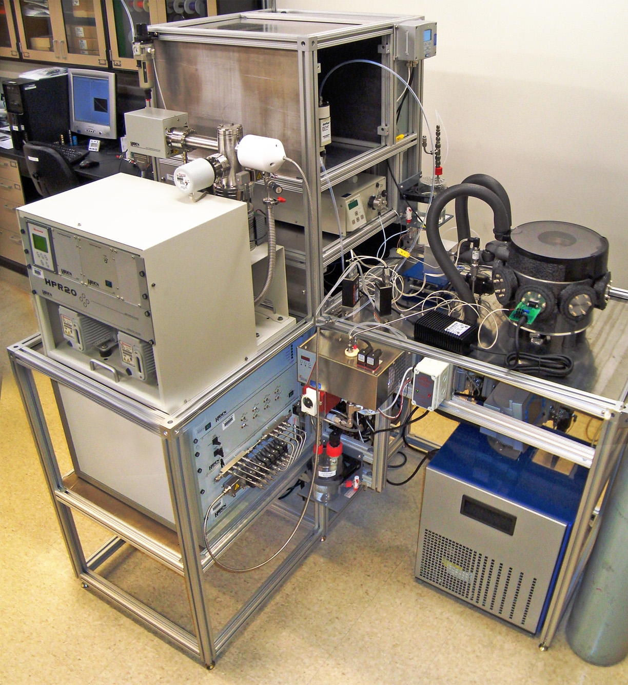
The NREL and JRC Sensor Test Facilities Collaboration
Similar missions, with on-going collaboration since 2008
  Research Activity guided by the needs of the Hydrogen Community
  Outcome includes numerous papers (ICHS) and common representation in other venues (SDOs/CDOs, safety committees)
  Currently formalized under a DOE-JRC Agreement
Approach: Direct Interaction with the Stakeholders
The Sensor Test Facilities are a resource to the hydrogen community

Slide 5

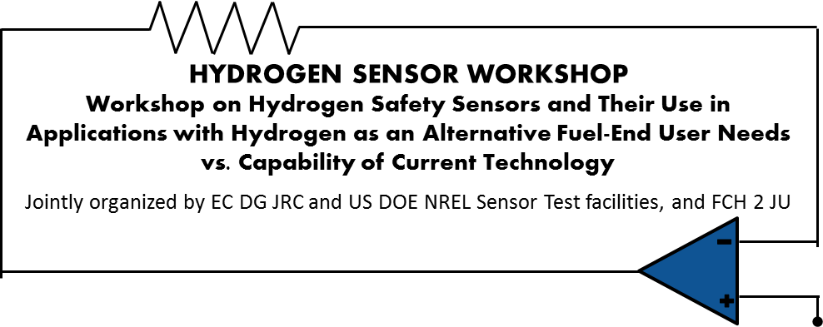

Hydrogen Sensor Workshop
Direct Interaction with Stakeholders
Hydrogen Sensor Workshops
Jointly organized: NREL-JRC Sensor Labs
Bring together stakeholders in H2 community
  Sensor manufacturers; infrastructure and vehicle; site safety
  The Sensor Laboratories are a resource to the H₂ community
Gap analysis: needs vs. capability
  Role of Sensor Test Labs in support of the H2 community
  Guidance document on proposed research direction
  Summary Report
Separate venues planned (for international input)
  EC: May 10, 2017 in Brussels (with the FCH JU)
  U.S.: Proposed Technical Forums: Fall 2017 (NREL)

Slide 6
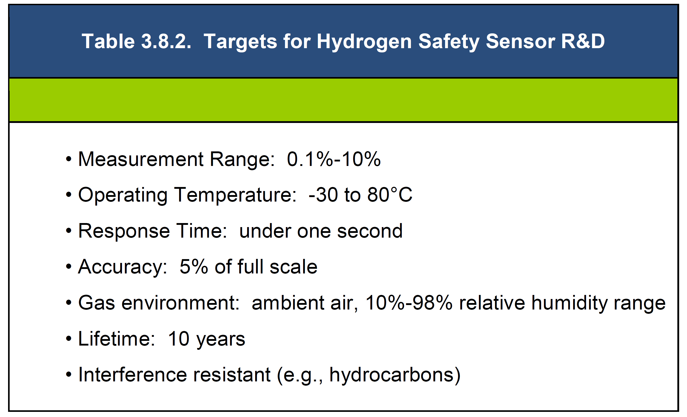

Hydrogen Sensor Gaps
Short list of critical sensor performance targets (gaps)
DOE Multi-Year Project Plan (2007, reiterated in 2012)
Other Gap Analyses Developed by JRC/BAM, NREL

Slide 7
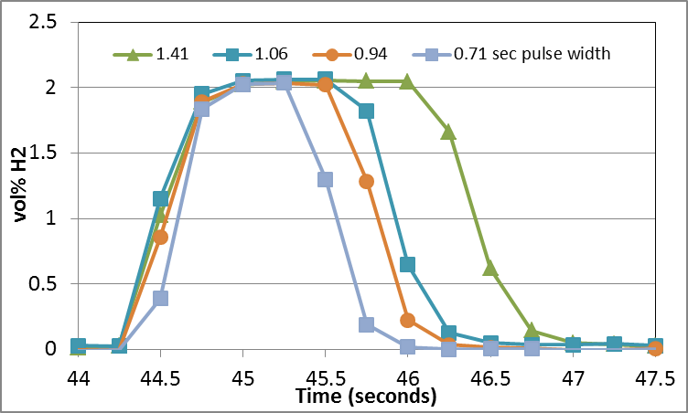
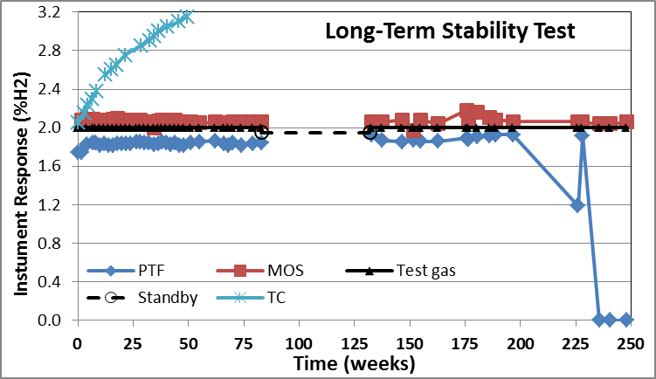
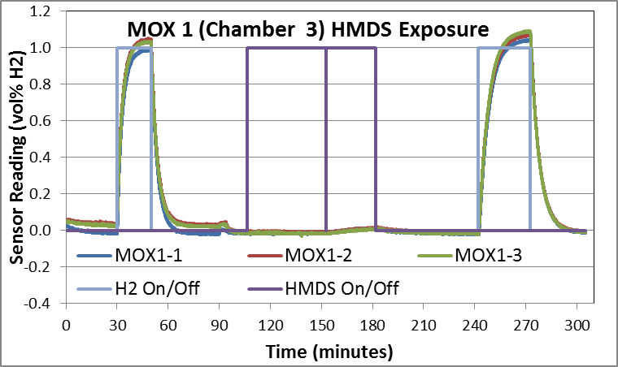
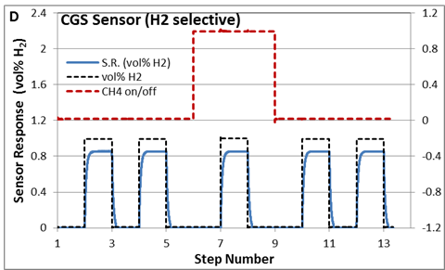
Recent Advances in H2 Sensor Performance
A
A: Fast Sensors are available
RT < 1 sec (actual RT ≈ 250 ms)
B: Sensor Lifetime/Long-term stability
Nearly 5 years (in the lab)
Poor performance often manifests early
C: Robustness to (some) poisons
Based on ISO 26142
Some MOX, CGS, TC passed
Some MOX, EC failed
D: Improved Selectivity
CGS H2 sensor available with no CH4 interference
B
C

Slide 8
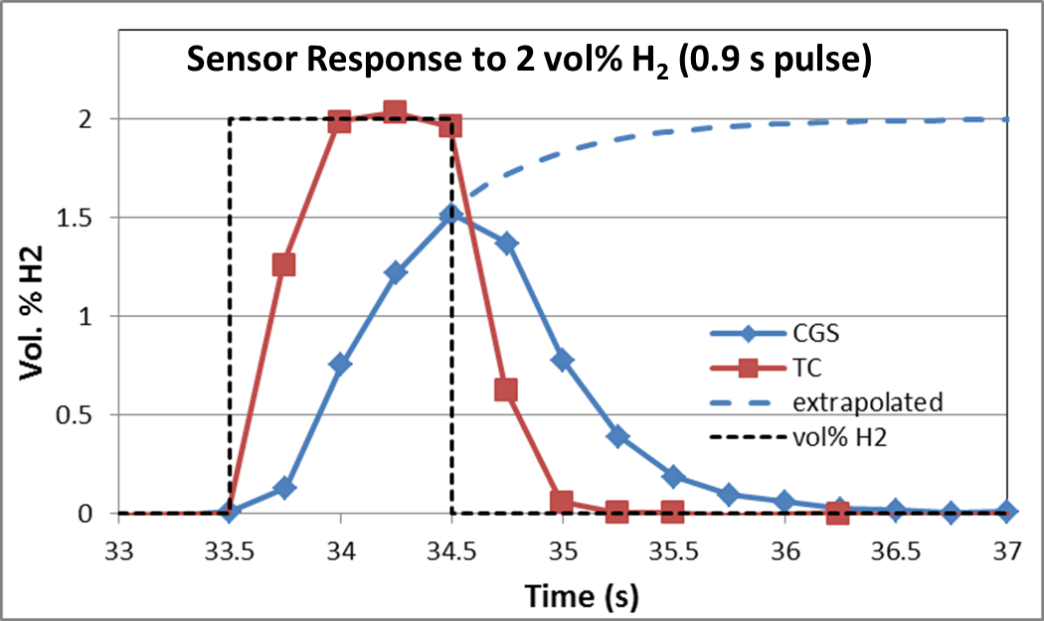
Advances in H2 Sensor Performance Not Universal
Fast Sensors are available, but…
  < 1 s RT pertains only to a few models
  Most RT > 5 - 10 s
  Slow RT may corrupt transients
Sensor Lifetime/Long-term stability
  Time consuming to validate (esp. in field)
  An Issue: One sensor (●) very expensive
Manufacturer’s Concerns
  An Issue: One sensor (▪) has been discontinued (market did not justify product line)
  Impact end-user
MARKET SUSTAINABILITY

Slide 9
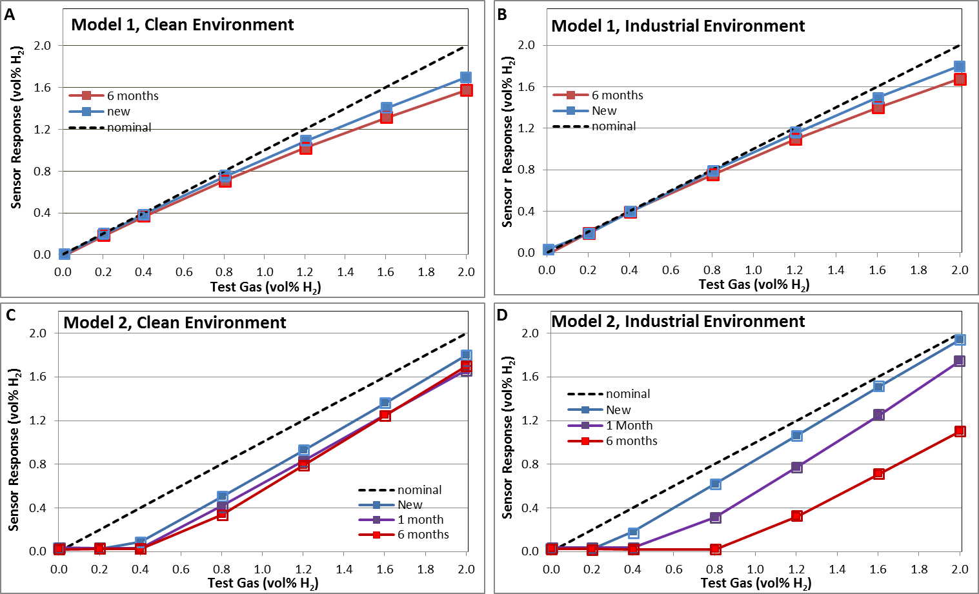
Advances in H2 Sensor Performance not Universal
Sensor Lifetime/Long-term stability
  Lab Environment ≠ Field Environment
  Time consuming to validate (esp. in field environment)

Slide 10
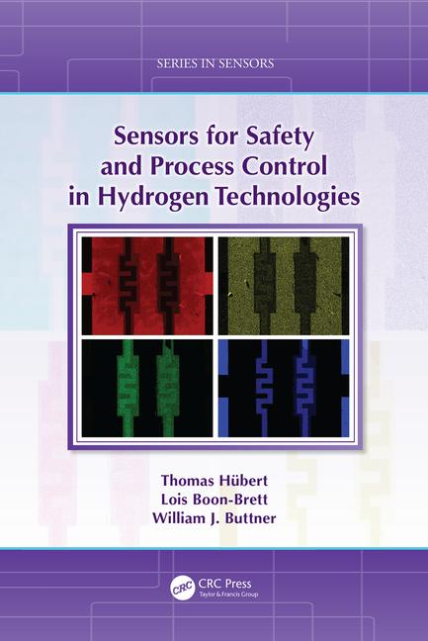
Sensor Performance Metrics / Specifications
Metrological Metrics: Accuracy, Baseline, Cross-sensitivity (Selectivity), Drift, Environmental Effect, Final Indication, Hysteresis, Limit of Quantification, Lower Detection Limit, Linear Range/Measuring range, Noise, Operation Range (T, P, RH), Poison, Uncertainty, Response/Recovery time, Reversibility, Resolution, Saturation, Sensitivity
Deployment Metrics: Capital Cost, Alarm Set Points, Capital Costs, Control Circuitry, Electronic Interface, Installation Cost, Commercial Maturity, Placement, Physical Size, Pneumatic Design, Power Requirements, RCS, Shelf Life, Perception of Performance
Operational Metrics: Maintenance Cost, Calibration Requirements, Maintenance Cost, Consumables, Device to Device Repeatability, Matric Effects, Mechanical Stability, Minimum Analyte Volume, Operation Lifetime, Orientation Effect, Warm-up Time

Slide 11
Workshop Topics and Discussion Points
Participants from a cross-section of stakeholders
End-Users—Automotive and Infrastructure some Special Applications (Research, Nuclear)
Manufacturers and Developers
Sensor Experts (NREL, JRC, BAM Sensor Test Facilities)
Topical Discussion
Overview of Hydrogen Sensor Test Facilities at NREL, JRC, BAM
End-User Experience and expectations for H2 Sensors / Manufacturer’s Perspective
Sensor Analytical Performance Requirements
Sensor Deployment Considerations
Sensor Lifetime
Gap Identification / Priortization
Strategies for moving forward

Slide 12
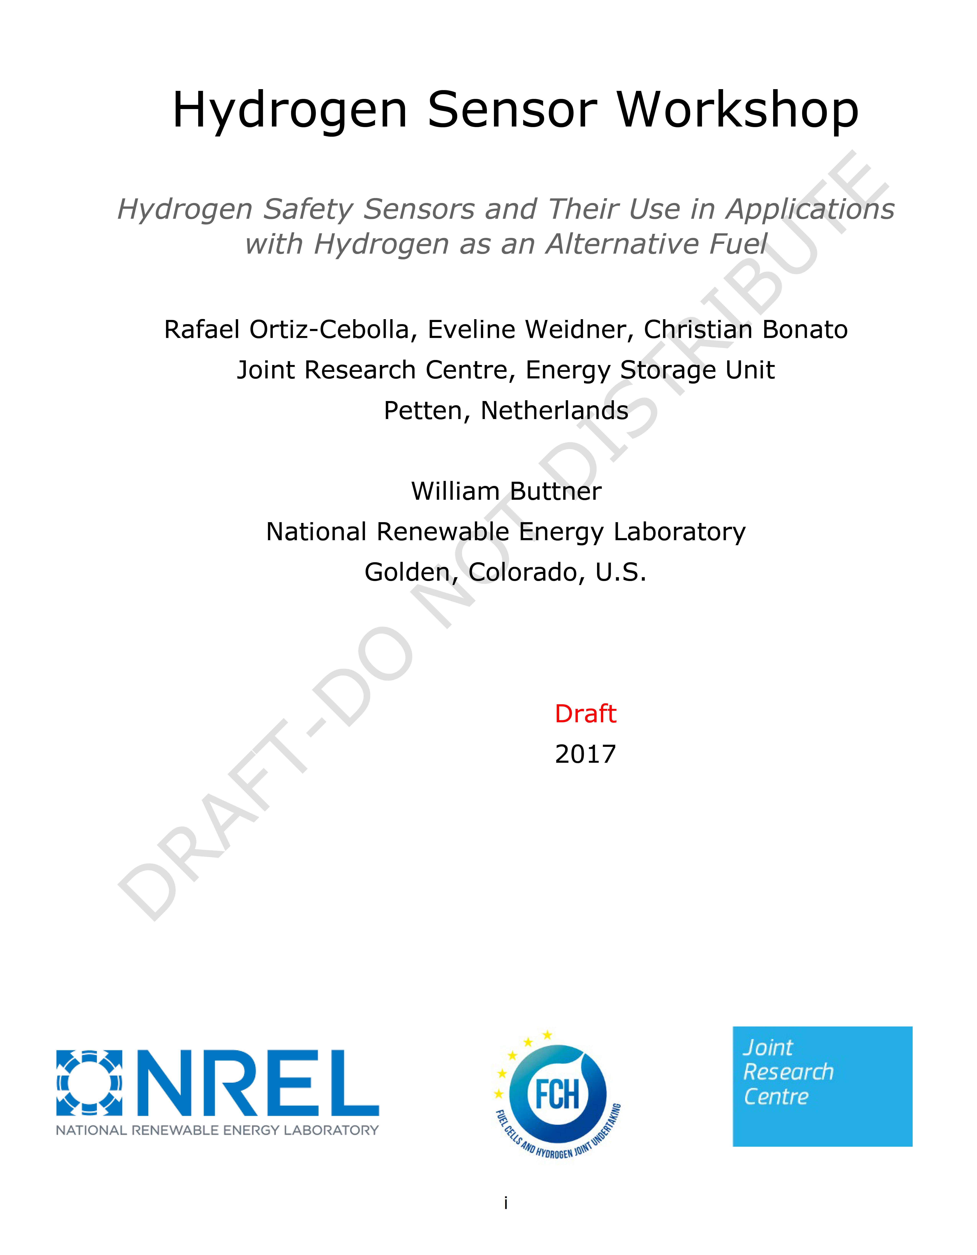
Outcomes of the Workshop
Summary Report (under review)
Synopsis of participant feed back
Detailed Identification of Sensor Gaps
  End-user and Supplier perspective
  Short-list of Priority Gaps
On-going Activity in Sensor Laboratories
Proposed Future Activity
Draft Summary Report is under review
For Publication as a JRC Report (pending)

Slide 13
Priority / Critical Gaps—End-User Perspective
Critical Gaps for H2 Sensors in Infrastructuere and Automotive Applications
Other Gaps were identified for each category
Different Barriers may be critical for special/alternative applications (Power to Gas, Process Control, GTR, Research Tools) and industries (Nuclear, Aerospace)

Slide 14
Priority / Critical Gaps—Manufacturer Perspective

Slide 15
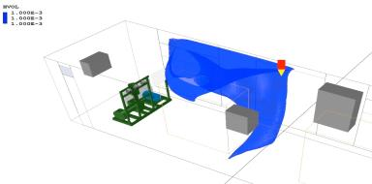
Path Forward
Current and Proposed RD&D and Support Activity at NREL and JRC
Sensor lifetime Investigations
  Impact of chemical and (some) physical stressors on lifetime
Selectivity (robustness against chemical and physical interference)
CDO/SDO and Outreach Activity
  Pre-Normative Research, Document Development, Expert Advice
Hydrogen Wide Area Monitoring
  Support of H2@Scale
  Review strategies for implementation
Sensor Use and Placement
Support Specialized Applications (Power to Gas, GTR)
Continued interactions with stakeholders
  Guidance Document to FCH-JU, DOE
  Formalized partnerships
  Workshops, topical WEBINARS
Indoor Hydrogen Dispersion

Slide 16
Limitations on Path Forward
What may be challenging to address
(without stakeholder feedback and support)
Long Term Stability
Mode of Failure, End of life indication, Autocal
Validated ALT
Some Physical Stress Testing
Certification (required use of national standards)
Can guide but not impose requirements
Market Sustainability and Cost

Slide 17

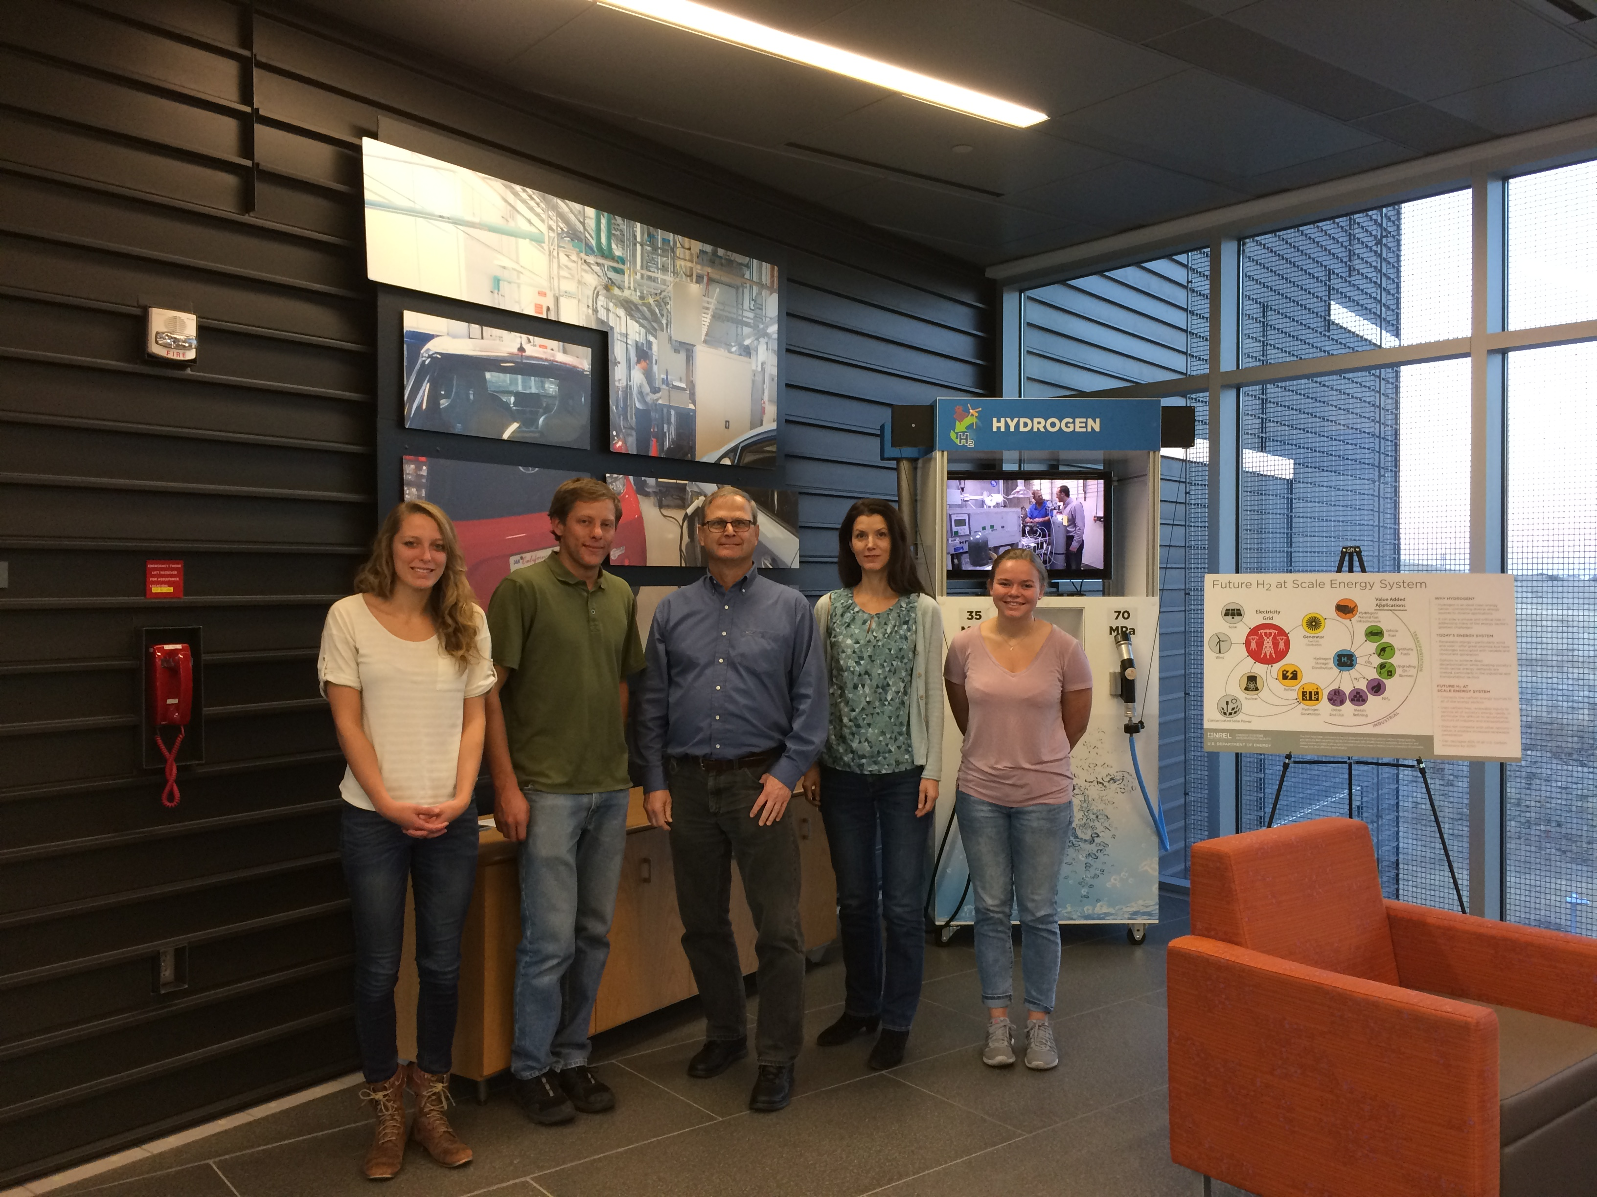
Acknowledgements
  The NREL-JRC partnership is performed under the auspices of a DOE-JRC agreement “Collaboration Arrangement for Research and Development in Energy-Related Fields” DOE-JRC (signed June 2, 2016)
The NREL Sensor Laboratory is supported by DOE-EERE Fuel Cell Technologies Office, SCS Sub-Program Will James, Program Manager Laura Hill, Project Manager
The Colorado School of Mines Interns (past and present)
(November 2016)
The NREL Sensor Laboratory and Friends
(L to R): Kara Schmidt¹, Kevin Hartmann¹, Bill Buttner², Eveline Weidner³, Hannah Wright¹
¹ NREL intern, Colorado School of Mines
² Director, NREL Hydrogen Sensor Laboratory
³ Director, JRC Sensor Test Facility (SenTeF)

