Slide 1
RBD-FAST BASED SENSITIVITY AND UNCERTAINTY ANALYSIS ON A COMPUTATIONAL HYDROGEN RECOMBINER TEST CASE
International Conference on Hydrogen Safety
11-13 September 2017, Hamburg
Jiyang Yu, Tsinghua University, Beijing, China
Bingxu Hou, CNNC CZEC, Beijing, China
Zhanjie Xu, Karlsruhe Institute of Technology, Karlsruhe, Germany
Thomas Jordan, Karlsruhe Institute of Technology, Karlsruhe, Germany
Guangming Jiang, CNNC NPIC, Chengdu, China
3rd Floor – Zollager, Former Main Customs Office, Hamburg
13.09.2017

Slide 2
Content
Introduction
Computation of DDT Ratio
Construction of a Hydrogen Recombiner Case
RBD-FAST Based Uncertainty and Sensitivity Analysis
Discussion and Conclusion

Slide 3
Introduction
During a severe accident in an NPP, hydrogen can leak into the atmosphere of containment, menacing its integrity.
Prediction of DDTR at each instant is an important task in hydrogen safety analysis.
DDTR can be evaluated with CFD output, which can be influenced by input error.
  Uncertainty analysis: quantify output uncertainty
  Sensitivity analysis: determine influence of input error on output uncertainty
A 3-step procedure for hydrogen safety analysis
  CFD simulation of hydrogen behavior
  Evaluation of detonation possibility and its destructiveness
  Uncertainty and Sensitivity analysis on computation results

Slide 4
Computation of DDT Ratio
Deflagration-Detonation-Transition Ratio
  D: characteristic geometrical size of the flammable gaseous cloud, V^{1/3} for arbitrary cloud shape
  λ: detonation cell width
Determination of flammable cloud border
  CFD simulation of detailed hydrogen distribution
  Sum up the volume of cells meeting flammable limits

Slide 5
Computation of Detonation Cell Width
Gavrikov’s method^{[1]}:
Improvements:
  Physical aspect:
  Mathematical aspect:
    Machine Learning Based Regression Method: Support Vector Regression
    No a priori assumption of fitting function
    Noise considered during regression, better fitness and better stability

Slide 6
Computation of Detonation Cell Width
Performance of 3-Parameter SVR method

Slide 7
Construction of a Hydrogen Recombiner Case
Sketch of the vessel
Initial hydrogen distribution
Siemens recombiner model^{[2]}
ϕ =1.5m
Hydrogen recombiner
3.5m
4.8m
Computational conditions
  Initial condition: 20°C, 1atm
  Boundary condition: t_{wall} = 20°C, h_{wall} = 5W/m²/°C
  Recombiner: FR-90/1-150, A = 0.48×10⁻³kg/s/bar, B = 0.58×10⁻³kg/s
  CFD code: HYDRAGON, in-house code developed by Tsinghua University^{[3][4][5]}
  Mesh: Hexahedral mesh, medium refinement (10×10×24, 20×20×48, 40×40×96)
  Turbulence model: Standard k-ε with buoyancy considered

Slide 8
Nominal Output
Thermal dynamical parameters
DDTR and maximum explosion energy
DDTR < 1
Detonation risk ruled out

Slide 9
RBD-FAST Based Uncertainty and Sensitivity Analysis
Statistics based method is applied to perform sensitivity and uncertainty (SU) analysis for fluid system.
By sampling and studying the distribution of output, uncertainty can be estimated.
In previous works, nonparametric statistical methods are applied to quantify sensitivity.
  Spearman’s correlation coefficient (SCC) is used as sensitivity coefficient.
  Advantage: less samples (~100) and less computation amount
  Disadvantage: valid only when output and input are monotonously correlated
    ρ→1, positive correlation;
    ρ→-1, negative correlation;
    ρ→0, uncorrelated;

Slide 10
RBD-FAST Based Uncertainty and Sensitivity Analysis
In RBD-FAST (Random balance design - Fourier aptitude sensitivity test), sensitivity coefficient is defined as the variance caused by a given input parameter to the whole variance of the output.
  Output can be decomposed as Fourier series;
  Random arrangement is performed on sample input while de-arrangement on sample output;
  sensitivity coefficient can be computed by calculating the spectrum of the fast Fourier transform (FFT).

Slide 11
Input and Output Parameters to be Analyzed
Input parameters to be sampled (1000 samples)
  Distribution: Gaussian, Standard deviation: 5% nominal value
Output parameter to be analyzed
  DDTR
  maximum explosion energy, Q_{max}
Symbol | Parameter name | Nominal value
x₁ | Wall temperature, T_{w} | 20°C
x₂ | Wall heat transfer coefficient, h_{w} | 5J/m²/°C
x₃ | Initial temperature, T₀ | 20°C
x₄ | Initial hydrogen volume fraction coefficient, α* | 1
x₅ | Recombiner performance parameter, A | 0.48 × 10⁻³ kg/s/bar
x₆ | Recombiner performance parameter, B | 0.58×10⁻³ kg/s

Slide 12
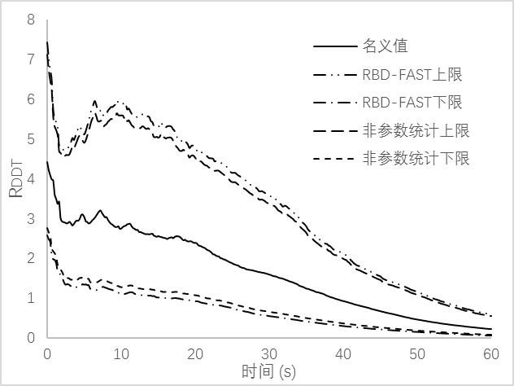
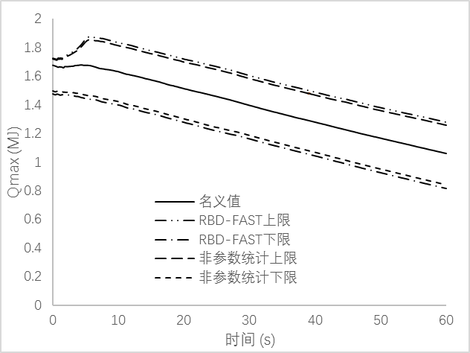
Uncertainty Analysis
DDTR
Q_{max}
Nominal
RBD-FAST upper
RBD-FAST lower
Nonparametric upper
Nonparametric lower
Nominal
RBD-FAST upper
RBD-FAST lower
Nonparametric upper
Nonparametric lower
Time (s)
Time (s)

Slide 13
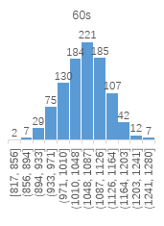
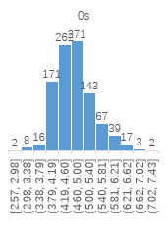
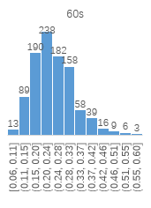
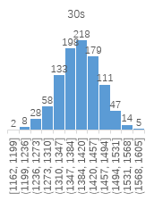
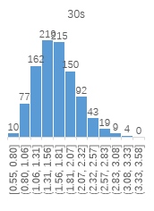
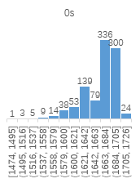
Uncertainty Analysis
Distribution of DDTR and Q_{max}
  DDTR
  Q_{max}

Slide 14
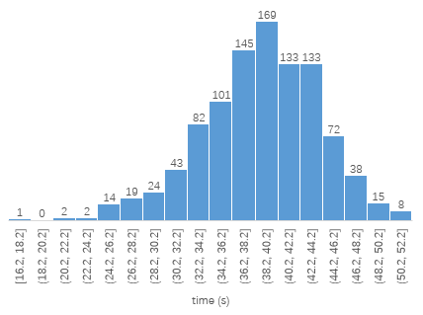
Uncertainty Analysis
Distribution of time needed for DDTR to fall below 1
  Average value: 38.7s
  Standard error: 5.2s

Slide 15
Sensitivity Analysis
DDTR
Q_{max}
The uncertainties of DDTR and Q_{max} are produced mainly due to the uncertainty of the initial hydrogen distribution (x₄) in this case!

Slide 16
Comparison of Comparison of the sensitivity (x₄) between SCC and RBD-FAST
DDTR
Q_{max}
The sensitivity coefficients by RBD-FAST are generally lower and drops faster than SCC.

Slide 17
Discussion & Conclusion
A 3-step procedure is proposed and demonstrated for nuclear containment hydrogen safety analysis. It is applicable to evaluate hydrogen detonation risk, to determine the key factors resulting in the risk and, to facilitate the design of hydrogen mitigation measures.
SU analysis conclusions drawn from a case are only valid within the scope of the case itself. Dependency between output uncertainty and input uncertainty may be changed for different conditions.
For more complicated cases where the reliance of output uncertainty on input uncertainty is not monotonous, whether SCC can reflect sensitivity is still an issue to be further investigated.

Slide 18
Reference
[1] Gavrikov A I, Efimenko A A, Dorofeev S B. A model for detonation cell size prediction from chemical kinetics[J]. Combustion and flame, 2000, 120(1): 19-33.
[2] Travis J R, Spore J W, Royl P, et al. GASFLOW: a computational fluid dynamics code for gases, aerosols and combustion[J]. FZKA-5994 Vol I-III, 1998.
[3] Abdalla A A A, Yu J, Zhang C, et al. Investigation of the influence of turbulence models on the simulation of the gas distribution[C]. Proceedings of ICONE23, ASME, 2015.
[4] Saeed M, Yu J, Abdalla A A A, et al. The effect of turbulence modeling on hydrogen jet dispersion inside a compartment space using the HYDRAGON code. Journal of Nuclear Science and Technology[J]. 2017, 38(2): 72-77.
[5] Hou B, Yu J, Jiang G, et al. Numerical simulation of wall condensation phenomenon of steam in containment based on code HYDRAGON. Nuclear Power Engineering[J]. 2016, 37(4): 81-86.

Slide 19
Thank you!

