Slide 1


Modeling of hydrogen explosion on a pressure swing adsorption facility
*B. Angers¹, A. Hourri¹, P. Benard¹
E. Demaël², S. Ruban², S. Jallais²
¹ Institut de recherche sur l’hydrogène, Université du Québec à Trois-Rivières, Québec, Canada
² Air Liquide, Centre de Recherche Claude-Delorme, 78350 Jouy en Josas, France

Slide 2
Project scope
Numerical study of the consequences of an hydrogen release from a Pressure Swing Adsorption installation operating at 30 barg
Tool: FLACS-Hydrogen from GexCon
We investigated :
  The impact of different leak orientation and wind profile on the explosive cloud formation (size and explosive mass) and on explosion consequences
  Overpressures resulting from ignition as a function of the time to ignition
Notes:
The scope of the project was to numerically study the consequences of an hydrogen release from a pressure swing adsorption installation operating at 30 barg.
FLACS-Hydrogen from GexCon was used to do the simulations
We investigated the impact of different leak orientation and wind profile on the explosive cloud formation and on explosion consequences
We also investigated the overpressures resulting from ignition as a function of time to ignition

Slide 3
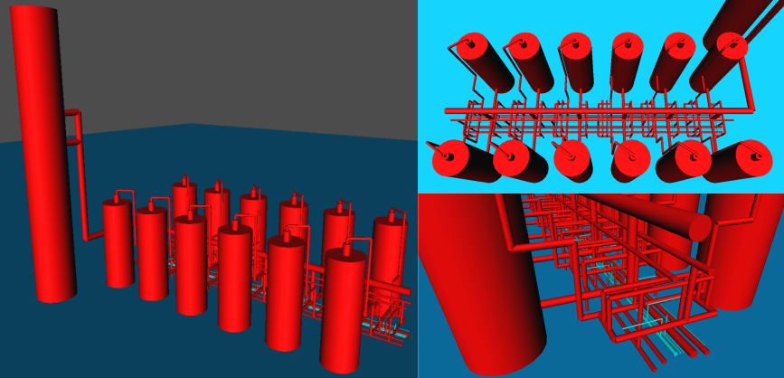
Pressure Swing Adsorption installation
Three of the 43.3 m³ reservoirs contain hydrogen
  P = 30.4 barg
  T = 45°C
Notes:
Here’s the pressure swing adsorption installation as seen in FLACS
2) The geometry was imported manually from CAD files
It consisted of 82 cylindrical elements
The congested area which contains most of the pipes is about 30 m long
Out of the 12 reservoirs, 3 of them contains hydrogen at 30.4 barg
This correspond to about 300 kg of hydrogen

Slide 4
Scenarios
Dispersion
  The jet was directed either horizontally or 45 ° toward the ground
  Some scenarios were done with wind
    3 m/s Pasquill class F
    5 m/s Pasquill class D
Combustion
  The ignition point was positioned on the ground inside the 30% concentration envelop along the centreline of the jet
  Ignition occurred at 2 seconds and 20 seconds after the leak onset
  In one case (35NW45°), the time to ignition was varied between 0.5 second and 60 seconds
Notes:
Here are the various scenarios that were considered
The simulations were divided into two stages: first the simulation of the gaseous release and then the ignition of the release
For the dispersion, the jet was directed along the PSA either horizontally or 45 degree toward the ground
Some scenarios were done with wind at 3 m/s and 5 m/s going in the same direction as the jet along the PSA
For the combustion, the ignition point was positioned on the ground inside the 30 % concentration envelop along the centerline of the jet
Depending on where the 30% concentration envelop was, the ignition position varied from case to case
The cloud was ignited at 2 seconds and 20 seconds after the onset of the leak
At 2 seconds because at that time the cloud is small but contains a higher concentration of hydrogen
And at 20 seconds because the cloud is well developed but more diluted and it covers most of the PSA
In one case where the diameter was equal to 35 mm, without wind and the jet directed 45 degree toward the ground, the time to ignition was varied between 0.5 second and 60 seconds
(Wind) In the windy cases, the reference height was set at 10 m and the ground roughness at 0.03 m (open flat terrain; grass, few isolated obstacles).

Slide 5
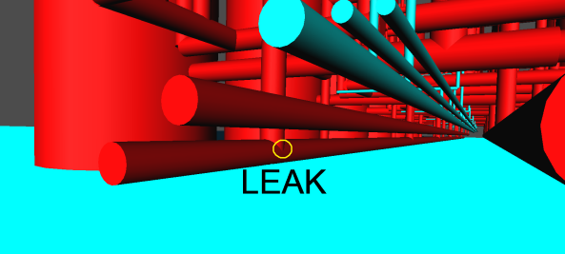
Leak (1)
The leak was assumed to originate from a broken branch connection at one end of the system 0.5 m above the ground
Two leak diameters were considered:
  20 mm (3/4")
  35 mm (1"1/2)
Notes:
The leak was assumed to originate from a broken branch connection at one end of the system 0.5 m above the ground
Two diameters were considered: 20 mm and 35 mm
As a conservative approximation, the pressure drop through the pipes from the reservoirs to the leak was not taken into account

Slide 6
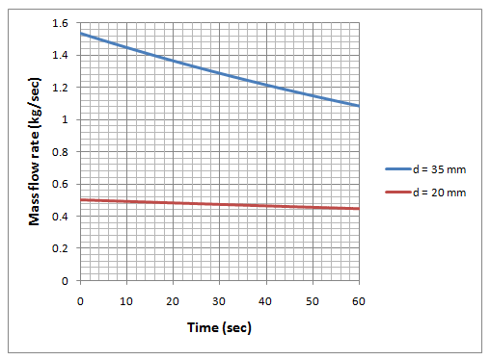
Leak (2)
Initial mass flow rates :
  0.50 kg/s for d = 20 mm
  1.54 kg/s for d = 35 mm
Notes:
For the 20 mm and 35 mm leak diameter, the initial mass flow rate was 0.50 kg/s and 1.54 kg/s respectively
For each scenario, the flow is choked at the jet exit
The jet outlet conditions were calculated using an imbedded jet program in FLACS
A discharge coefficient of 0.85 was used

Slide 7
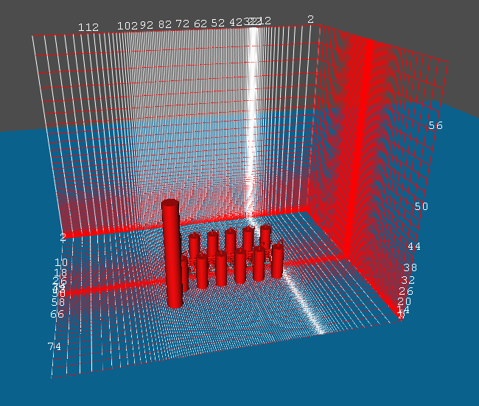
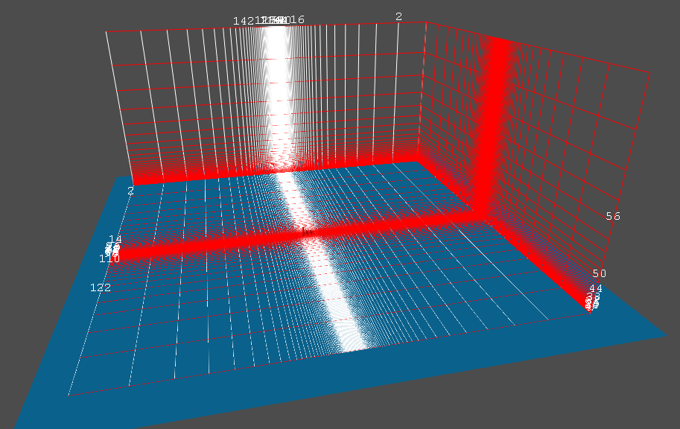
Grid
Dispersion
Combustion
Dispersion and combustion simulations are done on two different grids
The size of the cells encompassing the PSA was set at 0.5 m on both grids
Grid sensitivity studies were also conducted
Notes:
As shown on the figures, FLACS uses rectilinear grids
Dispersion and combustion simulations are done on two different grids
The data from the dispersion is imported unto the combustion grid prior to ignition
The size of the cells encompassing the PSA was set at 0.5 m on both grids
One grid was used for all combustion simulations
Grid sensitivity studies were also conducted
An average decrease of 14% in overpressure on monitor points and an average increase of 10% in the domain was seen when varying the combustion grid size from 0.50 m to 0.20 m
The overpressure measured in the domain capture every localised reflection, even if they appear only for a fraction of a millisecond
The monitor points on the other hand are in mid air or on the ground, away from any corners where multiple reflection can occur
When reducing the size of the grid, objects who used to be represented by the subgrid model because of their small size become bigger and fill up the cell
Local reflections which quickly dissipate can now occur on these closed up cells
That’s why you can see higher overpressure in the domain when reducing the size of the cells even though monitor points register lower overpressures
In the case of jet dispersion, a zone made of cubic cells was defined at the expanded jet location. Following Gexcon good practice recommendations, the cell size of the initial cubic zone at the expanded jet location was determined by the effective leak area A_{leak} so that A_{cv} > A_{leak} > 0.9A_{cv} where A_{cv} is the area of the control volume. The leak originates from one cell in the initial cubic zone. From that initial zone, the grid was stretched to a coarser cubic grid encompassing the PSA.

Slide 8
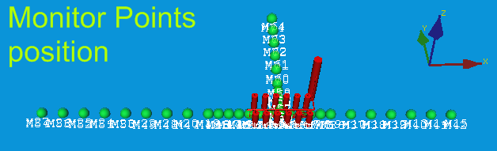
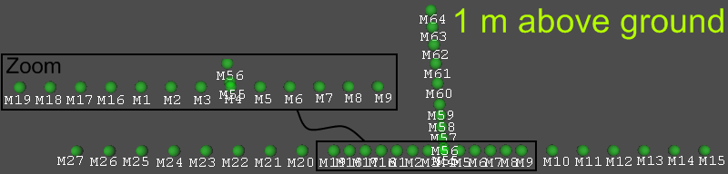
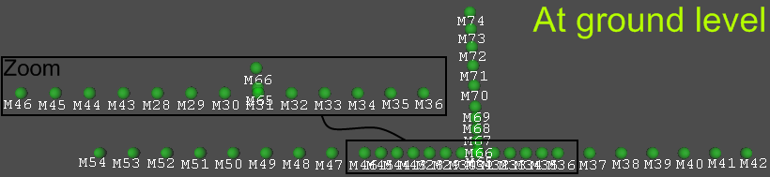
Notes:
Overpressure measurements were taken on monitor points set at regular intervals (every 5 m inside the PSA) along and perpendicular to the jet direction
The monitor points were positioned on the ground and 1.0 m above the ground
Overpressure measurements were also taken in the entire domain

Slide 9
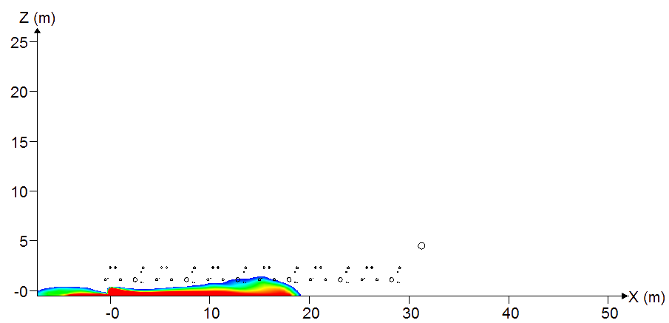
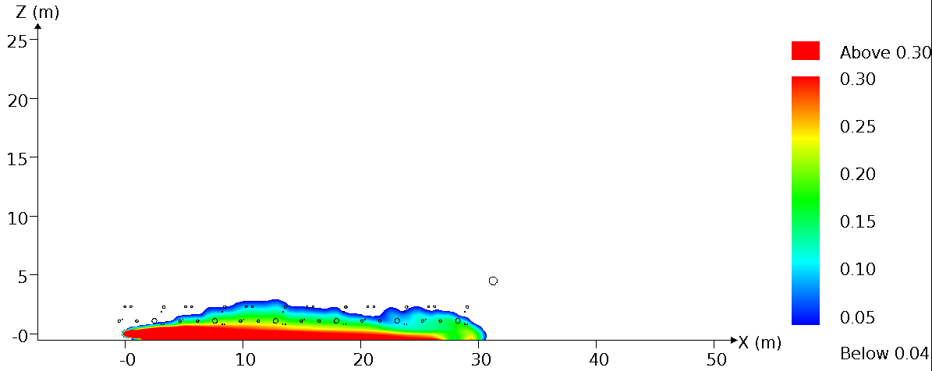
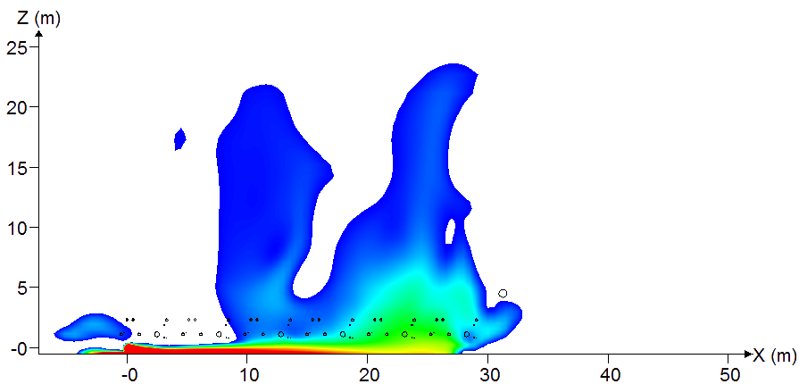
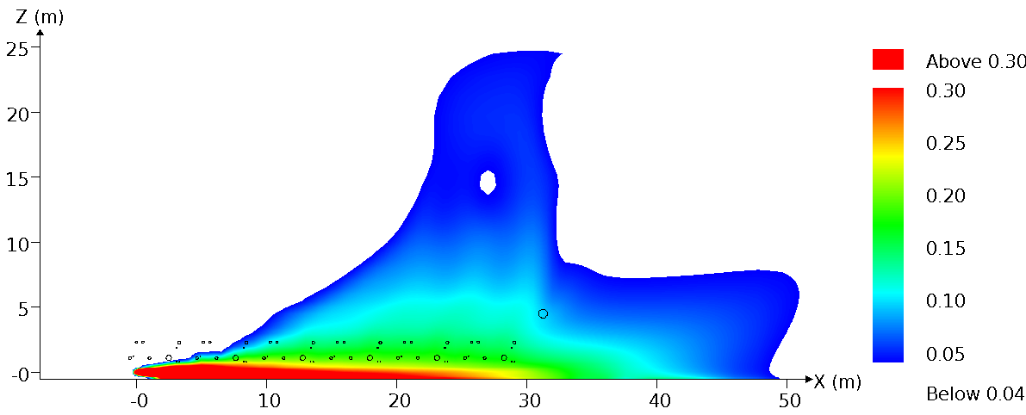
Hydrogen 4% molar concentration envelop profile d = 35 mm, no wind
2 seconds after the onset of the leak
45°
horizontal
20 seconds after the onset of the leak
45°
horizontal
Notes:
Here are dispersion results for windless scenarios
In this scenario, the leak diameter is 35 mm
2 seconds and 20 seconds release are presented
These figures show the hydrogen molar concentration envelop profile (up to 30% in red) of the lower flammability limit contour (4% in blue) along the jet direction
Notice how the cloud of the horizontal releases cover a greater part of the congested area than the 45 degree releases
When igniting, the overpressure will be much higher for the horizontal cases, even though the same amount of hydrogen was release in the domain

Slide 10
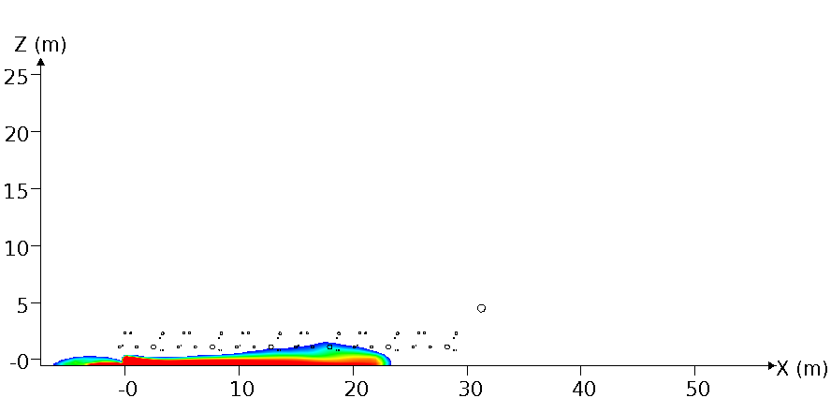
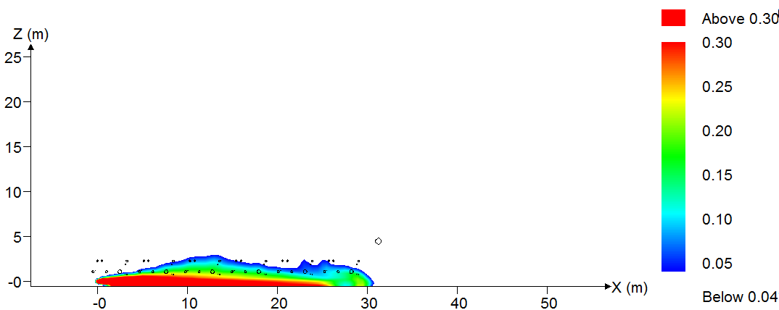
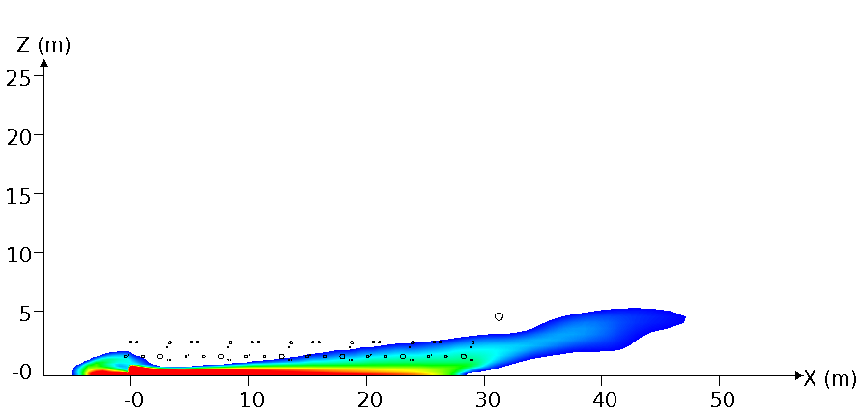
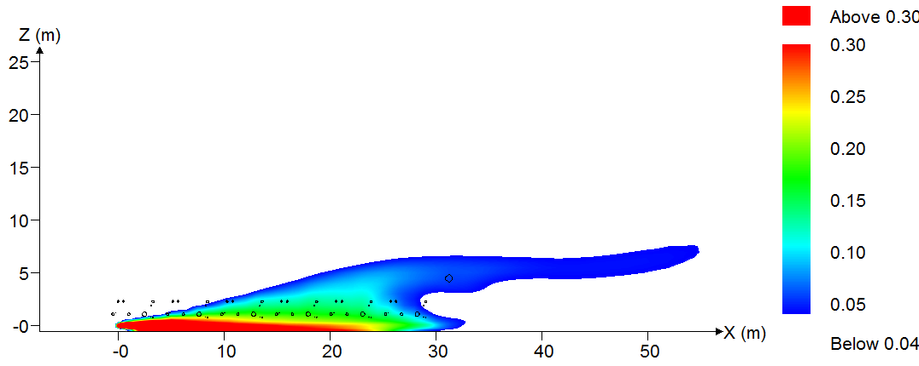
Hydrogen 4% molar concentration envelop profile
d = 35 mm, Wind 5 m/s Pasquill D
2 seconds after the onset of the leak
45°
horizontal
20 seconds after the onset of the leak
45°
horizontal
Notes:
Now let’s add some wind
Same scenario, but this time with a 5 m/s sec wind going along the jet
Notice how the wind does not influence significantly the shape of higher concentrations contours (red zones near the ground), especially for the 2 seconds release
On the other hand, the lower concentrations contours are greatly affected by the wind: they extend horizontally instead of dispersing upwardly

Slide 11
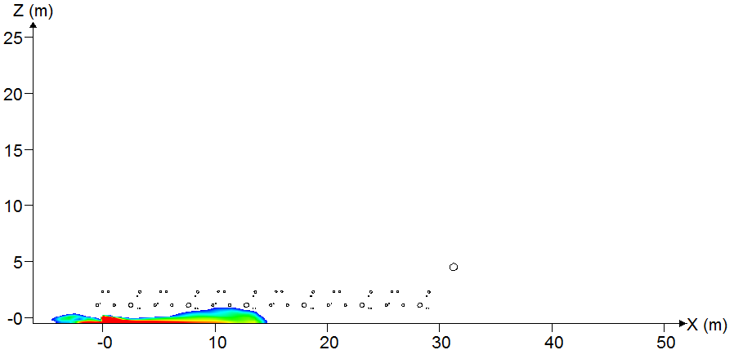
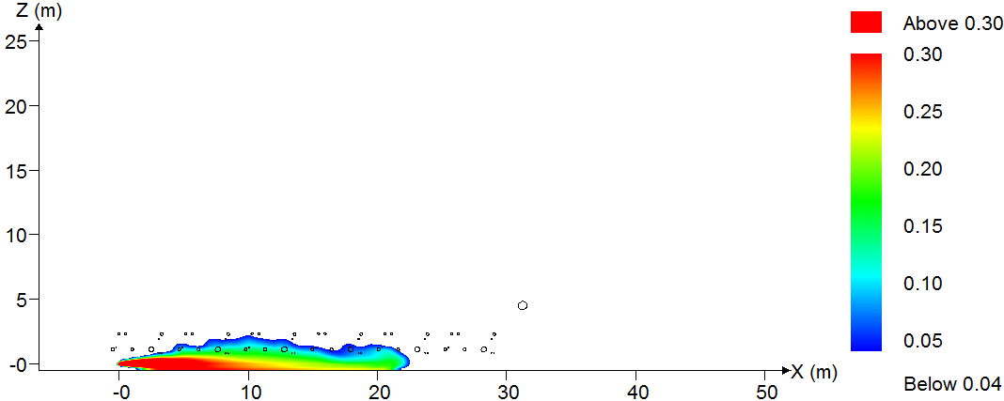
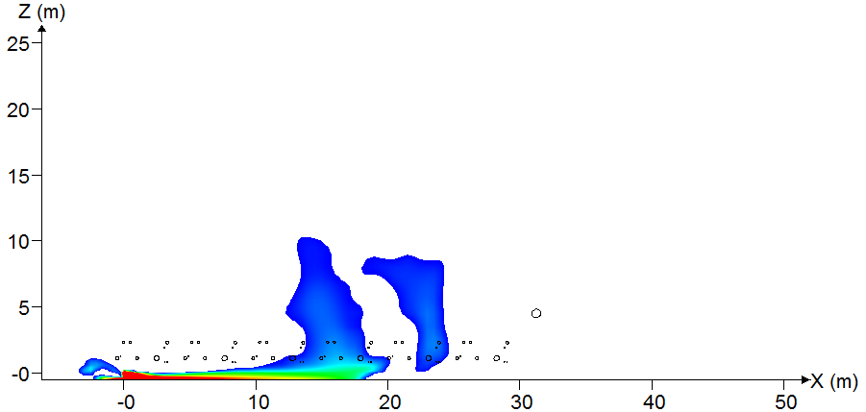
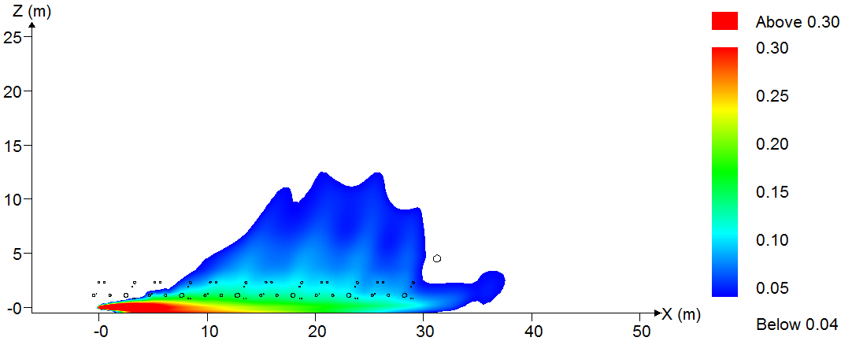
Hydrogen 4% molar concentration envelop profile d = 20 mm, no wind
2 seconds after the onset of the leak
45°
horizontal
20 seconds after the onset of the leak
45°
horizontal
Notes:
Now if we look at the 20 mm diameter release
Notice how small the higher concentration contour are compared to those of the 35 mm release
That’s to be expected since the leak rate is 3 times smaller
The resulting overpressure will be much smaller too

Slide 12
Maximum Overpressure, d = 35 mm
(ignition time = 2 sec and 20 sec)
Notes:
Let’s ignite
These graphs shows combustion results for the 35 mm release
The overpressure measured on the monitor points and in the entire domain are shown for 2 seconds and 20 seconds releases
The monitor points maximum overpressures shown here were measured at 5 m or 10 m away from the leak orifice
The maximum overpressure varies from 0.28 bar up to 2.05 bar depending on the jet orientation, wind strength and ignition delay
Notice how the maximum overpressures were 5 to 6 times more powerful for horizontal jets than for the 45˚ jets
That’s because, compared with the 45˚ jets, the horizontal release covers a greater part of the congested area which accelerates the flame
Also Notice how overpressures measured on monitor points are smaller then those measured in the domain ?
The overpressure measured in the domain capture every localised reflection, even if they appear only for a fraction of a millisecond
The monitor points on the other hand are in mid air or on the ground, away from any corners where multiple reflection can occur

Slide 13
Maximum Overpressure, d = 20 mm
(ignition time = 2 sec and 20 sec)
Notes:
Looking at the 20 mm release we see that the maximum overpressure on the monitor points are 2 times more powerful for horizontal jets than for 45˚ jets
The maximum overpressures on monitor points were all measured on the ground 5 m away from the leak orifice
An average maximum overpressure of 0.20 bar was obtained for most scenarios with a 20 mm diameter

Slide 14
Maximum travel distance of 50 mbar, 140 mbar and 200 mbar overpressure fronts measured from the origin of the leak
Notes:
These two graphs shows the travel distance of 50 mbar, 140 mbar and 200 mbar overpressure fronts measured from the origin of the leak
Again the horizontal release ends up being the most dangerous, generating the farther reaching overpressure fronts
In the worst case, a 50 mbar pressure wave travelled up to 40 m in the direction of the leak and 26 m perpendicular to it
35NW45°C2 means the leak diameter is 35 mm, there is No Wind, the jet direction is set 45° toward the ground, it is a Combustion simulation and the time to ignition is set at 2 sec after the leak onset

Slide 15
Maximum overpressure and hydrogen mass at stoichiometric concentration (28-32%) as a function of time to ignition d = 35 mm, no wind, 45°
Notes:
As I mentioned previously, we also investigated the effect of varying the ignition time on the overpressures
To do so, for the same scenario, the ignition delay was varied from 0.5 sec to 60 sec
This graph shows both the maximum overpressure and the hydrogen mass at stoichiometric concentration extracted from the 28-32% interval
Notice the overpressure peak at 2 seconds and 20 seconds
As shown in previous results, lower ignition delay resulted in higher overall overpressures
Experimental findings from Takeno et. al. and Royle et. al. showed the same phenomenon
Note also that the peak in hydrogen mass at 2 sec and at 20 sec follows the same trend as the maximum overpressure
A possible explanation is that while the total amount of flammable fuel is lower at 2 sec (~3 kg) than at 20 sec (~14 kg), the hydrogen mass at stoichiometric concentration is higher at 2 sec (0.21 kg) than at 20 sec (0.15 kg)
(It should be noted that we could not extract from FLACS the hydrogen mass at stoechiometric concentration. We can only extract mass values from concentration intervals. However, an approximate of the stoechiometric mass of hydrogen extracted from the interval 28-32% (vol.) was plotted in this figure as a function of time to ignition. Overpressure and hydrogen mass at stoechiometric concentration peaks are observed at 2 sec and 20 sec.)

Slide 16
Flammable mass of hydrogen between mole fraction intervals of 4-75% (vol.) and 11-75% (vol.) as a function of time to ignition d = 35 mm, no wind, 45°
Notes:
On this graph we show the flammable mass of hydrogen at two concentrations intervals: 4-75% and 11-75%.
The 11 – 75% interval is useful because it corresponds to the hydrogen concentrations for which there is a strong flame acceleration (this was observed by Dorofeev [8])
For both intervals, the flammable mass reaches a maximum at 20 sec
Also shown, is FLACS Q9 parameter which estimate an equivalent stoichiometric gas cloud with comparable explosion consequences as the size of the flammable gas cloud
As you can see, FLACS equivalence follows the same pattern as the 11-75% interval
The size of the equivalent stoichiometric cloud at the time of ignition is calculated as the amount of gas in the flammable range, weighted by the concentration dependency of the flame speed and expansion. For a scenario of high confinement, or a scenario where very high flame speeds (faster than speed of sound in cold air) are expected (either large clouds or very congested situations), only expansion based weighting is used. For scenario of low confinement lower flame speeds are expected and a weighting of reactivity and expansion is used.

Slide 17
Future perspective
Comparing results with traditional non-CFD methods
Notes:
As for future work on this project, it would be interesting to compare these results to some traditional non-CFD methods
FLACS validation on tests on H₂ jet explosions with obstacles

Slide 18
Questions ?

Slide 19
Thank you!

Slide 20
Grid sensitivity
 | Max overpressure in domain (barg) |  | Max overpressure on monitor points (barg)
 | T_{ign} = 2 sec | T_{ign} = 20 sec | T_{ign} = 2 sec | T_{ign} = 20 sec
Coarser grid (0.50 m) | 0.332 | 0.280 | 0.230 | 0.191
Refined grid (0.20 m) | 0.318 | 0.349 | 0.227 | 0.190
difference | -4% | 25% | -1% | -1%
Notes:
Combustion grid dependency studies were done for the windless case scenario with 35 mm leak diameter directed 45° toward the ground at 2 seconds and 20 seconds, by setting the size of the central region cells encompassing the PSA to 0.2 m.
Gexcon recommend that the reactive flammable cloud be resolved with a minimum of 10 grid cells in the direction where the cloud meets confinement. Due to our choice of using the same grid for all the combustion simulations, this rule was broken in the cases where the ignition time was lower.
The overpressure measured in the domain capture every localised reflection, even if they appear only for a fraction of a millisecond
The monitor points on the other hand are in mid air or on the ground, away from any corners where multiple reflection can occur

Slide 21
Grid sensitivity (overpressure)
Notes:
Ignition position moved inside the 30% concentration envelope
Average difference for overpressure measure in the domain: 7 %
Average difference for overpressure measure on monitor points: -11%
Same Ignition position between 0.2 m grid and 0.5 m grid
Average difference for overpressure measure in the domain: 10%
Average difference for overpressure measure on monitor points: -14%

Slide 22
Grid sensitivity (what was done)
Dispersion
  PSA zone cell size: 0.5m compared to 0.25m
  Without any geometry: no PSA
Combustion
  Various boundaries, with and without WIND (Plane_Wave, Euler, Nozzle)
  More precise domain (0.25, 0.2 m, 0.1 m)
  Without any geometry: no PSA
  Varied ignition position based on concentration contours (15%, 45%, 60%)

Slide 23
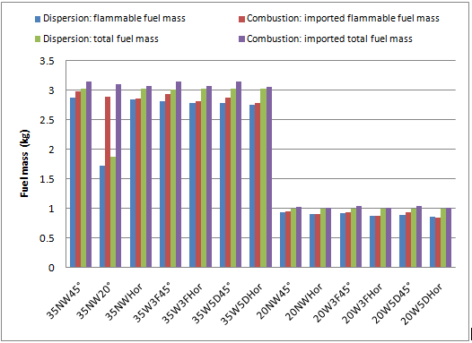
Grid sensitivity (fuel mass)
Notes:
- This figure show a comparison between the simulated fuel mass and the imported fuel mass at 2 sec. he flammable mass is calculated between the lower flammability limit (LFL) and upper flammability limit (UFL).
- In FLACS by default, for hydrogen, the LFL is 4% and the UFL is 80.7%.

Slide 24
Mass histogram prior to ignition d = 35 mm, no wind, 45°
Simulation time: 2 seconds
Simulation time: 20 seconds
Notes:
- These graphs shows the mass taken from the combustion grid for the 35NW45° scenario at 2 sec and 20 sec.
- Flammable mass at 2 sec release time is lower (near 3 kg) than at 20sec (near 12kg). However, the flammable cloud is more concentrated in hydrogen at 2 sec compared to 20 sec and is then more reactive.

