Slide 1
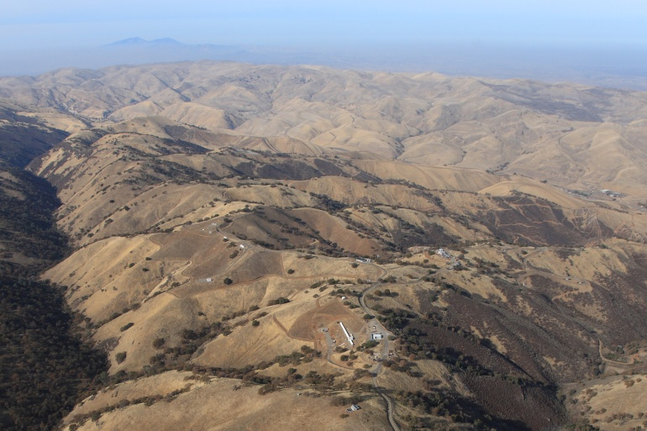
Experimental Investigation of Hydrogen Release and Ignition from Fuel Cell Powered Forklifts in Enclosed Spaces
Isaac W. Ekoto , William G. Houf, and Greg H. Evans
Sandia National Laboratories
Erik G. Merilo and Mark A. Groethe
SRI International
Funding provided by:
Antonio Ruiz
Fuel Cell Technologies Program,
Codes and Standards Program Element
U.S. Department of Energy
Corral Hollow Experiment Site(CHES)
ICHS 2011 – San Francisco

Slide 2
Fuel cell powered industrial trucks have gained rapid acceptance in the material handling sector.
Advantages
Captured fleets w/ 24/7 operation
Central fuel storage w/ multiple refueling sites
Fast refills and long run-times
Robust refrigeration operation
Roughly 2% of the ~600,000 US warehouses are refrigerated
EIA, Commercial Buildings Energy Consumption Survey, 1999.
DoD/DOE Funded Fuel Cell Units in Operation
13 separate sites
http://www.nrel.gov/hydrogen/proj_fc_market_demo.html#cdp, Feb 2011.
New Operational Considerations
Complex leak detection
Radiation/overpressure hazards from unintended releases
Complex regulatory authority (harmonization of NFPA and ICC codes needed)

Slide 3
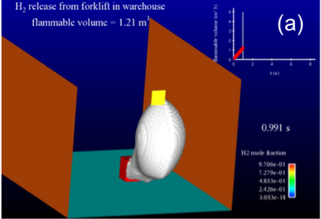
Project Goal: Develop analytic tools to assess unintended release scenario consequences during H₂ indoor refueling.
Experimental datasets needed to validate predictive simulations over various physical boundary conditions such as:
Release rate & total amount
Room volume & occupancy
Structural features
Ignition location
Mitigation and safety features
Validated models will augment quantitative risk assessment (QRA) efforts by providing inexpensive, yet reliable predictive tools.

Slide 4
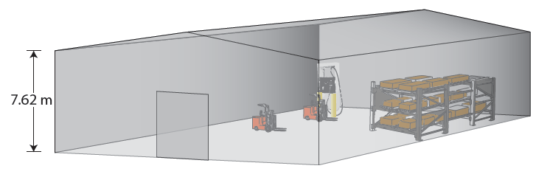
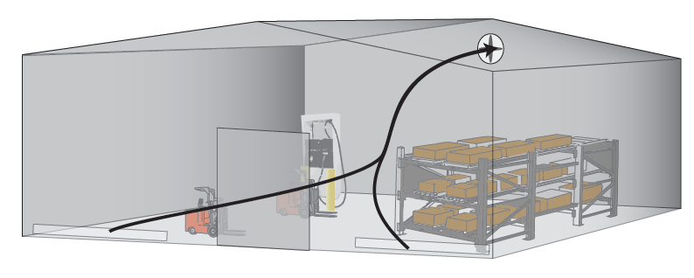
NFPA 52 Vehicular Gaseous Fuel Systems Code (2010) used to specify warehouse geometry.
Selected room volume
Max Fuel Quantity per Dispensing Event [kg] | Min Room Volume [m³] (ft³)
Up to 0.8 | 1,000 (35,315)
0.8 to 3.7 | 2,000 (70,629)
3.7 to 5.5 | 3,000 (105,944)
5.5 to 7.3 | 4,000 (141,259)
7.3 to 9.3 | 5,000 (176,573)
Min 25’ ceiling height (7.62m) required
Room volume requirement waived if threshold active ventilation rates are met
Selected ventilation rate
“The ventilation rate shall be at least 1 ft³/min∙ft² (0.3 m³/min∙m²) of room area, but no less than 1ft³/min∙12ft³ (0.03 m³/min∙0.34m³)”

Slide 5
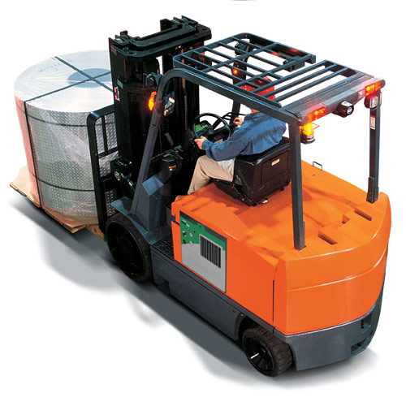
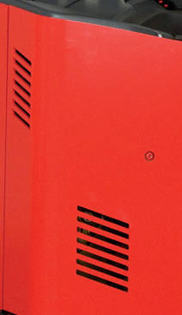
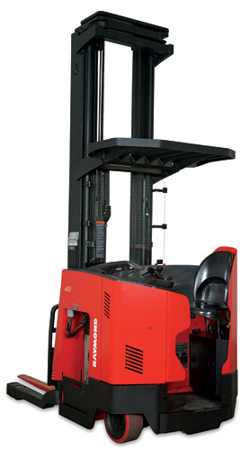
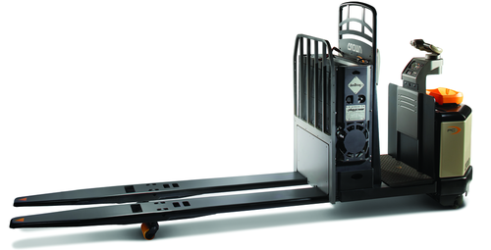
Industry supported Failure Mode and Effects Analysis (FMEA) used to identify catastrophic release scenarios.
Separate H₂ bulk storage (NFPA 55) and dispenser flow restrictors limit catastrophic refueling releases to onboard storage failures
Class I – Counterbalanced Truck
36 – 48 VDC (~10 kW continuous)
350 bar storage
1.0 – 1.8 kg onboard H₂
Class II – Reach Truck
36 VDC (~10 kW continuous)
350 bar storage
0.8 – 1.2 kg onboard H₂
Class III – Rider Pallet Jack
24 VDC (~2.5 kW continuous)
250 – 350 bar storage
0.4 – 0.8 kg onboard H₂
Medium leak selected with:
6.35 mm diameter
0.8 kg total storage
Vented release enclosure
Ignition source either near vehicle or at ceiling

Slide 6
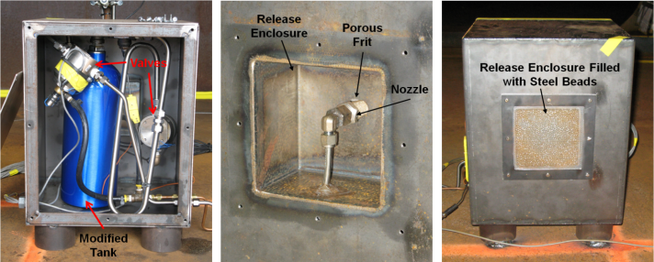
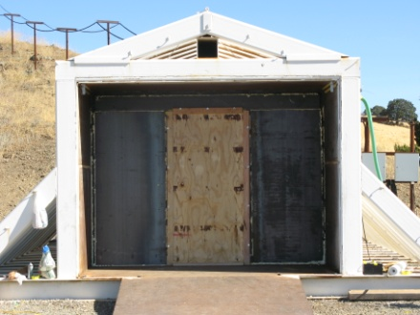
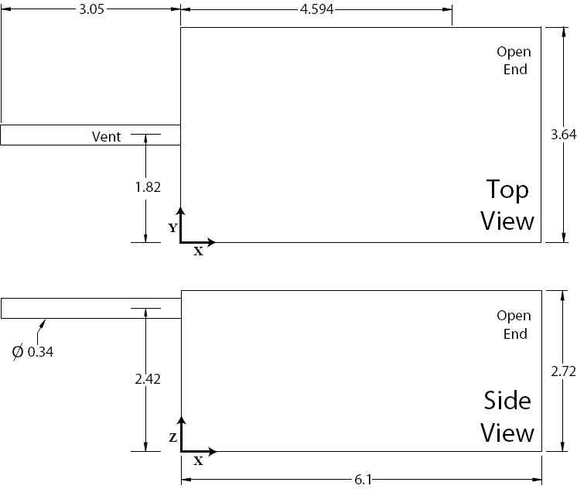
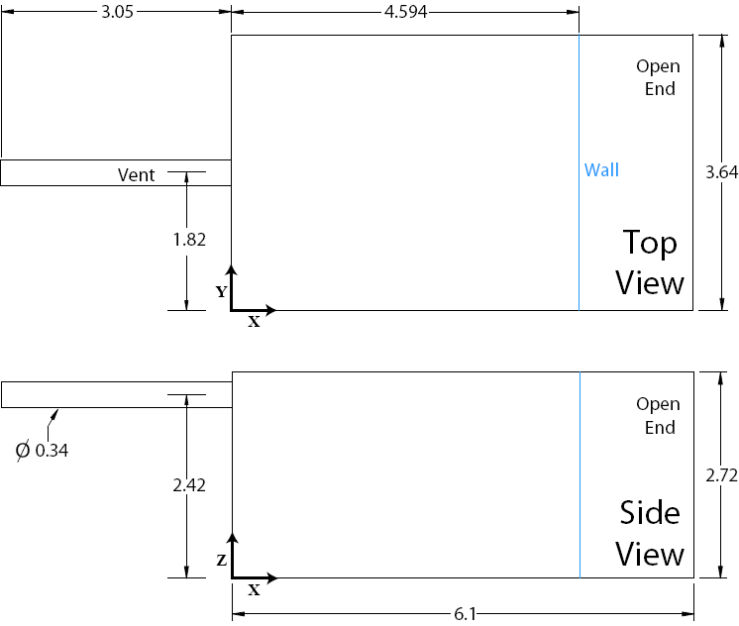
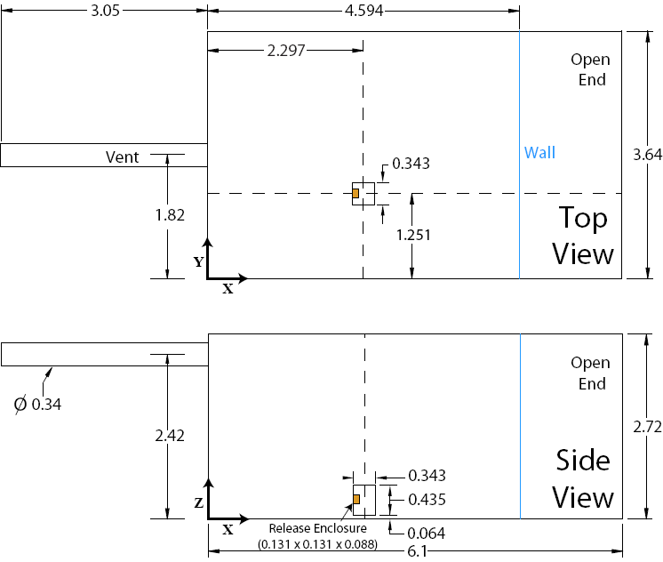
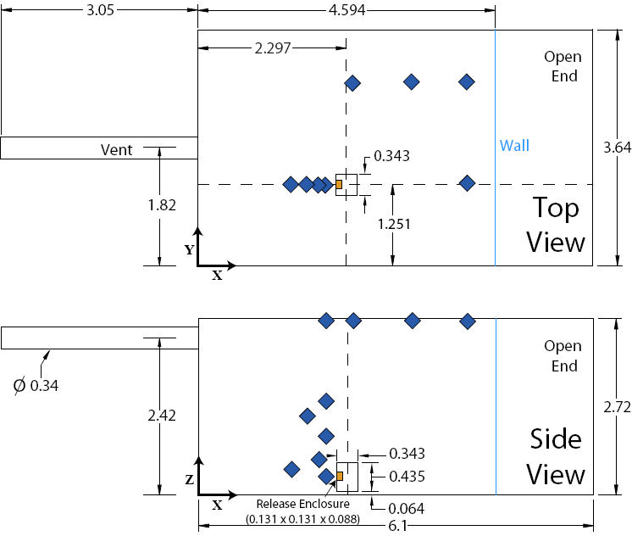
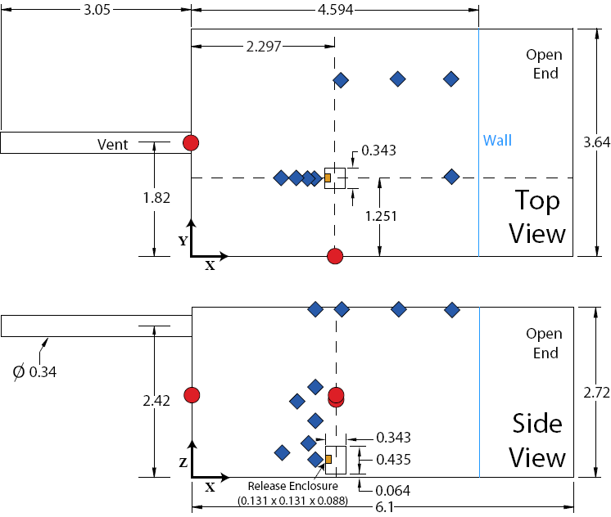
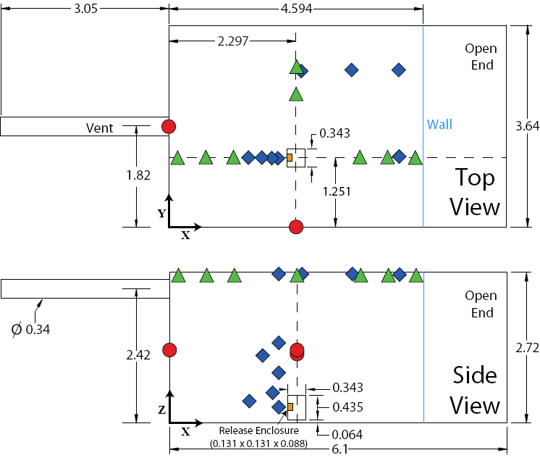
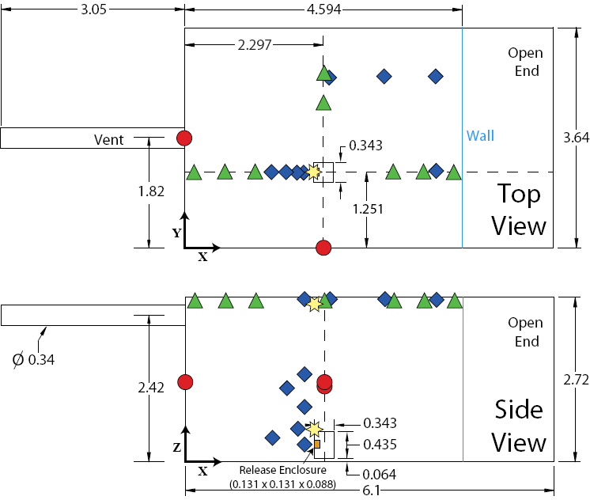
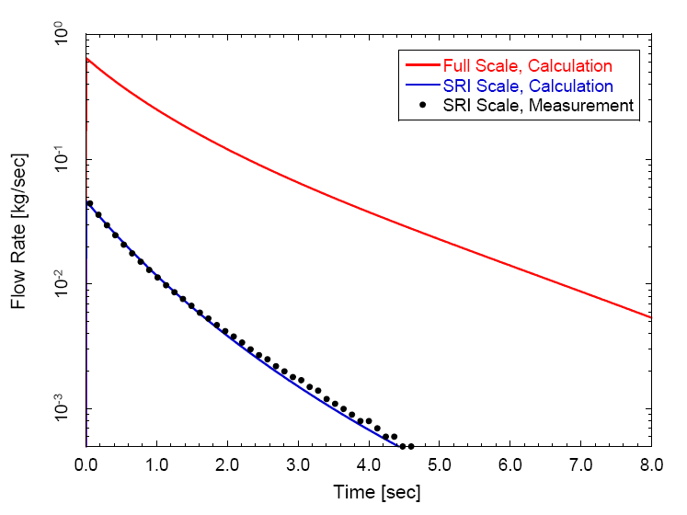
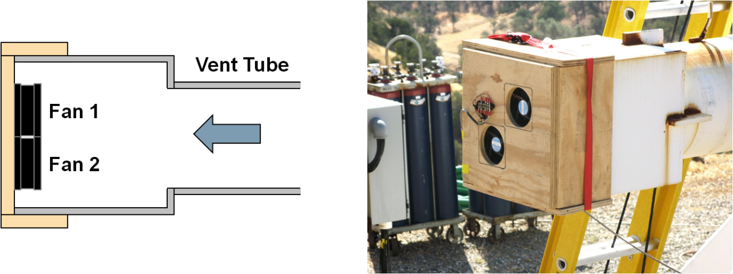
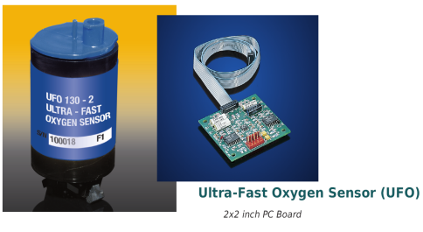
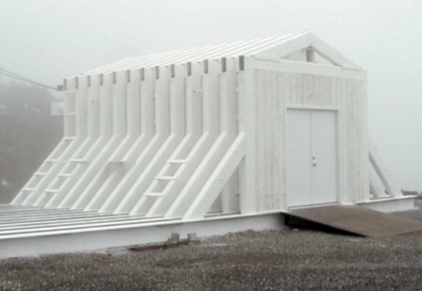
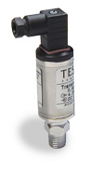
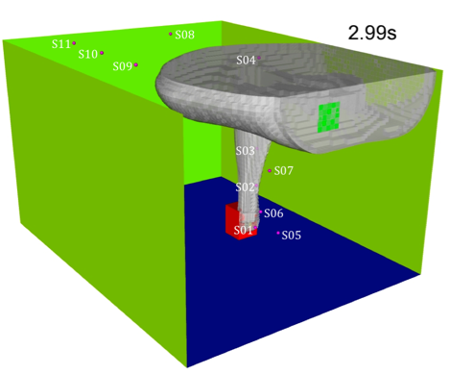
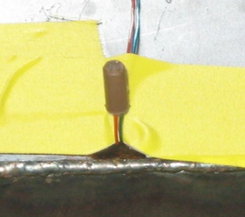
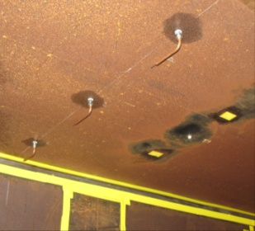
Experiments performed in a blast hardened, subscale test facility
Forklift model w/ modified release tank & enclosure
Full scale release: 0.8kg
Scaled release: 36.3g
Froude scaling is a well established method to compare flow phenomena in scaled geometries via a scale factor (SF).
Wall moved inward to preserve full scale warehouse aspect ratio w/ a 25’ high ceiling
Full scale volume: 1,000m³
Subscale volume: 45.4m³
Scale Factor: 2.8
Entrance Wall
Calibrated muffin fans produce desired active ventilation levels
Teledyne UFO 130-2
Resolution: 0.1% FS (O₂)
Response : ~ 0.1 s
SRI Corral Hallow Experiment Site
Hall DJ, Walker S, J Hazard Mater, 1997;54:89-111.
Houf WG, et al., Proc. World Hydrogen Energy Conf, 2010.
Tescom 100 series
Resolution: 0.25% FS
Response : ~ 1 ms
Bridge wire initiates ignition via a 40J capacitive discharge unit
Medtherm Type-E thermocouples measure flame speed

Slide 7
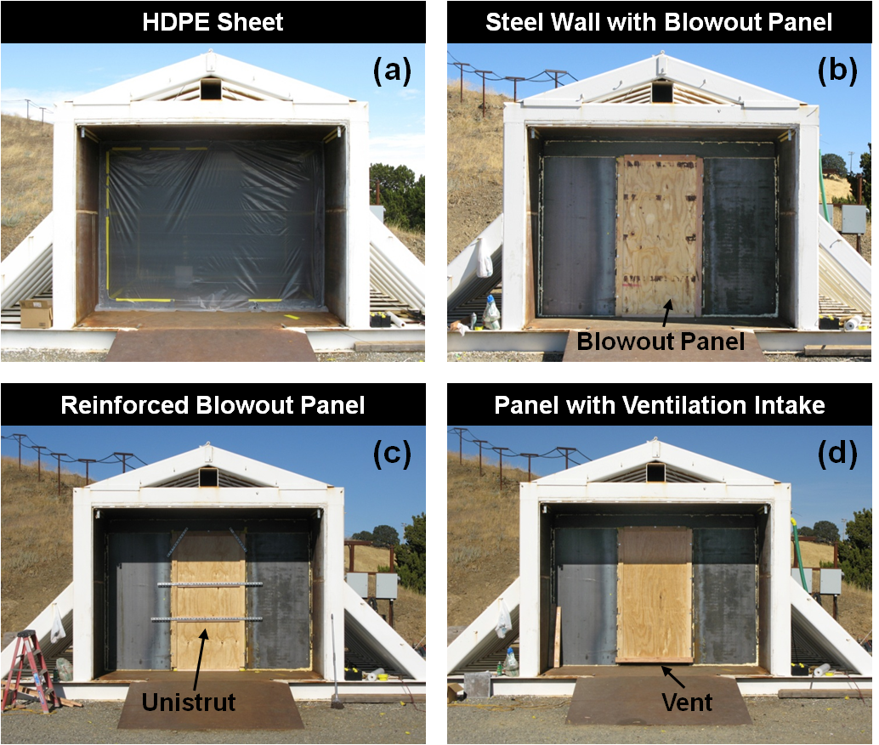
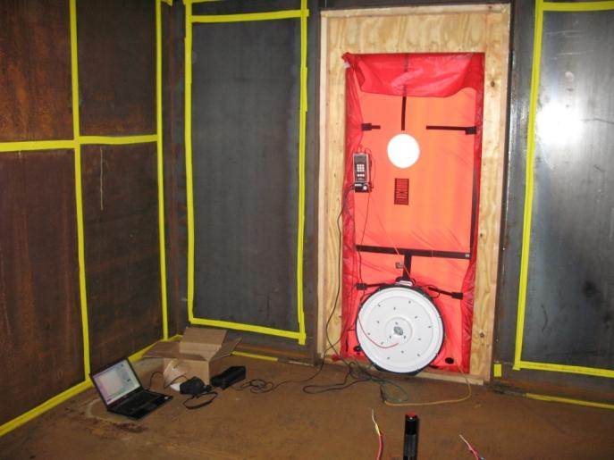
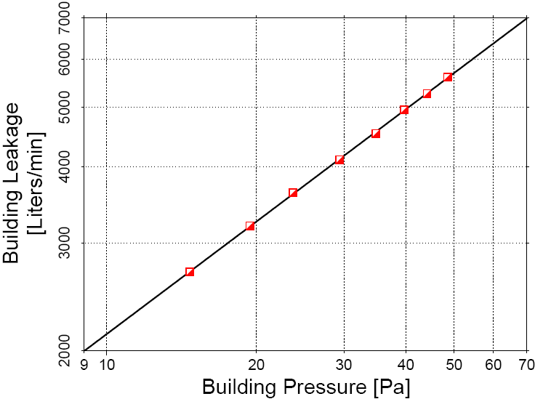
Test matrix was broken down into 3 phases:
Gas Dispersion
Flame Propagation Visualization
Overpressure Measurements
Model 3 Minneapolis Blower Door used to measure facility leakage
Different wall configurations needed for each test

Slide 8
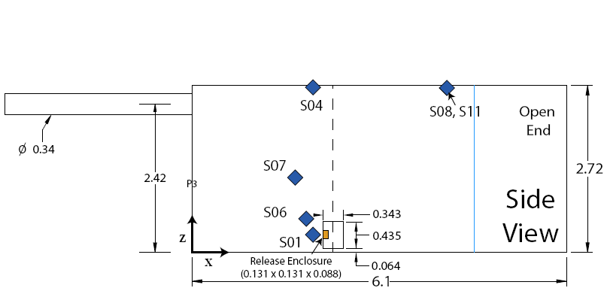
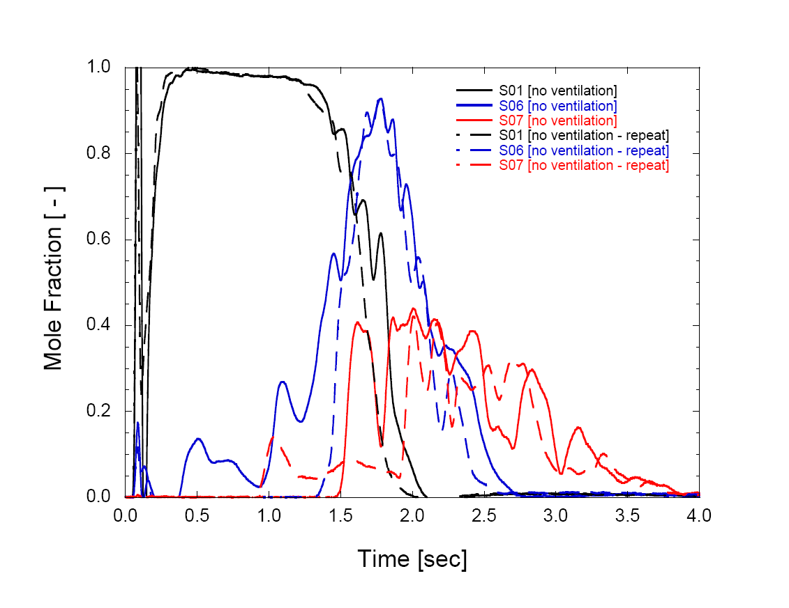
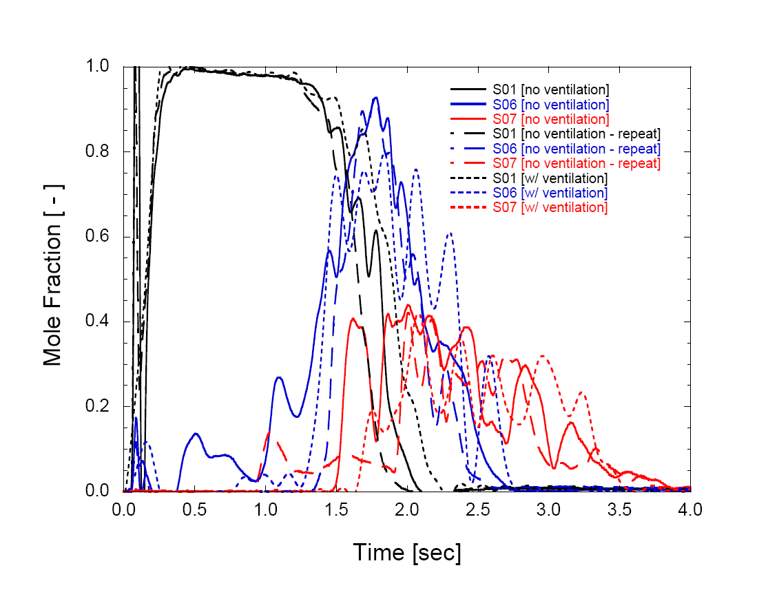
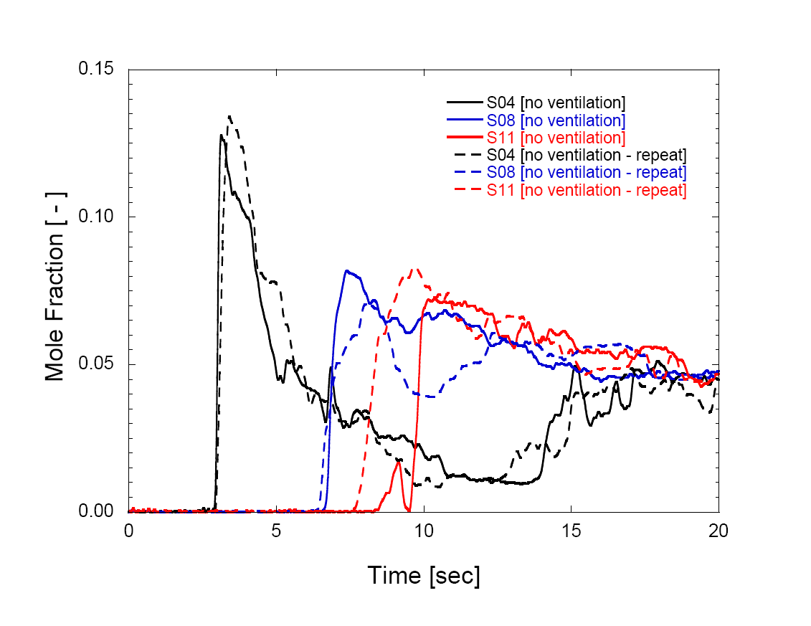
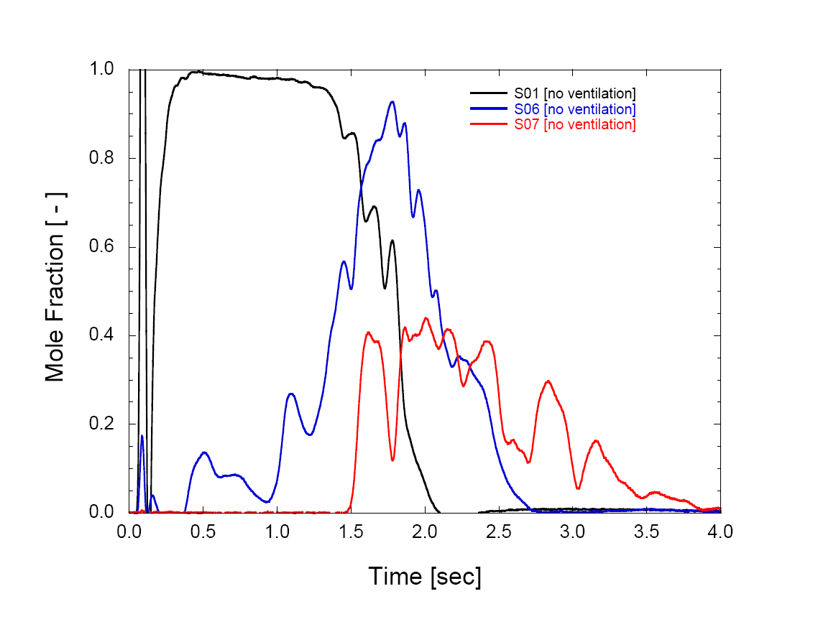
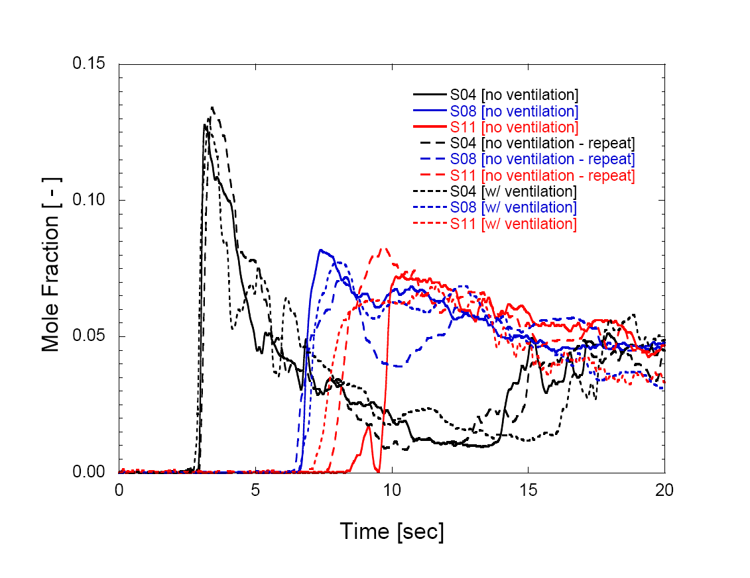
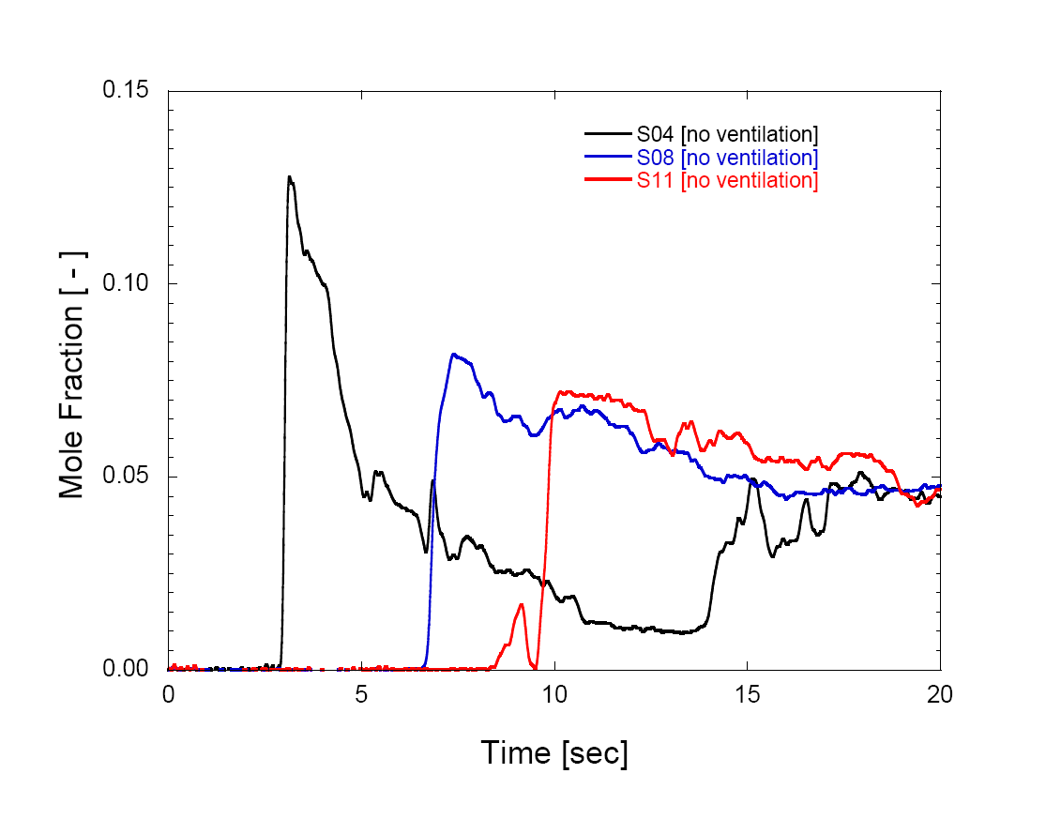
Unignited release tests used to quantify test-to-test variation and impact of active ventilation on dispersion.
Near Release Point
Along Ceiling
Release dispersion is highly repeatable and the impact of the active ventilation specified by NFPA 52 is negligible.

Slide 9
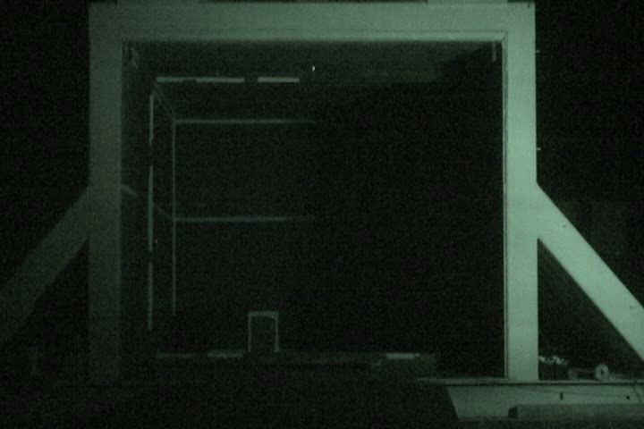
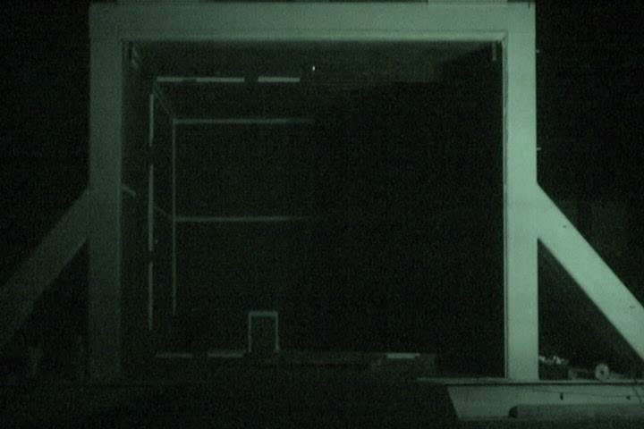
Infrared imaging was used to qualitatively highlight flame front development.
Vehicle Ignition (3.0 sec Ignition Delay)
Ceiling Ignition (3.5 sec Ignition Delay)
Concentration statistics were used to refine bridge wire location and ignition delay (spark timing relative to the release).

Slide 10
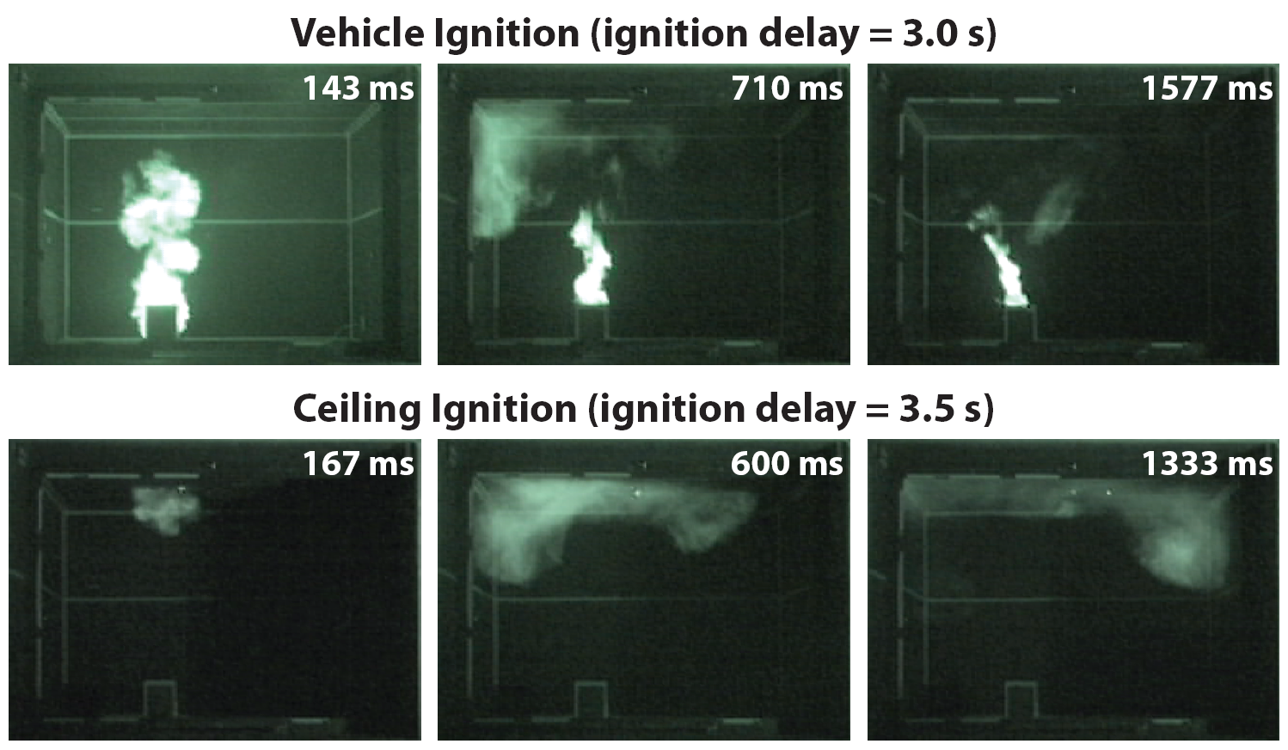
Infrared imaging was used to qualitatively highlight flame front development.
IR imaging indicates faster burning rates and more complete combustion for the scenario with near vehicle ignition.

Slide 11
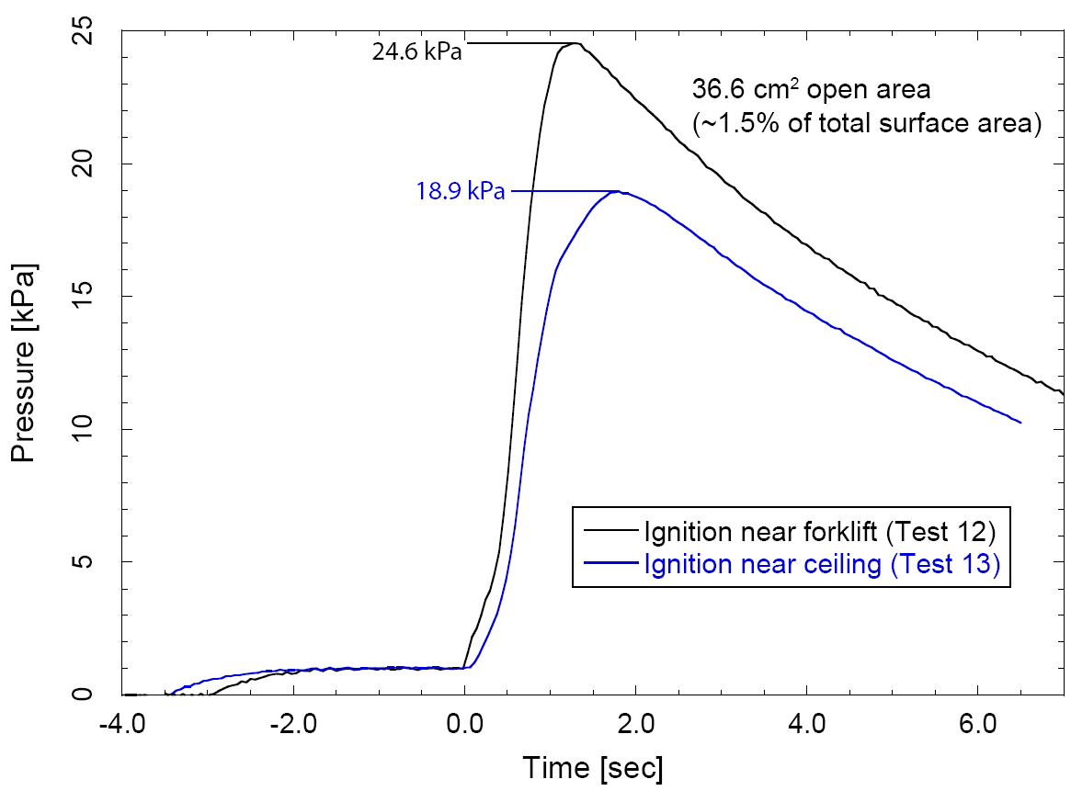
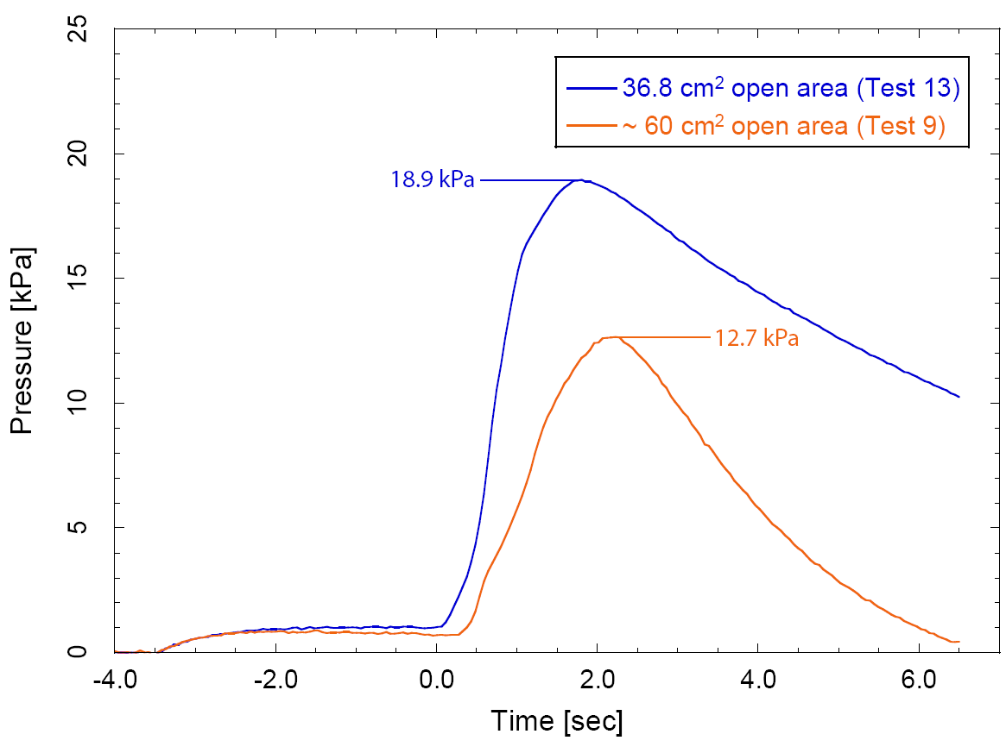
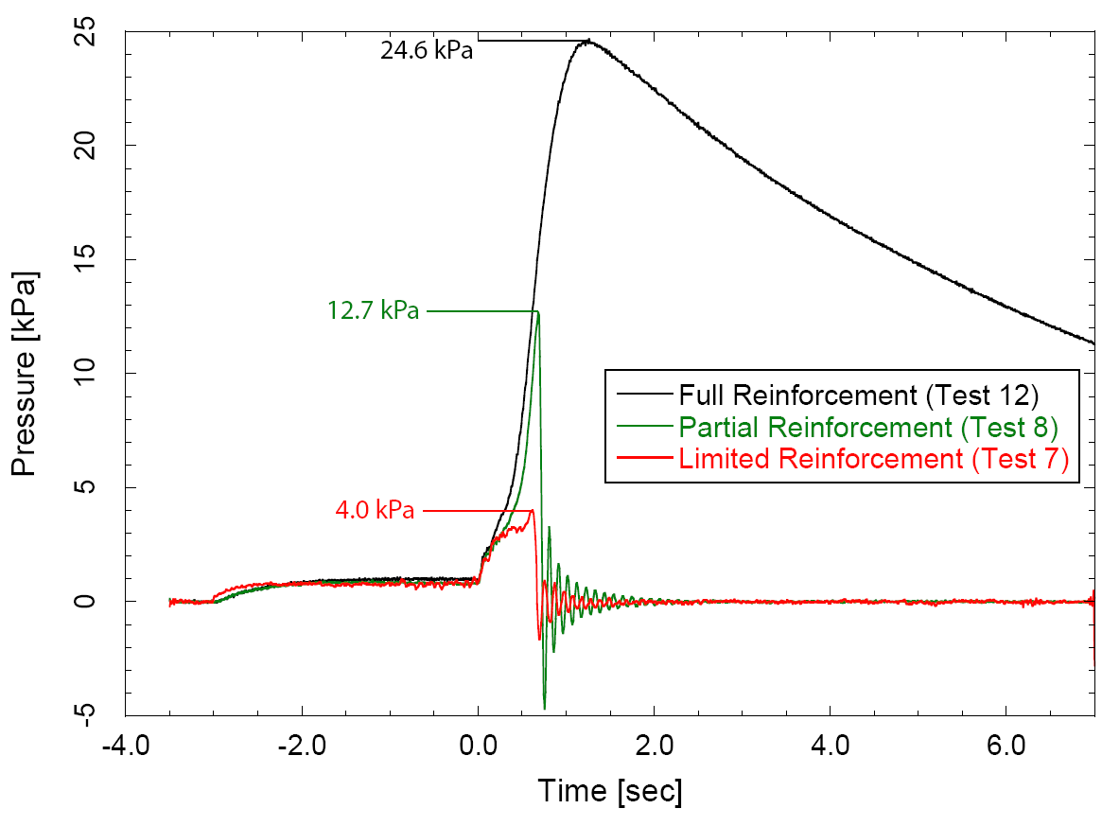
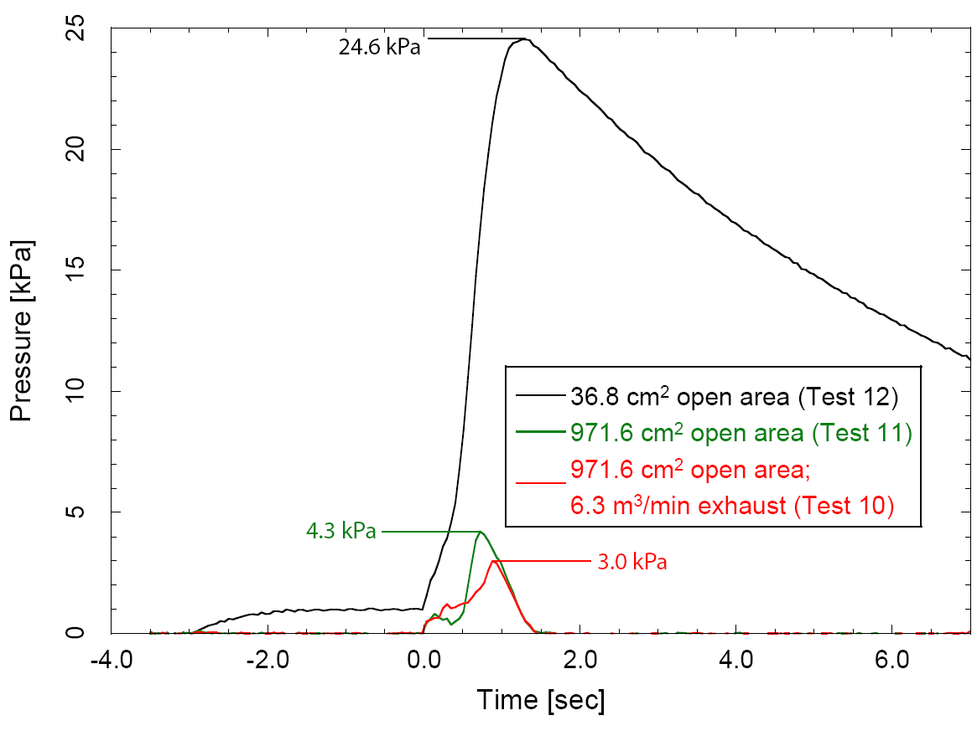
Vastly different overpressures were observed with differing ventilation rates and wall configurations.
Helmholtz pressure oscillations (9.6-Hz)
These results highlight the challenges in developing a sufficiently robust model that can adequately predict all scenarios.

Slide 12
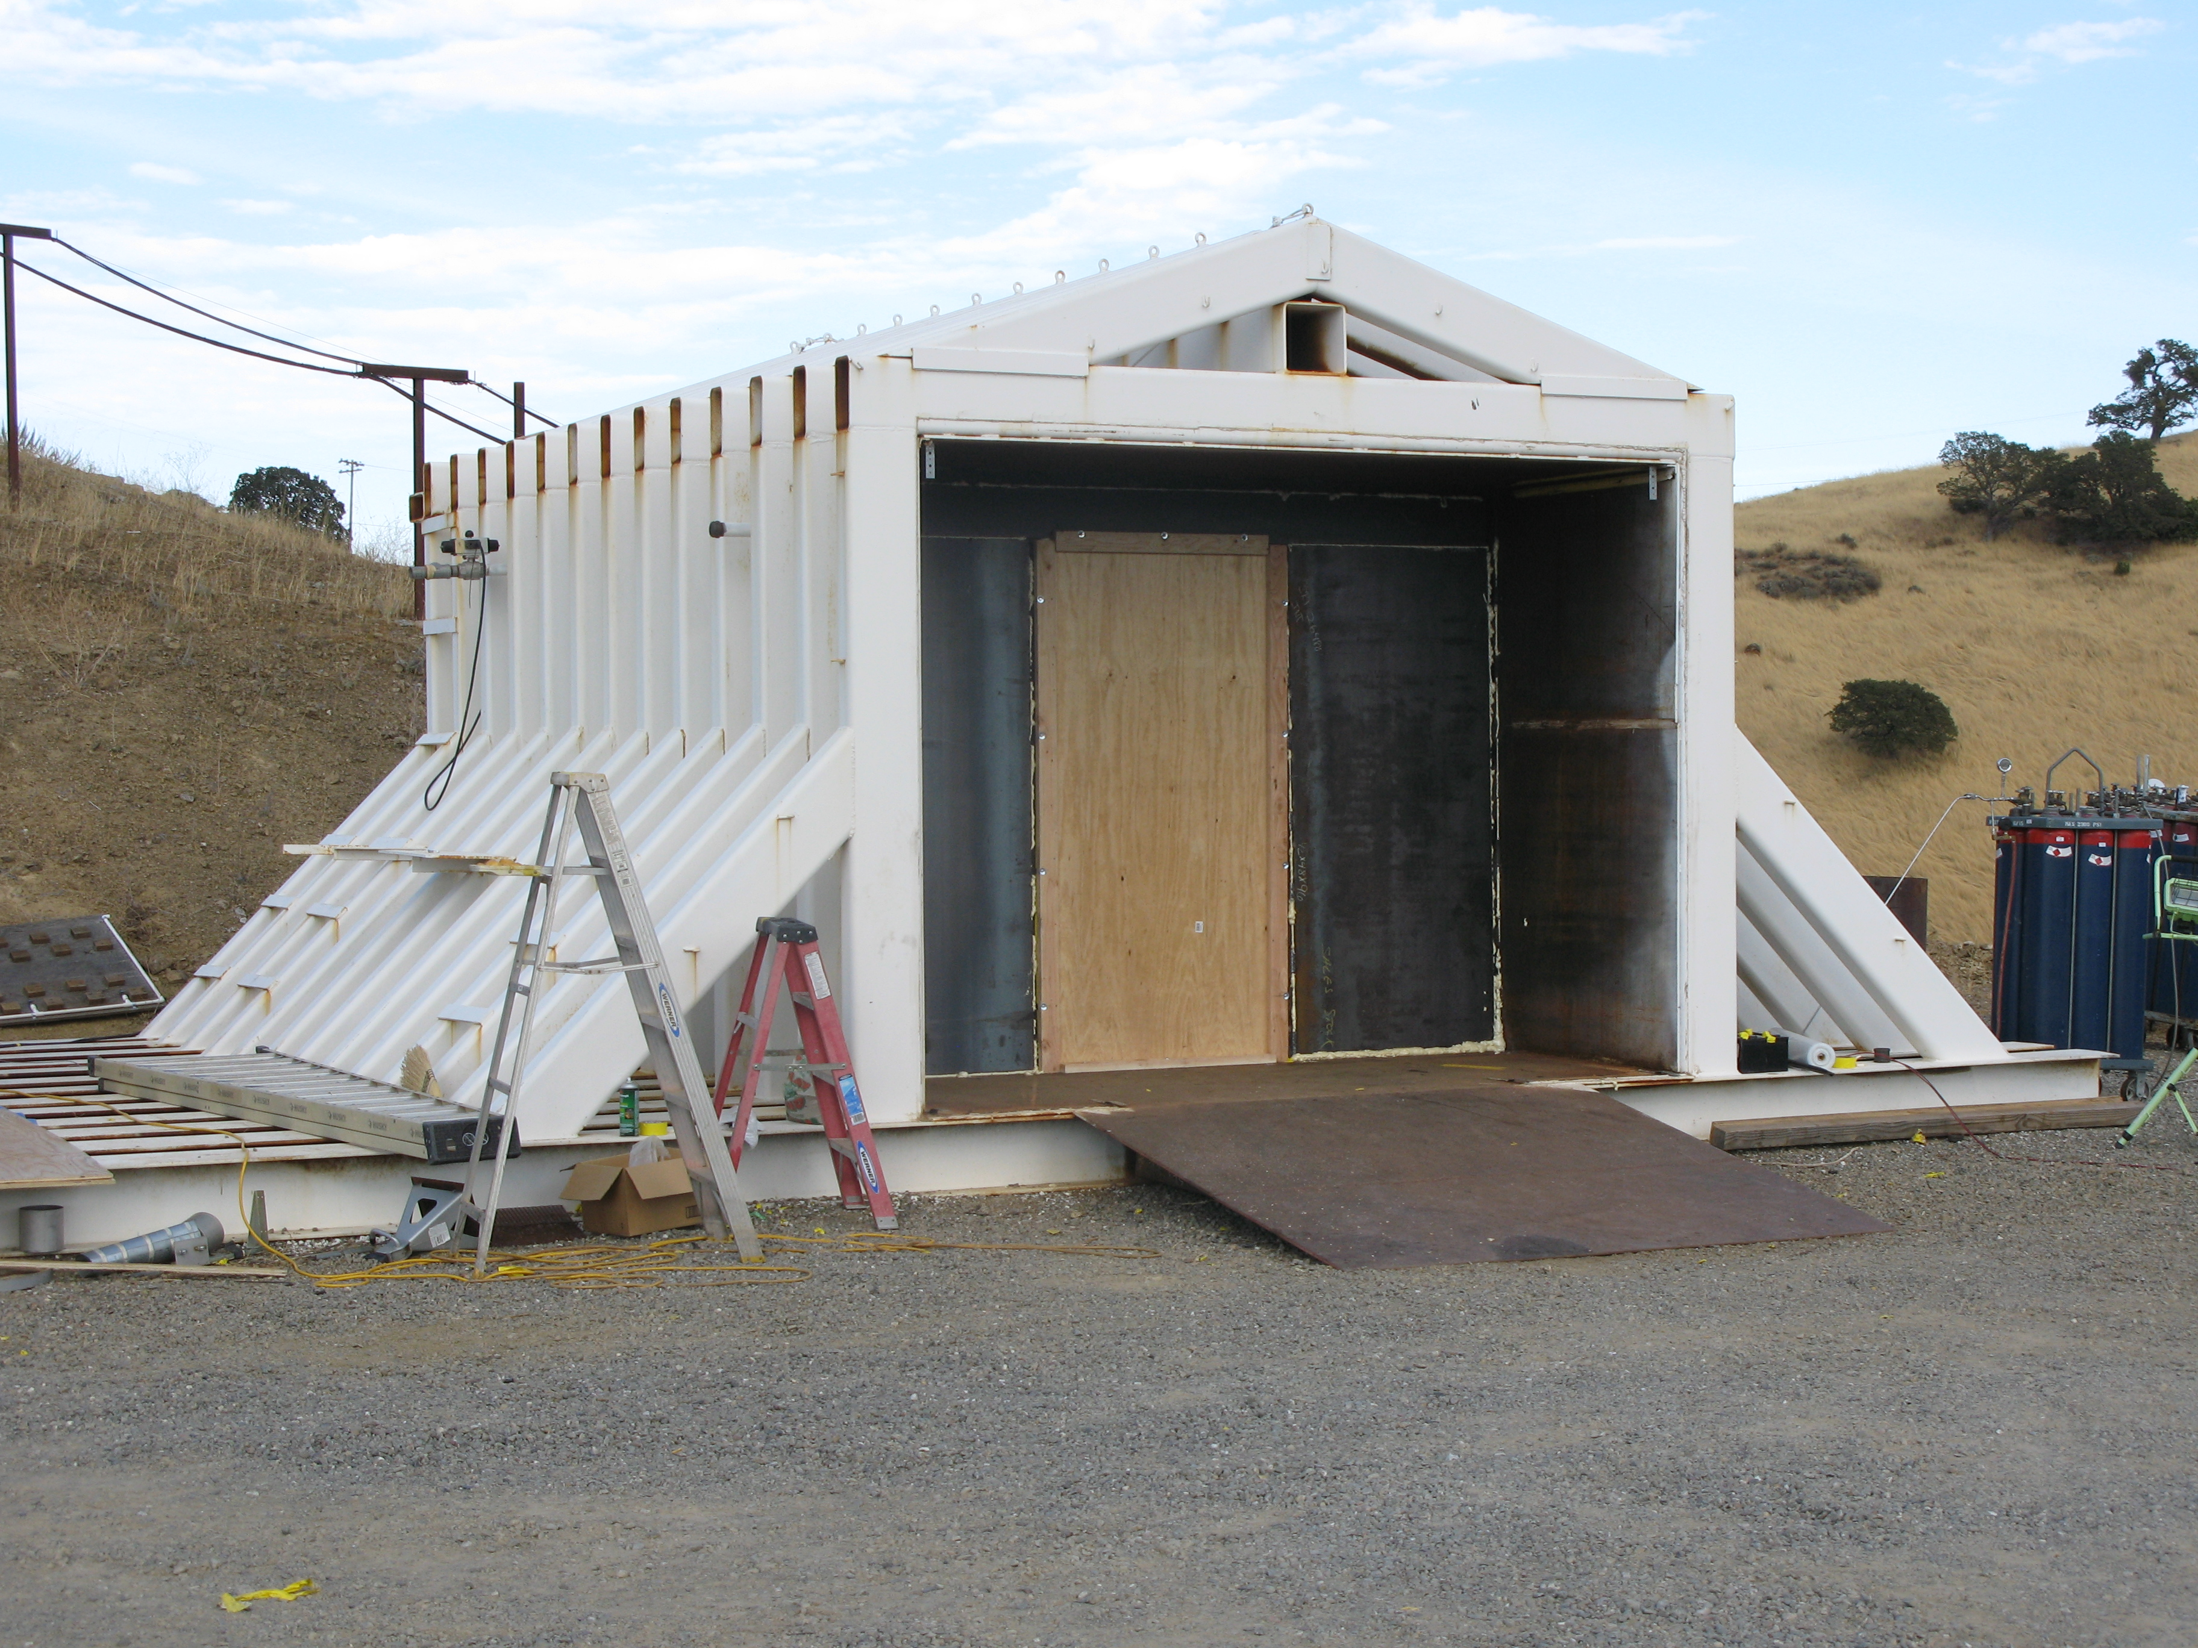
Concluding remarks:
Detailed benchmark experiments were conducted for unintended release and ignition scenarios during indoor fuel cell forklift refueling
Not meant to directly inform code language!
Dispersion results, qualitative ignition visualization, and overpressure measurements provide highly resolved model validation data sets.
Information regarding potential mitigation measures such as active/passive ventilation or blowout panels have been included.

Slide 13
Experimental Investigation of Hydrogen Release and Ignition from Fuel Cell Powered Forklifts in Enclosed Spaces
Isaac W. Ekoto, William G. Houf, and Greg H. Evans
Sandia National Laboratories
Erik G. Merilo and Mark A. Groethe
SRI International
Funding provided by:
Antonio Ruiz
Fuel Cell Technologies Program,
Codes and Standards Program Element
U.S. Department of Energy
Corral Hollow Experiment Site(CHES)
ICHS 2011 – San Francisco

Slide 14
US warehouse distribution by total floor space

