Slide 1
Estimation of Uncertainty in Risk Assessment of Hydrogen Applications
ID194_MarkertF
F. Markert, V. Krymsky, and I. Kozine
fram@man.dtu.dk
Produktionstorvet Building 426
DK-2800 Kongens Lyngby

Slide 2


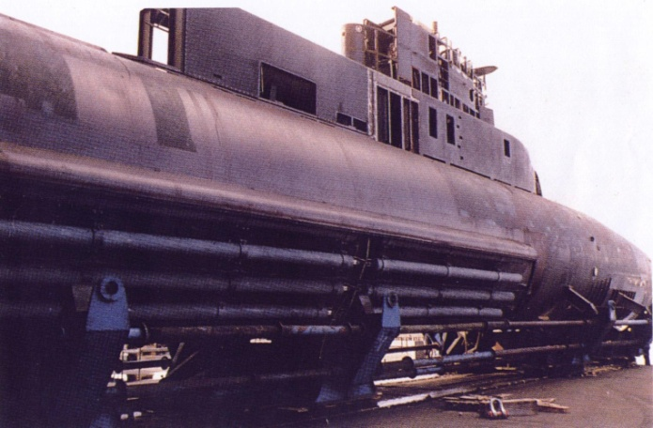
Prologue
”Improved safety comes from understanding the outcomes and probabilities of undesirable events that may occur with new technologies, and by mitigating any unacceptable risks posed by these new technologies.
In this regard, […] it is important to realize that hazards with new hydrogen technologies that are unrecognized or incompletely understood are difficult to mitigate against.”
Andrei V. Tchouvelev, 2008, White Paper Knowledge, Gaps in Hydrogen Safety,
(Joaquín MARTIN BERMEJO)

Slide 3
Risk Assessment of time & safety critical systems
1) Risk Assessment
Systems analysis
Risk Analysis
Hazard Identification
Hazard & Scenario Analysis
2) Likelihood
3) Consequences
Consider
risk-reducing
measures
4) Risk – Expected loss
5) Risk Evaluation
6) Safety Management
Risk acceptable?
No
Yes
Safe operation

Slide 4
Uncertainty treatment levels in RA
Paté-Cornell [23] identified six levels of uncertainty treatment:
Level 0: Simply procedure of hazard detection and failure modes identification
Level 1: “Worst case” approach
Level 2: “Quasi-worst cases” and plausible upper bounds
Level 3: Best estimates and central values
Level 4: Probabilistic risk assessment, single risk curve
Level 5: Probabilistic risk analysis, multiple risk curves
In RA all levels have their role
It is not always demanded to use level 4 or 5 assessments to describe the uncertainties
  in simple cases with low cost solutions a level 0 approach may be fully appropriate.

Slide 5
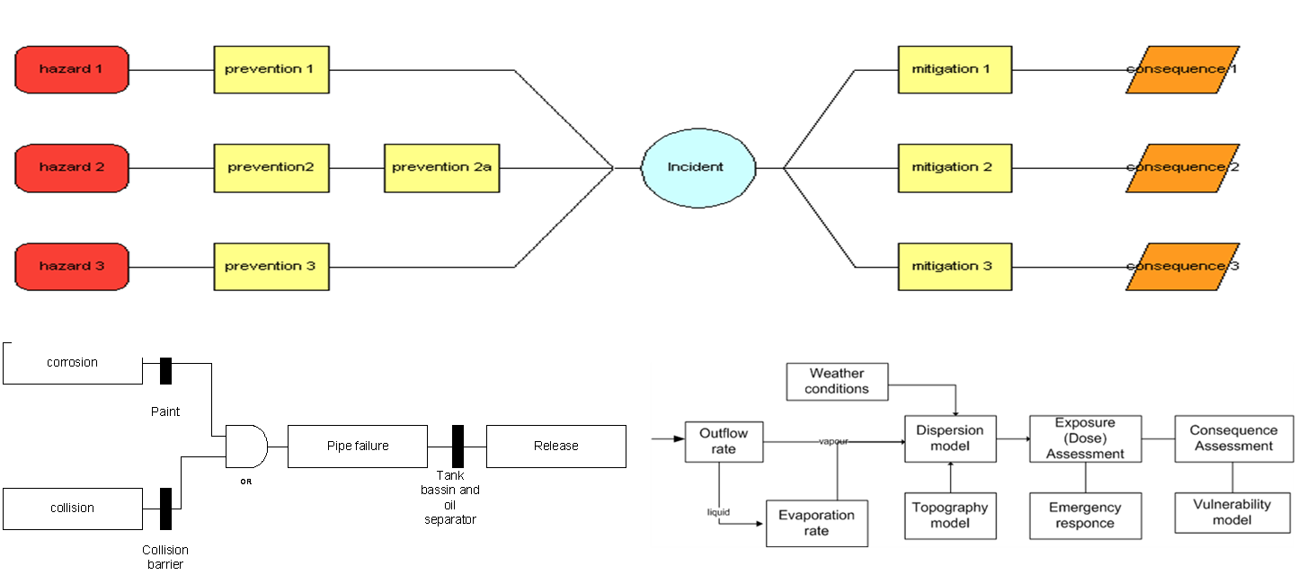
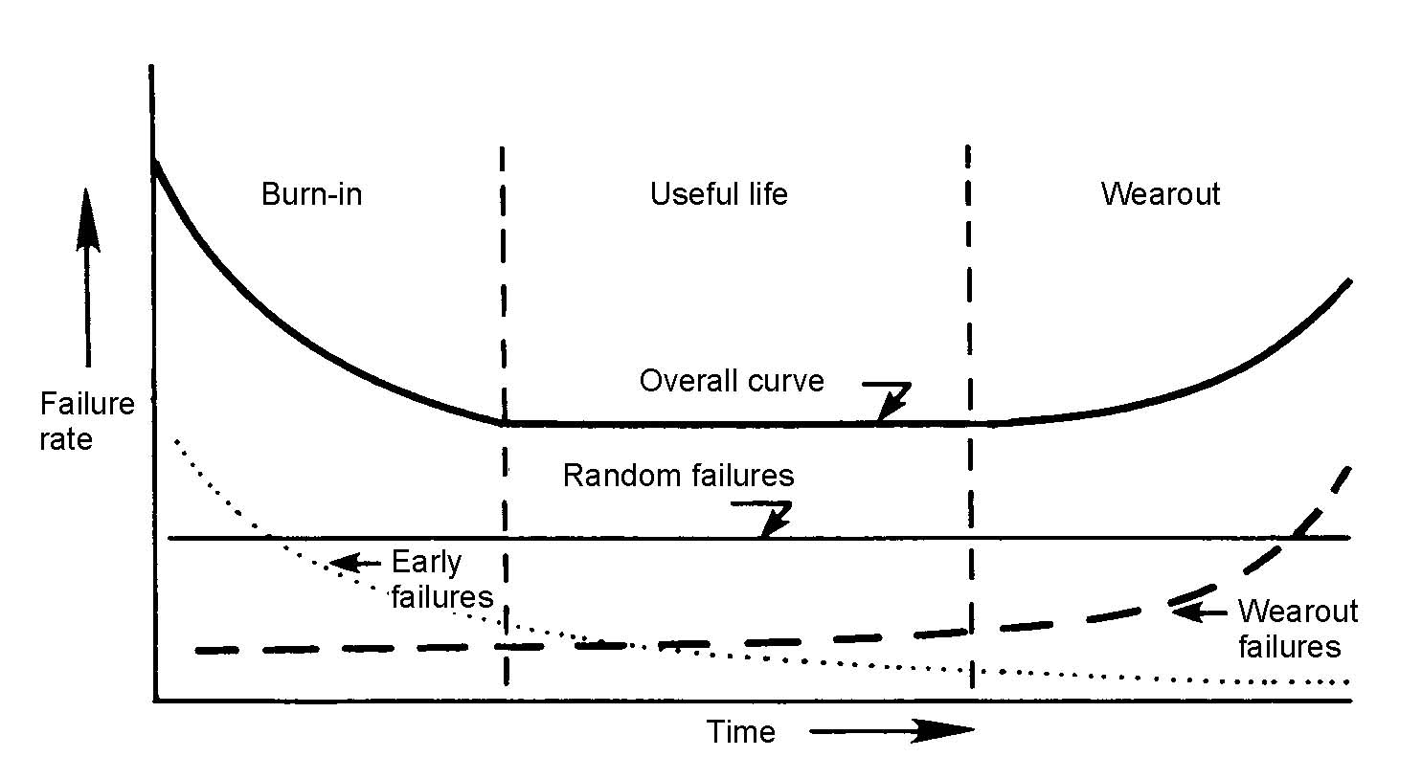
Uncertainty: Likelihood
Failure rates of Components
For the new hydrogen technologies the phases may not yet be fully estabilished -> failures due to ”known – unknowns” / ”unknowns - unknowns.” Large scale testing a.o.is needed:
To reduce the failure rate to a ”useful life” level
To find the optimal maintenance strategies to prevent ”Wearout”

Slide 6
Uncertainty: Consequence analysis

Slide 7
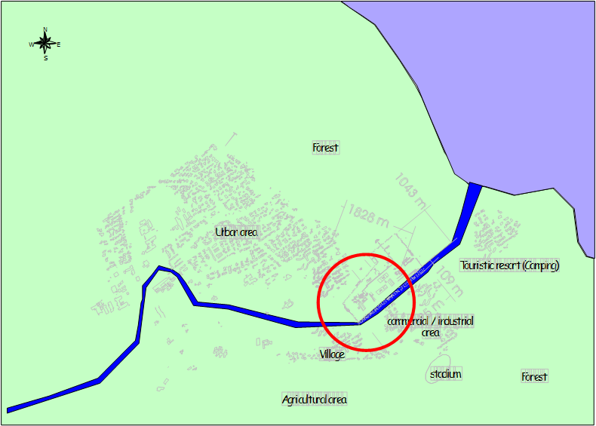
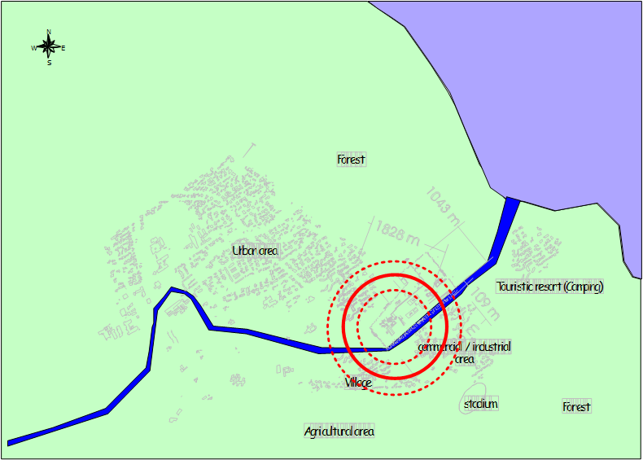
Benchmarking Individual Risks

Slide 8
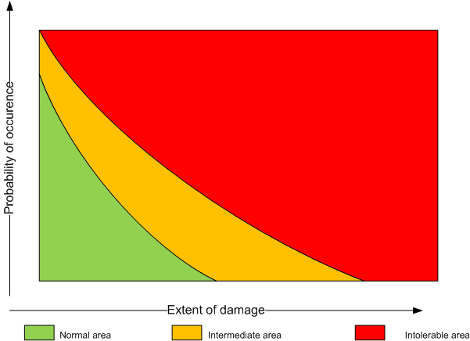
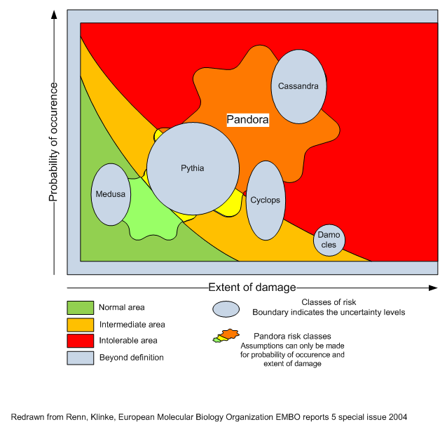
Managing risks and uncertainties
Normal practise
Consideration of uncertainties
Notes:
Explain the differnet management strategies for Medusa (well known RA aplicable, information startegy), Democles (RA approach possible) and Pandora (high uncertainty RA not possible - precautionary principle)

Slide 9
Management strategies depending on uncertainty
Damocles – RA based strategies
  sufficient technical knowledge as uncertainties rather small
Medusa – risk communication focus
  little technical uncertainty – risk perception problem
Pandora – precautionary strategies
  RA may be not applicable as cause –consequence relationships are not known, e.g. nanomaterials in food industry

Slide 10
The nature of Uncertainty
Aleatory uncertainty | Epistemic uncertainty
It describes the inherent variation associated with the physical system or the environment under consideration. | It derives from some level of ignorance, or incomplete information about the system / the surrounding environment.
Other equivalent terms:
stochastic uncertainty (variability) irreducible uncertainty inherent uncertainty | subjective uncertainty reducible uncertainty model form uncertainty
Real risk assessment problems typically present a mixture of the both types of uncertainty.

Slide 11
Estimation of Aleatory uncertainties
Aleatory uncertainties are accessible by mathematical procedures :
Characterized by probability distributions or other probability measures.
Models for deriving probability distributions and measures are available within the mathematics of probability

Slide 12
Estimation of Epistemic uncertainties
The mathematical representation of epistemic uncertainty is challenging.
A number of newer theories that capture (parts of) epistemic uncertainty are available.
E.g.:
Possibility theory,
Fuzzy set theory,
Evidence theory and
The theory of imprecise probabilities.

Slide 13
A Combined Model for
Risk Assessment and Uncertainties
Likelihood of the Consequences conditional to an Event
Event-likelihood
Term P₁ computed via the formula of the total probability
The ‘bias’ (only reflects uncertainties)
X* - acceptence criteria for certain risk
Pr – probability that the acceptence criteria violated
(Lit.: Zio E., Apostolakis G)

Slide 14
A Combined Model for
Risk Assessment and Uncertainties
the risk model is based on the formula of the total probability
this model captures aleatory uncertainty associated with the scenarios of accidents;
any model used for risk assessment is not perfect, this fact causes the appearance of the bias term which captures epistemic uncertainty.

Slide 15
A Combined Model for
Risk Assessment and Uncertainties
Lower and Upper boundaries for the bias

Slide 16
The term bias
Bias
Uncertainty of aleatory type
Uncertainty of epistemic type
Causes
Stochastic conditions of technology implementation (e.g. disasters, variable conditions, etc.)
Our knowledge restriction (e.g. the lack of information due to nonmature technologies, cause –effect relations)

Slide 17
Approach to Quantifying the Uncertainties
NUSAP methodology
UNCERTAINTY AND QUALITY IN SCIENCE FOR POLICY
NUSAP
Numeral
Unit
Spread
Assessment
Pedigree

Slide 18
Epistemic uncertainty quantification
Expert Judgments
Pedigree Questionnaire:
Model Quality Checklists
Quantification of expert judgments:
Scores per expert as a measure for epistemic uncertainty
The Pedigree is used to score the quality of the model
From the scores a degree of belief γ is calculated to estimate the bias

Slide 19
Calculating the degree of belief
Assume that the checklist contains N rows with the questions. Each i-th question will be answered by j-th expert with the score , e.g.:
We can compute the j-th expert’s ‘degree of belief’ in the precision of the value P₁ of the basic model of a specific risk assessment, which satisfies
So, it can be considered as some analogue to a subjective probability. The next step should be the aggregation of the individual judgments, as we compute the value of
is the combined ‘degree of belief’ of the expert group in the quality of risk assessments; K is the number of experts in the group, and is a weighting factor
is the weight associated with j-th expert.

Slide 20
Calculating the degree of epistemic uncertainty
The Bias Δ may be split into a ‘negative’ and a ‘positive’ sub-interval:
For the ‘two subintervals, we can compute a modified estimation of its width which takes into account the results of NUSAP procedure application:

Slide 21
Model quality questionaire (1/2)
Dimension | Question | Level | Score
Observation
Measure | How close a match is there between what is being observed and the measure adopted to observe it? | Primary - Standard - Convenience - Symbolic - (…) | 4 – 1 –(0)
Data | How strong is the empirical content? | Bespoke - Direct - Calculated - Educated guess - (…) | 4 – 1 –(0)
Sensitivity | How critical is the measure to the stability of the result? | Strong - Resilient - Variable - (…) | 4 -2 –(0)
Method
Theory | How strong is the theoretical base? | Laws - Well-tested theories - Emerging theories/computational models – Hypothesis / statistical processing - (…) | 4 -1 –(0)
Robustness | How robust is the result to changes in methodological specification? | Strong - Resilient - Variable - (…) | 4 -2 –(0)

Slide 22
Model quality questionaire (2/2)
Dimension | Question | Level | Score
Output
Accuracy | Has a true representation of the real world been achieved? | Absolute - High - Plausible - (…) | 4 -2 -(0)
Precision | Is the degree of precision as good as it can be for the phenomenon being measured? Could it be finer? Should it be coarser? | Excellent - Good - Fair - (…) | 4-2 - (0)
Peer review
Extent | How widely reviewed is the process and the outcome? | Wide - Moderate - Limited - (…) | 4 -2 –(0)
Acceptance | How widely accepted is the result? | Total - High - Medium - (…) | 4 -2 – (0)
State of the art | What is the degree of peer consensus about the state of the art of the field? | All but cranks - All but rebels - Competing schools - (…) | 4 -2 –(0)
Validity
Relevance | How relevant is the result to the problem in hand? | Direct - Indirect - (…) | 4 -3 -(0)
Completeness | How sure are we that the analysis is complete? | Total - (…) | 4 – (0)

Slide 23
Example
It can be seen that the hydrogen compressor leak contributes 99% and 68% to the total individual risk of the control room center and the refueling spot, respectively.” For the scenario “the individual risk at the center of the control room” a total individual risk of 3.42 x 10⁻⁴ is calculated. The bias is estimated in the following hypothetical calculation:
N= | 12
max Score /expert)= | 48
IR estimate = | 3.42E-04
 | expert 1 | expert2 | expert 3
weight | 0.629 | 0.274 | 0.097
score per expert | 47 | 46 | 45
degree of believe | 0.979 | 0.958 | 0.938
Total belief γ | 0.969
1- γ | 0.031
max bias | [ -0.000342 ; 0.999658 ]
Max bias *(1-γ) | [ -0.00001 ; 0.03057]

Slide 24
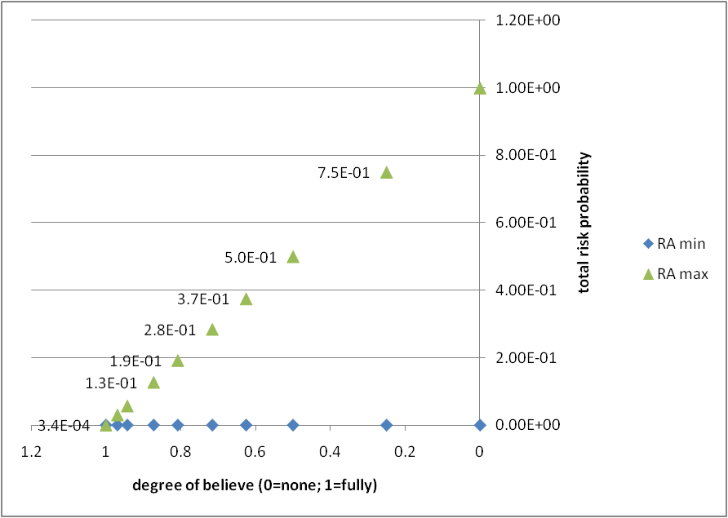
Example (cont.)

Slide 25
Conclusions
New Hydrogen technologies benefit from RA including uncertainty, e.g. for improved management decisions
The NUSAP is an established methode/notation and can be readily used to communicate information about model uncertainty to support policy decisions
To enable the quantification of aleatory & epistemic uncertainty related to risk assessment, we have established an interconnection between ‘our doubts and the quantitative measure of possible risk deviation’
The here described technique to calculate the ‘bias’ or ‘second order uncertainty’ enable us to quantify epistemic uncertainty in RA models
The technique may be an appropriate tool to support a general technology qualification framework

Slide 26
Epilogue
Thank you for your attention !
“One of the gravest errors in any type of risk management process is the presentation of risk estimates which convey a false impression of accuracy and confidence – disregarding the uncertainties inherent in basic understanding, data acquisition, and statistical analysis.”
(Cited from anon.)

Slide 27
literature
Zio E., Apostolakis G., TWO METHODS FOR THE STRUCTURED ASSESSMENT OF RADIOACTIVE WASTE REPOSITORIES, Reliab. Engineering and System Safety, 54 (2-3), 1996, p. 225-241
Joaquín MARTIN BERMEJO Unit “Energy production and distribution systems” DG Research – RTD/J-2

