Slide 1
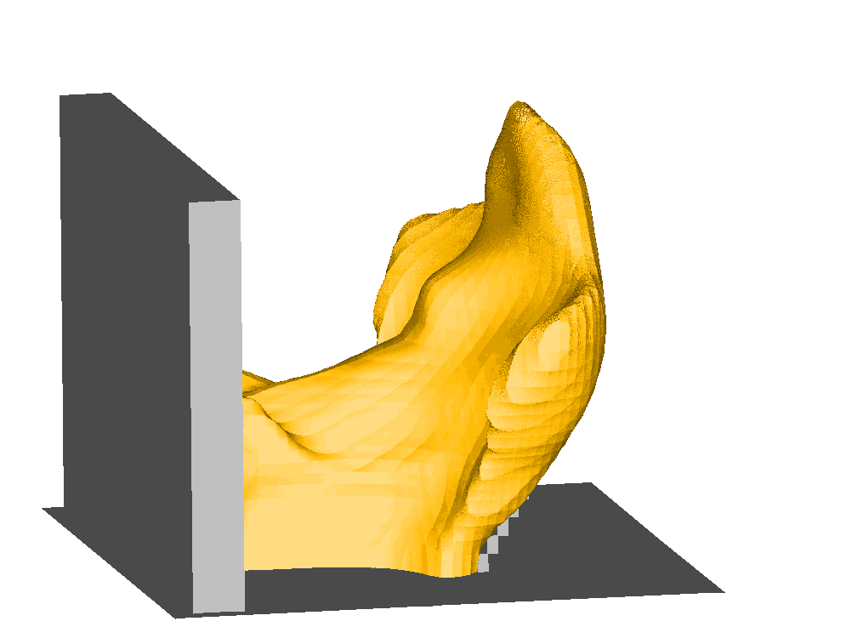
MODELLING OF HYDROGEN JET FIRES USING CFD
Deiveegan Muthusamy¹, Olav R. Hansen¹, Prankul Middha¹, Mark Royle² and Deborah Willoughby²
¹GexCon, P.O.Box 6015, Bergen, NO-5892, Norway
²HSL/HSE, Harpur Hill, Buxton, Derbyshire SK17 9JN, United Kingdom

Slide 2
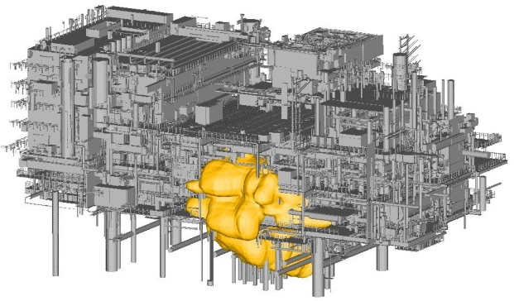
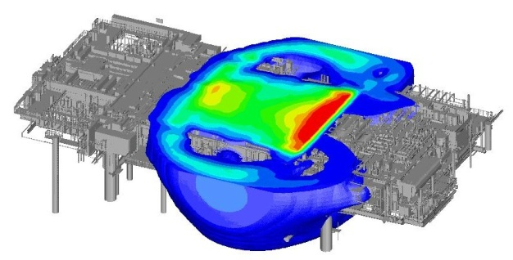
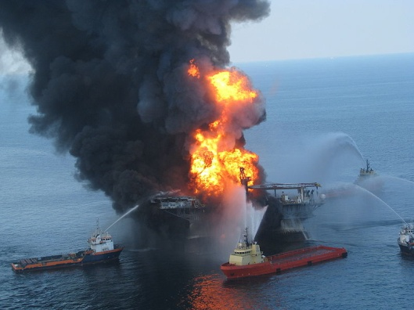
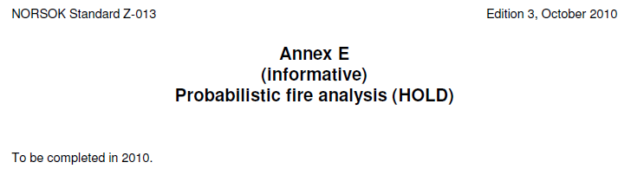
BACKGROUND FLACS-FIRE
FLACS is a leading tool within offshore oil and gas
Used in most oil and gas explosion/blast studies
Preferred tool for many types of dispersion studies
Leading tool for hydrogen safety (applicability & validation)
GexCon wants to add fire functionality
More complete tool for risk & consequence studies
Offshore installation standards: Escalation from accidental loads < 10⁻⁴ per year
NORSOK Z-013 (2010) and ISO 19901-3 (2010)
Combined probabilistic fire and explosion study wanted by oil companies

Slide 3
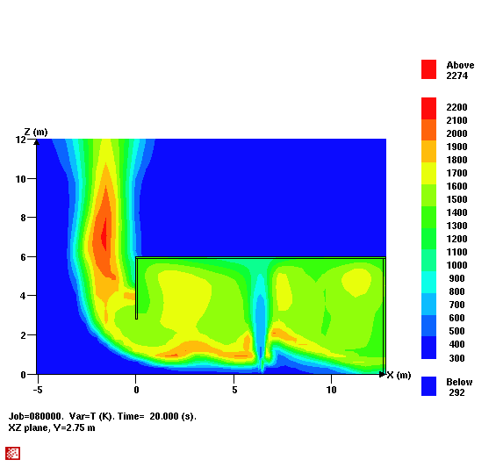
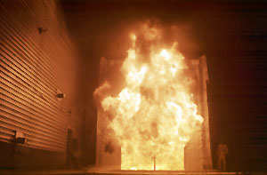
2008 FLACS-FIRE beta-release
Model to simulate jet-fires
Modified combustion models for non-premixed
Eddy dissipation concept (EDC) used by FLUENT, KFX, CFX
Mixed is burnt (MIB) used in FDS
Soot models developed
Formation oxidation model (FOM) used in FLUENT, KFX, CFX
Fixed conversion factor (FCM) used in FDS
Radiation model
6-flux model (correct heat loss, but wrong distribution)
Output parameters
QWALL (heat loads at surfaces) and Qpoint and QDOSE
Small validation report

Slide 4
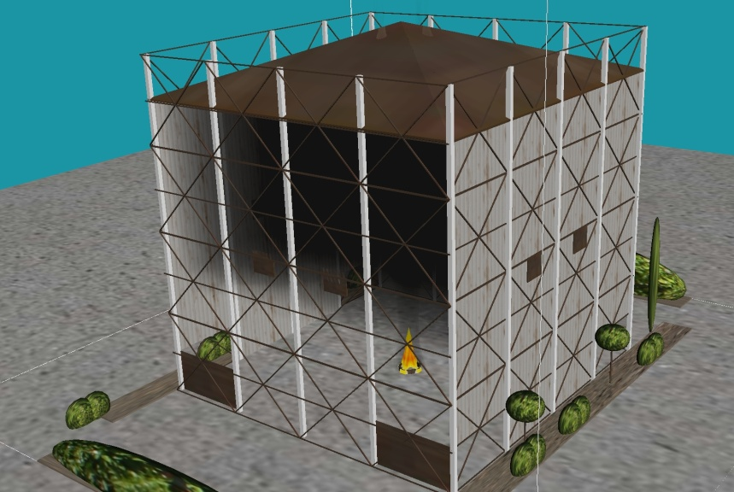
FLACS-FIRE 2008-2011
Temporary stop in development 2008
Main resources re-allocated to better paid activities
Some validation and evaluation work performed
FLACS-FIRE beta-version taken back
Conclusions of evaluation
Flame shapes and fire dynamics well simulated
Radiation pattern very wrong (along axes)
Model much too slow (explosion ~1s, fire ~1000 s)
Need for improved output
Joint industry project 2009-2011 (ExxonMobil, Total, IRSN, Statoil)
Parallel version of FLACS (~3 times faster with 4 CPUs)
Incompressible solver (~10 times faster)
Work on embedded grids (e.g. around jets) ongoing
2010 => Building up new fire modeling team
Ray-tracing model (DTM) for radiation (optimization remains)
Validation and methodology development ongoing
2012 => JIP on FIRE will start, partners get beta-versions and can influence development
FLACS-FIRE simulation
Murcia test facility

Slide 5
CURRENT WORK: FLACS-FIRE FOR HYDROGEN
For hydrogen simulations the following models are used
EDC combustion model (adaptively activated for non-premixed flames)
Soot model not relevant for hydrogen
DTM (raytracing) radiation model used
Simulated HSL jet fire tests (variation of barriers and release orifice diameter)

Slide 6
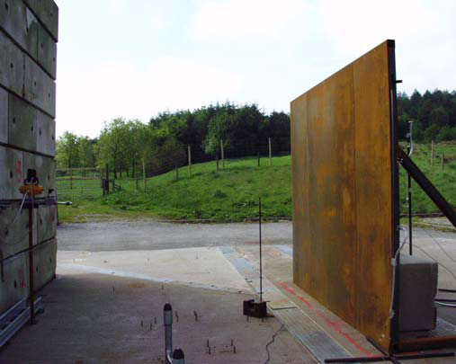
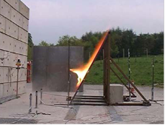
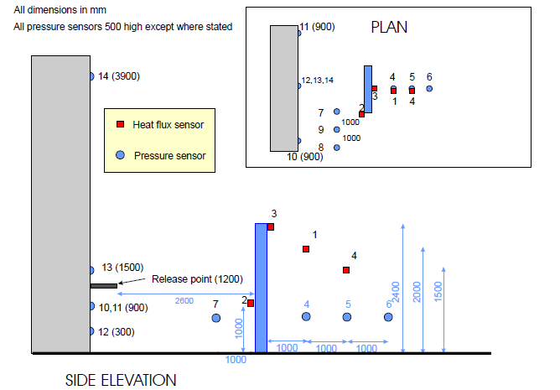
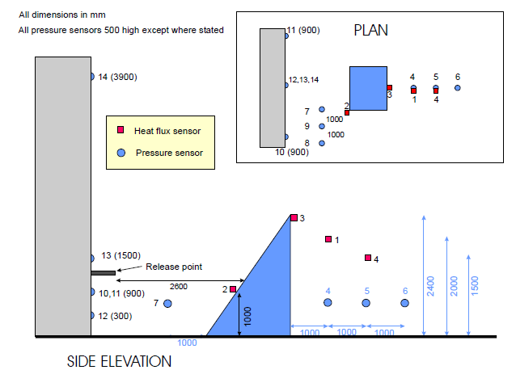
OVERVIEW HSL FIRE EXPERIMENTS
Horizontal jet fire experiments
Three release orifices (200 bar & 100 litre)
  3.2mm, 6.4mm and 9.5mm
Three barriers configurations
  90 degree, 60 degree and no barriers (only 9.5mm)
Release at 1.2m height
Ignition 2m from release at 800ms
Barriers 2.6m from release location

Slide 7
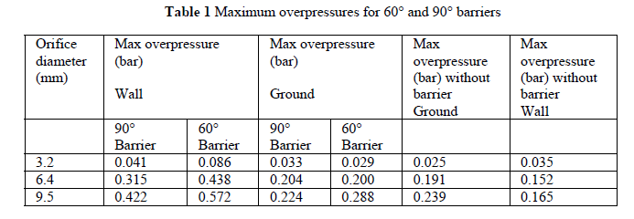
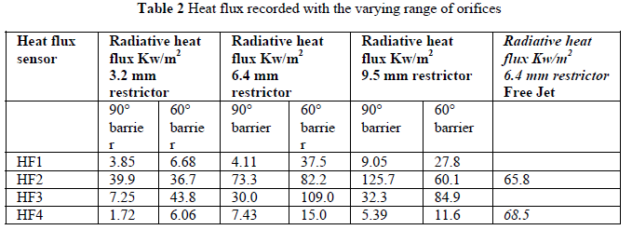
OVERVIEW HSL FIRE EXPERIMENTS
Results
Overpressures at sensors
Heat flux at sensors

Slide 8
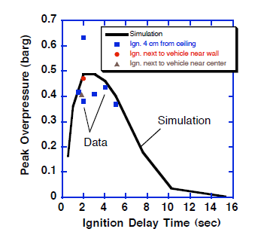
GexCon did not focus on explosion pressures
Guidelines for grid and time step for explosion and fire are different
For this study we optimized grid and timestep for fire => did not study pressures
Previously demonstrated that FLACS can predict exploding hydrogen jets well
FZK (KIT) ignited jets
Sandia/SRI tunnel tests
Sandia/SRI barrier tests

Slide 9
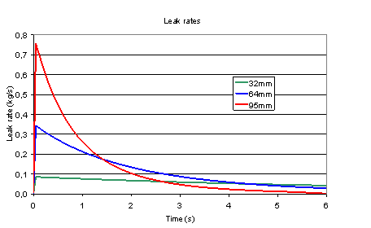
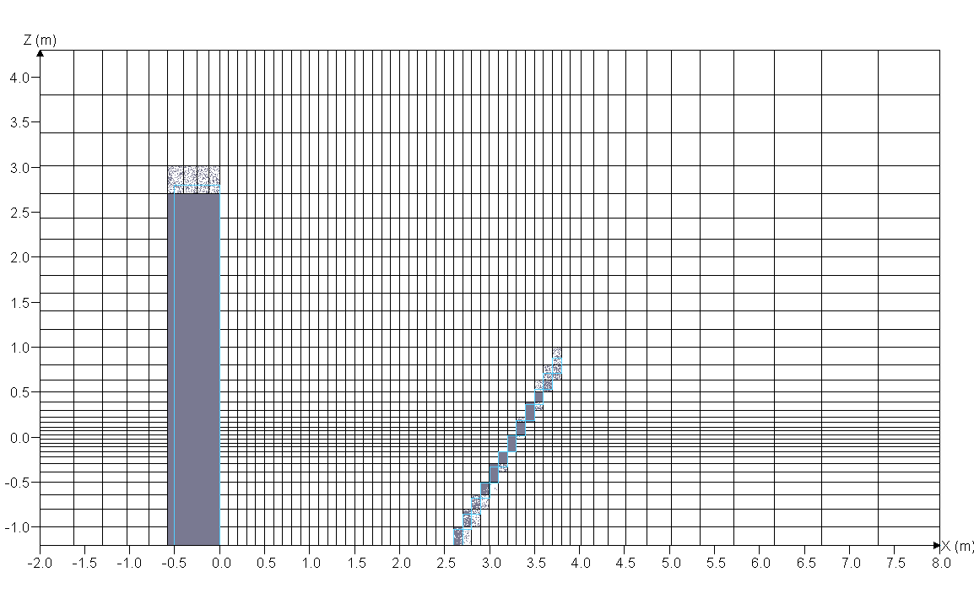


Simulation setup
Guidelines for FLACS-FIRE (grid / time step) as for FLACS-DISPERSION
Grid refinement near jet (Acv < Ajet < 1.25 Acv)
Refinement where gradients are expected
Maximum grid aspect ratio of 5 near jet
Time step: CFLV max 2
100.000 to 200.000 grid cells
Transient release rates (one tank instead of two?)

Slide 10
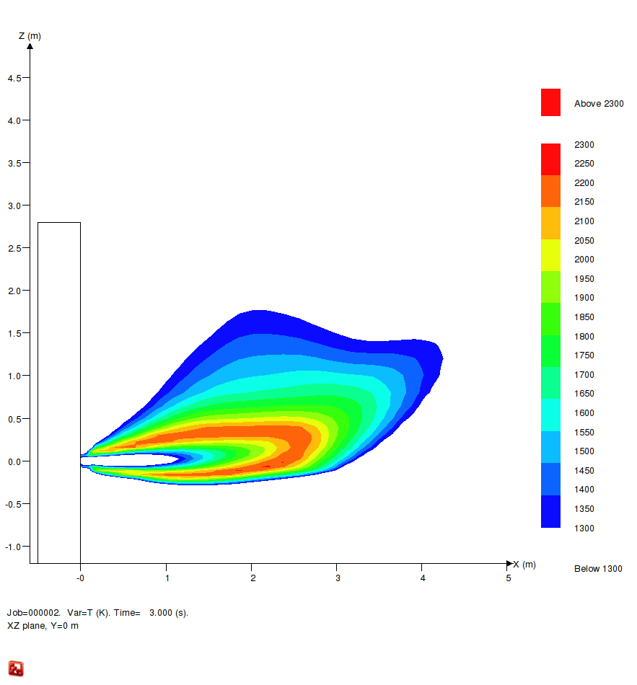
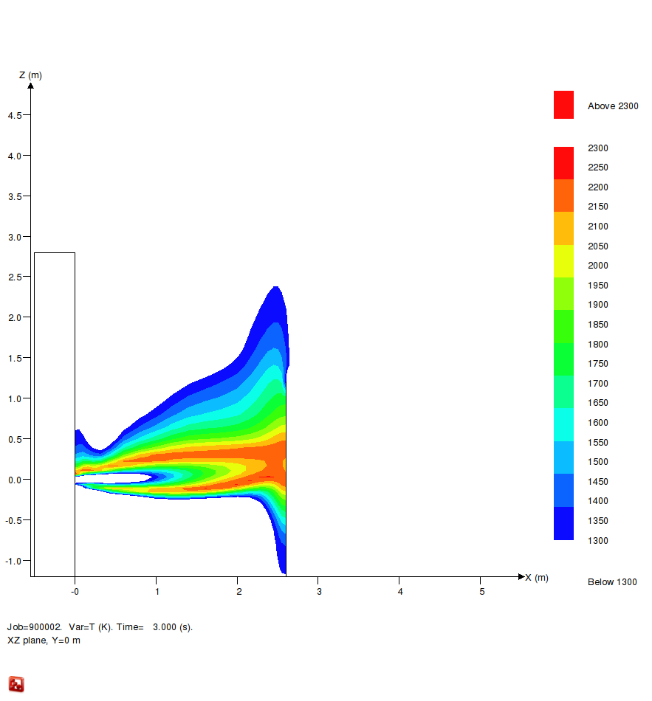
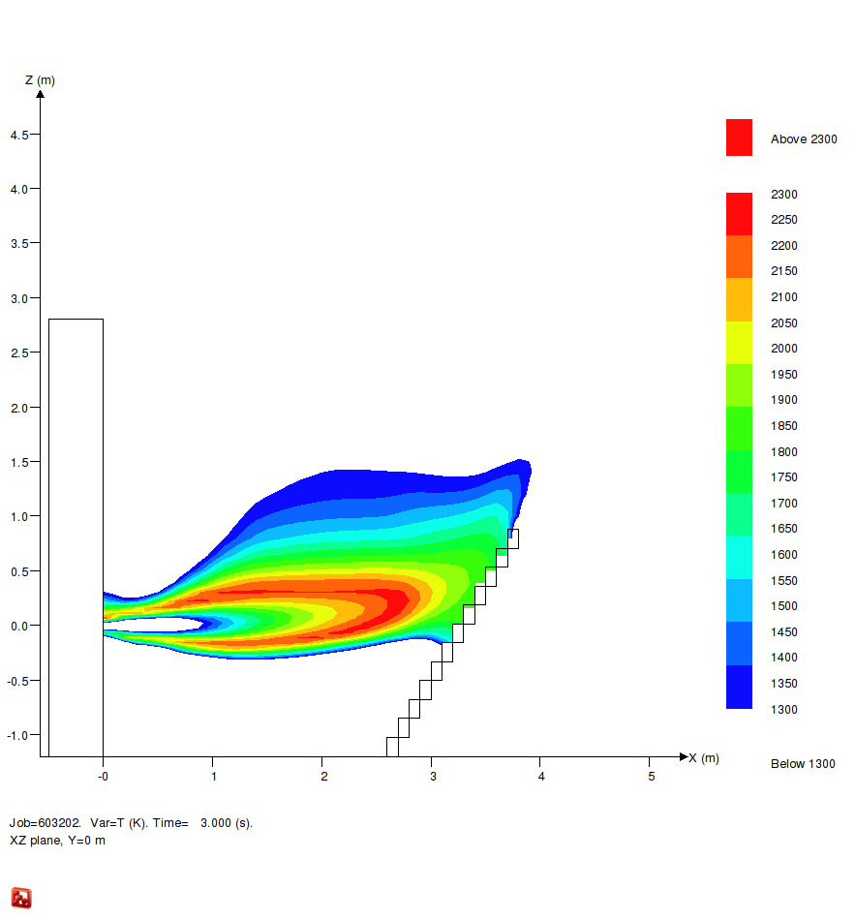
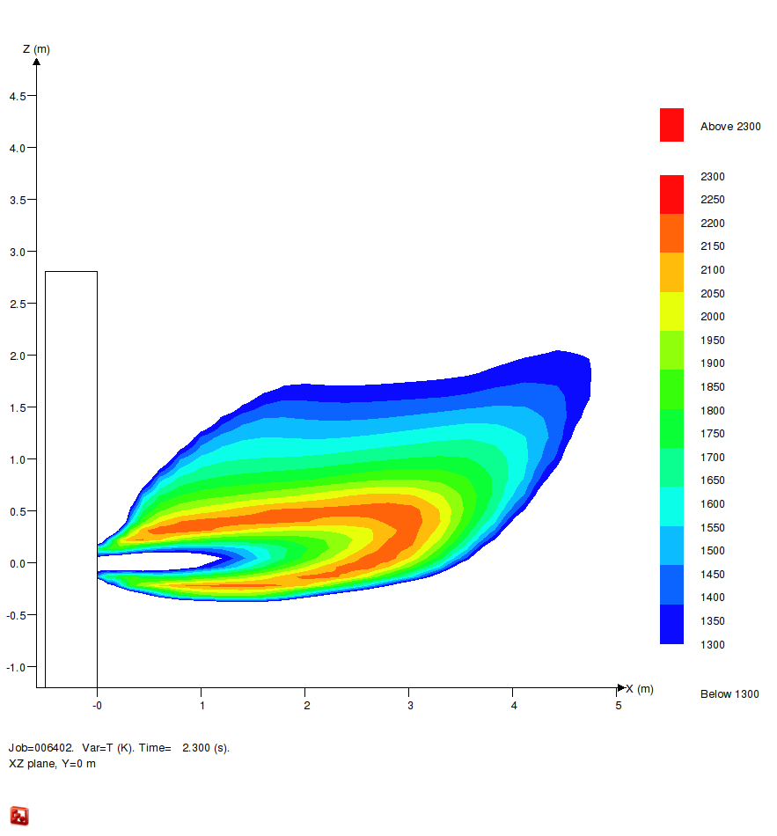
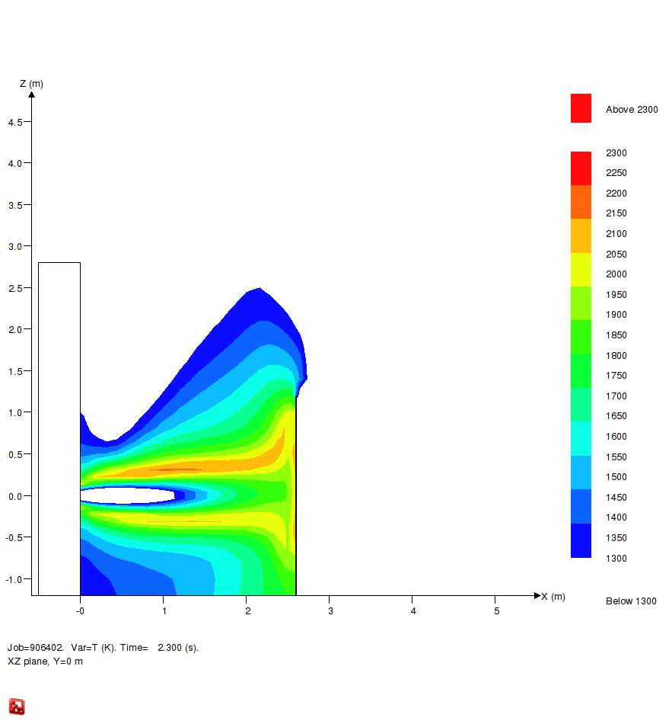
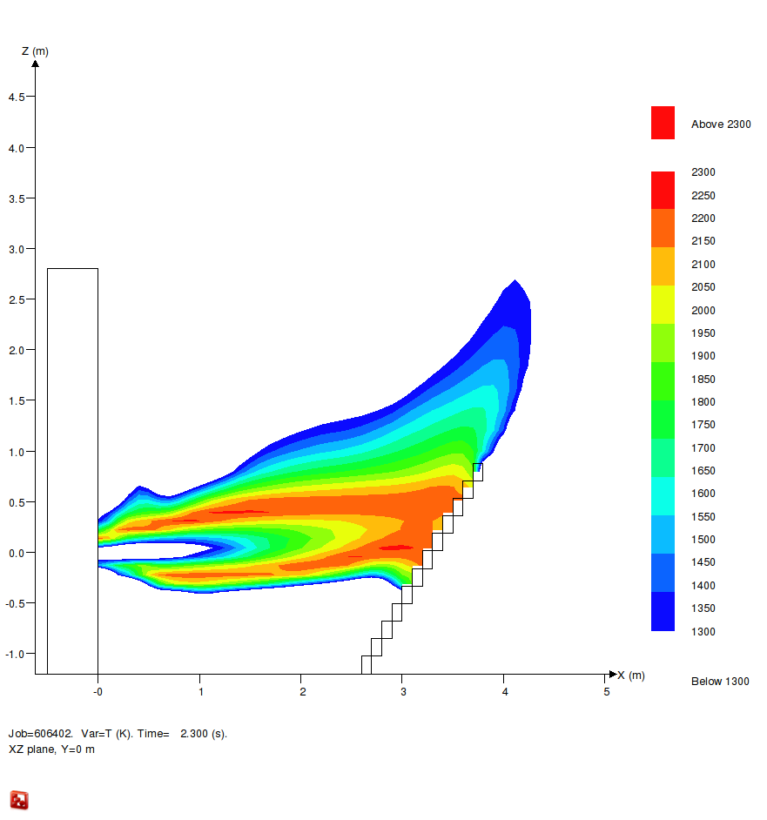
Results
Example of flame temperature distribution
3.2mm (3s)
6.4mm (2.3s)

Slide 11
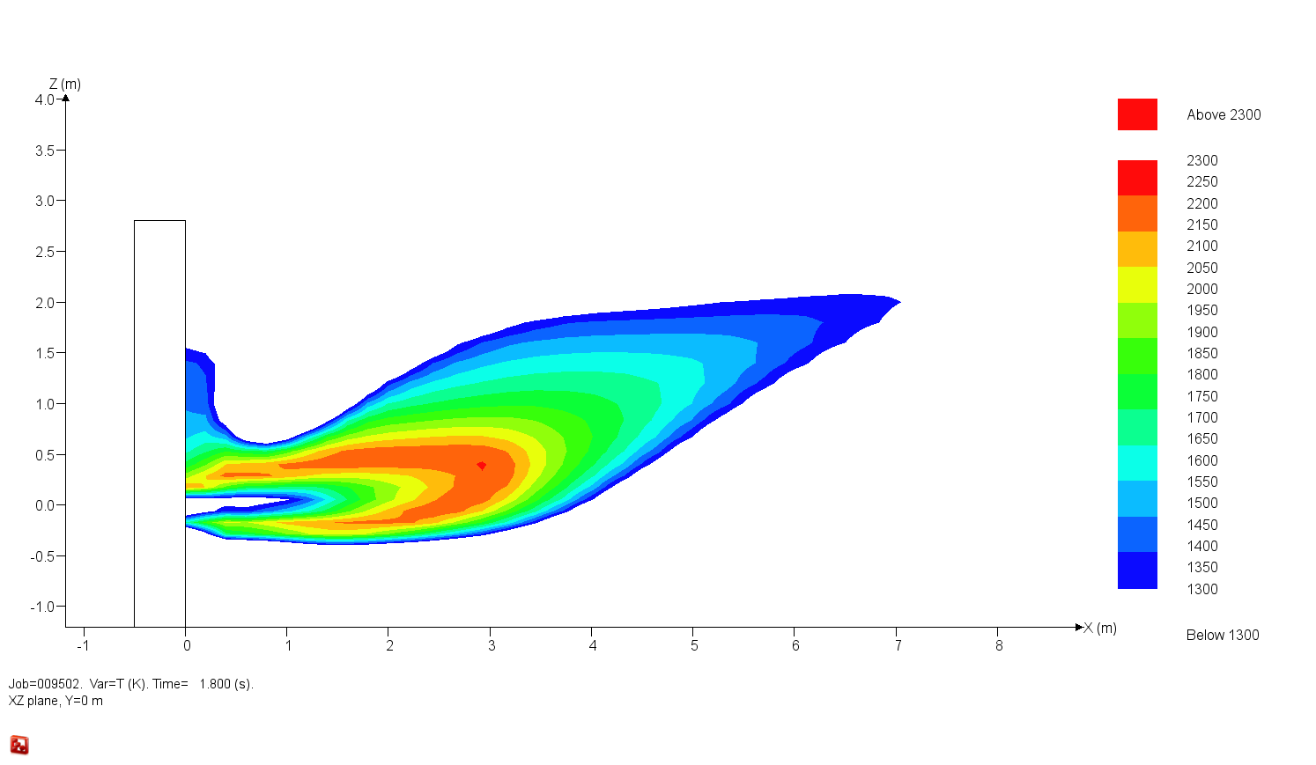
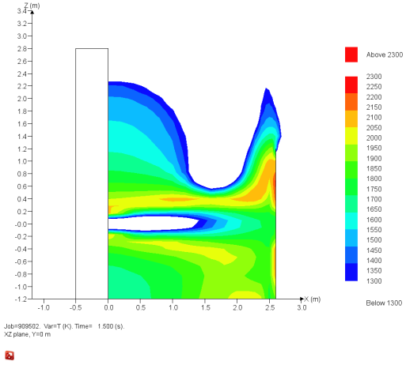
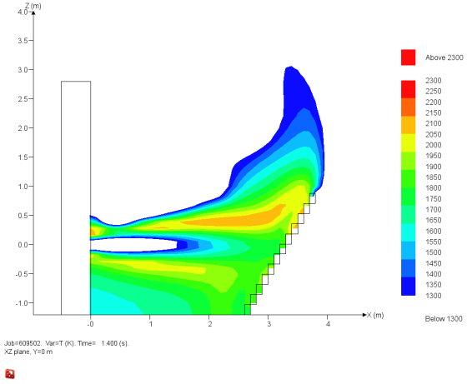
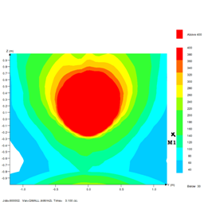
Results
Example of flame temperature distribution
9.5mm (1.4 to 1.8s)
During the work we «struggled» to get the proper heatfluxes as output
We identified errors in the radiation routines
Convective heat from jet-flame impingement not radiation, is reported in paper

Slide 12
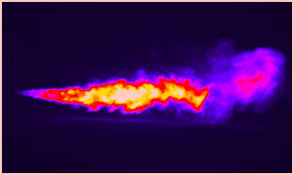
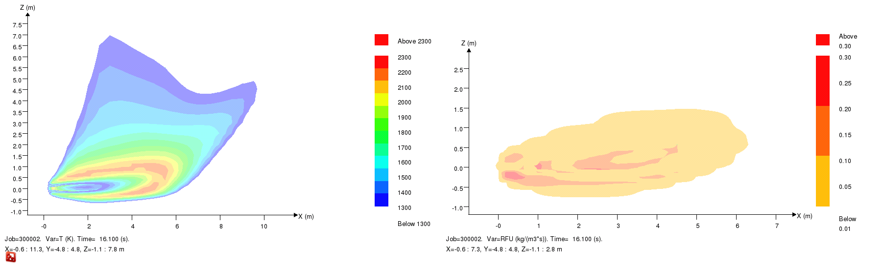
COMPARISON 9.5mm VS VIDEO
Photo of jet-flame indicates downwards angle
(possibly illusion due to camera position)
Reaction zone corresponds with bright region
1500 K contour with visible flame length?
T > 1300 K zone
Reaction zone
Notes:
12

Slide 13
COMPARISON 9.5mm VS VIDEO
Notice:
Photo of jet-flame indicates downwards angle
(could be illusion due to camera position)
Reaction zone corresponds with bright region
1500 K contour with visible flame length?
Rotated so jet becomes horizontal
T > 1300 K zone
Reaction zone
Notes:
13

Slide 14
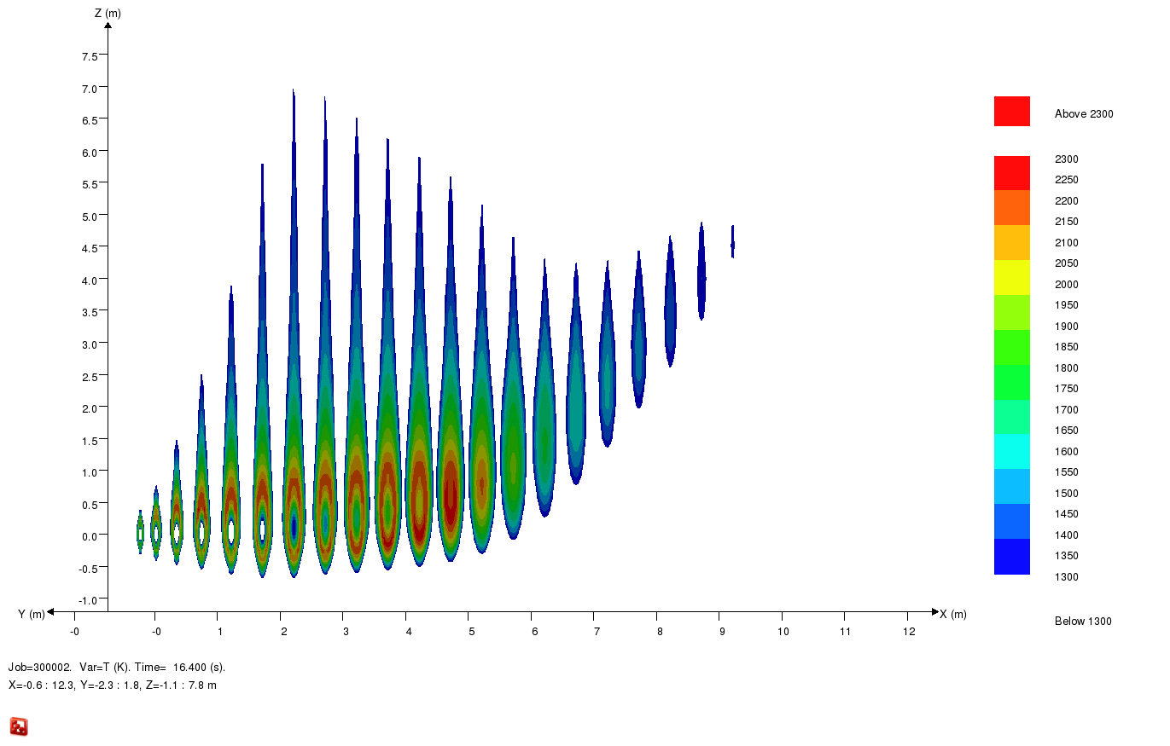
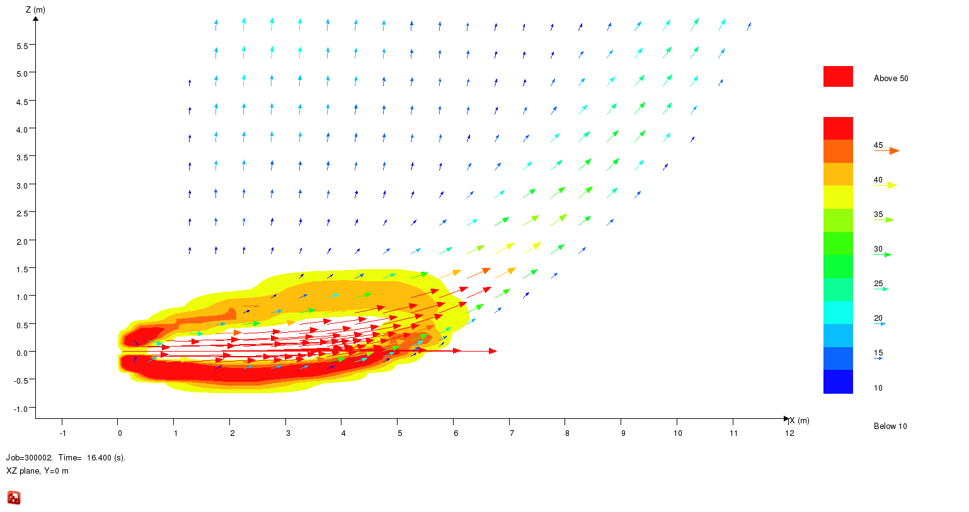
DOUBLE PEAK IN SIMULATION, NOT IN TEST?
T > 1300 K zone
Double peak seen in simulation, not in photo (?)
Rotated so jet becomes horizontal
peak 1
peak 2
Explanation 2: Slower velocity into ”peak 1” than ”peak 2”
glowing elements or particles will have quenched in ”peak 1”
Explanation 1: first peak optically ”thin”
< 10 m/s
>40 m/s
Notes:
14

Slide 15
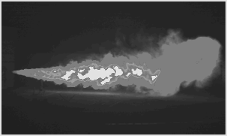
DOUBLE PEAK IN SIMULATION, NOT IN TEST?
T > 1500 K zone corresponds to visible plume?
peak 1
peak 2
Double peak also in test (weak contours seen)!
Explanation 2: Slower velocity into ”peak 1” than ”peak 2”
glowing elements or particles will have quenched in ”peak 1”
Explanation 1: first peak optically ”thin”
< 10 m/s
>40 m/s
Notes:
15

Slide 16
CONCLUSIONS
Due to setup errors and inaccuracies the FLACS-FIRE comparison to HSL tests not accurate
Also influenced by the fact that FLACS-FIRE is an unfinished product under development
Still promising result and progress seen
Expect prototype version for JIP-members 2012
Will be commercially available once quality is comparable to other FLACS-products (validation and functionality)
Predicted radiation kW/m² (horizontal surfaces) and flame simulating jet-fire on oil platform
Acknowledgment
Thanks to the research council of Norway for partial support to IEA Task 31 participation

