Slide 1
Effect of Hydrogen Concentration on Vented Explosions
C. Regis Bauwens, Jenny Chao, Sergey B. Dorofeev
6th ICHS
Sept. 13th, 2011

Slide 2
Outline
Background
Explosion Phenomena
Experiments
Correlation
Conclusion/Summary
Questions

Slide 3

Background
Vented Explosions

Slide 4
Background
Motivation
  Necessary to properly size vents
    Aim to minimize vent size while providing adequate protection
  Existing empirical standards based on limited data
    Predictions off by more than order of magnitude
    Greatly under predicts hydrogen-air mixtures

Slide 5
Background
Vented Explosion Research Program
  Generate a set of experimental data on vented explosions varying:
    mixture composition
    ignition location
    vent size
    presence of obstacles
    size of enclosure
    vent deployment pressure/panel mass
  Develop engineering tools/CFD models
  Develop/improve vent size correlations

Slide 6
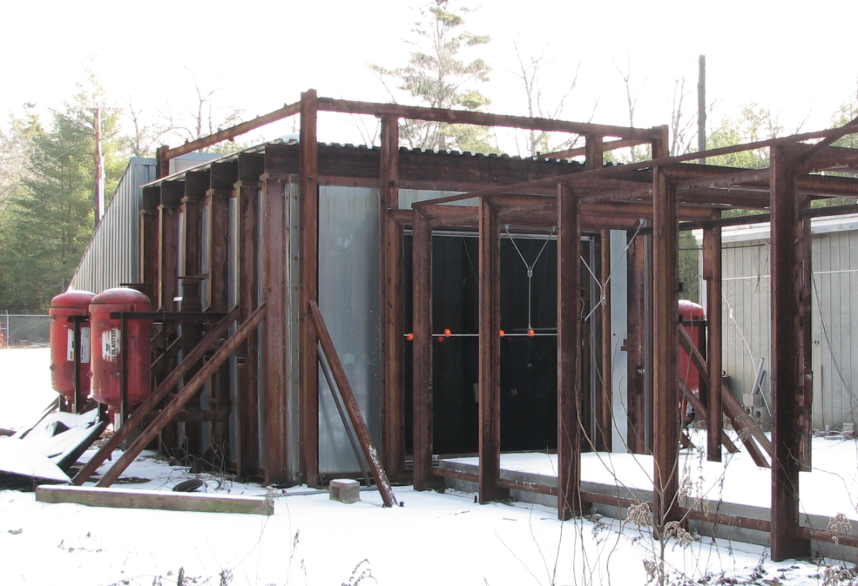
Background
Experimental Setup
Volume: 64 m³
Vent size: 5.4 m²
12 – 19 % vol. hydrogen-air

Slide 7
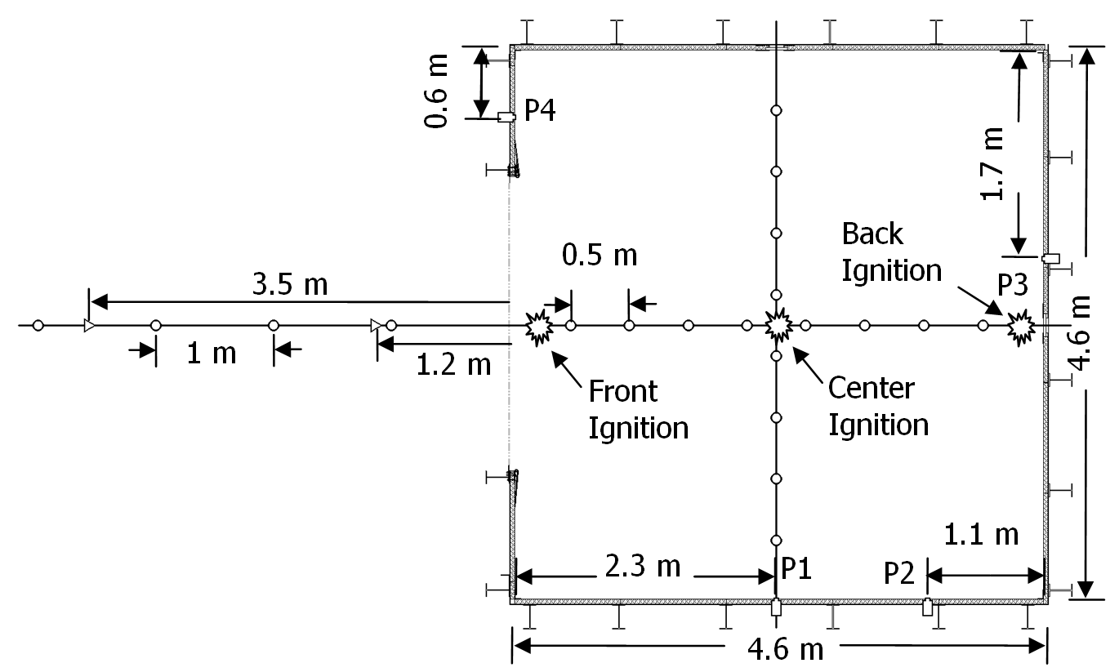
Background
Experimental Setup
  Instrumentation layout:

Slide 8
Background
Center ignition 19% hydrogen-air
P_{ext}
P_{vib}

Slide 9
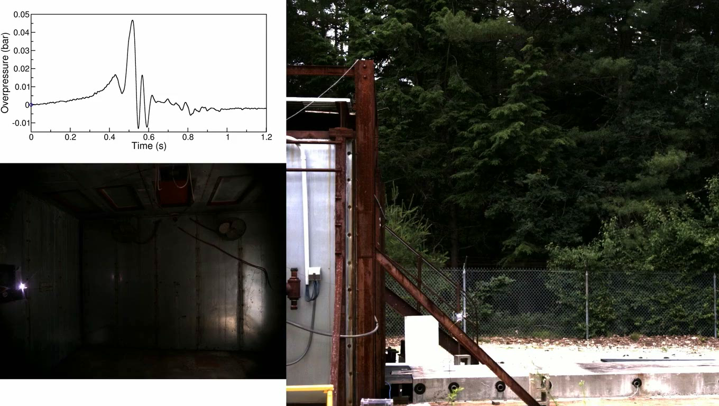
Explosion Phenomena
External Explosion

Slide 10
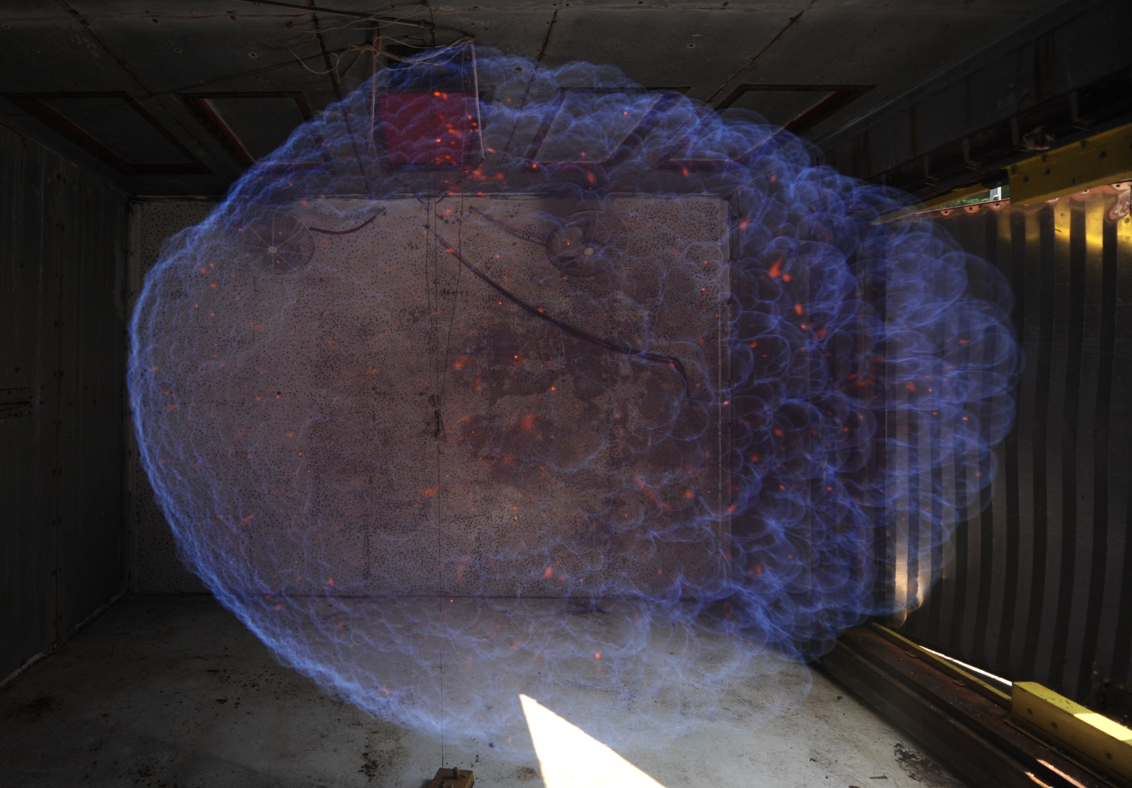
Background
Rayleigh-Taylor Instability

Slide 11
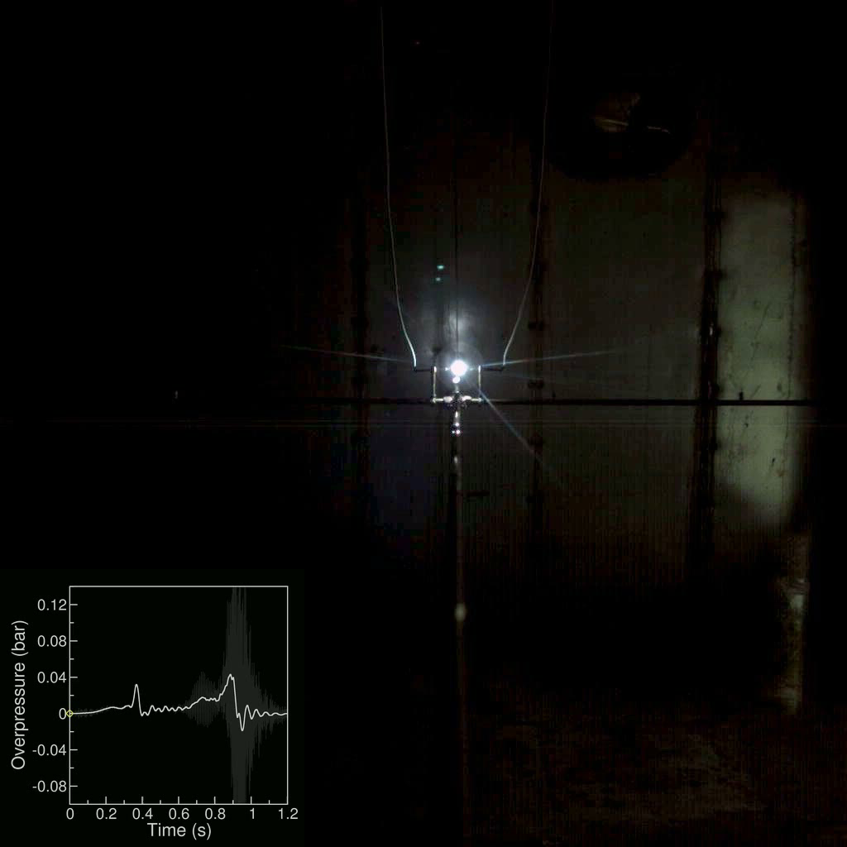
Explosion Phenomena
Flame-acoustic interactions

Slide 12
Explosion Phenomena
Lewis Number Effect
  LE < 1 enhances hydrodynamic flame instabilities
  LE decreases as hydrogen concentration decreases
  Increases effective burning velocity of flame

Slide 13
Experiments
Flame speed

Slide 14
Experiments
Flame speed
Normalized by σS_{L}
Normalized by σS_{L}Ξ_{LE}

Slide 15
Experiments
Internal Pressure
80 Hz Low Pass Filtered
80 Hz High Pass Filtered

Slide 16
Outline
Background
Explosion Phenomena
Experiments
Correlation
Conclusion/Summary
Questions

Slide 17
Correlation
Model Description
  Previous studies found each pressure peak independent of one another
  Pressure peaks occur when volume production matches volumetric flow rate through vent
    Rate of volume production depends on flame area, flame speed
    Rate of venting function of pressure across vent, vent size and density of vented gas

Slide 18
Correlation
Model Description
external explosion pressure
burning velocity
maximum flame area
production of combustion products = loss of volume due to venting

Slide 19
Correlation
External Explosion Peak, P_{ext}

Slide 20
Correlation
Flame-Acoustic Peak, P_{vib}

Slide 21
Discussion
Model accurately reproduces trends for peak pressures
Valid over wide range of initial conditions and ignition locations
Only two empirical constants in model

Slide 22
Conclusion/Summary
Experiments
  Experiments performed for 12-19% vol. hydrogen-air mixtures
  Throughout range of concentrations same peaks present
  High frequency flame-acoustic interactions increase in amplitude with lower concentration
  Flame-acoustic interactions did not result in more damaging over-pressures

Slide 23
Conclusion/Summary
Correlation
  Previously developed model performs well across range of concentrations
  Adding LE correction slightly improves performance of model
  LE correction may have larger contribution at higher concentrations

Slide 24
Questions?

