Slide 1

Fundamental study on accidental explosion behavior of hydrogen/ air mixtures in open space
Toshio Mogi, Woo-Kyung Kim, Ritsu Dobashi
The University of Tokyo
ICHS 2011
International Conference on Hydrogen Safety
September 12-14, 2011
San Francisco, California-USA
1

Slide 2
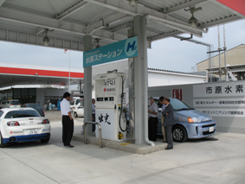
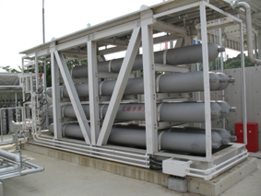
Background
Clean energy carrier Renewable energy
Expected as an alternative fuel ( ex. fuel-cell vehicle)
Hydrogen filling station
Hydrogen
Low ignition energy (0.019mJ)
Extensive flammable region (4-75vol%)
Easy leakage and high diffusivity
Properties on safety
If hydrogen leaks from hydrogen handling system,
electrostatic spark discharge
serious fire and/or explosion accidents.
2

Slide 3
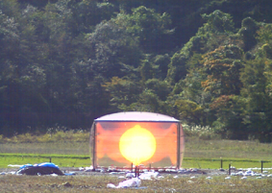
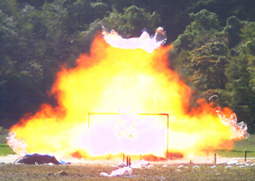
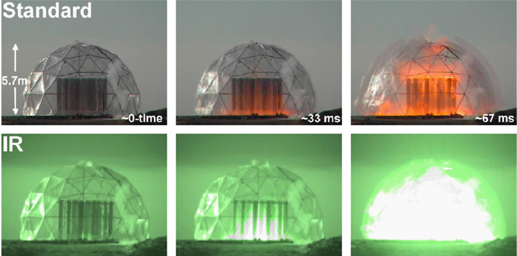
Background
Gas explosion causes indeed serious damages.
Hazard analysis on an accidental explosion is very important.
To evaluate the strength of hydrogen/air mixture explosion, unconfined large scale experiments were recently carried out.
K. Wakabayashi, et al, 1st ICHS, 2005
However, there has been little systematic research on the relation between flame propagation and blast wave in unconfined space.
M. Groethe, et al, 1st ICHS, 2005
3

Slide 4
Objectives
To understand the relation between flame propagation and blast wave in open space
Hydrogen/air deflagration experiment using soap bubble method
The effect of hydrogen/air mixture concentration to behavior of flame propagation and blast wave
4

Slide 5
Experimental setup
Ignition system
Sound pressure measuring system
High speed Schlieren photography system
Gas supplying system
5

Slide 6
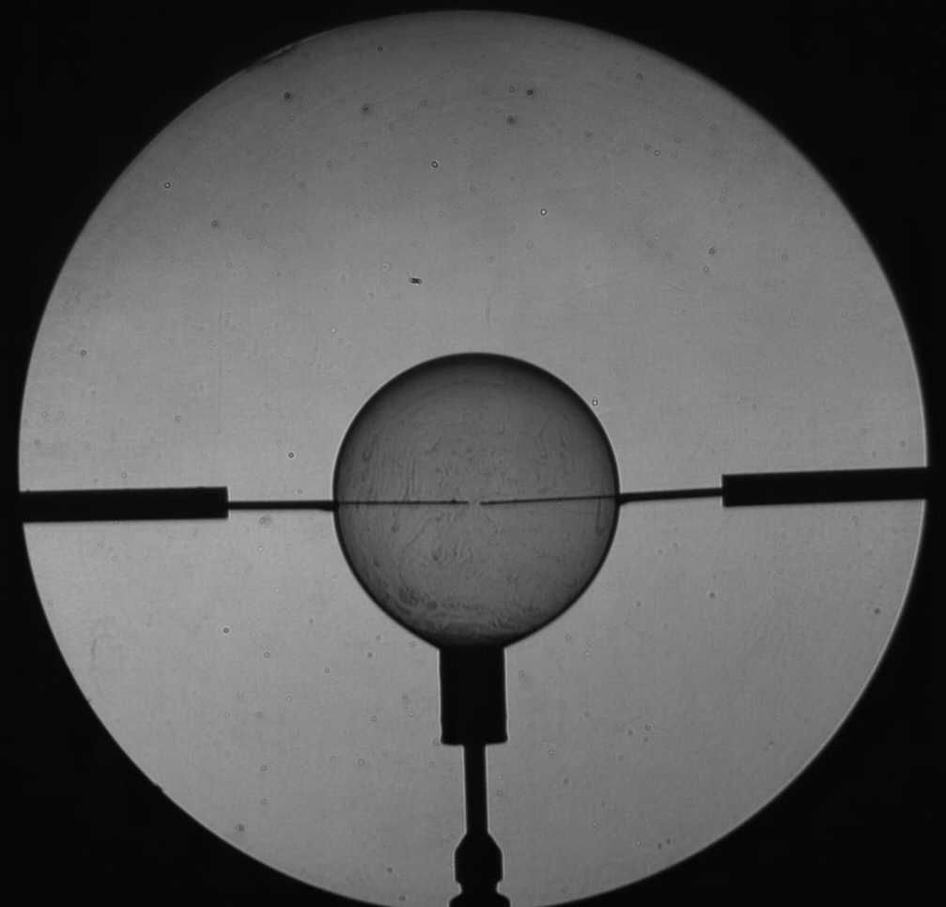
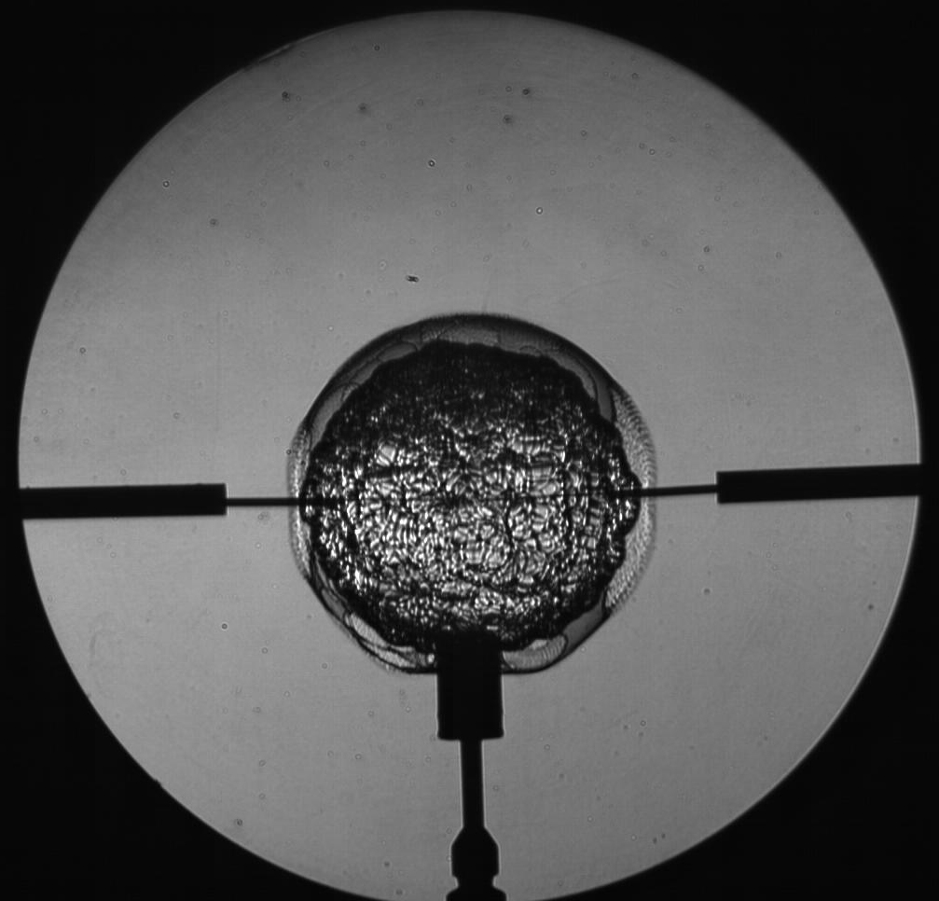
Detail of Schlieren pictures
Boundary between
mixture and surrounding air
Bubble surface
Bubble surface
Insulator
Electrode
Flame front
Nozzle
Before ignition
After ignition
6

Slide 7
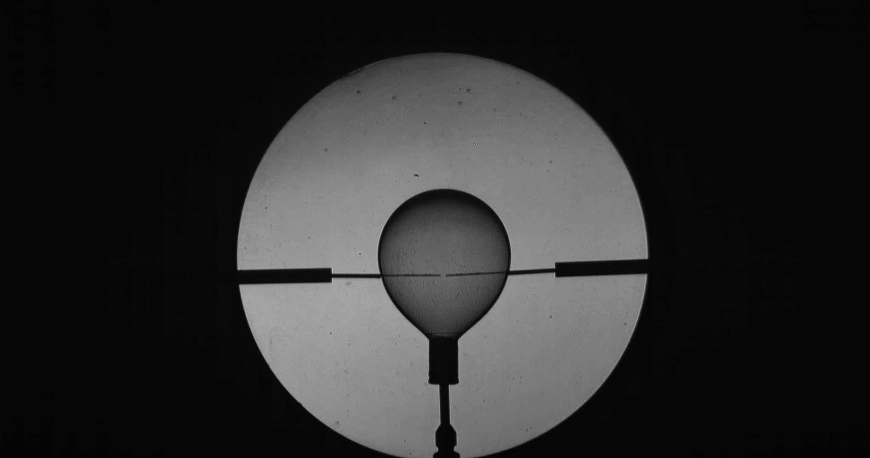
Movie (φ = 1.8 )
7

Slide 8
Flame propagation at equivalence ratios of 0.7, 1.0, 1.8.
φ
Time
8

Slide 9
Flame propagation at equivalence ratios of 2.5, 3.0, 4.0.
φ
Time
9

Slide 10
Flame radius versus time at various equivalence ratios
Mean burning velocity calculation
r_{u}: initial soap bubble radius
r_{b}: burned flame radius
10

Slide 11
Comparison between measured mean burning velocity and literature data
11

Slide 12
Pressure wave histories with different equivalence ratio
12

Slide 13
Comparison with existing simple model
Theory of acoustics
The blast overpressure at the position d from the explosion point is equated by the theory of acoustics;
p : pressure
t : time
dV/dt : volumetric rate of combustion
A.Thomas et al. (Proc. R. Soc. Lond. A 294: 449-466 ,1966)
ε S
S : burning velocity
ε : volumetric expansion ratio
r_{q} : flame radius at quenching
ｒ
13

Slide 14
Comparison between measured and predicted peak overpressure
14

Slide 15
Discussion-Existing study on blast wave at acceleration of flame propagation
Laminar flame propagates spherically
ε S
ｒ
S=constant
S : burning velocity
ε : volumetric expansion ratio
r_{q} : flame radius at quenching
A.Thomas et al. (Proc. R. Soc. Lond. A 294: 449-466 ,1966)
15

Slide 16
Time histories of flame radius, burning velocity, overpressure (φ = 0.7)
≠constant
16

Slide 17
Time histories of flame radius, burning velocity, overpressure (φ = 1.8)
17

Slide 18
Time histories of flame radius, burning velocity, overpressure (φ = 3.0)
18

Slide 19
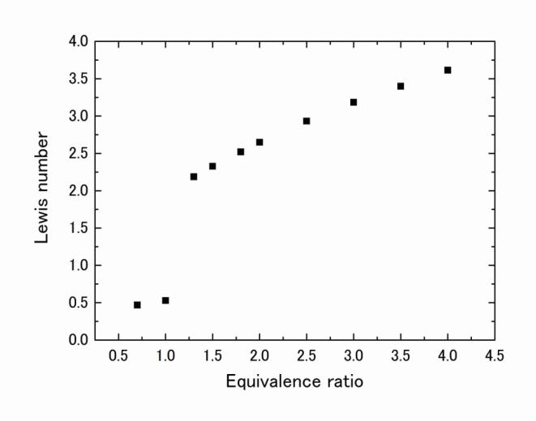
Discussion
Diffusive-Thermal instability(Lewis number)
Unburned
side
Unburned
side
Burned
side
Burned
side
stable
(Le>1,stable)
(Le<1,unstable)
Mass diffusion
unstable
Heat diffusion
19

Slide 20
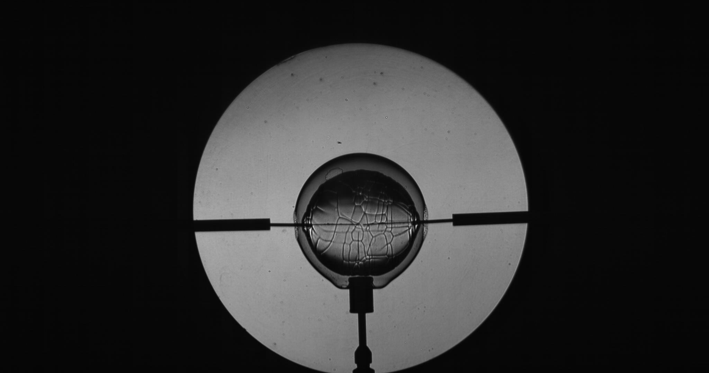
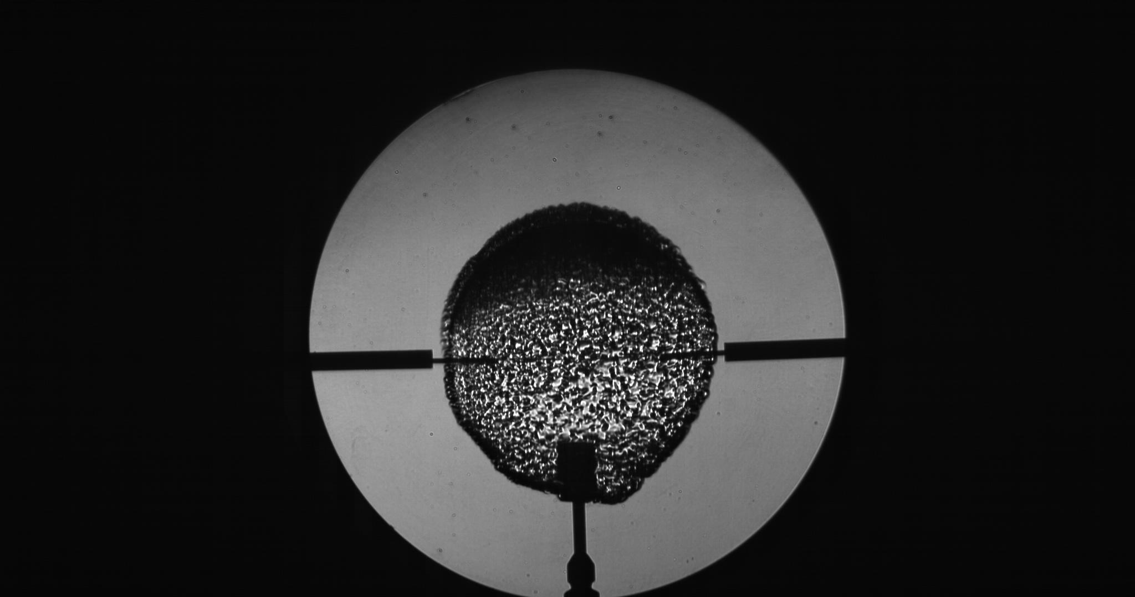
Discussion
Different type of wrinkled flame
φ = 0.7
φ = 4.0
Diffusive-thermal instability
Wrinkled flame by rupture of a soap bubble
wrinkled flame by the rupture of a soap bubble is related with
non-uniformity concentration distribution
20

Slide 21
Conclusions
1) The measurements of the intensities of blast wave show that;
in lean hydrogen-air mixture the overpressure grew linearly with time
in rich hydrogen-air mixture the overpressure grew linearly with time in the early stage and acceleratingly increase in later stage.
The accelerating increase in the later stage resulted in a much larger peak overpressure than that in the stoichiometric mixture.
2) The overpressure of blast wave can be predicted by the acoustic theory if the real burning velocity could be known.
The theory indicates that the intensity of blast wave is affected by burning velocity, volumetric expansion ratio and flame acceleration.
In particular, the intensity of the blast wave is strongly affected by the acceleration of the burning velocity.
21

Slide 22
Thank you for your attention!
mogi.toshio@mail.u-tokyo.ac.jp
22

