Slide 1
Flame acceleration and transition from deflagration to detonation in hydrogen explosions
A. Heidari and J.X. Wen
Centre for Fire and Explosion Studies
Faculty of Engineering, Kingston University London
Centre for Fire and Explosion Studies

Slide 2
Outilne
Introduction
Deflagration to Detonation Transition
Equations and Reaction
Detonation simulation
DDT Oran et al.
DDT Teodorczyk et al.
Detonation in larger scales in presence of obstacles
Summery

Slide 3
Combustion waves
low speed
High speed
Deflagrations
Detonations
Laminar
flames
Turbulent
flames
DDT
Detonations
U
3 m/s
800 m/s
2000 m/s
P
0.1 atm
5 atm
20 atm
Diffusion of mass and energy
Auto-ignition due to shock heating

Slide 4
DDT
reactivity gradients (gradient of induction time ) by Zeldovich
The turbulent flame → several shock-flame interactions → instabilities → gradients of reactivity→ ignition centres “hot spots” → detonation
SWASER (shock wave amplification by coherent energy release) by Lee
the time sequence of chemical energy release is such that it is coherent with the shock wave it generates, so it strengthen the propagating shock
Notes:
During the flame acceleration process the gases are pushed ahead of the flame due to the expansion in the products and it creates pressure waves moving ahead of the flame. When the reaction rate is high enough the fast energy release at the reaction front also creates pressure waves moving ahead. The reflection of these shocks hit the flame front and creates localised high pressure and temperature points called “hot spot”. If temperature and induction time gradient in these reaction points is appropriate, it coherently lead to a series of localised explosions in the shocked gas. These explosions create secondary shocks that magnify each other and under appropriate condition they trigger an overdriven detonation.

Slide 5
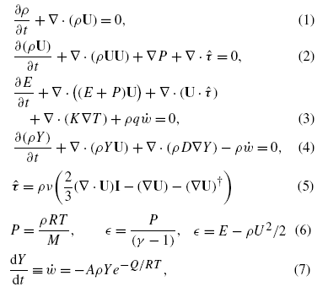
Governing equations
multidimensional, time-dependent, compressible reactive Navier–Stokes equations
Modelled:
chemical reactions
molecular diffusion
thermal conduction
viscosity
Discretization: Gaussian finite volume integration
Time derivatives: Crank-Nicholson
Van Leer (TVD) scheme for shock capturing

Slide 6
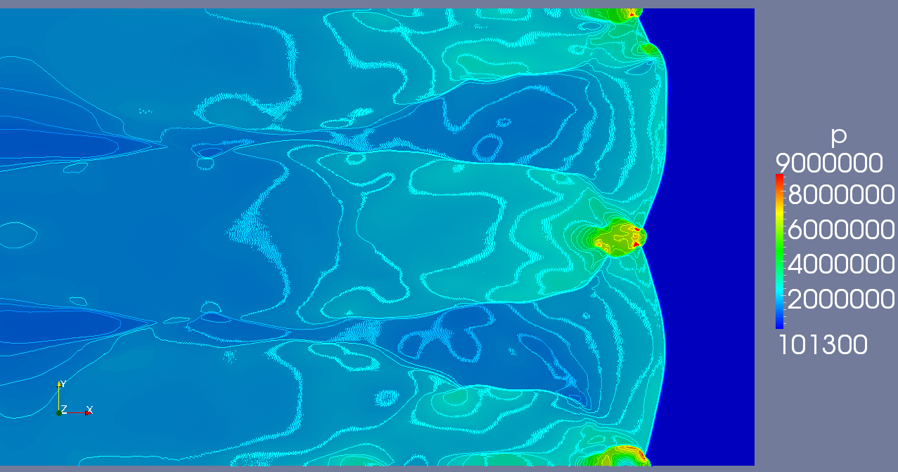
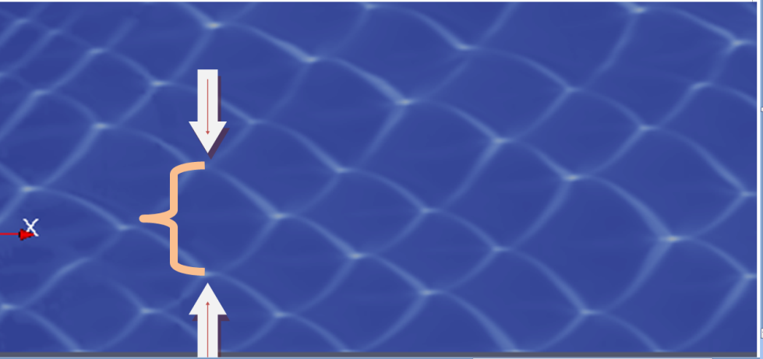
Testing the solver for Detonation and Deflagration waves
Notes:
We solved a couple of deflagration and detonation cases to verify the performance of the code and the results, however due to the time limitation, here I just present one of detonation validations using this solver.

Slide 7
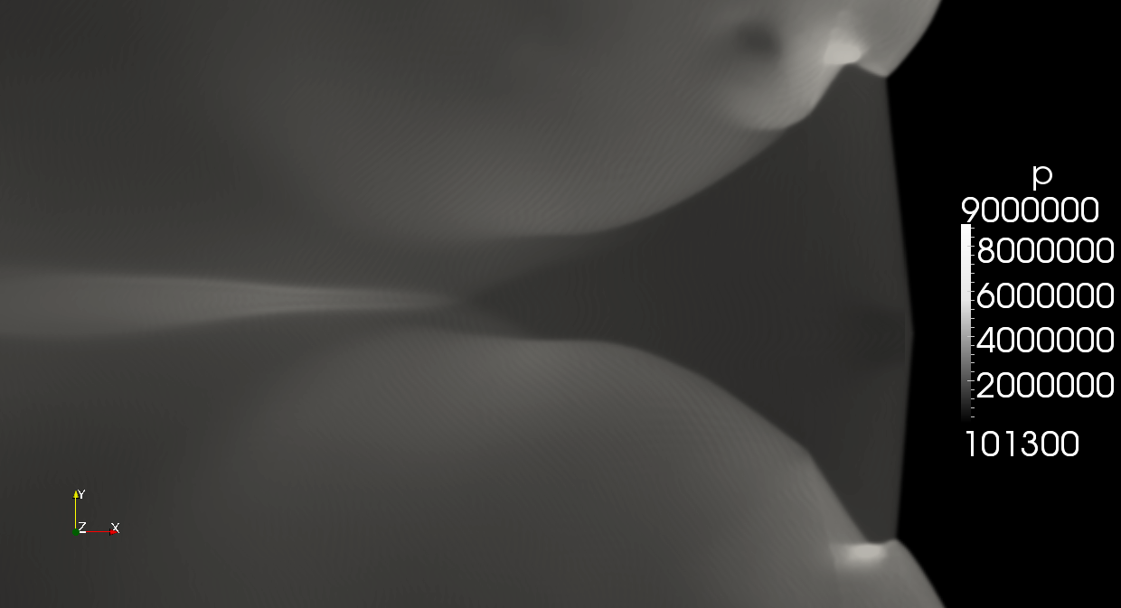
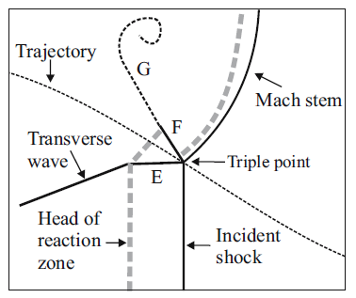
Structure of detonation front

Slide 8
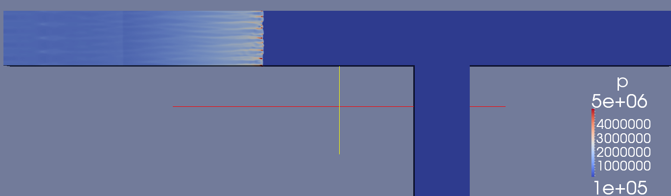
Detonation propagation in a bifurcated

Slide 9
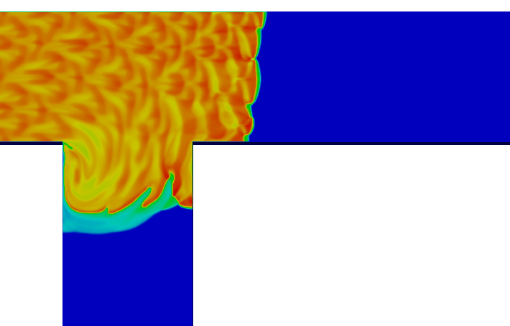
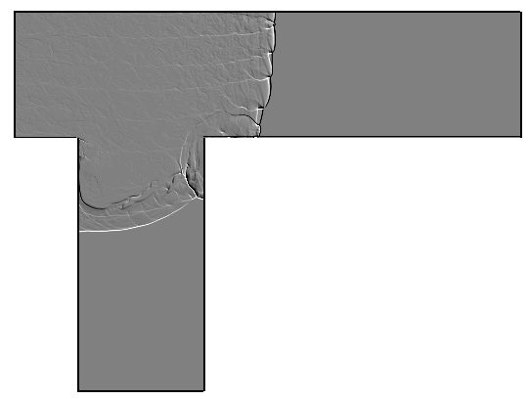
Detonation propagation in a bifurcated
C. J. WANG, S. L. XU AND C. M. GUO, “Study on gaseous detonation propagation in a bifurcated tube”, Journal of Fluid Mechanics (2008), 599: 81-110

Slide 10
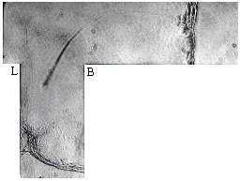
Detonation propagation in a bifurcated

Slide 11
Case study-1 (E. S. Oran)
Vadim N. Gamezo, Takanobu Ogawa, Elaine S. Oran, “Numerical simulations of flame propagation and DDT in obstructed channels filled with hydrogen–air mixture”, Proceedings of the Combustion Institute, Volume 31, Issue 2, January 2007, Pages 2463-2471
Smallest grid size : 20 micron, structured (AMR)
Boundary conditions : no-slip reflecting boundaries, symmetry, opening
Fuel: stoichiometric Hydrogen-air mixture
Ignition: a region of high temperature (2000 K)
Single step and 21 step reactions, 300K initial Temperature
21 step reactions, 293K initial Temperature

Slide 12
Notes:
However as Khokhlov and Oran has mention, the details of how DDT happens might vary from event to event and extra care must be taken in interpreting the results.

Slide 13
Case study-2 (A. Teodorczyk et. al)
80 mm×2000 mm tube, L=160 mm, BR = 0.5
Smallest grid size : 20 micron, structured (AMR)
Boundary conditions : no-slip reflecting boundaries.
Fuel: stoichiometric Hydrogen-air mixture
Ignition: a region of high temperature (2000 K)
A. Teodorczyk, P. Drobniak, A. Dabkowski, “Fast turbulent deflagration and DDT of hydrogen–air mixtures in small obstructed channel”, International Journal of Hydrogen Energy, Volume 34, Issue 14, July 2009, Pages 5887-5893
Ignition

Slide 14
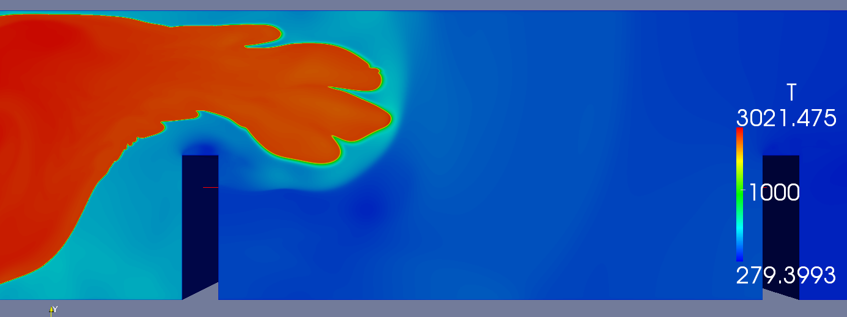
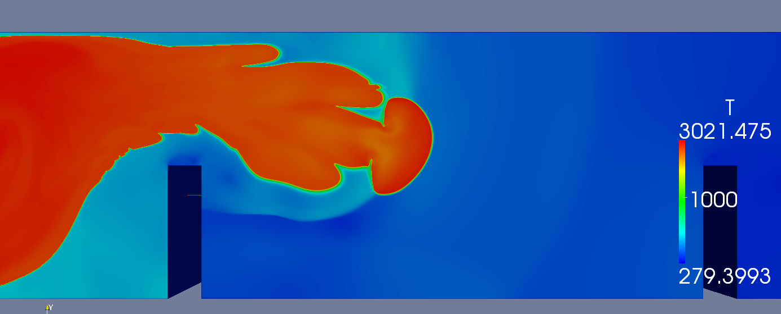
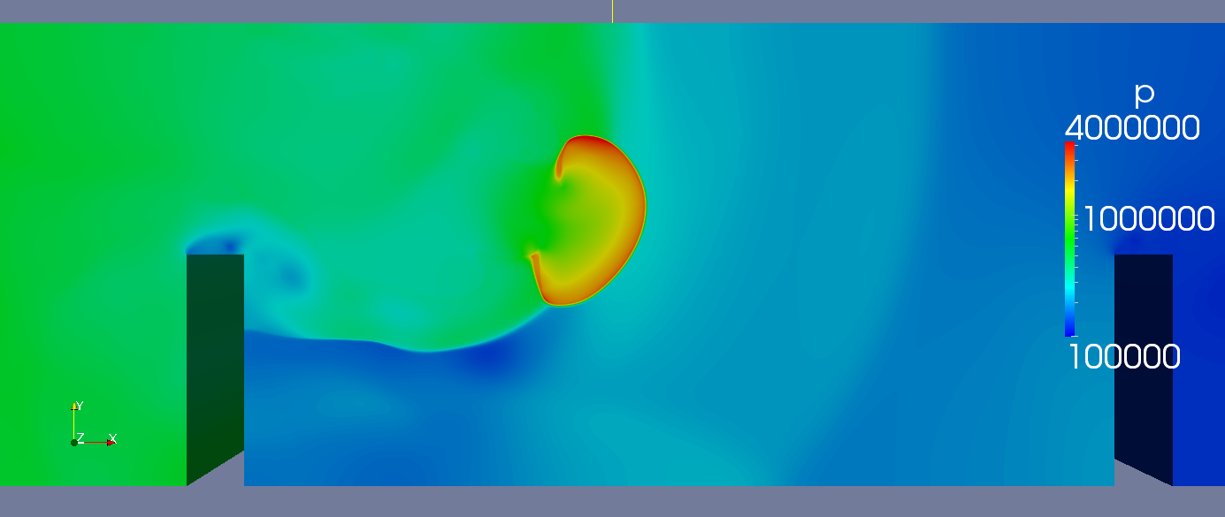
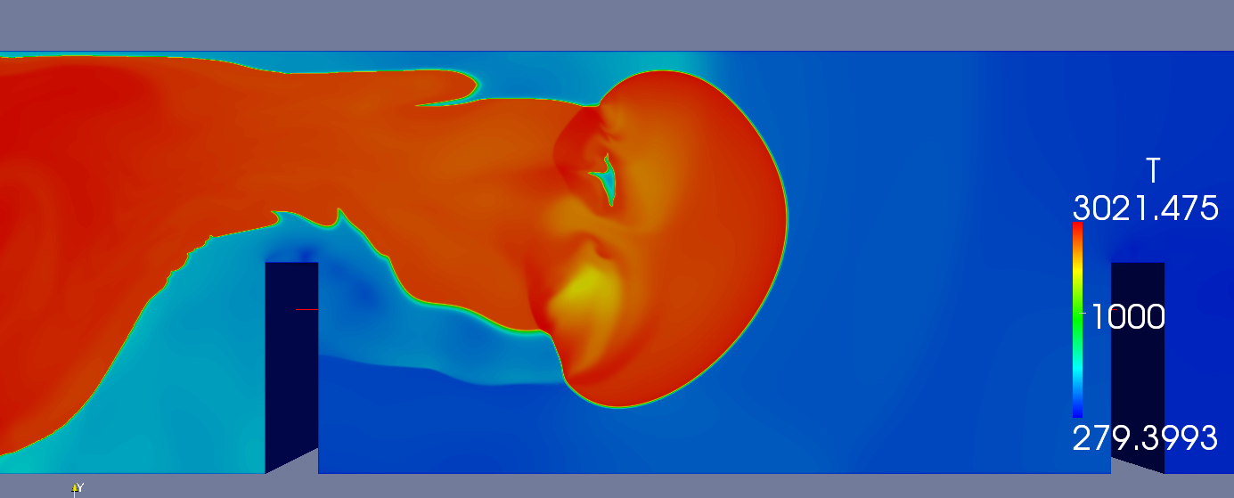
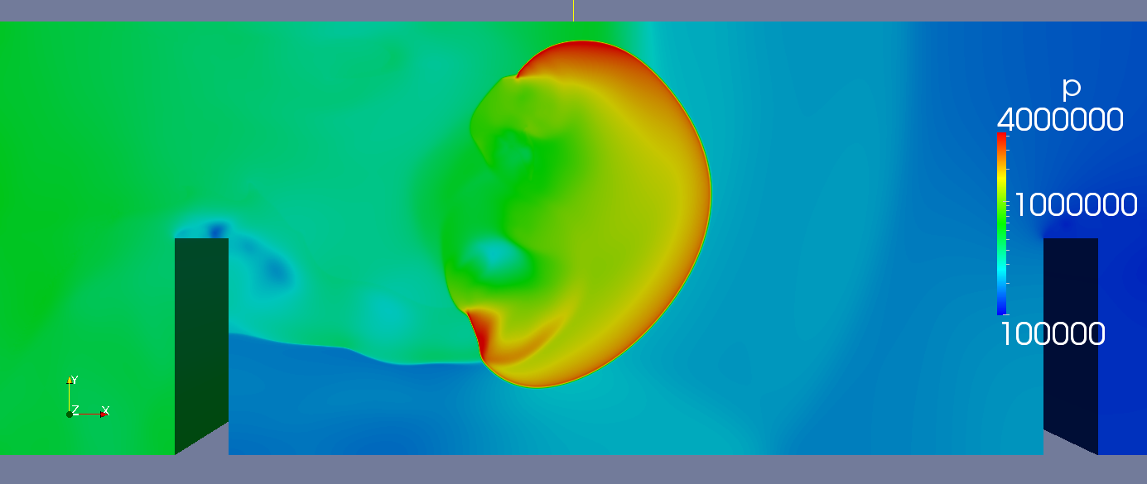
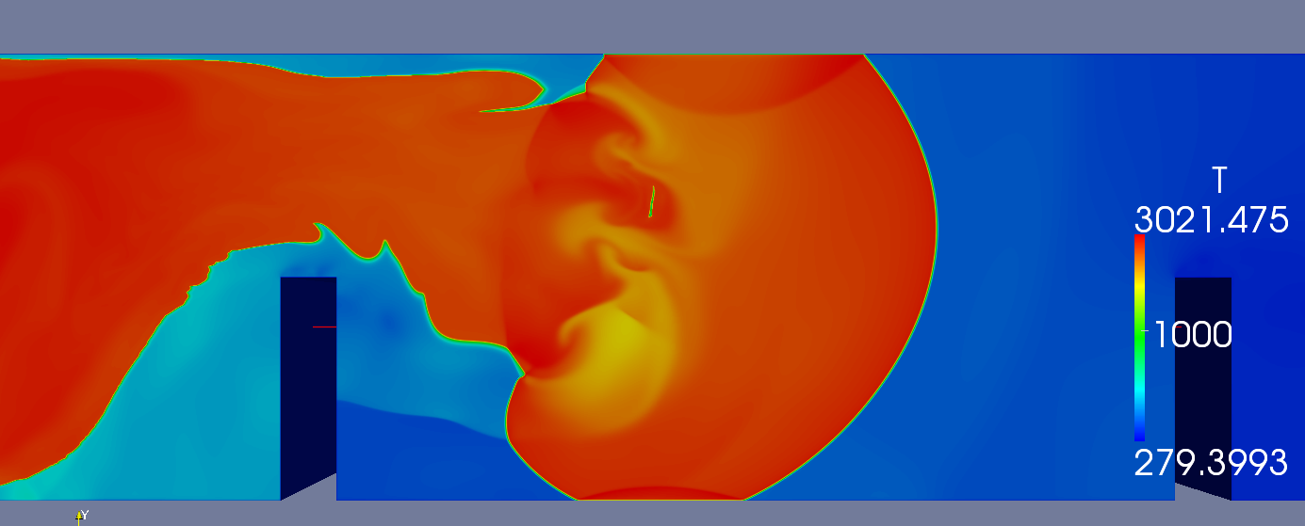
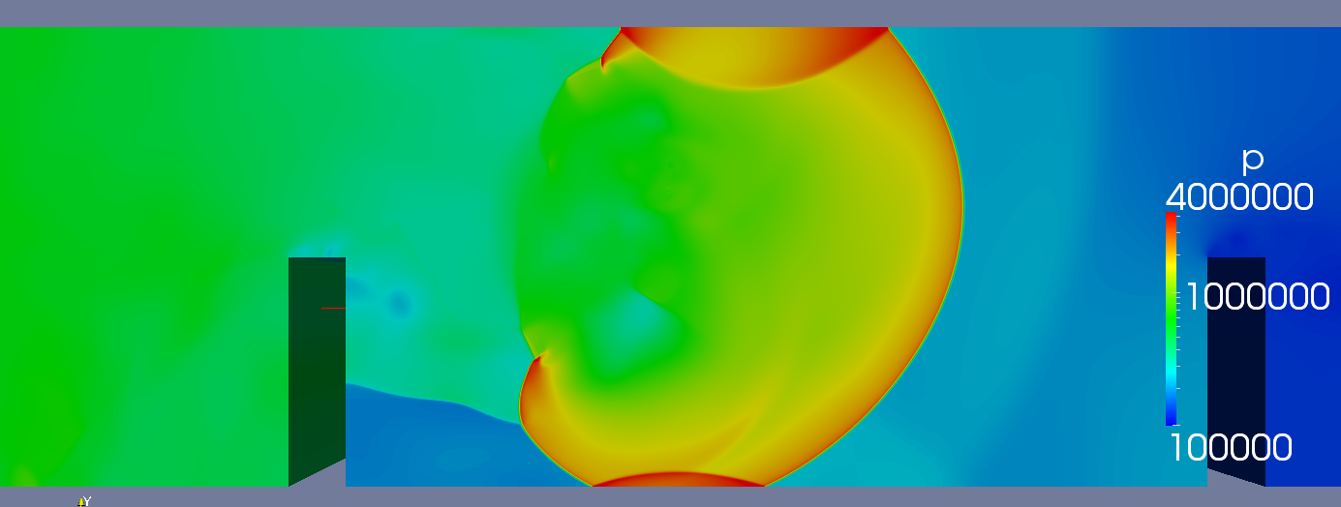
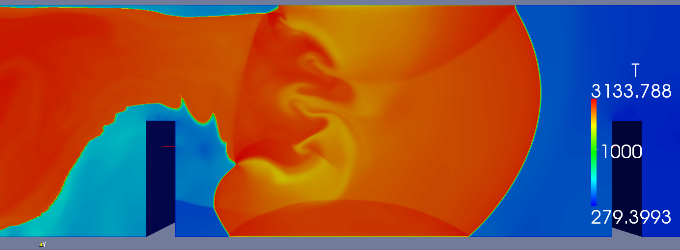
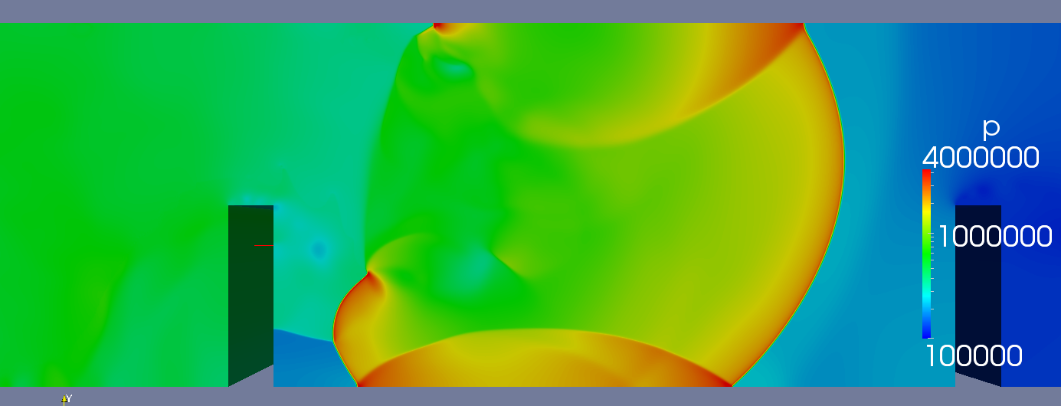
DDT
t=3.048 ms

Slide 15
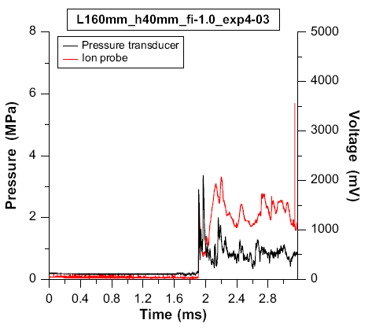
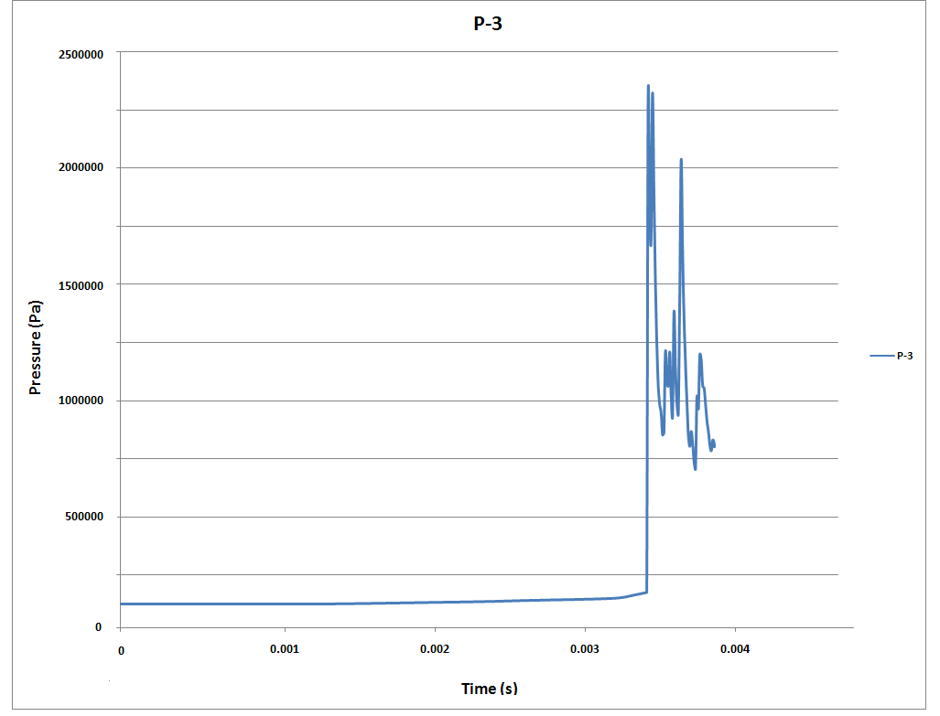
DDT
A. Teodorczyk, P. Drobniak, A. Dabkowski, “Fast turbulent deflagration and DDT of hydrogen–air mixtures in small obstructed channel”, International Journal of Hydrogen Energy, Volume 34, Issue 14, July 2009, Pages 5887-5893

Slide 16
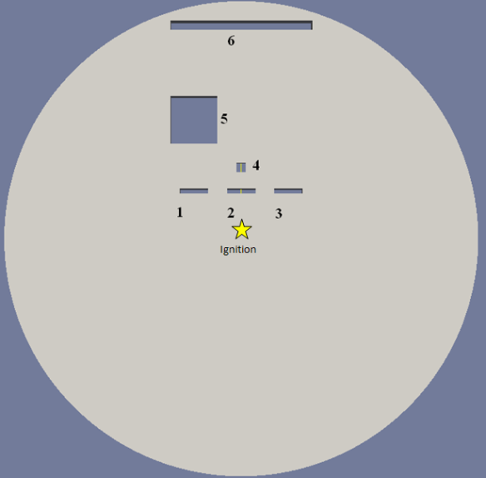
Comparison of the predicted temperature animation
Reactive Euler
Programmed CJ Burn
Small case 0.4 m diameter
Small case 10 m diameter

Slide 17
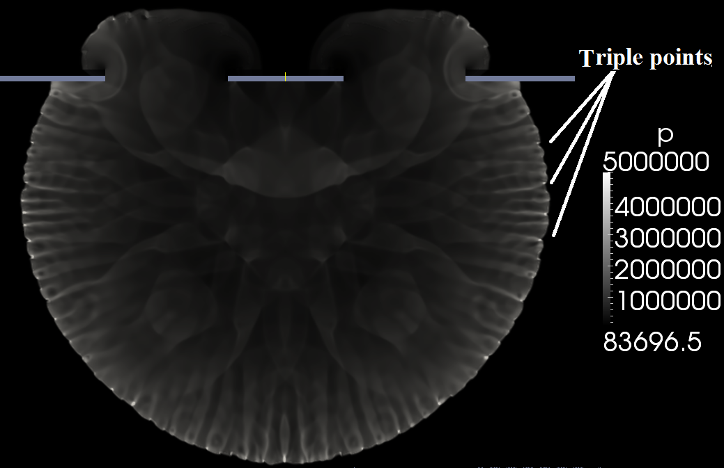
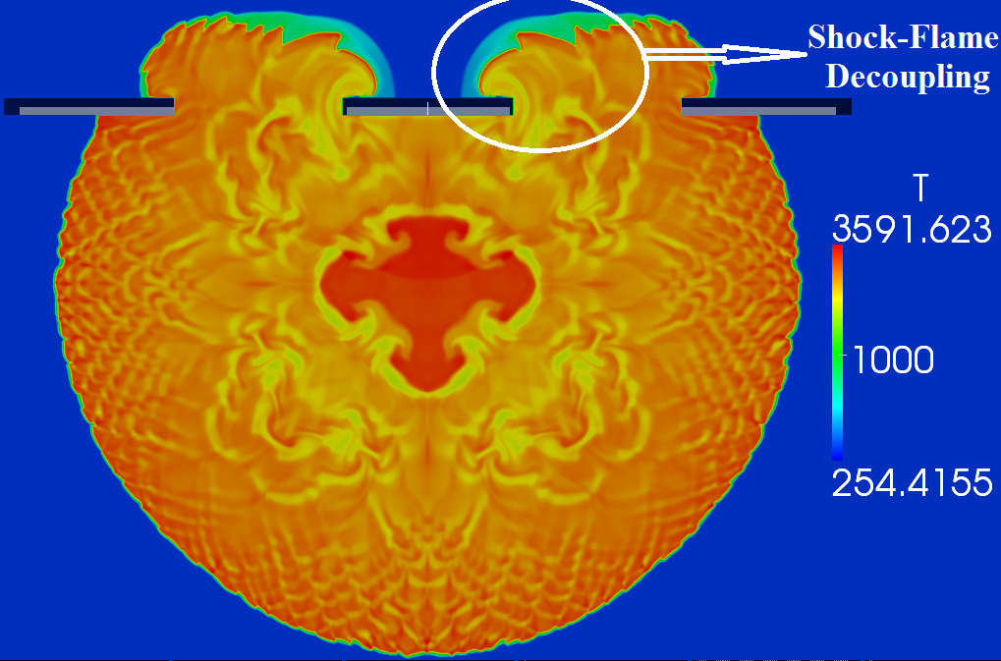
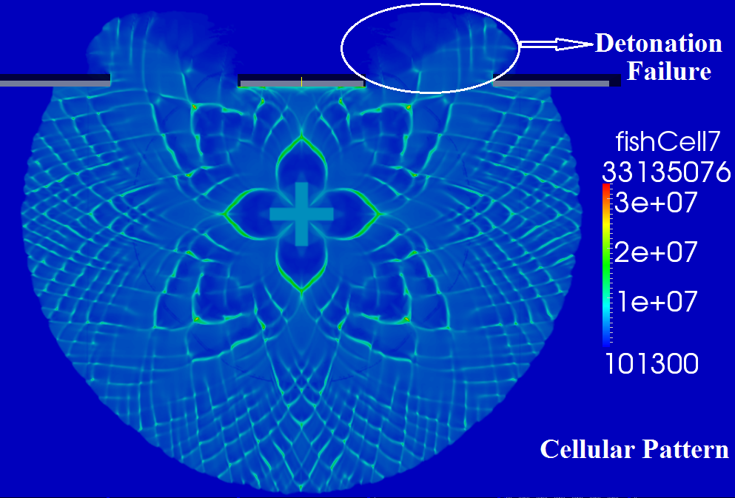
Detonation Failure while passing over obstacles
Small case 0.4 m diameter
Stoichiometric Hydrogen-Air mixture

Slide 18
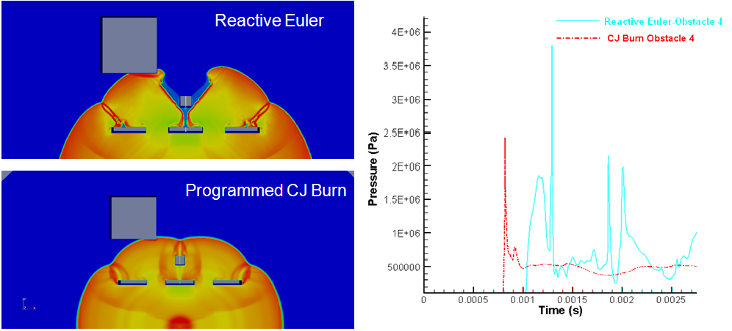
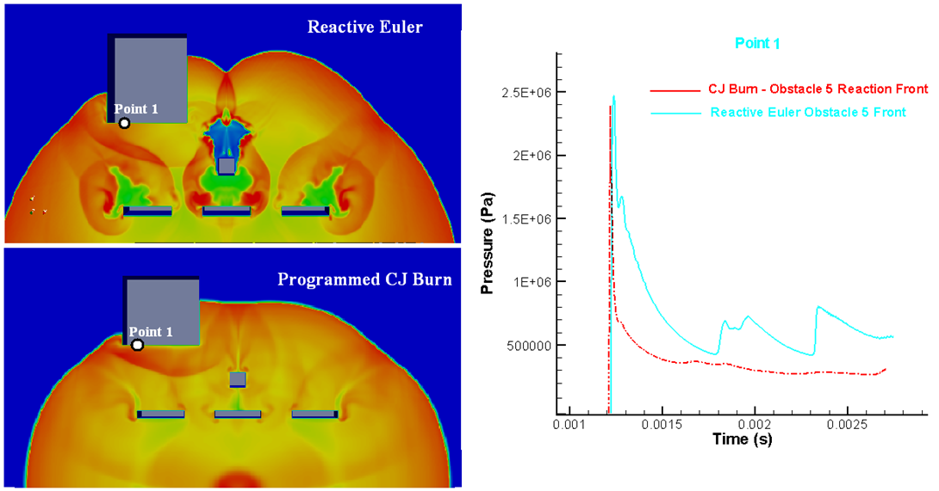
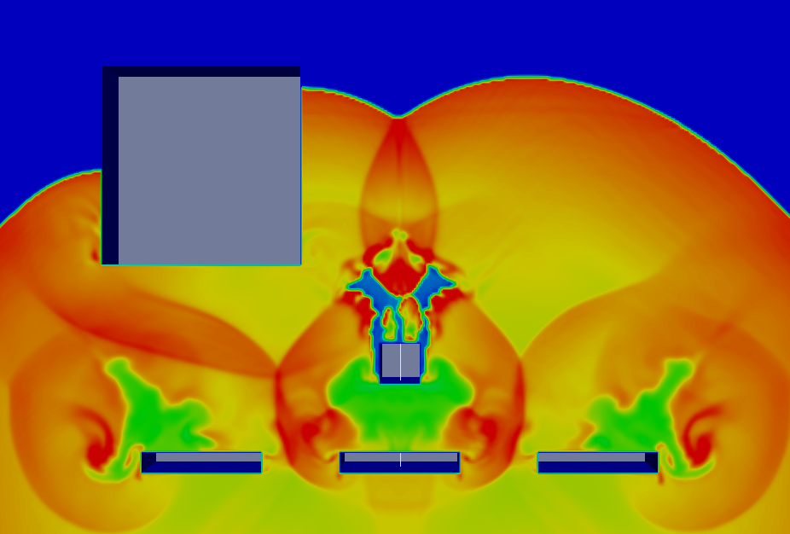
Programmed CJ Burn Technique →Detonation shock dynamics (DSD) – frequently used in hydrocode for detonation modelling
Constant velocity assumption for detonation propagation ( ) + fluid dynamics of detonation products
Detonation velocities have been observed to change by as much as 40% due to multi-dimensional effects. Failure of detonation waves has also been observed experimentally. Some other dynamic effects of detonation can not be predicted by such a simple propagation rule [*].
[*] Tariq D. Aslam, D. Scott Stewart “Detonation shock dynamics and comparisons with direct numerical simulation”, Los Alamos National Laboratory and University of Illinois, 1998.

Slide 19
Summery
A solver for simulation deflagration, flame acceleration and detonation is developed and validated under different conditions.
Unstructured mesh and Adaptive mesh refinement is used to increase the efficiency and reduce the computational cost.
Good agreement with experiments and other numerical works is achieved in detonation simulations.
DDT simulations are in good agreement with other numerical works.
Numerical simulations of Teodorczyk DDT experiment shows reasonable qualitative prediction of transition to detonation but no quantitative agreement is achieved.
Using different ignition and/or reaction mechanism could help to achieve quantitative agreement.

Slide 20
Thank you

