Slide 1

ANALYSIS OF THE PARAMETRIC-ACOUSTIC INSTABILITY FOR SAFETY ASSESSMENT OF HYDROGEN-AIR MIXTURES IN CLOSED VOLUMES
Yáñez, J., Kuznetsov, M., Redlinger, R., Kotchourko, A., Lelyakin, A.
J. Yáñez, et al. Analysis of parametric-acoustic instabilities for Hydrogen-Air mixtures

Slide 2
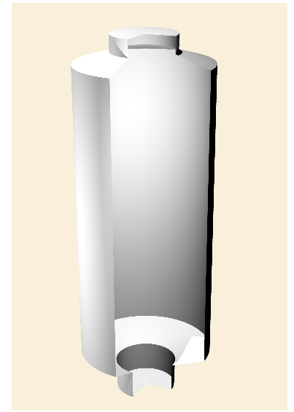
Introduction
  The interaction of flame fronts and acoustic waves

Slide 3
Introduction
  Feed-back process: pressure wave intensity and heat released influence each other
  The alternating velocity field created by the pressure waves produces oscillations of the amplitude of the cellular structures existing in the flames
  This variation of the surface modifies, in turn, the total amount of fuel consumed and the heat released by the flame

Slide 4
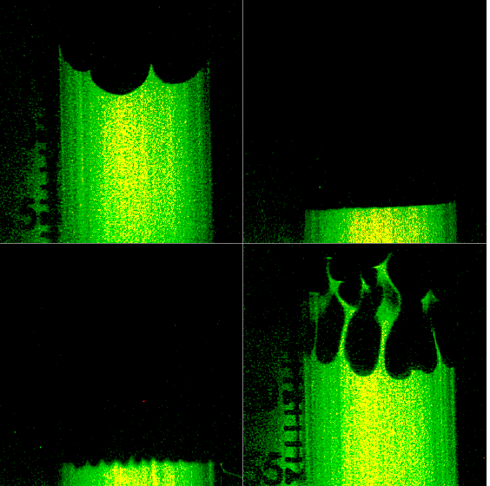
Introduction
Two different instabilities due to flame-pressure waves interaction
  Acoustic: flame front oscillate with the frequency of the acoustic alternating field (Figure A)
  Parametric: The cellular structures of the flame oscillate with half of the acoustic frequency
  (Figure B)
Institut de recherche sur les phénomènes hors équilibre
A
B
B

Slide 5
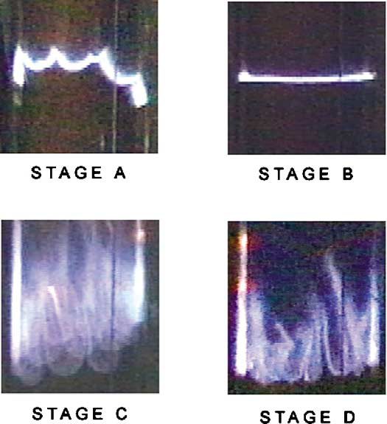
Introduction
Influence on explosion severity
  If the two instabilities do not co-exist in ranges of acoustic velocities
    The acoustic instability tends to suppress the Darrieus-Landau instability
    The parametric instability regime is never reached
    Planar flame fronts can be stable
  If the two instabilities co-exist
    Planar flame front is never stable
    The acoustic instability transform spontaneously into the parametric
Coexist?
R.C. Aldredge, N.J. Killingsworth / Combustion and Flame 137 (2004) 178–19

Slide 6
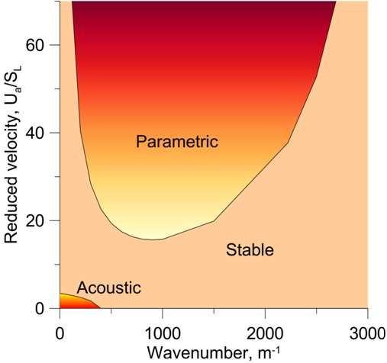
Introduction
Acoustic perturbations. Characterized by
Two main instability regions
  The acoustic region
  Parametric region
Parametric instability develops? Are regions separated by a band of acoustic intensities? Spontaneous transition impossible
Three parameters characterize the instability for every fuel composition, U_{a}, ω, g

Slide 7
Mathematical formulation
Flame front represented by F(x,t)=0 and F(x,t)≠0 elsewhere
Small perturbations of the front considered in the form
The stability problem formalized as
Coefficients of the equation function of the surface wavenumber and of the overall parameters of the flame
Coefficients
Overall flame parameters

Slide 8
Mathematical formulation
Bychkov analytical solutions derived in the limit of high acoustic frequency and long wavelength flame surface perturbations
Acoustic growth rate
Methodology valid provided

Slide 9
Mathematical formulation
Changing variables, the simplest equation
Solution of the form
Substituting this solution in the equation, the Mathieu equation for Y(z) is obtained
Y(z) numerically solved with the Whittaker’s and the Sträng methodologies (see article for details)

Slide 10
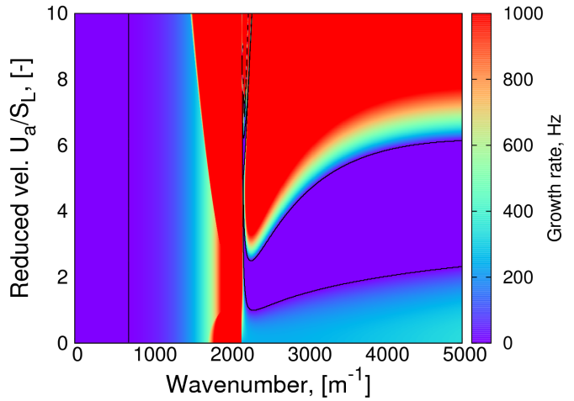
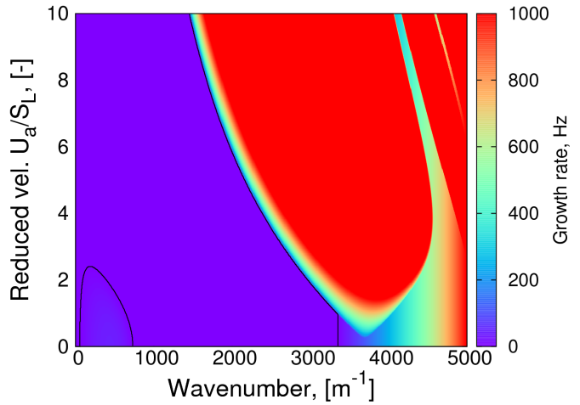
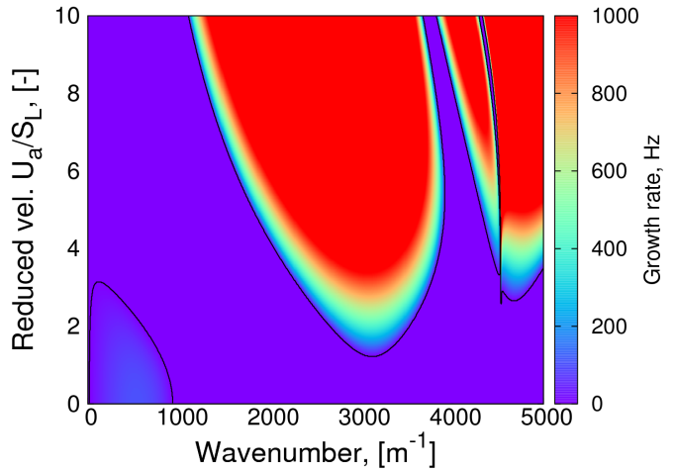
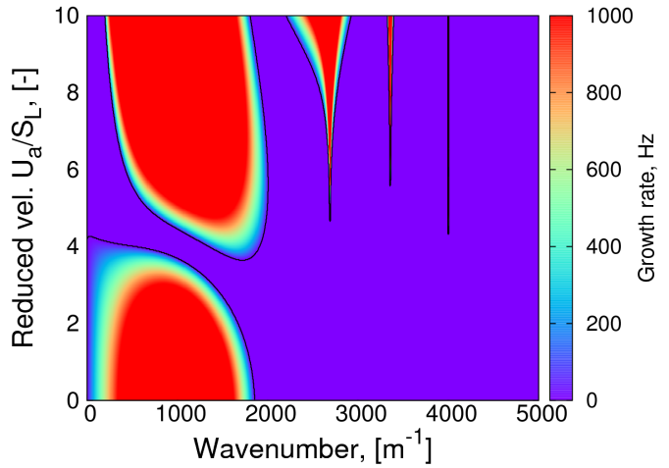
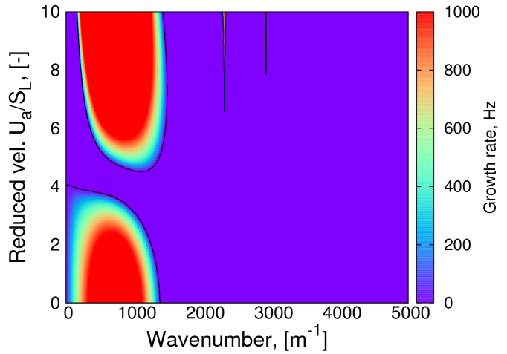
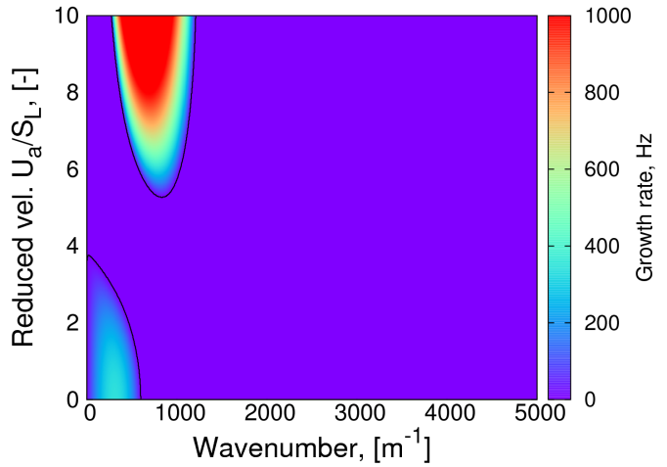
Acoustic-Parametric instability
Normal conditions P, T. Excitation frequency of 1000 Hz.
H₂ 7.5, 12.5, 15; 30, 45, 60 vol. H₂
Rich H₂-air mixtures more stable for acoustic-parametric instability

Slide 11
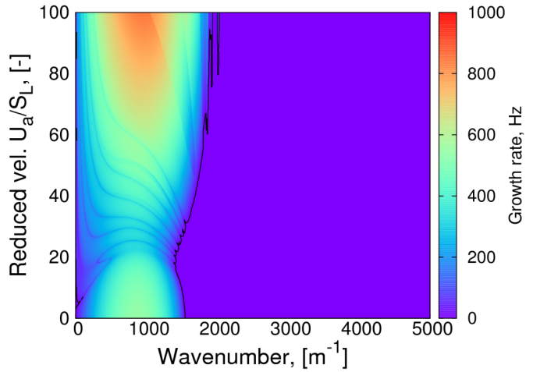
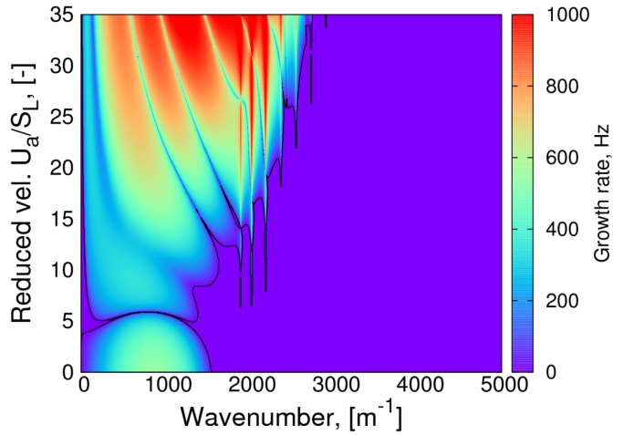
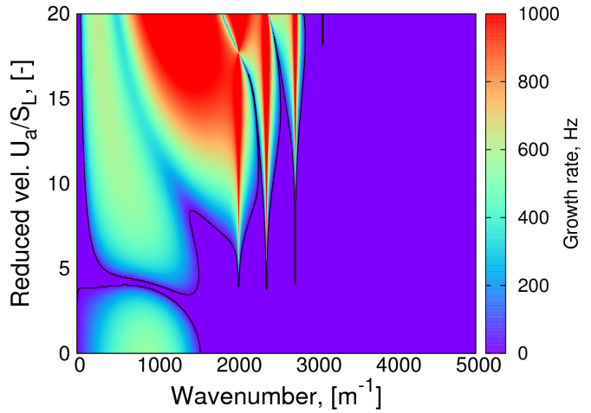
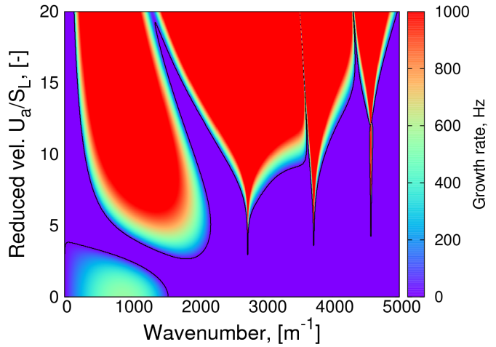
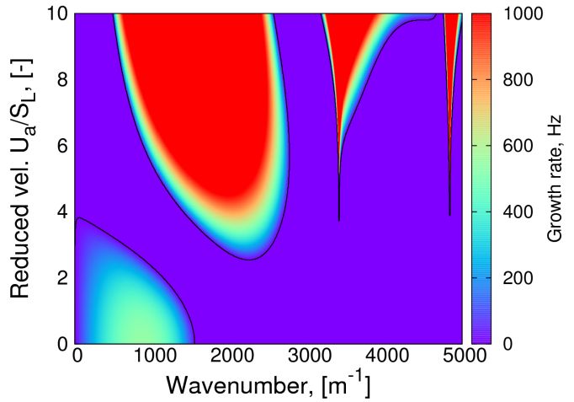
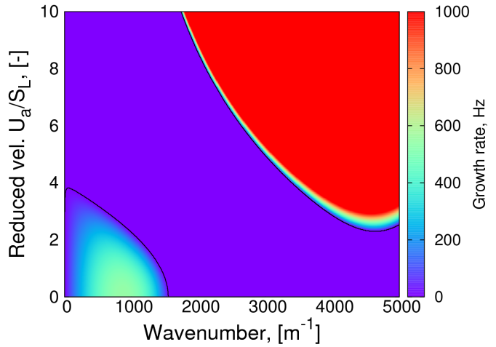
Acoustic-Parametric instability
20% vol. H₂-air. Normal conditions P,T
Excitation frequency of 20, 100, 200; 600, 1000, 4000 Hz
Higher frequency excitation implies more stable H₂-air mixtures

Slide 12
First conclusions
An enlarged perturbation frequency increases the thickness of the stability band
Higher perturbation frequencies enlarge the interval of concentrations in which the acoustic instability will not transform spontaneously into the parametric
In the extreme case of 20.0 Hz perturbations, no concentration interval resulted to be stable
Significant for the nuclear safety
  Contention building will produce such order of magnitude of frequencies

Slide 13
The existence of a new instability region for flame-pressure waves interaction which may exist for all mixtures with Le<1
We postulate:

Slide 14
Acoustic-Parametric instability
Whitaker solution fo the form
Necessary condition for stability
There exist a region for Lean mixtures. That is, a band of instability for all intensities of the perturbation is present
Ka is a resonance. Kb just stability limit
Ka and Kb are independent of the intensity and of the frequency on the perturbation

Slide 15
Acoustic-Parametric instability
The conditions in which κ is negative are Le<1
Experiments are necessary to prove postulate!
Distribution of the instability band with the concentration of H₂
For mixtures with more than 30% vol H₂ the mechanism do not exists
For concentrations bigger than 21% vol H₂ all short modes suffers such effect

Slide 16
Summary
The acoustic parametric instability was analysed under the conditions that apply for hydrogen safety assessment
Conditions to apply Bychkov methodology are not fulfilled. Solution must be numerical
Effect of H₂ concentration and excitation frequency on the flame response was analysed
  To higher H₂ concentration corresponds more stable mixtures, and more difficult transition from acoustic to parametric instability
  To higher excitation correspond a more stable response. Separation between the acoustic and the parametric instability grows with frequency
A new domain of instability was postulated for gaseous mixtures with Le<1. Its effect will be of significance for lean mixtures
Experimental confirmation of this new domain is needed

