Slide 1

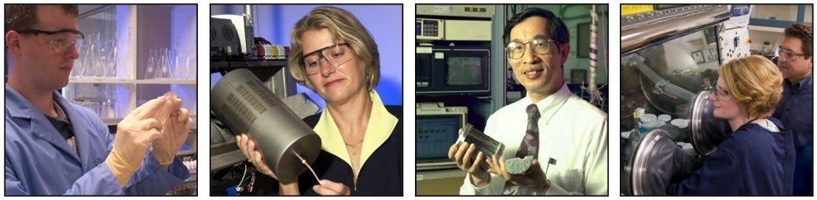
Risk Mitigation Strategies for Hydrogen Storage Materials
José A. Cortés-Concepción, Charles W. James, Susan M. Everett, David A. Tamburello and Donald L. Anton
September 13, 2011

Slide 2
Objectives
The objective of this study are to understand the safety issues regarding solid state hydrogen storage systems through:
Development & implementation of internationally recognized standard testing techniques to quantitatively evaluate both materials and systems.
Determine the fundamental thermodynamics & chemical kinetics of environmental reactivity of hydrides.
Build a predictive capability to determine probable outcomes of hypothetical accident events.
Develop amelioration methods to mitigate the risks of using these systems to acceptable levels.

Slide 3
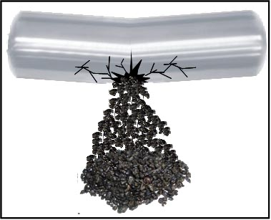
Relevant Accident Scenarios
Examining relevant accident scenarios based on risk analysis. (Y. Khalil, UTRC)
Vehicular collision leading to rupture of the vessel and spewing the material out of vessel
Vehicular collision leading to rupture of the on-board hydride storage vessel.
External fire beneath the on-board hydride storage vessel.
Effect
Probability
Notes:
As the project moves forward, our goal is to look at the relevant accident scenarios for our subscale modeling and testing.
Based on UTRC’s risk analysis, there are 3 scenarios that offer both a severe effect and a high probability, which include:
Vehicular collisions leading to rupture of the on-board hydride storage vessel that allows the environment (air, water, etc) into the tank.
Vehicular collisions leading to rupture of the vessel and releasing the material into the environment
External fire beneath the on-board hydride storage vessel.

Slide 4



UN Test Results
Follows the United Nation’s Recommendation on the Transport of Dangerous Goods: Manual of Tests and Criteria (in conjunction with DOT)

Slide 5
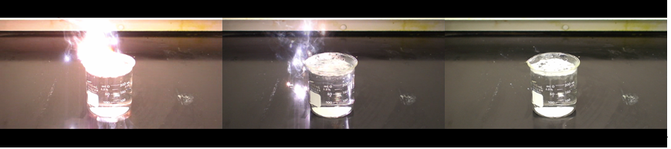
Alane Water Immersion Test
Time
Material was synthesized chemically (Finholt et al. J. Chem. Soc., 69 (1947)) by Joe Teprovich and Ragaiy Zidan (SRNL).
Identity of material was confirmed by XRD as α-AlH₃ with aluminum impurity. A crystallite size of 40 nm was calculated by Sherrer method.
Material sparked upon contact with water. Precipitate formed upon completion of reaction.

Slide 6
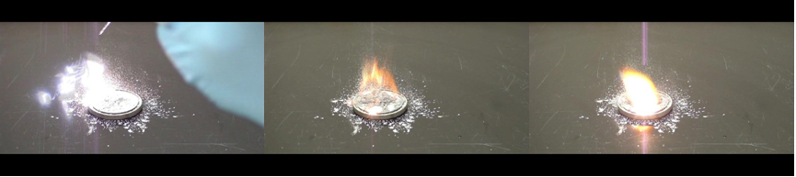
Alane UN Water Drop Test
Time
A conical-shaped pile of Alane was placed inside of a laboratory hood and a water drop is added on top of the pile.
Sample reacted upon contact with water, initiating an ignition event. The pile showed an orange-white flame.

Slide 7
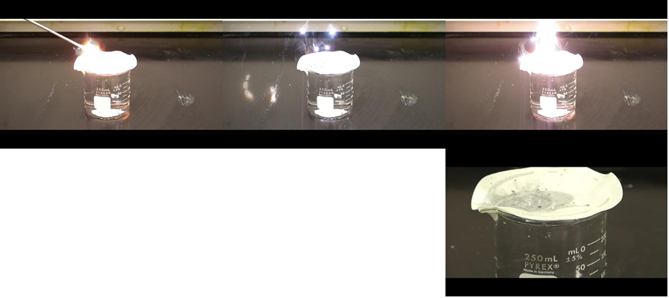
Alane Wet Surface Contact
Time
Sample reacted by sparking instantaneously upon contact for a few seconds.
Residual material bubbled for about 15 minutes.
Time

Slide 8
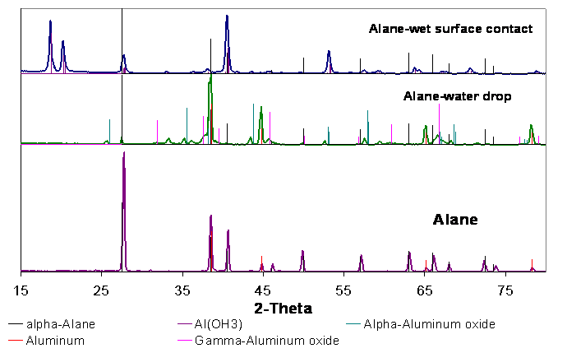
XRD Results for Alane Water Reactivity
Al(OH)₃,
α-AlH₃
Al, α-AlH₃,
α-Al₂O₃, γ-Al₂O₃
α-AlH₃, Al
In the Water Drop Test, the heat generated by droplet initiates the combustion of Alane that forms primarily aluminum oxide.
The larger amount of water present in the Wet Surface Contact Test dissipates heat, avoiding ignition beyond that of sparking. Material releases hydrogen as it produces aluminum hydroxide.

Slide 9
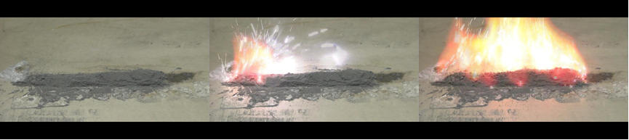
Alane Burn Rate Test
Time
Modified scale burn rate test was conducted (100 mm L x 10 mm H x 20 mm W).
Test result validity has been assessed with other materials (~3% difference).
Flame propagation rate ~ 250 mm/sec.
Reactivity Rank:
8LiH·3Mg(NH₂)₂ > AlH₃ > NaAlH₄ > 2LiBH₄·MgH₂ > NH₃BH₃

Slide 10
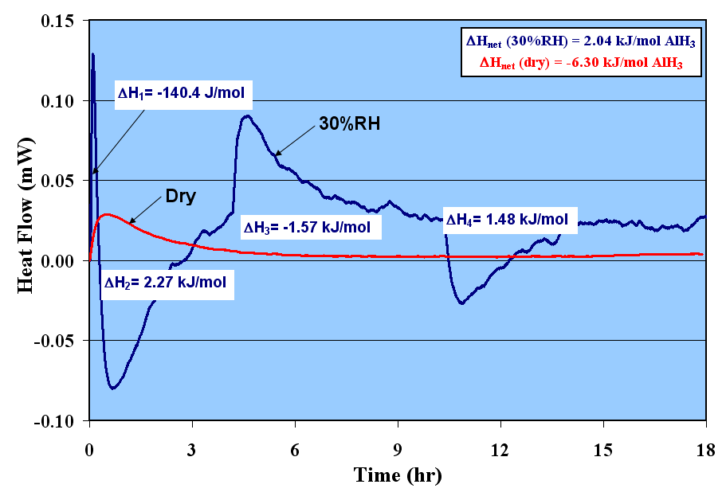
Calorimetry of Alane: Air exposure at 40 ºC
2AlH₃ → 2Al + 3H₂
The initial exothermic event (ΔH₁) is due to the water vapor interaction with AlH₃.
A competing effect is believed to take place between the dehydrogenation of AlH₃ (endothermic) and the oxidation of Al (exothermic).
Subtle changes in crystal structure are difficult to identify from reacted samples by XRD.
Notes:
This slide shows calorimetry results for alane at 40 ºC.
The graph shows heat flow versus time, with the red curve representing alane in dry air and the blue curve representing alane in air with 30% relative humidity.
The dry air results [red line] are typical for what we’ve seen in previously studied materials.
However, the water vapor results are drastically different, with the reaction changing from exothermic to endothermic throughout the experiment, beginning with the exothermic heat release.
The curve then shows the competing effects of the oxidation of aluminum [exothermic] and the dehydrogenation of alane [endothermic].

Slide 11
Risk Mitigation
Water reactivity testing of common commercial flame retardants
    Deca-bromodiphenyl ether/ antimony oxide
    Metal-X
    Aluminum hydroxide
Four risk mitigation strategies (A, B, C, D) have been identified and tested in 8LiH·3Mg(NH₂)₂
Testing strategies include:
  UN Water Drop Testing
  Water Vapor Calorimetry
  Cycling Experiments w/ Seivert’s Apparatus
Risk mitigants were successfully identified for aluminum hydride and lithium borohydride

Slide 12
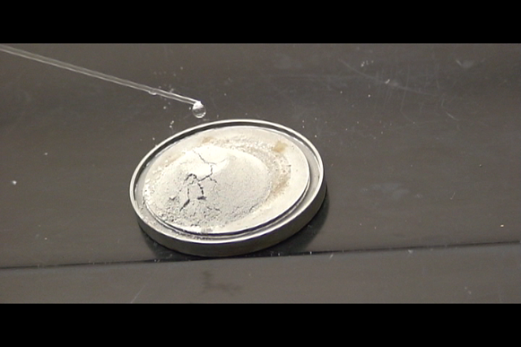
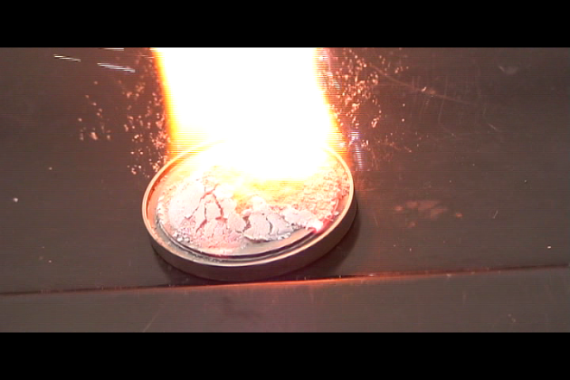
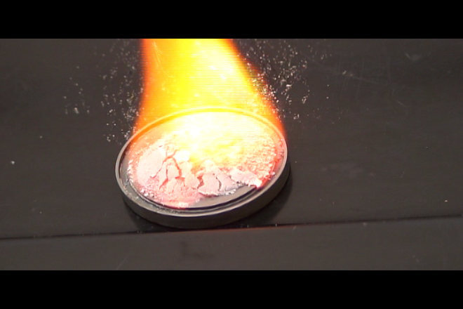
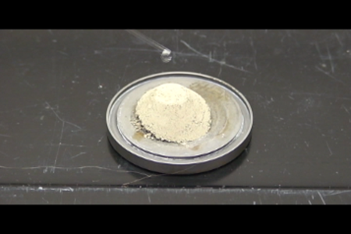
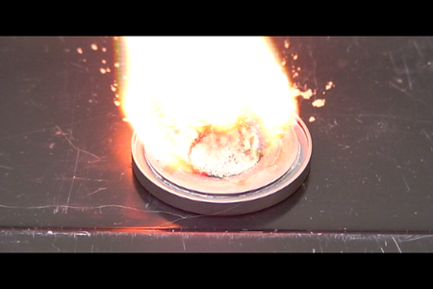
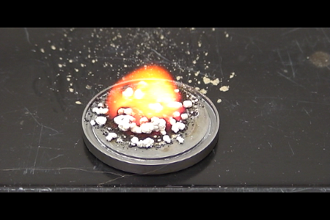
Decabromo diphenyl ether (Deca-BDE)
Sample
After 1st drop
Modified Sample
After 1st drop
Time
Deca-BDE containing sample exhibits vigorous reaction
Possible side reaction leading to formation of metal bromides

Slide 13
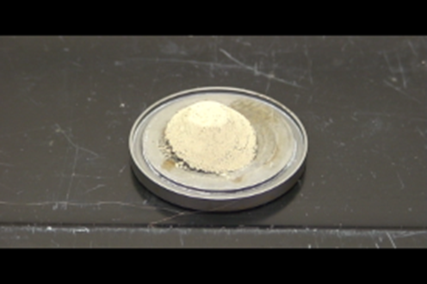
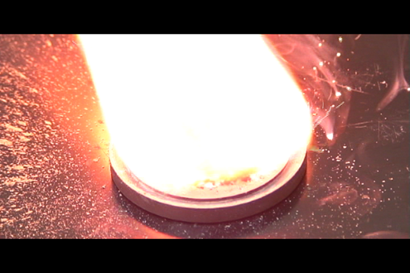
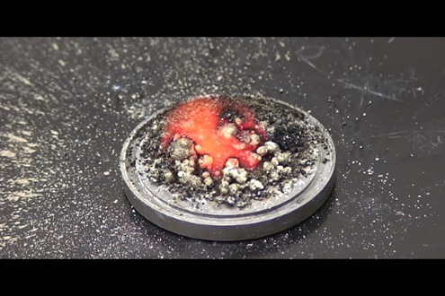
Decabromo diphenyl ether (DBDE+Sb₂O₃)
Sample
After 1st drop
Modified Sample
After 1st drop
Time
Deca-BDE+SB₂O₃ containing sample exhibits vigorous reaction
Possible side reaction leading to formation of metal bromides

Slide 14
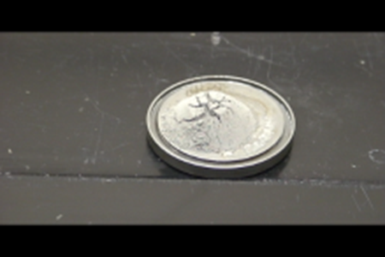
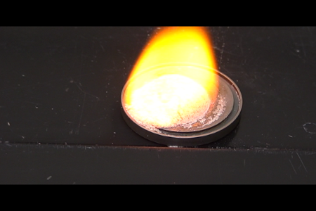
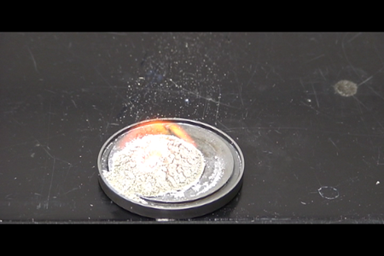
Metal-X
Sample
After 1st drop
Modified Sample
After 1st drop
Time
Modified sample ignited upon contact with water
Marginal effect observed in reactivity

Slide 15
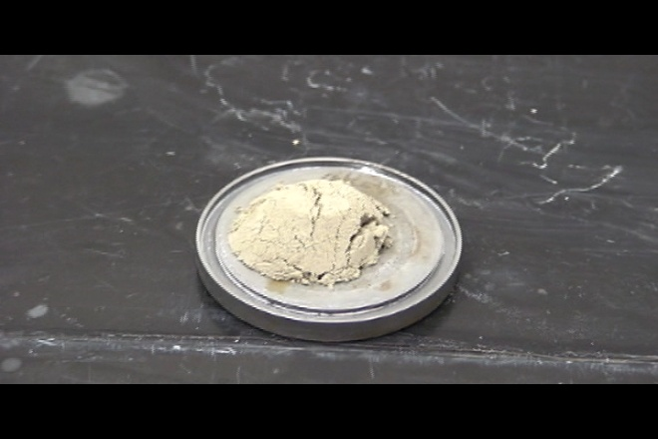
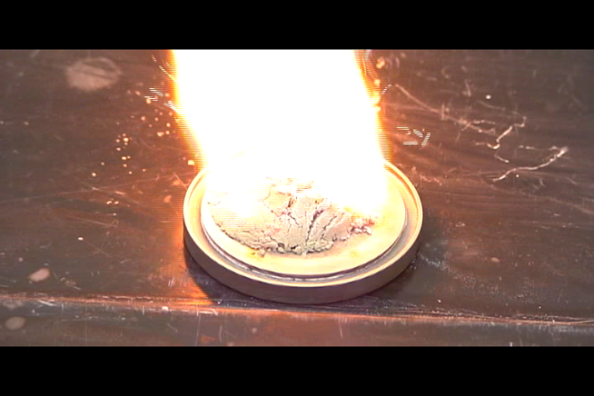
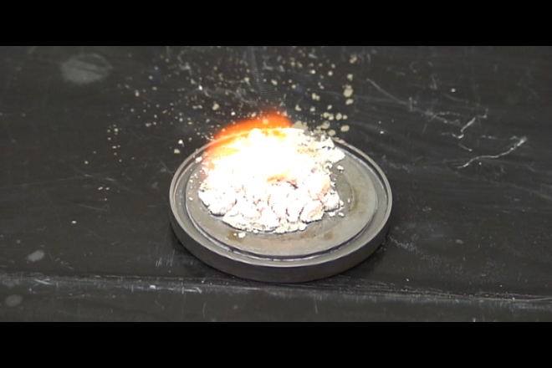
Aluminum hydroxide
Sample
After 1st drop
Modified Sample
After 1st drop
Time
Modified sample ignited upon contact with water
No differences observed compare to unmodified sample

Slide 16
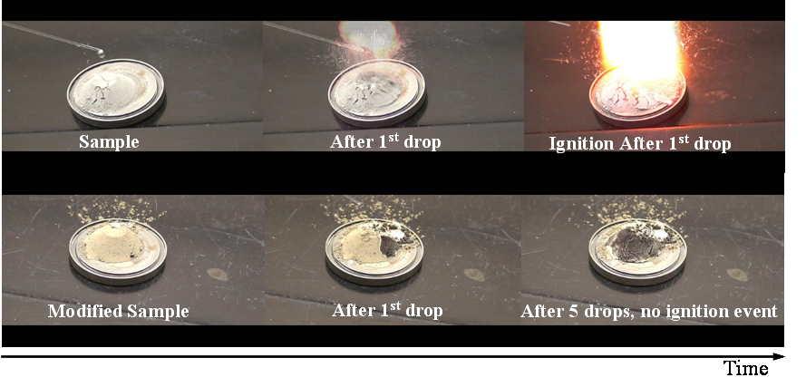
8LiH:3Mg(NH₂)₂ Water Drop Test
Reactivity towards water is reduced.
Risk mitigation strategy A avoid ignition event characteristic of unmodified sample

Slide 17
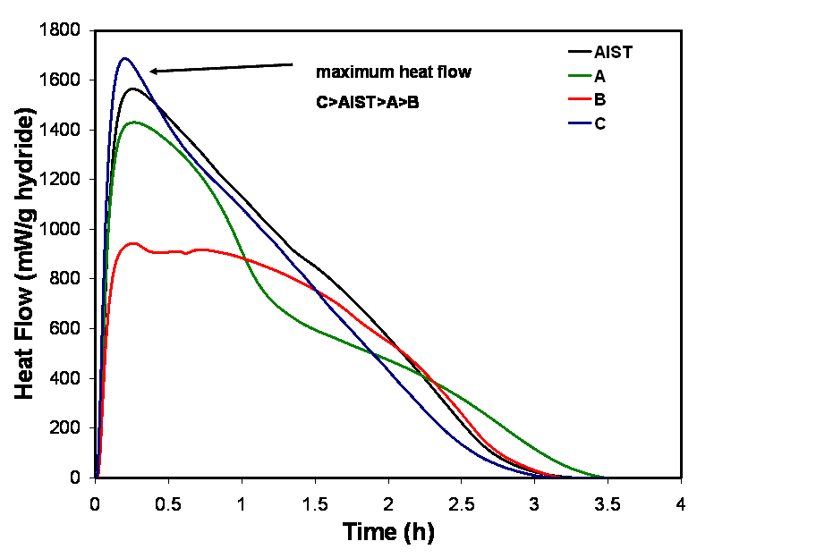
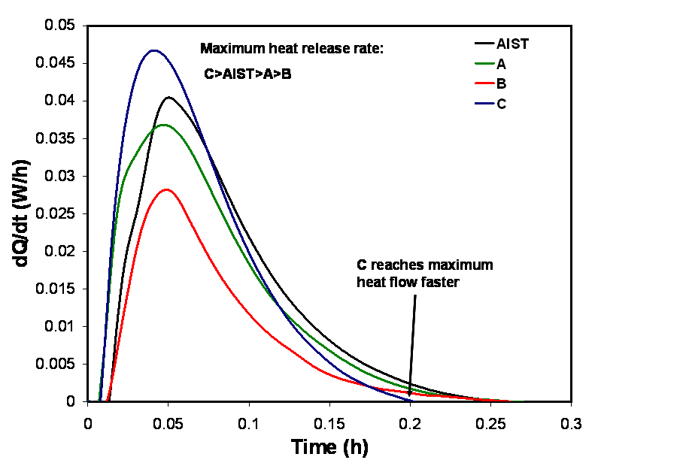
Risk Mitigation-Calorimetry, T=40°C, RH=30%
Comparable heat release for unmodified samples to A and C.
  Mitigant might not be affecting the release of hydrogen
The rate of heat release:
  C > AIST > A > B

Slide 18
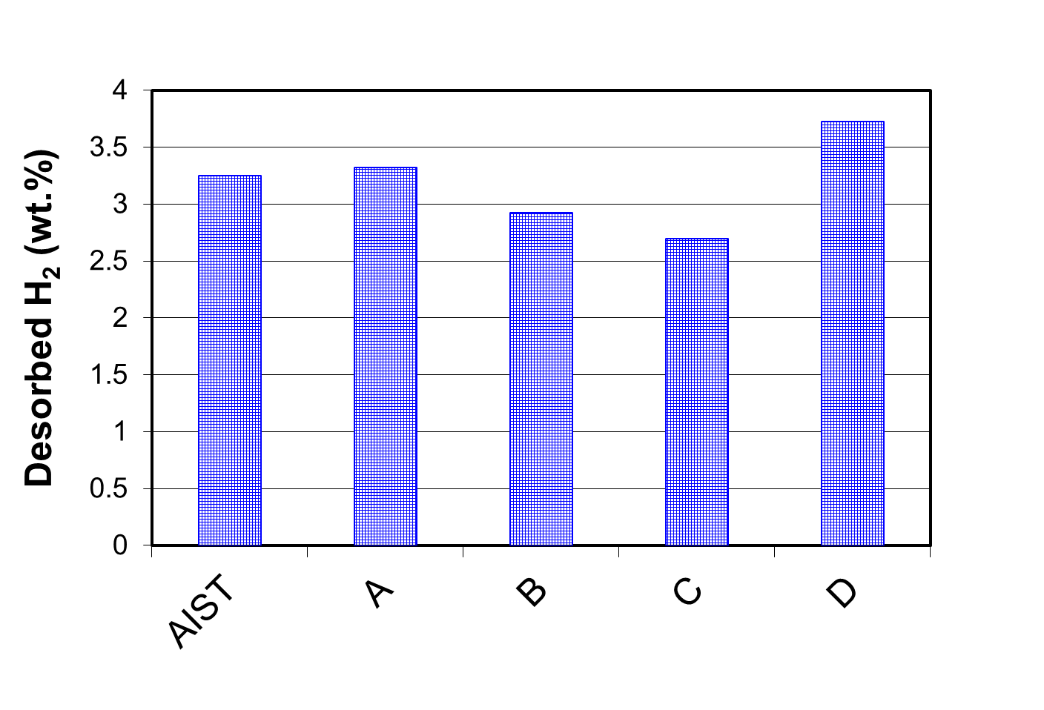
Risk Mitigation-Cycling
Isothermal Cycling at 200ºC, 1 bar (Desorption), 100 bar (absorption)
Average capacity over a minimum of 4 cycles excluding the 1st cycle.
No significant effect of modifier in the hydrogen storage capacity

Slide 19
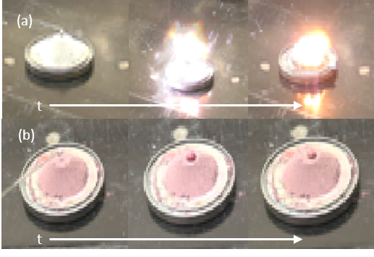
Alane Water Drop Test
No ignition on modified sample
Modified sample shows hydrophobic character
Modifier did not affect the desorption of hydrogen

Slide 20
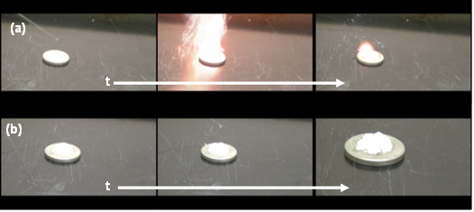
Lithium Borohydride (LiBH₄) Water Drop Test
No ignition of modified sample
Modified sample agglomerates and partially dissolves
Modifier is an effective mitigant even a low loadings (~1 wt%)

Slide 21
Summary
Alane has unique environmental reactivity properties; non-pyrophoric, but highly water-reactive resulting in “sparking” as opposed to ignition.
Calorimetry behavior of alane is unique in the presence of water as oxidation and dehydrogenation compete.
Commercial flame retardants tested in 8LiH·3Mg(NH₂)₂ proved to be ineffective.
Novel mitigants were identified for 8LiH·3Mg(NH₂)₂, AlH₃, and LiBH₄.
Some mitigants tested are potential additives to hydrogen storage materials due to kinetic enhancing effects observed under cyclic conditions.

Slide 22



Acknowledgements
A Special Thanks to the following people:
  SRNL
  Josh Gray
  Kyle Brinkman
  Joe Wheeler
  Ragaiy Zidan
  Joe Teprovich
  Department of Energy
  Ned Stetson, Program Manager

