Slide 1
Numerical Investigation of Subsonic Hydrogen Jet Release
Boris Chernyavsky¹, Pierre Benard¹, Peter Oshkai² and Ned Djilali²
¹Hydrogen Research Institute, Trois-Rivieres, QC, Canada
²Institute for Integrated Energy Systems, Victoria, BC, Canada
4th ICHS San Francisco, 12-14 September 2011
Notes:
1

Slide 2
Motivation (I)
Existing safety standards for hydrogen storage, transportation and utilization are often excessively conservative. Further expansion of hydrogen-based infrastructure is hinged upon the development of guidelines for safety standards. Development of new safety codes requires reliable characterization of emergency gas release/leak processes and the extent and evolution of the resulting flammable gases concentration fields in a variety of environmental conditions, with account for variable such as:
release velocity
distance from the underlying surface
cross-wind conditions
Due to the safety concerns and high expense of experiments, a tool of choice is numerical simulation.
4th ICHS San Francisco, 12-14 September 2011
Notes:
2

Slide 3
Motivation (II)
Good agreement with published averaged concentrations data. Demonstrated data collapse for various Froude numbers. Clear illustration of buoyancy effects.
However, published works also note significant disagreement between predicted (from averaged fields) and experimentally measured ignition distances for the jets. It is suggested that the cause lies in a turbulence-driven transient effects.
Need for high-fidelity fully time-dependent simulation with accurate turbulence modeling
4th ICHS San Francisco, 12-14 September 2011
Notes:
3

Slide 4
Project Outline
Objective: perform time-dependent modeling of hydrogen jet release and investigate the extent and importance of transient concentration fields and their relative contribution to the extent of flammable gas concentration envelope.
Approach: Large Eddy Simulation (LES)
Tools: Fluent, SPARC
Modeling: Step 1 – Validation of LES simulation, including turbulence characteristic by comparison of Helium jet simulation with experimental (University of Victoria) and previously published results.
Modeling: Step 2 – LES of hydrogen jet. Comparison with published data as additional validation. Investigation of turbulence influence on the concentration fields and the extent of transient flammable envelope.
Modeling: Step 3 - Investigation of detailed structure of transient flammable concentration envelope.
4th ICHS San Francisco, 12-14 September 2011
Notes:
4

Slide 5
Case: Vertical jet for Air, Helium and Hydrogen cases. Conditions are chosen to match experiment for validation. M=0.3 gas release.
Domain: High resolution grid is used for LES for accurate capture of turbulence. The potential of grid refinement reduction will be investigated through comparison of experimental and numerical data.
Simulation restricted to a momentum-dominated region (35 D long domain). Physically correct inflow conditions are generated by utilizing 1D long cylindrical nozzle. Turbulence data analysis requires extended statistics acquisition.
4th ICHS San Francisco, 12-14 September 2011
Notes:
5

Slide 6
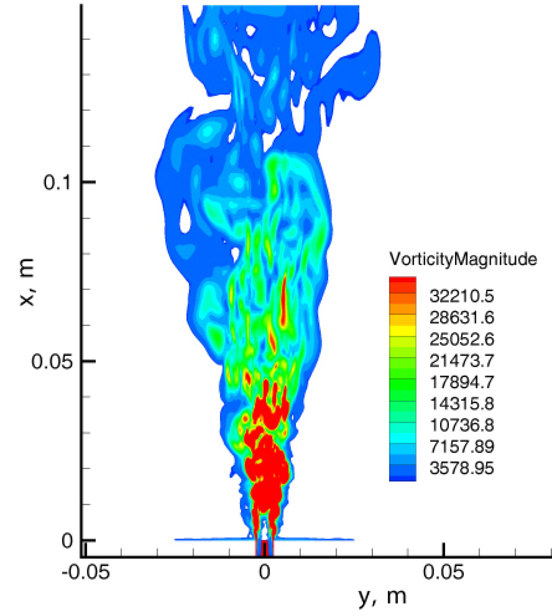
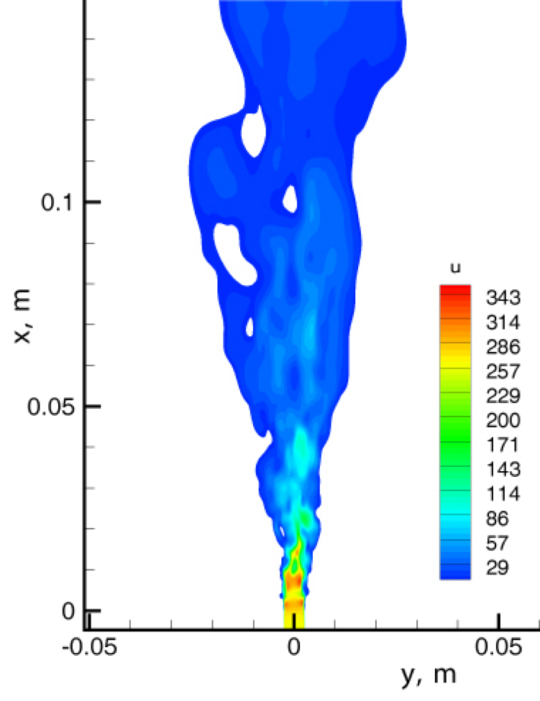
Numerical LES of near field Initial Condition influence
Vorticity magnitude contours (left) and instantaneous velocity contours (right)
4th ICHS San Francisco, 12-14 September 2011
Notes:
6

Slide 7
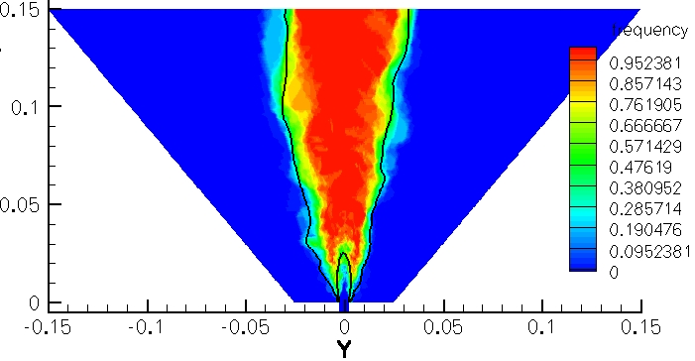
Frequency of “flammable”* condition occurrence, Helium jet
* same concentration range as for the Hydrogen , 0.04 < X [He] < 0.75 is designated “flammable” for comparison purposes
4th ICHS San Francisco, 12-14 September 2011
Notes:
7

Slide 8
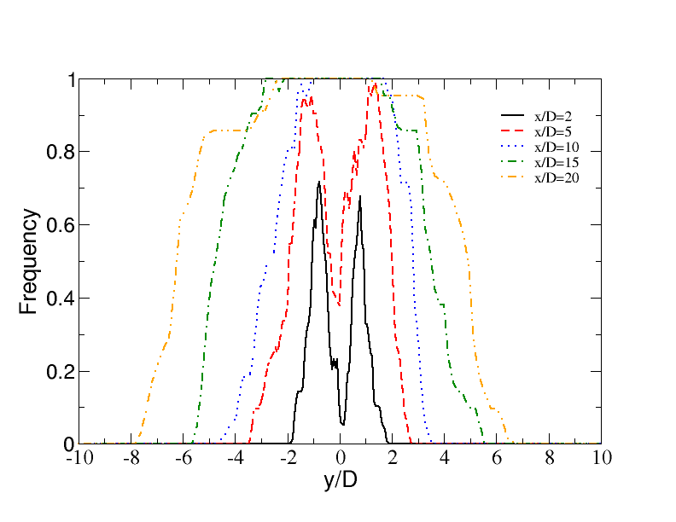
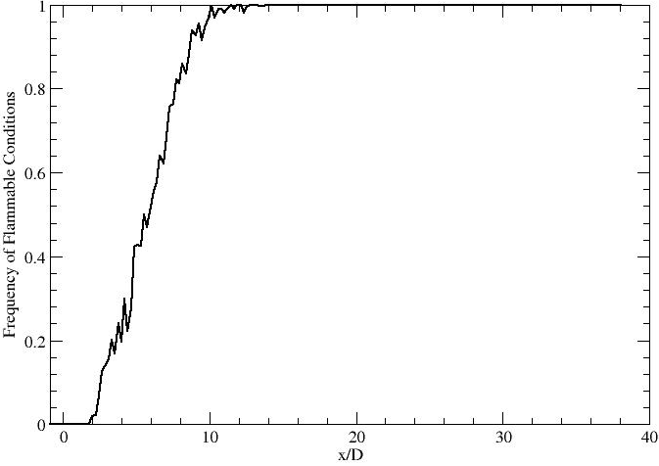
Frequency of “flammable” condition occurrence along the centerline
Frequency of “flammable”* condition occurrence, Helium jet
* same concentration range as for the Hydrogen , 0.04 < X [He] < 0.75 is designated “flammable” for comparison purposes
4th ICHS San Francisco, 12-14 September 2011
Notes:
8

Slide 9
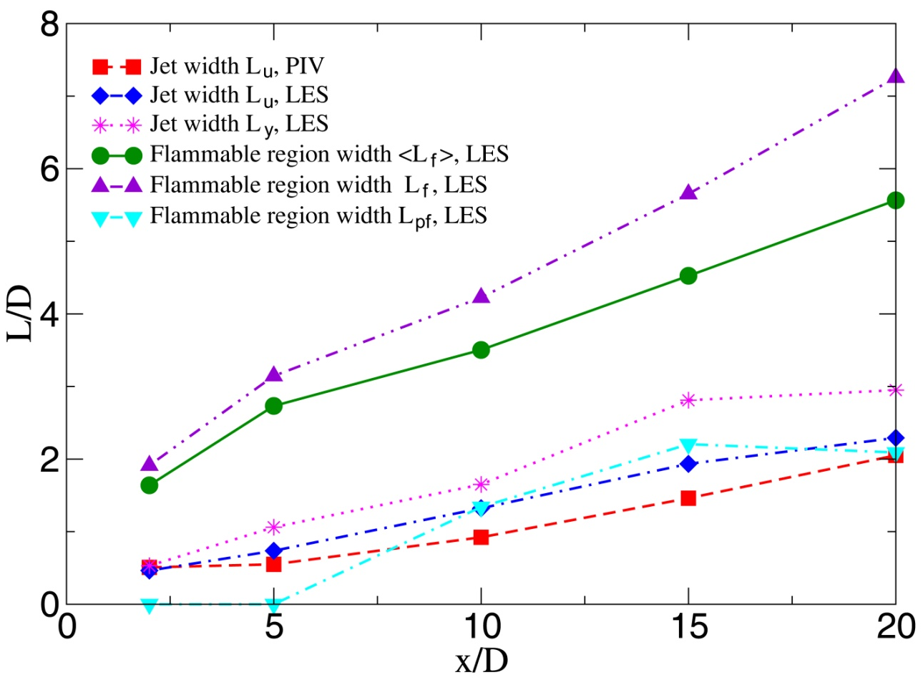
Jet spread rate and transient flammable area extent L_{f} – maximum extent of transient flammable area <L_{f}> - flammable envelope based on mean concentrations L_{pf} – extent of persistently flammable area
4th ICHS San Francisco, 12-14 September 2011
Notes:
9

Slide 10
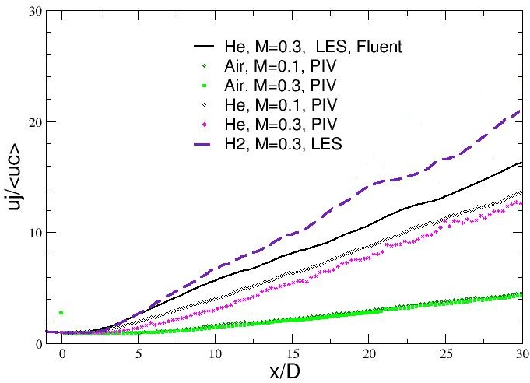
u_{c}⁻¹ ~ x at x/D > 5 potential core ~ 2-3 x/D
x_{vo} = -0.3 x/D (experiment -0.2 x/D)
Axial velocity decay A (u_{j}/u_{c} = 2A((x-x_{vo})/D_{ef})
A=0.099 vs. 0.063 experiment
4th ICHS San Francisco, 12-14 September 2011
Notes:
10

Slide 11
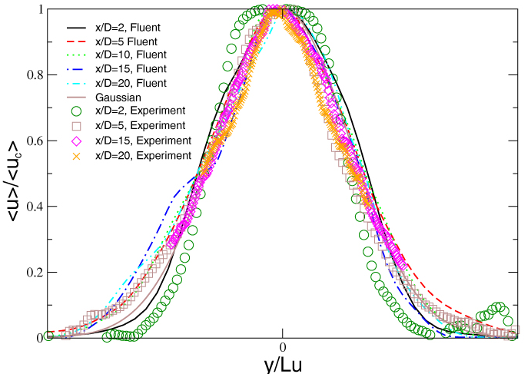
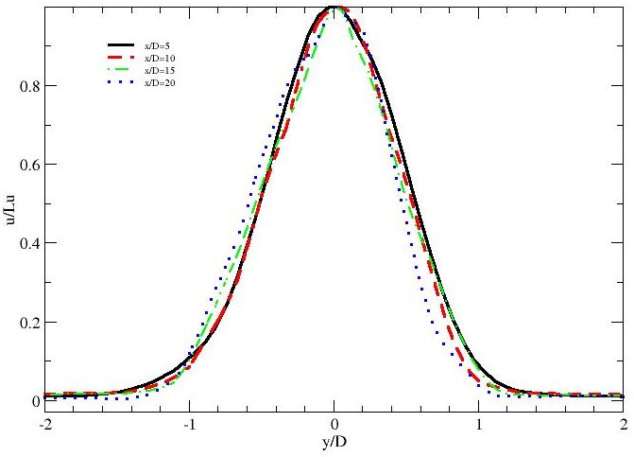
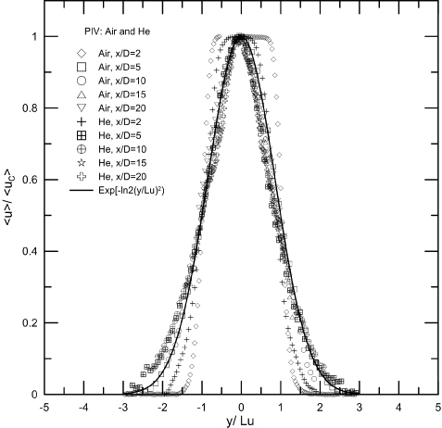
Mean velocity profiles normalized by centerline velocity u_{c} and jet half-width Lu.
Left – Helium, right – Hydrogen. Lower right figure shows PIV data for Air -Air and Air-He jets and comparison with LES.
4th ICHS San Francisco, 12-14 September 2011
Notes:
11

Slide 12
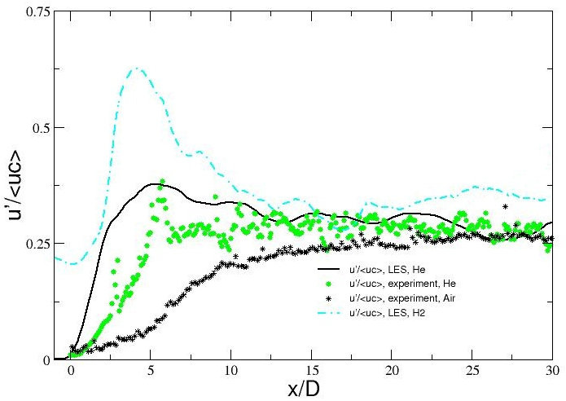
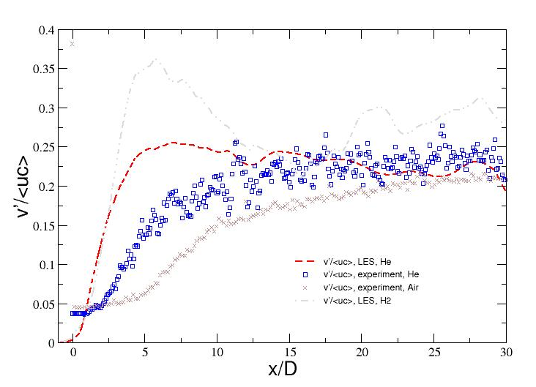
RMS to Mean velocity ratios u'/<u_{c}> (left) and v'/<u_{c}> (right) for Air, Helium and Hydrogen
asymptotic ratios:
Helium: u'/<u_{c}> ~ 0.28 at x/D > 15 v'/u' ~ 0.78
Hydrogen: u'/<u_{c}> ~ 0.35 at x/D > 15 v'/u' ~ 0.86
4th ICHS San Francisco, 12-14 September 2011
Notes:
12

Slide 13
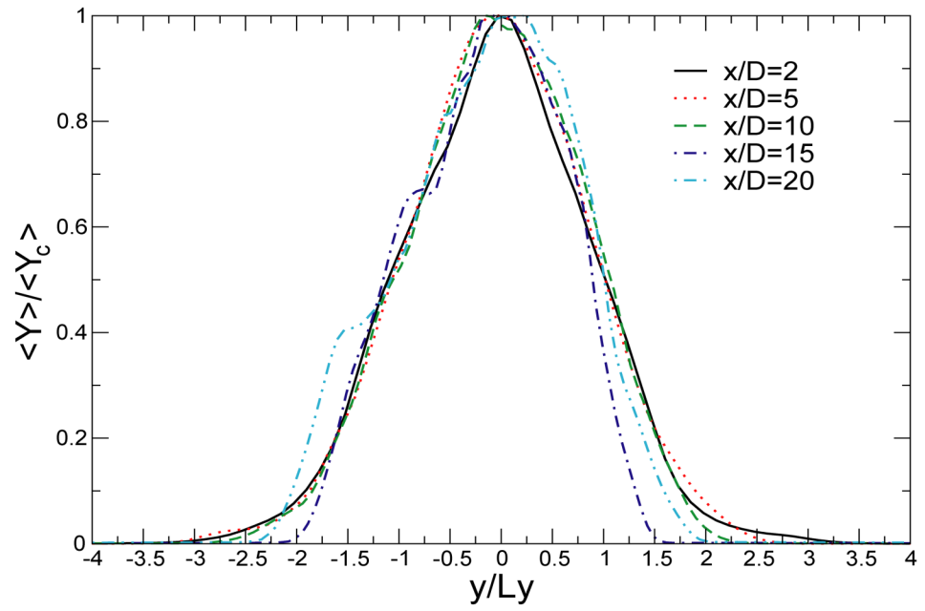
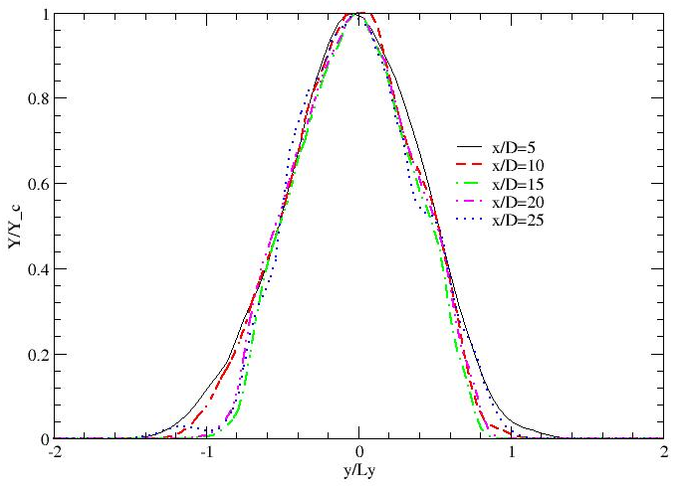
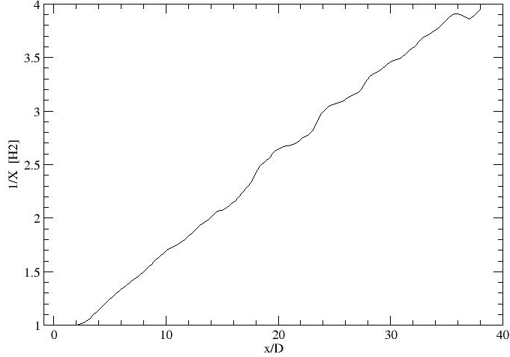
Normalized concentration(mass fractions) profiles for Helium (left) and Hydrogen (right),
and Hydrogen axial concentration decay (1/X[H₂]) (lower right)
4th ICHS San Francisco, 12-14 September 2011
Notes:
13

Slide 14
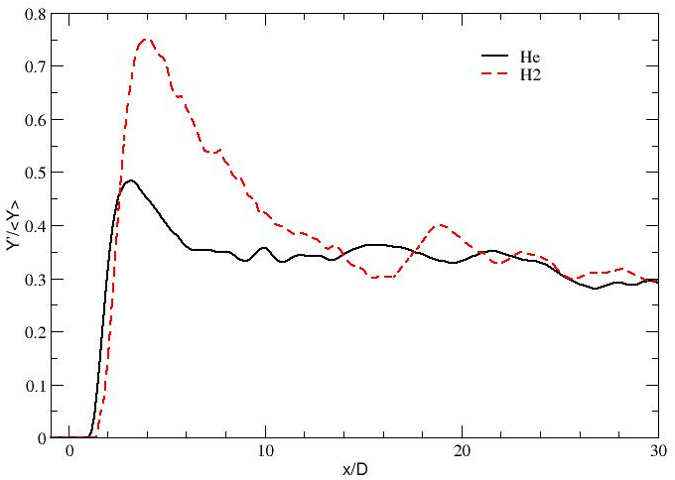
Unmixedness (Mass fraction RMS to mean ratio) for Helium (left) and hydrogen (right)
Y'/<Y_{c}> ~ 0.29, 0.48 peak (Helium)
Y'/<Y_{c}> ~ 0.32, 0.75 peak (Hydrogen)
4th ICHS San Francisco, 12-14 September 2011
Notes:
14

Slide 15
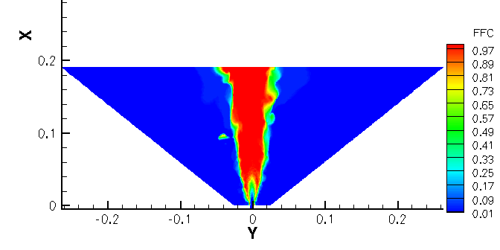
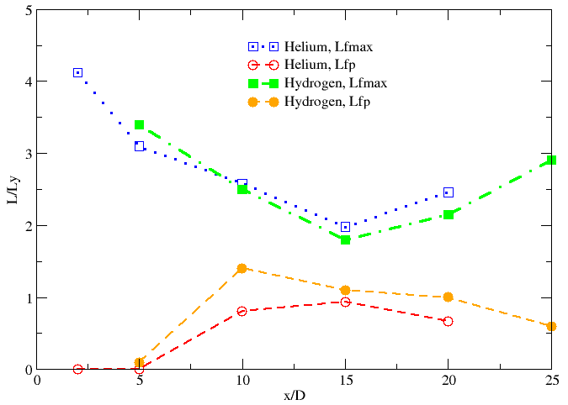
Transient Flammable Fields: Hydrogen
Transient envelope can increase the potentially flammable envelope by up to 40-60%
4th ICHS San Francisco, 12-14 September 2011
Notes:
15

Slide 16
Transient Flammable Envelope Extent
Frequency of flammable condition appearance
(0.04 < X [H₂] < 0.75)
4th ICHS San Francisco, 12-14 September 2011
Notes:
16

Slide 17
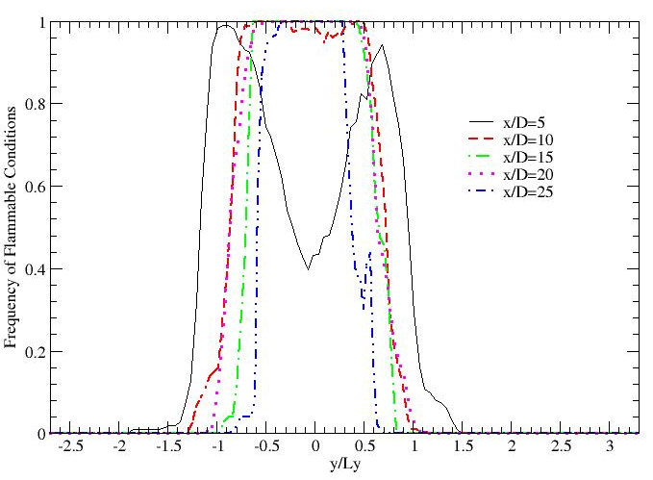
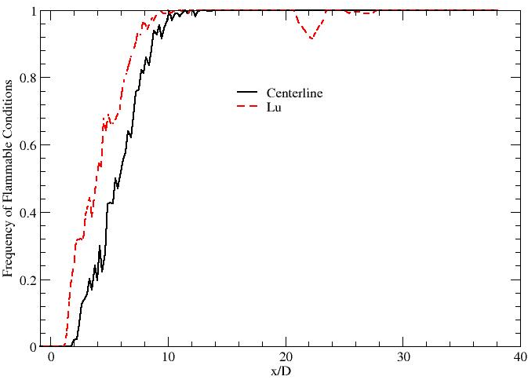
Frequency of flammable condition occurrence along the centerline and along Ly line
Frequency of flammable condition appearance 0.04 < [X_{H2}] < 0.75
4th ICHS San Francisco, 12-14 September 2011
Notes:
17

Slide 18
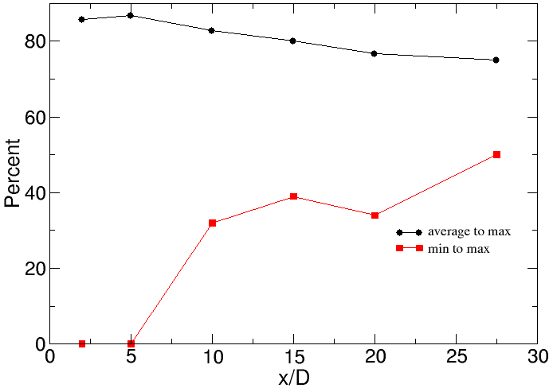
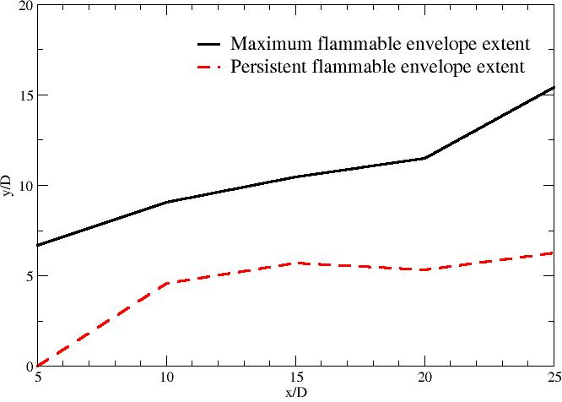
The width of the transient “flammable” region relative to the entire width of the flammable envelope for Helium jet (left), and maximum and persistent flammable envelope extents for Hydrogen jet (right). Note that at x/D=5 there is no persistently flammable area for the Hydrogen, due to concentration exceeding 0.75; the region near jet centerline at x/D=10 also has significant non-persistently flammable core.
4th ICHS San Francisco, 12-14 September 2011
Notes:
18

Slide 19
Left:
H₂ Mass fractions at 2D and 10D
Right:
H₂ Mass fraction at 5D and mass fraction along axis
4th ICHS San Francisco, 12-14 September 2011
Notes:
19

Slide 20
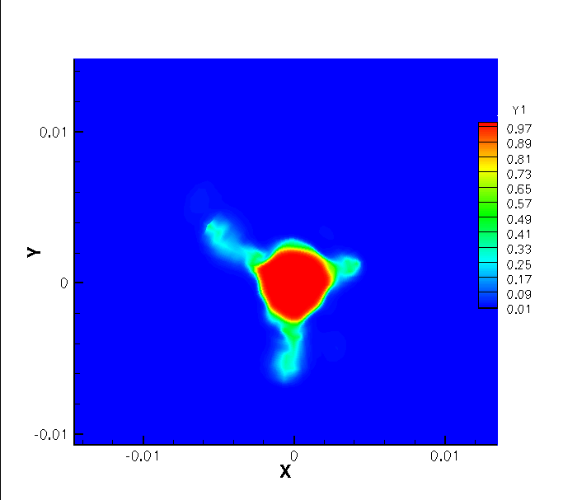
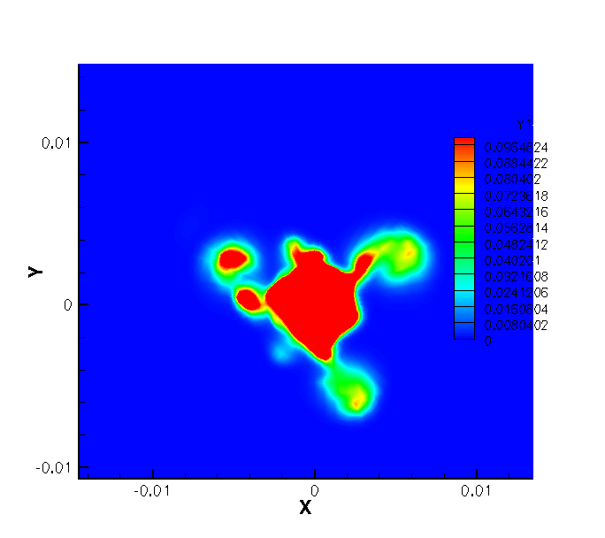
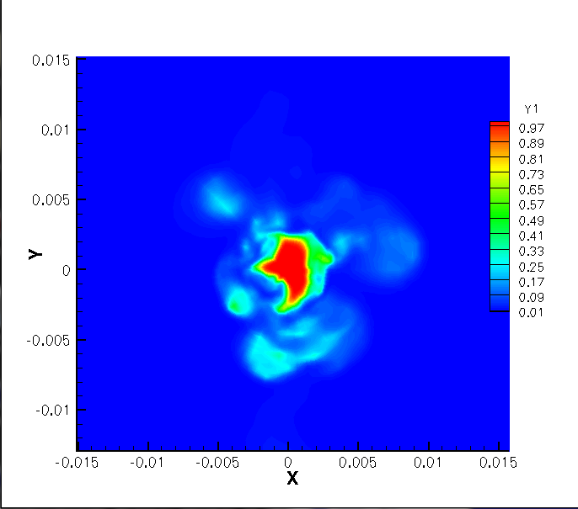
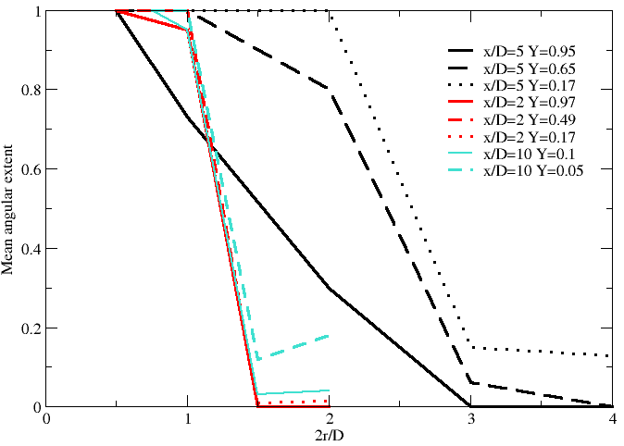
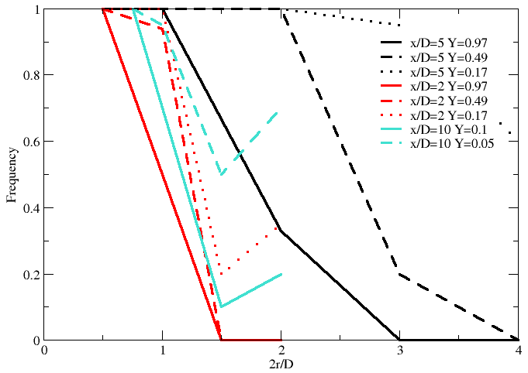
LES of near field: Transient Hydrogen Mass Fraction Contours
4th ICHS San Francisco, 12-14 September 2011
Notes:
20

Slide 21
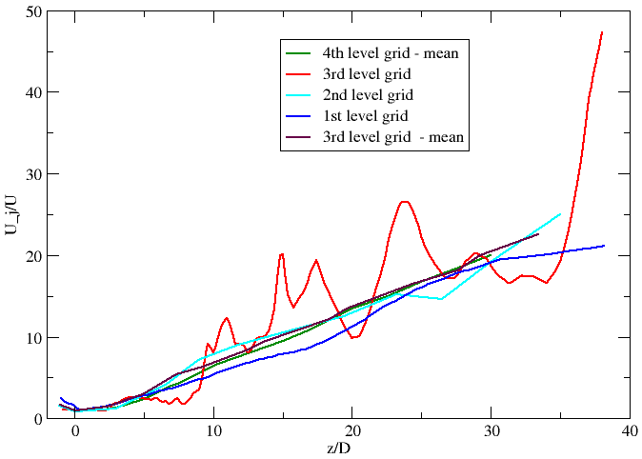
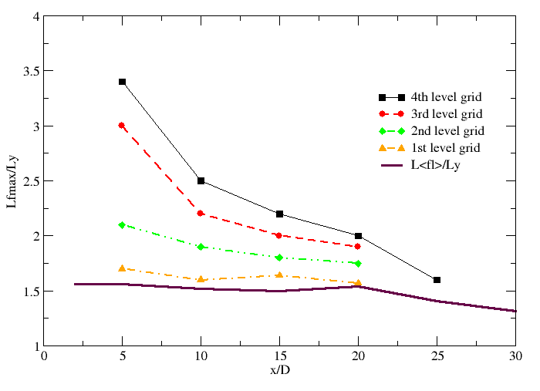
LES: Grid resolution influence
Influence of grid resolution, LES:
Centerline and averaged values are adequately modeled even on poor grids...
... But not the transient flammable envelope extent
4th ICHS San Francisco, 12-14 September 2011
Notes:
21

Slide 22
Conclusions
High turbulence/mixing persists through entire near field region.
LES has been extended to hydrogen jet.
Confirmed the existence and large extent of transient envelope of flammable gas concentration, previously observed for helium jet.
The nature of the transient flammable concentration envelope varies with the distance from the jet origin.
Significant share of the transient flammable concentration envelope can be attributed hydrogen pockets trapped in compact but relatively long lived vortices separated from the jet.
Adequate grid resolution is critical for capture of transient phenomena in the jet
4th ICHS San Francisco, 12-14 September 2011
Notes:
22

Slide 23
Supporting slides
4th ICHS San Francisco, 12-14 September 2011
Notes:
23

Slide 24
Numerical LES of near field
How much accuracy is needed to capture “true” flow behavior in LES?
A number of work (e.g., Sato et al, etc) use “underresolved LES” approach
Significant savings in CPU time, critical for industrial applications…
…but can it be considered “true” LES?
SPARC allows us to perform simulation at the same condition with different grid resolution…
… however direct comparison beyond averaged quantities is difficult due to the nature of LES – grid change also affect filter width
For our (safety) purposes comparison of transient concentration fields prediction can serve as efficient tool for comparison of different resolution applicability
4th ICHS San Francisco, 12-14 September 2011
Notes:
24

Slide 25
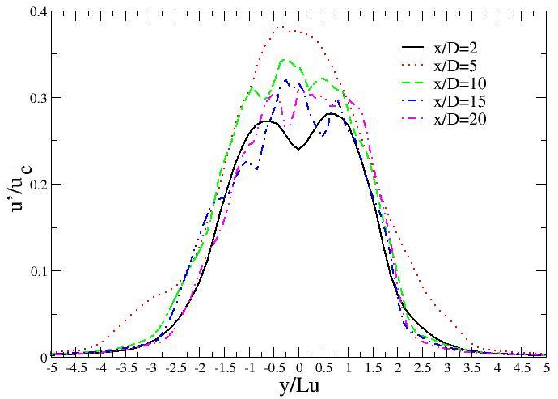
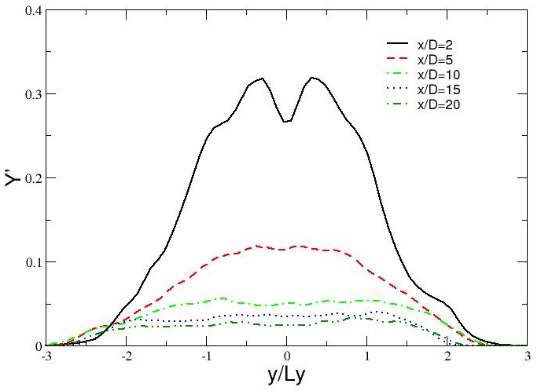
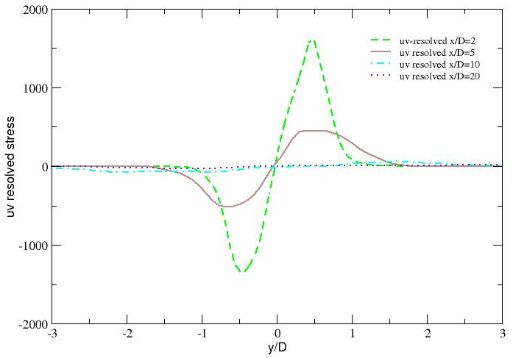
Turbulence Characteristics: Helium Jet
Normalized RMS of axial velocity (left), Helium mass fraction (right) and resolved Reynolds stresses (lower right)
4th ICHS San Francisco, 12-14 September 2011
Notes:
25

Slide 26
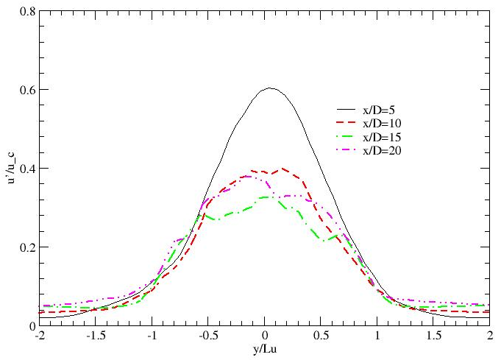
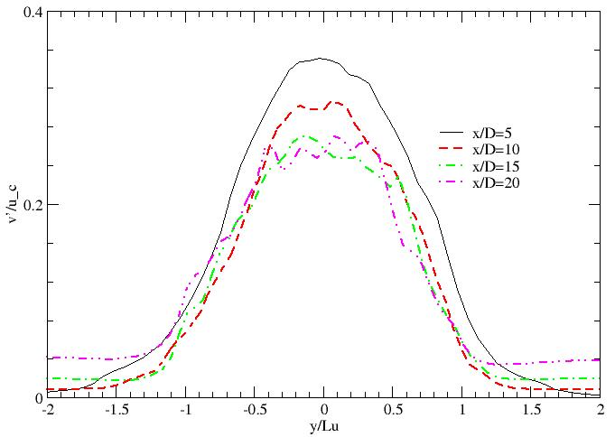
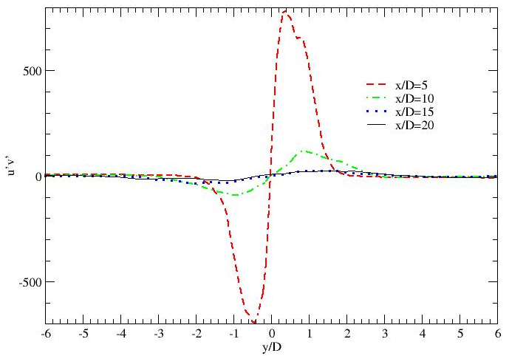
Turbulence Characteristics: Hydrogen Jet
Normalized RMS of axial (left)
and transversal (right) velocity and resolved Reynolds stresses (lower right)
4th ICHS San Francisco, 12-14 September 2011
Notes:
26

Slide 28
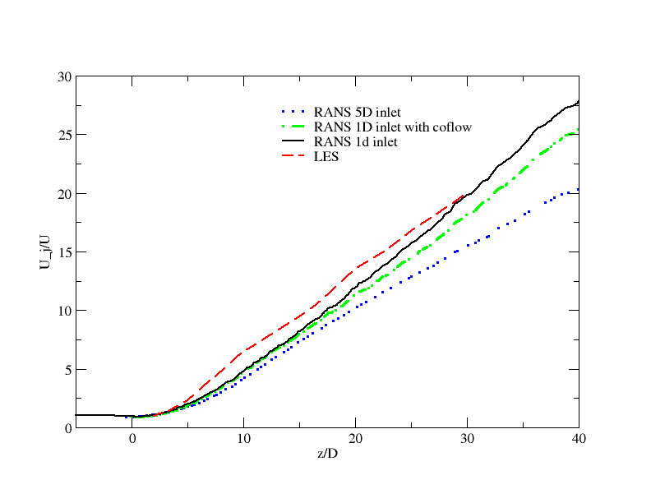
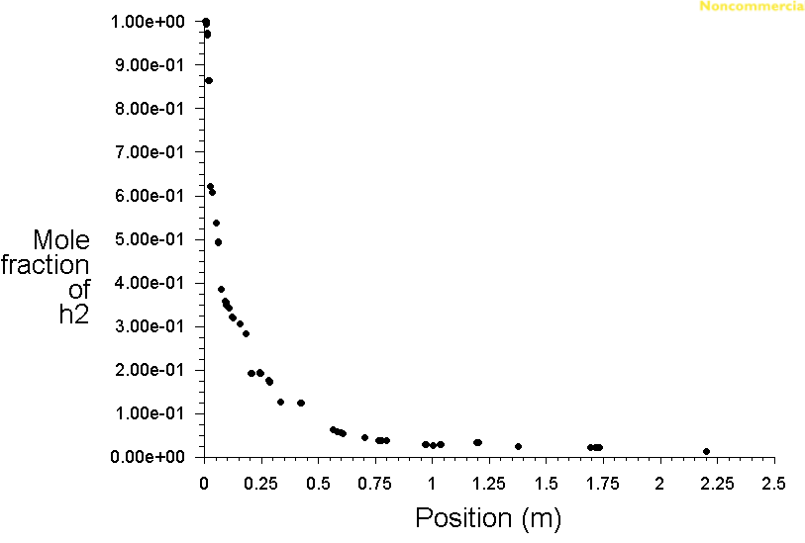
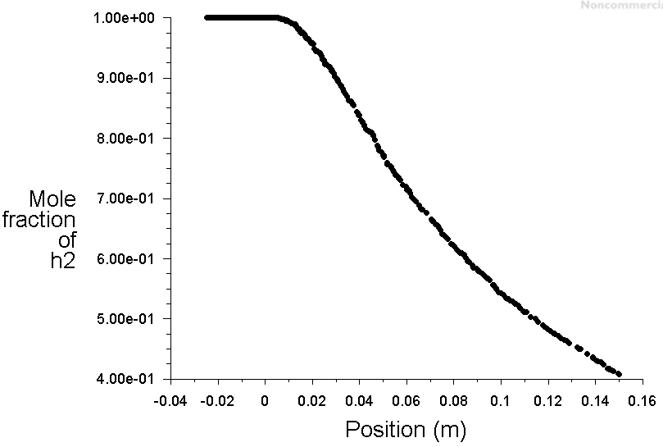
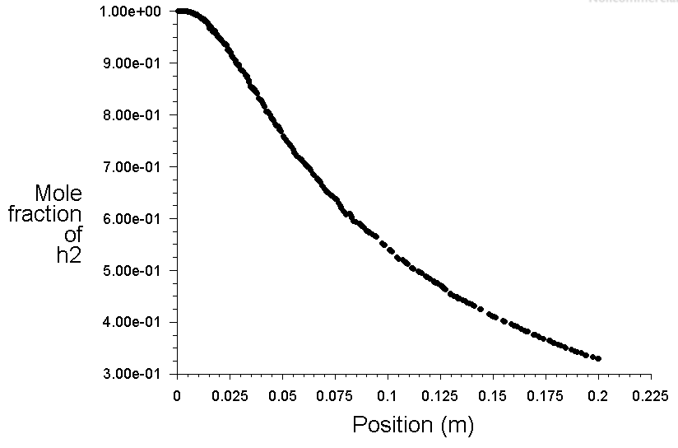
Initial Condition influence
Inflow condition can affect the jet evolution through the transition and self-similar regions (cf. Mi et al)
Three inflow conditions were considered:
- 1D inflow nozzle
10D inflow nozzle
“flat” orifice plate
4th ICHS San Francisco, 12-14 September 2011
Notes:
28

Slide 29
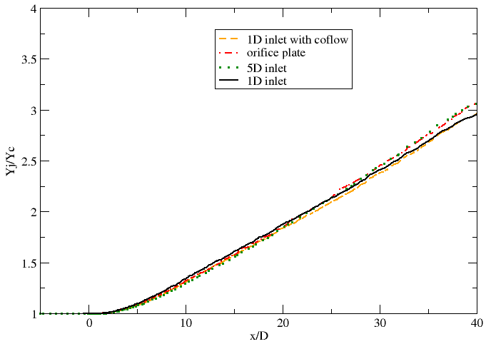
RANS and LES: Initial Condition Influence of near field Centerline Properties Evolution
1-D long inlet provides best agreement. Influence is much less noticeable for
LES plot is for 1-D inlet case. Concentration than velocity
4th ICHS San Francisco, 12-14 September 2011
Notes:
29

