Slide 1
Risk Reduction Potential of
Accident Mitigation Features
Jeffrey L. LaChance
Distinguished Member of Technical Staff
Sandia National Laboratories
Presented at the
4th International Conference on Hydrogen Safety
San Francisco, CA
September 12-14, 2011

Slide 2
Presentation Outline
Mitigation Features Evaluated
Facility and Risk Model
Risk Assessment Results
Summary

Slide 3
Project Background
Work performed under contract to U.S. DOE
  Hydrogen Safety, Codes & Standard R&D
Sandia National Laboratories is developing the scientific basis for assessing credible safety scenarios and providing the technical data for use in the development of codes and standards
  Includes experimentation and modeling to understand behavior of hydrogen for different release scenarios
  Use of Quantitative Risk Assessment (QRA) methods to help establish requirements in codes and standards

Slide 4
Mitigation Features Evaluated
Active Detection and Isolation
  Exterior detectors (hydrogen and flame)
  Process flow detection (pressure and flow)
  Excess flow valves
Flow Limiting Orifices
Reduction in Number of Components (leak reduction feature)
Barriers (presented at NHA 2010*)
*J. LaChance, J. Phillips, and W. Houf, “Risk Associated with the Use of Barriers in Hydrogen Refueling Stations ,“ NHA Conference and Expo, Long Beach CA, May 4, 2010.

Slide 5
Facility and Risk Model
Utilized facility descriptions and QRA model from NFPA separation distance analysis*
1.7 MPa (250 psig) and 20.7 MPa (3000 psig) Systems
Tube Trailer
Stanchion
Pressure Control
1
51.7 MPa (7500 psig) and 103.4 MPa (15000 psig) Systems
Tube Trailer
Stanchion
Compressor
Storage
Pressure Control
*J. LaChance et al., “Analyses to Support Development of Risk-Informed Separation Distances for Hydrogen Codes and Standards”, SANDIA REPORT, SAND2009-0874, Printed March 2009

Slide 6
Detection and Isolation
Assumed 1% flow area leaks can be detected and isolated with 0.9 reliability
  Sensitivity performed if 10% leaks are detected
Isolation Valve Location
3000 psig (20.7 MPa) System | 15000 psig (103.4 MPa) System
Tube trailer manifold | Tube trailer and high pressure storage manifold
 | Tube trailer manifold
 | High pressure storage manifold
Outlet of stanchion | Outlet of stanchion
On tube trailer cylinders | Tube trailer manifold and high pressure storage cylinders

Slide 7
Example Risk Reduction – Detection/Isolation
Tube Trailer
Stanchion
Compressor
Factor of 2.8 reduction in separation distance. 5 m corresponds to 0.38% leak (7.8 reduction from 3%)
Estimated risk associated with current separation distance for a person at the lot line
5E-6/yr reduction in risk
Lot line separation distance for 3% leak in largest pipe
Residual risk is from components upstream of isolation valve

Slide 8
Isolation Valve
Location Sensitivity
Tube Trailer
Stanchion
Compressor
Storage
Pressure Control
Separation distance for 3% leak in largest pipe
1.5E-5/yr reduction in risk

Slide 9
Detection Sensitivity
Tube Trailer
Stanchion
Compressor
Storage
Pressure Control
Increasing detector sensitivity reduces risk contribution from large leaks down stream of isolation valves. Leaks upstream of isolation valve continue to contribute to risk regardless of detector sensitivity.

Slide 10
Flow Limiting Orifices
Tube Trailer
Stanchion
Pressure Control
Risk from components down stream of orifice is reduced.

Slide 11
Flow Limiting Orifice
Tube Trailer
Stanchion
Pressure Control
Putting orifices as close to source results in the greatest reduction in risk.
Smaller flow orifices result in shorter separation distances.

Slide 12
Number of Components
Reducing the number of high risk components (joints, valves, compressors, and hoses) in a system is effective in reducing the risk or separation distances
Risk Guideline of 2E-5/yr
Evaluated for 110 MPa systems with ID=8mm

Slide 13
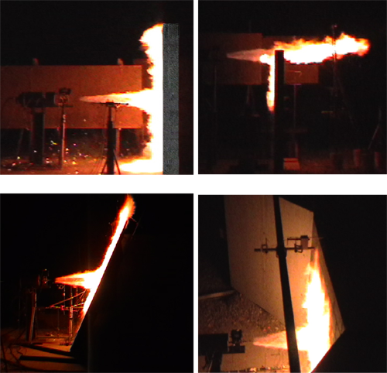
Barrier Effects on Risk from
Hydrogen Releases
Barrier walls will reduce the consequences from hydrogen jets if properly configured
  Reduces unignited jet flammability envelope
  Deflects jet flames and protects from direct flame impingement
  Reduces thermal radiation exposure
  Do not introduce significant overpressure hazards

Slide 14
Barrier Risk Results
The use of barriers will reduce risk to a person at the lot line by a factor ~4 for the leak diameters used in NFPA-55.
Alternatively, barriers can be used to reduce the separation distance to the lot line. For a risk level equal to that without a barrier, the distance to the facility lot line can be decreased to ~3.5 m (measured from the leak location) for the leak diameters shown above. Separation distance from the front of the barrier would be ~2 m.

Slide 15
Summary
Mitigation features can be used to reduce the risk or separation distances at hydrogen facilities
  Effectiveness of leak detection and isolation system is dependent upon detection capability and isolation location
  Flow limiting orifices, if process allows, can limit maximum leak size down stream of orifice
  Reducing the number of risk-significant components (e.g., joints and valves) in a system reduces the leak potential
  Barriers are effective in reducing the consequences from hydrogen releases

Slide 16
Additional Slides
Barrier Results from 2010 presentation

Slide 17
Direct Flame Effects
Barriers are effective in reducing the downstream exposure to ignited hydrogen jets
Some flame deflection back towards the hydrogen components can occur for straight barriers
The height of the barrier is important for protecting potential targets

Slide 18
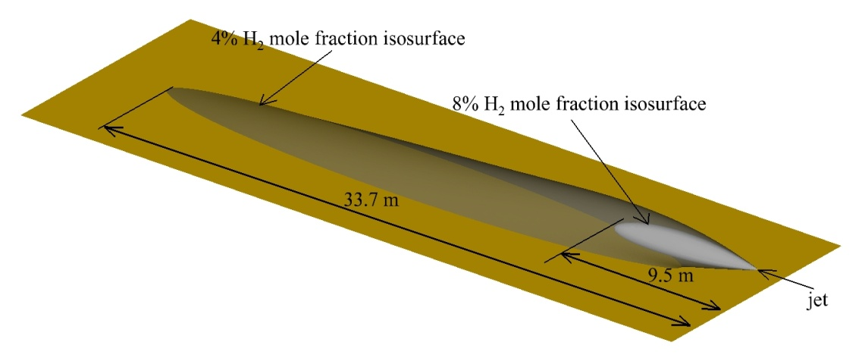
Effect on Hydrogen Envelope
Unignited hydrogen envelopes are essentially limited to a region close to
the barrier, greatly reducing the axial extent of the unignited release.
Lateral and vertical extent of hydrogen envelope increases due to barrier.
Free Jet Flame
1-Wall Vertical Barrier
3-Wall Vertical Barrier
1-Wall Tilted Barrier

Slide 19
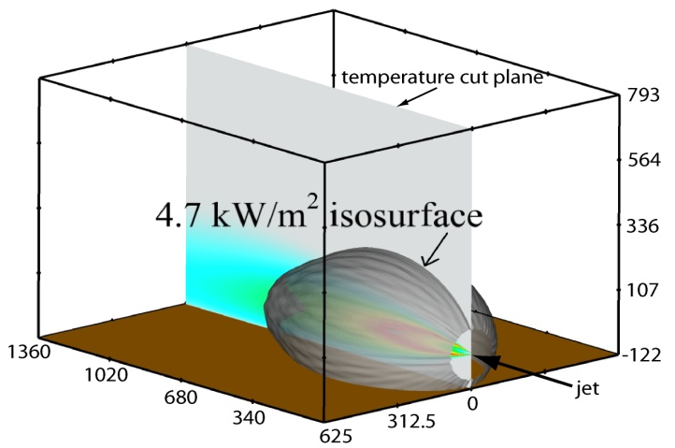
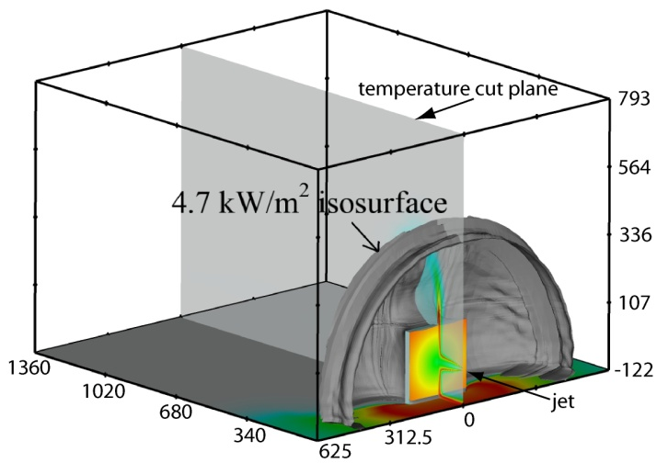
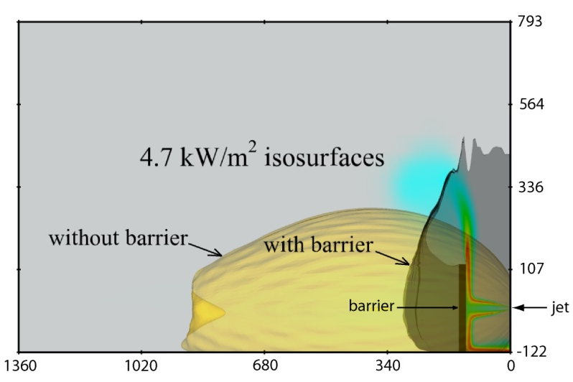
Thermal Radiation Reduction
Free jet
Single wall vertical barrier
Hydrogen flames impinging on a barrier will be reshaped by barrier.
Radiation downstream of the barrier from the reshaped flame contour can be greatly reduced (~3 fold reduction)
Lateral and vertical extent of radiation isosurface can be greater than for a free jet with no barrier – requires proper design of barrier (can be specified in hydrogen standards)
Comparison of isosurfaces

Slide 20
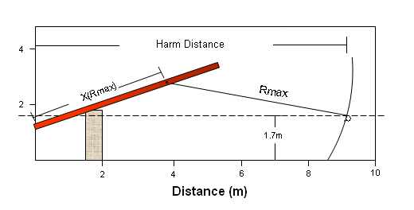
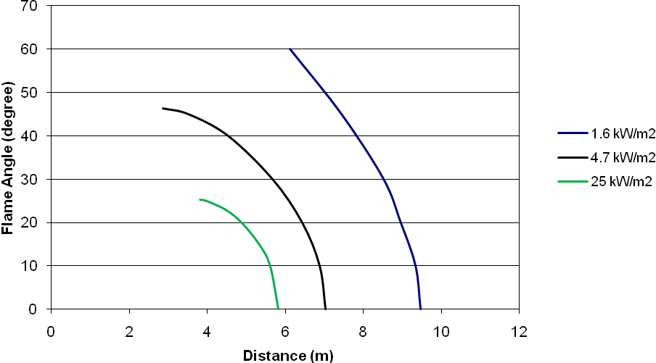
Thermal Radiation from Hydrogen Flames Directed Above Barrier
Some fraction of hydrogen flames may be directed over top of the barrier
Although direct contact with the flame may not occur, thermal radiation exposure is still possible
Heat flux will decrease as the angle of the hydrogen jet passing over the barrier increases
Harm distance will not substantially decrease for small angles
There is an angle at which a heat flux level will not occur for a specified target downstream of the barrier (can be specified in hydrogen codes and standards)

Slide 21
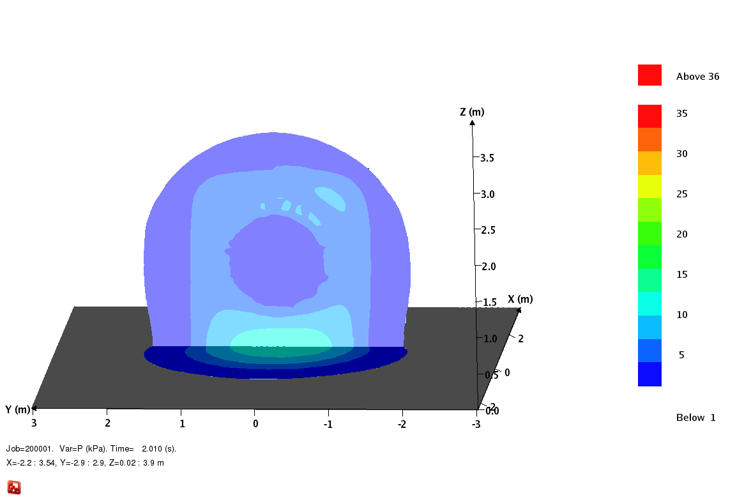
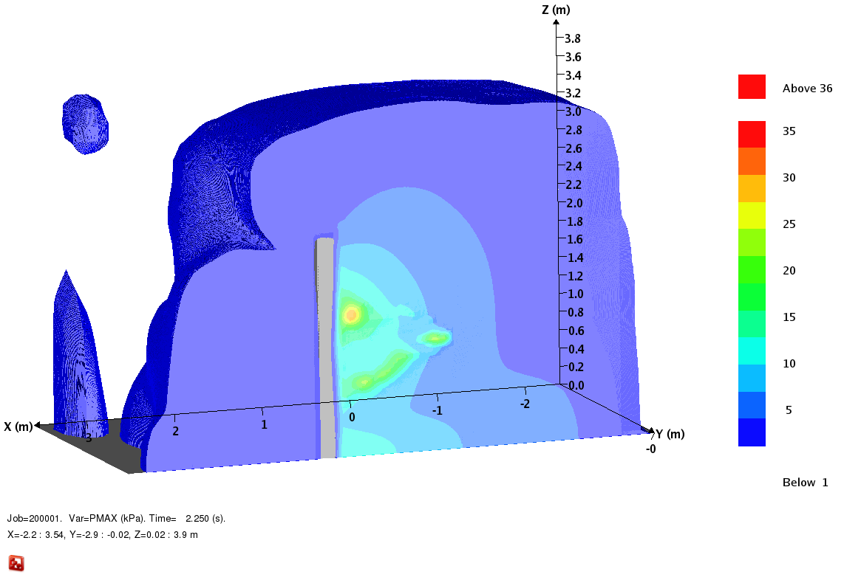
Overpressure Effects
Barriers will result in higher pressures due to delayed ignition of hydrogen
Although peak overpressures can be significant, average pressure and impulses on the barrier surface are small
Pressure downstream of wall is small
Potential harm to barrier and individuals is minimal
Pressure on wall
Maximum pressure contour
3.28 mm leak in 20.8 MPa system ignited at 2 s

Slide 22
Barrier Impacts on
Hydrogen Releases
Barriers between facility and the public eliminate risk from direct flame contact
Reduces the axial extent of unignited jets significantly and associated risk if ignited; however, increases the lateral and vertical extent which increases 4% hydrogen envelope significantly
Reduce the axial extent of thermal radiation from deflected flames significantly but increases vertical and lateral area of flame surface
Thermal radiation from flames passing over the barrier can be reduced to low limits by increasing barrier height
Overpressure from delayed ignition is not sufficient to challenge barrier integrity or harm individuals

