Slide 1
Attained Temperature During Gas Fuelling and Defueling Cycles of COMPRESSED HYDROGEN TANKS FOR FCV
Y. Matsuno, Y. Maeda, N. Otsuka, Y. Tamura, H. Mitsuishi
Japan Automobile Research Institute
FC･EV division
Presented at the
4th International Conference on Hydrogen Safety
San Francisco, CA
September 12-14, 2011
Notes:
Firstly, I 'd like to show you about our study "Attained Temperature During Gas Fuelling and Defueling Cycles of COMPRESSED HYDROGEN TANKS FOR FCV"
In this study, we conducte
Our tests were very detailed but I’m sorry today I don’t have time to explain everything, so will just give you an overview. If you have any questions, please ask me at the end of the presentation.
ご紹介ありがとうございます。日本自動車研究所の松野です。
今日発表する内容は、自動車用圧縮水素容器におけるガスサイクル充填・放出試験における容器内ガス温度の到達温度についてです。
この発表では、容器への充填と放出を連続して繰り返し行うガスサイクル試験における試験結果の概要について報告します。
我々の試験はとても詳細な内容であり、すべてを説明する時間がありませんので、概要のみお伝えします。質問がありましたら、発表の終わりにお願いします。

Slide 2
1. Introduction
2. Gas cycle test
3. Test Results
4. Deriving Empirical
Formulae of Attained
Temperature
5. Summary
Table of contents
Notes:
I would like to explain about these contents.
この発表の内容をスライドに示します。

Slide 3
1. Introduction
2. Gas cycle test
3. Test Results
4. Deriving Empirical
Formulae of Attained
Temperature
5. Summary
Table of contents

Slide 4
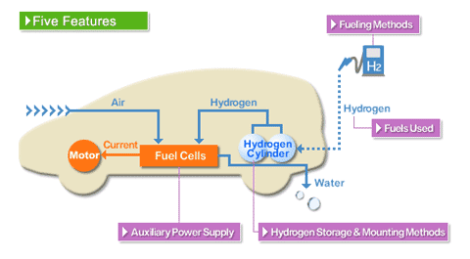
1. Introduction
We have focused on temperature behavior of tanks for FCV when filling and discharging hydrogen.
Gas temperature of tanks
・ increases in filling
・ decreases in discharging
Figure. Fuel Cell Vehicle（FCV）
JHFC HP,
http://www.jari.jp/jhfc/e/beginner/about_fcv/index.html
In previous studies, the thermal behavior of gas temperature
in tanks by 1 shot filling or discharging was investigated.
(That is, not continuous filling and discharging)
→ They contributed to revising the standard of tanks and
validating the filling protocol.(SAE TIR J2601, etc.)
Notes:
We have focused on temperature behavior of tank for FCV when filling and discharging hydrogen.
This is the tank setup on FCV. In general, the gas temperature of tanks increases in filling or decreases in discharging, because of the thermal effects of gas compression and expansion.
In previous studies, the thermal behavior of gas temperature in tanks by 1 shot filling or discharging was investigated.
我々は、水素充填および放出時の燃料電池自動車の容器におけるガス温度挙動について注目している。
こちらはFCVのタンクのセットアップです。一般的には、容器内のガス温度は、充填中は上昇し、放出中は、下降します。
これまでの研究では、1回の充填または放出におけるタンク内のガス温度の挙動について調査してきました。

Slide 5
1. Introduction
Up?
Pressure Gas Temp.
Down?
Discharging
Filling
0
Time
Figure. The behaviour of gas pressure and temperature of a tank for FCV
It is important to understand the temperature behaviour of tanks assuming that gas filling and discharging are continually repeated.
But, there is no data of repeated gas filling and discharging continually with actual hydrogen gas
Notes:
This represents the discharging and filling cycle. Over time does the temperature go up or down?
So, it is important to understand the temperature behavior of tanks assuming that gas filling and discharging are continually repeated during long time driving. But There is no date of repeated gas filling and discharging continually with actual hydrogen gas.
したがって、長時間走行するような実使用環境を想定すると，走行と燃料補給を連続して繰返す場合の容器内温度挙動を把握する必要がある
In extreme use conditions, does the gas temperature not exceed the allowable temperature range of the vessel?
ガス温度は容器の許容温度範囲を超えないか？

Slide 6
1. Introduction
Object
To understand the temperature behaviour of tanks assuming the conditions of actual use
We investigated the behaviour of the attained temperatures of gas in a tank with continuous repetition of cycles of gas filling and discharging, by using a gas cycle test.
Notes:
Therefore, to understand the temperature behaviour of tanks by assuming the conditions of actual use,
we investigated the behaviour of the attained temperatures of gas in a tank with continuous repetition of cycles of filling and discharging, by using gas cycle tests and assuming tanks in a gas cycle test.

Slide 7
1. Introduction
2. Gas cycle test
3. Test Results
4. Deriving Empirical
Formulae of Attained
Temperature
5. Summary
Table of contents
Notes:
In next slide, I’ll show you about gas cycle test.
さて、ガスサイクル試験について次のスライドで説明します。

Slide 8
2. Gas cycle test
Repeated gas filling and discharging
・
Cycle１
Cycle２
Cycle３
Ambient temp.
Pressure Gas Temp.
Initial condition
Initial condition
discharging
filling
0
0
60
120
180
240
300
360
420
Time[min]
Figure. Behavior of gas temperature and pressure
in case of starting from discharging
※At the initial condition (before filling or discharging), the temperature of gas in a tank is almost the same as the ambient temperature.
Notes:
The gas cycle test repeats gas filling and discharging to tanks continuously.
This shows 3 cycles. In this test, at the initial conditions, the temperature of gas in a tank is controlled almost the same as the ambient temperature.
And there are 3 important points considering to evaluate the thermal behavior of tanks.

Slide 9
2. Gas cycle test
A gas cycle test was conducted to consider the following:
The relationship between the ambient temperature and
that of gas in a tank
(2) The effect of start conditions (filling start vs discharging start)
Same?
or
Different?
Pressure Gas Temp.
Pressure Gas Temp.
Discharging start
Filling start
0
0
0
60
120
180
240
300
360
420
0
60
120
180
240
300
360
420
Time[min]
Time[min]
Notes:
A gas cycle test was conducted to consider the following:
The first is the relationship between the ambient temperature and that of gas in a tank
The second is the effect of start conditions (filling start vs discharging start)
And next we checked the discharging flow rate.

Slide 10
2. Gas cycle test
A gas cycle test was conducted to consider the following:
(3) The effect of discharging flow rate
Comparison
Pressure Gas Temp.
Pressure Gas Temp.
Slow Discharging
Fast Discharging
0
0
0
60
120
180
240
300
360
420
0
60
120
180
240
300
360
420
Time[min]
Time[min]
Notes:
And the third is the effect of discharging flow rate.
For detailed conditions​​, I’ll show later.

Slide 11
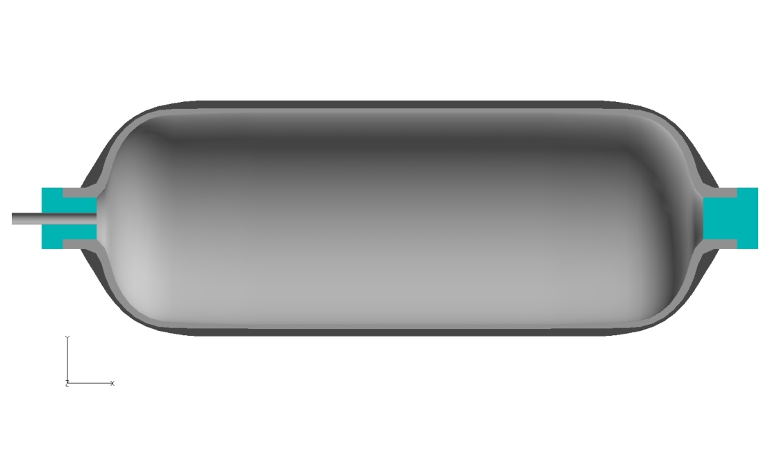
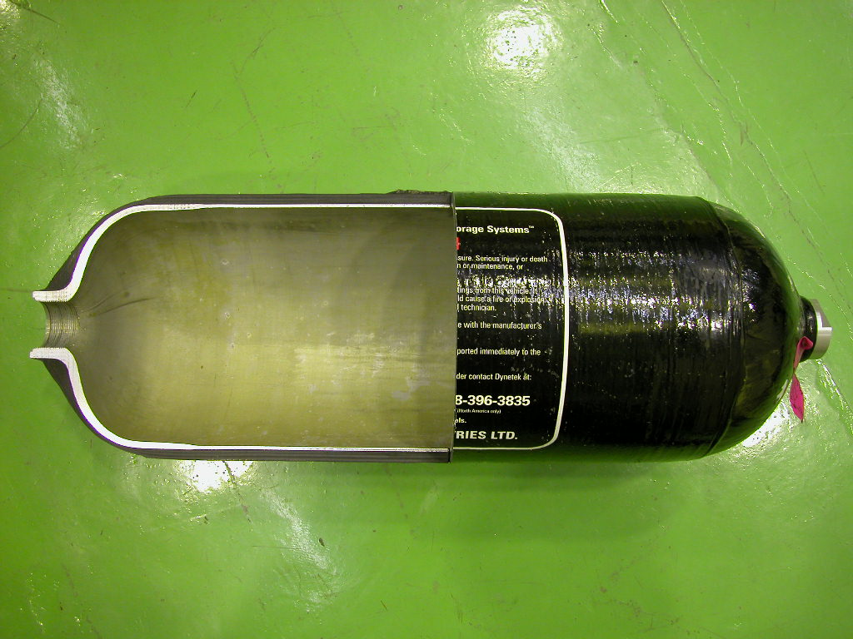
2. Gas cycle test
Test tanks for FCV
（Thermal upper limit : 85ºC）
Liner
Fiber-reinforced layer
Type | Size[mm] | Volume[L] | Liner material （Thermal cond.） | Fiber-reinforced layer
Type-3 tank (VH3) | D600-L1000 | 125 | Aluminum alloy （200 [W/mK]） | CFRP^{*1}
Type-4 tank (VH4) | D300-L900 | 40 | Plastic （0.4 [W/mK]）
*1) CFRP: Carbon Fiber Reinforced Plastic
Notes:
These are the specification of the two tanks we tested type3 and type4, and Some differences of both tanks are the volume, the liner material, the thermal conductivity and so on.

Slide 12
2. Gas cycle test
Measuring temperatures of the tank
Thermocouple
T15
T
T15
T9
T10
T5
T
T4
T4
T11
T18
④
d=3mm
50mm
T19
T8
T16
T3
T2
45°
T
T2
⑤
T6
T
①
,
T1
②
,
③
T
T1
T16
Liner
T14
T6
T7
T13
T
⑥
CFRP
T12
T17
T
T17
The representative temperature
in the tank
(lowest when discharging)
T
upper
45°
④
50mm
T
⑤
Hydrogen Flow
Direction
Φ= 3mm
T
①
H₂
,
②
,
③
T
⑥
The temperature distribution of the gas becomes almost uniform when filling because of convection.
Notes:
Here are diagrams to represent how we measured the tank temperature, and
the representative temperature in the tank is set to T6 empirically, because the temperature of T6 becomes lowest when discharging in previous our study.
On the other hands, the temperature distribution of the gas becomes almost uniform when filling because of convection by design.
Let’s go to the next slide.
水素充填時は、容器上部へ対流を起こすため，
容器内ガスの温度差がほとんど発生しない

Slide 13
2. Gas cycle test
Filling Rate
← Control parameter
Main chiller
P
P
FM1
Heat exchanger
Gas storage bank
Gas control unit
Pre-cooling unit
Filling Pressure
Temperature control chamber
P
T
Filling Gas Temp.
Test tank
H2 Compressor
T
Test pit
Ambient Temp.
FM2
Discharging Rate
Figure. Flow diagram of filling test equipment
Notes:
This is the filling test equipment for this tests.
In gas cycle test, we controlled filling rate, filling pressure and gas temperature, ambient temperature, and discharging rate to get to the test conditions.
And then, I’ll show you the test conditions.

Slide 14
2. Gas cycle test
Table Test conditions
RT gas
Precooled gas
Ambient Temperature [ºC] |  | 15 | 25 | 50 | 40 | -20 | -40
Filling Gas Temperature [ºC] |  | 15 | 25 | -20 | -20 | -20 | -20
Test Start, Initial gas Press. in Tank [MPa] | Discharging Start^{※1} | 56.3 | 58.3 | 63.2 | 61.2 | 49.5 | 45.6
 | Filling Start | 1.0
Pressure Ramp Rate^{※2} [MPa/min] （constant rate） |  | 7 | 7 | 5 | 12 | 16 | 16
Discharging flow Rate |  | Constant Rate to 1MPa
Discharging Time |  | 1hour or 2hours
Pressure Range |  | 1 ～ 70[MPa]
※ 各試験条件において，VH4とVH3容器は同じ充填速度で実施
（VH4容器が85℃を超えない速度または16MPa/min）
※1 Full at Ambient Temperature relatives to density : 40.2[g/L](70[Mpa], 15[ºC])
※2 Which is controlled so that the gas temperature in the tank doesn’t exceed 85ºC, and same rate for both Type-3 and Type-4.
Notes:
Here is the table of our test conditions. The temperature conditions are set assuming normal or severe use.
The pressure in discharging start and pressure ramp rate are based on the filling protocol for 70MPa hydrogen tank defined by SAE(Standard of American Engineering) TIR J2601 which hydrogen station in japan.
Hydrogen was filled up in tanks at constant pressure ramp rate till the pressure of the tank reaches to the density, and discharged at constant flow rate to 1 MPa on 1hour or 2hours.
上記条件は、実際の車両走行における消費（放出）速度に比べ、過酷な条件を想定している。
（FCV諸元として、100km走行に1kgの水素を使用すると考えると、最大条件では、VH3-125L容器（＝約5kg@70MPa満タン）では500km走行できる。
その場合、1hourですべて放出する試験条件では、500km/hour で走行するのと同等の放出条件である。
ちなみに、VH4-40L容器（＝約1.6kg@70MPa満タン）では、160km/hourで走行するのと同等の放出条件である。）
※1 満タン時の容器内ガス密度は40.2g/L（＠70MPa, 15℃）を基準（←SAE参照）
※2 VH4容器が85℃を超えない速度および設備最大流量（16MPa/min）、
VH3とVH4容器は同じ充填速度とした．

Slide 15
1. Introduction
2. Gas cycle test
3. Test Results
4. Deriving Empirical
Formulae of Attained
Temperature
5. Summary
Table of contents
Notes:
So, Let’s go to the next section.

Slide 16
3. Test Result
(1) The relationship between the ambient temperature and that of gas in a tank in case of room temperature (RT) gas filling.
High-temperature side
Type-3
Ambient temp.＝25℃
Filling gas temp.＝25℃
Low-temperature side
Test Condition
Def | Start from Discharging
Fill | Start from Filling
2h | Discharging Time =2hours
A+15℃ | Ambient Temp. →15℃
G+15℃ | Filling Gas Temp. →15℃
The changes in the attained temperature on the high-temperature side and low-temperature side are stable after the second cycle.
Notes:
In this slide, I will explain the results of gas cycle test.
At first, let’s look at this graph. In this graph, the temperature of gas in type-3 tank in case of the room temperature gas filling in discharging start condition is plotted along the time axis. For example, focusing on the conditions of both the temperature of the ambient and filling gas are 25 degrees Celsius indicated by red line, we found that the temperature goes up and down and the changes in the attained temperature on the high-temperature side and low temperature side are stable after the second cycle.
This occurs because the heat input in discharging is equal to the heat absorption in filling.
Then next slide is the result in case of pre-cooled gas filling

Slide 17
3. Test Result
(1) The relationship between the temperature of ambient and that of gas in a tank in case of pre-cooled gas filling.
High-temperature side
Type-3
Low-temperature side
Test Condition
Def | Start from Discharging
Fill | Start from Filling
2h | Discharging Time =2hours
A+15℃ | Ambient Temp. →15℃
G+15℃ | Filling Gas Temp. →15℃
Ambient temp.＝－40℃
Filling gas temp.＝－20℃
In case of pre-cooled gas filling, the attained temperature is the same behavior and stable as RT gas filling.
Notes:
For example, focusing on the conditions of the ambient temperature is -40 degrees celsius and filling gas temperature is -20 degrees celsius, the attained temperature is the same behavior as RT gas filling.

Slide 18
3. Test Result
The attained temperature after each cycle of gas filling and discharging
High-temperature side
Low-temperature side
Δ20ºC
□ Def_2h(A+50C_G-20C)
△ Def_2h(A+40C_G-20C)
● Def_2h(A+25C_G+25C)
◆ Def_2h(A+15C_G+15C)
○ Def_2h(A-20C_G-20C)
◇ Def_2h(A-40C_G-20C)
Type-3（125L）
Cycle Time
Type-4（40L）
The attained temperature tends to stabilize after several cycles.
The attained temperature of the Type-4 tank is max. 20ºC higher than that of the Type-3 tank under the same temperature condition.
Notes:
The results in both tanks is brought together on this slide.
From the test results for the Type-4 tank, Fig.ure indicates the behaviour of temperatures under the same test conditions as for the Type-3 tank. The behaviour of gas temperatures in the Type-4 tank also tended to stabilize after the second cycle. However, it was a maximum of 20oC higher than the attained temperature in the Type-3 tank under the same temperature, and a maximum of 20oC lower on the low-temperature side. It can be assumed that this result occurred because the thermal conductivity of the liner material of the Type-4 tank (plastics: 0.4[W/(m・K)]) is less than that of the Type-3 tank (aluminum alloy: 180[W/(m・K)]), and the heat transfer between the gas inside the tank and the tank itself is less than. And then surface-to-volume ratio is less
容器タイプの差（容器材質、熱伝導率（AL：200W/mK、Plastic：0.4W/mK）、容器肉厚、容積）
18

Slide 19
3. Test Result -The effect of start conditions
(2) The effect of start conditions (filling start vs discharging start)
Same?
or
Different?
Pressure Gas Temp.
Pressure Gas Temp.
Discharging start
Filling start
0
0
0
60
120
180
240
300
360
420
0
60
120
180
240
300
360
420
Time[min]
Time[min]

Slide 20
3. Test Result -The effect of start conditions
Type-3
Filling start
Discharging start
Stabilizes after several cycles
The attained temperatures become stable after several cycles .
The starting condition has little influence on the change of the attained temperature of the gas in the tank.

Slide 21
3. Test Result -The effect of discharging time
(3) The effect of discharging time (discharging flow rate)
Comparison
Pressure Gas Temp.
Pressure Gas Temp.
Slow Discharging
Fast Discharging
0
0
0
60
120
180
240
300
360
420
0
60
120
180
240
300
360
420
Time[min]
Time[min]

Slide 22
3. Test Result -The effect of discharging time
Type-3
Discharging
1 hour
Discharging
2 hours
Rises as discharging time increased
Stabilizes after 2 cycles
■ Compared with the case of 2 hours discharging, the attained temperature of the gas in the tank on the low-temperature side decreased further in case of 1 hour discharging.

Slide 23
1. Introduction
2. Gas cycle test
3. Test Results
4. Deriving Empirical
Formulae of Attained
Temperature
5. Summary
Table of contents
Notes:
Let’s move on final section

Slide 24
4.DERIVING EMPIRICAL FORMULAE OF ATTAINED TEMPERATURE
The Trend of attained temperature of gas in the tank
・ Almost the same differences from the ambient temperature
・ Proportional to each test parameter that
filling gas temperature, precooling temperature, and discharging rate
・ No relationship between the start conditions
We obtained the linear expression of the attained temperature with respect to each test parameter.
 | Parameter （Adoptable range）
T_{H}:c | Hot side temp.［℃］
T_{L}:c | Low side temp.［℃］
T_{G} | Filling gas temp.［℃］ （－20～25）
T_{A} | Ambient temp.［℃］ （－40～50）
V_{F} | Filling rate［MPa/min］ （5～16）
V_{D} | Discharging rate［MPa/min］ （0.58～1.17）
■ Type-3 tank
T_{H} ;c ＝ 0.67V_{F}+（－5.40）V_{D}+0.55（T_{G}－T_{A}）＋T_{A} +45.03
T_{L} ;c ＝ 0.50V_{F}+（－15.86）V_{D}+0.23（T_{G}－T_{A}）＋T_{A}－30.95
■ Type-4 tank
T_{H} ;c ＝ 1.83V_{F}+（－2.82）V_{D}+0.43（T_{G}－T_{A}）+T_{A}+47.48
T_{L} ;c ＝ 0.22V_{F}+（－17.87）V_{D}+0.07（T_{G}－T_{A}）+T_{A}－26.70
Notes:
Coefficients include factor of thermal conductivity, surface to volume ratio, and other.

Slide 25
4.DERIVING EMPIRICAL FORMULAE OF ATTAINED TEMPERATURE
＜High temp. side＞ ● ： Measured T ○ ： Estimated T
＜Low temp. side＞ ▲ ： Measured T △ ： Estimated T
±7℃
Type-3
Type-4
 |  | a | b | c | d | e | f | g | h
Filling gas temp. | [℃] | 15 | 25 | -20 |  |  |  | 15 | -20
Ambient temp. | [℃] | 15 | 25 | 50 | 40 | -20 | -40 | 15 | 50
Filling rate | [MPa/min] | 7 |  | 5 | 12 | 16 |  | 7 | 5
Discharging time | [hour] | 2 |  |  |  |  |  | 1
Discharging rate | [MPa/min] | 0.58 |  |  |  |  |  | 1.17
Figure. Measured values and estimated values from empirical formulae

Slide 26
1. Introduction
2. Gas cycle test
3. Test Results
4. Deriving Empirical
Formulae of Attained
Temperature
5. Summary
Table of contents

Slide 27
Summary
Although the attained temperature changed with changes in parameters such as the environmental temperature, filling gas temperature, discharging time(or flow rate), and test starting condition in both the Type-3 tanks and the Type-4 tanks, it became stable after several cycles.
Under the condition of same temperature, the attained temperature in the Type-4 tanks was higher than that in the Type-3 tanks. This phenomenon can be considered to be caused by the difference in heat transfer due to the difference in liner material and tank capacity.
For the attained temperatures during gas filling and discharging, the estimated value of the attained temperature calculated using an empirical formula roughly agreed with the measured value; therefore, this method is useful for estimating the attained temperature.
Notes:
Rather than focusing on only one cycle of filling and releasing hydrogen gas, we conducted gas cycle
tests to investigate the behaviour of the attained temperature of the gas in the tank when cycles of
filling and releasing hydrogen gas were repeated. We obtained the results as follows.
今回実施した条件において，VH3およびVH4容器における到達温度は，数ｻｲｸﾙ以降の到達温度の挙動は安定する傾向が見られた．
放出時間が長くなると，到達温度が上昇する傾向が見られた．
容器内ガスの安定化温度を算出する実験式を求めた．これにより，到達温度を±7℃の精度で概ね推測可能になったが，精度向上が課題
繰返し充填・放出しても容器内ガス温度は上昇または下降傾向のまま推移せず，安定する．
容器内ガスの温度挙動は容器の構成材料や容積の違いなどの影響を受ける．
容器内ガスの安定化温度を推測する手段の一つとして，また試験を安全に実施する目安として利用できる．
同じ試験条件では，VH4容器の到達温度は，VH3容器より高く推移した．
We investigated the gas temperature in the tank during continuous cycles of gas filling and
discharging, assuming an environment of actual use, although the attained temperature differed with
test conditions. We found that the attained temperature became stable after the second cycle; this
finding is important for considering the safety of tanks.

Slide 28
Future Actions
For further understanding of gas temperatures in a tank, it is important to:
・acquire more data by conducting tests on many tanks under other temperature conditions which are surface temperature, volume, heat transfer, etc.
・improve the accuracy of common formulae that enable estimating the attained temperature from the test parameters.
We examined the replacement of the gas cycle test with the hydraulic pressure cycle test (defined in SAE J2579) to evaluate tank performance. The results indicate that this test method is useful for understanding tank performance.
Notes:
For further understanding of gas temperatures in a tank, it is important to acquire more data by
conducting tests on many tanks under other temperature conditions. In this study, we
analyzed the data obtained and considered that surface temperature, volume, and heat transfer differ
depending on the type of tank. In doing so, we confirmed the possibility of understanding the behavior
of gas temperature in a tank by assuming an environment of actual use in more detail and by
improving the accuracy of common formulae that enable estimating the attained temperature from test
parameters. We examined the replacement of the gas cycle test with the hydraulic pressure cycle test
to evaluate tank performance. The results indicate that this test method is useful for understanding tank
performance.
今後の課題 ： より多くの容器および試験パラメータでの温度特性の把握

Slide 29
Summary and Future Actions
Although the attained temperature changed with changes in parameters in both the Type-3 tanks and the Type-4 tanks, it became stable after several cycles.
Under the same temperature, the attained temperature in the Type-4 tanks was higher than that in the Type-3 tanks. This phenomenon can be considered to be caused by the difference in heat transfer due to the difference in liner material and tank capacity.
⇒acquire more data by conducting tests on many tanks under other temperature conditions which are surface temperature, volume, and heat transfer differ depending on the type of tank.
For the attained temperatures during gas filling and discharging, the estimated value of the attained temperature calculated using an empirical formula roughly agreed with the measured value
⇒improve the accuracy of common formulae that enable estimating the attained temperature from test parameters.

Slide 30
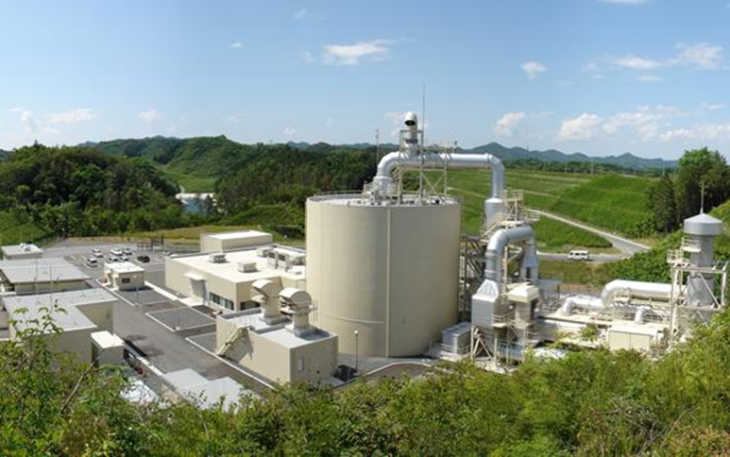

Thank you for your attention.
This work was supported by the New Energy and Industrial Technology Development Organization of Japan (NEDO) under a research program "Establishment of Codes & Standards for Hydrogen Economy Society".

Slide 32
Start Conditions
Filling
makes to increase temperature of gas in a tank
Discharging
makes to decrease temperature of gas in a tank
▼The start from discharging
Pre- filled to 40.2g/L
(full fill at 70MPa＠15℃)
1MPa
70MPa
▼The start from filling
Initial Pressure is 1MPa
70MPa
1MPa

Slide 33
Test Result（Type-4）
・RT gas filling
VH4
環境温度＝25℃
充填ガス温度＝25℃
記号 | 試験条件
Def | 放出スタート
Fill | 充填スタート
2h | 放出時間 →2時間
A+15℃ | 環境温度 →15℃
G+15℃ | 充填ガス温度 →15℃
環境温度＝15℃
充填ガス温度＝15℃
VH3と同様，数サイクル後には，容器内ガスの到達温度は安定傾向を示した．
VH3に比べて容器内ガスの到達温度が高温側に推移した．
Notes:
33

Slide 34
Test Result（Type-4）
・Pre-cooled gas filling
VH4
記号 | 試験条件
Def | 放出スタート
Fill | 充填スタート
2h | 放出時間 →2時間
A+15℃ | 環境温度 →15℃
G+15℃ | 充填ガス温度 →15℃
充填ガス温度が低い場合でも，数サイクル後には，容器内ガスの到達温度は安定する傾向を示した．
VH3に比べ，容器内ガスの到達温度は最大20℃程度 高温側へ推移した．
Notes:
34

Slide 35
Test Result -The effect of discharging time
Type-4
Rises as discharging time increased
Stabilizes after 2 cycles

Slide 36
Test Result -The effect of discharging time
Type-4
Stabilizes after
2 cycles

Slide 37
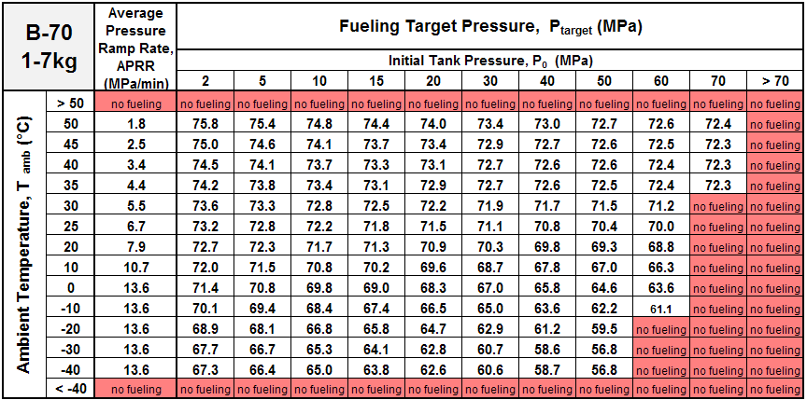
Filling Protocol
⇒ SAE TIR J2601 Default communication
・Pressure around 70MPa, Volume:＜7kg、with -20℃ pre-cooled Gas

Slide 38
Results by Calculated EMPIRICAL FORMULAE
Type3
Type-4
High end
High end
Low end
Low end

