Slide 1
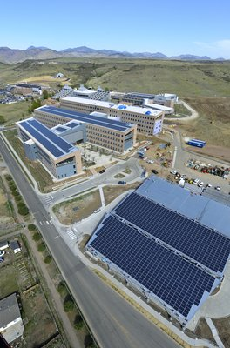
Real-World Hydrogen
Technology Validation
ICHS 2011: T5 #217
S. Sprik, J. Kurtz, K. Wipke, T. Ramsden, C. Ainscough, L. Eudy, G. Saur
September 12-14, 2011

Slide 2
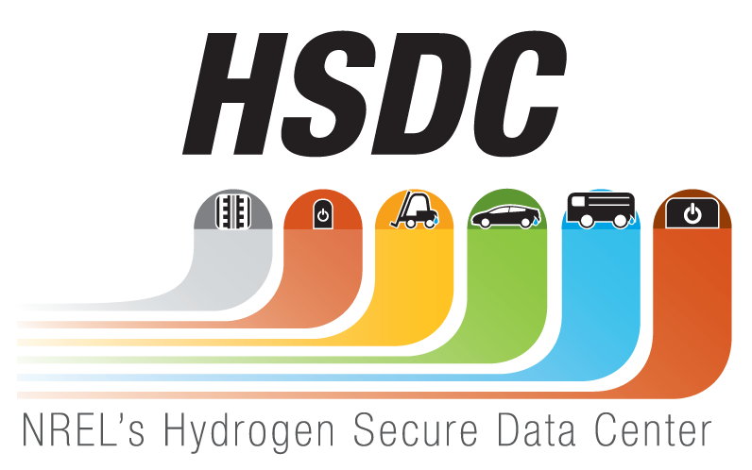


Contents
NREL Hydrogen Technology Validation
Overview of Tech Val Projects
Selected Composite Data Products (CDPs) including Safety and Maintenance

Slide 3
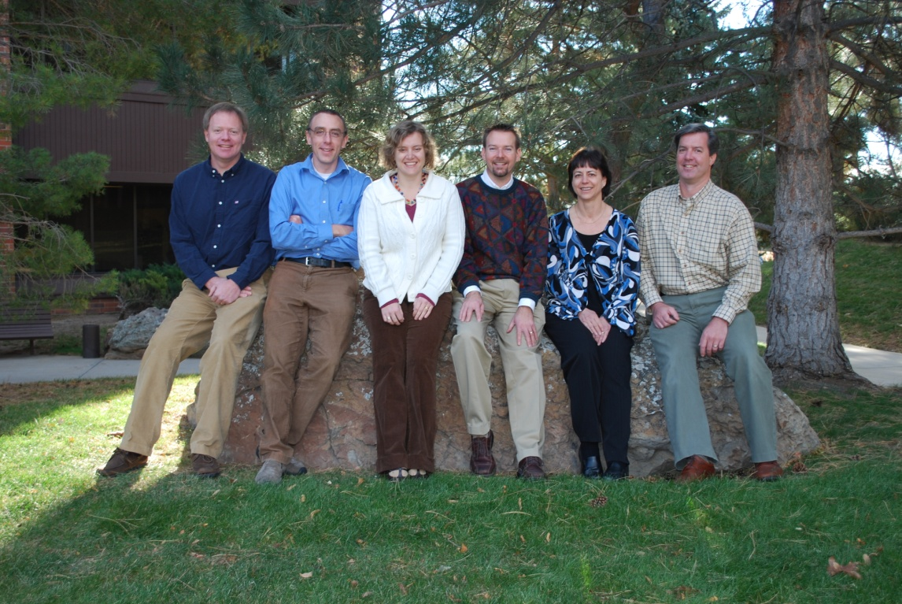
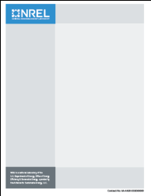
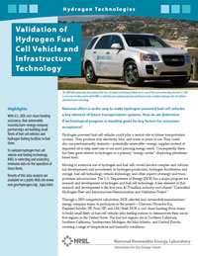
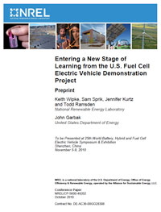
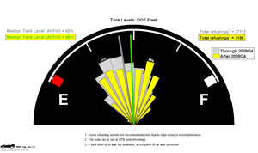
NREL Tech Val – Who We Are, What We Do
Within NREL’s Hydrogen Technologies and Systems Center, the Technology Validation group works on confirming that technical targets have been achieved for components and systems under “Real World” conditions.
Collection
Analysis
Collaboration
Reporting on Real World Operation Data from the Field and State of the Art Performance Data from the Lab

Slide 4
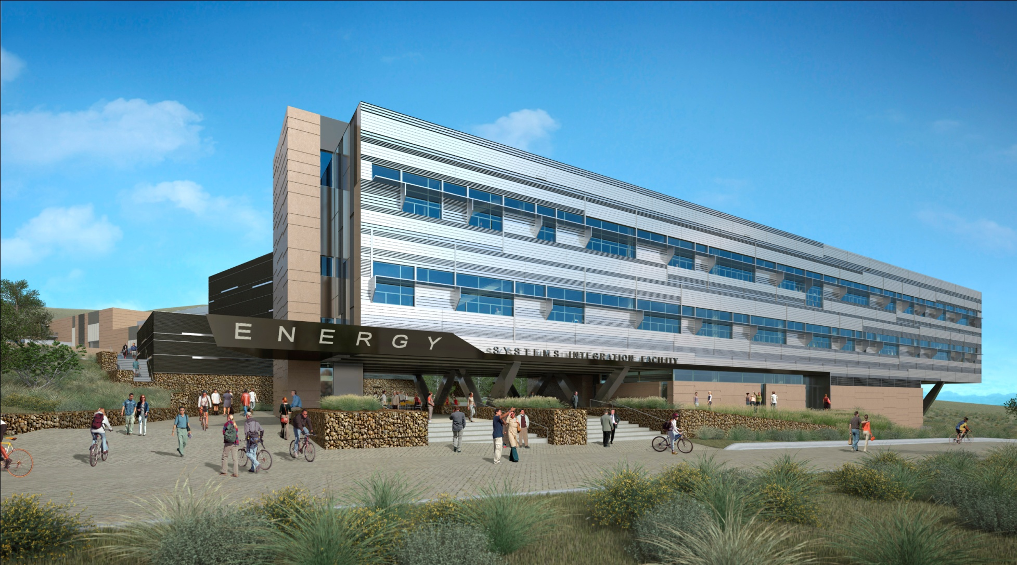
Energy Systems Integration Facility - ESIF
(This is a rendering. Building completion expected in 2012)
Rendering courtesy of Smith Group

Slide 5
HSDC Data
Data Transfer
Data delivered to NREL via secure avenues (e.g. ftp, DVD)
Data stored and analyzed within HSDC
HSDC not connected to external network
Badge access to only NREL’s tech val team
Password protected detailed data analysis shared back with data provider
Proprietary Data
Aggregated data to protect commercially sensitive and proprietary data
CDPs reviewed by data providers (2 review cycles) before publishing the results
Analysis consistent across data sets

Slide 6
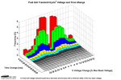
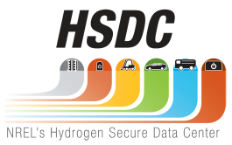
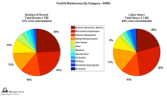



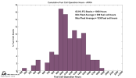



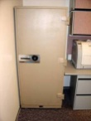


Data Flow Supports both DOE/Public as Well as Fuel Cell Developers
Bundled data (operation & maintenance/safety) delivered to NREL quarterly
Internal analysis completed quarterly
Results
DDPs
CDPs
Detailed Data Products (DDPs)
Individual data analyses
Identify individual contribution to CDPs
Only shared with partner who supplied data every 6 months¹
Composite Data Products (CDPs)
Aggregated data across multiple systems, sites, and teams
Publish analysis results without revealing proprietary data every 6 months²
Data exchange may happen more frequently based on data, analysis, & collaboration
Results published via NREL Tech Val website, conferences, and reports

Slide 7
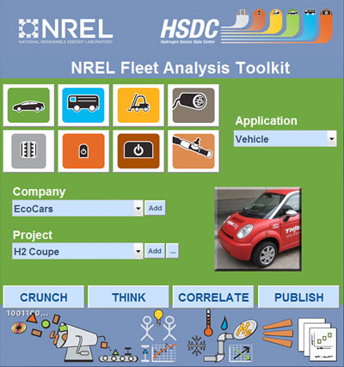
Analysis Tool
Code developed at NREL
Started out just for fuel cell cars and their infrastructure
Added other applications as they came along
Allows for batch processing
Select which analyses to perform and which projects to go into a CDP
Updated continuously

Slide 8
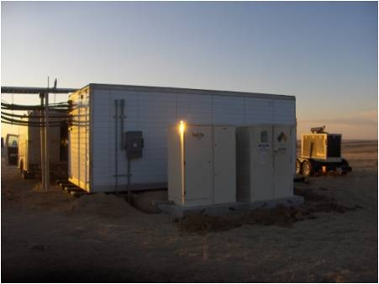
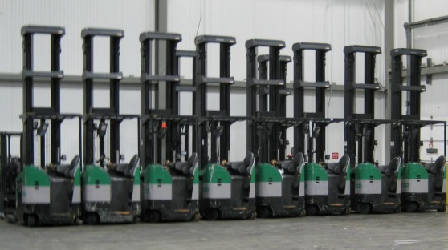
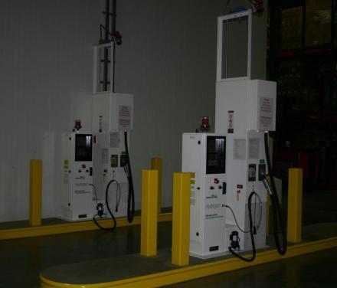
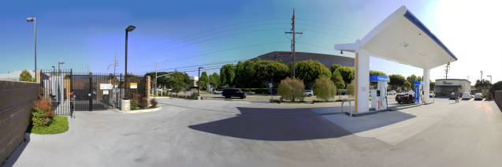
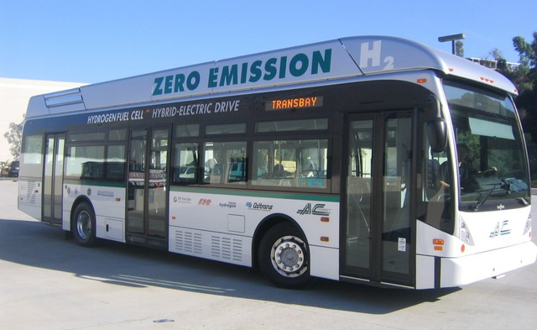
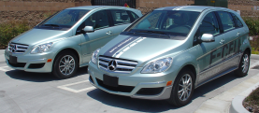
Technology Validation
Demonstrations are essential for validating the performance of
technologies in integrated systems, under real-world conditions.

Slide 9
Cross Application Usage

Slide 10
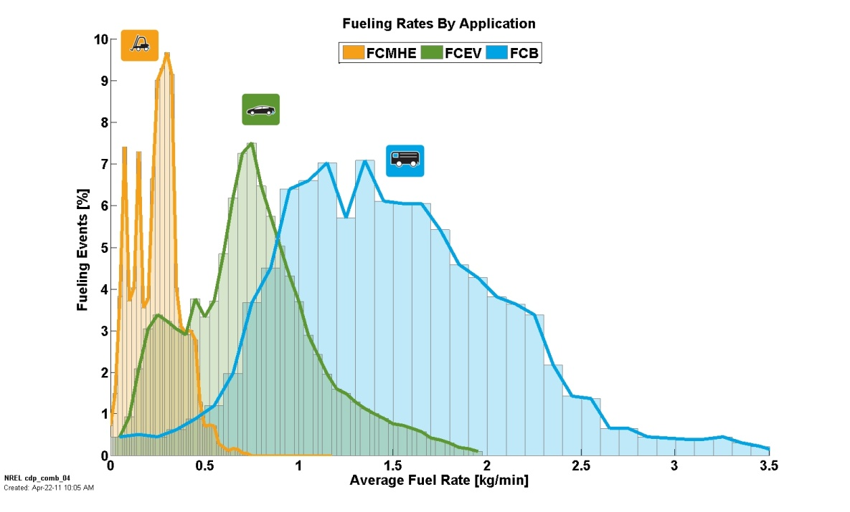
Fueling Rates by Application

Slide 11
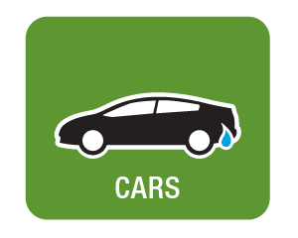
FC Learning Demo
Funding from DOE

Slide 12
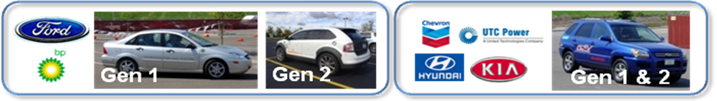
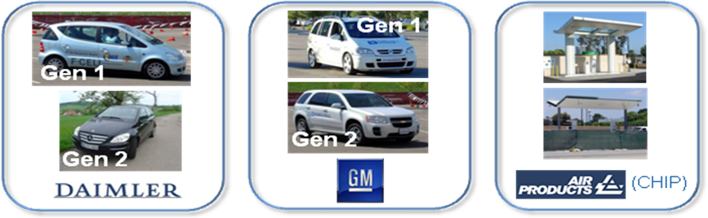
FCEV Learning Demonstration Teams
Teams through end of 2009
Teams through 2011

Slide 13
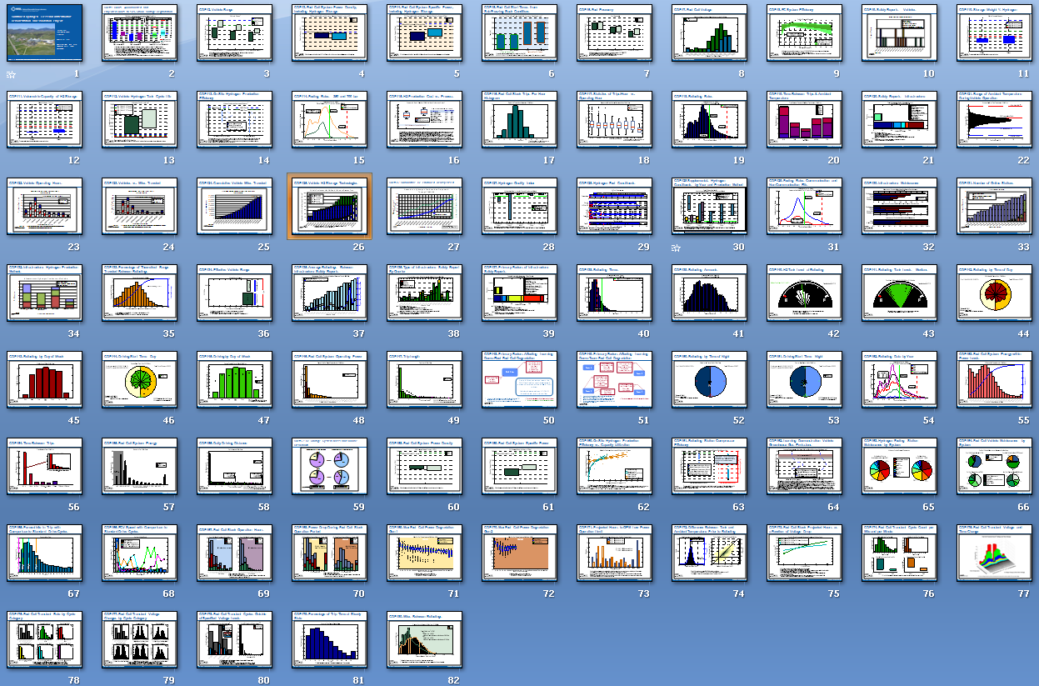
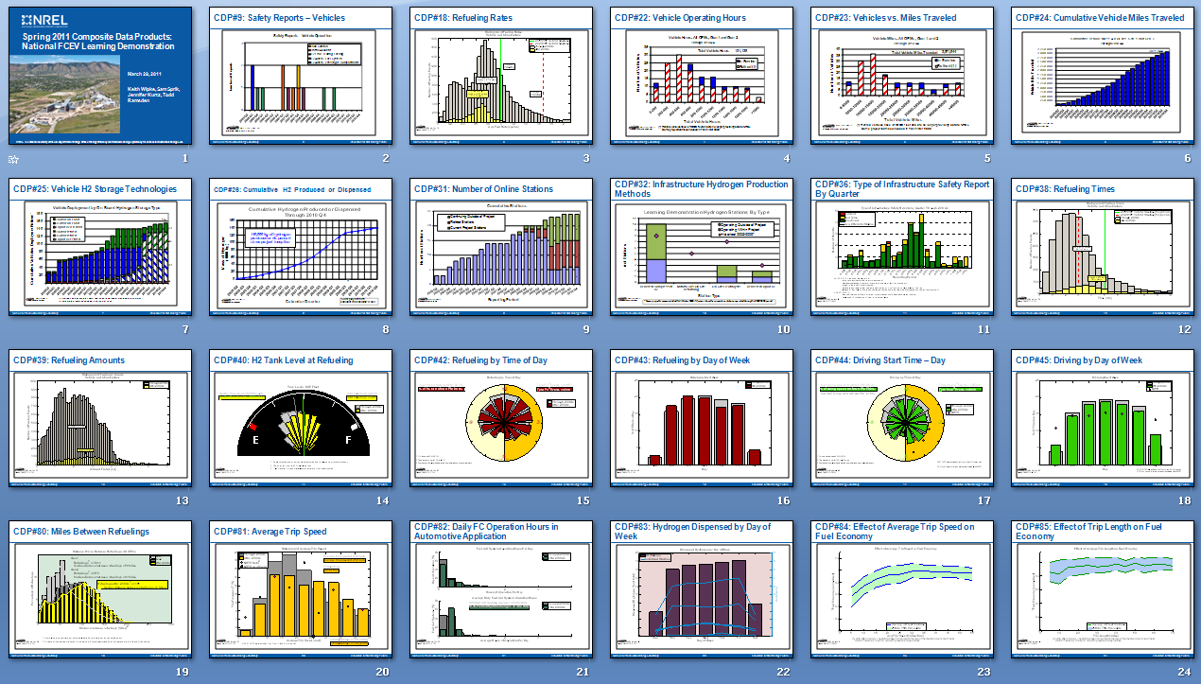
Two Sets of CDPs
Through 2009Q4 After 2009Q4
Spring 2011
80 Spring 2010 Results
23 Results
Most comprehensive set we ever published
Includes durability, range, fuel economy
Covers data from all 4 Learning Demo teams + CHIP project over 5-year period
Majority of these are now static, serving as a historical record of Gen 1 & Gen 2 comparisons.
5 new CDPs, and updated 18 previously published CDPs with data from last 12 months
Results on most recent durability, range, fuel economy, not yet possible to publish until more data accumulated (end of 2011)
Covers data from 2 Learning Demo OEMs + CHIP project
Emphasized changes observed between older data and the newer data

Slide 14

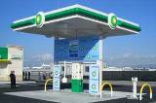
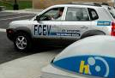
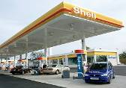
Technology Validation FCEV
The Learning Demonstration has Exceeded Technical Goals
for Driving Range and Fuel Cell Durability
DOE Vehicle/Infrastructure Demonstration Four teams in 50/50 cost-shared projects with
DOE Fuel Cell Technologies Program
155 fuel cell vehicles and 25 fueling stations demonstrated
More than 3 million miles traveled
More than 147,000 kg of hydrogen produced or dispensed*
Analysis by NREL shows:
  Efficiency: 53 – 59% (>2x higher than gasoline internal combustion engines)
  Range: ~196 – 254 miles
  Fuel Cell System Durability:
    ~ 2,500 hrs (~75,000 miles at 30 mph avg. speed)
*includes hydrogen not used in the Program’s demonstration vehicles

Slide 15
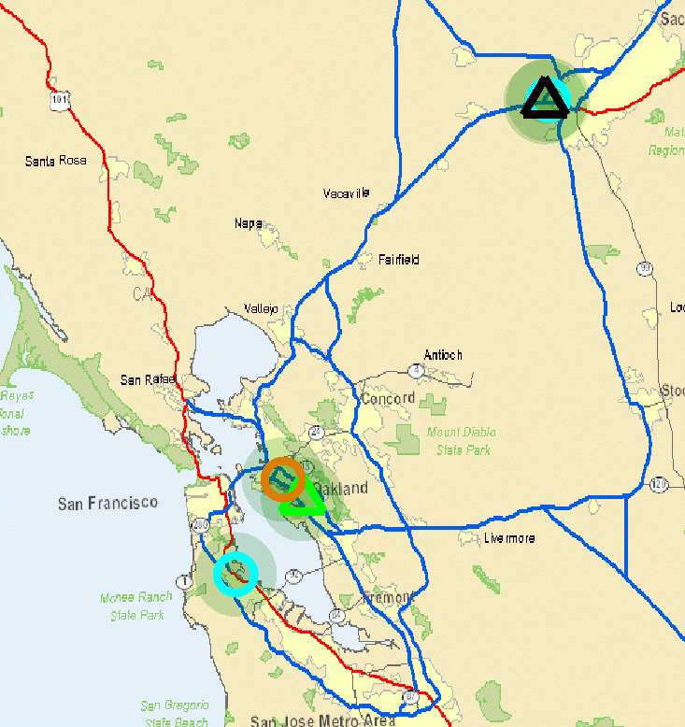
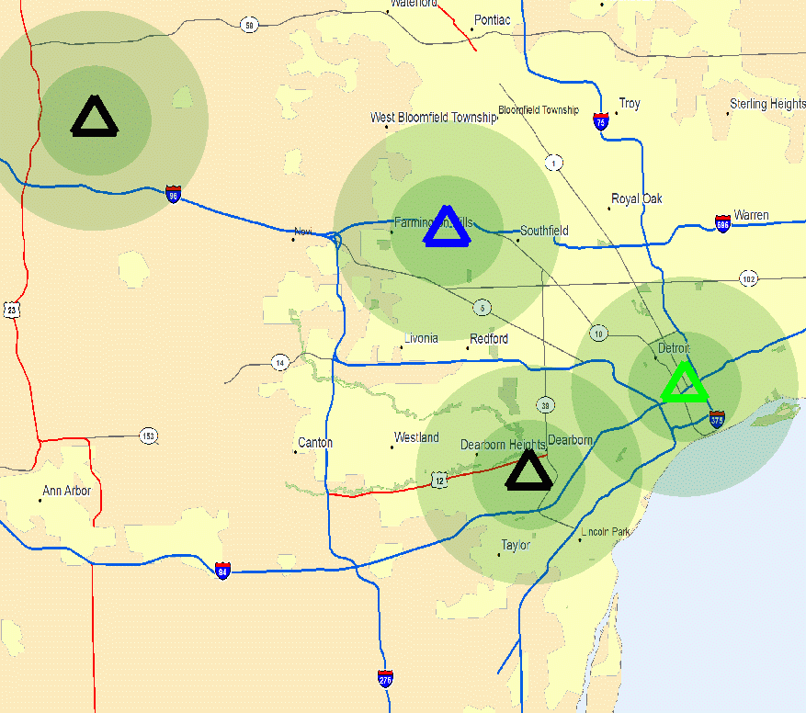
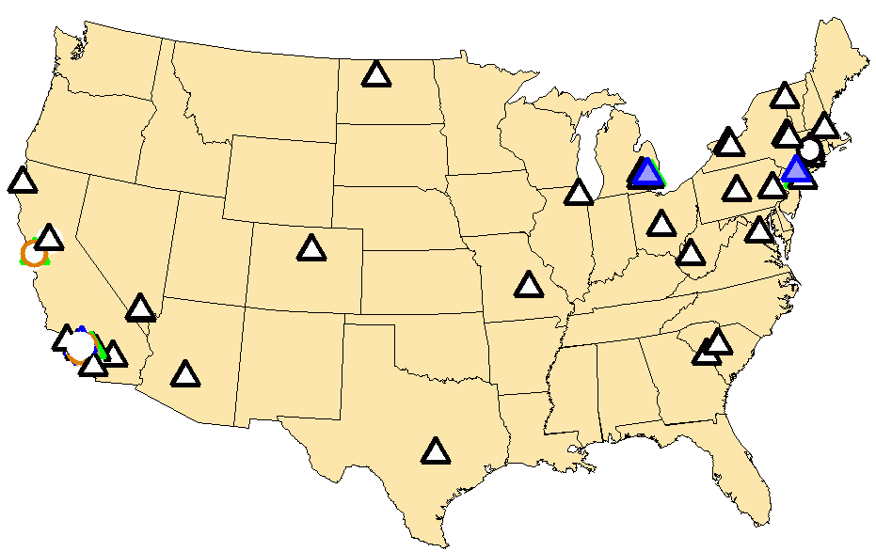
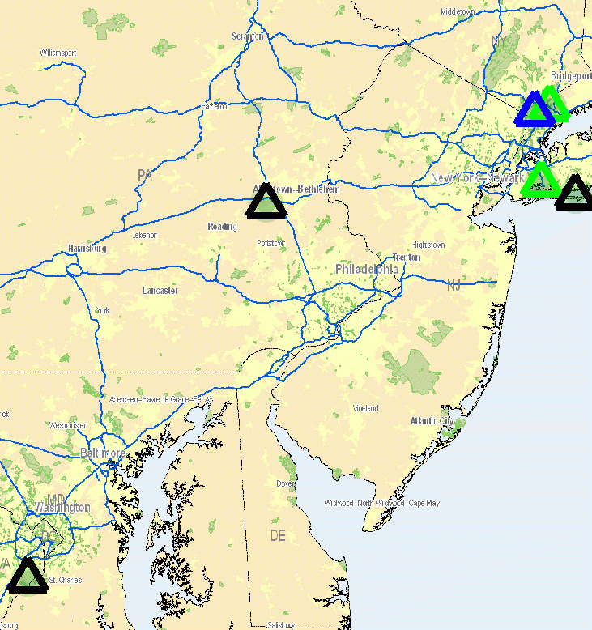
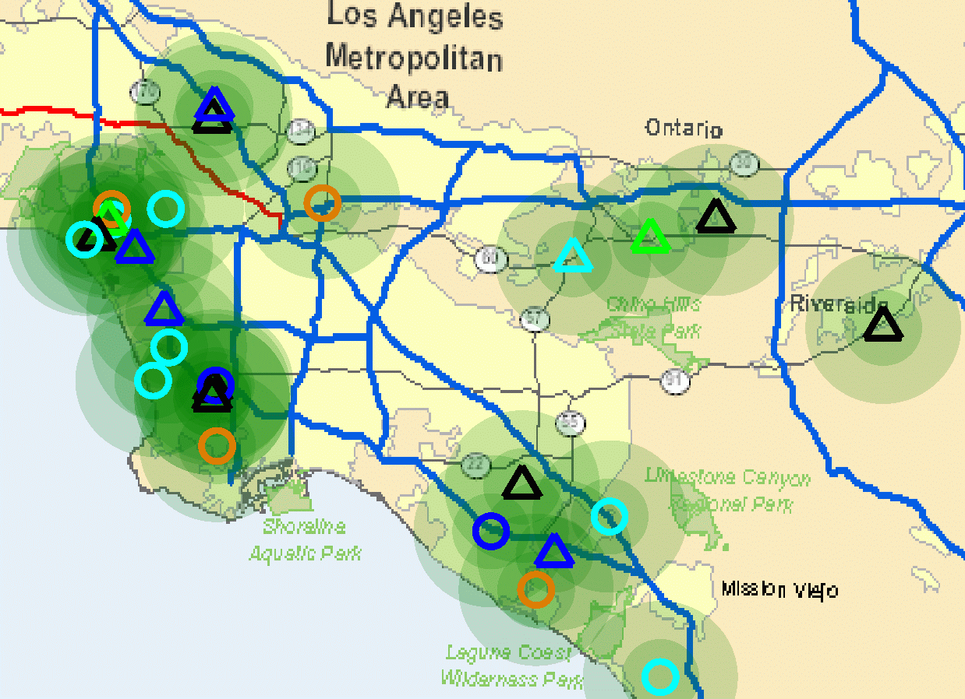
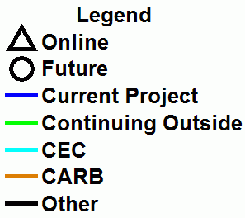
Status: Out of 25 Project Stations, 13 Are Still Operational (3/5 outside of DOE project)
SF Bay Area
* CDP station status is as of 12/31/10
Detroit Area
2 Online
3 Future
9
9
6
4 Online
DC to New York
Los Angeles Area
54 Online
15 Future
**
17 Online
11 Future
6 Online
6 mile radius
3 mile radius
** Funded by state of CA or others, outside of this project
Mar-31-2011

Slide 16
Vehicle Deployment Over Time

Slide 17
Number of Stations Over Time

Slide 18
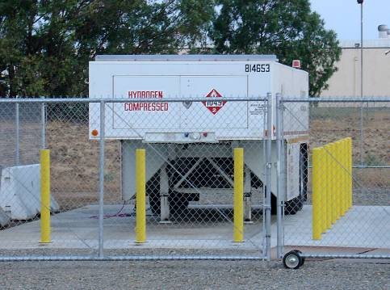
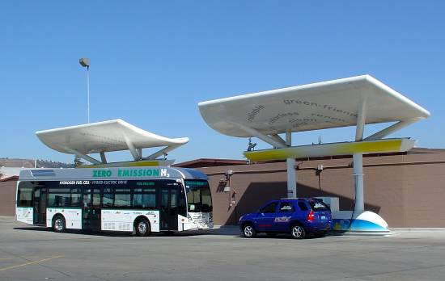
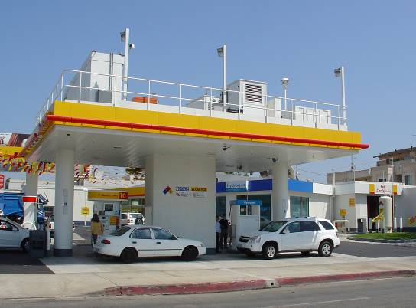
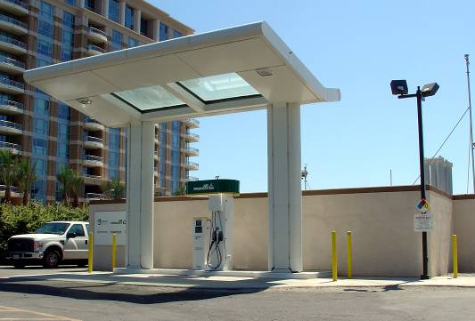
Station Types in FCEV Learning Demo

Slide 19
Safety Reports for FCEV Learning Demo
13 events
4 traffic accidents
4 leaks during fueling

Slide 20
Definitions for Safety Reporting
An incident is defined as an event that results in any of the following:
  A lost-time accident and/or injury to personnel
  Damage/unplanned downtime for project equipment, facilities, or property
  Impact to the public or environment
  Any hydrogen release that unintentionally ignites or is sufficient to sustain a flame if ignited
  Release of any volatile, hydrogen-containing compound (other than the hydrocarbons used as common fuels)
A near miss is defined as:
  An event that, under slightly different circumstances, could have become an incident
  An unplanned hydrogen release insufficient to sustain a flame

Slide 21
Safety Reports for FCEV Infrastructure
5 incidents

Slide 22
Safety Reports by Type
Equipment malfunctions
Significant H2 Release
Leaks

Slide 23
Safety Reports Primary Factors
Controls issue
2 operator error
2 design flaws

Slide 24
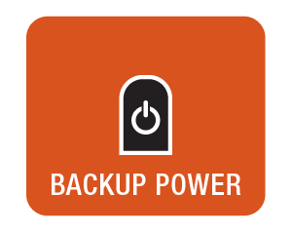

Backup Power,
Material Handling Equipment
Funding from DOE-ARRA, DLA

Slide 25
Early Market Locations

Slide 26
Early Market Applications

Slide 27
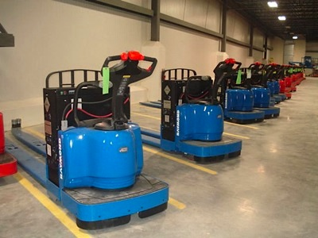
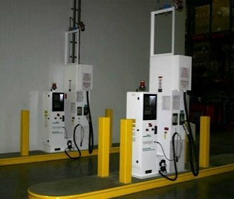
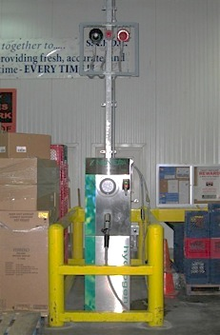
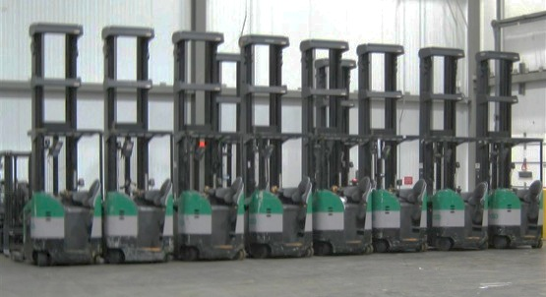
Summary of FC MHE Operation - ARRA
Sites | 5 | CDPARRA-MHE-#
Units in Operation (60 Class 1, 76 Class 2, 172 Class 3) | 308* | 01
Hours Accumulated | 307,433 hrs* | 11
FC Systems > 2360 hrs | 25%* | 02
Hydrogen Dispensed | 18,597 kg* | 04
Hydrogen Fills | 38,863* | 03
Average Fill Amount | 0.48 kg/fill* | 10
Average Fill Time | 1.8 min/fill* | 06
FCMHE operating at end user facilities, accumulating many hours and hydrogen fills safely, and already showing productivity improvements.
*Through December 2010

Slide 28
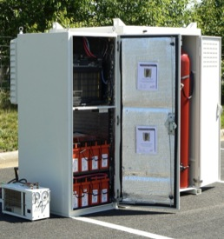
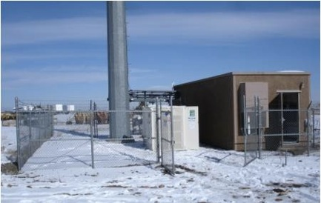
Summary of Backup Power System Operation
Sites | 85 | CDP-BU-#
Deployed Systems | 189* | 01
Total Successful Starts | 408 (99.8%)* | 04
Total Run Time | 218 hours* | 05
Total Hydrogen | 32.3 kg* | 06
Key Performance Metrics
Reliability
Low Emissions
Low Noise
Ease of Use
Remote Monitoring
* Through December 2010

Slide 29
ARRA Deployment
>750

Slide 30
Fuel Cell Deployments for DLA
~75

Slide 31
Fueling by Quarter for ARRA

Slide 32
Fueling by Quarter for DLA

Slide 33
MHE Infrastructure Maintenance By Category

Slide 34
ARRA FC System maintenance

Slide 35
DLA FC System Maintenance by Category

Slide 36
MHE Infrastructure Safety Reports
Most incidents were dispenser hose break-away

Slide 37
ARRA FC System Safety Reports

Slide 38
DLA FC System Safety Reports
Possible static discharge
Short from power washing

Slide 39
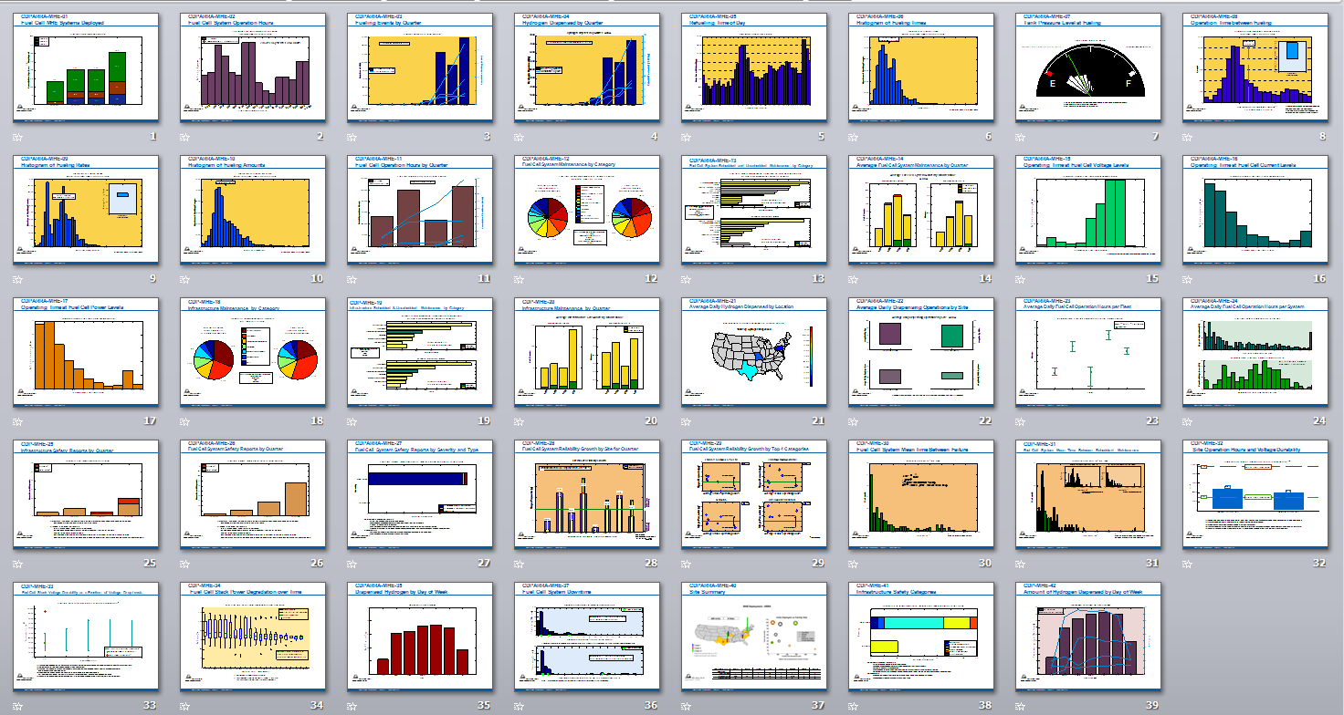
FCMHE 42 CDPs
Results include
Units deployed, operation hours, & fuel cell operation trends
Hydrogen fill count, amount, time, & rate
Tank level at fill & downtime from fill
Fuel cell durability & reliability
Fuel cell and infrastructure maintenance events & safety reports

Slide 40

FC Bus
Funding from DOE and DOT Federal Transit Administration

Slide 41
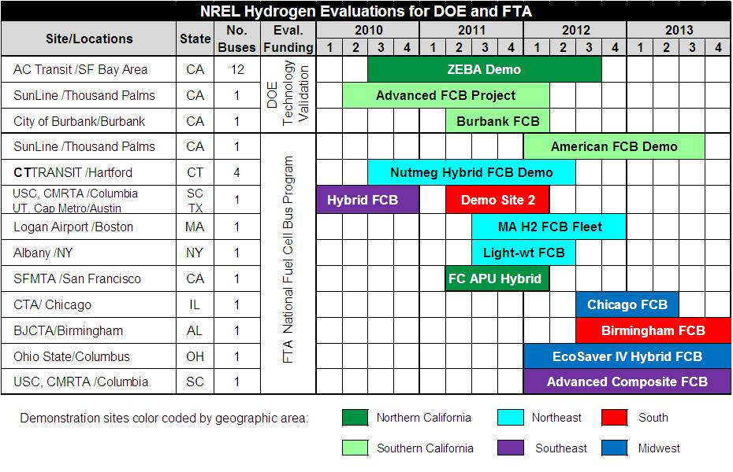

Technology Validation FCB
FC Buses Are Demonstrating Long Life and Superior Fuel
Economy Compared to their Diesel and CNG Baselines
Traveled:
>547,000 miles
Dispensed:
>96,000 kg H₂
Fuel economy results: 41% to 132% better than diesel and CNG buses

Slide 42
Bus Safety
Break-away not functioning as intended
Tanks on top of bus increase height/center of gravity

Slide 43
Specific Safety Reports
Car accident
Vibrating machinery (cold)
Fire at a Fueling Station
Breakaways not operating as intended
FL water spill
FL fire power washing
FL evap pad caught on fire

Slide 44
Lessons learned from Safety Reports
First responders may need training more often or when new to area
Need to prevent drive-offs with hose still attached
Need systems to prevent incidents or near misses getting worse because of cascading events
Want technology to be transparent to user but there are differences that user needs to be aware of
  Power washing of fuel cell forklift
Routine inspections are necessary to catch problems early
Make sure alarms are appropriate to the event to prevent over reaction.
Redundant checks to make sure maintenance is done properly
Fail-safe systems are working as intended

Slide 45
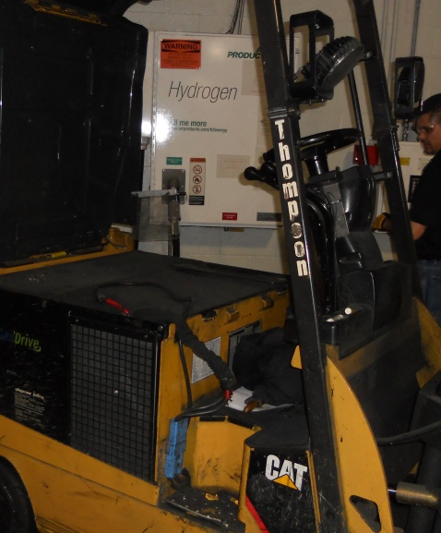
Preventing drive offs

Slide 46
New CDPs Coming Soon
In the next round of CDPs (Oct 2011)
  Performance
    More detailed durability CDPs
  Safety and Maintenance
    Hydrogen leaks by equipment category
    Hydrogen compressor failure modes
    Mean time between safety events
    Equipment category of safety events

Slide 47
Summary
Safety data collected from teams
Safety data reported in CDPs and available on NREL’s website
Incidents reported to H2Incidents.org when possible
Tech Val has seen a good safety record

Slide 48
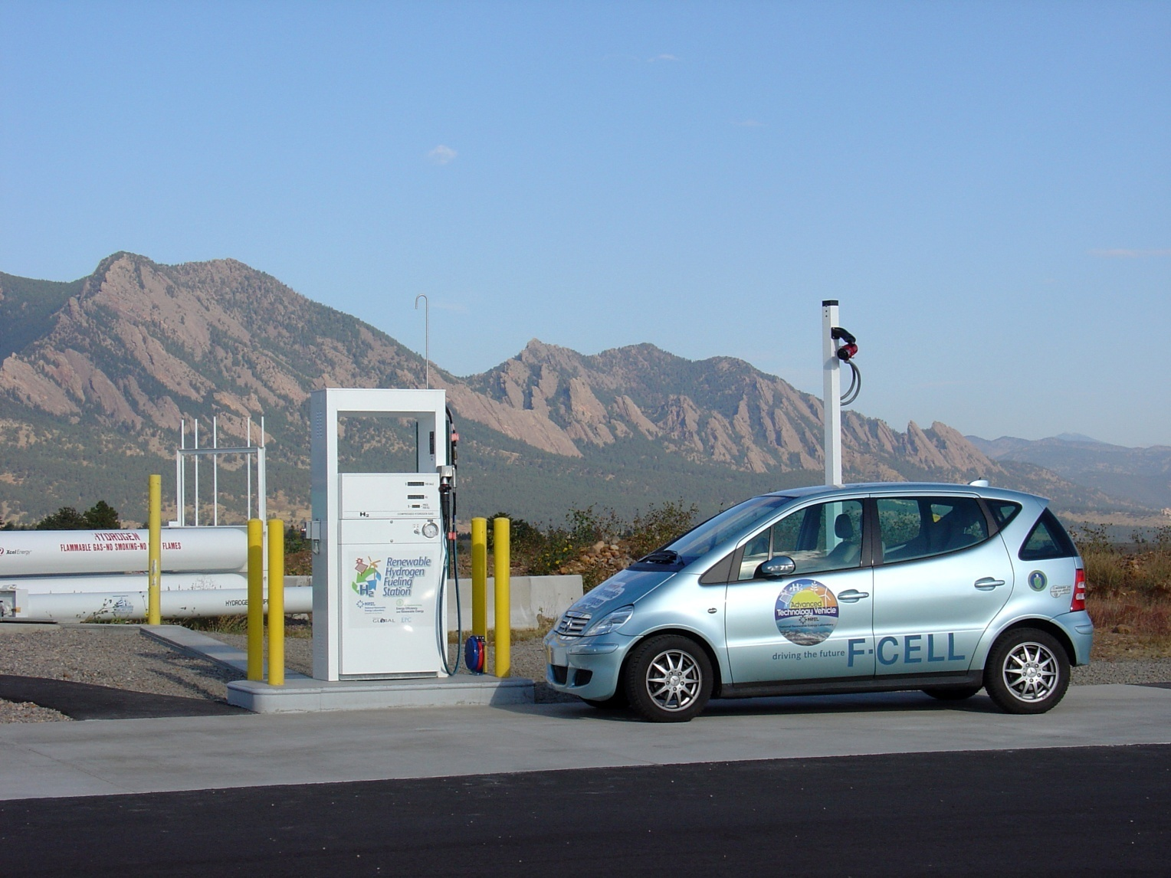
Daimler F-Cell at NREL
NREL’s Renewable H2 Station, storing
over 250 kg H2 and dispensing at 350 bar

Slide 49

Kia Borrego Fuel Cell at NREL

Slide 50

Ford Hydrogen Shuttle at NREL

Slide 51

Proterra Bus at NREL

Slide 52

Questions and Discussion
All public Learning Demo, FC Bus, and Early Market papers and presentations are available online at www.nrel.gov/hydrogen/proj_tech_validation.html
Contact: Sam Sprik, National Renewable Energy Lab
303.275.4431 sam.sprik@nrel.gov

Slide 54
FC Durability Target of 2000 Hours Met By Gen 2 Projections (2010)
*
*
Durability is defined by DOE as projected hours to 10% voltage degradation
Spring 2010

Slide 55
Vehicle Range Achieved 2009 Target of 250 Miles with Gen 2 Adjusted Fuel Economy

Slide 56
Factors Affecting Fuel Economy Show Large Spread in Data
Fuel economy relatively insensitive to average trip length, except for very short trips
Factor of 2X observed for fuel economy as a function of average trip speed

Slide 57

Fuel Cell System Reliability Analysis
Failure events (i.e. unscheduled maintenance records) are tracked per unit and per fleet
Crow-AMSAA analysis method^{1,2}
Study failure rates (e.g Shape Parameter > 1 is an increasing failure rate)
Highlight common failures per category and unit
Tracks progress and reliability predictions
The New Weibull Handbook, 5th ed., Robert Abernethy, (2007)
IEC 61164:2004, Reliability Growth – Statistical Estimation Methods, International Electrotechnical Commission, (2004)

Slide 58
NREL Tech Val
Third party technology assessment
Proven ability to process large amounts of real world data from multiple applications
Public reporting and validation of technology with aggregated data to protect commercially sensitive and proprietary information
Technology and industry experience
Detailed communication and collaboration with project partners
Team members focused on technology analysis
Analysis toolkit that has been adapted and applied to
multiple technologies
Analysis methods applied uniformly across data partners
Analyses examples include efficiency, durability, reliability, operation trends, and safety
Central location for data

