Slide 1
Hydrogen Safety Training for Researchers and Technical Personnel
Salvador Aceves, Francisco Espinosa,
Guillaume Petitpas, Tim Ross,
Vernon Switzer
International Conference on Hydrogen Safety
San Francisco, CA
September 12, 2011

Slide 2
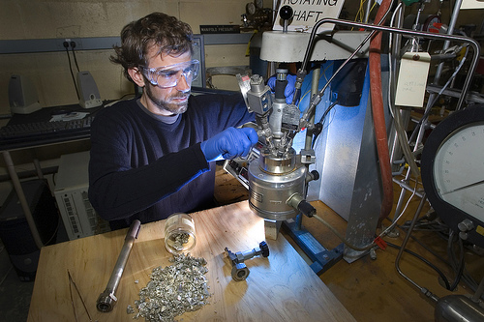
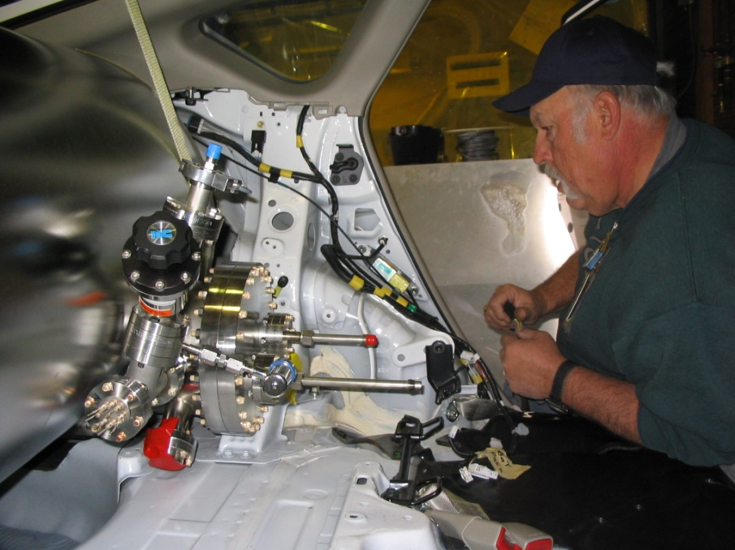
Appropriate H2 safety instruction
is key to avoiding accidents
Laboratory researchers handling small amounts of hydrogen
Technical personnel in charge of assembling and testing systems

Slide 3
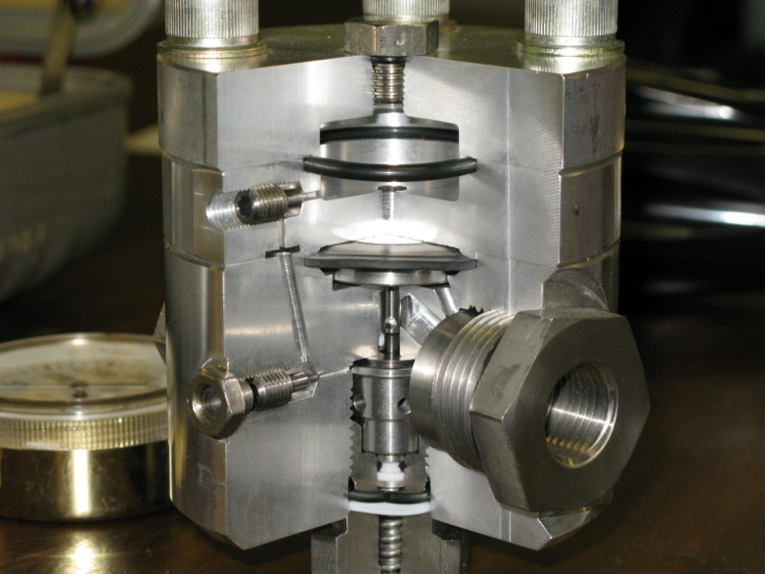
We are developing training materials
targeting these two key groups
Web-based class (4 hours) teaches basic information on pressure, cryogenics, flammability, asphyxiation, and other risks and precautions for using hydrogen
Hands-on safety class (3 days) teaches detailed component information as well as design, assembly, and testing of H2 systems

Slide 4
We have produced and peer reviewed a web-based hydrogen safety class for researchers
Four hours long
Six modules:
Introduction
Hydrogen properties
Pressure safety
Cryogenic safety
Emergency response
Codes and standards
End of module quizzes (passing grade 85%)
Web address: www.h2labsafety.org

Slide 5
Class demonstration: pressure safety module

Slide 6
3-day hands-on safety class
First day: Classroom discussion on detailed component characteristics
Definitions
Hazards
Personal Protective Equipment (PPE)
Gas Cylinders
Gas Cylinder Manifold
Pressure Reducing Regulators
Gauges/Pressure Transducers
Regulator Safety Manifold
Relief Devices
Valves
Fittings
Tubing and Piping
Flash Arrestors
Quiz
Notes:
Check image

Slide 7
First day of hands-on class: Classroom discussion on detailed component characteristics
Definitions
Hazards
Personal Protective Equipment (PPE)
Gas Cylinders
Gas Cylinder Manifold
Pressure Reducing Regulators
Gauges/Pressure Transducers
Regulator Safety Manifold
Relief Devices
Valves
Fittings
Tubing and Piping
Flash Arrestors
Quiz
Example:
class materials for pressure reducing regulators
Notes:
Check image

Slide 8
Pressure Reducing Regulators
Regulator Types
Single stage
Two-stage
Back pressure
Dome loaded

Slide 9
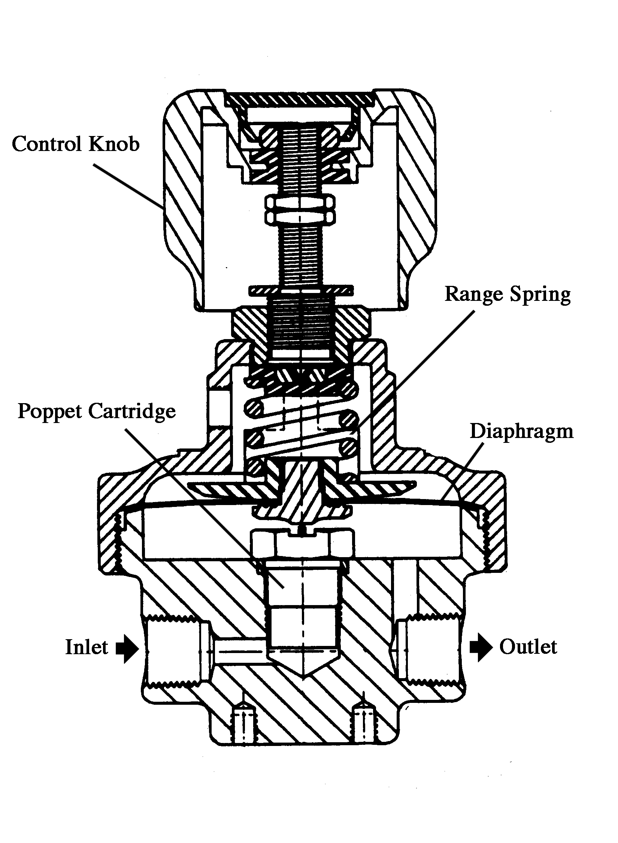
Pressure Reducing Regulators
Single Stage Regulator
Two Typical Applications:
High Pressure
Manifold Regulator
High Flows
Low Pressure
Line Station Regulator
Low Flows
Notes:
Check image

Slide 10
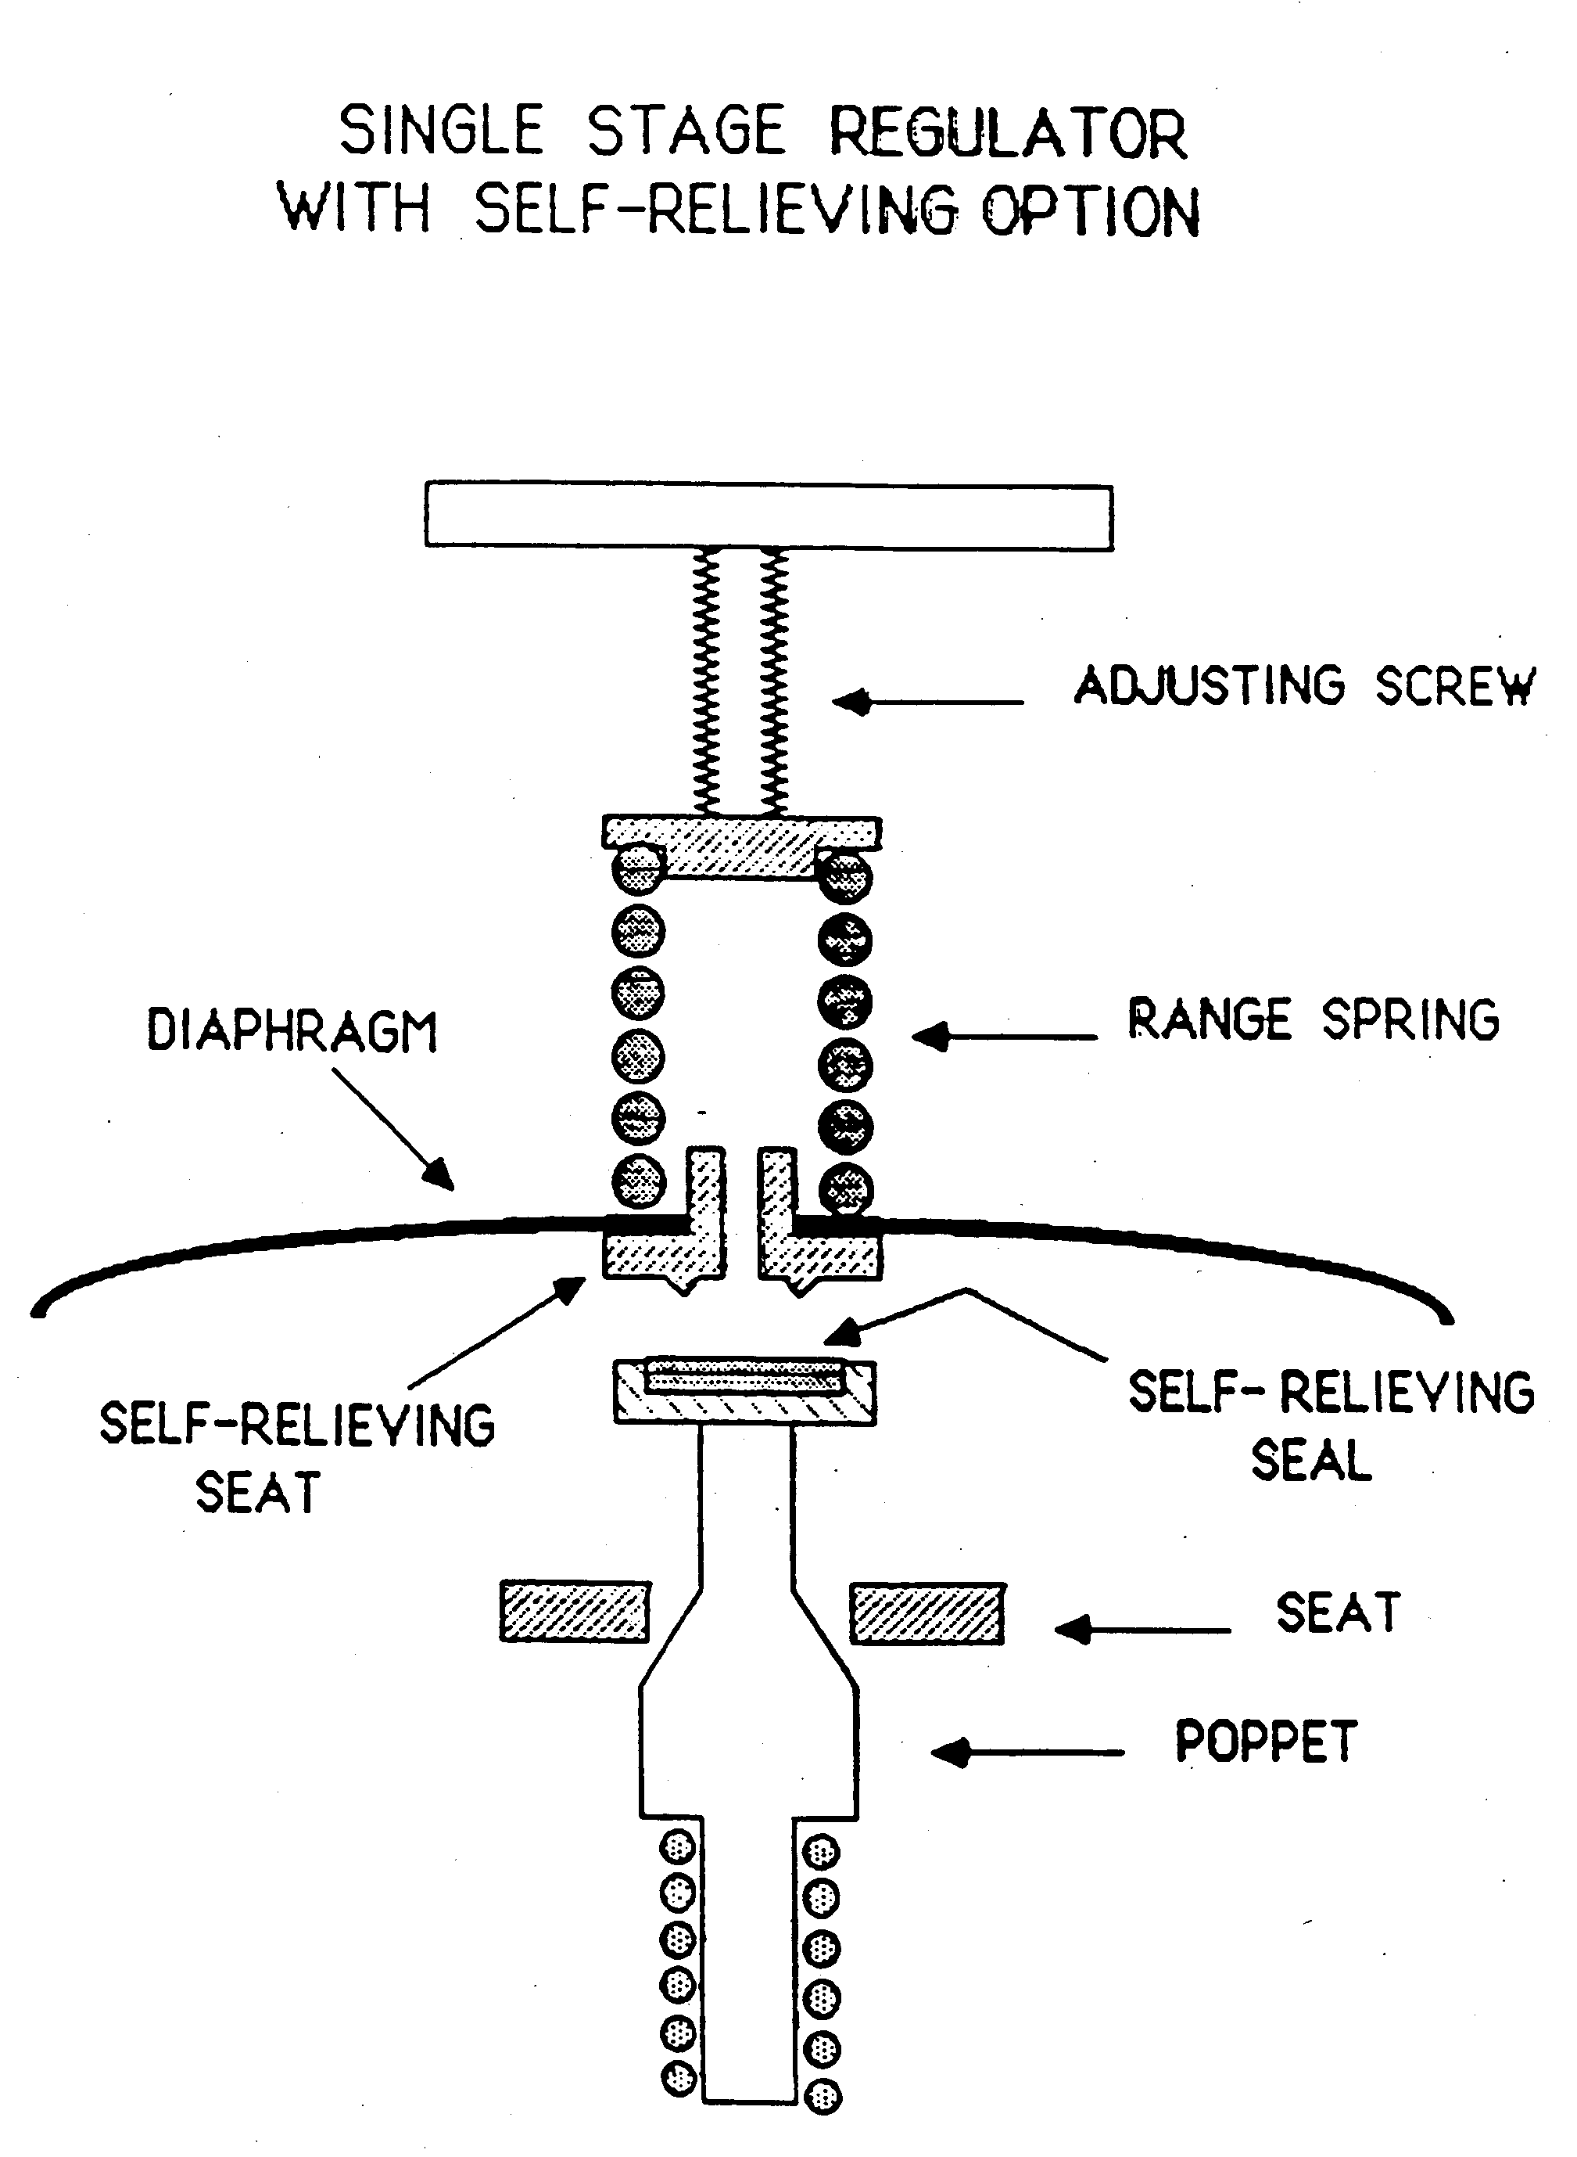
Pressure Reducing Regulators

Slide 11
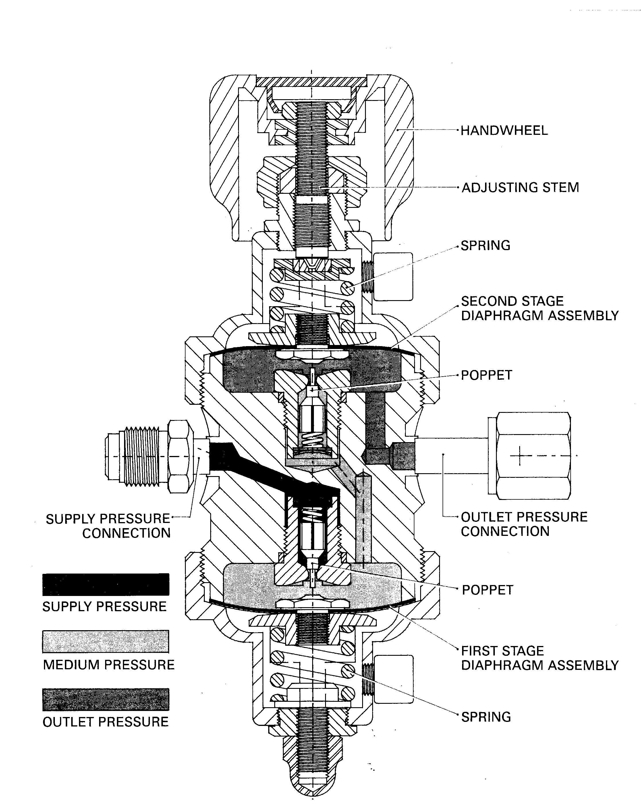
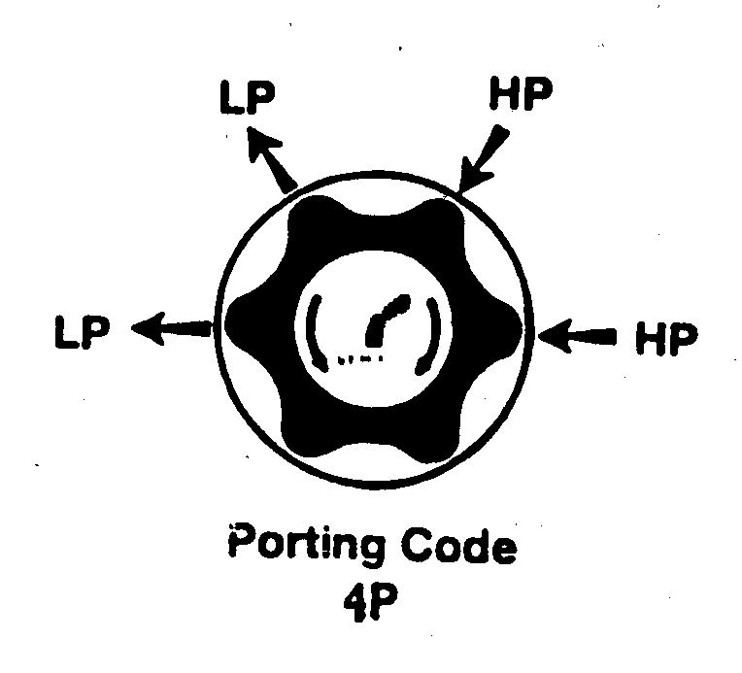
Pressure Reducing Regulators
Two Stage Regulator
Applications:
Precise Control
Lower Pressures
Lower Flows
Minimal Supply Pressure Effect
Notes:
Check image

Slide 12
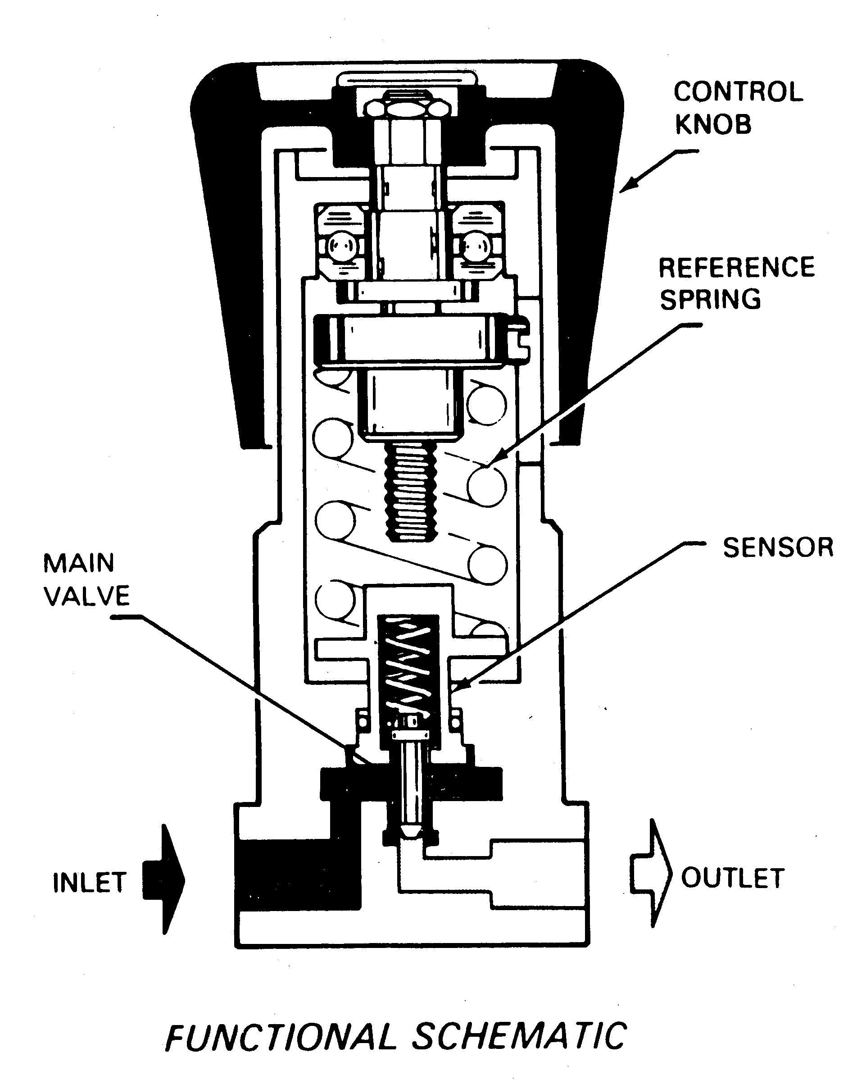
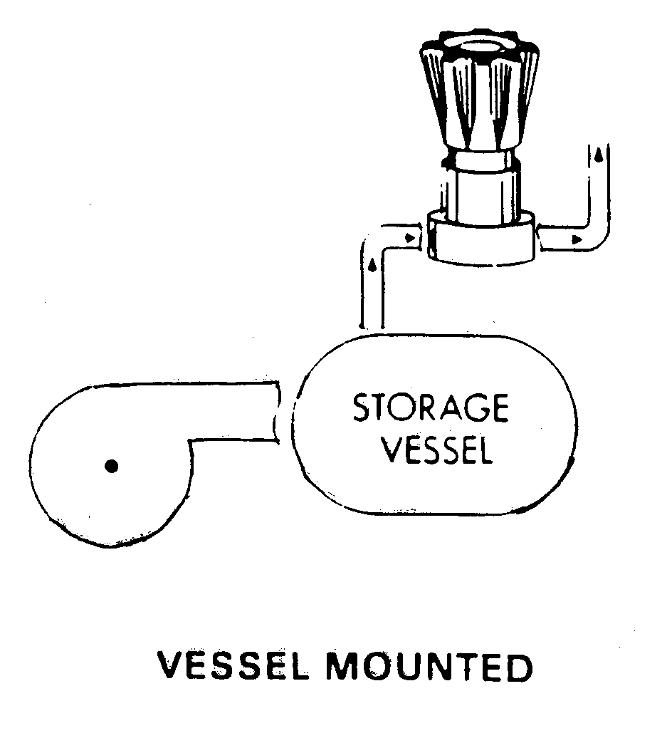
Pressure Reducing Regulators
Back Pressure Regulator
Applications:
Controlling Pump Pressures
Fluid Sampling
Industrial Controls
Adjustable Relief for Test Consoles
Notes:
Check image

Slide 13
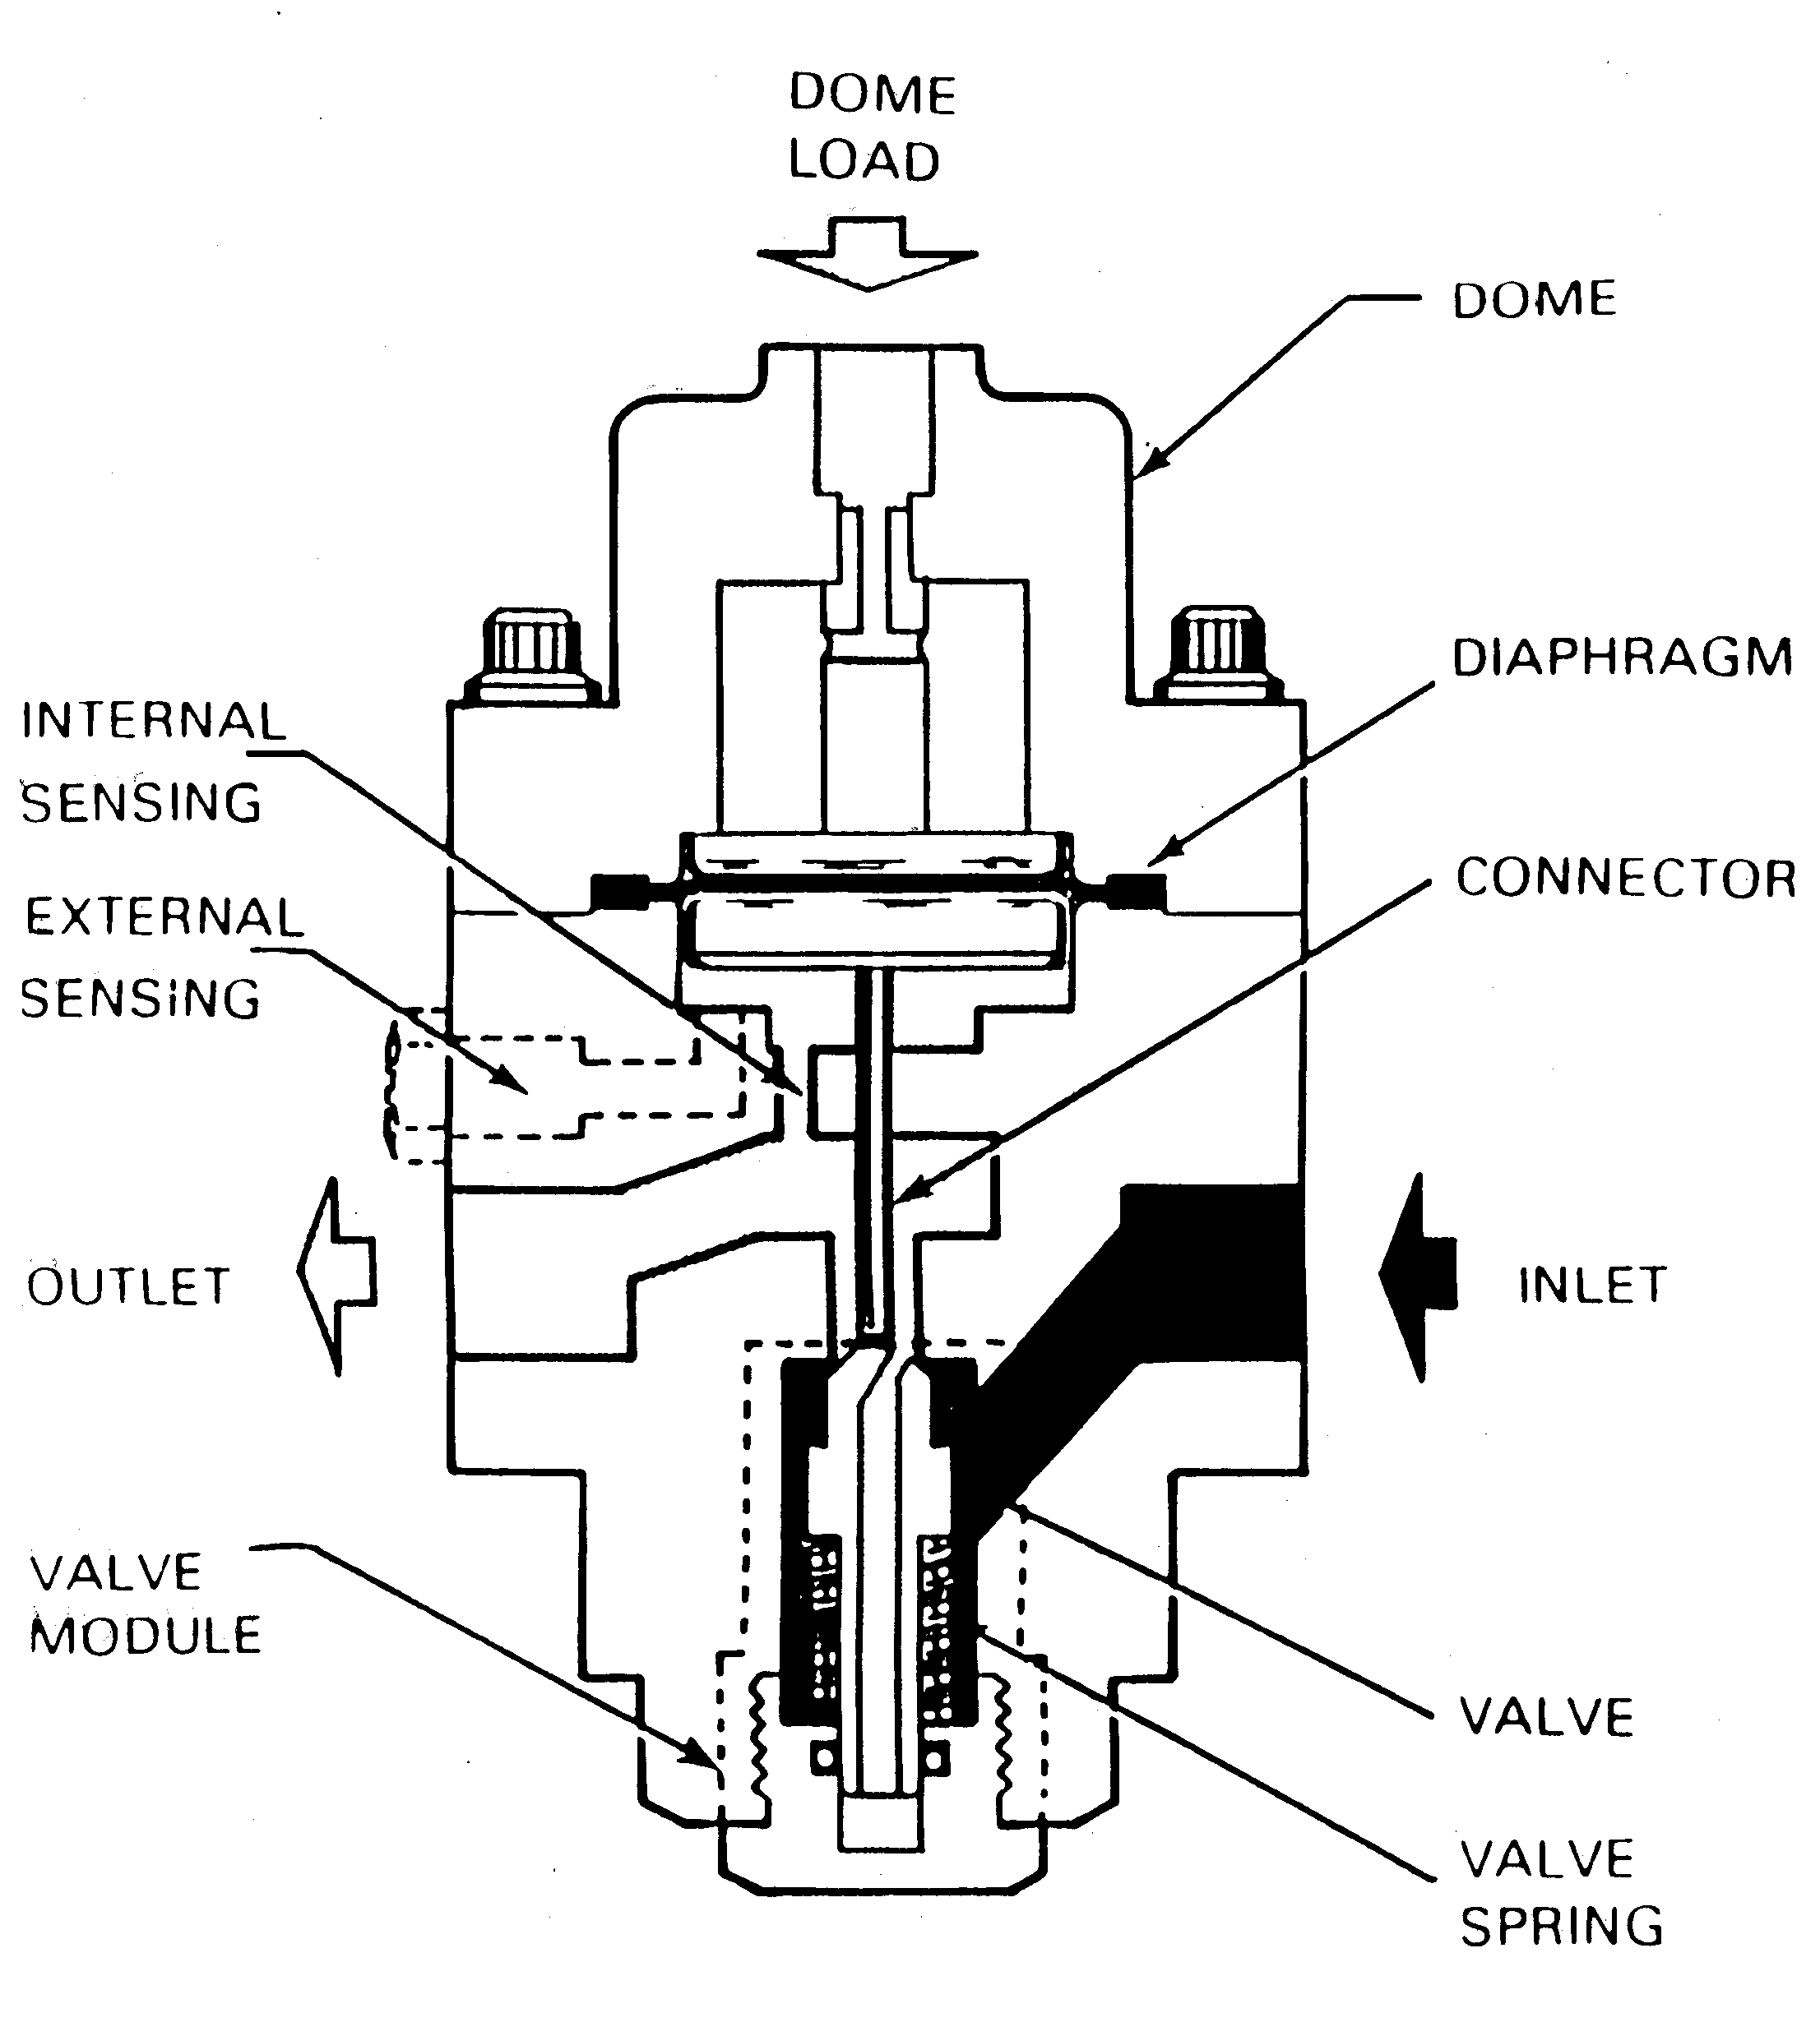
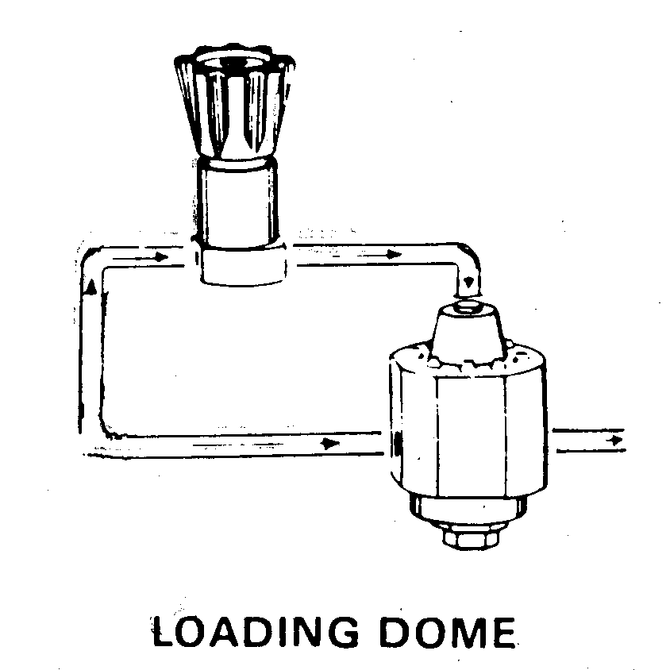
Pressure Reducing Regulators
Dome Loaded Regulator
Applications:
High Pressure
High Flow Purge
Manifold Regulator
Test Consoles
Notes:
Spring loaded?
Get better images

Slide 14
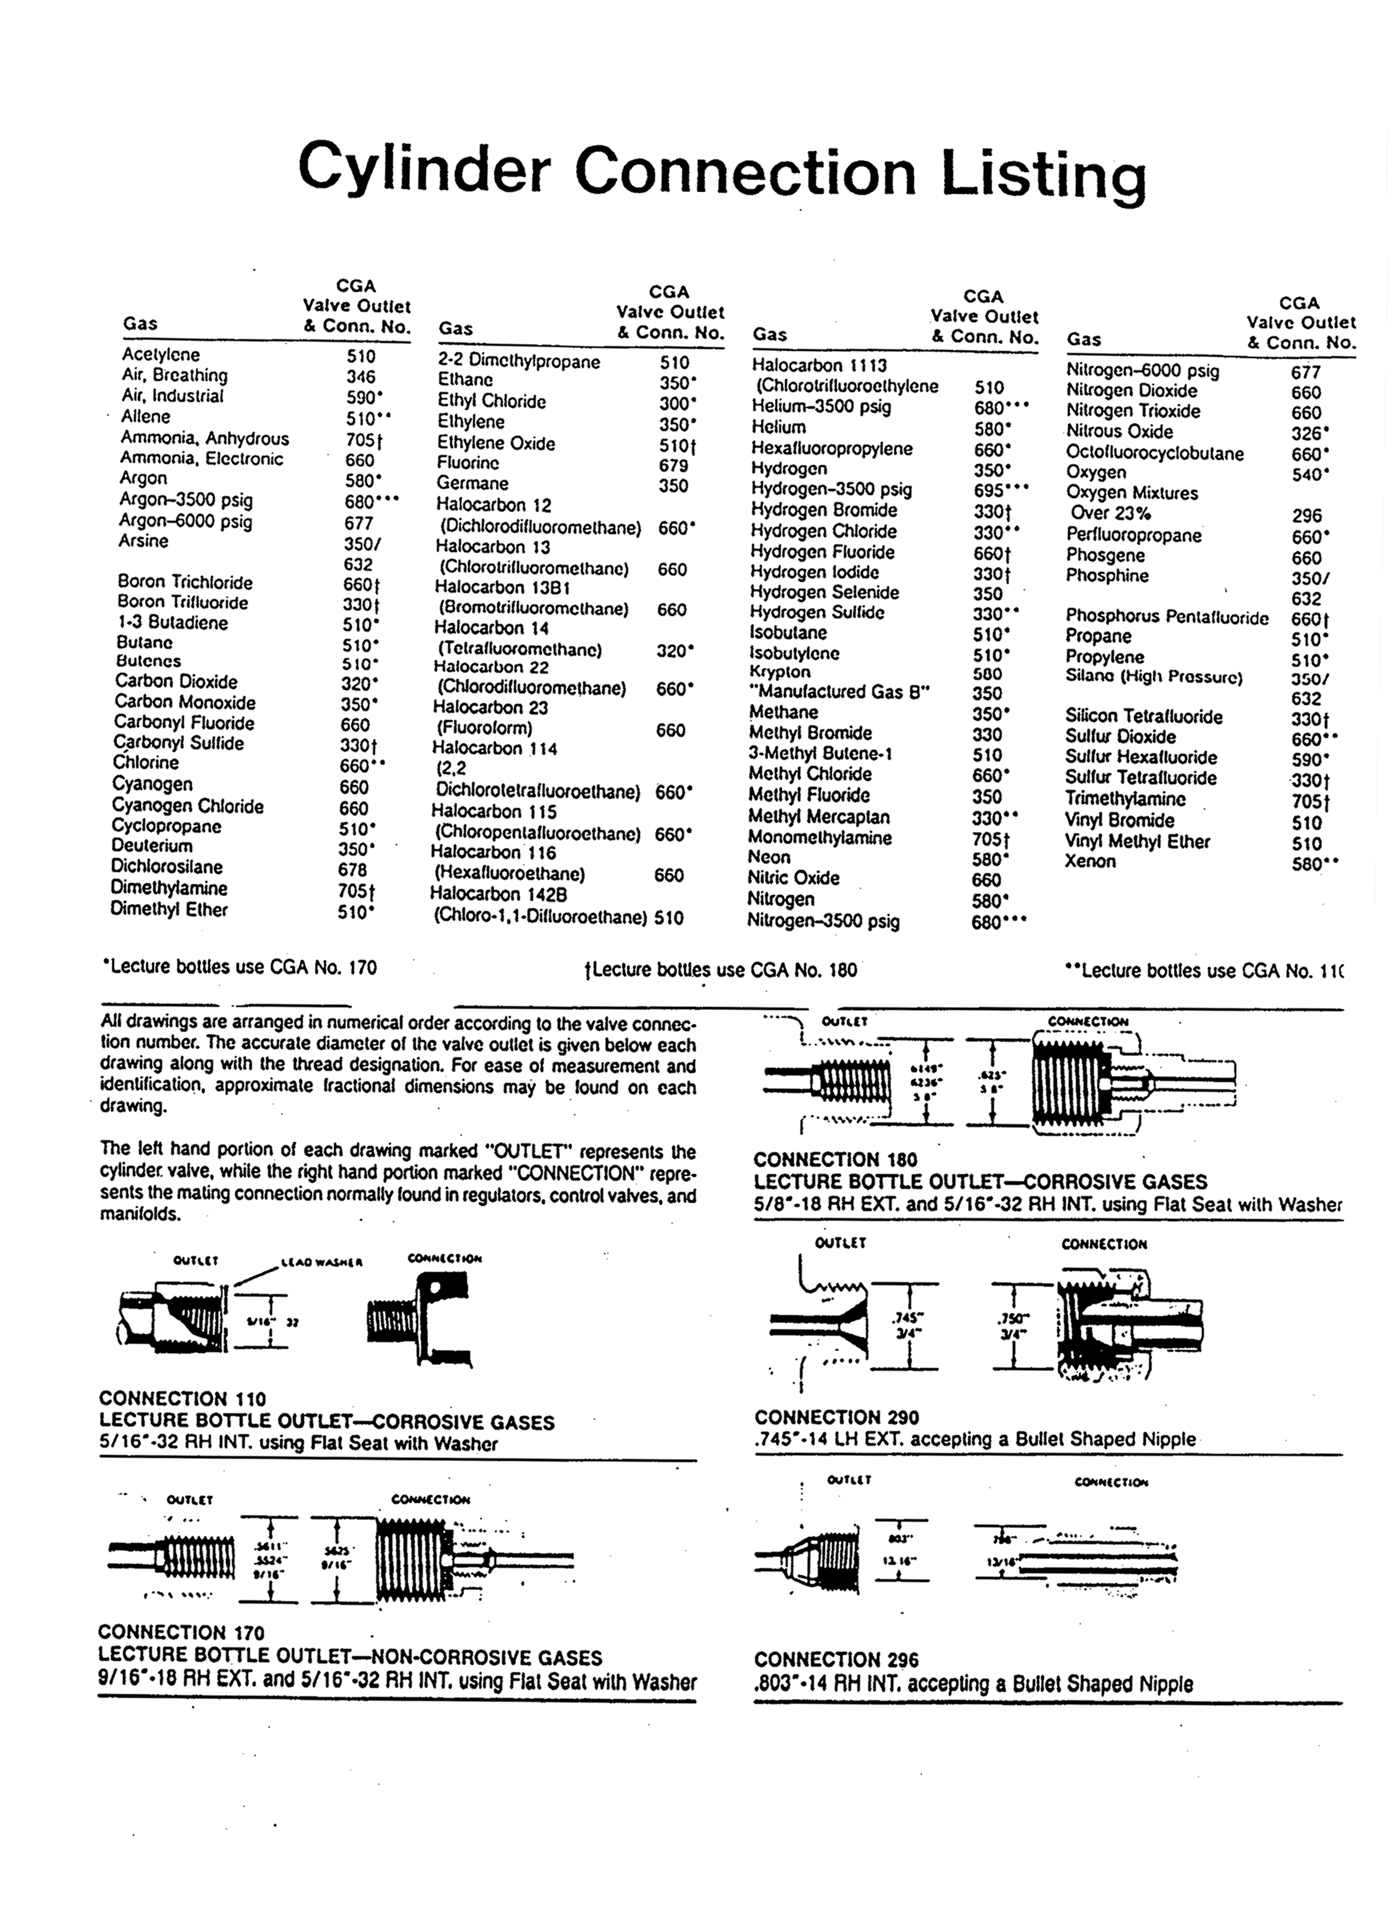
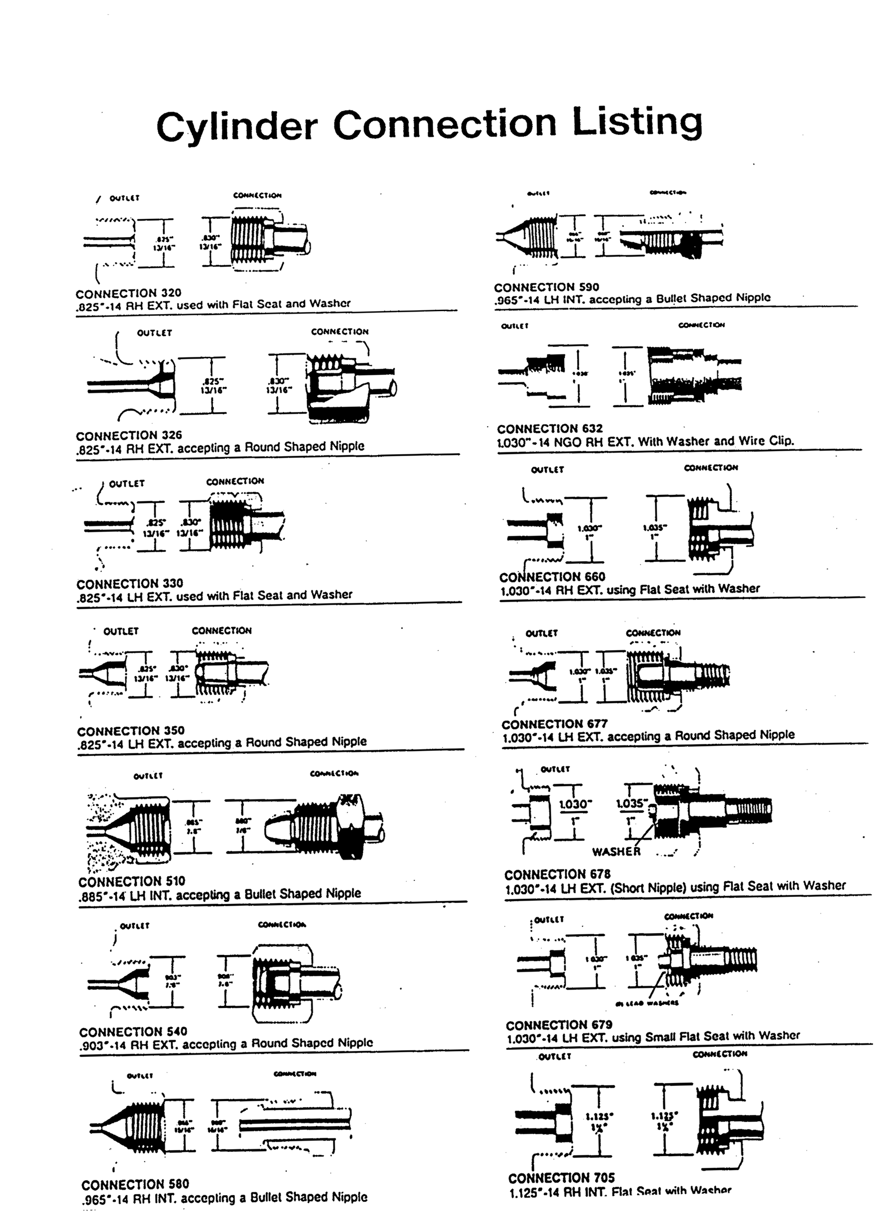
Pressure Reducing Regulators

Slide 15
Pressure Reducing Regulators
Cylinder Relief Devices
Type:
Spring loaded
Frangible disc
Fusible plug
Frangible disk backed
by fusible metal
No relief device
Use:
propane, mapp gas
CO₂, N₂, O₂, argon, He
acetylene, chlorine
hydrogen, methane
arsine, fluorine,
phosgene

Slide 16
Pressure Reducing Regulators
Compressed Gas Cylinder Handling
DOT cylinder identification
*,+, Hydro test date
Cylinder status tag
Use proper discharge controls
Keep cylinders away from heat

Slide 17
Pressure Reducing Regulators
Always
Read the shoulder label on the cylinder, verify gas
Select the proper regulator for the gas being used
Secure the cylinder before installing the regulator
Inspect the cylinder valve and regulator for damage

Slide 18
Pressure Reducing Regulators
Always (continued)
Make sure the cylinder valve and regulator connections are free of dirt, oil, grease, and foreign material
Close the regulator by turning the pressure control knob counterclockwise until the knob turns freely without tension before opening the cylinder valve
Open the cylinder valve slowly

Slide 19
Pressure Reducing Regulators
Never
Use a damaged regulator
Adjust, remove, or plug relief devices
Change CGA or inlet connection
Lubricate any part of the regulator or cylinder valve

Slide 20
Pressure Reducing Regulators
Never (continued)
Force threaded connections
Stand in front of the regulator while opening the cylinder valve
Attempt to perform any type of repair to the regulators, consult an authorized repair shop

Slide 21
Pressure Reducing Regulators
Glossary
Droop
This is the amount of outlet pressure decrease with respect to increasing flow demand on a pressure reducing regulator. It can be expressed in percentage change of the set point or can be shown as pounds per square inch change with respect to flow increases
Lockup
This is the amount of outlet pressure increase beyond the set pressure with respect to decreasing flow demand on a pressure reducing regulator.
Critical Flow
This is also sometimes referred to as sonic flow and is the maximum flow which can pass through a regulator or an orifice

Slide 22
Pressure Reducing Regulators
Glossary (continued)
Creep
This is an increase in outlet pressure occurring after lockup. Creep normally appears as a gradual rise in outlet pressure over a period of time. The usual cause of creep is contamination in the regulator seat causing the regulator to remain slightly open henceforth additional outlet pressure.
Bubble Tight Shutoff
Determined by connecting the outlet of a regulator with a piece of tubing and submerging the end under an inch or two of water. With inlet pressure applied and the regulator in an off condition, there should not be any bubbles within a time period of one minute. This constitutes “Bubble Tight Shutoff”.
Set Point
This is the control point desired for operation of a regulator.

Slide 23
Pressure Reducing Regulators
Glossary (continued)
CGA Fittings
Compressed Gas Association (CGA) is the group that has established standards in the gas industry for fittings which are used to attach to gas cylinders.
DIN Fittings
Deutsches Institut für Normung (DIN), English translation would be German Industrial Standard. The DIN system was developed by Germans and is used in Europe.
Coefficient of flow (C_{v})
For a valve is the volume of water in U.S. gallons per minute at room temperature…which will flow through the valve with the stem fully open…with a pressure drop of 1 psi across the valve. C_{v} is the valve sizing factor that permits selection of the appropriate valve to meet the flow requirements of a given fluid system.

Slide 24
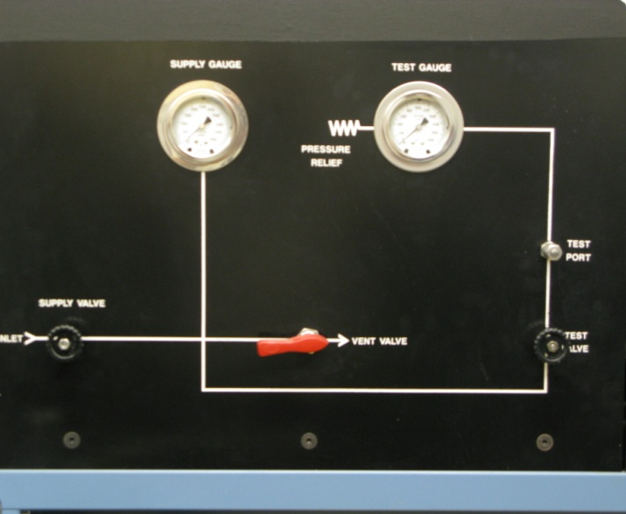
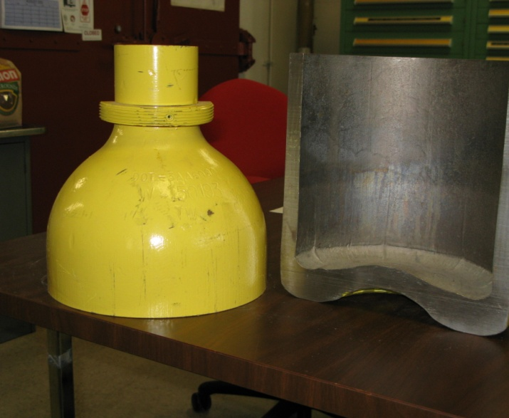
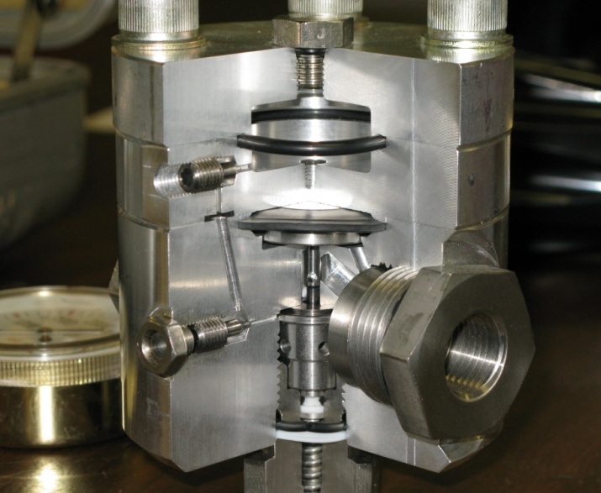
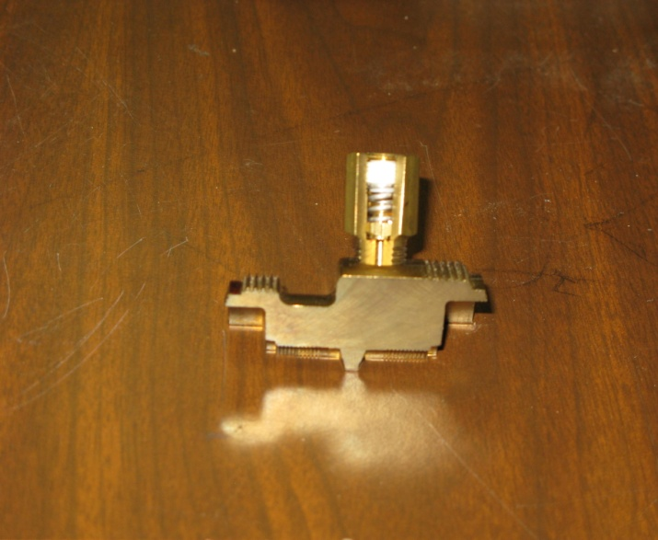
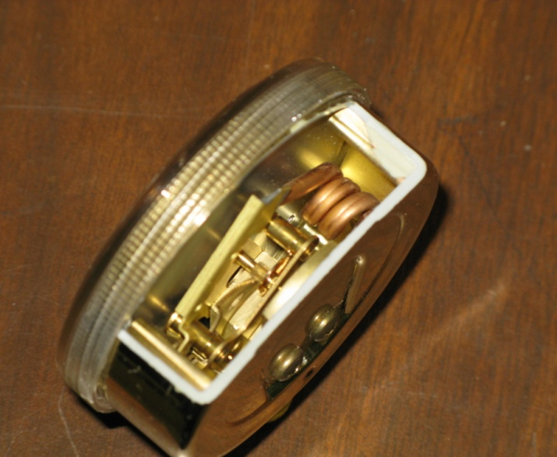
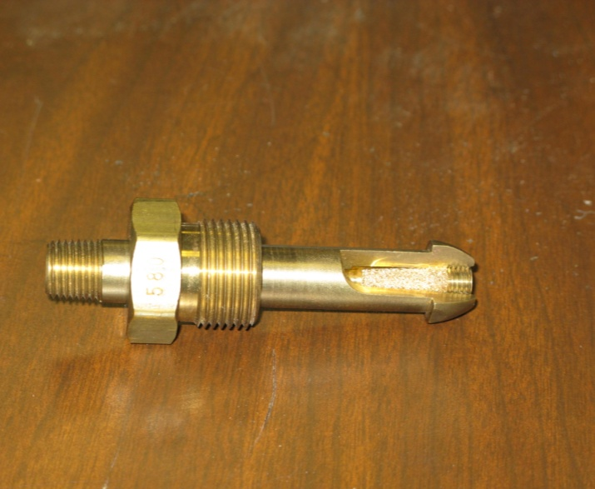
We have developed a variety of instructional materials for 3-day hands-on hydrogen safety class
Working table pressure vessels regulator
Relief device pressure gauge CGA fitting

Slide 25
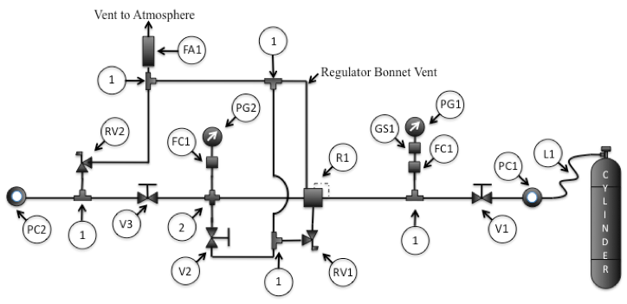
Second day: assemble pressure system described in engineering safety note

Slide 26
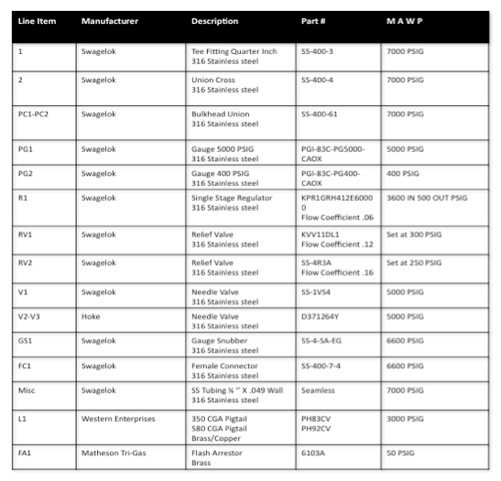
Second day: assemble pressure system described in engineering safety note

Slide 27
Second day: video illustrates planning, component installation, tube cutting and bending, compression fittings, and leak testing using mass spectrometer leak detector

Slide 28
Third day: video illustrates data acquisition setup, pressure test, leak test at MOP, and system operation

Slide 29
Summary
We are contributing to safe hydrogen operations by developing instructional materials for researchers and operators
Web-based class (now complete) addresses the need of laboratory researchers handling small amounts of hydrogen www.h2labsafety.org
Hands-on class (in process) will present in-depth information for technical personnel tasked with installing and testing hydrogen systems
Participation from the hydrogen community will improve the class through suggestions, bug reports, etc.

