Slide 1
Towards sustainable energy systems with fuel cells and hydrogen
6th International Conference on Hydrogen Safety | Yokohama | October 19th, 2015
Thorsten Herbert | Head of Programme Transportation and Infrastructure, NOW GmbH

Slide 2



Three reasons why it is inevitable to change the energy system in Germany and Europe
Climate protection:
Global responsibility for the next generation.
Energy security:
More independency from fossil fuels.
Securing the economy:
Creating new markets and jobs through innovations.

Slide 3


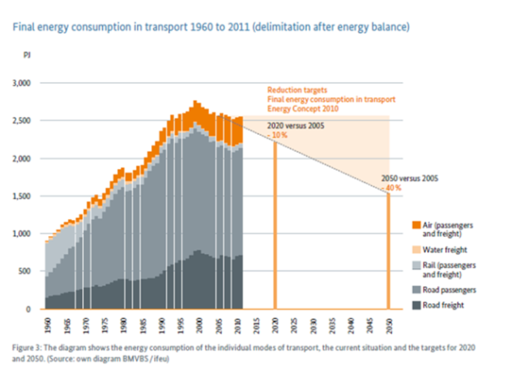
Policy Goals in Germany for Renewable Energies in the Energy System and for Road Transport
Energy Concept (2010)
reduce overall GHG emissions (vs. 1990):
40% by 2020 ➔ 80%-95% by 2050
increase share of renewables in final energy consumption:
18% by 2020 ➔ 60% by 2050
reduce primary energy consumption:
20% by 2020 ➔ 50% by 2050
reduce final energy consumption
of transport (vs. 2005):
10% by 2020 ➔ 40% by 2050

Slide 4
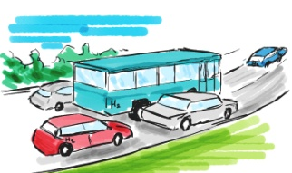
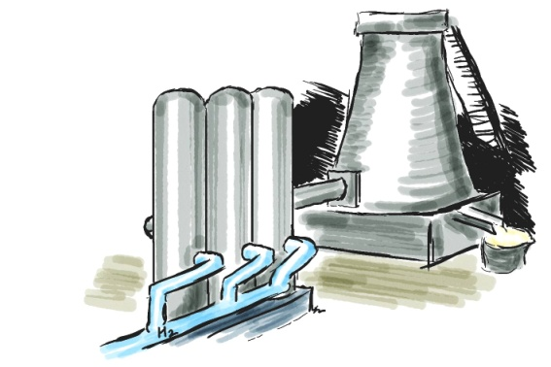
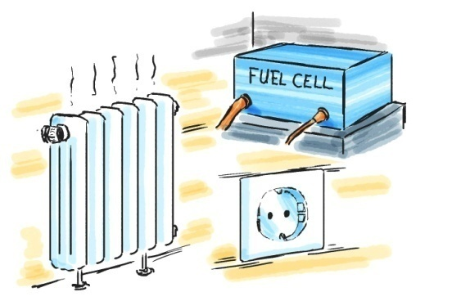
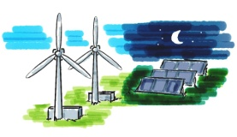
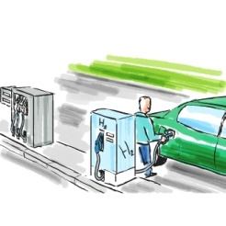
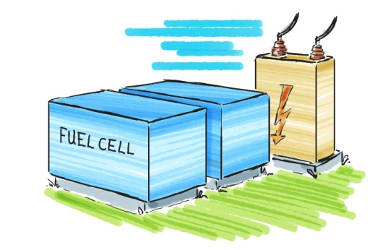
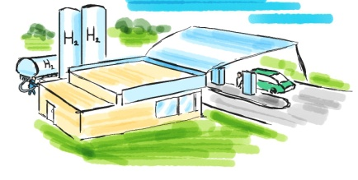
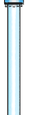
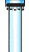
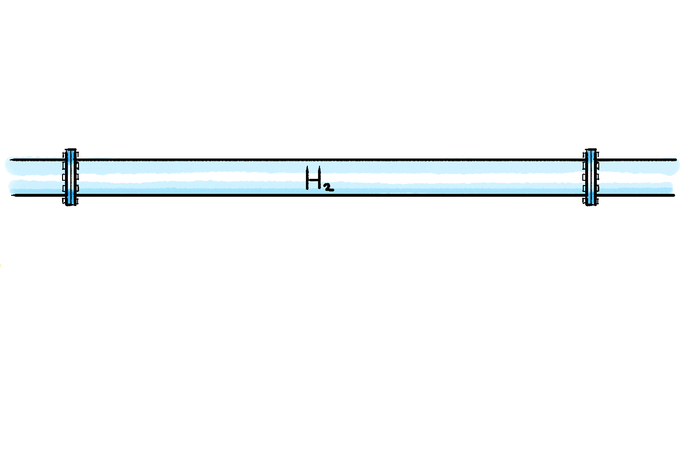
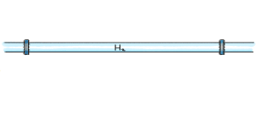
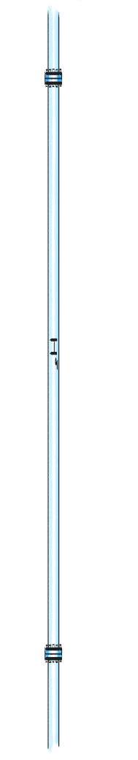
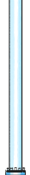
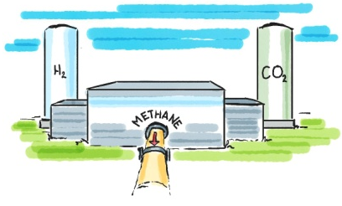
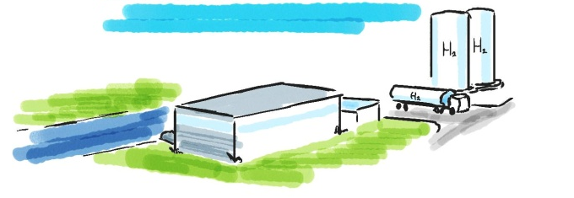
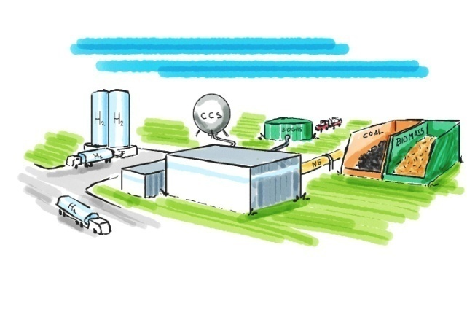
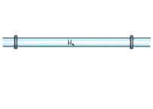
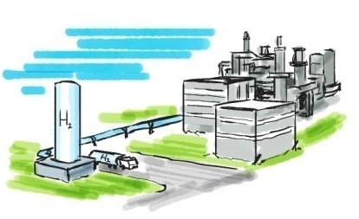
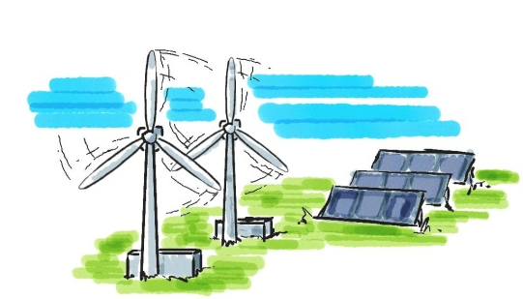
Key role of hydrogen as an energy carrier to facilitate the energy transition in Germany
Mobility
Hydrogen for
industrial processes
Decentralized power-heat
cogeneration
Energy storage for
supply from renewables
Up to 5% H2 feed in natural gas pipeline possible
Byproduct of the
chemical industry
Water electrolysis
Reforming of natural gas/biogas or gasification of biomass/coal

Slide 5


The National Innovation Programme
Hydrogen and Fuel Cell Technology (NIP)
Politics
Industry
BMVBS / BMWi / BMBF / BMU
€ 500 million
for demonstration
+ € 200 million
for R&D
+ € 700 million
Co-payment from industry
Preparing hydrogen & fuel cell markets
Focus on R&D combined with everyday demonstration
Hydrogen & fuel cells driven by applications and markets: transport, stationary energy supply, special markets
€ 1,4 billion
2007-2016

Slide 6
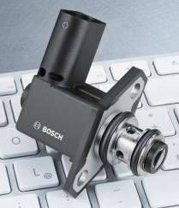

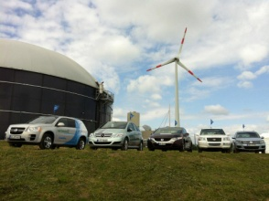
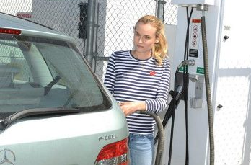

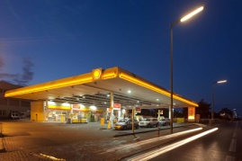
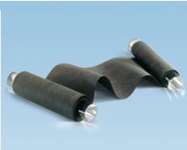
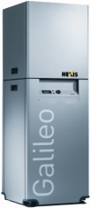
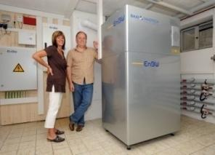

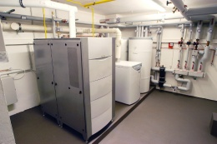
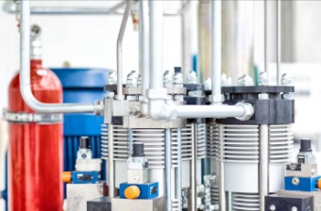
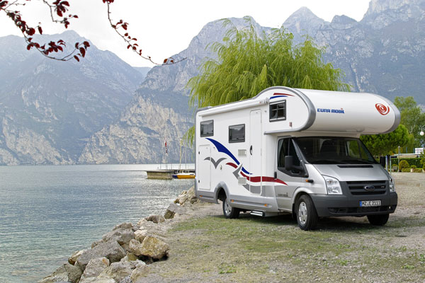

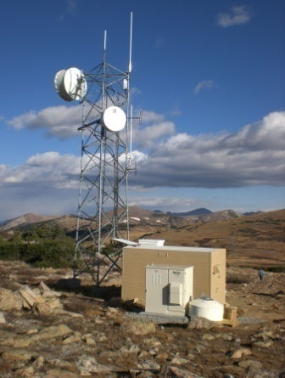

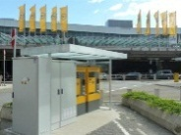
NIP – Integrated Approach for Market Preparation
Technology
Market
Application
components
subystems
systems and products
cost
reliability
durability
customer acceptance
safety
approval / certification
Bosch:
Wasserstoffgas-Injektor HGI
FCCT:
Gasdiffusionsschicht
(GDL)
Linde:
Ionic H2-Kompressor

Slide 7
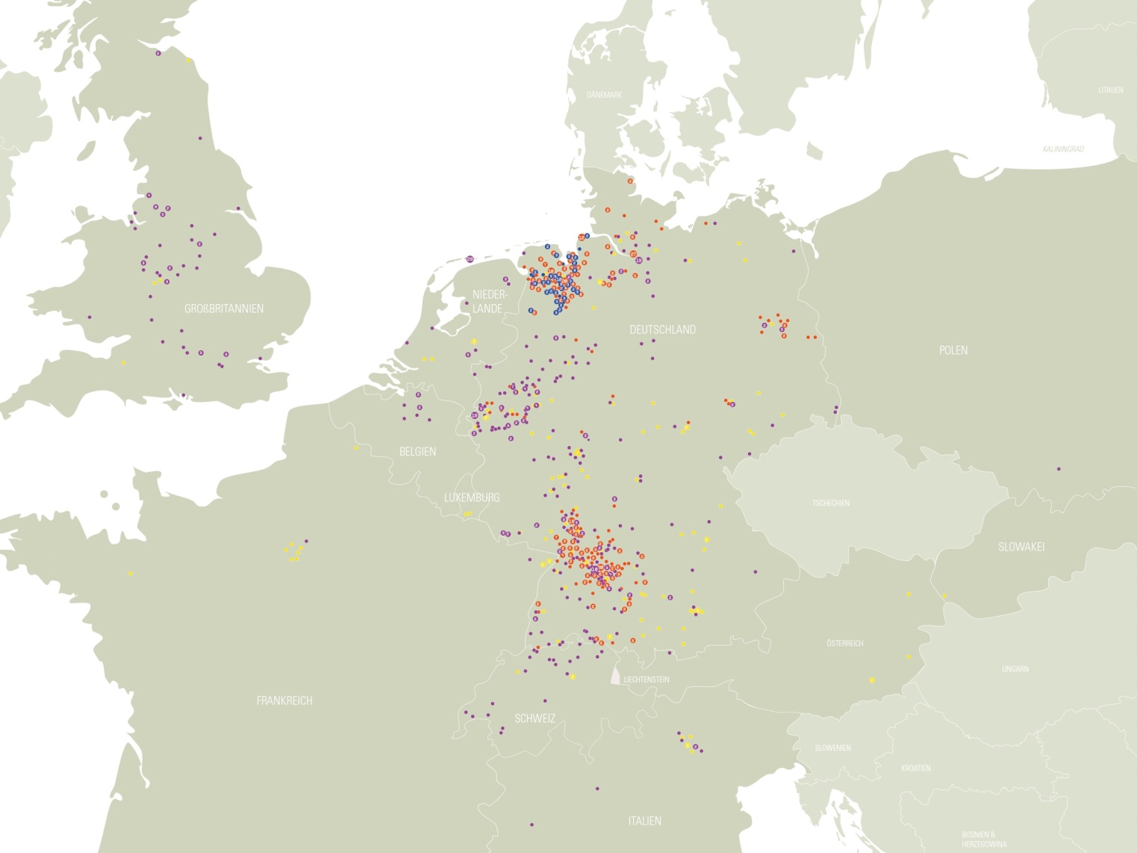
Residential Applications in Europe
red: callux
yellow: ene.field
blue: FuelCell@Home
purple: other projects

Slide 8
Funding Activities Residential Applications
Research & Development
Demonstration
&
Fieldtest
Market-introduction
Market-
penetration
Marketsaturation
FC CHP Technology Introduction Program
Volume
FCµCHP Funding Directive
Callux
R&D Projects
Time
Typical Innovation- and Diffusion Process of new Technologies

Slide 9
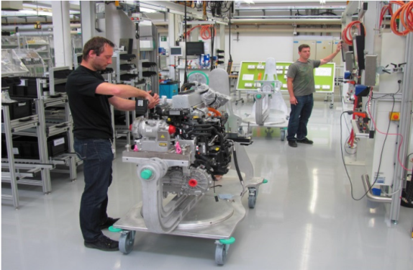

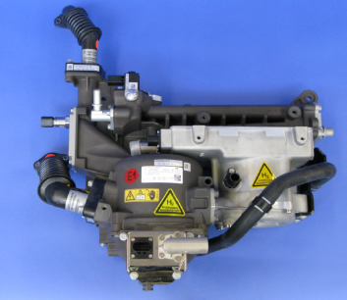
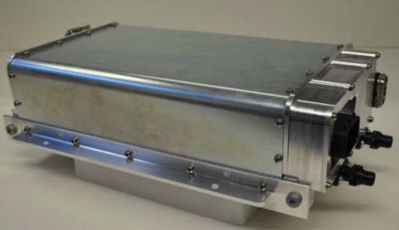

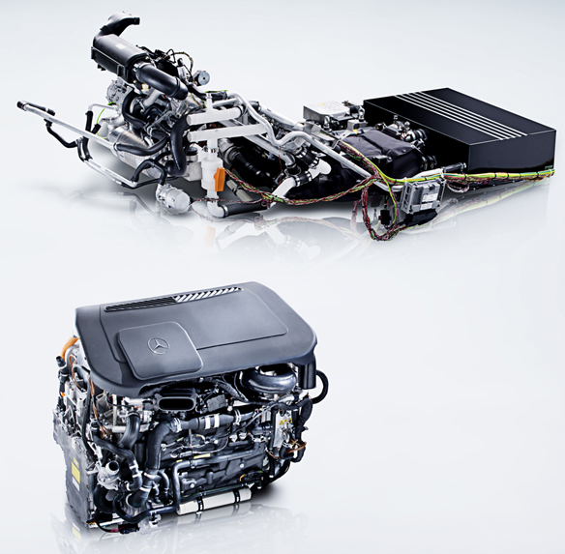

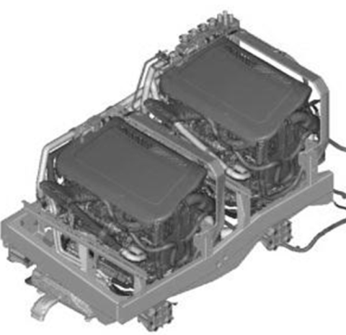
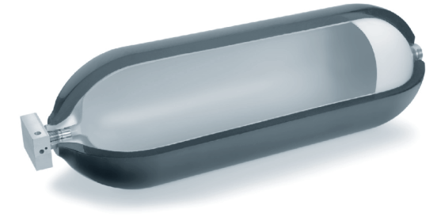
NIP R&D activities – Examples

Slide 10
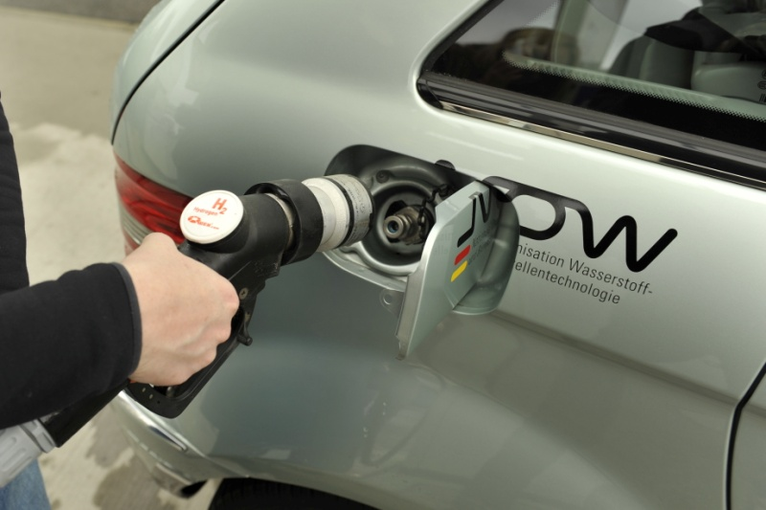
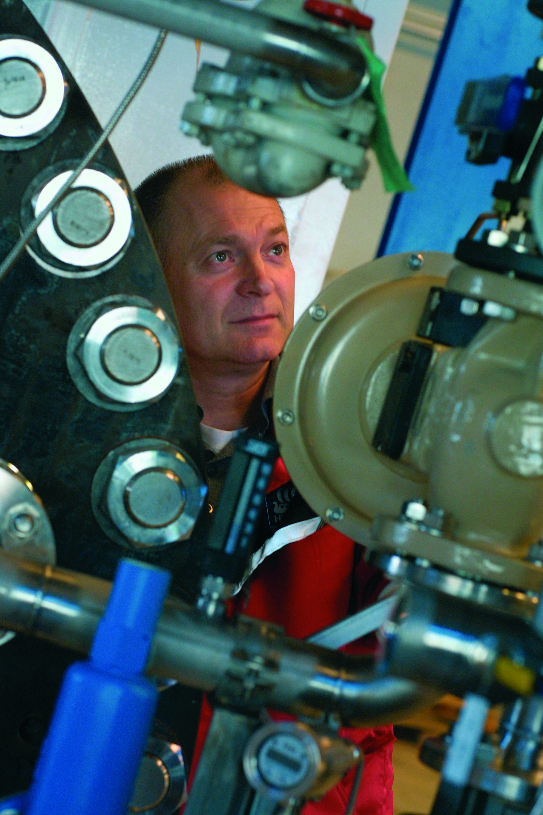

R&D success stories since 2007
Components
Weight -30%
Volume -30%
Interfaces -60%
Cost -65%
Durability +100%
Cost
Weight and Volume
Reliability and Durability
System
Production cost -75%
Participating companies (all application areas)
2008: 34
2014: 167
Infrastructure
Cost -50%

Slide 11
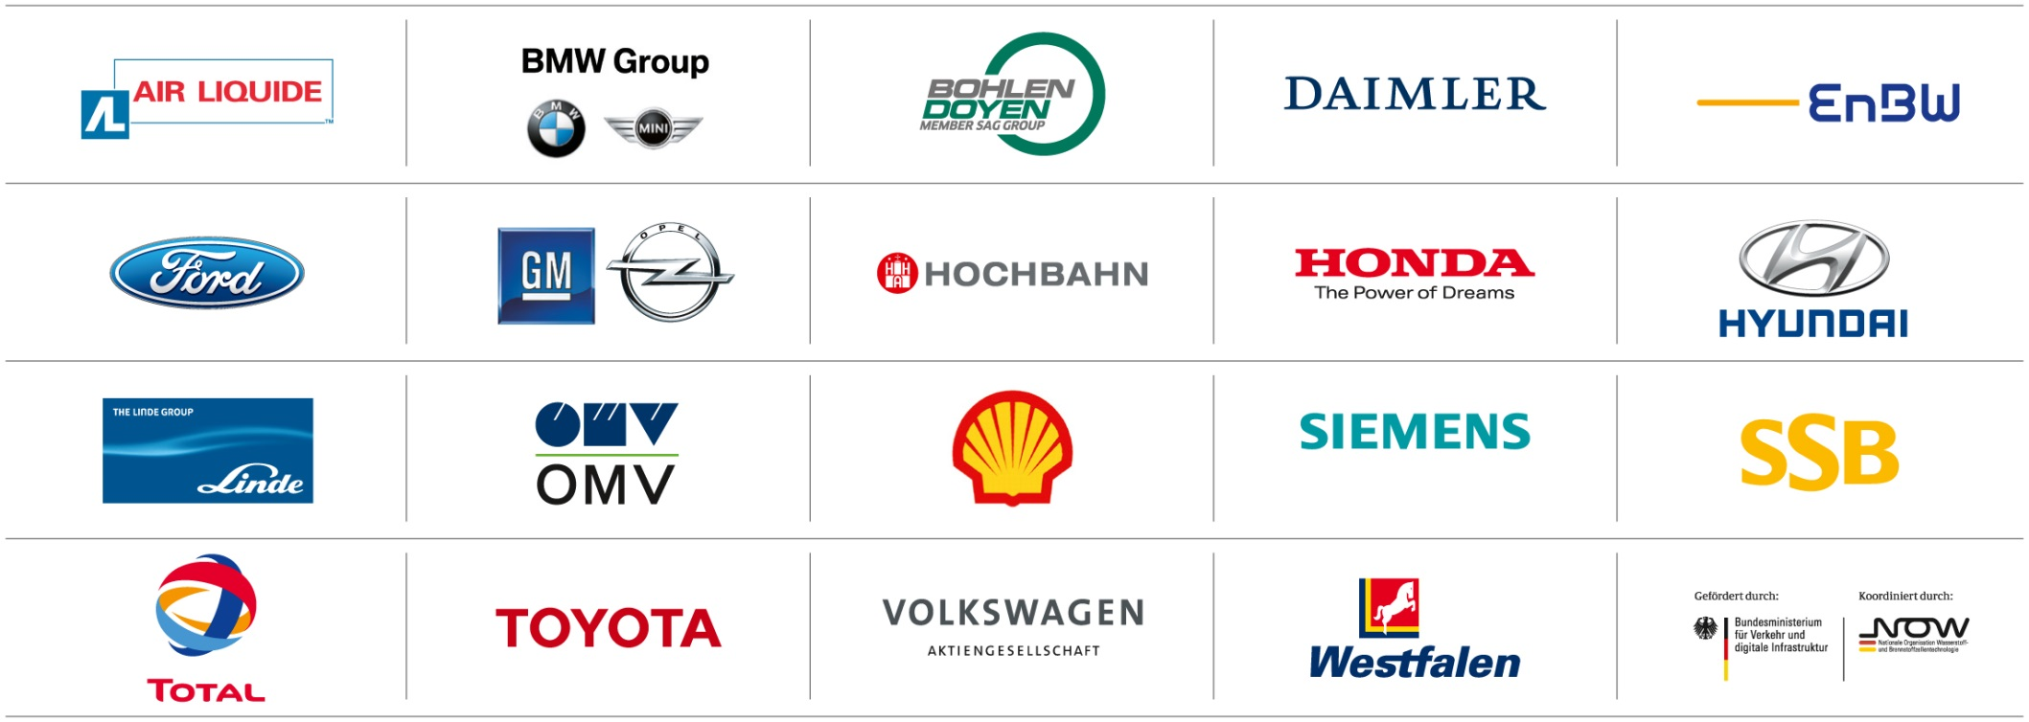
Clean Energy Partnership –
NIP Lighthouse Transportation

Slide 12
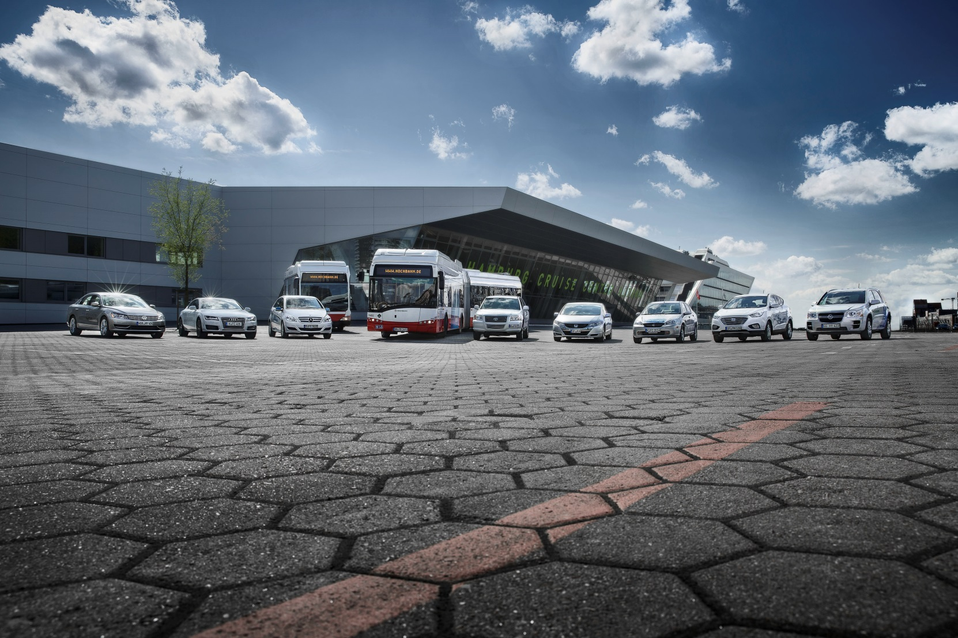
Clean Energy Partnership –
More than 100 vehicles

Slide 13
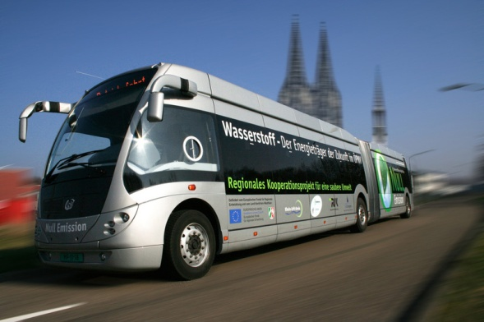
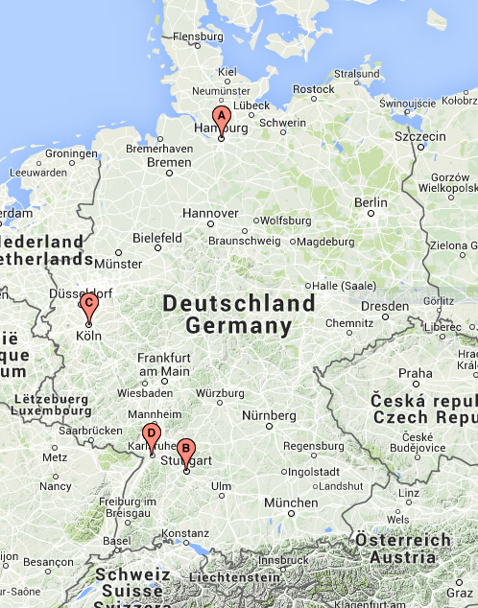
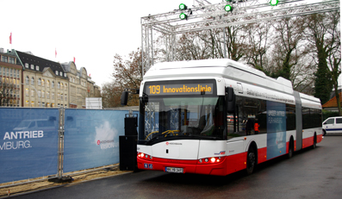
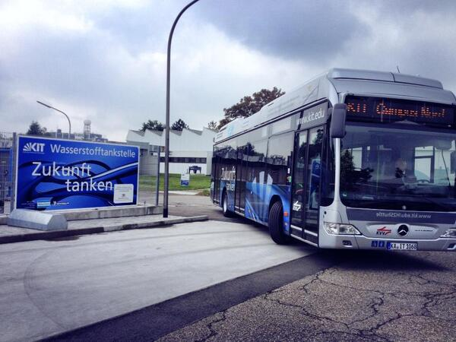
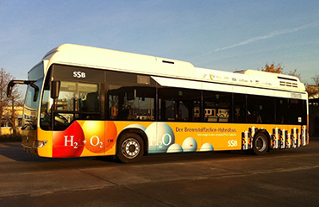
Clean Energy Partnership –
16 buses in public transport
Hamburg - NaBuZ
2 Solaris articulated
4 Daimler solo
Köln
2 APTS articulated
2 Van Hool solo
Stuttgart –
S-PRESSO
4 Daimler solo
Karlsruhe –
KIT-H₂-Shuttle
2 Daimler solo

Slide 14
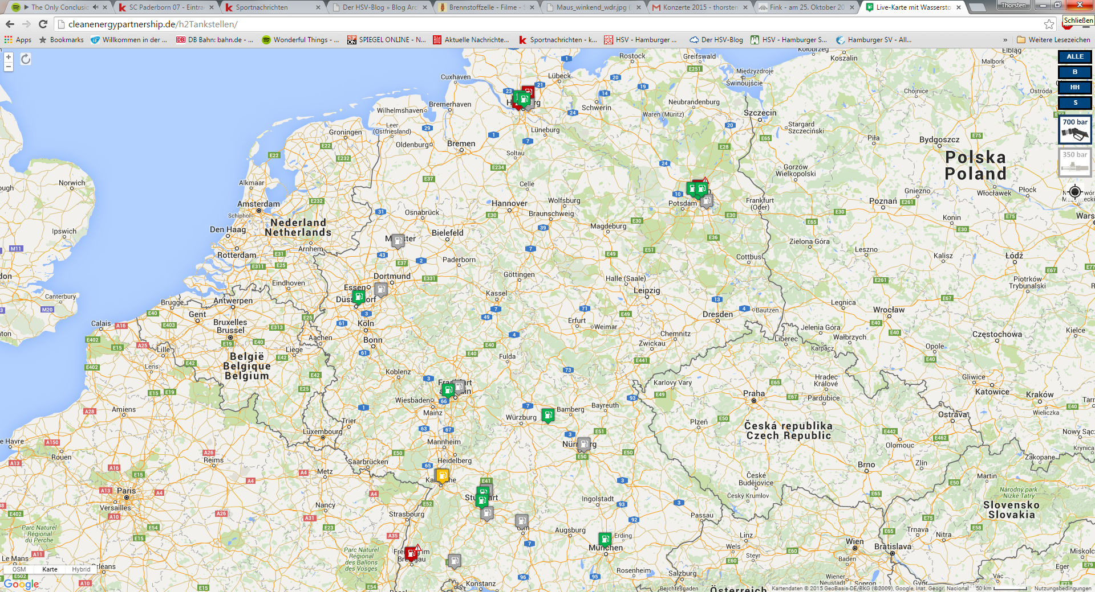
Clean Energy Partnership –
19 hydrogen refueling stations
source: www.h2station.info

Slide 15

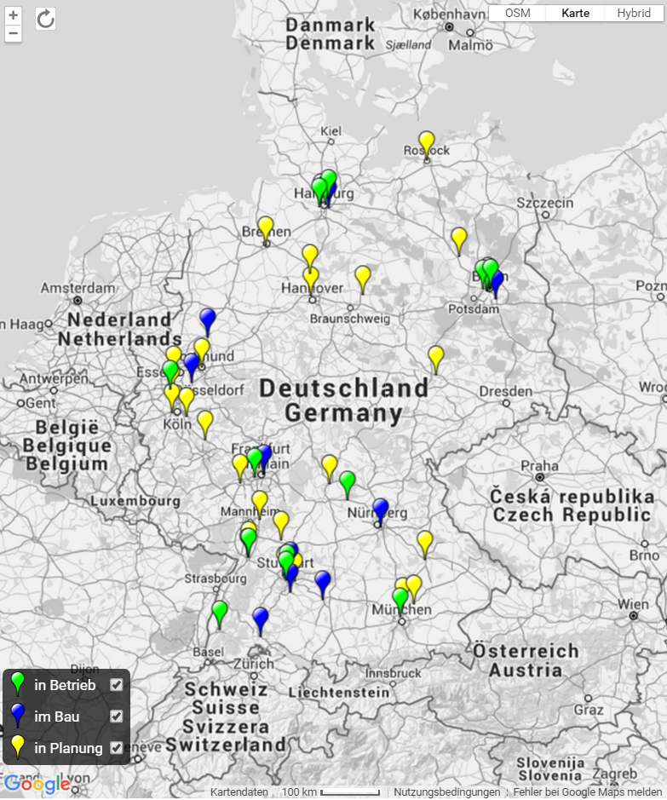


50 Hydrogen Refuelling Stations for Germany
Planning September 2015
2012
2014
www.now-gmbh.de/aufbau-eines-wasserstofftankstellennetzes.html

Slide 16






50 Hydrogen Refuelling Stations for Germany – Latest News
Geiselwind, May 4th,2015
GERMANY'S FIRST HYDROGEN FILLING STATION ON THE AUTOBAHN OPENS
Munich, July 16th,2015
CEP PARTNER TOTAL AND BMW OPENS NEW HYDROGEN PUMP IN MUNICH
Fellbach, October 1st, 2015
CEP PARTNERs DAIMLER, LINDE and TOTAL OPEN NEW HYDROGEN PUMP IN FELLBACH

Slide 17





Filling up with hydrogen will soon be possible Germany-wide
Berlin, October 13th, 2015
H2 MOBILITY Deutschland becomes operative as a joint venture between six industrial partners
Go-ahead for staged expansion of H2 filling stations in Germany
Germany on the way to having the world’s first inter-regional H2 supply network
Federal Minister of Transport Dobrindt gives prospect of further support
17

Slide 18








European Hydrogen Infrastructure Activities – Challenge Coordination
45 km
150 km
120 km
150 km
220 km
310 km
165 km
75 km
175 km
150 km
130 km
+
70 km
150 km
85 km
120 km
70 km
75 km
120 km
95 km
160 km
270 km
370 km
230 km

Slide 19

European Hydrogen Infrastructure Activities – Alternative Fuels Infrastructure Directive
22th October 2014: Alternative Fuels Infrastructure Directive (2014/94/EU)
‘Under the directive, each member state has two years to draw up an alternative fuel deployment strategy and send it to the Commission. These strategies or "national policy frameworks" will set out the country's national targets for putting in place new recharge and refueling points for the different types of "clean fuel", such as electricity, hydrogen and natural gas, as well as relevant supporting actions.’

Slide 20
European Hydrogen Infrastructure Activities –
The Government Support Group
Informal group of currently 7 EU member states on ministerial level.
(NL (Chair),UK, F, SWE, DK, AUT, GER)
Exchange national and international (EU) developments in the field of sustainable mobility and alternative fuels for transport.
Establishing a dialogue between governments, industry and financing institutions (e.g. 1. Dialogue Meeting in Berlin)
Aligning National Policy Frameworks (NPF) as they are requested in the CPT (e.g. non-discriminatory access)

Slide 21








NIP 2 – R&D and Market Activation
Research and Development
Market Activation
Technical and economical targets
Milestones (units / cost)
Basic
research
Applied R&D
Demonstration
Hydrogen in transport
Hydrogen from renewable energy
CHP
(residential/industry)
Safe power supply
Cost reduction
Lead market / supplier Germany
German value creation / competitiveness

Slide 22
Thank you very much!
Dipl.-Ing., M.Sc. Thorsten Herbert
Head of Programme Transportation and Infrastructure
NOW GmbH
Nationale Organisation Wasserstoff- und Brennstoffzellentechnologie
Fasanenstr.5 – D-10623 Berlin – Germany
Phone: +49 30 311 61 16-18 Mobil: +49 172 382 31 32
Fax: +49 30 311 61 16-99
Email: thorsten.herbert@now-gmbh.de
Internet: www.now-gmbh.de

