Slide 1
Regulations, Codes and Standards (RCS) for Hydrogen Technologies- A US Historical Overview
International Conference on Hydrogen Safety
Yokohama, Japan
Carl Rivkin, P.E. (presenter NREL), Chris San Marchi (SNL), and Rangachary Mukundan (LANL)
20 October 2015

Slide 2
Outline
RCS History
Regulatory structure for hydrogen technologies
The early years of Hydrogen RCS 1960-1995
Codes and standards for emerging hydrogen technologies 1995-2012
Codes and standards for deployment of emerging hydrogen technologies 2012-beyond
US Department of Energy contributions to codes and standards development

Slide 3
Regulations, Codes and Standards History
Hazardous Material Regulation
Town Gas 20th St. New York 1938
1905- National Board of Fire Underwriters published recommended building code
1910- US Bureau of Mines created
1970- Occupational Safety and Health Administration created
1988- Article 80 Uniform Fire Code

Slide 4
Regulations, Codes and Standards History
Rough Timeline
Early NFPA Standards
Notes:
Actually talk through timeline

Slide 5
Regulatory Structure for Hydrogen Technologies
The Law
Regulatory Hierarchy
Why are codes and standards complied with?- Because they are the law
Jurisdictions adopt a building/fire code such as the International Building Code/International Fire Code
The Building or Fire Code reference hydrogen specific codes or standards such as NFPA 2 Hydrogen Technologies Code
Hydrogen specific documents (such as NFPA 2) reference documents such as CGA S-1.3 pressure relief

Slide 6
The Early Years of Hydrogen RCS 1960-1995
NFPA 50A Tentative Standard for Gaseous Hydrogen at Consumer Sites 1961
NFPA 50B Tentative Standard for Liquefied Hydrogen Systems at Consumer Sites 1967
Documents applied only to the sites where the hydrogen provided by industrial gas companies was consumed
Later versions of these documents became Federal regulations

Slide 7
Codes and Standards for Emerging Hydrogen Technologies 1995-2012 Three RCS Areas
Requirements for the design, installation, and operation of stationary fuel cells
Documents | Subject Matter
NFPA 853 Standard for the Installation of Stationary Fuel Cell Power Systems | Addresses installation requirements for stationary fuel cell systems including hydrogen powered systems
NFPA 55 Compressed Gas and Cryogenic Fluids Code | Addresses requirements for storage of hydrogen in bulk and non-bulk configurations
CSA Fuel Cell (FC)1 | Addresses requirements for the design and operation of fuel cells
Requirements for FCEVs
Documents | Subject Matter
SAE J2578 Recommended Practice for General Fuel Cell Vehicle Safety | Addresses general safety issues
SAE J2579 Standard for Fuel Systems in Fuel Cell and Other Hydrogen Vehicles | Addresses fuel system integrity and performance
SAE J2719 Hydrogen Fuel Quality for Fuel Cell Vehicle | Addresses allowable contaminant levels for select materials
SAE J2601 Fueling Protocols for Light Duty Gaseous Hydrogen Surface Vehicles | Addresses fueling protocols setting allowable temperature and pressure parameters to achieve desired fill time
SAE J2600 Compressed Hydrogen Surface Vehicle Fueling Connection Devices | Addresses requirements for the fueling nozzle
GTR Global technical regulation (GTR) on hydrogen and fuel cell vehicles-Established in the Global Registry on 27 June 2013 | Addresses requirements for vehicle fuel system
SAE J2601/2 Fueling Protocol for Gaseous Hydrogen Powered Heavy Duty Vehicles | Addresses fueling protocols setting allowable temperature and pressure parameters to achieve desired fill time
SAE J2601/3 Fueling Protocol for Gaseous Hydrogen Powered Industrial Trucks | Addresses fueling protocols setting allowable temperature and pressure parameters to achieve desired fill time
Requirements for Infrastructure
Documents | Subject Matter
International Fire Code (IFC) | Addresses basic hydrogen fueling system safety and flammable gas and cryogenic fluid storage
NFPA 55 Compressed Gases and Cryogenic Fluids Code | Addresses the safe storage, handling, and use of flammable gases including hydrogen
NFPA 2 Hydrogen Technologies Code | Addresses all aspects of the safe, design, use, and storage of hydrogen
ASME Boiler and Pressure Vessel Code , Section XIII | Addresses safe design of pressure vessels for hydrogen storage

Slide 8
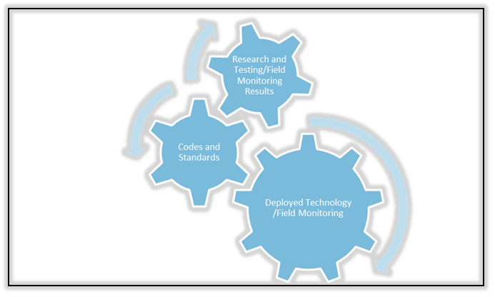
Codes and Standards for Deployment of Emerging Hydrogen Technologies 2012-beyond
Deployment
Continuous Codes and Standards Improvement Process
The baseline codes and standards have been promulgated
Early deployment has started
Deployment is quality assurance test to determine if the RCS work

Slide 9
Codes and Standards for Deployment of Emerging Hydrogen Technologies 2012-beyond
System performance issues as hydrogen fueling stations move from very low volume fueling to commercial scale fueling.
Unforeseen safety issues with hydrogen technologies usage among the general public
Major changes in technology
Hydrogen technologies end of life RCS issues

Slide 10
US Department of Energy contributions to codes and standards development
Sandia National Laboratories
Risk-informed setback distances for NFPA codes
Materials qualification for hydrogen service
National Renewable Energy Laboratory
Codes and standards coordination
Component testing
Los Alamos National Laboratory
Fuel quality testing for SAEJ2719

Slide 11
Conclusions
Significant progress has been made in developing RCS to address emerging hydrogen technologies
As commercial deployment proceeds, RCS will need to be modified to incorporate lessons learned
USDOE has directed research to support hydrogen RCS development and will continue this effort
The research will be defined by the RCS issues identified from deployment efforts

Slide 12
Thank You! ありがとう

