Slide 1
Guidelines and Recommendations for indoor use of fuel cells and hydrogen systems
Béatrice Fuster, Deborah Houssin-Agbomson, Simon Jallais, Elena Vyazmina, Guy Dang-Nhu, Gilles Bernard-Michel, Mike Kuznetsov, Vladimir Molkov, Boris Chernyavskiy, Volodymyr Shentsov, Dmitry Makarov, Randy Dey, Philip Hooker, Daniele Baraldi, Evelyn Weidner, Daniele Melideo, Valerio Palmisano, Alexandros Venetsanos, Jan Der Kinderen
ICHS 2015 – Yokohama, Japan | ID209
2015 October, 20th

Slide 2
Context
Provide general rules and best practices for indoor safe use of hydrogen energy applications
Information given is based on already published research results
and on Hyindoor new research results (experiments, analytical modelling, numerical simulation)

Slide 3
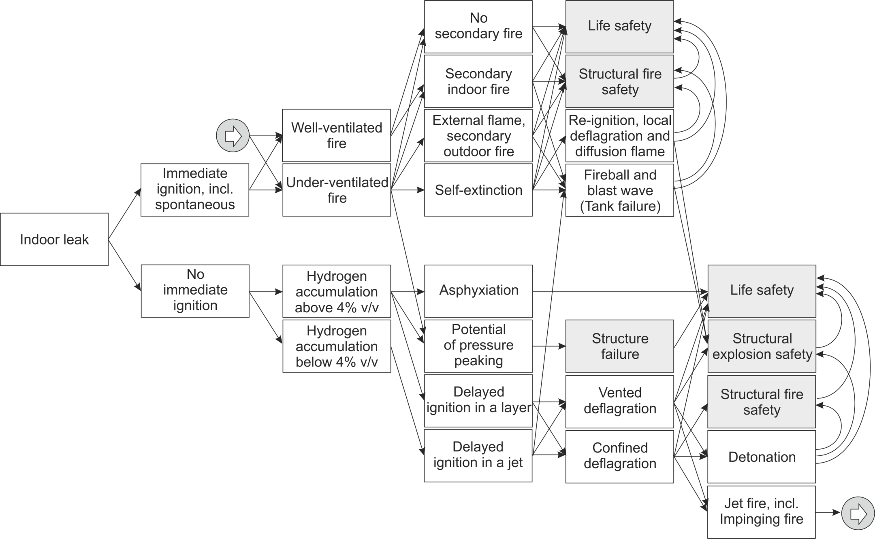
Addressed phenomena
Hydrogen release and build-up inside a confined enclosure
Hydrogen-air deflagration
Jet fire and underventilated fire
Phenomena and Consequences Map

Slide 4
Hydrogen release and build-up in confined area

Slide 5
Limiting hydrogen build-up inside a confined area
Limiting release source
Decrease release points by limiting number of connections; prefer welding when possible
Limit high pressure sources inside the confined enclosure; keep HP outside the enclosure as much as possible and avoid indoor HP storage
Limit potential release flow rate by using adapted flow restrictor diameter
Limiting hydrogen build-up
Prevent accumulation of flammable concentrations of hydrogen in an enclosure by providing adequate ventilation openings for passive/natural ventilation
Use two (or more) vents located at different heights is preferable; this ventilation configuration is more effective than a single vent (or more) only located at the top of the enclosure, considering the same total ventilation area
Increase ventilation area
Limit obstruction in front of ventilation openings
Locate openings at the top of the enclosure for single vent ventilation mode
A distribution of the vents on each side of the enclosure is preferable when possible

Slide 6
Limiting hydrogen build-up inside a confined area and calculation mean
Pressure peaking phenomenon
PPP has to be taken into account in risk assessment
A complex combination of parameters is to be considered to observe this phenomenon
High release flow rate, small enclosure, small size of vents
A nomogram is proposed to size vent considering PP phenomenon (see Hyindoor Guidelines Report)

Slide 7
Calculation means for hydrogen build-up assessment
Calculation means can be used to assess consequences, to evaluate mitigation means, aiming at safely designing hydrogen applications and/or setting up additional safety precautions
Analytical models and correlations for build-up consequences assessment
One-opening passive ventilation modelling approach proposed by Molkov et al. (2014)
When all the openings are at the top of the enclosure
Nomograms to assess hydrogen build-up are provided in Hyindoor Guidelines Report
Two-openings natural ventilation modelling approach proposed by Linden (1999)
When vents are located at different heights: one (series) at top of the enclosure, the other at bottom
Equations of analytical approach to assess hydrogen build-up are provided in Hyindoor Guidelines Report
Numerical simulation
Computational Fluid Dynamics (CFD) is the approach especially for complex geometries, multiple vents and release parameters different from those more classical considered to develop analytical engineering tools

Slide 8
Additional mitigation means for hydrogen build-up limitation
Additional mitigation means can be used when the hydrogen application does not passively reach safety targets
Forced or mechanical ventilation which allow releasing hydrogen to be evacuated
Flow restrictors can be installed at strategic location in piping to limit release flow rate in case of full bore rupture, thus limiting hydrogen build-up
Detection devices can early alert operators in case of release before reaching LFL and launch automatically safety actions
Mechanical/forced ventilation – characteristics to be considered
Operating conditions
Blowing or extraction, if extraction is chosen the equipment could be ATEX-certified
Automatic or manual
Permanent or punctual
Adequate ventilation flow rate to be determined
Setup
Sufficient openings for air admission or expulsion (according to the ventilation mode)
Correct location of openings in order to avoid by-pass (i.e. areas which will not be ventilated)
Take car about internal congestion which can create unventilated areas too

Slide 9
Additional mitigation means for hydrogen build-up limitation
Mechanical/forced ventilation – characteristics to be considered
Sizing of the mechanical/forced ventilation
Waiting new developments, forced ventilation in an enclosure with one opening could be calculated using equations and/or the nomogram proposed in Hyindoor Guidelines Report
Flow restrictors
Flow restrictors could be used to reduce the maximal leakage flow rate
A correlation to size the flow restrictors is given in Hyindoor Guidelines Report
Sensors
Performances and good practices are given into Hyindoor Guidelines Report

Slide 10
About hydrogen-air deflagration

Slide 11
Limiting deflagration consequences
Ignition sources
Limit ignition sources
Position deflagration relief vent(s), if possible, close to potential ignition source(s)
Limiting deflagration overpressure
Venting of deflagrations is the most widespread technique to mitigate explosions in an enclosure decreasing overpressure
Apertures initially dedicated to ventilation will participate in the venting of the explosion
Increase vent surface(s) decreases internal overpressure in case of ignition
Avoid or minimize obstruction in front of the venting apertures
Avoid or minimize internal congestion in the enclosure
Be careful the gases vented from a deflagration is discharged outside into a safe area
If initial apertures are not effective enough to mitigate overpressure, dedicated venting apertures can be added

Slide 12
Calculation means for deflagration consequences assessment
Calculation means can be used to assess consequences, to evaluate mitigation means, aiming at safely designing hydrogen applications and/or setting up additional safety precautions
Vented deflagration correlations
Vent size can be calculated using analytically derived and experimentally validated correlations between allowable overpressure, enclosure volume, flammable mixture parameters, and vent area
Hyindoor Guidelines Report presents a correlation for the case of hydrogen fraction uniform across the entire enclosure (Chernyavsky et al., 2014) and localized mixture (Makarov et al., 2014)
Numerical simulation
CFD may be used to predict vented deflagration pressure dynamics

Slide 13
Jet fire and underventilated fire

Slide 14
Dealing with jet fire and underventilated fire
Limiting consequences of fire
Where practicable, avoid the conditions for underventilated jet-fires to occur by providing sufficient ventilation
Use fire resistant materials where possible
Avoid the presence of combustible materials close to vents if there is a potential for an underventilated jet-fire to occur
Use piping of smallest possible diameter or introduce flow restrictors to reduce flame length; flame length is generally proportional to leak diameter

Slide 15
Calculation means for fire consequences assessment
Calculation means can be used to assess consequences, to evaluate mitigation means, aiming at safely designing hydrogen applications and/or setting up additional safety precautions
Analytical models and correlations for vented explosion consequences assessment
Hyindoor Guidelines Report presents a dimensionless correlation for calculation of free flame length (Molkov and Saffers, 2013)
A methodology to calculate thermal radiation is given in Hyindoor Guidelines Report
Numerical simulation
Computational fluid dynamics (CFD) can be used as a contemporary tool for hydrogen safety engineering in assessment of jet fires indoors as no other tool available

Slide 16
RCS recommendations

Slide 17
RCS recommendations
Results from Hyindoor bring valuable inputs for improving Guidelines and making proposal for RCS, and filling some existing gaps in current guidelines and standards as:
Recommending to use in a proper way flow restrictions in order to limit the maximum flow rate in case of hydrogen leaks
Giving general qualitative/quantitative requirements for designing the openings for natural ventilation
Proposing validated engineering tools and models for assessing hazard related to hydrogen accumulation within an enclosure, with some different standards configuration of openings
Proposing practical nomograms based on these engineering tools and models
Proposing a generic phenomena and consequences diagram
Recommendations for RCS resulting from Hyindoor project are organized following three main topics
Ventilation → 12 recommendations implementation of ventilation for preventing the formation of an explosive atmosphere, or for limiting the hydrogen concentration, in the event of a hydrogen leak release
Limitation of overpressure → 3 recommendations implementation of venting devices for limiting the overpressure developed in the event of a hydrogen release as a result either of the Pressure Peaking Phenomenon (PPP) or of the deflagration of a flammable hydrogen-air mixture
And other → 3 recommendations Jet-fire, sensors and flow restrictors

Slide 18
To go further…
Please visit Hyindoor website
www.hyindoor.eu
Download the public documents
D5.1: Widely accepted guidelines on Fuel Cell indoor installation and use
D6.1: Report on recommendations for RCS

Slide 19
ICHS 2015 – Yokohama, Japan | ID209 2015 October, 20th
Guidelines and Recommendations for indoor use of fuel cells and hydrogen systems
Thanks for your attention
Acknowledgment to FCH JU for funding HyIndoor project and to Hyindoor project partners

Slide 20
Additional slides on RCS

Slide 21
RCS recommendations 1. Ventilation
This section covers recommendations regarding the ventilation for preventing the formation of an explosive atmosphere, or for limiting the hydrogen concentration, in the event of an accidental hydrogen release
RCS recommendation #1. Effect of wall thickness supporting the ventilation vent:
the thicker the vent, the more the concentration inside the vessel
the choice for the vent location is on the thinner wall
RCS recommendation #2. Effect of horizontal ducts
should be avoided
RCS recommendation #3. Position of the vent
on the wall preferred to roof
RCS recommendation #4. Effects of rain cover:
should be avoided
RCS recommendation #5. Height of a single vent position:
should preferably be located at the top of a wall

Slide 22
RCS recommendations 1. Ventilation
RCS recommendation #6. Obstruction in front of the openings
should be avoided
RCS recommendation #7. Vent shape:
vents bigger in height than width preferred.
vents of the same area with higher vertical dimension should be selected compared to vents with a wider horizontal dimension
RCS recommendation #8. Ventilation system: Calculate hydrogen concentration in an enclosure with one vent and using passive ventilation model
the Guidelines (D5.1) provides the nomogram for calculation of maximum (conservative) hydrogen concentration for the steady-state release in enclosure with one vent
RCS recommendation #9. Ventilation system: Calculate hydrogen concentration in an enclosure with two-openings natural ventilation system
the Guidelines (D5.1) provides engineering modelling approach for calculation of maximum (conservative) hydrogen concentration at the steady-state in enclosure

Slide 23
RCS recommendations 1. Ventilation
RCS recommendation #10. Ventilation – numbers, location
multiple vents at different heights on opposite walls are preferable to one vent of the same area
RCS recommendation #11. Ventilation – distribution of vents
locate vents as low for the bottom and as high at the top as possible
RCS recommendation #12. Mitigate hydrogen build-up when passive/natural ventilation is not effective enough
when passive/natural ventilation is not effective enough, other efficient ways can be investigated like: mechanical/forced ventilation, devices limiting release flow rates or detection devices.

Slide 24
RCS recommendations 2. Limitation of overpressure
This section covers recommendations regarding the implementation of venting devices for limiting the overpressure developed in the event of an accidental hydrogen release as a result either of the Pressure Peaking Phenomenon (PPP) or of the deflagration of a flammable hydrogen-air mixture
RCS recommendation #13. Enclosure with high pressure hydrogen equipment: Pressure Peaking Phenomenon (PPP) in enclosures with low ventilation level and high release flow rate
PPP is a recently revealed phenomenon characteristic only for gases lighter than air and particularly pronounced for hydrogen. The Guidelines (D5.1) provide published and validated technique to calculate the overpressure inside vented enclosure with hydrogen release due to PPP

Slide 25
RCS recommendations 2. Limitation of overpressure
RCS recommendation #14. Deflagration mitigation: Limit hydrogen inventory in enclosure to exclude structural damage (such as warehouse)
the Guidelines (D5.1) presented the analytical thermodynamic model, which was validated against experimental data published elsewhere.
the validated model establishes the upper limit for hydrogen mass allowed to be released (stored) in an enclosure of known volume without causing overpressure above 10 kPa in case of its combustion.
if the limitation of inventory is not possible other safety measures should be applied, e.g. passive or forced ventilation to prevent flammable mixture formation, or mitigation of deflagration by venting technique.
RCS recommendation #15. Vented deflagration: Use updated correlation for vent sizing of enclosures fully filled by hydrogen–air mixture, and new correlation for vent sizing of enclosures partially filled by flammable hydrogen-air mixture
the Guidelines (D5.1) reported new techniques for vent sizing developed as result of Hyindoor analytical and experimental studies.

Slide 26
RCS recommendations 3. Other
This section covers recommendations regarding Jet-fire, hydrogen sensor and optional use of flow restrictors.
RCS recommendation #16. Jet-fire: Use the universal correlation for jet fire length to calculate three deterministic separation (hazardous) distances
the Guidelines (D5.1) provides a methodology for flame length calculation
RCS recommendation #17. Sensors, effect of poisoning
ISO 26142 is specific to hydrogen sensors, providing performance requirements and test methods for stationary hydrogen detection apparatus.
the tests showed that the effect of poisons is often transient.
the recommendation is to evaluate the effect of the poison both immediately after exposure and after three (or more) cycles with air/hydrogen

Slide 27
RCS recommendations 3. Other
RCS recommendation #18. Use of flow restrictors to be used optionally
generally, for outdoor and indoor use of hydrogen, flow restrictors on the pipe are a good intrinsically safe design measure.
for indoor application the flow restriction could also limit the likelihood and possibly prevent the risk of accumulation of Hydrogen above the Lower Explosion Limit (LEL) within the confined space.
while it is clear that sometimes due to technical requirements one cannot add or can only use a wide restrictor, it is an important safety feature that is easily added.

