Slide 1
COMPARISON OF A TWO-LAYER MODEL FOR HIGH PRESSURE HYDROGEN JETS WITH NOTIONAL NOZZLE MODEL PREDICTIONS AND EXPERIMENTAL DATA
Xuefang Li, David M. Christopher
Tsinghua University, Beijing, China
Ethan S. Hecht, Isaac W. Ekoto
C R F, Sandia National Laboratories

Slide 2
CFD models are too slow
Notional nozzle models
Simplified, fast reduced order solutions
All flow passes through the effective exit
No entrainment
Which model is best for high pressures?
Agreement with experimental data?
Are these applicable to obstructed flows?

Slide 3
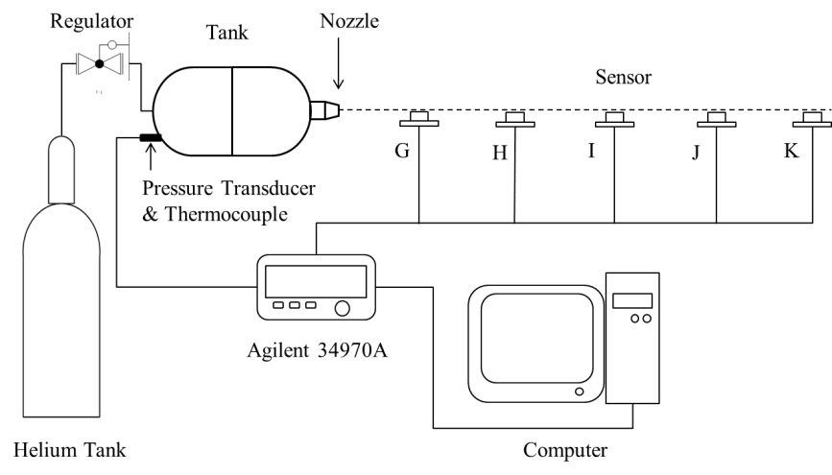
Experimental Setup
Helium concentrations
20 cm to 170 cm from the nozzle
XEN-TCG3880Pt katharometers
Tank: 3.5 L, maximum pressure of 150 bar

Slide 4
Typical katharometer calibration curve
4 calibration points from pure helium to pure air
Notes:
Helium used in place of hydrogen for safety reasons, properties and physical characteristics are quite similar.

Slide 5
CFD Model
CFD model, 0.8 m radius, 5 m long
Navier-Stokes equations
steady state, 2D axisymmetric
turbulent flow
Standard k-ε turbulence model
Ideal gas density model
Density solver
Nozzle had a ASME long radius nozzle shape
Constant mass diffusivity
(kinetic theory predictions were slightly higher
near the nozzle and very similar downstream)
Number of elements: 302,000, 316,000 and 418,000*
Notes:
Needed 5 m to reach the 4% LFL at higher pressures, buoyancy effects negligible for these conditions.
Other two-equation turbulence models gave similar results. The one-equation Spalart-Allmaras model gave much lower concentrations
Results are from the largest mesh, 20 elements along the nozzle exit.

Slide 6
4 Notional Nozzle Models
Birch et al. [17, 18]
Ewan and Modie [19] and Molkov et al. [21]
Yuceil and Otugen [20]
Used to determine inlet conditions for CFD models
2D, axisymmetric, turbulent flow
Meshes: Similar results for 41,000, 57,000 (20
elements across inlet) and 88,000 elements
Notes:
57,000 element mesh used for the results here

Slide 7
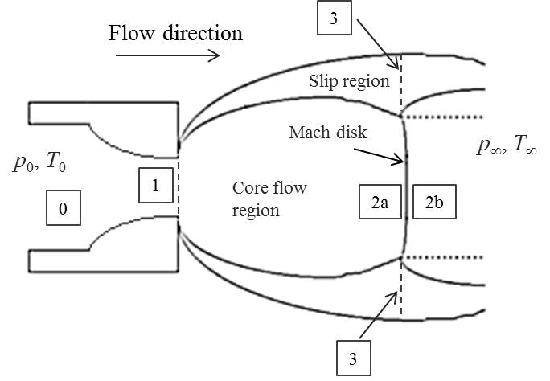
Two-layer Partitioned Model
Flow at 2a is pure hydrogen
Slip region flow is supersonic with entrained air
Isentropic expansion, ideal gas

Slide 8
Mach disk diameter:
Slip region thickness:
From Hecht et al., 5th ICHS
Isentropic expansion
Conservation of mass, momentum and energy
from 1 to 2 and 3
Results: velocity and temperature at point 2b
Velocity, temperature, mixture density and
air mass fraction at 3
Notes:
Slip region diameter is the Mach disk diameter plus twice the slip region thickness.

Slide 9
CFD Model using Two-layer Partitioned Model
Inlet Boundary Conditions
Two inlet regions for the Mach disk region
and for the slip region
2D, axisymmetric, turbulent flow
Meshes with 27,900, 52,500* and 101,000
elements
Notes:
The results were the same for the two larger meshes. The results presented here are for the 52,500 element mesh.

Slide 10
Helium mole fraction centerline concentrations 2.6 MPa tank pressure
2 mm diameter orifice.
Notes:
Experimental data is well represented by the CFD model for x< 1 m and then better by the two layer model.
The two layer model is closer to the data than all of the notional nozzle models, with the Birch 1987 model being the best of the notional nozzle models.
Other CFD models (Han et al. [37]) also underpredicted their data.

Slide 11
Hydrogen mole fraction centerline concentrations
10 MPa tank pressure
1 mm diameter orifice
Data from: Han et al., 2013
Notes:
Data agrees very well with the two-layer partitioned model predictions. Birch 1987 model is also quite close.
Data only for longer distances (note also point at 5 m, where all models agree).
CFD model underpredicts, perhaps because turbulent Schmidt number which is assumed to be 0.7. A larger turbulent Sc would reduce diffusion and give better agreement.

Slide 12
Hydrogen mole fraction centerline concentrations
20 MPa tank pressure
1 mm diameter orifice.
Notes:
Higher pressure, CFD model agrees better. Inset shows data point half way between the CFD and partitioned models.
Partitioned model better than all the notional nozzle models
Need more data closer to the nozzle.

Slide 13
Average relative errors for each model
relative to the measured data
P | Ewan [19] | Yuceil [20] | Birch [17] | Birch [18] | Two Layer Model | Full CFD
2.6 MPa | 31% | 22% | 21% | 13% | 10% | 8%
10 MPa | 22% | 12% | 13% | 9% | 4% | 19%
20 MPa | 23% | 11% | 12% | 18% | 4% | 14%

Slide 14
Hydrogen mole fraction centerline concentrations 35 MPa tank pressure
1 mm diameter orifice
Notes:
No data for this pressure.

Slide 15
4% lower flammability limit locations along the centerline for hydrogen jets
(2.6 MPa data is for helium)
Notes:
Notional nozzle models all overpredict the 4% LFL location. The two-zone partitioned model gives much better results. The CFD model underpredicts (needs larger turbulent Sc).

Slide 16
Conclusions
Two-layer, reduced order flow partitioning model
High pressure underexpanded jets
Mach disk core flow region
Slip flow region
Helium data – 2.6 MPa
Hydrogen data – 10 MPa and 20 MPa (from Han et al.)
Two-layer model - better predictions than notional nozzle models especially for higher stagnation pressures
Birch et al. [1987] gives best predictions of notional nozzle models
CFD model underpredicts measured concentrations
too much entrainment
too much diffusion (larger turbulent Schmidt number?)
Notes:
Predictions are all relative to measured data.
Birch [1987] gives the best predictions of the notional nozzle models, but the two-layer models gives better predictions.

Slide 17
Conclusions
4% lower flammability limit locations along centerline
well predicted by the two-layer model
over-predicted by notional nozzle models
under-predicted by full CFD model
Future Work
Need more data at higher pressures
closer to the nozzle
Need to evaluate these models for obstructed flows

