Slide 1

Enhancing Safety of Hydrogen Containment Components Through Materials Testing Under In-Service Conditions
B.P. Somerday, J.A. Campbell, K.L. Lee, J.A. Ronevich, and C. San Marchi
Sandia National Laboratories, Livermore CA, USA
6th International Conference on Hydrogen Safety (ICHS 2015)
Yokohama, Japan
October 21, 2015
Sandia is a multiprogram laboratory operated by Sandia Corporation, a Lockheed Martin Company, for the United States Department of Energy under contract DE-AC04-94AL85000

Slide 2
Hydrogen can permeate into containment materials and activate hydrogen embrittlement
s_{local}, e_{local}
s_{remote}
hydrides
H₂
H₂
H₂
H₂
H₂
H₂
H₂
H₂
H₂
H₂
H₂
H₂
H₂
H₂
H₂
H₂
H₂
H
H
H
H₂
H₂
H
H
H
H
H
H
H₂
H
H
H
H
H
H
H
H₂
H₂
H
H
H
H₂
HEDE
H
H
H
H
H
H
H
H
H
H
H
H
H
H
H
H₂
H₂
H₂
H₂
H₂
H₂
H₂
H₂
H
H
H
H
H
H₂
H₂
H₂
H₂
H₂
H
H
H
H
H
H
H
H₂
H₂
H₂
H₂
H₂
H₂
H
H
H
H
H₂
H₂
H₂
H₂
H
H
H
H
H
H
H₂
H₂
H₂
H₂
H₂
H
H
H
H
H
H
H
H
H
H
H
H
H₂
H₂
H₂
H
H
H
H
H₂
H
H
H₂
H₂
H₂
H₂
H₂
H₂
τ₁ > τ₂
H₂
H₂
H₂
H₂
τ₁
τ₂
H₂
H₂
H₂
H₂
H₂
H₂
H
H
H
H
H
H
H
H₂
H₂
H₂
H₂
HELP
H
H
H
H
H
s_{local}, e_{local}
s_{remote}
H
H
H
Mobility of H at ambient temperature distinguishes it from other embrittlement species (e.g. S, P)

Slide 3
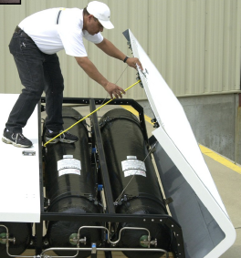
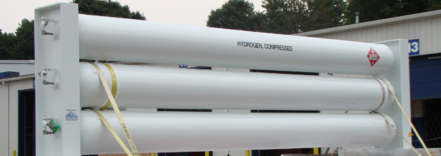
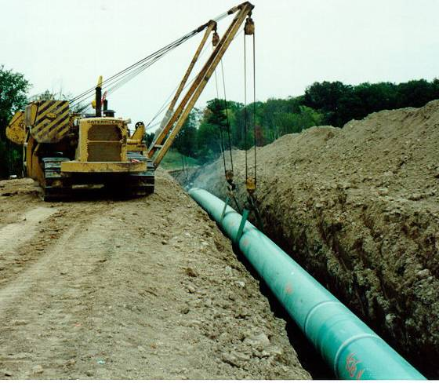
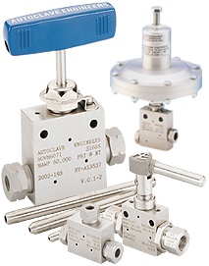
Materials in range of H₂ containment components can be susceptible to hydrogen embrittlement
stationary and transport vessels
(martensitic steels)
on-board tanks
(stainless steel boss)
pipelines
(ferritic steels)
manifold components
(stainless steels)

Slide 4
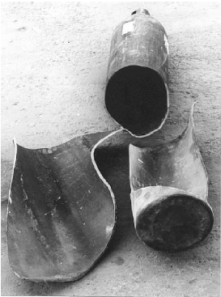
Hydrogen embrittlement accelerates crack extension, potentially compromising component safety
a
crack in H₂
crack in N₂
Number of pressure cycles, N
Δp
H₂
H₂
H₂
H₂
H₂
a
H₂
H₂
H₂
Barthélémy, 1st ESSHS, 2006
Hydrogen embrittlement accounted for in design and safety qualification through materials testing

Slide 5
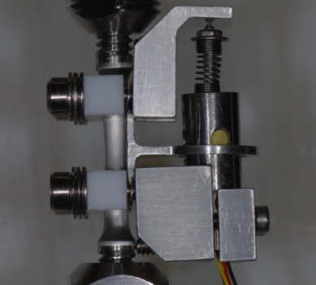
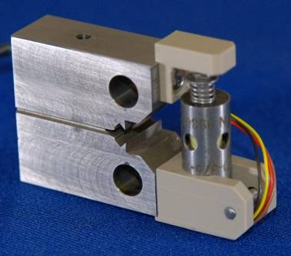
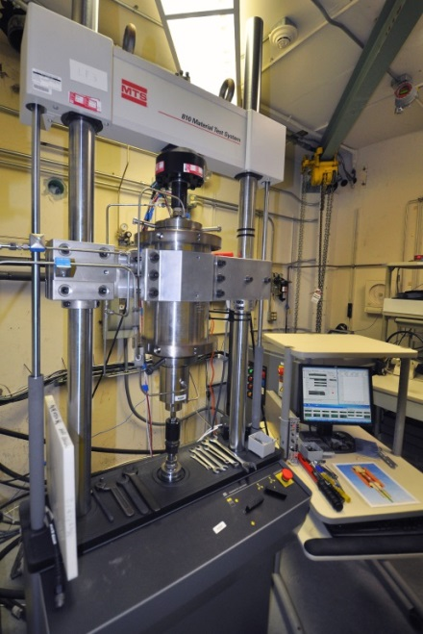
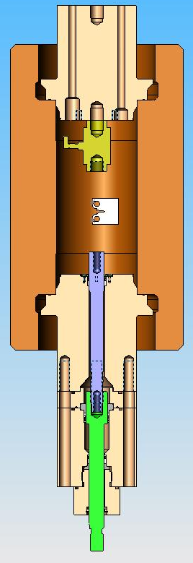
Dynamic-Load Testing in High-Pressure H₂ Gas: concurrent mechanical loading and H₂ exposure
Dynamic mechanical loading
  Monotonic or cyclic
Operating envelope
  H₂ gas pressure up to 138 MPa
  Load-cycle frequency from 10⁻³ to 10 Hz
  Room temperature
Instrumentation
  Internal load cell
  LVDT-based displacement gauges
  Direct-current potential difference crack measurement system

Slide 6
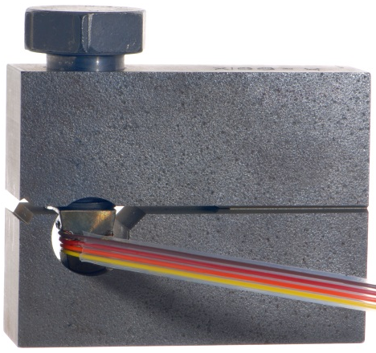
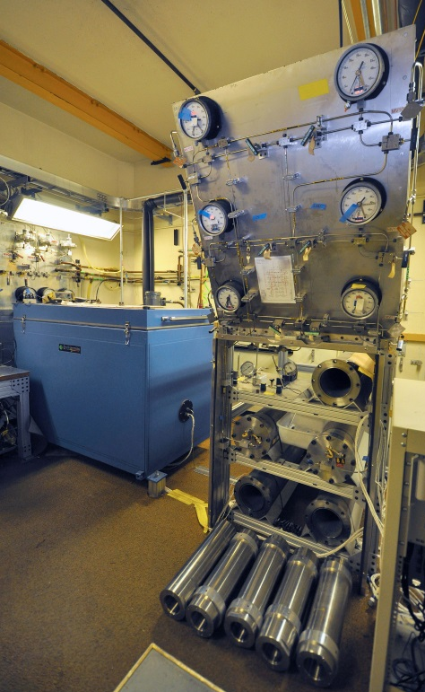
Static-Load Crack Growth Testing in H₂ Gas: concurrent mechanical loading and H₂ exposure
Static mechanical loading
  Constant displacement imposed by bolt reacting against pin
Operating envelope
  H₂ gas pressure up to 200 MPa
  Temperature chamber: -70 to 170 ºC
Instrumentation
  Reaction pins with strain gauges serve as load cells
da/dt
K_{THa}
crack extension
load
time

Slide 7

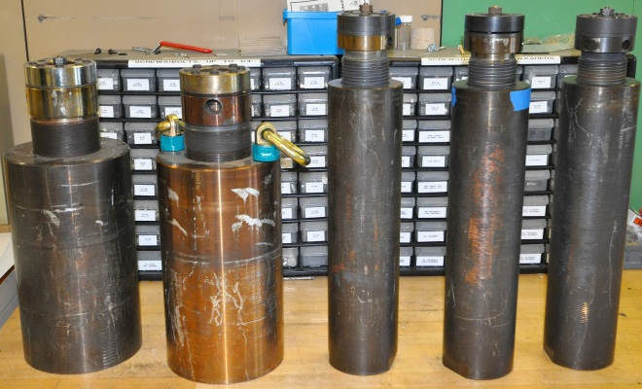
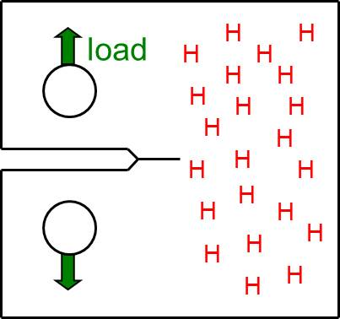
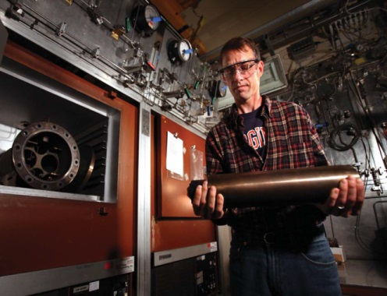
Thermal Precharging in H₂ Gas: mechanical loading follows H₂ exposure
Operating envelope
  H₂ gas pressure up to 138 MPa
  Furnace temperature up to 300 ºC
Dynamic or static mechanical loading
  Subsequent to H₂ gas exposure
Instrumentation
  Load cells and displacement gauges on mechanical test frames

Slide 8
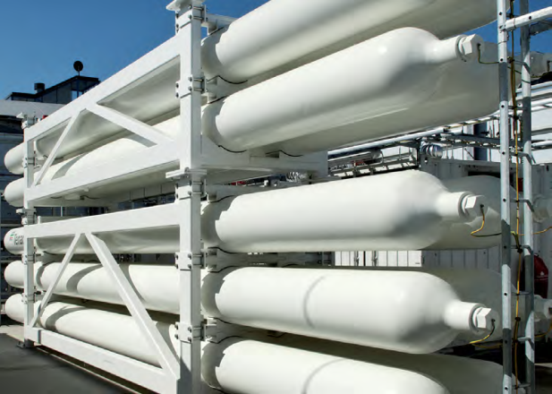
Steel pressure vessels store high-pressure compressed hydrogen at refueling stations
ASME developed Article KD-10 in Section VIII-3 of Boiler and Pressure Vessel code for high-pressure H₂ vessel design
  “Special Requirements for Vessels in High Pressure Gaseous Hydrogen Service”
  Mandatory for seamless vessels with H₂ pressure > 41 MPa and welded vessels with H₂ pressure > 17 MPa (upper limit 100 MPa)
KD-10 requires fracture mechanics measurements on containment materials in high-pressure H₂ gas

Slide 9
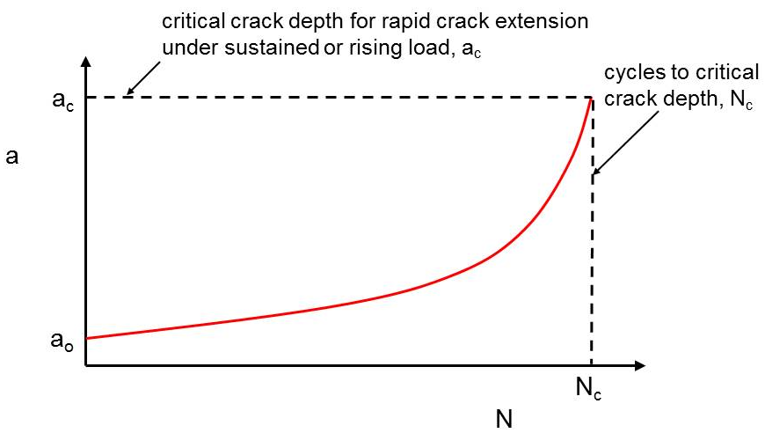


Design life analysis in ASME Article KD-10 requires data from materials testing in H₂ gas
Δp
H₂
H₂
H₂
H₂
H₂
a_{o}
H₂
H₂
H₂
Materials testing must be performed in the service environment: high-pressure H₂ gas

Slide 10
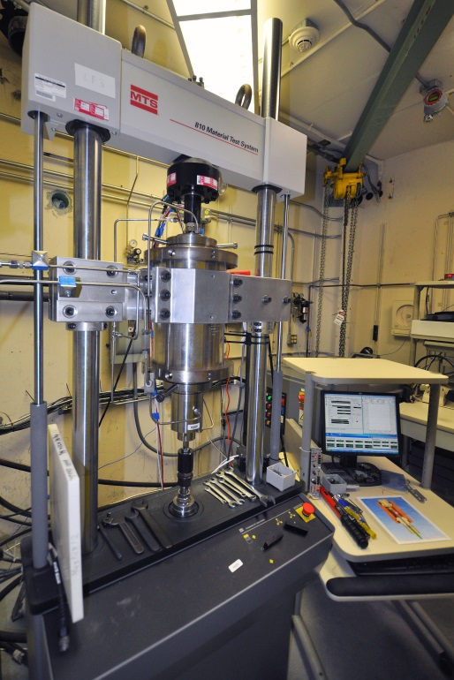
Fatigue crack growth relationships measured for Cr-Mo pressure vessel steel in high-pressure H₂ gas
Materials
  Three different heats of SA-372 Grade J
Instrumentation
  Internal load cell in feedback loop
  Crack-opening displacement measured internally using LVDT
  Crack length calculated from compliance
Mechanical loading
  Triangular load-cycle waveform
  Constant load amplitude
  Load-cycle frequency = 0.1 Hz
Environment
  99.9999% H₂ supply gas
  Pressure = 100 MPa
  Room temperature

Slide 11
Measurements reveal significant effect of H₂ gas on fatigue crack growth rates for SA-372 Gr. J steel
B. Somerday, C. San Marchi, K. Nibur, ASME PVP, 2013
Accelerated crack growth rates in H₂ gas can be accounted for in pressure vessel design through analysis

Slide 12
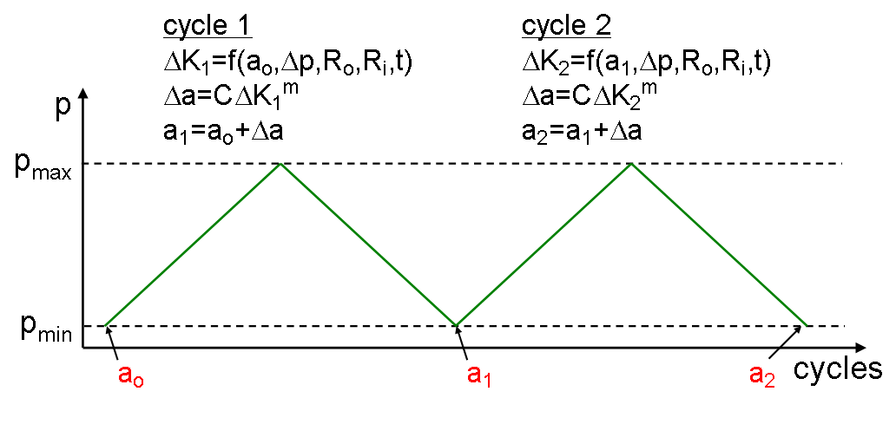
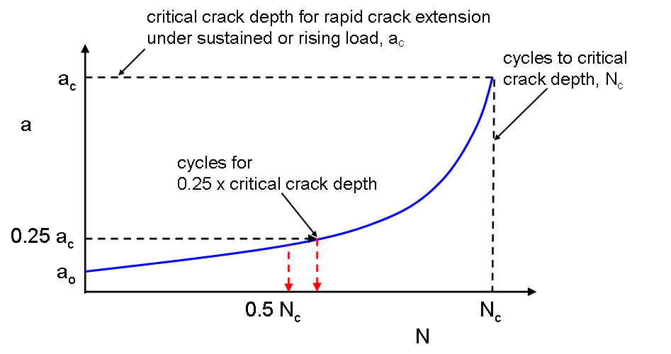
Design life analysis in ASME Article KD-10 accounts for effect of H₂ gas on fatigue crack growth rates
ΔK = Δp[f(a, t ,R_{o}, R_{i})]
da/dN=CDK^{m}
Analysis determines number of pressure cycles for safe operation of pressure vessel

Slide 13
Summary
Hydrogen embrittlement accounted for in design and safety qualification of components through materials testing
Sandia National Laboratories features three systems for materials testing in H₂ gas:
  Dynamic-Load Testing in High-Pressure H₂ Gas
  Static-Load Crack Growth Testing in H₂ Gas
  Thermal Precharging in H₂ Gas
  Distinguishing feature: high-pressure (>138 MPa) H₂ gas
Materials testing at Sandia National Laboratories motivated by developing and exercising standards
  Fatigue crack growth testing of pressure vessel steel in H₂ gas supported design-life calculation prescribed in ASME code

Slide 14
Back-up Slides

Slide 15
Measurement of da/dN vs. frequency indicates that crack growth rates at 10 Hz are not upper bounds
General trend: da/dN increases as frequency decreases, then reaches plateau value
  Most pronounced for 34CrMo4 steel in 45 MPa H₂ gas at ΔK = 24 MPa m^{1/2}
da/dN vs. f data reveal effects of material and environmental variables
  Higher-strength 34CrMo4 steel generally more susceptible to hydrogen-accelerated fatigue crack growth than lower-strength SA-372 Gr. J steel
  Crack growth rates for SA-372 Gr. J steel equal at 45 and 100 MPa H₂ pressure

Slide 16
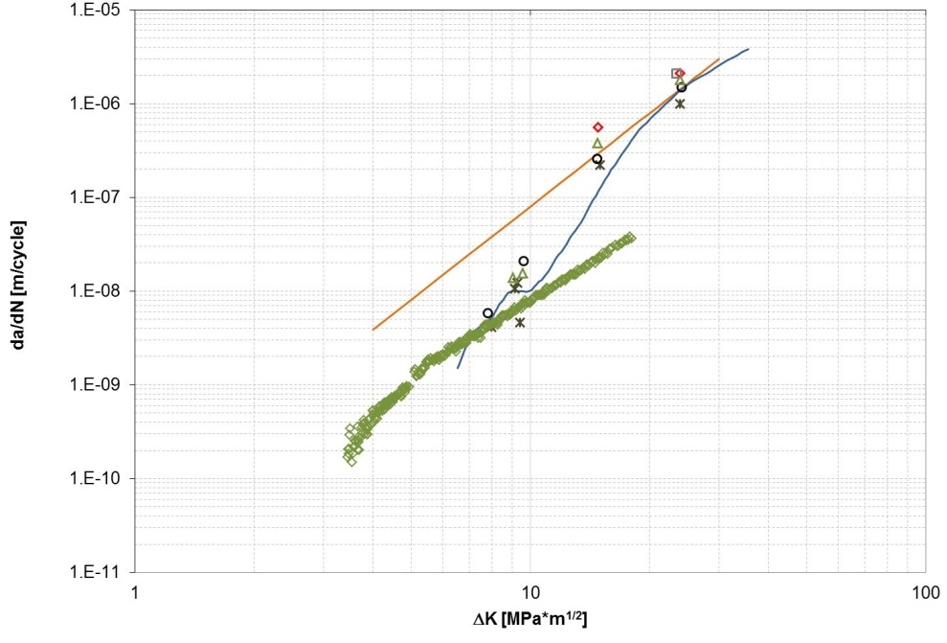
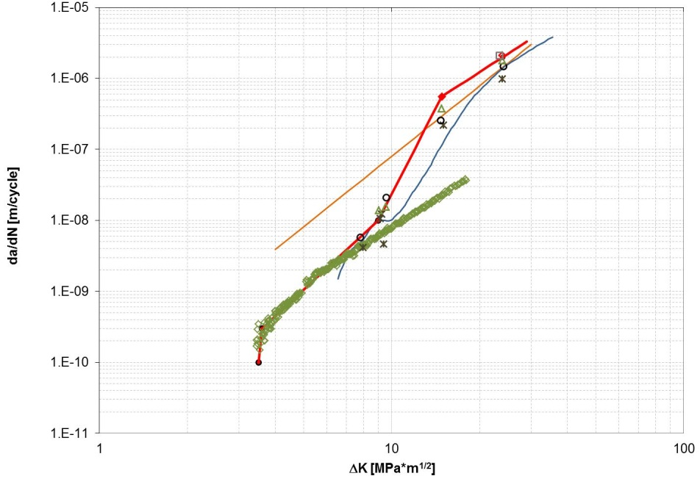
Extrapolated and multi-step FCG relationships formulated from multiple data sets
100 MPa H₂
R=0.2
SA-372 Gr. J
45 MPa H₂
R=0.1
SA-372 Gr. J
extrapolated FCG relationship
multi-step FCG relationship
Air
R=0.7
AISI 4130X
Extrapolated FCG relationship: SA-372 Gr. J at 100 MPa H₂ and 0.1 Hz
  Crack growth rates do not vary with H₂ pressure above 45 MPa
Multi-step FCG relationship: SA-372 Gr. J at 45 MPa H₂ and 4130X in air
  At intermediate and high ΔK, curve fit to upper-bound crack growth rates
Assumption: relative differences between extrapolated and multi-step FCG relationships maintained at higher R ratios (i.e., R = 0.5 and 0.7)

Slide 17
Fatigue-life analysis for manufactured vessel: consider extrapolated and multi-step FCG relationships
extrapolated
multi-step
Double-neck cylinder designed according to EN-1964-1 + 2010/35/EU (TPED qualification)
  220 x 9.1 mm (OD x WT min)
  MAWP = 28 MPa
  Fabricated from 34CrMo4 steel (S_{y} min = 600 MPa, 780 < S_{u} < 890 MPa): not ASME-qualified, but cylinder thickness compliant with Section VIII-2
  For fatigue-life calculations, assume SA-372 Gr. J steel

Slide 18
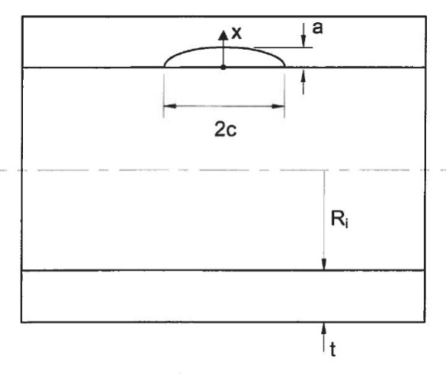
Fatigue-life analysis follows fracture mechanics approach using K solutions from API579-1/ASME FFS1
Applied K solution for internally pressurized cylinder with longitudinal-oriented, semi-elliptical surface crack
Semi-elliptical defect size and shape:
  Depth: a = 0.455 mm (5% min WT)
  Length: c = 1.365 mm (a/2c = 1/3, as specified in KD-4)
Crack depth (a) vs. number of cycles (N) calculated from two different fatigue crack growth relationships:
Extrapolated: single power-law relationship fit only to high-DK data
Multi-step: multiple power-law relationships fit to data in low-, intermediate-, and high-DK ranges

Slide 19
Fatigue crack growth relationship has prominent effect on calculated pressure vessel design life
Δp | FCG relationship | Allowable # cycles
14 – 28 MPa (50% MAWP) | extrapolated | 36,000
 | multi-step | 179,000
19.6 – 28 MPa (30% MAWP) | extrapolated | 194,000
 | multi-step | ∞
Developing test procedures that allow construction of reliable multi-step FCG relationship has significant impact

