Slide 1

Flammability profiles associated with high pressure hydrogen jets released in close proximity to surfaces
ICHS 6
Yokohama
20-10-2015
Hall, J., Hooker, P., O’Sullivan, L., Angers, B., Hourri, A. and Bernard, P.

Slide 2
Content
Introduction
Background to H2FC Trans National Access
Objectives
Programme of Work
HiPress Facility
  Modifications
Release Configurations/Conditions
Test Set Up
Hydrogen Concentration Measurements
Comparative Simulation Work and Results
Ignited Releases
  Heat flux measurements
  IR comparison
Conclusions

Slide 3
Introduction
Hydrogen and fuel cell technologies and applications are rapidly developing
Hydrogen can be stored at high pressure to increase the mass of hydrogen
  Feed to fuel cells: ≈ 500 kPa (5 bar)
  Storage tank pressure: 35–70 MPa (350-700 bar)
High pressure gases may leak and impinge on, or parallel to surfaces
Surfaces affect the dispersion behaviour of jets impacting the flammable extent
  The effect is controlled by proximity, momentum and buoyancy forces. In addition, turbulence levels are affected potentially resulting in a Coanda effect

Slide 4
Trans National Access (TNA) Background
Funded under EU H2FC Project (FP7 Capacity Programme, Grant Agreement no. FP7-284522)
  Allows access to selected research facilities
User group for the work reported here led by Professor Pierre Benard at Université de Québec à Trois-Rivières in Canada
Access provided to HiPress facility at HSL

Slide 5
Objectives
To gain a better understanding of the dispersion behaviour of an unignited high-pressure hydrogen jet released close to a surface
To gain a better understanding of the influence of surface proximity on ignited high-pressure hydrogen releases
To generate experimental data to validate computational fluid dynamics (CFD) modelling

Slide 6
Programme of Work
Four test series were performed:
  Unignited experiments of high-pressure hydrogen jet releases close to the ground (SERIES 1)
  Ignited experiments of high-pressure hydrogen jet releases close to the ground (SERIES 2)
  Unignited experiments of high-pressure hydrogen jet releases close to a ceiling (SERIES 3)
  Ignited experiments of high-pressure hydrogen jet releases close to a ceiling (SERIES 4)
Test Storage Pressure (barg) | Orifice Size (mm) | Series 1-2 |  |  |  |  |  |  |  |  | Series 3-4
 |  | Distance from Ground (m) |  |  |  |  |  |  |  |  | Distance from Ceiling (m)
 |  | 0.05 |  |  | 0.48 |  |  | 1.22 |  |  | 0.08 |  |  | 0.49
150 | 1.06 | 1 | 2 | 3 | 4 | 5 | 6 | 7 | 8 | 9 | 1 | 2 | 3 | 4 | 5 | 6
425 | 0.64 | 10 | 11 | 12 | 13 | 14 | 15 | 16 | 17 | 18 | 10 | 11 | 12 | 13 | 14 | 15

Slide 7
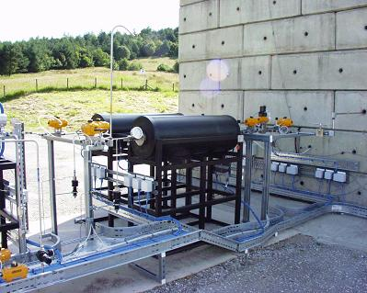
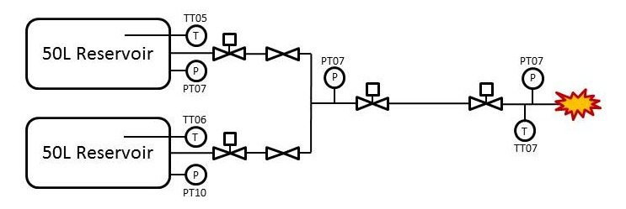
HiPress Facility
1000 bar working pressure
Two 50 litre storage vessels
Gas booster charging unit
Remote operation, timing and firing system including data capture

Slide 8
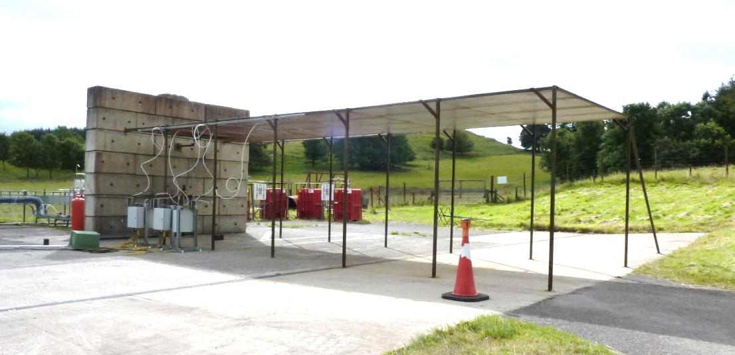
HiPress Facility Modifications
Ceiling constructed above release area
12 m long, 4 m wide mild steel along the line of the release
3 m above ground

Slide 9
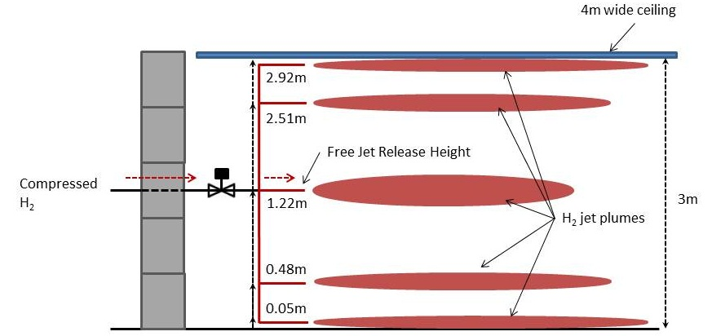
Release Configurations
5 different release configurations
One release configuration at a time
1.22 m represents free jet release

Slide 10
Release Conditions
Two flow conditions identified:
  425 bar through a 0.64 mm nozzle
  150 bar through a 1.06 mm nozzle
Flow conditions chosen to maintain similar distance to free jet LFL [1] and flow rate [2]
Flow rate approximately 7.3 g/s
[1] W., Chen C. and Rodi. Vertical turbulent buoyant jets – a review of experimental data. Oxford : Pergamon Press, 1980
[2] Bragin, Maxim. Personal Communication. s.l. : University of Ulster, 18/07/2012

Slide 11
Test Set Up
Unignited test specific
  Five GDS Technologies F1 Gas Sensor katharometer type hydrogen sensors
Ignited test specific
  Three 110 kW/m², 160° field of view, ellipsoidal radiometers, measuring only radiative heat
  Thermal imaging using FLIR camera with 7.5-13 μm spectral range
  Propane pilot light for igniting jet, lit throughout release
Meteorological measurement, wind speed/direction etc

Slide 12
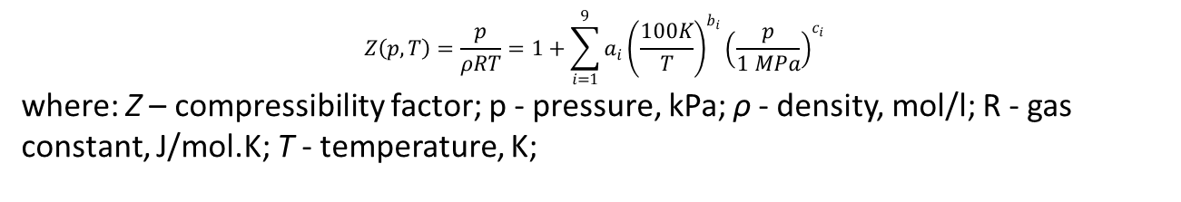
Release Pressure Drop
Reduced from ≈150 to ≈127 barg during 20 second release (84% of starting pressure)
Release flow rate can be calculated ^{[3]}:
Actual flow rate: 7.7 g/s
  (close to predicted 7.3 g/s)
$$Z\left(p,T\right)=\frac{p}{ρRT}=1+\sum_{i=1}^{9}{a_{i}}{\left(\frac{100K}{T}\right)}^{b_{i}}{\left(\frac{p}{1 MPa}\right)}^{c_{i}}$$
  where: Z – compressibility factor; p - pressure, kPa; ρ - density, mol/l; R - gas constant, J/mol.K; T - temperature, K;
[3] Revised Standardized Equation for Hydrogen Gas Densities for Fuel Consumption Applications. Lemmon E, Huber M, Leachman J. Journal of Research of the National Institute of Standards and Technology (2008) 113, 341-350

Slide 13
Hydrogen Concentration
Free jet unignited release at 150 bar, 1.06mm nozzle
‘Steady state’ period difficult to determine
Instability due to wind variation
Averaged 20 s period

Slide 14
Hydrogen Concentration
Ground release vs. free jet release with same release conditions
Clear increase in concentration for ground release at same distance, therefore distance to LFL increased
Ground release vs. ceiling release with same release conditions
Marginally higher concentration at ground level with same distance from release

Slide 15
Comparative Simulations
Simulated using FLACS-Hydrogen from GexCon [4].
  Uses the k-ε turbulent model and the ideal gas equation of state
  Extensively validated against experimental data and reasonable agreement was seen for hydrogen dispersion simulations for various release conditions [5].
  A zone made of cubic cells is defined next to the leak origin. From that initial zone, the grid is stretched to a coarser rectangular grid away from the leak orifice
  The cell size of the initial cubic zone is determined by the leak area
  Grid sensitivity studies were performed, results varied by less than 5%.
[4] Using computational fluid dynamics as a tool for hydrogen safety studies. Middha P. & Hansen O.R . Journal of Loss Prevention in the Process Industries (2009) 22:295-302.
[5] Validation of CFD model for hydrogen dispersion. Middha P, Hansen O.R., Storvic. World Conference on Safety of Oil and Gas Industry, Storvic I.E Korea, April 10-13, Gyeogju, 2007

Slide 16
Comparative Simulations
The jet outlet conditions, i.e. the leak rate, temperature, effective leak area, velocity and the turbulence parameters (turbulence intensity and turbulent length scale) for the flow, were calculated using imbedded jet program in FLACS.
FLACS also calculated the time dependent leak and turbulence parameter data for continuous jet releases during high-pressure vessel depressurisation.
Fifteen unignited jets close to the ground and one jet close to the ceiling were modelled with FLACS using the flow and ambient conditions prevailing at the moment of each corresponding experiment.
  Average wind velocity and average wind direction were used.
  To quantify the effect of the wind on the results, free jet releases at 150 barg and 425 barg, as well as an attached jet release close to a ceiling at 425 barg were modelled without wind.

Slide 17
Comparative Results
Effects of wind: free-jet scenario
  Experiments carried out in highly unstable wind conditions with time dependant velocities and directions

Slide 18
Comparative Results
In most cases CFD tool greatly over predicts the concentrations and consequently the distance to LFL

Slide 19
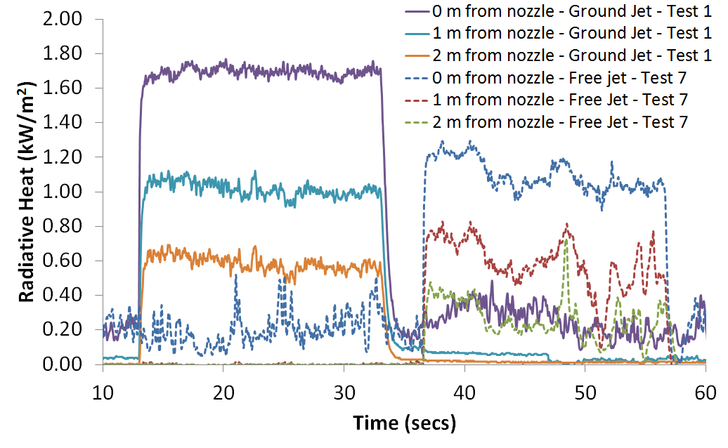
Ignited Tests – Radiative Heat
Reaches steady state throughout release
40% increase in radiative heat output for release close to ground compared with free-jet scenario
  stand-off distance of 2m from the release jet
No harm – 1.6 kW/m²

Slide 20
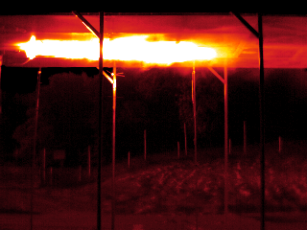
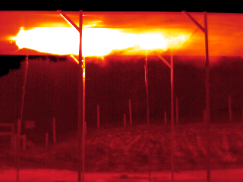
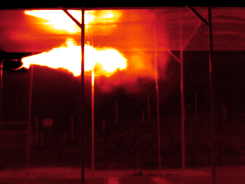
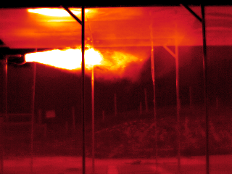
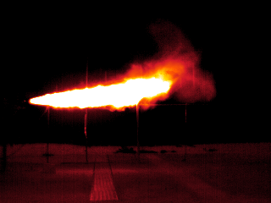
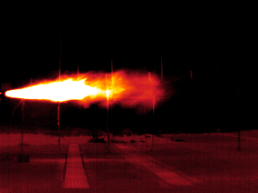
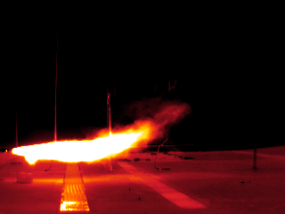
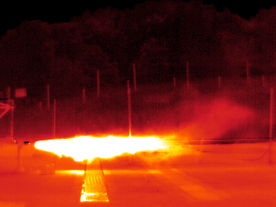
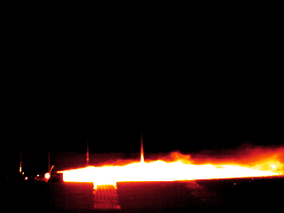
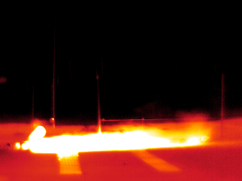
Ignited Tests – IR Comparison
150 bar, 1.06mm releases
Ceiling (0.05 m)
Below ceiling (0.49 m)
Free jet (1.22 m)
Above ground (0.48 m)
425 bar, 0.64mm releases
Ground (0.05 m)

Slide 21
Conclusions
Distance to LFL increases the closer to a surface hydrogen is released, in comparison with a free jet release. This is confirmed by CFD simulation and experimentation.
The distance to LFL is slightly increased for an equivalent release close to the ground compared with close to a ceiling. This means buoyancy is reducing the distance to LFL and decreasing the overall flame length
A maximum radiative heat flux was measured as 1.8 kWm⁻² at a distance of 2 m; this is barely enough to cause any pain as the threshold for “no-harm” is 1.6 kWm⁻². Therefore a sonic release of hydrogen at ≤7.7 g/s between 150 and 425 barg is unlikely to cause harm from heat effects outside of the jet itself regardless of exposure time
The CFD simulations over-predict the extent of jets in most cases, as the highly unstable ambient conditions encountered during the experiments could not be reproduced in the CFD tool. This has implications for the use of CFD tools to predict the behavior of hydrogen releases close to surfaces in the presence of unstable wind conditions.

Slide 22
Acknowledgements
Colleagues at HSL
University of Quebec
Fuel Cell & Hydrogen/Joint Undertaking
European Commission

Slide 23
Thank You for Your Attention!
Any Questions?

