Slide 1

Engineering Safety in Hydrogen-Energy Applications
Audrey DUCLOS¹, C. Proust², J. Daubech², and F. Verbecke¹
6th ICHS, October 19-21, 2015 – Yokohama, Japan
¹ AREVA ENERGY STORAGE
² INERIS

Slide 2
Content
Context
Overall objectives
State-of-the-art : European projects on Risk management
Application of ARAMIS method
Discussion
Conclusions

Slide 3
Overview
Context
  Hydrogen technologies and applications are already introduced into the market (Fuel Cell Vehicles for instance)
  Objectively, hydrogen ignites easily and explodes violently > Safety engineering has to be particularly strong and demonstrative
Overall project objectives
  Various risk analysis methods used/developed so far in the field of hydrogen safety are reviewed and assessed
  None of them seem to be fully adapted to engineer safety on a practical daily basis
  An alternative is presented in the following

Slide 4
State-of-the-art : European projects on Risk management
BEMHA Benchmark Exercise on Major Hazards Analysis 1988-1990
  Resulted in a overview of methodologies for chemical risk assessment in Europe
  Highlighted the strong influence of the assumptions made all along the risk assessment process
ASSURANCE Assessment of the Uncertainties in Risk Analysis of Chemical Establishment 1998-2001
  The hazard identification phase was very critical
  Quite different ranking of the accidental scenarios were obtained
  As for the scenarios’ frequency assessment, the estimates were also quite contradictory

Slide 5
Comparison of probabilities calculated in ASSURANCE project. (Grey tanned cells contain the lower assessments. Black tanned cells contain the upper assessments)
# |  | 3 | 5 | 7
Scenario |  | Rupture or disconnection between ammonia ship and unloading arm | Rupture of a ship tank | Rupture of 20" pipe (distribution line of cryogenic tank)
Partner | 1 | 4.8 10⁻⁴ | 2.8 10⁻⁷ | 6.0 10⁻⁶
 | 2 | 4.8 10⁻⁶ | 6.4 10⁻¹⁰ | 1.0 10⁻⁶
 | 3 | 8.0 10⁻³ | 5.7 10⁻⁵ | 5.0 10⁻⁶
 | 4 | 5.0 10⁻³ | --- | 9.0 10⁻⁷
 | 5 | 5.4 10⁻⁵ | 2.3 10⁻⁶ | 4.0 10⁻⁷
 | 7 | 1.3 10⁻⁵ | 4.9 10⁻⁶ | 4.0 10⁻⁷
Range of deviation |  | 4.8 10⁻⁶ - 8.0 10⁻³ | 6.4 10⁻¹⁰ - 5.7 10⁻⁵ | 6.0 10⁻⁶ - 4.0 10⁻⁷

Slide 6
International Energy Agency - Hydrogen Implementing Agreement Tasks 19 and 31 2004-present
  The overall outcomes of IEA HIA Task 19 are:
    The use of off-shore or HydroCarbon Release database is irrelevant
    > HIAD (Hydrogen Incident and Accident Database) is a valuable tool to estimate the hydrogen-associated event frequencies
    Hydrogen systems risk analysis should also reflect the importance of the safety barriers
    Safety barriers must: avoid releases, detect gas leak, remove ignition source and/or shut down and isolate part of the process
    The human factors and so the safety culture had to be integrated into risk assessment.

Slide 7
ARAMIS (2002-2004)
METHOD PRESENTATION
Accidental Risk Assessment Methodology for Industries
The ARAMIS project is based on:
  an approach by barriers: identification of all conceivable major accident scenarios + the inventory of all safety equipment impeding the development of an accident
  the final acceptability = the demonstration that the proper dimensioning of safety barriers is capable of keeping the identified risks under control
  decision making = a quantified line is drawn between acceptable and unacceptable accidents
ARAMIS contains two methods:
  MIMAH (Methodology for Identification of Major Accident Hazards) : identification of all accidental scenarios physically conceivable
  MIRAS (Methodology for the Identification of Reference Accident Scenarios) : selection the reference scenarios to be modelled and entered into the severity map

Slide 8
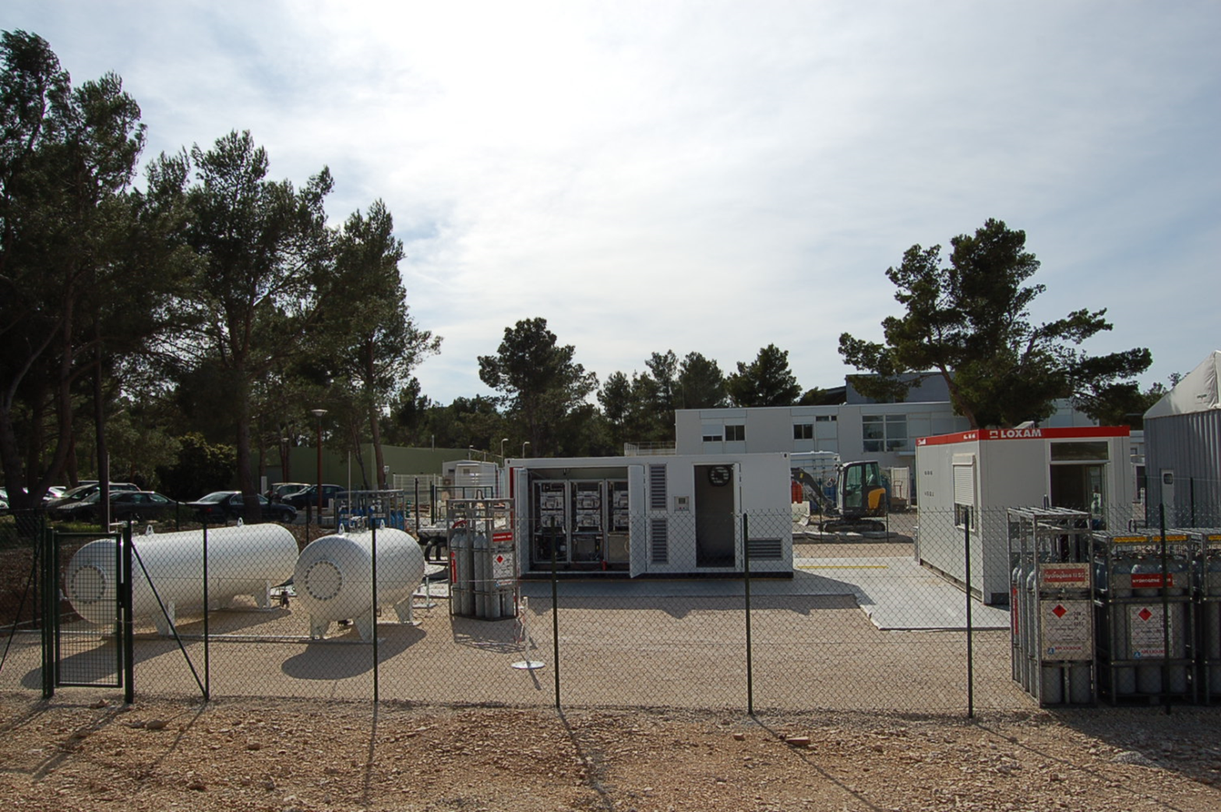
APPLICATION TO AN HYDROGEN OBJECT
Storage | Pressure | 35 | bar
 | Volume of hydrogen | 6 | m³
 | Volume of oxygen | 3 | m³
Pipe | Pipe diameter | 9.5 | mm
 | Pipe length inside container | 45 | m
 | Pipe length outside container | 6 | m
 | Fuel cell pressure | 9 to 2 | bar
 | Electrolyser pressure | 40 | bar
Container | Free volume | 20 | m³
 | Ambient temperature | 288 | K
Container
Fuel Cell’s modules
Over-Flow Valve
Differential of pressure
DP1
H2 Storage
Regulator
Water Storage
O2 Storage
Electrolyser
Mode ELY
Mode FC
No-return Valve
DP2

Slide 9
ARAMIS – APPLICATION
Identification of accident scenarios
  1. Selection of the potential hazards present in this application.
    Hydrogen
    oxygen
  2. For all of those substances, identification of the potential hazardous equipment
    Pipe
    Electrolyser
    Fuel cell
    Storage, …
Scenario :
Small leak on a pipe in the container
  3. Selection of the critical event, also called central event defined as a loss of containment
    Small leak
    Large leak
    Collapse of capacity
    …

Slide 10
BUILDING OF THE BOW-TIE
Small H2 leak
CENTRAL EVENT

Slide 11
BUILDING OF THE BOW-TIE
Failure of the cooling function
Valve or component blocked
Process overpressure
CREATION OF THE FAULT TREE
OR
Internal overpressure
Small H2 leak
OR
Mechanical attack
(Ageing…)
Small H2 pipe leak
OR
Leak on joint...

Slide 12
BUILDING OF THE BOW-TIE
Failure of the cooling function
CREATION OF THE EVENT TREE
Delayed ignition
VCE
Valve or component blocked
Process overpressure
OR
PhD n°2
H2 accumulation
Internal overpressure
Small H2 leak
Ignition
Jet fire
OR
PhD n°1
Mechanical attack
(Ageing…)
Small H2 pipe leak
OR
Leak on joint...

Slide 13
BUILDING OF THE BOW-TIE
INSERTION OF THE SAFETY BARRIERS
Failure of the cooling function
Pressure relief valve
Detection of overpressure in the process
Delayed ignition
VCE
Valve or component blocked
Process overpressure
OR
H2 accumulation
Internal overpressure
Small H2 leak
Ignition
Jet fire
OR
Mechanical attack
(Ageing…)
No hazardous phenomena
Small H2 pipe leak
OR
H₂ detection in the container (threshold set at ¼ of H₂-air LFL)
Leak on joint...

Slide 14
ESTIMATION OF PROBABILITIES
Only the fully developed dangerous phenomena are taken into account
Ignition probability is equal to 1 (ignition happens in all of cases)
Failure of the cooling function
Frequencies = orders of magnitudes
10⁻²
10⁻¹
Delayed ignition
VCE
Valve or component blocked
Process overpressure
OR
H2 accumulation
Ignition of an explosive atmosphere from a small leak in the container > Probability = 10⁻⁷
2.10⁻⁷
10⁻⁵
10⁻⁵
1
Internal overpressure
10⁻²
Small H2 leak
Ignition
Jet fire
OR
2.10⁻⁵
Mechanical attack
(Ageing…)
No hazardous phenomena
Small H2 pipe leak
OR
10⁻²
Leak on joint...
10⁻⁵

Slide 15
ESTIMATION OF PROBABILITIES
Failure of the cooling function
Hazardous phenomenon studied next
Delayed ignition
VCE
Valve or component blocked
Process overpressure
OR
H2 accumulation
10⁻⁷
Internal overpressure
Small H2 leak
Jet fire
Small H2 leak
Ignition
Jet fire
OR
Ignition
2.10⁻⁵
Mechanical attack
(Ageing…)
No hazardous phenomena
Small H2 pipe leak
OR
Leak on joint...

Slide 16
ESTIMATION OF CONSEQUENCES
For a small leak (10% of pipe diameter – ø=0,9mm/P=40b)
  Most likely hazardous phenomena = immediate ignition of jet
    Jet fire (thermal effects) > model of Houf and Schefer (2007)
    Explosion of jet (overpressure effects) > Multi-Energy Method
  The characteristics of the jet :
    a supersonic release
    a mass flow rate of 1,64*10⁻³ kg/s
    the flame length is 2.2 m
Possible effects inside the container but no effect outside
Effect |  | Distance
Explosion | Thermal | Explosion | Thermal
20mbar | 1.8 kW/m² | 10 m | 1.6 m
50mbar | 3 kW/m² | 5 m | 1.3 m
140mbar | 5 kW/m² | 2 m | 1 m
200mbar | 8 kW/m² | 2 m | 0.8 m

Slide 17
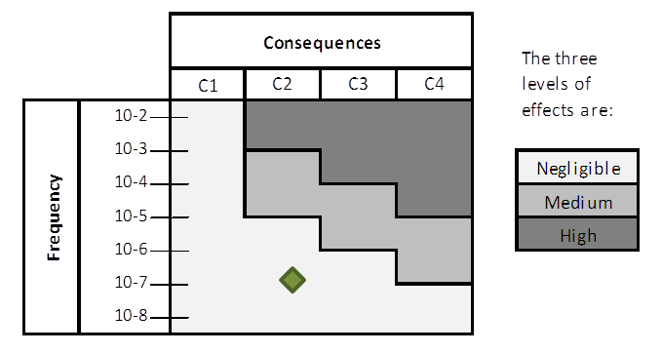
Probability classes
Class of consequences
Probability | Quantitative estimation (per year) | Qualitative estimation
Improbable | < 10⁻⁵ | Possible but extremely unlikely event
Extremely rare | 10⁻⁴ to 10⁻⁵ | Very improbable event
Rare | 10⁻³ to 10⁻⁴ | Improbable event
Possible | 10⁻² to 10⁻³ | Likely event
Occasional | > 10⁻² | Common event
Definition of consequences class used in the case of a containerized hydrogen application
Ranking | Definition
C1 | Light effect inside
C2 | Moderate to Important effect inside, no effect outside
C3 | Important effect inside and light effect outside
C4 | Important effect outside, leading to dominos effects

Slide 18
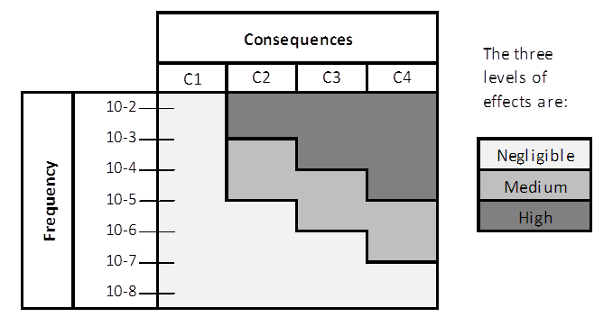
Risk Matrix; frequencies and consequences classes
Critical scenarios >
Potential effects outside
Mitigation strategies >

Slide 19
DISCUSSION
ARAMIS methodology can be implemented, however, some limitations may jeopardize its usefulness.
  The frequencies depend very much on the past experience of incidents, defaults or accidents.
    The available databases do not represent the state of the art of the technology
  A similar comment about the classes of consequences.
    Available accident database is limited and may not represent the state of the art
    Consequences models take in account process and/or environmental conditions (Potential domino effects on/from the container would have to be considered)
  Again a “strong” demonstration of the safety is required for hydrogen-energy >
    Independency of the barrier; Failure on demand rate; Response time; Efficiency

Slide 20
CONCLUSION
Using and adapting the ARAMIS method permits to use a demonstrative method and to incorporate and to take into account the safety barriers.
  Identification of all conceivable major accident scenarios
  Inventory of all safety equipment or barriers impeding the development of an accident,
  Generic calculation of the frequencies via the bow-ties.
The current databases (of frequencies and consequences) are unsuitable for the hydrogen applications.
The central character of the barriers is not sufficiently rested on, and particularly the assessment of efficiency (level of reduction) of the safety barriers.

Slide 21
CONCLUSION
Future works:
  Calculation of the frequencies via a generator of probabilities with more detailed bow-ties
  Establishment of a specific database to hydrogen gathering information on initiating events probabilities
  Work on the criteria evaluation of the barriers in order to assess their influence on both frequencies and consequences. For example the evaluation of the barriers can be based on the evaluation of independence of barriers and the probabilities of failure on demand.
  Finally the calculations of the effects should also be reviewed in order to have a better estimation of the consequences knowing the conditions of use.
    Experiments in progress about jet explosions in obstructed area and vented deflagrations with turbulent flammable mixtures

Slide 22

THANK YOU FOR YOUR ATTENTION
Engineering Safety in Hydrogen-Energy Applications
Audrey DUCLOS,
PhD Student
Research engineer
AREVA Energy Storage
Audrey.duclos@areva.com

Slide 23
Failure of the cooling function
Pressure relief valve
Detection of overpressure in the process
Delayed ignition
VCE
Valve or component blocked
Process overpressure
OR
H2 accumulation
Internal overpressure
Small H2 leak
Ignition
Jet fire
OR
Mechanical attack
(Ageing…)
No hazardous phenomena
Small H2 pipe leak
OR
H₂ detection in the container (threshold set at ¼ of H₂-air LFL)
Leak on joint...

