Slide 1

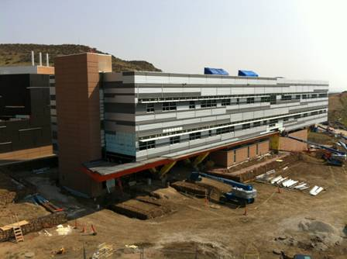
Hydrogen Monitoring Requirements in the Global Technical Regulation on Hydrogen and Fuel Cell Vehicles
William Buttner, C. Rivkin, R. Burgess, K. Hartmann*, I. Bloomfield*, M. Bubar*, M. Post
Safety Codes & Standards Group
Hydrogen Technologies & Systems Center
National Renewable Energy Laboratory
Golden ,Colorado 80401; USA
and
Eveline Weidner, L Boom-Brett, P. Moretto
Institute for Energy and Transport
Joint Research Centre
Petten, the Netherlands
Presented to
International Conference on Hydrogen Safety
October 18-21, 2015
* Intern, Colorado School of Mines
The Energy Systems Integration Facility
NREL is a national laboratory of the U.S. Department of Energy, Office of Energy Efficiency and Renewable Energy, operated by the Alliance for Sustainable Energy, LLC.

Slide 2
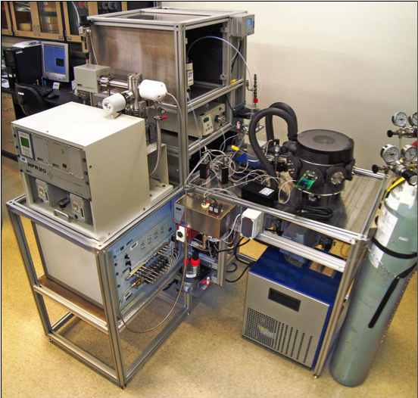
The NREL Sensor Testing Laboratory
Assessment of H₂ sensing element, sensor, detection apparatus performance
Interact with manufacturers to improve sensor performance to meet targets, e.g., ISO 26142, DOE, specialized applications
Support hydrogen sensor codes and standards development (national and international)
Support end-users (deployment)
  “Topical Studies”—information on sensor use
  Direct collaborations with the H₂ Community
NREL Sensor laboratory does not certify
Client confidentiality
The NREL Sensor Testing Facility
The ultimate goal of the Hydrogen Sensor Testing Laboratory is to ensure that end-users get the sensing technology they need

Slide 3

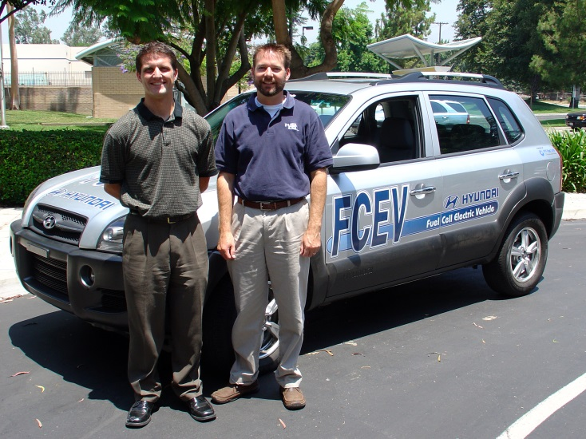
UN GTR No. 13
“Global Technical Regulation concerning the hydrogen and fuel cell vehicles”
GTR No. 13
International agreement on FCEV safety
Basis of the US DOT FMVSS
To harmonize international vehicle safety standards
Contracting parties are to start the adoption process
Requirements must be verifiable
GTR 13 can be obtained on-line:
http://www.unece.org/fileadmin/DAM/trans/main/wp29/wp29wgs/wp29gen/wp29registry/ECE-TRANS-180a13e.pdf
(Google: GTR 13 Document)

Slide 4
GTR 13
Regulated Hydrogen Levels
Section 6.1.2: Post-Crash Concentration Test for Enclosed Spaces
Sensors are selected to measure either the build-up of the hydrogen or helium gas or the reduction in oxygen (due to displacement of air by leaking hydrogen/helium)
3 per cent hydrogen or 2.25 per cent helium by volume in air
Section 5.2.1.3.2: Vehicle Exhaust System
At the vehicle exhaust system’s point of discharge, the hydrogen concentration level shall:
Not exceed 4 per cent average by volume during any moving three-second time interval during normal operation including start-up and shutdown;
And not exceed 8 per cent at any time (para. 6.1.4. test procedure) .
NOTE: A means to verify compliance is necessary to enforce a requirement
Section 5.2.1.4.3: Vehicle Compartments
If during operation, a single failure results in a hydrogen concentration exceeding 2 ± 1.0 per cent by volume in air in the enclosed or semi-enclosed spaces of the vehicle, then a warning shall be provide (para 5.2.1.6). If the concentration exceeds 3 ± 1.0 per cent by volume in the air in the enclosed or semi-enclosed spaces of the vehicle, the main shutoff valve shall be closed to isolate the storage system (para 6.1.3 test procedure).
NOTE: There is no formal requirement mandating the use of on-board hydrogen sensor.

Slide 5




H2 Sensor R&D in support of DOT and the GTR
FCEV Crash Test
Requirements for H₂ Storage System
  Vehicles to be subjected to standard crash test.
  Actual tests may be performed with helium surrogate
  H₂ <3 ± 1% or He <2.25 ±0.75% for 1 hour following impact
  Failure may result in vehicle recall
Successful Field Deployment
  Actual FCEV crash test
  No sensor failure
    3 conventional vehicle crash test (demonstration)
    2 FCEV crash tests
  Coordinated with DOE, DOT, TRC, KARCO
http://www.nrel.gov/docs/fy12costi/56177.pdf

Slide 6
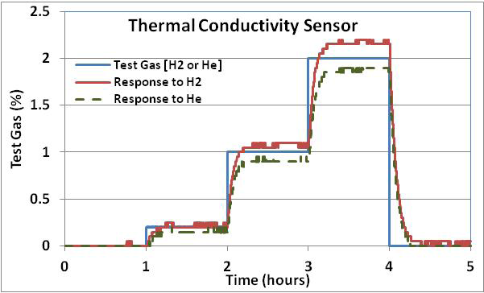
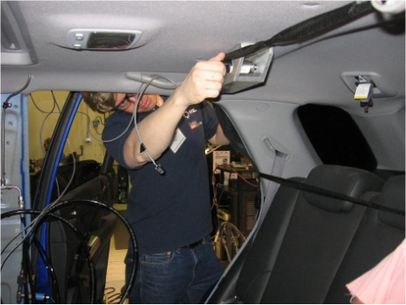
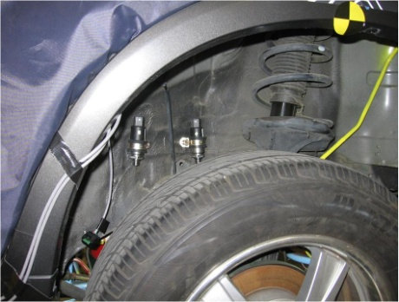
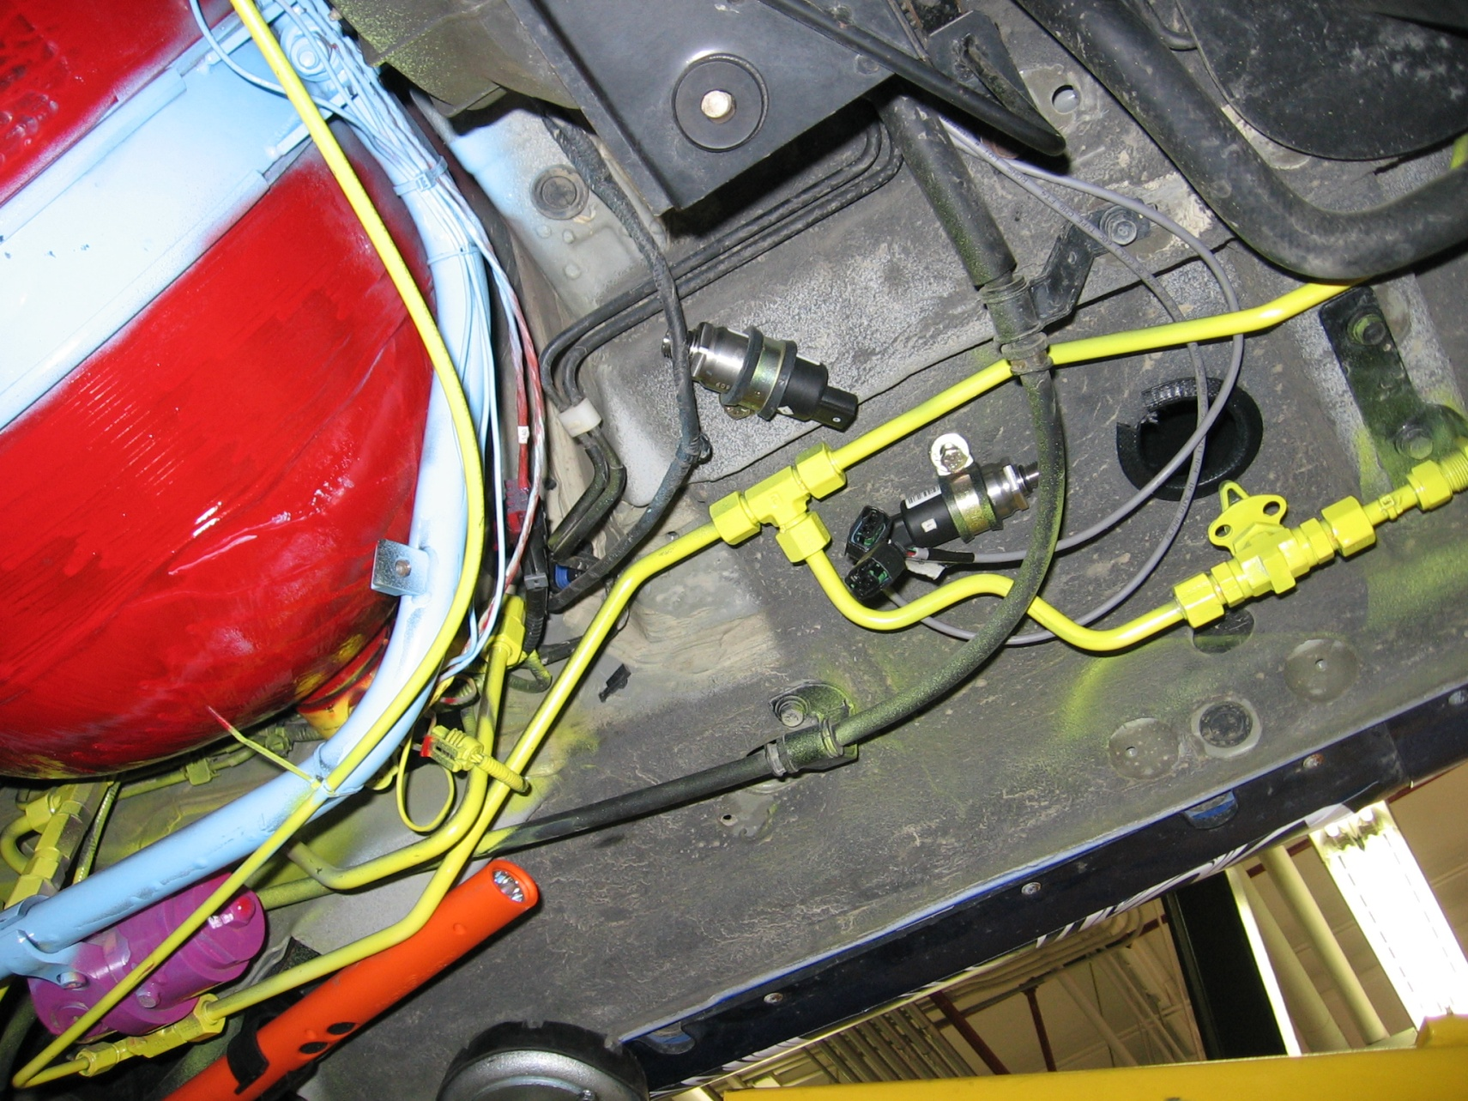
Sensor Selection
  Direct Approach (USED)
H₂ determination using TC sensors
  TC Sensors low cost and easy to use
  Applicable for Hydrogen and Helium
  Sensors were subjected to up to 5 crash tests without failure
  Successfully deployed in vehicle crash test
Indirect Approach
H₂ determination via O₂ displacement using O₂ sensors
  O₂ Sensors low cost and easy to use
  Applicable for Hydrogen and Helium (indirect method)
  Used in numerous modelling studies
  Buttner et al. (ICHS 2013, IJHE) “A Critique on the Quantification of Hydrogen Releases Through Oxygen Displacement Using Oxygen Sensors”

Slide 7
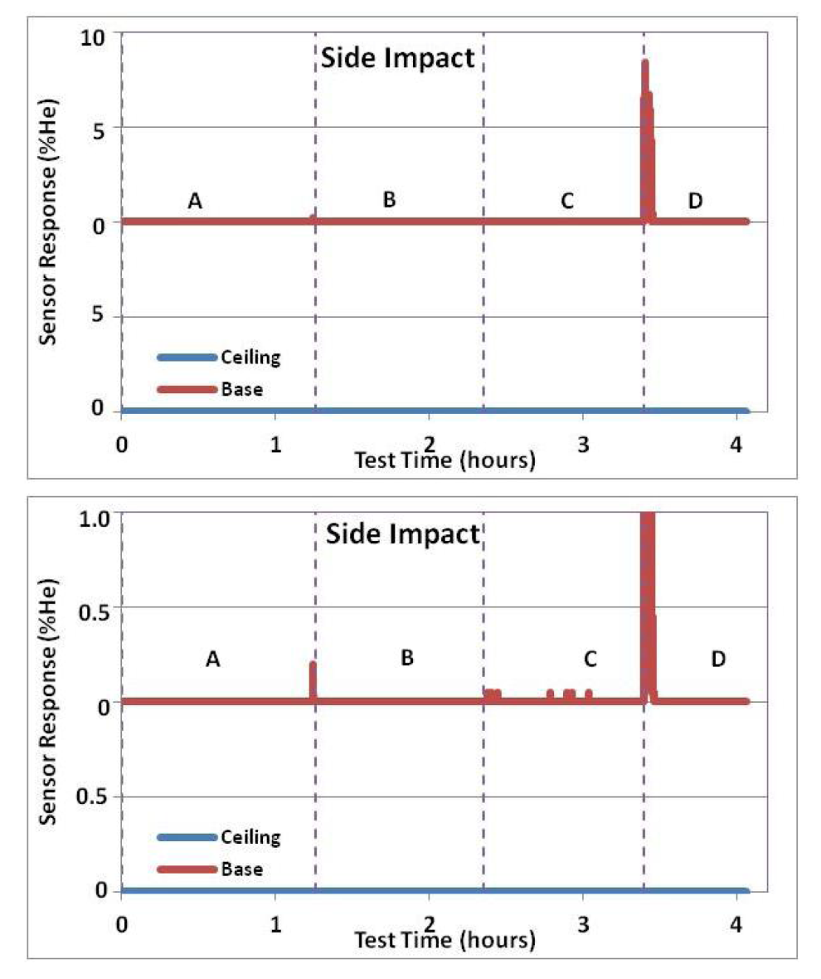
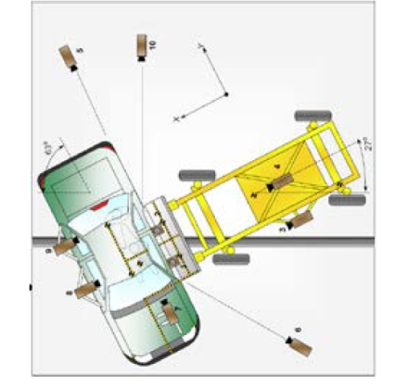
Sensor Monitoring in Side Impact Test
Expanded View
A: Vehicle final preparation
B: Pressure hold
C: Post Impact (impact at line separating B and C)
D: Depressurization

Slide 8
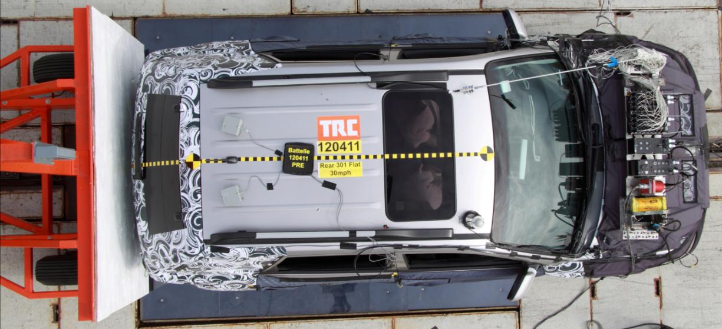
Summary and Conclusions
Thermal conductivity hydrogen sensor technology are compatible with FCEV crash tests and works for helium and hydrogen.
  Commercial devices available (linear to 10% with an LDL of 0.05–0.1% H₂ or He
  Physically robust to survive crash test environment
Remote interrogation of the sensors via telemetry is strongly urged for any hydrogen test.
An automated, self-contained sensor module system should be developed to facilitate sensor deployment and pretest and post test performance validation (or calibration).

Slide 9
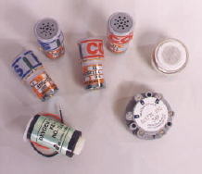
H₂ determination via oxygen sensor measurements
Background
Oxygen Sensors
Applications
  Actual: Modeling of controlled releases
  Proposed: Global Technical Regulation (GTR)
  Potential: General Deployment?
Vol% O₂
Great for O₂ Determinations
From the GTR (Hydrogen Fueled Vehicles)
(Section B.6.1.2: Post-Crash Concentration Test for Enclosed Spaces)
“Sensors are selected to measure either the build-up of the hydrogen or helium gas or the reduction in oxygen (due to displacement of air by leaking hydrogen/helium)”

Slide 10
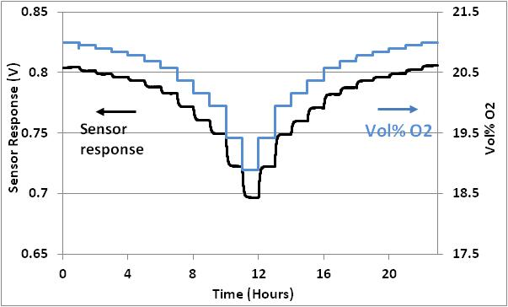
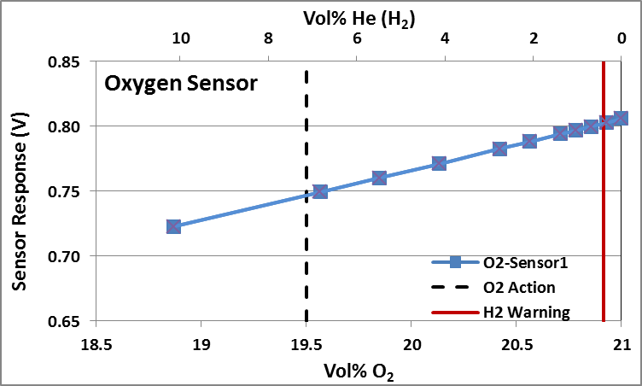

H₂ determination via oxygen sensor measurements
Basic Premise
Basic Premise
      Sensor Response ≈ K * Vol% O₂
      Vol% O₂ = 21 – 0.21* Vol% Diluent
        1 vol% [Diluent] suppress ambient O₂ from 21 to 20.79 vol%
      Applicable for H₂, He, (other)
Advantages
  O₂ Sensors--COTs, low-cost, simple
  Broad-Range, Linear response to O₂
Disadvantages
  Small drift => significant [diluent]
  Finite life (sometimes short)
  Non-selective (for diluent)

Slide 11
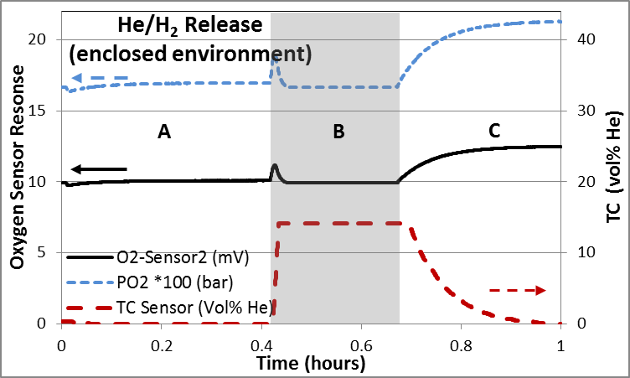
H₂ measurements via O₂ displacement in enclosed spaces
O₂ sensors are sensitive to partial pressure (p_{O2}) not vol%
Closed System (Region A and B)
A: Air at 0.8 bar 21 vol% O2; P_{O2} = 0.17 Bar
B: Pressurize chamber to 1 Bar with Helium
17 vol% O2; P_{O2} = 0.17 Bar
Open System (Region C)
C: Purge chamber with air
21 vol% O2; P_{O2} = 0.21 Bar
Gray Region: 20 vol% He
No response for H₂ /He release into closed system (P_{O2} vs. Vol% O₂)
  Direct manifestation of the O₂ Sensor P_{O2} dependence
TC range: 0 to 14 vol% He (not a fundamental limitation)
Use of this approach in GTR is inappropriate

Slide 12
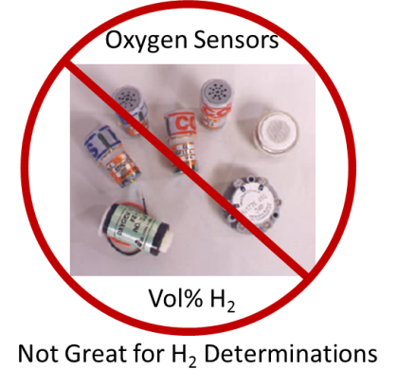
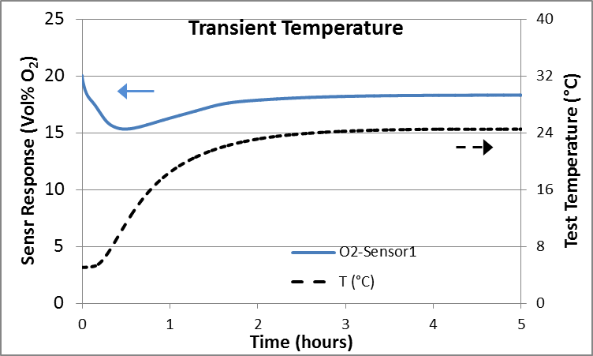
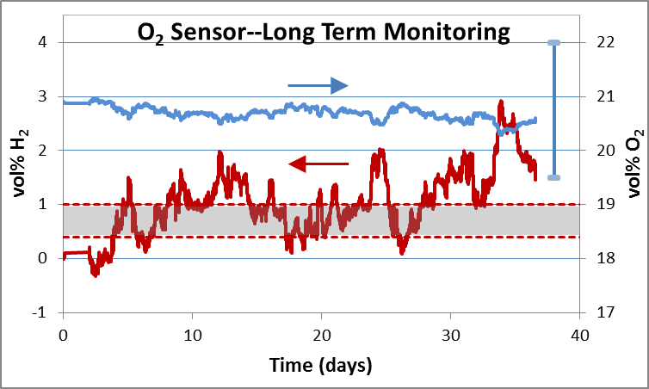
Summary
General critique of approach
O₂ sensors are very good for O₂
O₂ Sensors are NOT good for H₂ monitoring
  Indirect method for H₂/He
  Propagation and amplification of errors
  Detection limit, H₂/He accuracy ~20% O₂ resolution
  Potentially misleading/inaccurate results
    Inappropriate for general deployment
  Diluent ambiguity (H₂, He, and OTHER)
    “Other” could be Air Bag Exhaust
Not necessary in crash test for H₂ or H₂ surrogates
  TC sensor compatible for H₂/H₂ surrogates
  Other platforms (EC, CGS, MOX, Pd) for other applications
Recommendation to edit GTR text
“Sensors are selected to measure either the build-up of the hydrogen or helium gas or the reduction in oxygen (due to displacement of air by leaking hydrogen/helium)”

Slide 13

Current Activity
Global Technical Regulation on hydrogen and fuel cell vehicles
(Exhaust Requirements)
5.2.1.3.2. Vehicle Exhaust System
At the vehicle exhaust system’s point of discharge, the hydrogen concentration level shall:
Not exceed 4 per cent average by volume during any moving three-second time interval during normal operation including start-up and shutdown;
And not exceed 8 per cent at any time (para. 6.1.4. test procedure).
Off-Vehicle Analyzer for Verification of Tailpipe H₂ Emissions
Issues and Challenge
  A method must exist to verify compliance to an enforceable requirements
  Hydrogen transients must be detected in < 1 sec (implies ~ 300 ms response time)
    Measurement Range: 0 to 10 vol% (8 vol% in < 1sec pulses but average level remains < 4 vol%)
  No known commercially available sensor was available (as of September 2014)
    Analytical instrumentation (e.g., Mass Spectrometry) was available but expensive
  Generation a test gas with a known duration of 1sec or less

Slide 14
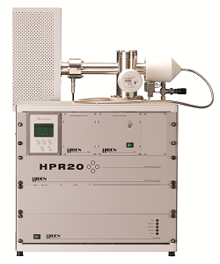
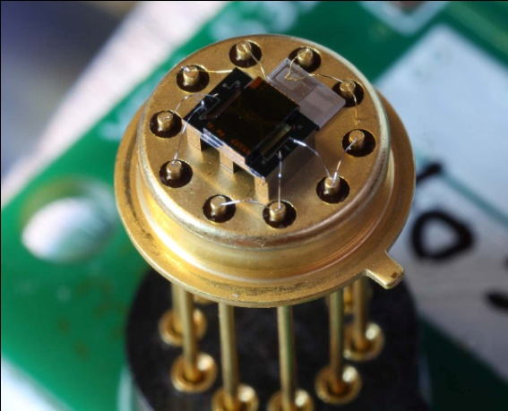
Analyzer for Verification of Tailpipe H₂ Emissions
Approach 1
Mass Spectrometry
  Sampling rate: better than 5 times/min
  Sufficient range, maybe transportable
  Overkill (multiple component detection)
  Highly selective
  Multiple models potentially available
  Expensive (~ $10⁵)
  Still an option and backup
  Measurement verification
Approach 2
Micro TC sensor
  Response time <0.25 sec (not verified)
  Sufficient range
  ID’d via “H2Sense”
  Portable and “simple to use” (~ $10³)
  Under evaluation (received Feb 2015)
  Multiple manufacturer’s id’d

Slide 15
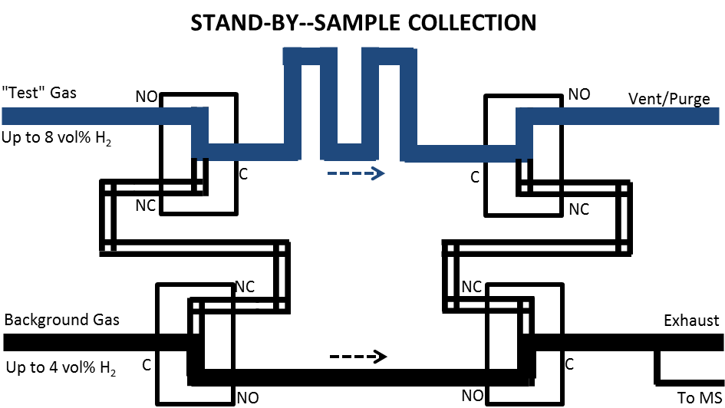
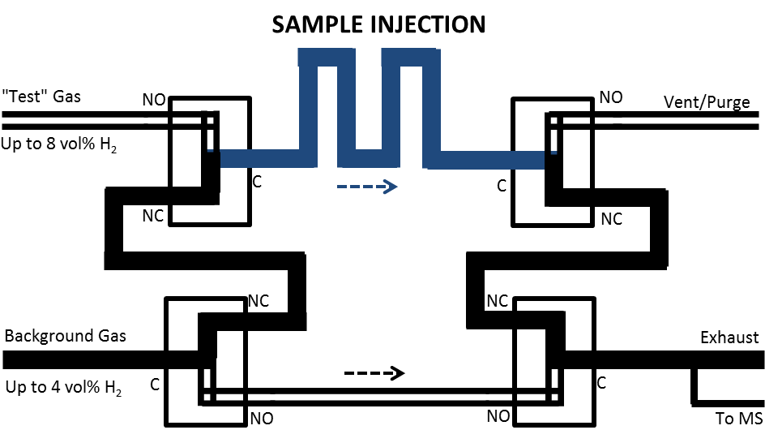
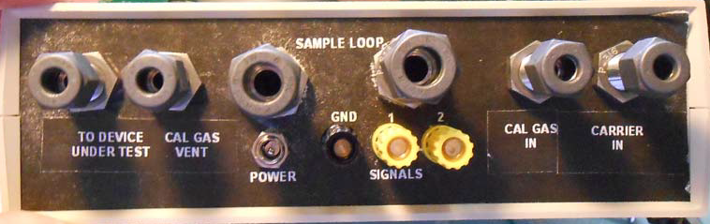
Control of the test gas pulse
Gas sample loop
Provided by Custom Sensor Solutions
Flow rate controlled by MFC (slpm) at inlet of Test Gas and Background Gas
Pulse width = volume/flow rate
  1 sec pulse: 1L/min flow, 16.7 cm³ loop
  2 sec pulse: 0.5L/min flow, 16.7 cm³ loop
  Adjust loop size or flow rate to change pulse width
MFC
MFC

Slide 16
Initial Testing
Gas flow directly over the sensor
Use a “gas pulser” to generate H2 pulses of known duration and concentration
Plug flow of H2 sample in series with air stream
Response time <1s (about 250ms)
Accurate and linear to 10 vol%
Looking into other fast response sensors options
1 second

Slide 17
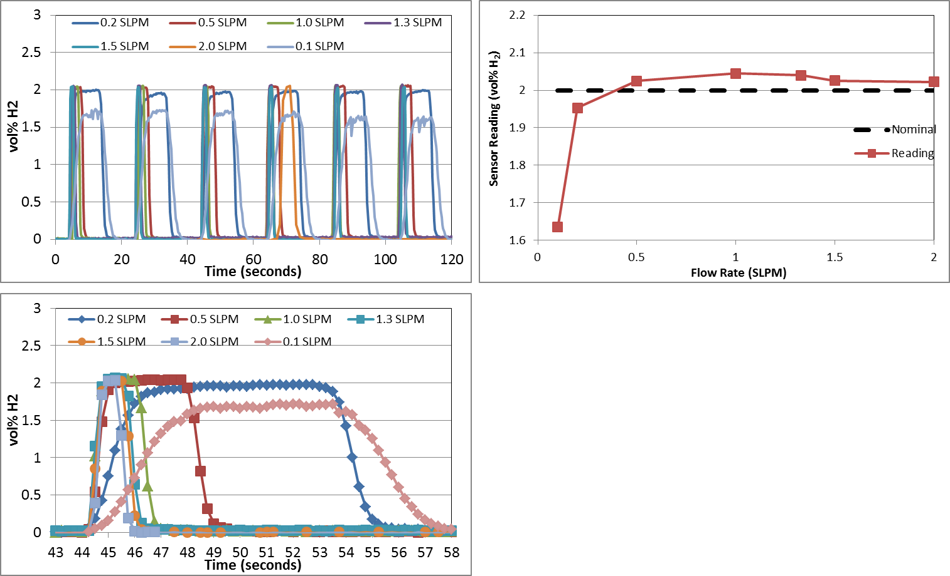
Effect of Flow Rate
Flow rate independent > 0.5 SLPM
Measured gas pulses down to ~0.75 s
Repeatable sensor resposne

Slide 18
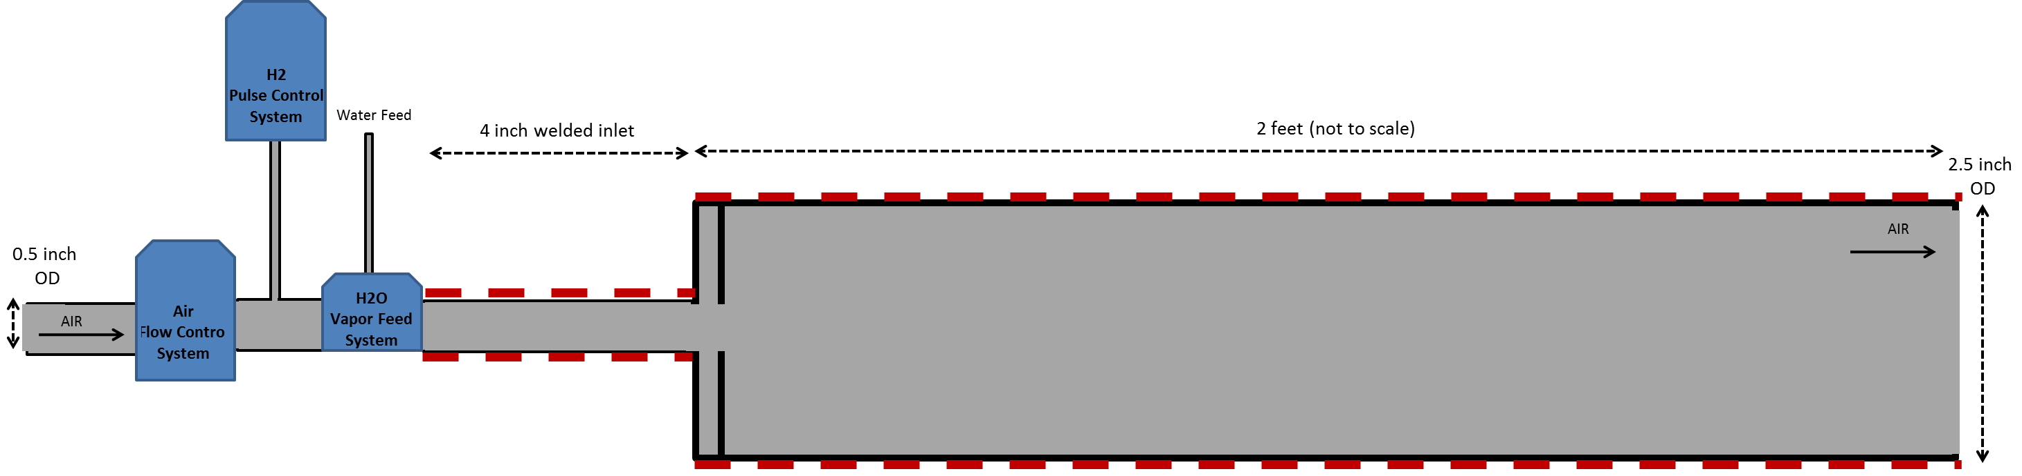
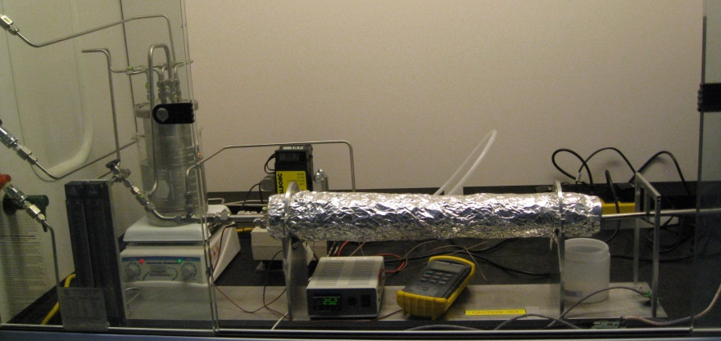
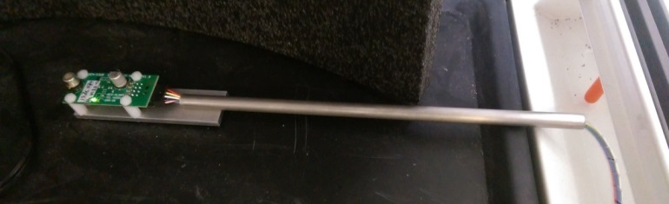
Concepts for Tailpipe Text Fixture
Tail Pipe Test Fixture
Subsystems
  Pneumatic system
    Up to 80 L/min air feed
    Independent H₂ Feed
  Temperature Control System ( )
    Up to 80°C
  H₂0 Vapor Feed System
    RH up to 80% at temperature (“normal”)
  Probe configurations
    In-situ
    Extractive

Slide 19
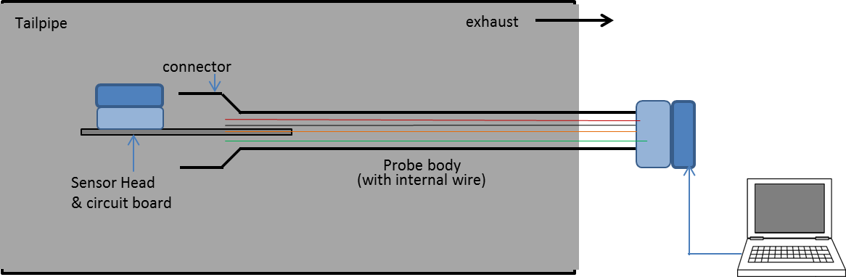
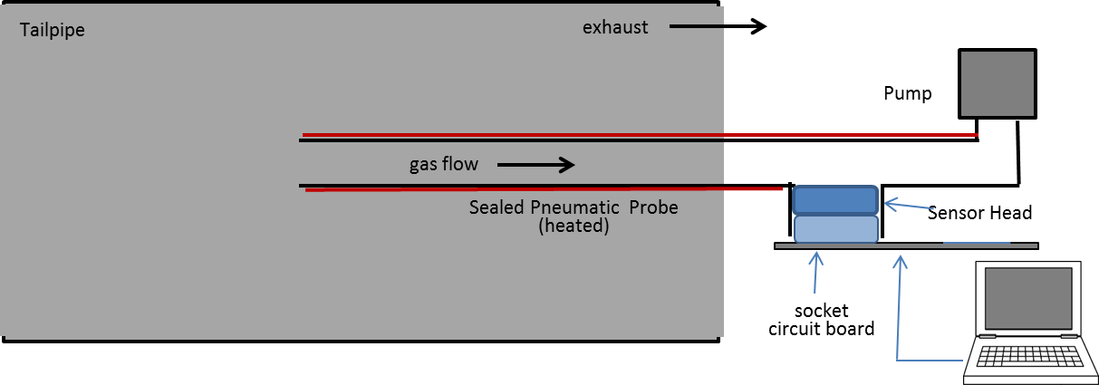
Probe Design
Option 1 (in-situ Probe): Sensor is placed in gas stream within tail pipe
Option 2 (extractive probe): Sensor external from tail pipe with sample gas pumped to it
The two sampling systems produce similar results

Slide 20
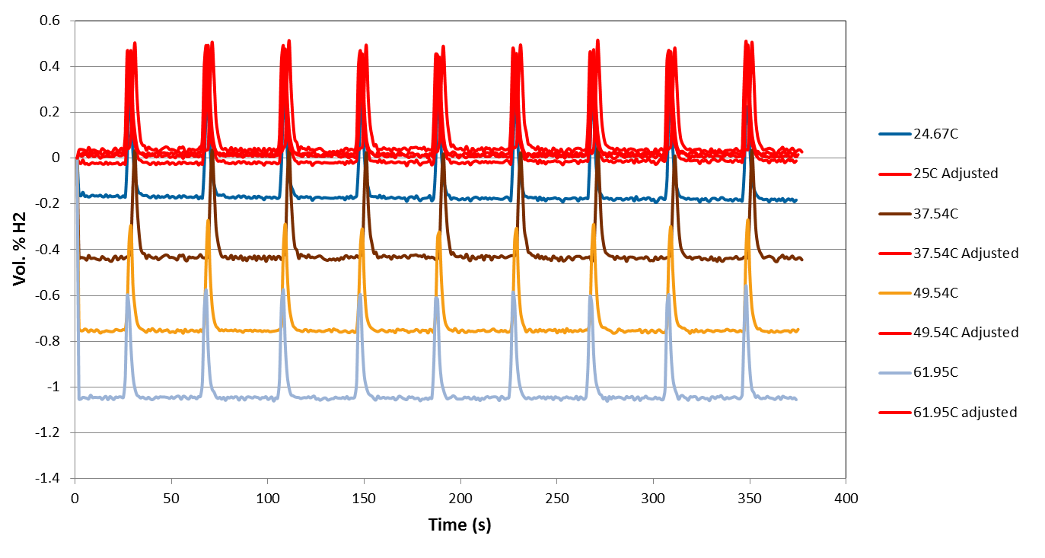
TC Temperature Dependence Compensation
TC Senor Response vs. Temperature (25 to 62ºC)
TC sensing element can exhibit a temperature dependence
Simultaneous T measurement and S.R. with an automated empirical correction provides accurate H2 determination
Humidity impacts are currently being characterized
Field usable probe and field trials are planned

Slide 21
On-Board Hydrogen Monitoring Considerations
GTR Does NOT require on-board sensors
  Sensors are just an option to verify compliance to GTR requirements
  The NREL Sensor Laboratory provides support to OEMs
Guideline for qualifying sensors considered for automotive applications (SAE J3089)
  Developed within the SAE Fuel Cell Safety Task force
SAE J3089 IS NOT A STANDARD
- provides guidance and proposed test methods for hydrogen sensors –
There are no pass/fail criteria
It does not dictate that sensors are required on-board vehicles

Slide 22

Summary and Conclusions
A sensor and method for H₂-FCEV crash test requirements has been identified and verified (TC sensor directly monitoring H₂ releases)
Indirect method via O2 displacement is too ambiguous
  It is recommended that the GTR be edited to remove the text endorsing this method
An off-vehicle low-cost, sensor-based analyzer to verify GTR Tailpipe Emission Requirements is being developed
  To be proposed as a recommended method for GTR
  Work is coordinated and shared with U.S. DOT-NHTSA, OEMS (via the SAE FCSTF)
On-board sensors are a viable option to verify compliance to GTR vehicle compartment requirements

Slide 23
Acknowledgements
The NREL Sensor Laboratory is support by DOE-EERE Fuel Cell Technologies Office Will James, Program Manager (William.buttner@nrel.gov)
JRC-IET is supported through the European Commission’s 7th Framework Programme (FP7) (Eveline.Weidner@ec.europa.ec)

Slide 24

THANK YOU
Arigatō - ありがとう
For more information:
William Buttner
william.buttner@nrel.gov
(303) 275-3903
http://www.nrel.gov/hydrogen/facilities_hsl.html
(or Google “NREL Sensor Laboratory”)
Coming Soon
Book: “Sensors for Process Monitoring and Safety in Hydrogen Technology”
T. Hübert, W. Buttner, L. Brett, CRC Press

