Slide 1
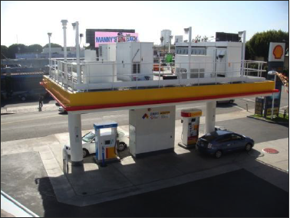
Application of quantitative risk assessment for performance-based permitting of hydrogen fueling stations
A. Christine LaFleur, Alice Muna & Katrina M. Groth
Sandia National Laboratories
Albuquerque, NM
International Conference on Hydrogen Safety
Yokohama, Japan
October 21, 2015
Sandia National Laboratories is a multi-program laboratory managed and operated by Sandia Corporation, a wholly owned subsidiary of Lockheed Martin Corporation, for the U.S. Department of Energy’s National Nuclear Security Administration under contract DE-AC04-94AL85000. SAND2015-8880 C

Slide 2
Outline
PBD overview & introduction
Analysis to benchmark station risk

Slide 3
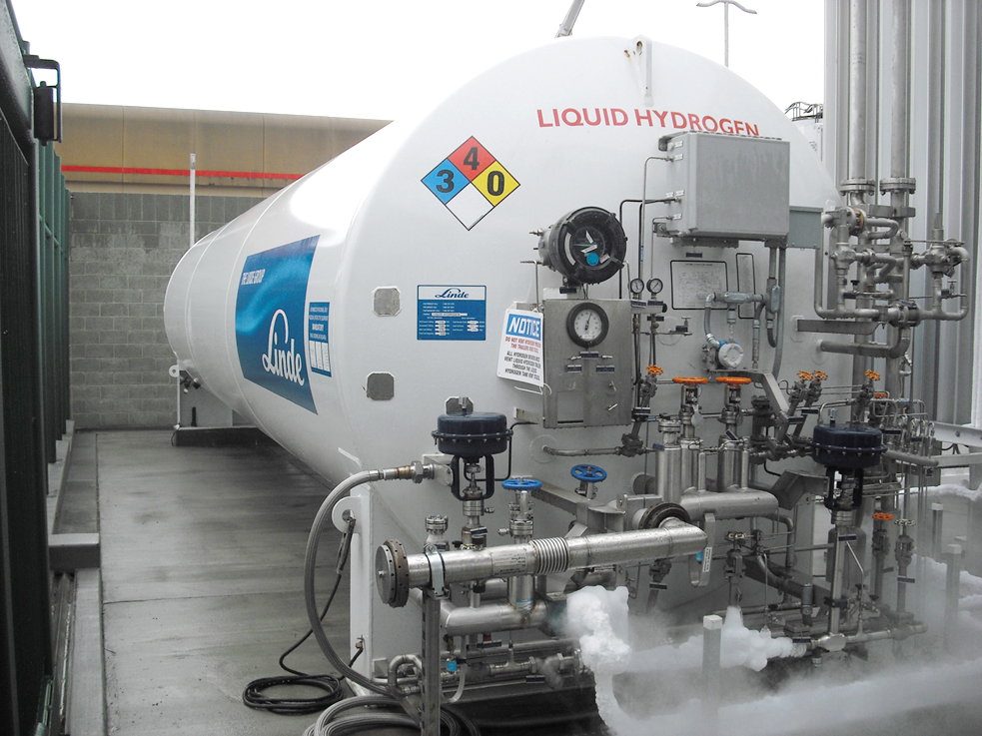
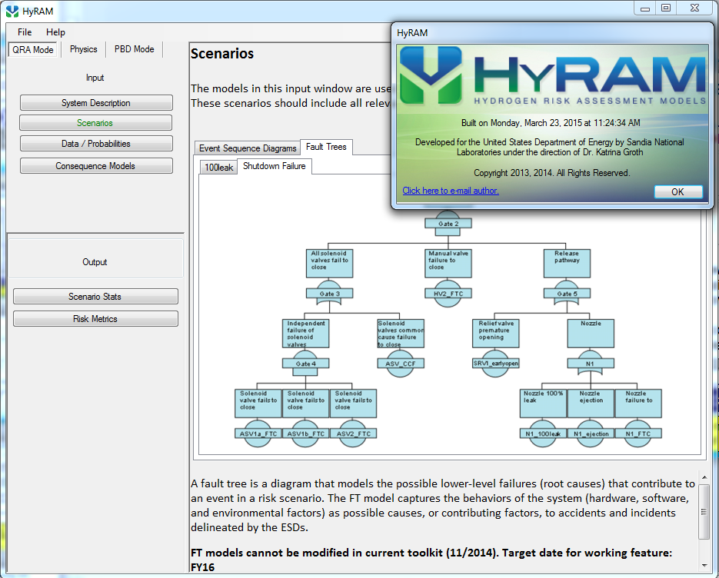
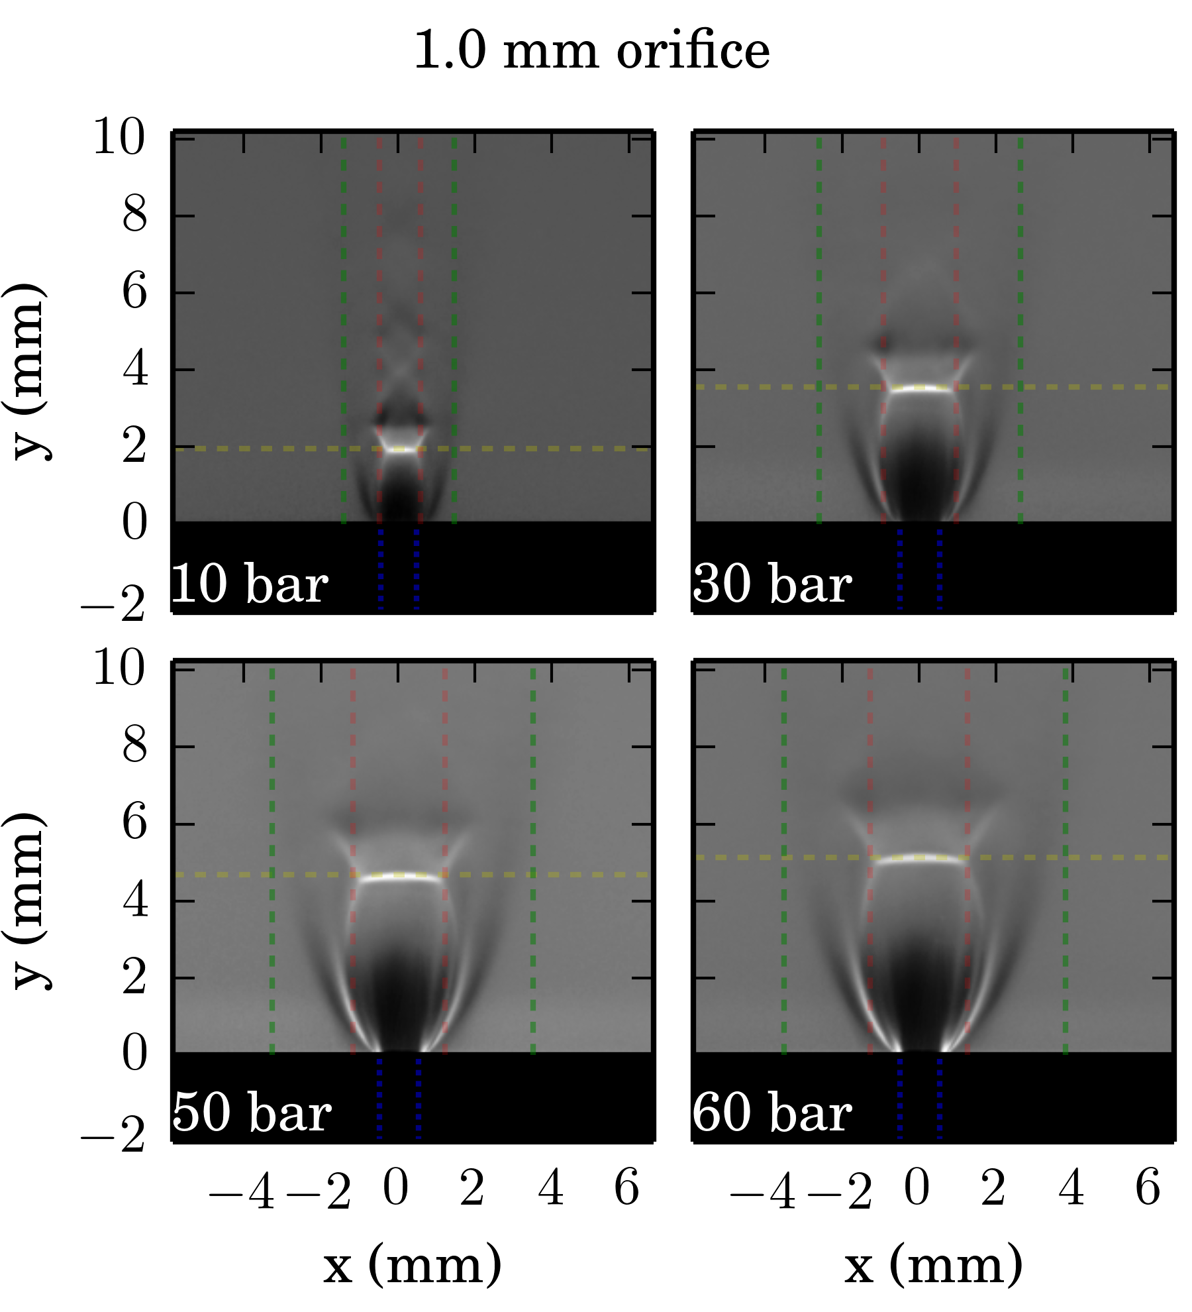
Project Approach: Three coordinated activities
Apply risk assessment techniques in step-out hydrogen technologies
Develop integrated algorithms for conducting QRA (Quantitative Risk Assessment) for H₂ facilities and vehicles
Develop and validate scientific models to accurately predict hazards and harm from liquid releases, flames, etc.
Apply R&D in RCS
QRA methods, tools R&D
H2 behavior R&D
Enabling methods, data, tools for H₂ safety & RCS community
Notes:
We’re conducting two main research activities that feed into an applied activities to impact codes and standards.
This arrangement is in line with our program focus on identifying R&D needs, performing high-priority R&D, and impacting codes and standards.
Three pieces: Developing the methods, developing scientific models, and piloting the application of the methods and models.

Slide 4
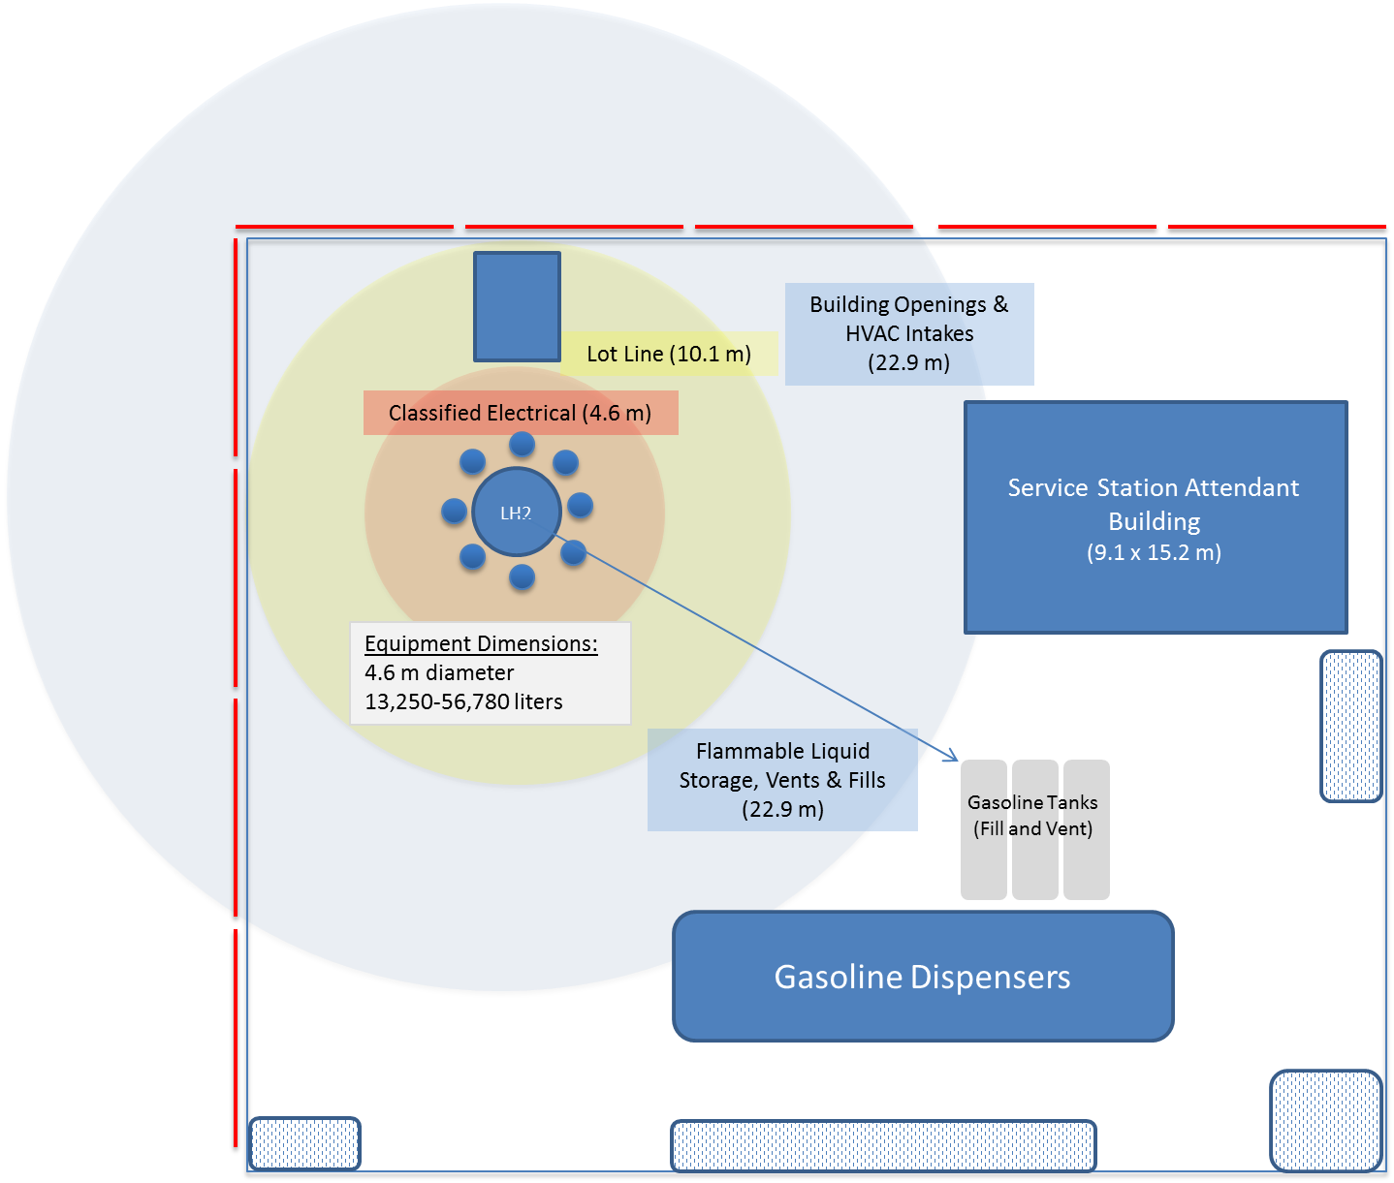
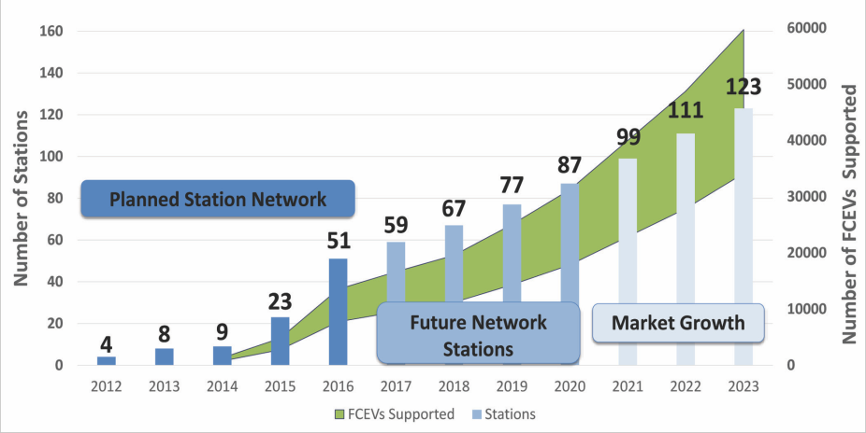
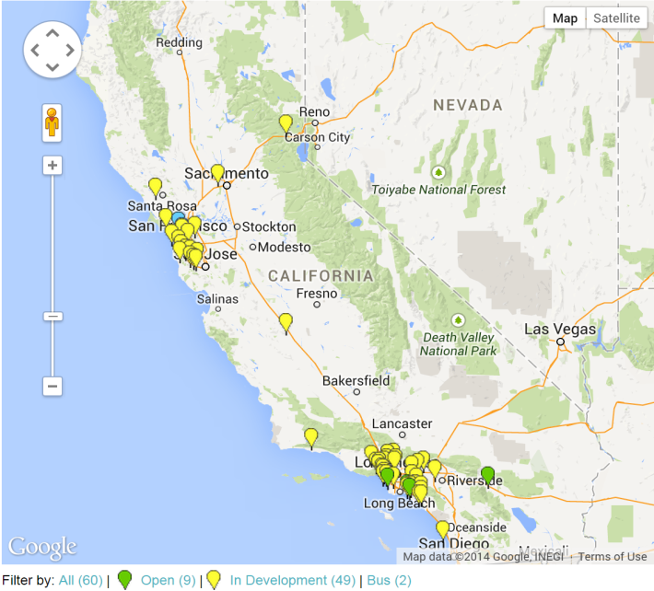
Separation distances in NFPA 2 for liquid hydrogen stations are often prohibitively large
A California Road Map: The Commercialization of Hydrogen Fuel Cell Vehicles, CalFCP, July 2014
Harris, SAND-2014-3416
Of 70 stations surveyed (out of 343), none met the NFPA 2 Ch. 6 separation distance requirements.
Harris, SAND-2014-3416
http://www.cafcp.org/stationmap

Slide 5
Key Barrier – Prescriptive LH2 Separation Distances
Current bulk distance values
Based on historical values
Present critical limitation to hydrogen infrastructure growth
Science-based Code Improvements - Ongoing effort by NFPA 2 subcommittee to revise based on risk-informed science of LH2 release behavior. Best case schedule for 2019 code edition, jurisdictional adoption later
Alternative Methods for Code Compliance - In the meantime, this effort is exploring a path forward for short term deviation from separation distances for LH2

Slide 6
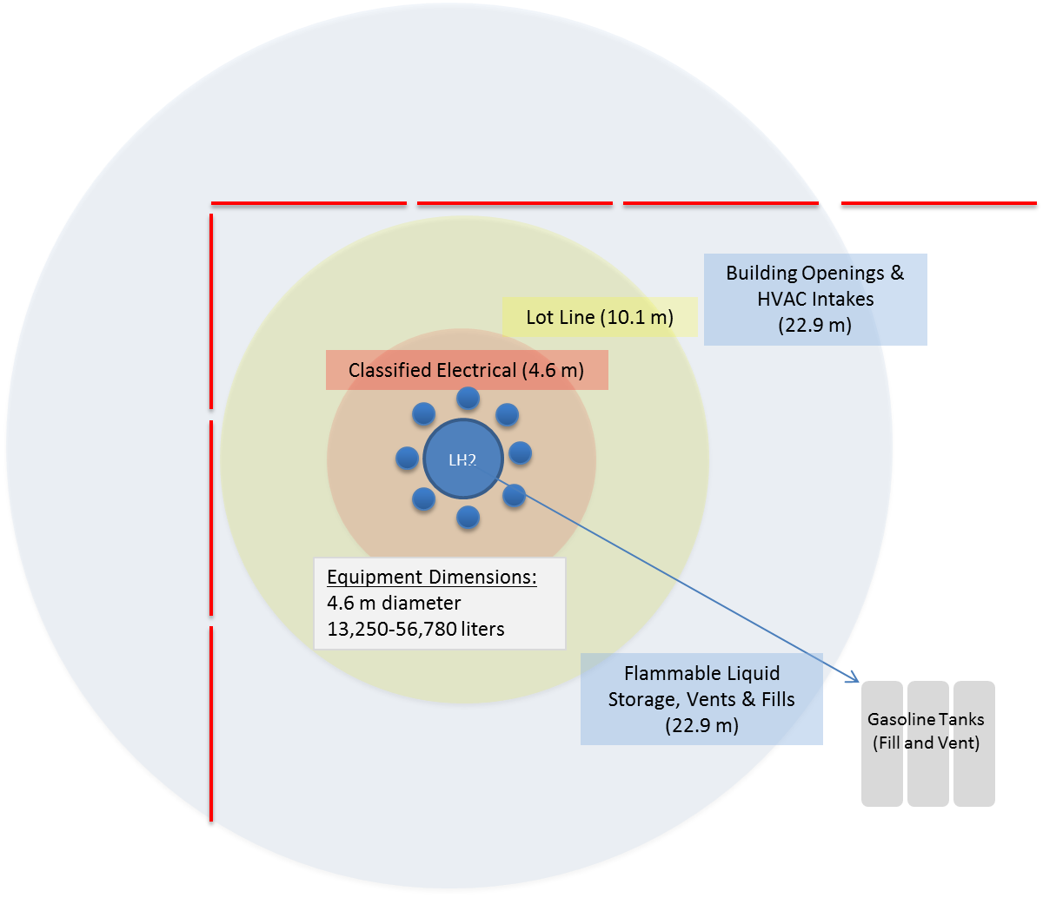
Enabling Hydrogen Codes & Standards: Two related paths
Alternative Methods for Code Compliant Hydrogen Infrastructure
Science-based Code Revisions to Address Critical Limitations to Station Implementation
Notes:
https://en.wikiquote.org/wiki/File:Balanced_scale_of_Justice.svg

Slide 7
PBD: An Alternative Methods for Code Compliance
NFPA 2 (Hydrogen Technologies Code) specifically allows performance-based designs for hydrogen facilities. Performance-based designs (PBD) enable alternate specifications that do not conform with the prescriptive code requirements, but ensure equivalent safety through the use of performance criteria.
Performance-based design solutions have not been developed for hydrogen applications due to:
Perceptions that PBD is cost prohibitive
Uncertainty surrounding acceptance by (AHJs) due to lack of familiarity with risk methods
Lack of validated methodology
Tenability
Tenability
Heat Flux
Heat Flux
Risk
Risk

Slide 8
Performance-Based Design Process
Standard process developed by NFPA and SFPE
Assumptions
Only a single fire source is assumed to be present
Multiple, simultaneous unauthorized releases of hazardous materials from different locations are not considered
Combinations of multiple events are not considered
NFPA Performance-Based Design Process

Slide 9
Outline
PBD overview & introduction
Analysis to benchmark station risk

Slide 10
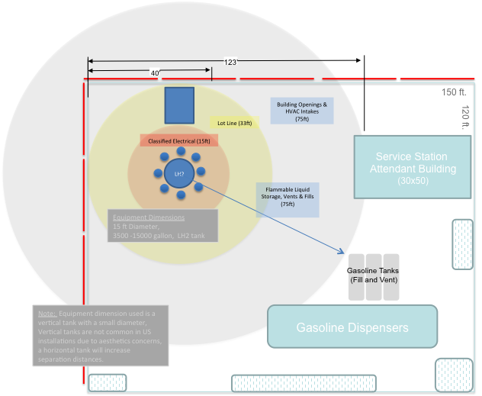
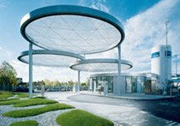
Application of QRA to Benchmark PBD criteria
Performance-Based Design of Refueling Station
Real-World Station
Representative Station:
H2FIRST Reference Liquid Station
Meets all Prescriptive Requirements
Modifies Key Requirements
Modifies One Key Requirement and Incorporates Mitigating Factors
Prepare Performance-Based Design Report and Documentation Utilizing HyRAM QRA Toolkit
Calculate Benchmark Performance Criteria
Incorporate Mitigating Factors
Follows Real-World Permitting Process
Calculate Risk Risk Equivalent Performance Criteria
Vet with H2 Code Industry and Stakeholders

Slide 11
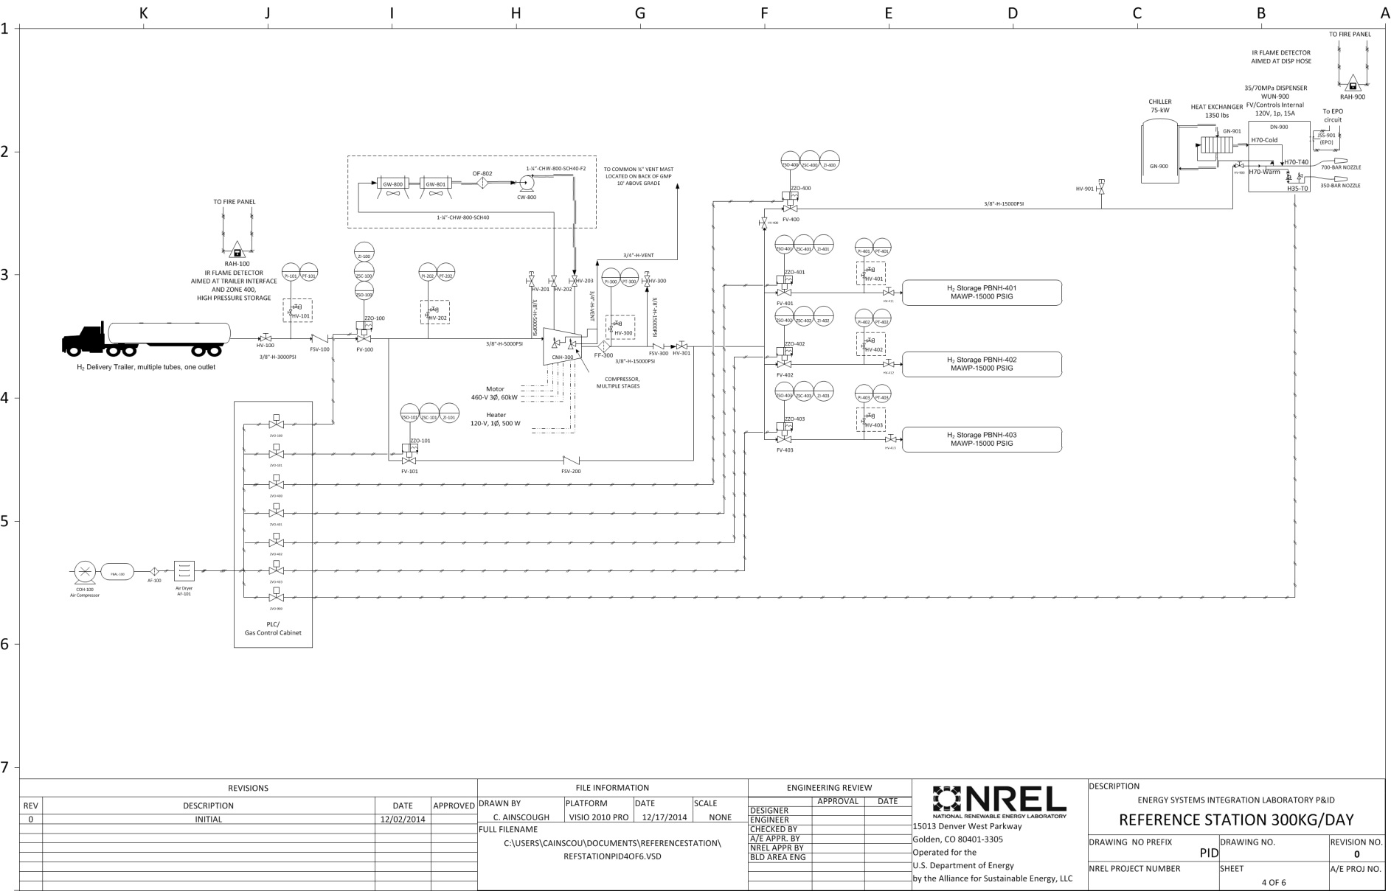
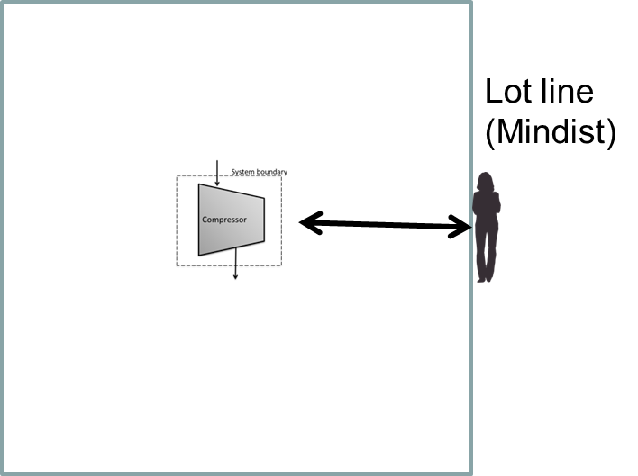
System Description & Target Positions
Pratt, NREL/TIP-5400-64107, SAND2015-2660 R
The example system is an outdoor, publically-accessible, gaseous hydrogen station
The analysis will determine the risk to a member of the public outside the NFPA-2 compliant lot line distance

Slide 12
Performance-Based Design Required Scenarios Specified in NFPA 2, Hydrogen Technologies Code
Fire
Explosions
Pressure Vessel Burst
Hydrogen Deflagration
Hydrogen Detonation
Hazardous Materials
Unauthorized Release
Exposure Fire
External Factor
Discharge with Protection System Failure

Slide 13
NFPA 2 Performance-Based Design: Fire & Explosion Scenarios
Fire
Pressure Vessel Burst
Hydrogen Deflagration
Hydrogen Detonation
5.4.3.3: Detonation of a hydrogen-air or hydrogen-oxidant mixture within a process vessel or within piping containing hydrogen
Deflagration within the enclosure housing the compressor
Unintended release forms localized H2/air mixture that detonates
HyRAM peak overpressure and risk metric calculation
Prevention of detonation by meeting vent pipe length to diameter ratio
5.4.3.2: Deflagration of a hydrogen-air or hydrogen-oxidant mixture within large process equipment
Scenario Description
5.4.2: Design for life safety
5.4.3.1: Pressure vessel ruptures
Outdoor Fueling Station Scenario
Hydrogen fire resulting from a leak at the dispenser
Prevention of gaseous H2 vessel rupture
Performance Criteria
Approach
HyRAM jet fire risk calculation
Pressure relief devices and leak –before-burst design specification

Slide 14
NFPA 2 Performance-Based Design: Hazardous Materials Scenarios
Unauthorized Release
5.4.4.1: Unauthorized release from a single control area
Exposure Fire
5.4.4.2: Exposure fire on a location where hydrogen is being stored, used, handled or dispensed
External Factor
5.4.4.3: Application of an external factor that is likely to result in a fire, explosion, toxic release or other unsafe condition
Discharge with protection system failure
5.4.4.4: Unauthorized discharge with each protection system independently rendered ineffective
An unrelated car fire at the gasoline dispensing pump
Liquid hydrogen release model analysis
Seismic Event where a pipe bursts (100% Leak Size on largest system pipe)
An unauthorized discharge where the interlock or pressure relief valve fails
Characterization of flame radiation from vehicle fire on nearest hydrogen system components
HyRAM risk metric calculation
Accidental release of hydrogen from liquid storage tank
Discussion of layered safety features present in the system
Scenario Description
Outdoor Fueling Station Scenario
Performance Criteria Approach

Slide 15
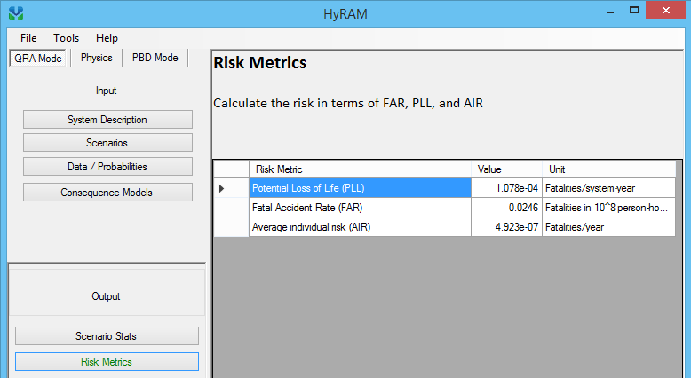
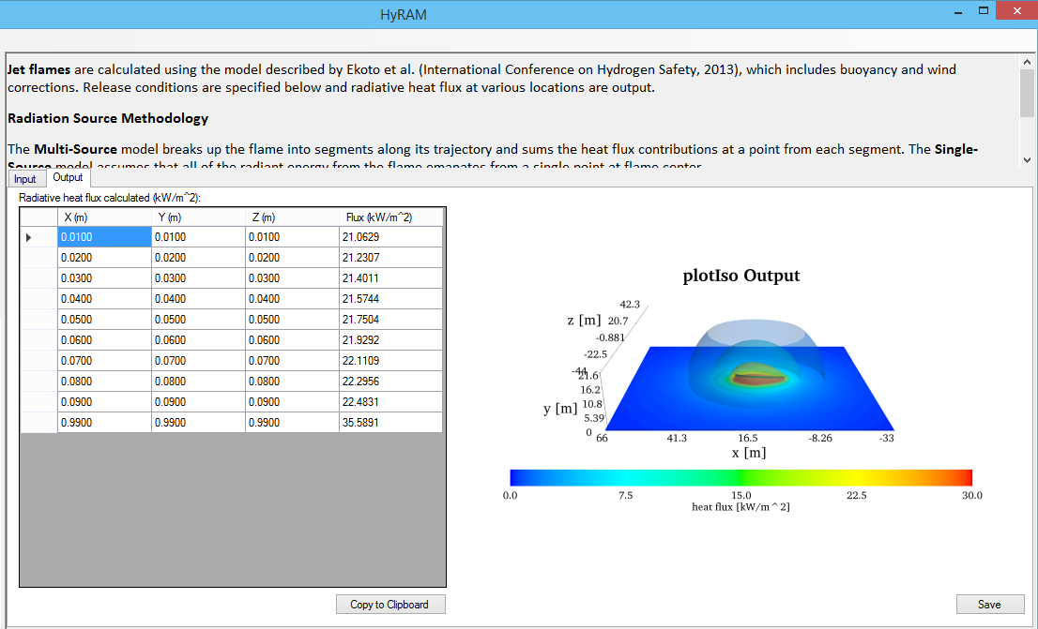
HyRAM QRA used to develop baseline
HyRAM toolkit is being used to calculate risk values for the performance criteria on a representative station, fully compliant with prescriptive codes
This will provide a Baseline for risk values and enable easy comparison of the changes made in the second iteration
The AIR value is used for comparison purposes
Notes:
Coordinate station with H2FIRST project

Slide 16
NFPA 2 Performance-Based Design: Fire Scenario
Description:
Leak from gaseous side of H2 system, at dispenser. System parameters for largest pipe size, pressure and temperature were inputted into HyRAM and a baseline risk value for a code compliant station was calculated.
HyRAM Input Parameter | User Input Value
Compressors | 0
Cylinders | 0
Valves | 7
Instruments | 10
Joints | 10
Hoses | 2
Pipes (length) | 10
Filters | 1
Flanges | 0
Pipe OD | 0.5625 inch (9/16) (1.43 cm)
Pipe wall thickness | .12575 in (0.32 cm)
Internal Temperature | 15 C (59 F)
Internal Pressure | 900 bar
External Temperature | 15 C (59 F)
External Pressure | .101325 MPa
Release Rate <0.125 kg/s | 0.008
Release Rate0.125-6.25 kg/s | 0.053
Release Rate >= 6.25 kg/s | 0.23
Release Rate <0.125 | 0 – jet fire only
Release Rate 0.125-6.25 | 0 – jet fire only
Release Rate >= 6.25 kg/s | 0 – jet fire only
HyRAM Input Parameter | User Input Value
Number of Vehicles | 50
Annual fueling demands | 18,000
Notional Nozzle | Birch2
Flame Radiation Model | Ekoto/Houf (curved flame)
Deflagration Model | None - Fire scenario only
Thermal Probit | Tsao and Perry
Thermal Exposure | 60 sec
Overpressure Probit | None - Fire scenario only
Population | 6 people, based on 2 at H2 dispenser, 2 in the gasoline dispenser and 2 entering store.
Working hours per year | 6480 hrs (30 days*12 months*18 hours a day)
Max Distance | 120 ft. (36.6 m) distance to lot line
Min Distance | 1 ft. (0.3 m)

Slide 17
Baseline Result for Fire Scenario
Fire Scenario Result:
AIR: 1.05 x 10 ⁻⁴ Fatalities /year
Risk Values for US Gasoline Stations
Member of Public (Used in NFPA 2): PLL or AIR below 2 x 10 ⁻⁵ fatalities/station-yr
Based on 2 fatalities/yr and 100,000 refueling stations in the US
Workers: One order of magnitude higher than public risk 1 x 10 ⁻⁴
Other Risk Statistics
Average Individual Risk (CDC actuarial data 2005)
= (9117,809 Deaths/Year)/296,748,000 Total U.S. Pop.
= 4 x 10 ⁻⁴ Deaths/Person-Year (~ 1/2,500 Deaths/Person-Year)
In any given year, approximately 1 out of every 2,500 people in the entire U.S. population will suffer an accidental death
Norwegian Petroleum Directorate guidelines use a total frequency of 5 x 10 ⁻⁴/yr for all accidents for all safety functions

Slide 18
NFPA 2 PBD: Hazardous Material Scenario 3 — External Factor
HyRAM Input Screen | Parameter | Value
Components | Compressors | 0
 | Cylinders | 0
 | Valves | 0
 | Instruments | 0
 | Joints | 0
 | Hoses | 0
 | Pipes (length) | 10
 | Filters | 0
 | Flanges | 0
Piping | Pipe OD | 1.315 inch (3.34 cm) (1 inch nominal)
 | Pipe wall thickness | .179 in (0.45 cm)
 | Internal Pressure | 10 bar
Pipe Leak Size for Pipe component only: Mean | 0.01% | 0
 | 0.10% | 0
 | 1% | 0
 | 10% | 0
 | 100% | 1
Pipe Leak Size for all components except Pipe: Mean | 0.01% | 0
 | 0.10% | 0
 | 1% | 0
 | 10% | 0
 | 100% | 0
Description
A seismic event occurs that results in a 100% leak of the largest pipe in the hydrogen system due to shearing. Because explosive conditions are dealt with independently in other design scenarios, only the effects of a fire are considered in this scenario.

Slide 19
Baseline Result for External Event
External Event Scenario Result:
AIR: 1.81 x 10 ⁻² Fatalities /year, conditional upon occurrence of an earthquake
Fire Scenario Result:
AIR: 1.05 x 10 ⁻⁴ Fatalities /year
Next Steps:
Analyze all applicable performance-based design scenarios to determine a baseline performance criteria
Design various ‘trial designs’ that do not meet specific prescriptive requirements which may be infeasible given site specific conditions
Evaluate trial designs against the baseline prescriptive criteria

Slide 20
Impacts
Increase options for industry in siting hydrogen fueling stations
Increase confidence in the performance-based approach for station design
Reduce effort required by industry to use the performance-based approach by providing template and test case
Provide path for international harmonization of the performance-based approach to station design
Lay groundwork (establish precedence) for similar performance-based approach for other alternate fuels (i.e. CNG and LNG)

Slide 21
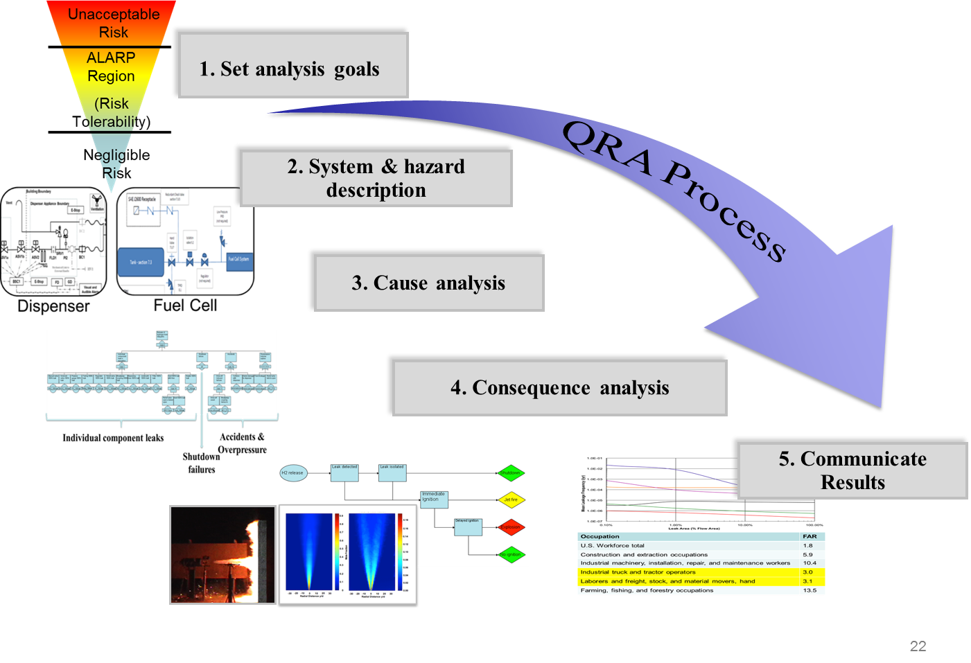
Thank you!
Katrina Groth
Sandia National Laboratories
kgroth@sandia.gov
Research supported by DOE Fuel Cell Technologies Office (EERE/FCTO)

Slide 22
NFPA 2 Performance-Based Design: Scenarios which do not apply to an outdoor fueling station
Max Occupant Load with Blocked Exit
5.4.5.1: Maximum occupant load is in the assembly building and the principal exit/entrance is blocked
No assembly occupancies in the vicinity and no exits to block
Construction in area of building with suppression system out of service
5.4.5.2: Fire in an area of the building undergoing construction while remainder of building is occupied. The suppression system has been taken out of service.
No partially-occupied buildings with suppression system out of service to analyze
Egress System
5.4.2: Design for life safety affecting the egress system
Scenario Description
No egress system since fueling station is outdoors
Discussion of Applicability

