Slide 1

CRISE – ICHS 2015
MIXED E-LEARNING AND VIRTUAL REALITY PEDAGOGICAL APPROACH FOR INNOVATIVE HYDROGEN SAFETY TRAINING FOR FIRST RESPONDERS
Tretsiakova-McNally S (1), Maranne E (2), Verbecke F(3) and Molkov V (1)

Slide 2










CRISE
C.R.I.S.E. company
  From cartography to virtual reality
  3D simulation for civil protection
  Dedicated to risk and emergency management
  training and tools
Specifics: ARFF, HyResponse …
Joint Forces
CBRNE
Technological & man made
Urban crises
WildFire & Natural risks
1998
Notes:
Crise is a high tech company which started in 1996. Our main objective is to bring civil defense 3D real-time simulation technologies in order to improve their training systems and/or conceive tools to assist their deciders on the operational field, generally in the frame of a major crisis. The adventure started in 1996 with the ECASC, which is… then we open up to other types of risks: chemical risks (with Chevron and the ENSOPS, and more recently Gesip), urban risks (BMP, BSPP). Now our tools are used everyday by all the major firefighters schools in France (ENSOPS, BMP, BSPP), and we have common projects with US Firefighting Schools (USFS).

Slide 3
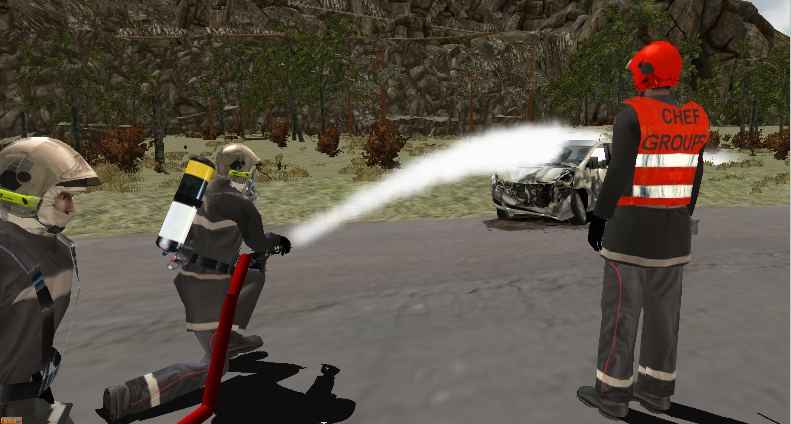
Cooperative virtual training platforms for frontliners in mono or multi agency exercises.
Put everyone at the heart of the action, from operator to corporate level, multi-agency.
Notes:
15 sec

Slide 4
HyResponse project Motivation
Hydrogen and Fuel Cell (FCH) technologies and applications both in transport and energy sectors arrive to the market today
Fire authorities’ and First Responders’ awareness and knowledge of these new technologies are limited.
An adequate training is therefore required to provide knowledge and essential skills on
  how to handle potential incidents/accidents at FCH systems and infrastructure;
  how to protect the public without putting First Responders’ own life at risk.

Slide 5
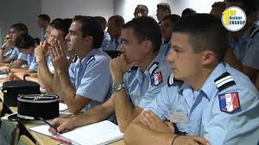
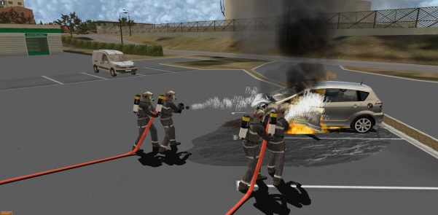
HyResponse: key objectives
Develop a comprehensive training for First Responders dealing with all safety aspects of FCH transport and stationary applications:
Organize three pilot sessions to train up to 70 FR in a face to face mode
Free online interactive hydrogen safety training
Deliver an Emergency Response Guide
Educational training
Operational training
Virtual Reality training

Slide 6
Andragogy, Sense Making & common ground
Knowles (1984)
Adults need to be involved in the planning and evaluation of their instruction.
Experience (including mistakes) provides the basis for learning activities.
Adults are most interested in learning subjects that have immediate relevance to their job or personal life.
Adult learning is problem-centered rather than content-oriented
  Knowles, M.S., et al., Andragogy in Action. Applying modern principles of adult education, 1984, Jossey Bass, San Francisco

Slide 7
HyResponse:
Education, Experience Acquisition,Dissemination
Frontliner
Awareness
Understanding
Experience
Real Life
Validate
Skills
Online
Exercises
Practice Skills
Hands On
Task Oriented virtually , Full Scale and Mixed
Acquire Skills
In Class Training
Classroom
Familiarize
Lectures
Online
General Public
Beliefs
Preconceptions

Slide 8
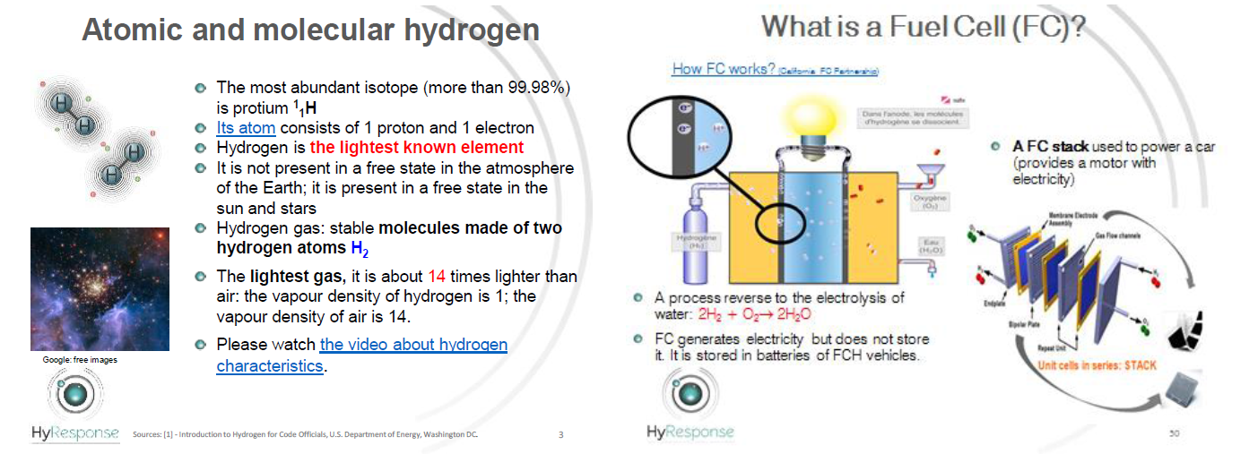
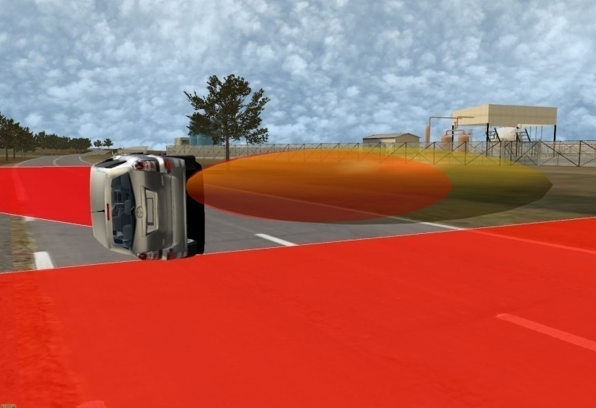
Classroom
Lectures
VR as illustration
as link to reality
as common ground

Slide 9
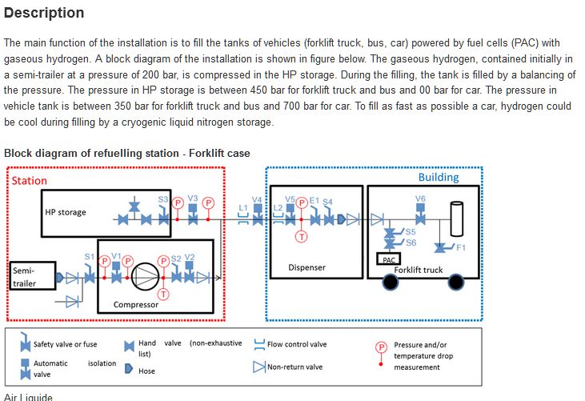
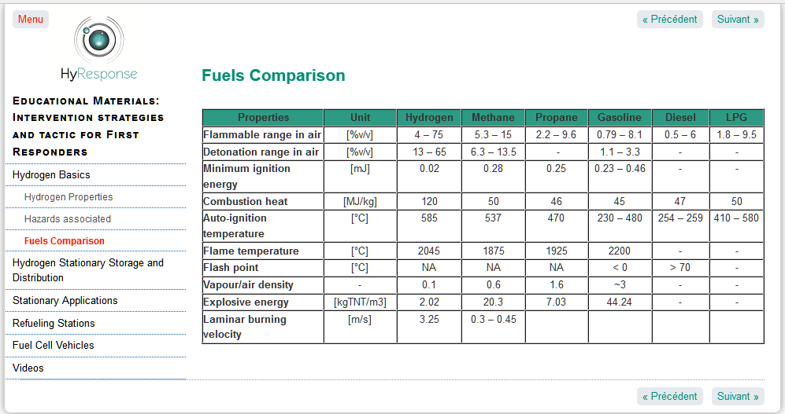
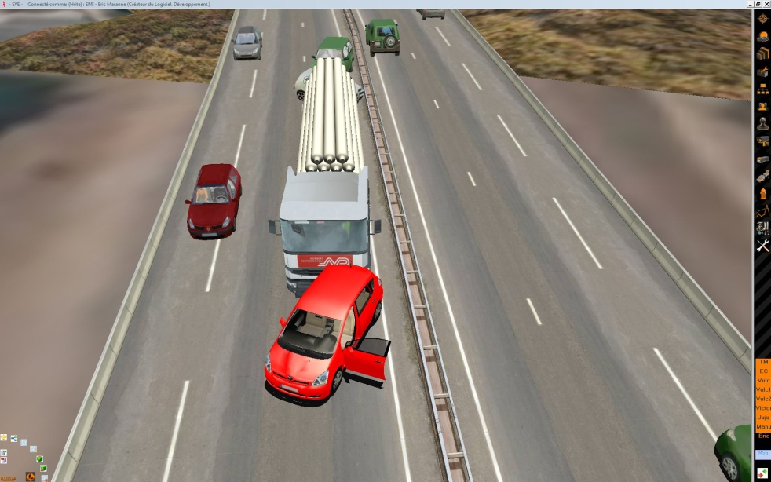
Online learning
Web based course
VR as illustration
as link to reality
as common ground

Slide 10
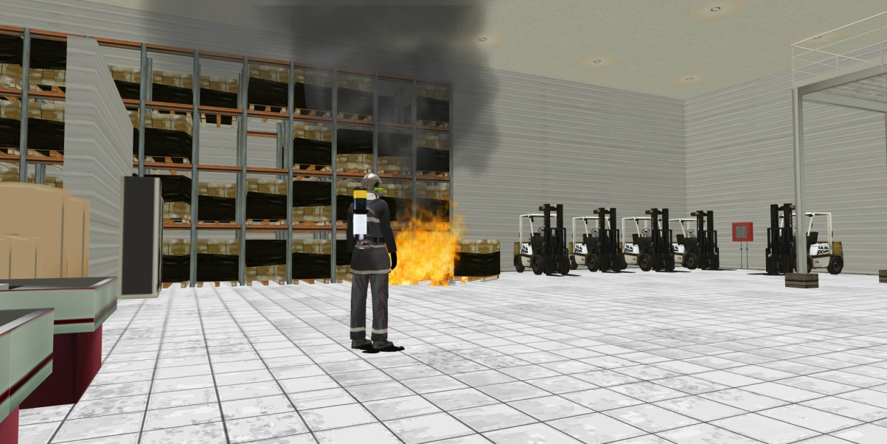
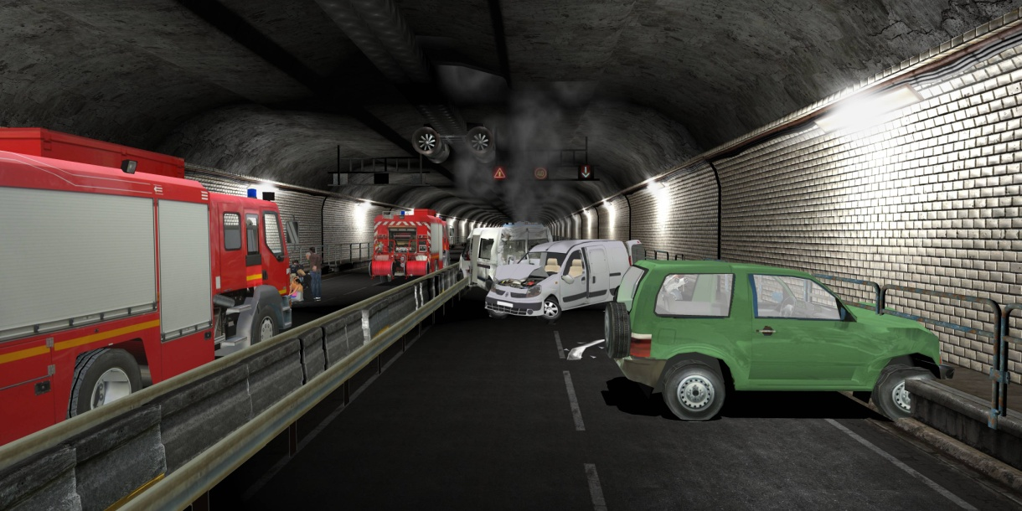
Online Exercises
Single user exercise
‘Man against the Machine’
Multi User/agencies Exercise
VR as shared experience enabler
as common ground

Slide 11
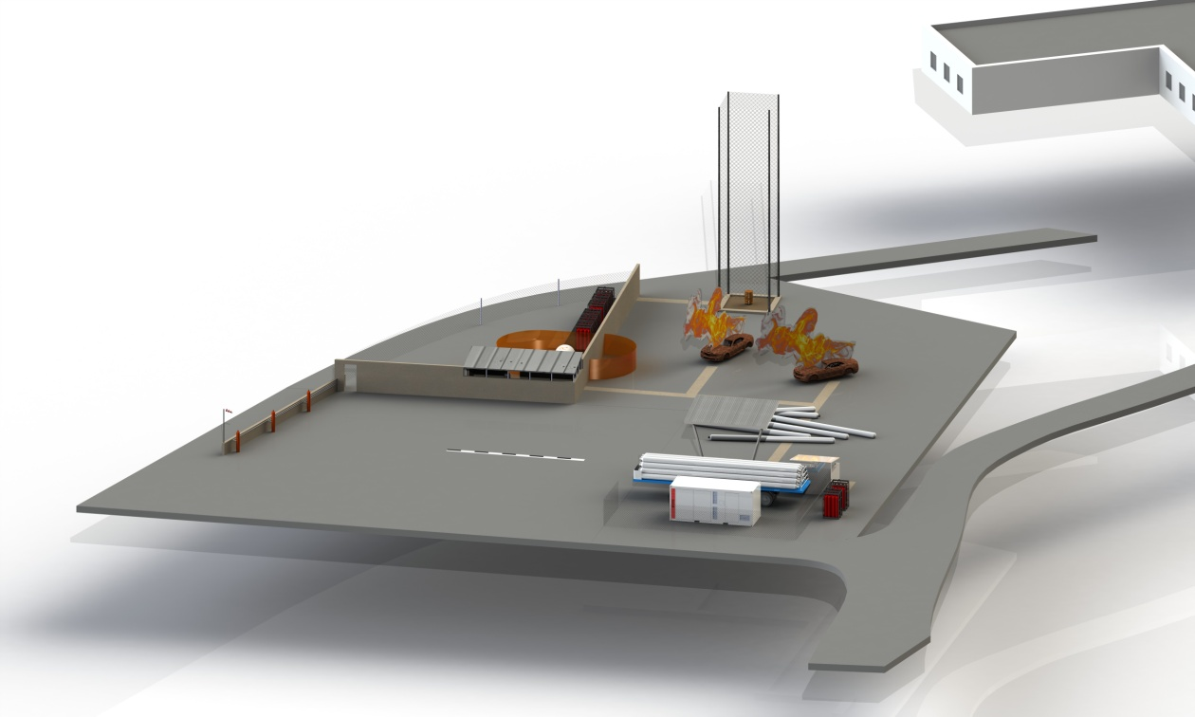
Hands On Training - Operational
Full Scale Simulator
Feel, Experience
and Practice
VR as preparation
for ROE / Safety
for SOP rehearsal
for AAR & lessons learned
for Augmented Reality and Mixed training
HyResponse operational training platform

Slide 12
Hands On – Virtual Exercises
Orientation Exercises
Tabletop Exercises
Drills
Functional Exercises
Full-Scale Exercises

Slide 13
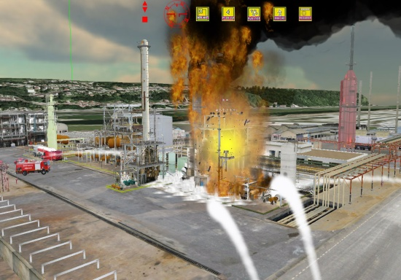
EVE: a flexible and comprehensive pedagogic platform
On-demand events
Drag-and-drop objects and behaviors
Computer-driven Models
Automatic evolution of physical phenomena and realistic events
Scenarized events
Drag-and-drop scenarios threads
Visualization
Action
First person level or commandment level
Representations
Interaction
Team/ Individuals
Analysis / Decision making / Planning
Notes:
3 min

Slide 14
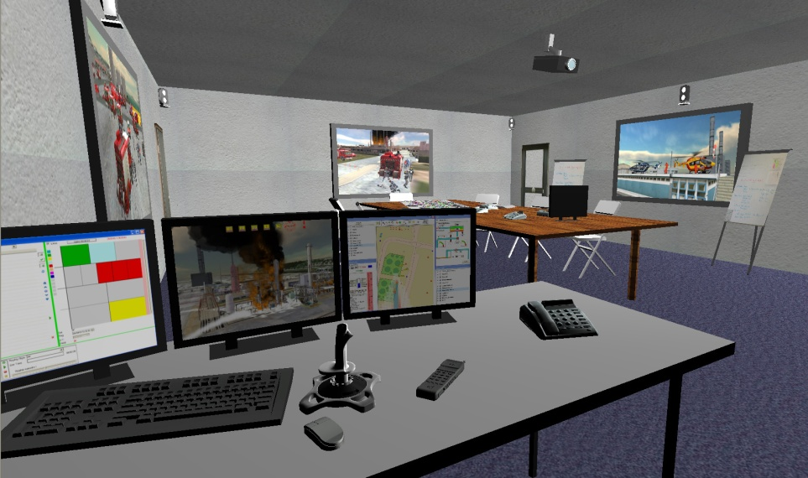
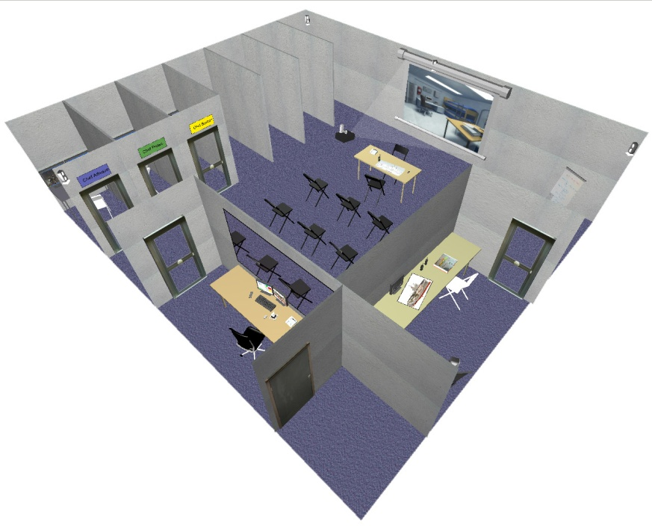
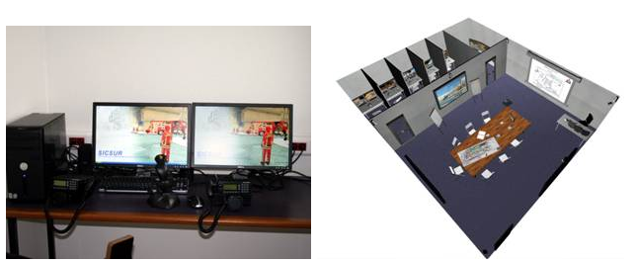
HyResponse Virtual Training setup example

Slide 15
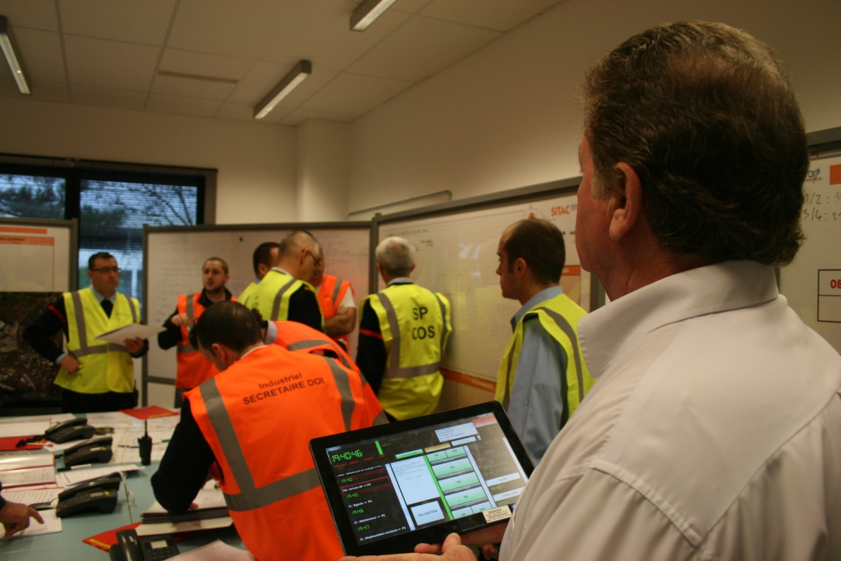
An EXCON interface

Slide 16
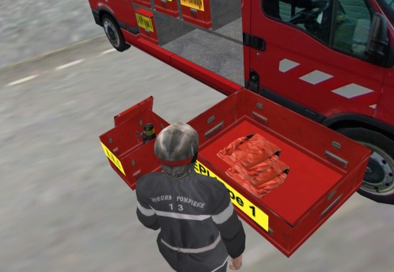
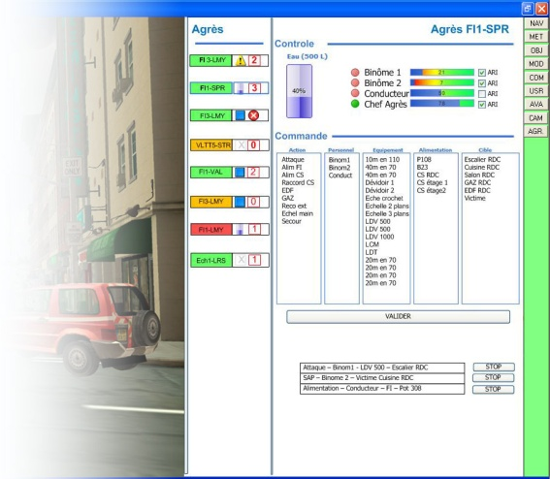
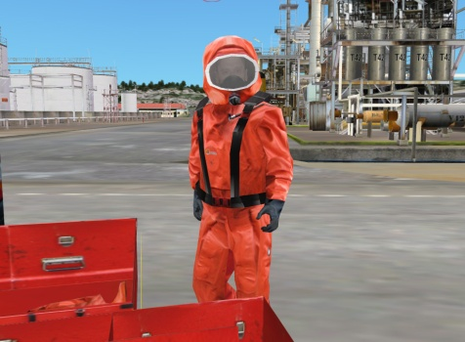
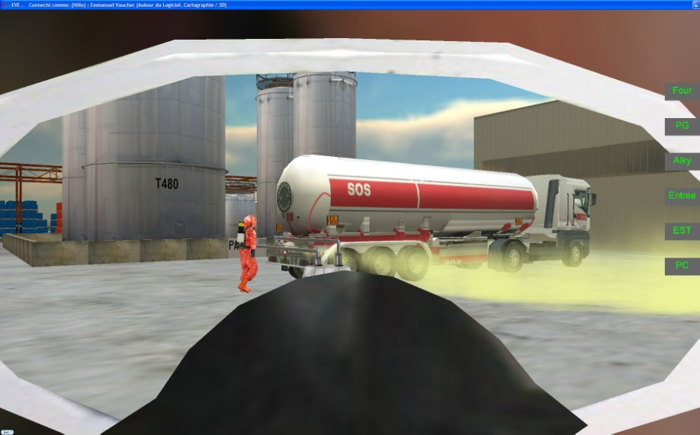
First responder trainee interface

Slide 17
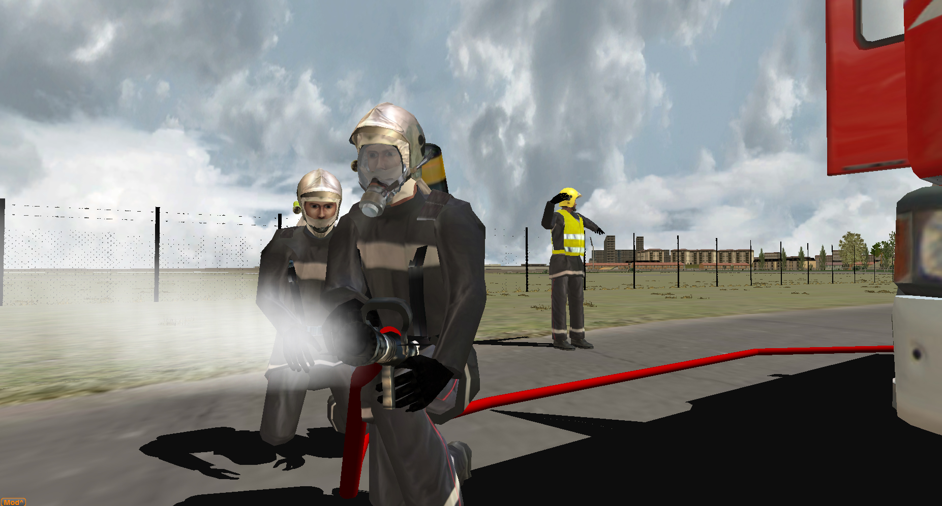
Exercises environments examples

Slide 18
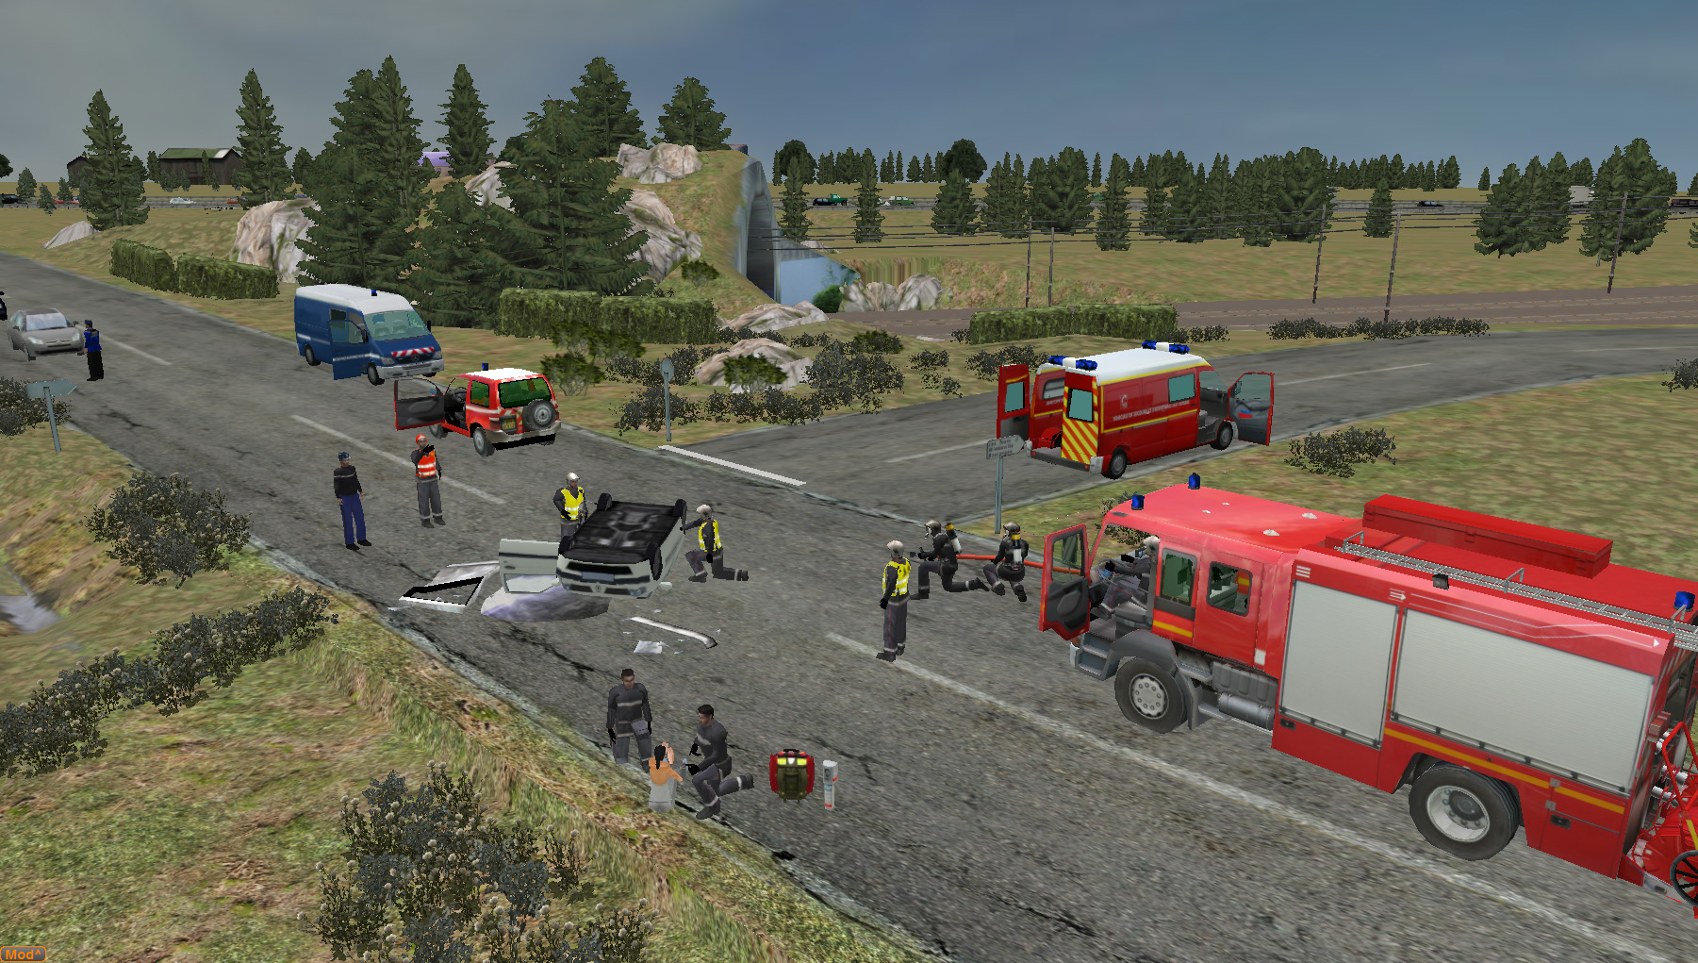

Slide 19
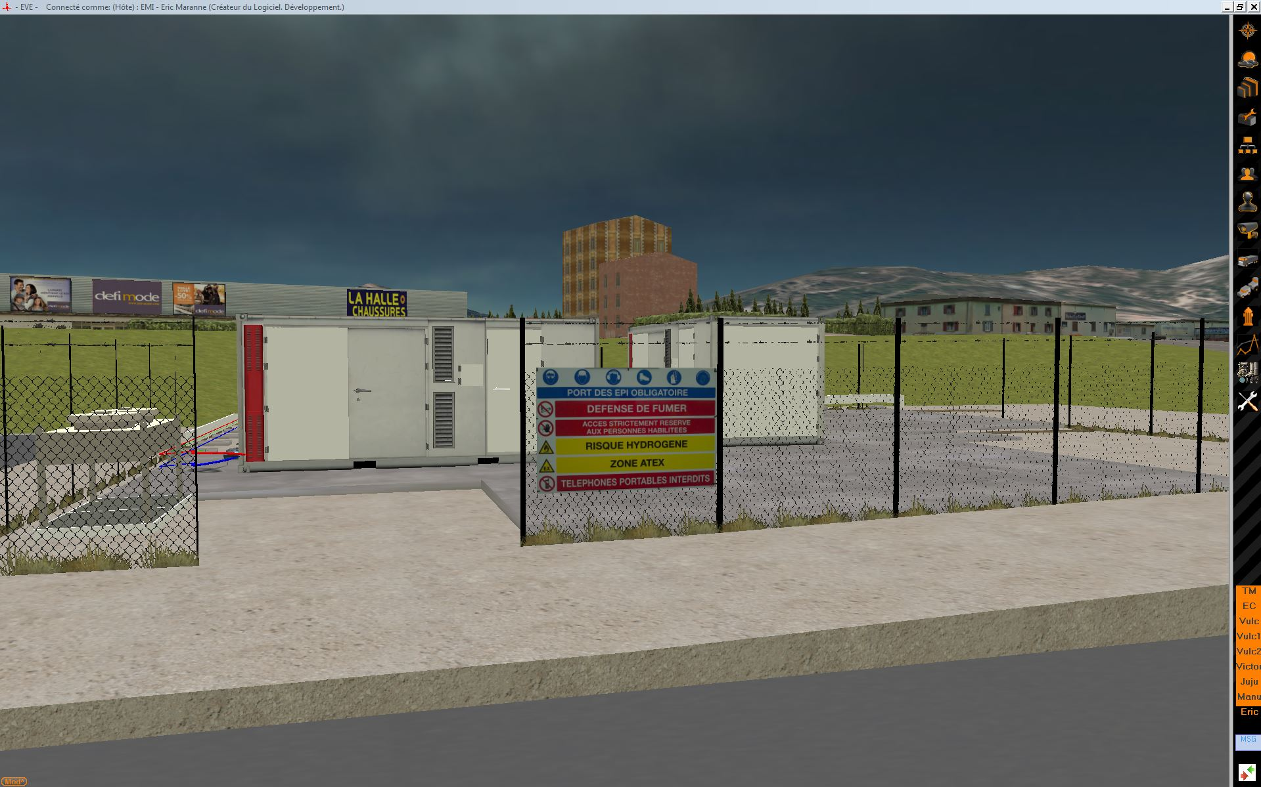

Slide 20
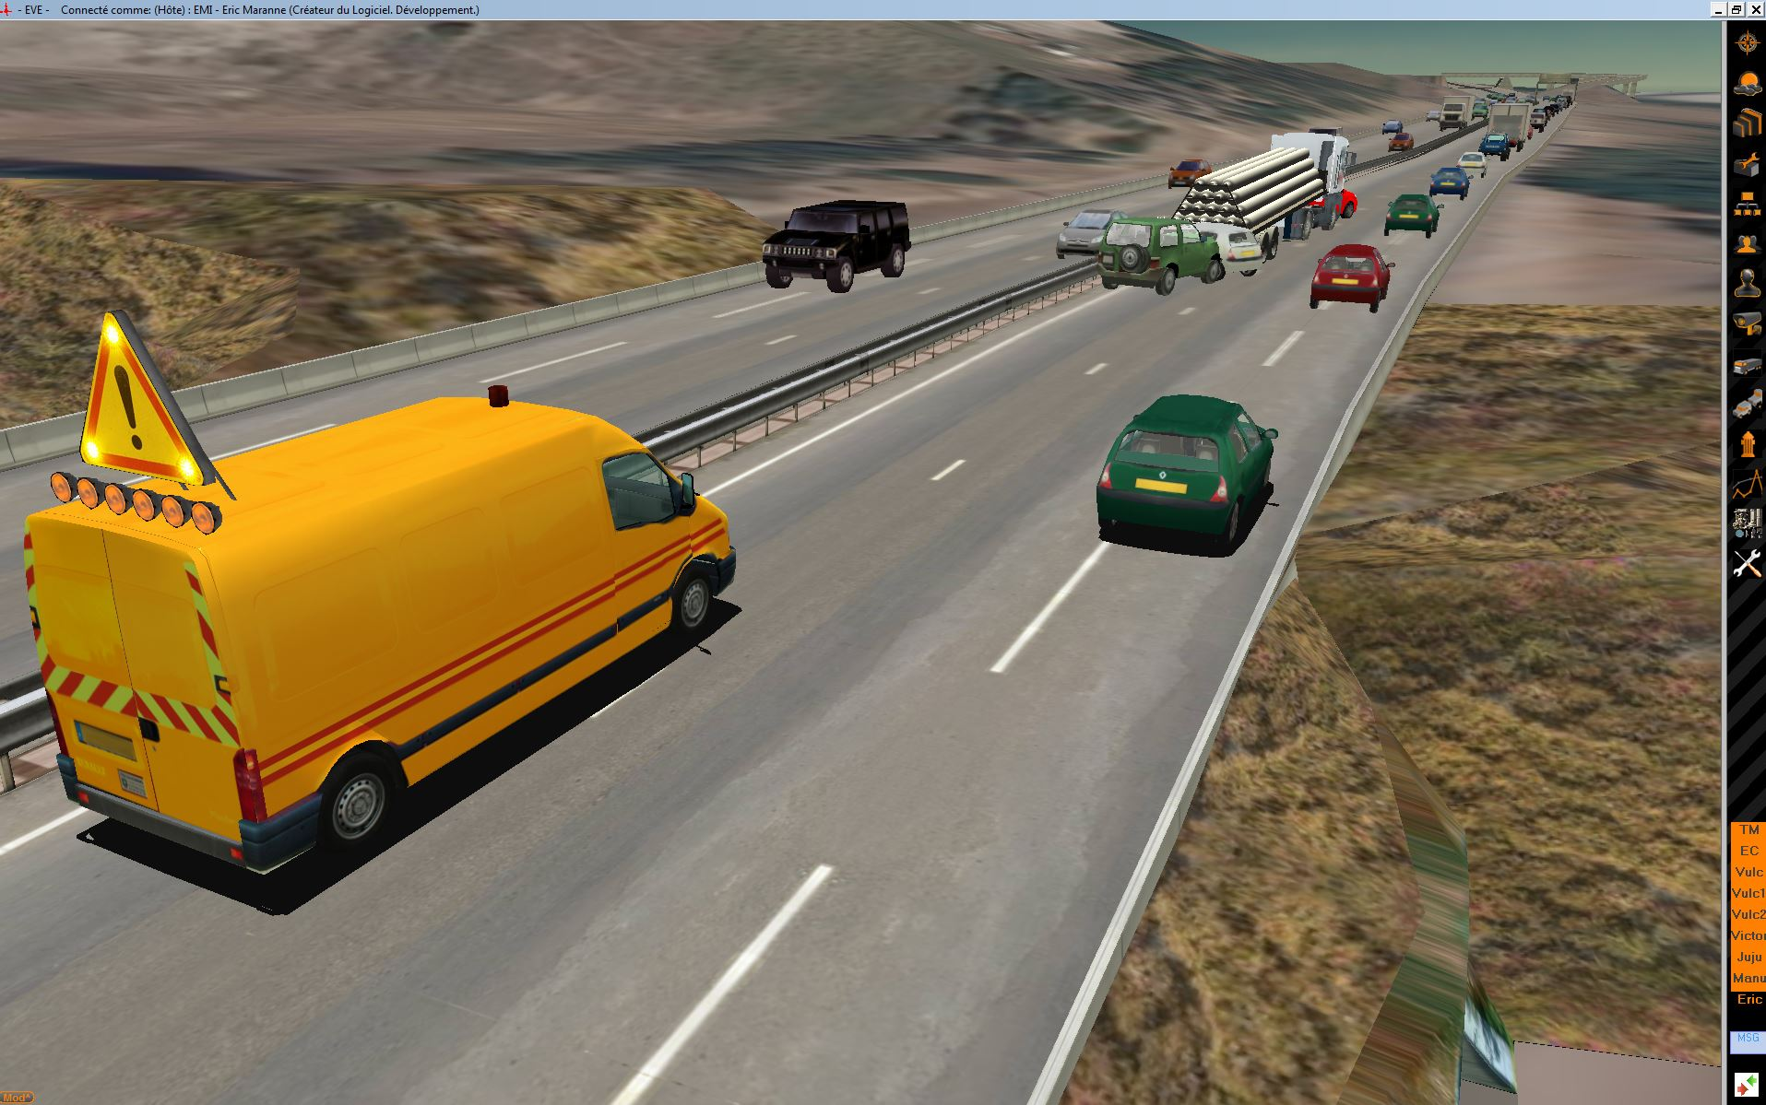

Slide 21
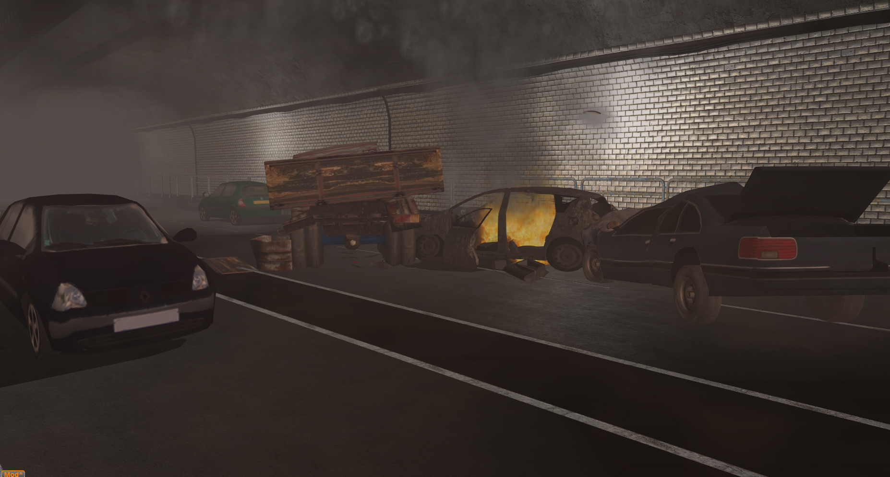

Slide 22
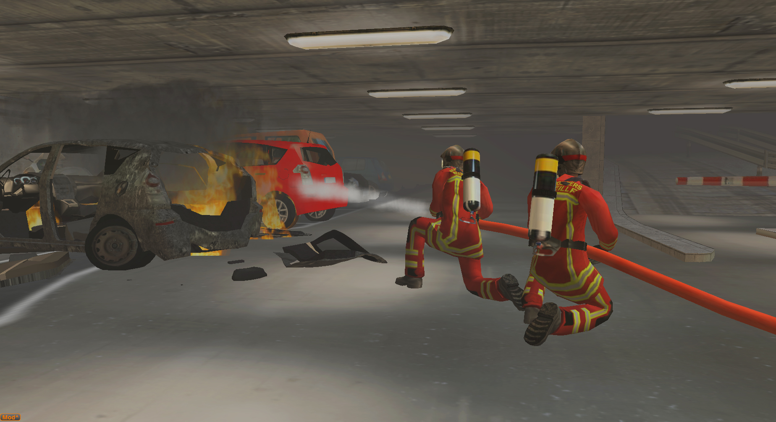

Slide 23
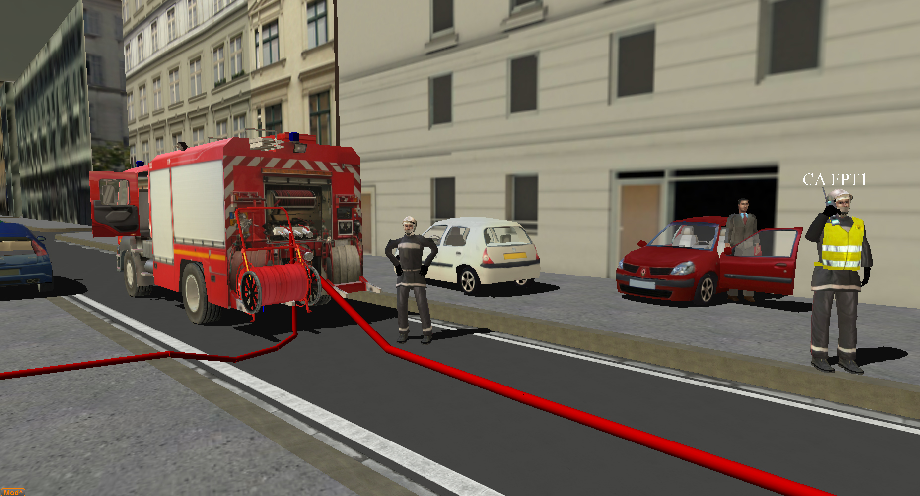

Slide 24
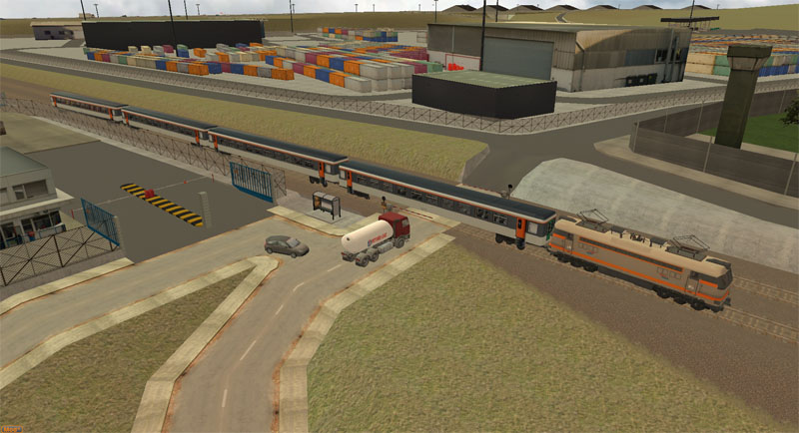

Slide 25
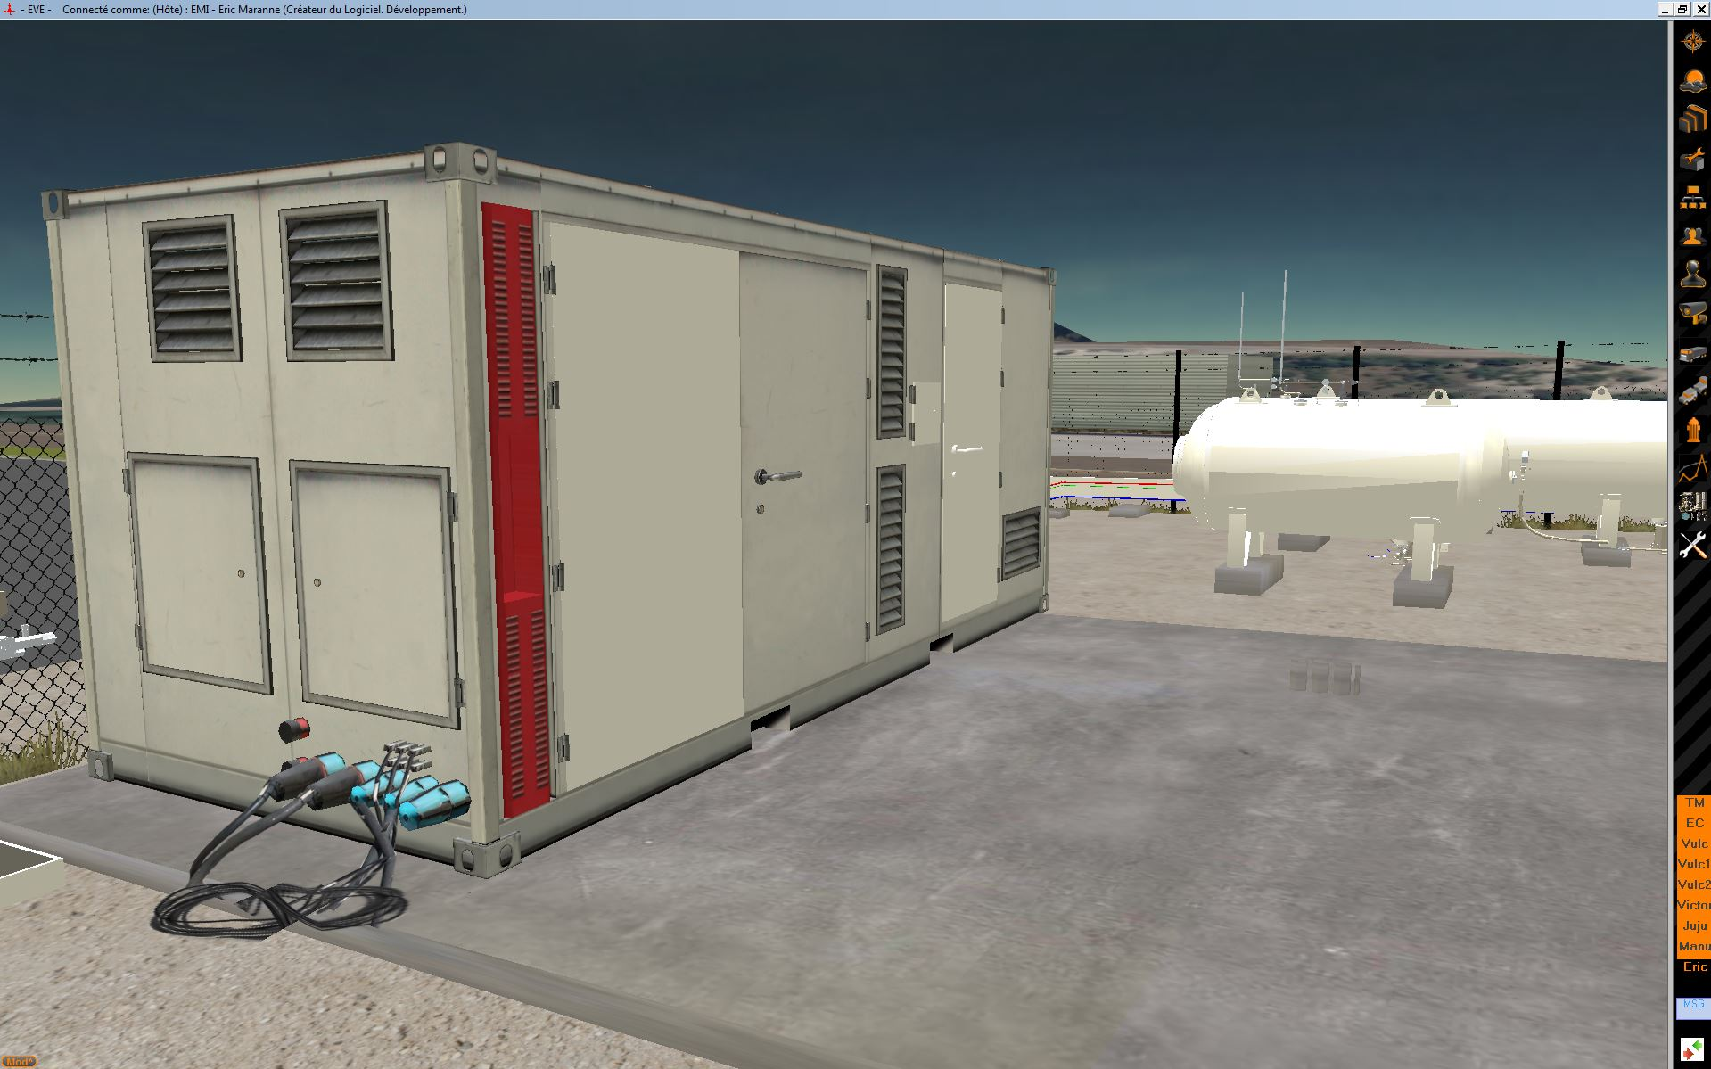

Slide 26
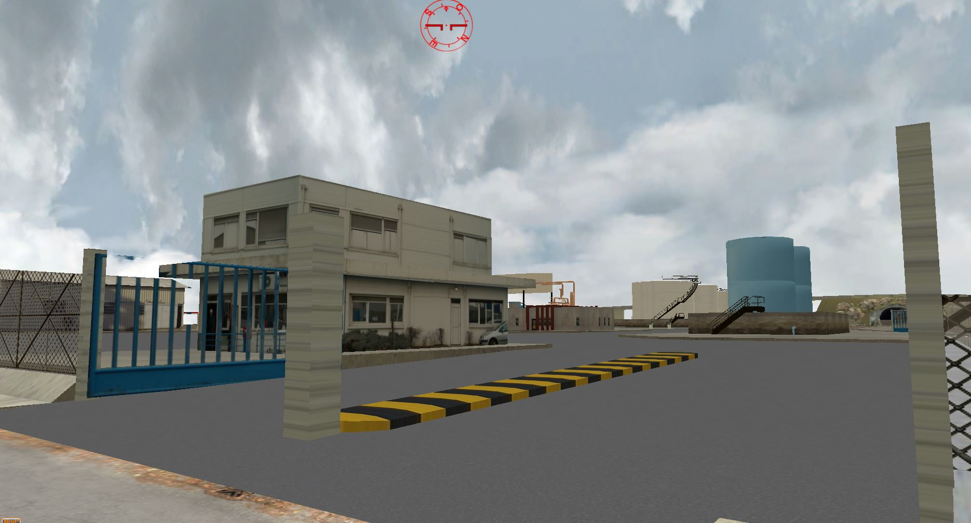

Slide 27
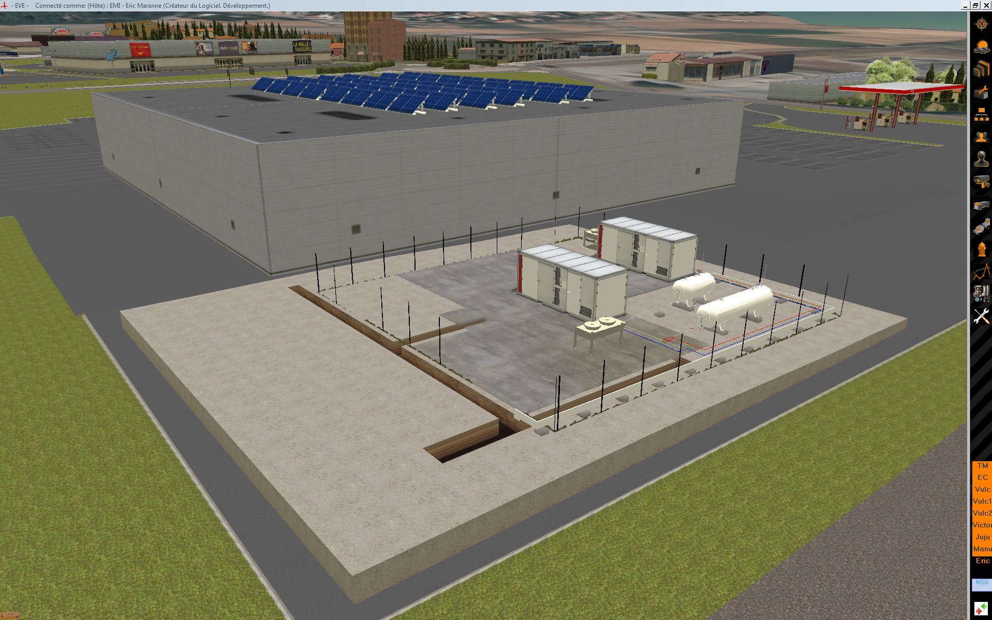

Slide 28








HyResponse - Project
Fuel Cells and Hydrogen Joint Undertaking (FCH JU) for funding the HyResponse project, grant agreement number 325348
http://www.hyresponse.eu
HyResponse: Coordination and Support Action funded by Fuel Cells and Hydrogen Joint Undertaking and supported by the European Commission under the 7th Framework Program. Project reference: 325348.

Slide 30
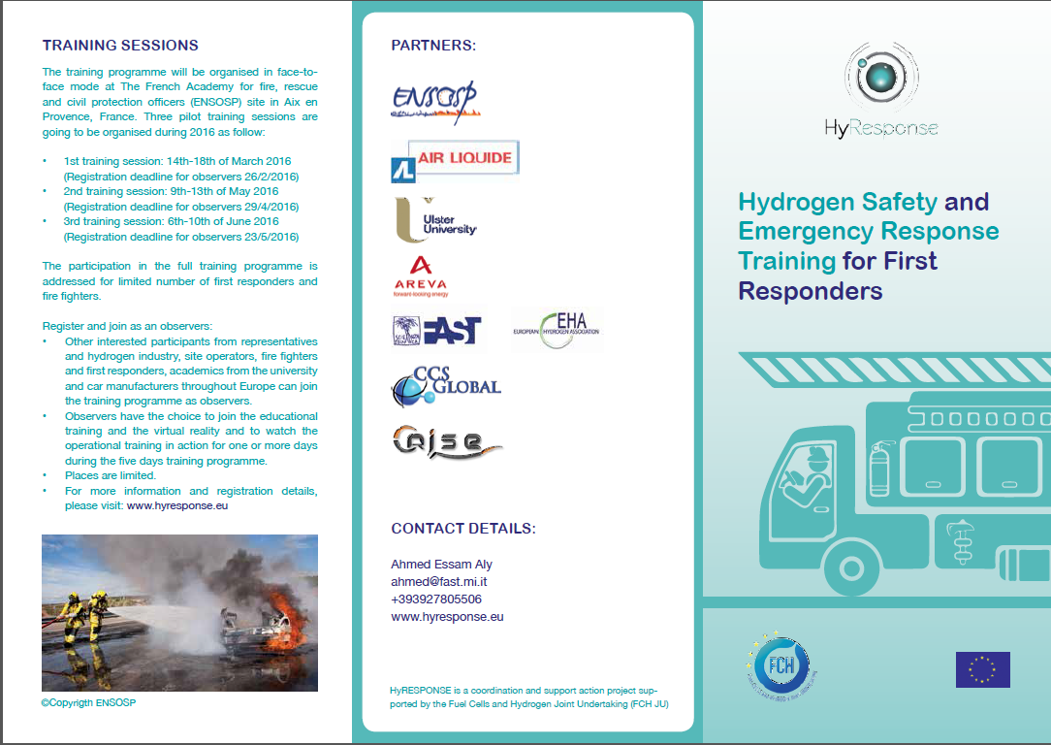

Slide 31
