Slide 1
Hydrogen Safety in Japan
Kiyoshi YOSHIZUMI
New Energy and Industrial Technology Development Organization(NEDO)
Notes:
Good afternoon, Ladies and Gentlemen.
I am Kiyoshi Yoshizumi of NEDO, and I am in charge of NEDO’s Hydrogen and Fuel Cell R&D program.
I am very pleased to have this opportunity of making a presentation.
Today I would like to explain the Hydrogen Safety in Japan.
Hydrogen is widely utilized as clean energy and the safety use of hydrogen is required for realizing the hydrogen society.

Slide 2
Why Hydrogen?
To promote Hydrogen Energy,
there are reasons such as;
Reducing Environmental
Burdens
Energy
Security
Competitiveness
Notes:
Why do we need Hydrogen? This is a question.
There are some reasons, today I would like to mention these three points , energy conservation, energy security and environment protection. These are important issues for sustainable development.
Fuel Cell, hydrogen application, shows good performance for energy efficiency. For example, total energy efficiency of ENE-FARM reach over 90% with best mix of electricity and thermal. With this application, we can save energy resources.
Energy security is very important issue in Japan. For example, over 90% of energy for transportation depend on oil product and almost all of it is imported from middle east. Hydrogen can be produced from many resources. Oil, Natural Gas, even Coal. Bi-products from steal, chemical process. Resolving water by electricity. It means that we can have flexibility for energy resources.
To mitigate climate change, we need to reduce green house gases, 50% whole the world, 80% in developed countries by 2050.
From Fuel Cell only water is emitted. It means that no emission of green house gases is realized.
Furthermore , by using CO2 free hydrogen, we can minimize emission of green house gases.
That’s why the hydrogen energy is promoted.

Slide 3
Japan’s Road Map toward Hydrogen Society
“Strategic Road Map for Hydrogen and Fuel Cells”
( Agency for Natural Resources and Energy, METI)
Phase:1
Phase:2
Phase:3
H2 Power Plant/
Mass Supply Chain
Installation Fuel Cell
CO2-free Hydrogen
2009: Micro-CHP FC
2015: FCV
2017: Large-CHP FC
around 2020:
FCV fuel cost
≦ HEV fuel cost
around 2025:
FCV cost competitive
≧ HEV
- Accelerate RD&D
- Realize reasonable
H2 Price
2020
Tokyo Olympic /
Paralympics
2nd half of 2020’s:
-H2 Cost (CIF) : JPY30/Nm³
-Enhance Supply Chain
in Japan
around 2030:
-Import H2 from overseas
-Full Scale H2 Power Plant
2030
2040
around 2040:
-Full Scale CO2-free H2
(w/ Renewable Energy, CCS, etc)
Create New Market on Hydrogen / Fuel Cell (Japan)
Approx. 1 trillion yen in 2030 → Approx. 8 trillion yen in 2050
Notes:
This figure shows Highlights of the road map
Concerning the utilization of hydrogen, METI focused on the difference in time periods required for solving technical challenges and for securing economic efficiency, and decided to advance efforts by categorizing them into three phases, as follows:
Phase 1: Expanding the scope of applications for fuel cell technology, e.g., fuel cells for households and fuel cell vehicles, and aiming to achieve dramatic energy conservation as well as acquiring a new global market.
(scheduled to begin in 2014);
Phase 2: In terms of the supply side measures, establishing a system for supplying hydrogen using unconventional energy resources imported from other countries, while, for the demand side, aiming to enhance energy security measures, keeping an eye on full-fledged introduction of hydrogen power generation
(time frame: putting the technology into practice by the late 2020s); and
Phase 3: , CO2-free hydrogen supply system using Renewable Energy and Carbon Capture and Storage technology will be established by 2040.

Slide 4
NEDO’s approach realizing Hydrogen Society
Step 1: micro-CHP/ Enefarm
- to make fuel cell to those familiar
Step 2: FCV / Hydrogen Refueling Station
- to use hydrogen as energy
Step 3: Hydrogen Power Generation
- to expand hydrogen demand
Realizing Hydrogen Society
Notes:
水素利用のホップ、ステップ、ジャンプ
まず、比較的インフラ変更を伴わないエネファームで、水素利用の先鞭をつけるとともに、消費者の皆様にとって水素を身近なものと感じていただく。
続いて、燃料電池自動車と水素ステーションで、水素をエネルギーとして使うための技術を確立し、インフラを整備する。ここでは安全が重要なポイント。
そして、最終的には、新たな水素用途を拡大し、日本のエネルギー・システムにおける水素の位置付けを高めていく、というものです。

Slide 5
NEDO’s Activities
NEDO’s Budget for Hydrogen Energy in 2015
Total: JPY 11,860 million (85 million Euro)
Notes:
NEDOの水素に関する予算の内１／３は水素利用（HRS)

Slide 6
NEDO’s Project: HRS
Item 1: Streamlining Regulations
“Regulation Reform Plan” (Cabinet approved in June 2013)
- 24 items were identified as priority
(e.g. location, distance, materials, etc.)
Item 2: R&D on low cost equipment for HRS
e.g. Compressor, Pre-cooler, Reformer, etc.
Item 3: HRS Reliability
e.g. Safety, Awareness, Added Value, etc.
Notes:
予算の１／３を占める水素利用の事業の簡単な説明
２０１５年６月の改訂も書いておく？

Slide 7
NEDO’s Project: HRS
Item1:Streamlining Regulation
Regulations on operations
Regulations on location
Regulations on materials
Transport regulations
Multistation
Accumulator
Compressor
Hydrogen trailer
Storage
Hydrogen dispenser
Hydrogen production unit
H₂
Open space for fueling
Clearance/distance regulations
Other traffic regulations
Notes:
In Japan, construction cost is estimated a few times higher than European and/or American one. One of the reasons is the strict Japanese hydrogen gas safety regulation.
Therefore we are performing a lot of projects regarding the streamlining regulation

Slide 8
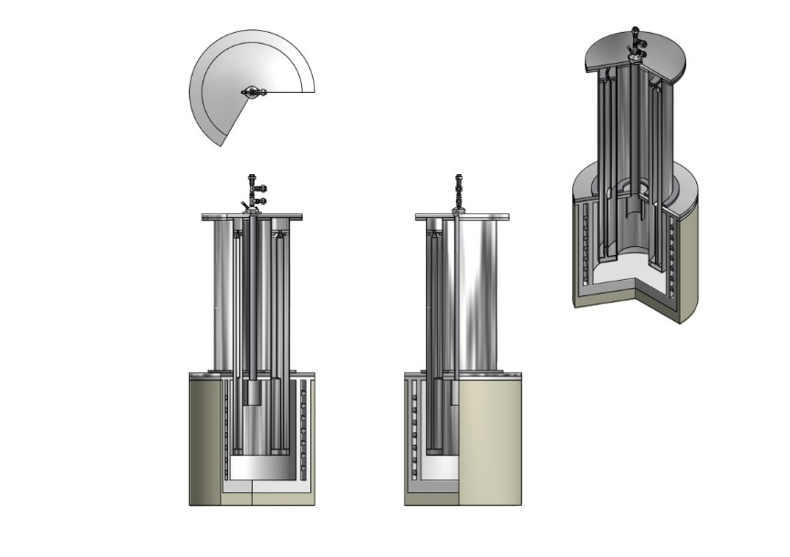
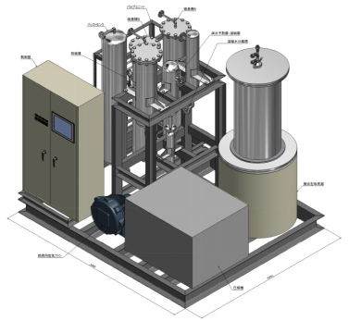
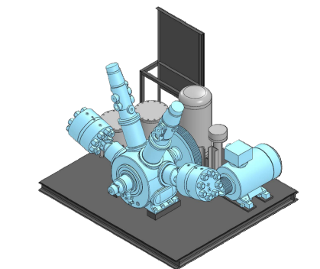
NEDO’s Project: HRS
Item2:R&D on Low Cost Equipment for HRS
The present cost of supply equipment is 500 to 600 million yen.
The goal is to reduce the cost of H2 refueling stations by half.
Cost breakdown for
hydrogen refueling station
Type II
Example of medium-scale on-site costs
CFRP
Cr-Mo liner
Notes:
To reduce the construction cost, another is the cost reduction of equipment in the hydrogen station.
This is the cost breakdown for the stations, hydrogen production unit, compressor, pressure vessel and so on
We are also proceeding the projects for low cost equipment.

Slide 9
NEDO’s Project: HRS
Professional Operator
to ensure safety
Equipment, System
to reduce Human Error
Item3:
HRS Reliability
Automatic Fueling
By Each Company
Monitoring System of HRS
Hardware
Software
S1
Reduction of parts to reduce the risk
S4
さい
Education & Training
New Tech.Development
for sensor etc.
S2
Sharing of Safety Information
High-frequency
Inspection
Seamless pipe etc
to reduce leak
Database
User-friendliness
to avoid risk
by non-professional
･Streamlining Regulations
･Safety Manual etc.
Safety Handbook
Voluntary Standards
Etc.
(JHFC3)
･Development of new structural materials
･Review of design factor
Material
Self-
Fueling
Case study
for self-fueling
･Characteristics for
temp., press.
･Material Design
2015
(Beginning)
Training system
for natural disaster
S3
Tech. Development
for durability life
（Hose etc.）
2025年
Outreach Activity
Reinforcement of
preparing for natural disaster, thunder etc.
-Further Safety & Security
-Enhancement of
Social Acceptability
Eenhancement of knowledge for Hydrogen Safety
…Ongoing
Disaster Countermeasure
Appropriate
Information Provision
Social Acceptability
Notes:
水素社会実現のために
ソフト面、ハード面及び社会受容性の観点から必要とされる技術開発等を探索。
グリーンは現在進行中のプロジェクト。
その中で、安全・安心に関するプロジェクトについて説明。 （S1～S4)

Slide 10
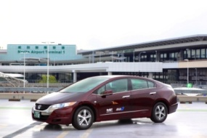
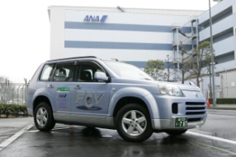
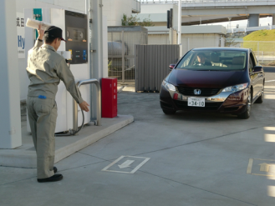

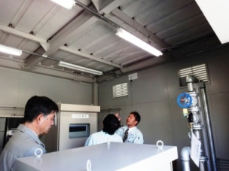
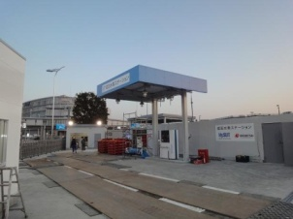
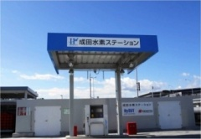
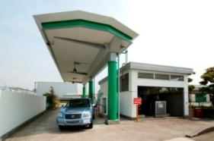
NEDO’s Activities: Safety & Security －S1
Education & Training
FCV Application
Inspection
Maintenance
Vehicle Guidance
H2 Fueling
Narita H2 ST
Training
Osaka H2 ST
Guideline
Notes:
水素ステーションでの教育訓練
実際の水素ステーション、成田及び大阪のステーションを使用し実施。

Slide 11

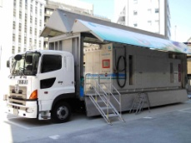
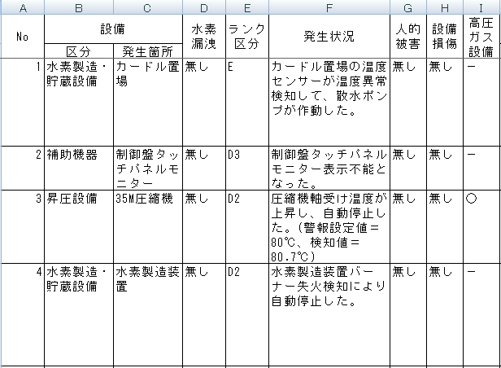
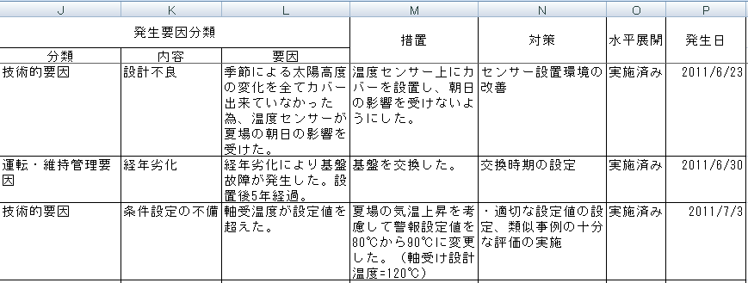
NEDO’s Project: Safety & Security －S2
Sharing of Safety Information
HySUT ST
Commercial ST
Accident
Trouble
Data
Accident
Trouble
Data
Feedback
Feedback
New Technology
Development
Data Collection
Data
Distribution
International
Partnership
Data Analysis
Safety Database
HySUT
Notes:
情報共有を行うためにDatabase化を行った。
今後商用ステーションでの情報収集を積極的に行う。

Slide 12
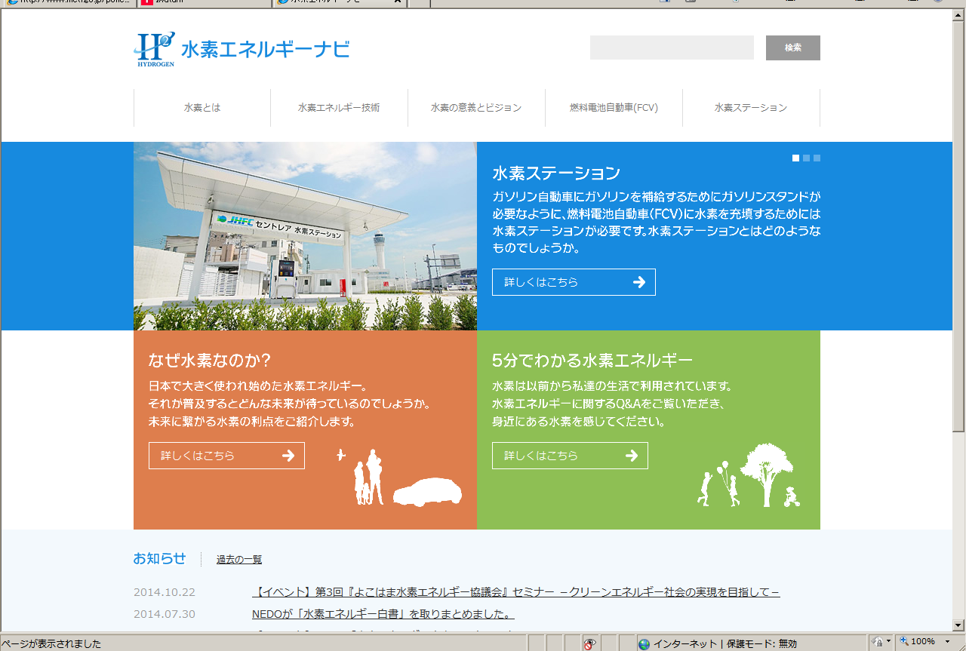
NEDO’s Project: : Safety & Security －S3
Outreach Activity
Portal Site of Hydrogen Energy
http://www.hydrogen-navi.jp/
Notes:
社会受容性向上の一貫として
水素エネルギーに関するワンストップポータルを開設。

Slide 13
NEDO’s Activities: Safety & Security －S4
New Technology Development for ensuring “Safety”
The followings are on-going projects.
-Welding Joint for high pressure hydrogen gas
-Guideline for countermeasure of Thunder Damage
-Hydrogen Gas Sensor for applying quartz crystal
-Optical Hydrogen Gas Sensor and Leak Detector
-Monitoring System with visualization of flame
Notes:
より安全・安心な水素ステーションの次世代技術開発として行っているプロジェクト。
高圧水素ガス用高窒素高強度ステンレス鋼配管の溶接継手に関する研究開発
水素ステーションにおける雷被害対応技術の研究開発
水晶振動子を利用した信頼性向上が期待できる水素センサの研究開発
光学式水素ガスセンサおよび水素ガスリークディテクタの開発
水素火炎可視化機能を有する監視システムの研究開発

Slide 14
Conclusion
To popularize Hydrogen and expand Infrastructure
 | Current Status | Future Activity
Cost Reduction | Streamlining Regulations Simplification of system components | To establish Business Model To achieve Mass production To standardize system components
To Ensure more safety and security | Safety Database for HRS Training Manual for professional operator Guideline for Refueling, Quality, Measurement etc. | To enforce International cooperation of Safety Database To realize Self-fueling
Social Acceptability | Portal site Participation in exhibitions to introduce Hydrogen Society | To enhance knowledge for Hydrogen Safety
Notes:
インフラの普及のために、下記観点からそれぞれにやっていること、これからやらなくてはいけないことをまとめた。
コスト低減
安全の確保
理解活動

Slide 15
NEDO’s Activities: Hydrogen Supply Chain
Future image of production, storage, transportation and utilization
Develop Hydrogen Demand
Notes:
将来に向けて水素大量利用を見据えたサプライチェーンに関する技術開発に着手

Slide 16

www.nedo.go.jp
New Energy & Industrial Technology Development Organization (NEDO)
Notes:
Thank you very much for your kind attention.

