Slide 1

IEA HIA Activities: R,D&D Collaboration
in the Evolving Hydrogen World
Trygve U. Riis, and
Mary-Rose de Valladares
ICHS 2015 – Yokohama, Japan – 19 October 2015

Slide 2
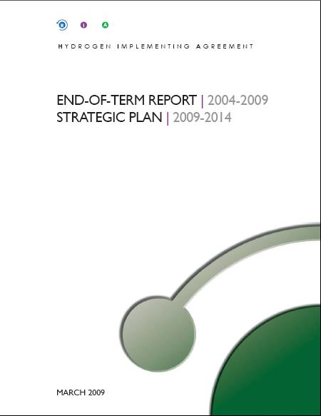
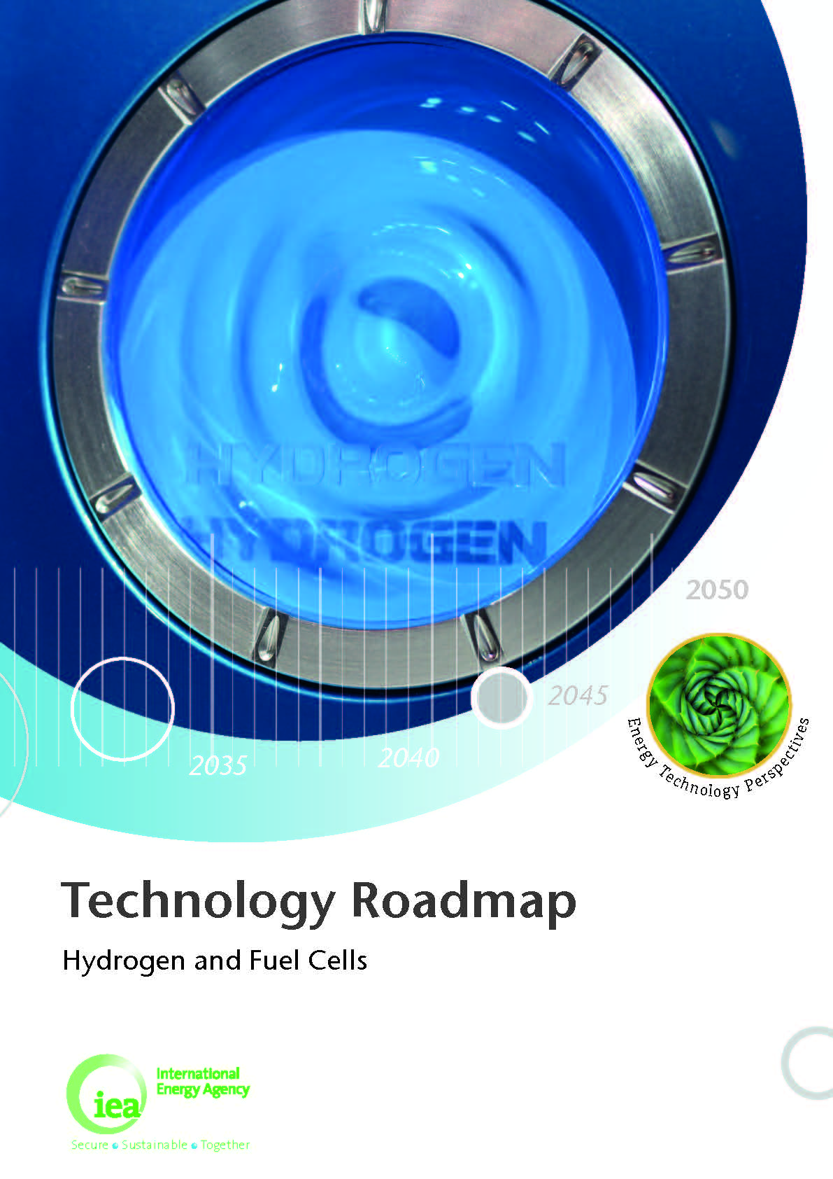

AGENDA
End of Term Report: 2009‒2015
Strategic Plan:
2015‒2020
Perspectives
Members
Strategic Framework
Themes
Task Portfolios
Success Stories – IEA HIA wide
Success Stories - Tasks
Information Dissemination & Outreach
Key Numbers &
Outcomes
Overarching Objectives
Priorities for all themes
Priorities for Analysis portfolios
Current task highlights
The IEA Technology Roadmap for Hydrogen and Fuel Cells
The 2015 COP
Notes:
Read Notes below
The Table of Contents above provides an orientation to the IEA HIA presentation and the various topics of discussion. I will now talk about the Strategic Plan for 2015-2020, as well as the IEA Technology Roadmap for Hydrogen and Fuel Cells

Slide 3
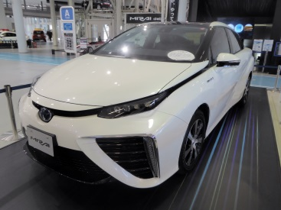
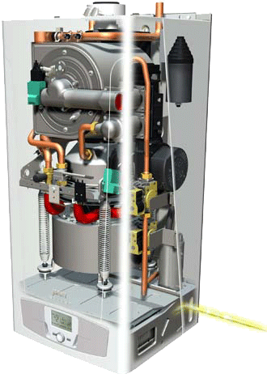
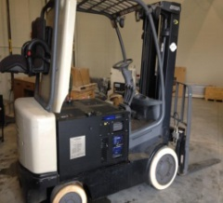
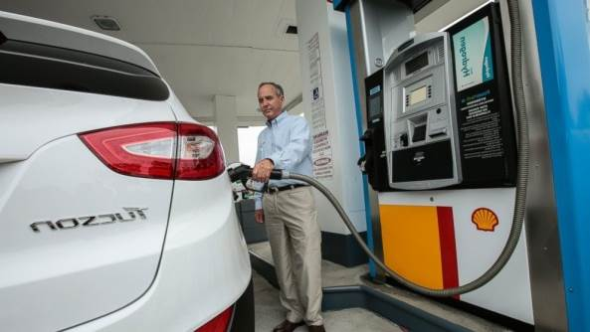
Perspectives – Changing Global Context
Geographic Outlook
Asia
  Car manufacturers are gearing up for the coming FCEV market. Launch of Toyota Mirai imminent. Mirai has 312 mile EPA rated driving range.
  Strategic plans in Japan, Korea, China feature hydrogen. Japan supporting 100 HRS
  Progress on Micro-CHP: 90,000 installations reported as of 2009
Europe
  Strategic plans on mobility and implementation: H2 Mobility(ies), HyNor
  German public-private partnership will develop 50 fueling stations in Germany through a public private partnership; 400 HRS by 2020
  Power–to–Gas: increasing number of demo project at large scale
  Second phase of Private/Public partnership FCH JU 2 (2014-2020)underway
US
  US-CA – infrastructure plan: 44 currently funded fueling stations will be in operation
  year-end 2015; 51 currently funded fueling stations will be installed by 2016
  H2 USA published maps showing potential fuel cell transportation applications in the
  Northeast states in preparation for infrastructure development; Toyota to team
  with Air Liquide to deploy 12 stations in NE US.
  > 13,500 fork lift installations
International level
  IEA Technology Roadmap Hydrogen and Fuel Cells released 30 June 2015
Toyota Mirai
MICRO CHP AND FORKLIFT
Hyundai’s Tucson Refueling at Shell Station in Newport Beach, CA 2014
2012 Paris Motor Show
Notes:
Read notes below
Stefan – this is a transition slide from the 2009-2015 cycle to the 2015-2020 cycle.
Here you see a geographic perspective – the global context for hydrogen is changing
Major Asian car manufacturers are gearing up for the coming FCEV market. And there has been progress in micro-CHP systems for stationary applications, particularly in Japan and Korea.
“Power to Gas” is a very hot topic in Europe and there is a lot of activity and plans for hydrogen mobility and infrastructure – using wind as the major source for hydrogen as transportation fuel.
By 2013 in CA funding for as many as 100 hydrogen refueling stations was approved. Nationally, the US has created the new H2 USA and H₂FIRST. The US has also had good success in early commercialization efforts with forklifts for material handling.

Slide 4




OECD
Organisation for Economic Co-operation and Development
(Created by treaty post war)
IA
IA
IA
IEA
International Energy Agency
(Created by treaty in 1974, enabling Implementing Agreements)
IA
IA
IA
IA
IA
IA
IEA HIA
IA
International Energy Agency Hydrogen Implementing Agreement
(Created by treaty in 1977)
Notes:
What exactly is the IEA HIA?
Actually, The story actually begins with the OECD, which was created post war to foster economic prosperity among its members. Then in 1974 the IEA was created (we just heard from the IEA) to focus on energy.
This slide depicts the constellation of OECD, IEA and R,D&D collaborations known as Implementing Agreements. The Implementing Agreements constitute the IEA energy Technology Network.

Slide 5





















IEA HIA Members - Executive Committee (October 2015)
European Commission
Dr Marc Steen
UNIDO (UN)
TBA
Europe
Finland
Dr Michael Gasik
France
Mr Paul Lucchese
Denmark
Mr Jan Jensen
Greece
Dr Elli Varkaraki
Belgium
Mr Adwin Martens
Germany
Mr J.-F. Hake
Lithuania
Dr R. Urbonas
Norway
Mr Trygve U. Riis
Italy
Dr Angelo Moreno
Sweden
Dr Bengt Ridell
Switzerland
Dr Stefan Oberholzer
Spain
Mr A. Garcia-Conde
The Netherlands
Dr Evert Everts
United Kingdom
Mr Ray Eaton
Sponsors
IA Hysafe
Dr A. Tchouvelev
Middle East
Israel
Dr Igor Derzy
NOW
Dr Klaus Bonhoff
Shell
Dr Gert Jan Kramer
North America
United States
Dr Eric Miller
Asia - Pacific
Oceania
Japan
Ms Hayasaka
Korea
Dr Y. Shul
Australia
Mr Chas. Thorn
New Zealand
Dr J. Leaver
20 Countries + European Commission + UN + 3 Sponsors
Notes:
Here you see the IEA HIA membership.
The IEA HIA is a an R,D&D collaboration consisting primarily, but not exclusively, of OECD nations and their governmental entities. Non-OECD nations and duly constituted international organizations may also be Members – they are called Contracting Parties. There is also a membership category called sponsors. Sponsors may be: companies, non-profits associations, public-private partnerships and a consortium of unfederated entities.
We now have 22 Contracting Parties and 3 Sponsors. Australia is a Contracting Party Member.
Given the level of interest from industry in IEA HIA activities, we opened the Sponsor Member category and now have three sponsors: They are: HySafe, NOW and Shell.

Slide 6
Strategic Framework 2009–2020
Vision:
A hydrogen future based on a clean sustainable energy supply of global proportions that plays a key role in all sectors of the economy.
Mission:
To accelerate hydrogen implementation and widespread utilization to optimize environmental protection, improve energy security and promote economic development internationally while establishing the HIA as a premier global resource for expertise in hydrogen
Strategy:
To facilitate, coordinate and maintain innovative research, development and demonstration activities through international cooperation and information exchange
Notes:
Read Notes below
The IEA HIA is a collaborative research, development and demonstration (R,D&D) program created in 1977. It operates as a “task-shared” collaboration, pooling expertise, and creating its research framework and portfolio on a bottom-up basis. Here you see the core of our Strategic Framework – the HIA vision, mission and strategy.
Our vision is of “A hydrogen future based on a clean sustainable energy supply of global proportions that plays a key role in all sectors of the economy.”

Slide 7
Themes and Portfolios
  Collaborative RD&D that advances hydrogen science and technology
  Hydrogen production
  Hydrogen storage
  Integrated hydrogen systems
  Integration of hydrogen in existing infrastructure
  Analysis that positions hydrogen
  Technical progress and optimization
  Market preparation and deployment
  Support in political decision-making
  Understanding, Awareness and Acceptance that fosters technology
  diffusion and commercialization
  Information dissemination
  Safety
  Outreach

Slide 8
Task Portfolio (Status September 2015)
NR | NAME | DURATION | STATUS
18 | Integrated Systems Evaluation | 2004‒2009 | completed
19 | Hydrogen Safety | 2004‒2010 | completed
21 | Biohydrogen | 2005‒2010 | completed
21 | Bioinspired and Biological Hydrogen Production | 2010‒2014 | completed
22 | Fundamental & Applied H₂ Storage Materials Development | 2006‒2012 | completed
23 | Small-Scale Reformers for on-Site H₂ Supply | 2006‒2011 | completed
24 | Wind Energy and Hydrogen Production (Electrolysis) | 2006‒2011 | completed
25 | High Temperature Production of Hydrogen | 2007‒2011 | completed
26 | Advanced Materials for Waterphotolysis with H₂ | 2008‒2013 | completed
27 | Near-Term Market Routes to H₂ via Co-Gasification with Biomass | 2009‒2011 | completed
28 | Large-Scale Hydrogen Delivery Infrastructure | 2010‒2014 | ongoing
29 | Distributed and Community Hydrogen (DISCO H₂) | 2011‒2013 | ongoing
30 | Global Hydrogen Analysis | 2010‒2013 | ongoing
31 | Successor Hydrogen Safety Task | 2010‒2013 | completed
32 | H₂ Based Energy Storage | 2013‒2016 | ongoing
33 | Local H₂ Supply for Energy Applications | 2013‒2016 | ongoing
34 | BioH2 for Energy & Environment (Successor to Task 21) | 2014‒2017 | approved
35 | Renewable Hydrogen | 2014‒2017 | approved
36 | Life Cycle Sustainability Assessment (LCSA) (Successor Task 30) | 2014-2017 | approved
37 | Safety | 2015-2018 | approved
XX | Power-to-Hydrogen | 2015-2018 | Preliminary approval
XX | Marine Sector |  | In Definition
Notes:
Read Notes below
Here you see the IEA HIA portfolio of tasks. Seventeen (17) of these tasks (from Task #18 to Task #33) were operational during the previous term from 2009-2015. Eleven (11) tasks highlighted in purple have been completed, while 6 these tasks (#s 28, 29, 30, 32, 33 and 35) are ongoing. Arrows indicate that the task will continue in the new 2015-2020 term. The tasks highlighted in blue were approved in the new term.
The P2H task has received preliminary approval. The Marine Sector task in is “In definition”. Finally, a Mining Sector task, which does not appear on this list, is under discussion.
The basic unit of organization in the HIA is the Task; several members collaborate on each task. Operating Agent is the person who manages the Tasks and who coordinates the Experts of the members to do work.
As a „task-shared“ implementing agreement, member countries fund their expert researchers directly according to the level of person hours agreed upon in each task.
Each member pays dues into a Common Fund for administration and promotion of the implementing agreement, which is performed by the Secretariat.
Experts are compensated directly by members so no money for labor changes hands at the Secretariat level. This “task-shared,” “in-kind” approach is very efficient. The IEA HIA tracks investment in expert labor in person hours.
Operating Agent is the person who manages the Tasks and who coordinates the Experts of the members to do work.
As a „task-shared“ implementing agreement, member countries fund their expert researchers directly according to the level of person hours agreed upon in each task.
Each member pays dues into a Common Fund for administration and promotion of the implementing agreement, which is performed by the Secretariat.
Experts are compensated directly by members so no money for labor changes hands at the Secretariat level. This “task-shared,” “in-kind” approach is very efficient. The IEA HIA tracks investment in expert labor in person hours.

Slide 9
28 | Large-Scale Hydrogen Delivery Infrastructure
29 | Distributed and Community Hydrogen (DISCO H₂)
30 | Global Hydrogen Analysis
31 | Successor Hydrogen Safety Task
32 | H₂ Based Energy Storage
33 | Local H₂ Supply for Energy Applications
34 | BioH2 for Energy & Environment (Successor to Task 21)
35 | Renewable Hydrogen
36 | Life Cycle Sustainability Assessment (LCSA) (Successor Task 30)
37 | Safety
XX | Power-to-Hydrogen
XX | Marine Sector

Slide 10
Success Stories: Task 18 to Task 23
Collaborative R,D&D Theme
TASK | SUCCESS STORIES IN COMPLETED TERM
Task 18 Integrated Systems Evaluation | State of the art analysis entitled Demonstration Project Evaluations used technical simulations that may be applied to other projects to replicate results General conclusions in critical areas of system evaluations, data monitoring, modeling tools, system design, control systems and cost-benefit analysis
Task 19 Hydrogen Safety | Contribution to global understanding of H2 safety through studies and databases laying foundation for codes and standards
Task 21 BioHydrogen (2008-2009) | Better genomic understanding of hydrogen-producing strict anaerobes
Task 21 BioInspired Hydrogen (2010-2014) | Sapporo Brewery in collaboration with Petrogas and the Ergostech Company in Brazil are constructing a pilot plant to produce BioHydrogen from beer waste water. Demonstration of first small industrial-scale microbial electrolysis cell (MEC) for hydrogen production using winery wastewater at the Napa Wine Company in Oakville.
Task 22 Fundamental and Applied Hydrogen Storage Materials Development | World’s largest collaboration on hydrogen storage materials R&D 2,500 publications (1,600 publications) and presentations (900) and 63 patent applications. Final Report include Appendix A 59 expert reports; Appendix B 260 page publication list.
Task 23 Small-Scale Reformers for On-Site Hydrogen Supply (SSR for Hydrogen) | Creation of a dedicated industry network that functioned as a platform for discussion and novel collaborations, supplying knowledge and experience on the use of reformers for on-site hydrogen production. The process of building trust to enable collaboration across industry segments and among competitors was a challenging and time-intensive process. a market guide and cost numbers A recommendation for harmonized capacities on three sizes (100Nm3/h, 300Nm3/h and 500Nm3/h) first-ever End of Task Workshop held April 2012 for Task 23
Notes:
Read Note below:
Here you see Task success stories that have been distilled from the “Select Results and Achievements” reported for each task in our End of Term Report (EOT). The Task success stories encompass findings, results and conclusions which, collectively, have contributed in a meaningful way to Technology Evolution in terms of research and Technology Deployment in terms of Market Facilitation.
This slide pertains to Tasks 18 to 23. All of these tasks fall under the collaborative IEA HIA theme.
Here are few highlights: 18, Task 21 (2010-2014), Task 22 and Task 23
Stefan – maybe you don’t need to go into any details here – just refer the audience to the success stories.

Slide 11
Success Stories: Task 24 to Task 31
Collaborative R,D&D Theme and Awareness, Understanding & Acceptance of Hydrogen Theme
TASK | SUCCESS STORIES IN COMPLETED TERM
Task 24 Wind Energy and Hydrogen Integration | Final Report expanded the body of knowledge on integration of hydrogen and wind energy, detailing its potential for overcoming the intermittent availability of the wind resources in both grid-connected and stand-alone applications and making the case for hydrogen as a storage option. ITHER Project, a Task 24 Project, won IEA HIA Project Prize award
Task 25 High Temperature Production of H2 | Identified promising technologies via multi-criteria analysis results: HyS Nuclear, HTSE nuclear, HTSE solar HyS solar Produced summary sheets on high temperature processes
Task 26 Advanced Materials for WaterPhotolysis | Two seminal books on PEC hydrogen production comprised of chapter contributions from the international experts in this field.
Task 28 Large Scale Hydrogen Delivery Infrastructure | Platform for all H2 industry stakeholders including energy companies and car OEMs Key messages on 1) status of H2 with Focus on Transport Applications and 2) H2 Distribution and Refueling Stations for Transport
Task 30 Global Hydrogen Systems Analysis | Cooperation with IEA ETP analysis in place A Database and Handbook of worldwide Hydrogen Production potentials and costs by the year 2050. A Global Hydrogen Resource Study that looks at potential hydrogen resource in particular countries for the purpose of meeting potential long term hydrogen demand for fuel cell electric vehicles.
Task 31 Hydrogen Safety | End of Task Workshop entitled A Hydrogen Safety Stakeholder Workshop: Sharing Knowledge, Celebrating Progress, Identifying Needs 2-3 October at the IEA HIA office in Bethesda, MD USA Significant contribution to global understanding of H2 safety through studies, databases and white papers laying the foundation for codes & standards and commercialization
Notes:
Read note below:
Again – maybe you just refer the audience to these slides.
This slide pertains to Tasks 24 to 31, comprised of tasks in the R,D&D theme and the Awareness, Understanding and Acceptance theme.

Slide 12



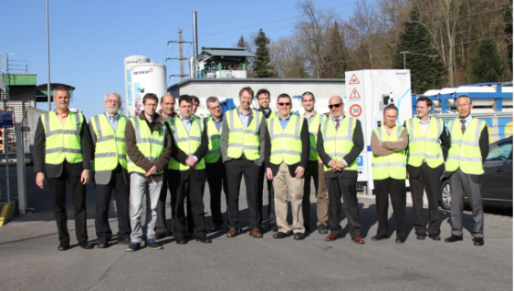



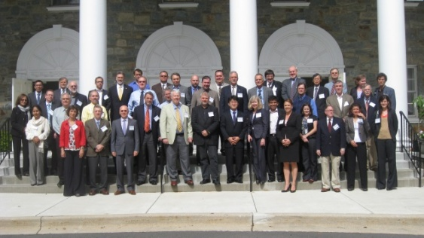






Success Stories IEA HIA wide
Growth of industry participation – 80 participants
Admission of Industry sponsor members
Development of systems analysis expertise
Cooperation established with IEA analysis
IEA Roadmap for H2 and Fuel Cells; H2 Chapter in ETP 2012
Successful management of a large portfolio of tasks
Steady and effective participation of ExCo Members and experts
Notes:
Read from slide

Slide 13
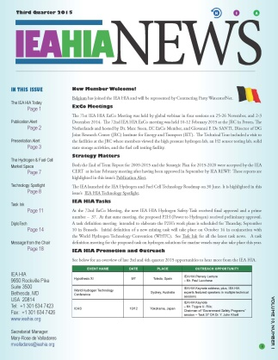
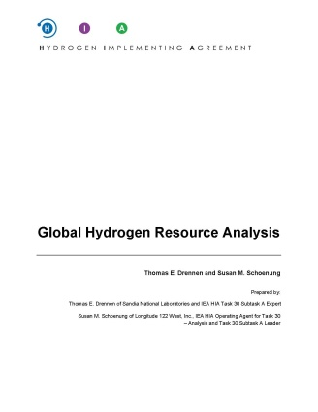
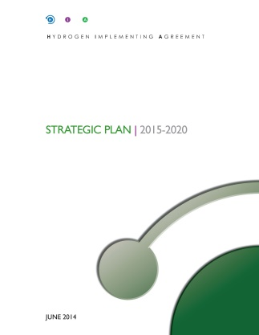
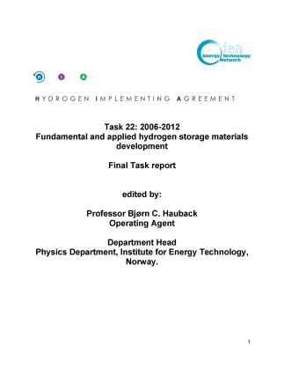
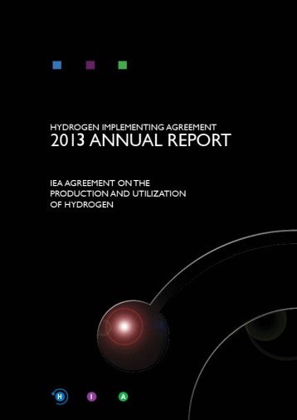
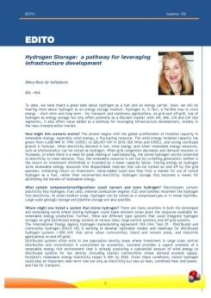
Information Dissemination and Outreach 2009-2015
IEA HIA
Newsletter
Final Report
Task 22
2013
Annual Report
Final Report
Task 30 Subtask A
EDITO
Strategic Plan
2015-2020
ExCo-Secretariat
3 REWP presentations; 6 REWP mtgs; 1 CERT mtg
3 OECD workshops/presentations
8 internal IEA workshops + 3 H2 Roadmap workshops
2 conference exhibits
114 external presentations
5 EUWP Transport Contact Group mtgs
1 EUWP Industry Group mtg
1 Joint Workshop – Black Sea EC
Operating Agents/Experts
31 IEA HIA Summary publications
2,609 expert publications
1,558 expert presentations
IEA HIA Task Workshops
Task 23: On-site H2 supply: Reforming vs. other options
Task 19/31 Hydrogen Safety
Notes:
Read note below
AT the top of this slide you see some of our information products.
This bottom half of this slide provides an overview of IEA HIA external outreach for the 2009-2015 planning period as of 2014. This includes the ExCo and Secretariat, the Operating Agents and Experts, and the End of Term IEA HIA Workshops associated with each task.

Slide 14

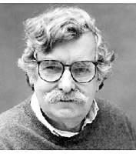
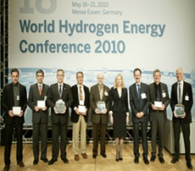
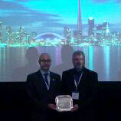
IEA HIA Prize
For RD&D characterized by
technical excellence and harmony in international cooperation that contributes to the understanding and advancement of basic and applied hydrogen science.
Peter Hoffmann was the (posthumous) winner of the 2014 IEA HIA Individual Prize
Peter Hoffmann
1935-2014
IEA HIA Prizes
Project Prizes 2010, 2012
Individual Prizes 2009,
2011& 2014
Fundamental R&D 2010
Project Prize Task 22 – H25
Applied R&D 2012
Project Prize Task 27 -- Elcogas
Notes:
The IEA HIA has awarded its 2014 Individual Prize to Peter Hoffmann, owner/editor of the Hydrogen and Fuel Cell Letter, who passed away in April 2014.
The IEA HIA actually awards two prizes – the Individual Prize and the Project Prize in alternating cycles. He Project Prize encompasses both basic (fundamental) and appied research.
Below you see some of the Project Prize awards in 2010 and 2012.

Slide 15
AGENDA
End of Term Report: 2009‒2015
Strategic Plan:
2015‒2020
Perspectives
Members
Strategic Framework
Themes
Task Portfolios
Success Stories – IEA HIA wide
Success Stories - Tasks
Information Dissemination & Outreach
Key Numbers &
Outcomes
Overarching Objectives
Priorities for all themes
Priorities for Analysis portfolios
Current task highlights
The IEA Technology Roadmap for Hydrogen and Fuel Cells
The 2015 COP
Notes:
Read Notes below
The Table of Contents above provides an orientation to the IEA HIA presentation and the various topics of discussion. I will now talk about the Strategic Plan for 2015-2020, as well as the IEA Technology Roadmap for Hydrogen and Fuel Cells

Slide 16
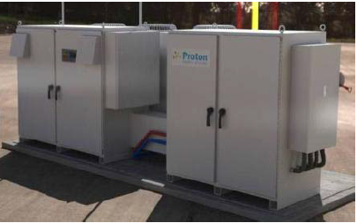
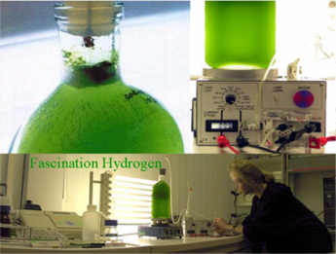
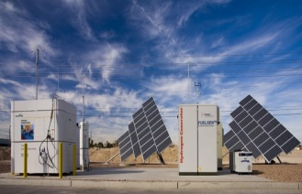
R,D&D Collaboration: Hydrogen Production
Task 33: Local H2 Supply for Energy Applications (2013-2016) - Applied
Platform for evaluation and harmonization of various technologies for local H2 supply for reduced costs and increased employment
Expands research on supply to include electrolysers
as well as reformers
Significant industry participation
Task 34: BioH2 for Energy & Environment (2014-2017) - Basic
Subtask 1 - BioHydrogen production (Dark Fermentation and Bioelectrolysis; light-drive BioHydrogen production; Enzymatic and Bio-inspired Molecular Systems
Subtask 2 – Applied Research and Biohydrogen Production
Task 35 Renewable Hydrogen Production (2014-2017) - Basic
SUPER TASK
Subtask 1 – Renewable Electrolysis
Subtask 2 – Photoelectrochemical Solar Water-Splitting
Subtask 3 – Solar High Temperature Thermochemical Cycles
electrolysers and reformers
Bio-inspired
Photoelectrochemical
Notes:
Hydrogen production from biological, photo-electrocemical and high temperature processes has been a large part of this term and two successor basic research tasks, Task 34 and Task 35, are in place.
In addition, Task 33 provides a platform for expanded research on electrolysers and reformers. You will hear from our Task 33 Operating Agent during WHTC. Key Learnings from Task 33 include:
- Small-scale water electrolyzers and reformer systems with H2 capacities in the range of 50-500Nm3/hr are commercially available; the specific cost (CAPEX) [USD per Nm3/hr] of small-scale water electrolyzers and reformers are comparable. Both alkaline and PEM water electrolyzers are available in MW-scale. While PEM is less prove and more costly (CAPEX) than alkaline, it is more compact and suitable for dynamic load following.
-New local hydrogen production approaches (Power-to-gas [PtG] and conventional reforming of biogas) can increase uptake of renewable energy and/or enable storage of RE
-Main barriers and opportunities for introduction of locally produced h2 for energy applications depends largely on availability and cost of natural gas, electricity and bulk delivery of H2, necessitating cost-benefit analyses on case-by-case basis.
-

Slide 17
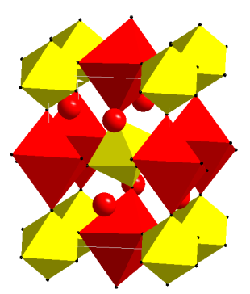
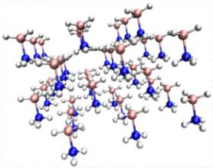
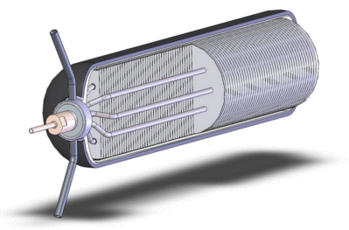
R,D&D Collaboration: Hydrogen Storage
Task 32: Hydrogen-Based Energy Storage (2013-2015)
Further research on new and improved compounds and demonstration of solid storage systems for stationary, mobile and portable applications, as well as electrochemical storage
Objective: Develop reversible or regenerative storage materials fulfilling relevant technical targets for stationary and mobile applications;
Objective: Develop the fundamental and engineering understanding of H2 systems and materials that have the capacity to fulfil the targets
Project based: 52 experts from 17 countries organized in 6 working groups:
  Porous materials
  Magnesium-based H2 and energy storage materials
  Complex and liquid hydrides
  Electrochemical storage of energy
  Heat storage – concentrated solar thermal using meta hydrides
  H2 storage systems for mobile applications
Present new research at each task meeting
World’s largest R&D collaboration in H2 Storage
Publication of a special issue of the international journal ‘Applied Physics A by Springer is underway

Slide 18
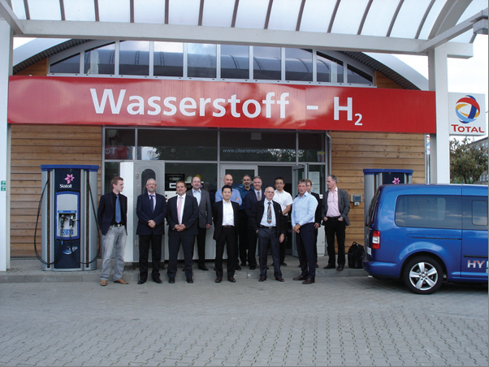
Infrastructure Portfolios: Integrated H2 Systems/ Integration in Existing Infrastructure
Task 29: Distributed and Community H2 (2011-2014)
Scope - H2 applications in energy communities integrating H2 with electricity & other energy and mobility networks and distributed systems
Community Size – 1000; installed H2 capacity NTE 500 kW
Community Types: Urban; Rural and Island; Distributed Industrial applications
Task 28: Large Scale H2 Delivery Infrastructure (2010-2014)
Subtask A – FCEV & HRS scenarios
Subtask B – HRS assessment
Subtask C – Analysis H2 Pathways
Subtask D – large-scale storage and greening of gas
Final Report approval imminent:
FCEVS, particularly passenger cars, are technically ready for commercialization
Market development rather than technology development is considered main barrier to large-scale introduction of H2 and FCEVs
Notes:
Read Notes below (and then go to slide if you want):
The tasks deal with Integration of hydrogen in existing or built up of new infrastructures for hydrogen. Task 29 addresses distributed and community hydrogen, while Task 28 addressed large scale H2 delivery infrastructure. The final report for Task 28 will be available soon.
Key learnings from Task 28 – Infrastructure:
FCEVS, particularly passenger cars, are technically ready for commercialization
Market development rather than technology development is considered main barrier to large-scale introduction of H2 and FCEVs

Slide 19
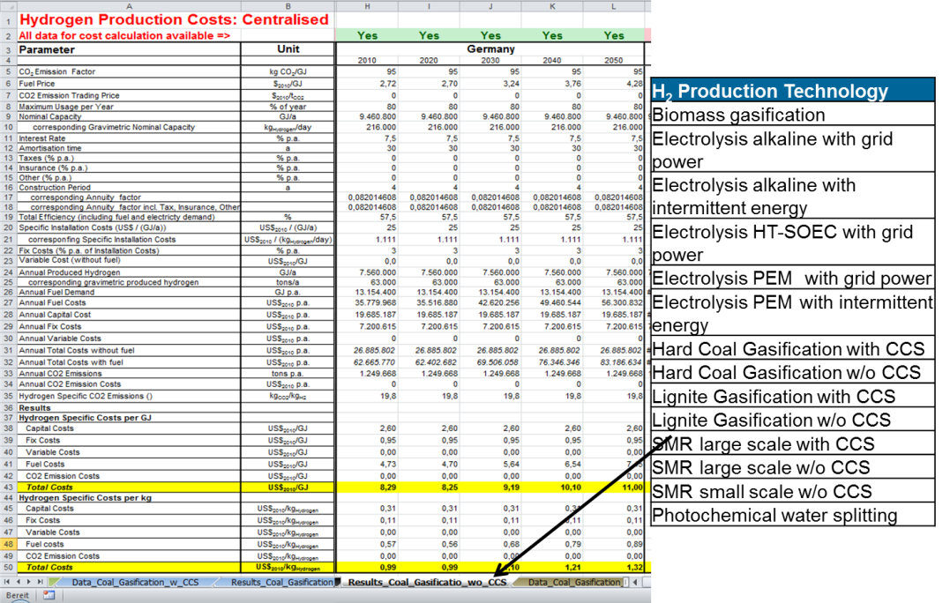
Analysis
Task 30: Global Hydrogen Analysis (2010-2013)
Global Hydrogen Resource Analysis on IEA HIA website (Subtask A)
Resources are not the limiting factor to a hydrogen economy: there are a large number of potential pathways for providing H2 to fuel a significant FCEV fleet.
Hydrogen data base on hydrogen production potentials expected soon (Subtask B)
Interaction with IEA Analysis
Task 36: Life Cycle Sustainability Assessment (LCSA) of H2 Energy Systems (2014-2017)
Environmental challenges
Economic Analysis
Social Indicators and Integrative approaches for LCSA
Notes:
Read notes below:
And here is our analysis portfolio with our two analysis tasks: Task 30 is completing. Task 36 is now underway.
Task 30 Subtask A Final report, soon to be published, speaks to the question of where hydrogen will come from in the future.
Task 30 Subtask B is producing a database and handbook for worldwide hydrogen production potentials, including harmonized technological and economic data.
The database and handbook are expected to inform IEA analysis.

Slide 20
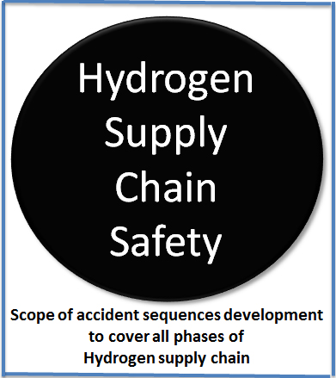
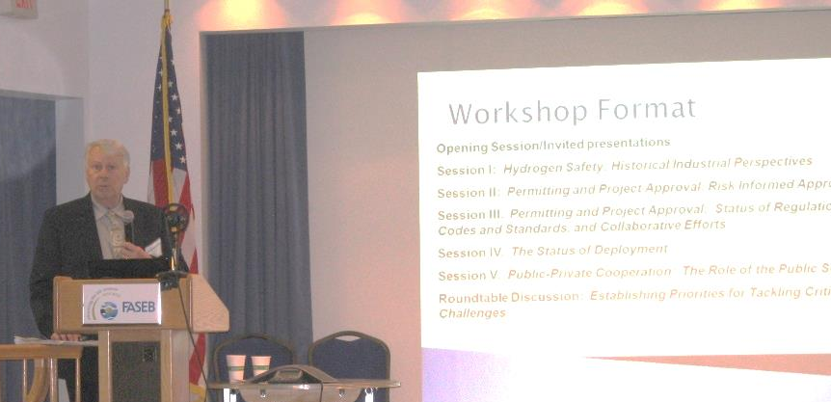
Hydrogen Safety
Task 37: Safety (2015-2017)
Subtask A – Integrated Tool Kit for Hazards and Risk Assessment
Subtask B – Accident Scenarios/Sequences Development
Subtask C- Physical Effects
Subtask D – Human Reliability Analysis (HRA)
Subtask E – Materials Compatibility
Safety is crucial to the IEA HIA.
Tasks 19/31 held an End of Task North American Workshop in 2013. A companion workshop is expected to be held in Europe in 2016.
Notes:
Read notes below:
Safety is crucial importance to the IEA HIA and a successor safety task is in definition.
Tasks 19/31 held an End of Task North American Workshop in 2013. A companion workshop is expected to be held in Europe in 2015.

Slide 21
AGENDA
End of Term Report: 2009‒2015
Strategic Plan:
2015‒2020
Perspectives
Members
Strategic Framework
Themes
Task Portfolios
Success Stories – IEA HIA wide
Success Stories - Tasks
Information Dissemination & Outreach
Key Numbers &
Outcomes
Overarching Objectives
Priorities for all themes
Priorities for Analysis portfolios
Current task highlights
The IEA Technology Roadmap for Hydrogen and Fuel Cells
The 2015 COP
Notes:
Read Notes below
The Table of Contents above provides an orientation to the IEA HIA presentation and the various topics of discussion. I will now talk about the Strategic Plan for 2015-2020, as well as the IEA Technology Roadmap for Hydrogen and Fuel Cells

Slide 22




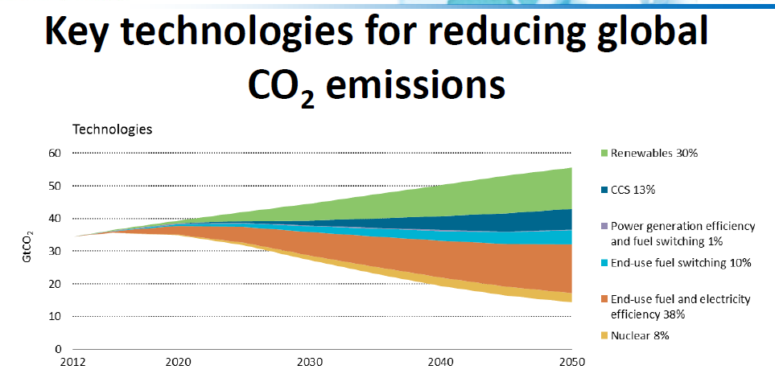
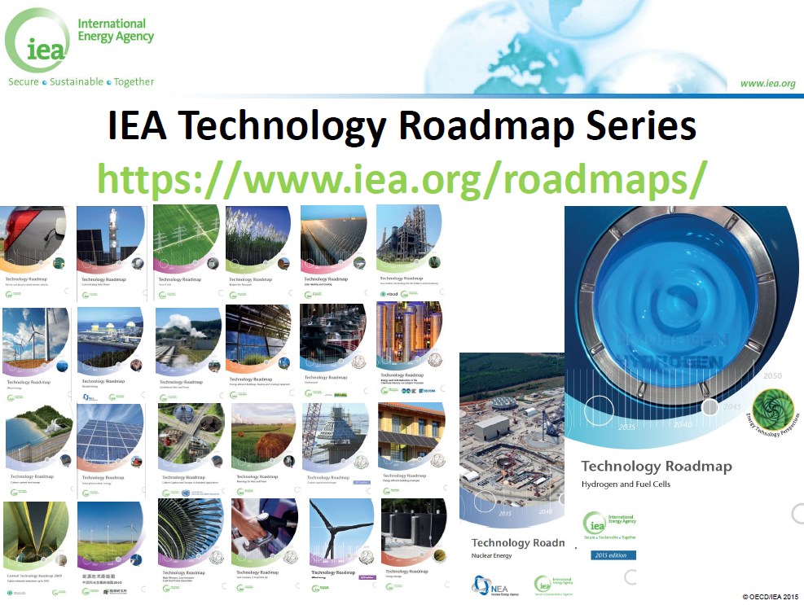

Slide 23
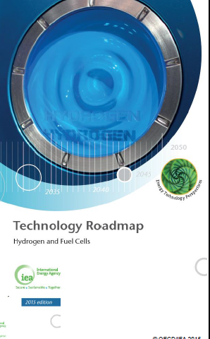
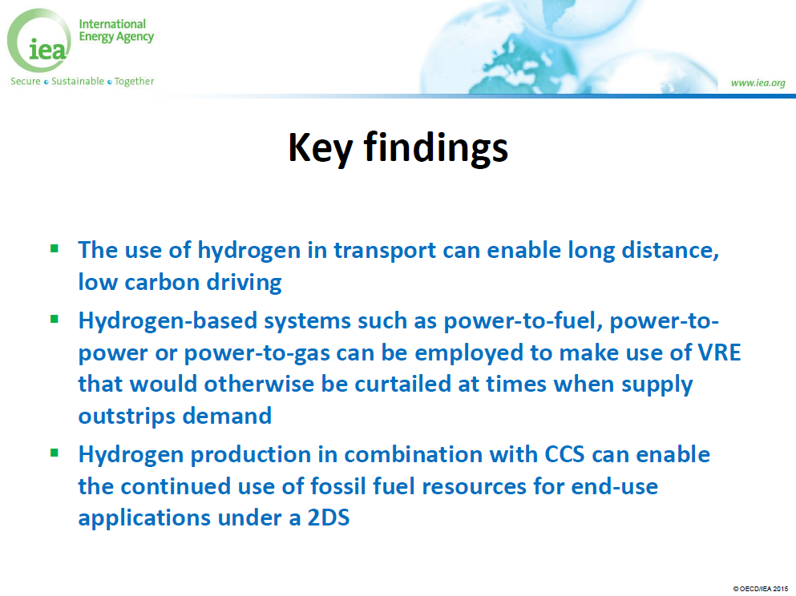

Slide 24
Key actions for the next ten years
Stimulate investment and early market deployment of hydrogen and fuel cell technologies and their infrastructure
Continue to strengthen and and harmonise international codes and standards
Put the first ten thousands of FCEVs on the road, along with hydrogen generation, and refueling infrastructure, including at least 500 to 1000 stations
Establisg regulatory framework that remove barriers to grid access for electricity storage as well as for the blending of hydrogen into the natural gas grid

Slide 25
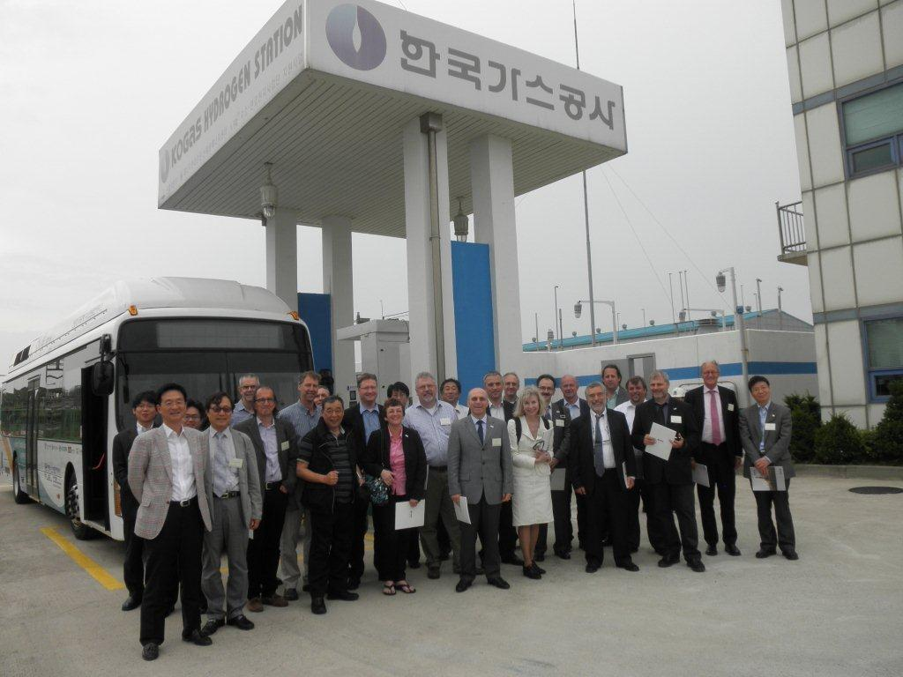
Thank you from the IEA HIA
A premier global resource for technical expertise in H2 RD&D
Contact:
Dr. Stefan Oberholzer
ExCo Chairman
stefan.oberholzer@bfe.admin.ch
+41 58 465 89 20
Ms. Mary-Rose de Valladares
ExCo Secretariat Manager
mvalladares@ieahia.org
+1 301 634 7423
Notes:
If you are already cooperating with the IEA HIA, we are glad to have you with us. If you are not already cooperating with us, we hope you will join us.
Thank you very much.

