Slide 1
Hydrogen South Africa (HySA) and
SA H2 Safety Programmes
Brian North
HySA Infrastructure/CSIR
ICHS, Yokohama 19 October 2015

Slide 2
Outline of presentation
HySA overview
  Rational/background
  Centres of Competence
  Major achievements to date
Hydrogen Initiatives in South Africa
Status of H2 RCS in South Africa (SANS)
Case study – use of High Pressure H2 in laboratories

Slide 3




HySA Centres of Competence
DST
RCS efforts focussed in Infrastructure
NWU / CSIR
UCT / MINTEK
UWC

Slide 4







HySA R&D Programmes
Materials and Components
Components and
Systems
Systems
and Infrastructure
Key Programme 1: Combined Heat and Power
Key Programme 2: Portable Power Systems
Key Programme 3: Hydrogen Fuelled Vehicles
Key Programme 4: Hydrogen Filling Stations
Key Programme 5: Renewable H₂ Production
Value Chain

Slide 5
Implementation phases
2008 - 2013
2014 - 2018
2014 - 2018
Commercialise South African Innovation
Demonstrate
and Validate
Technology
Establish
R&D Capability
Recruit mission-critical staff
Identify initial markets
Develop first-pre commercial technologies
Establish critical supply chain capability
Deliver first products to market
Demonstrate capabilities in pilot markets
Contribute to international innovation
Compete successfully on world market
Capture 25% of global catalysis value chain in hydrogen and fuel cells

Slide 6
HySA Strategic Goals
Develop local cost competitive hydrogen generation solutions based on renewable resources
Wealth Creation through value added manufacturing of PGM catalysis with a goal of supplying 25% of PGM catalysts demand by 2020
Promote equity and inclusion in the economic benefits of South Africa’s resources
Strong focus on Human Capital Development in line with DST’s broader HCD Strategy

Slide 7
Industry Collaborations: Local Supply Chain Development
Project Description | Fuel Cell type and Size (kW) | Project Partners
Fuel Cell Mini grid providing primary power to 34 homes | 3 x 5 kW (15 kW) PEM FCs (MeOH) | Anglo Platinum and Ballard Power Systems, Other local companies
Provision of back up power to ICT equipment in three rural schools | 3 x 5 kW PEM FCs | Department of Science and Technology (DST), Anglo Platinum, Clean Energy, Air Products
Provision of back up power to vaccine fridges at a clinic in Johannesburg | 5kW PEM FC | DST, Anglo Platinum, Clean Energy, Powertech System Integrators, Air Products, Gridline Construction, City of Johannesburg
Provision of base-load power to the Chamber of Mines building in Johannesburg | 100 kW PAFC powered by NG | DTI, Chamber of Mines, Egoli Gas, Mitochondria Energy Company
Provision of power to the University of Western Cape Nature Reserve building | 2.5 kW PEM FC | DST, HySA Systems, Hot Platinum
Telecomm back-up power | 300 by 5kW PEMFC (MeOH OSR) | Idatech, Inala Technology, Ballard
Telecomm back-up power | 133 by 5kW PEMFC | Powertech Systems Integration

Slide 8
HySA Highlights: Catalysis
HySA Catalysis
Competence Centre Director: Dr Sharon Blair
Key Programme: 2 (Portable Power)
Areas of expertise: Catalysts (FC and fuel processing), MEAs

Slide 9

Fuel Cell Materials and Components
PGM-based Catalyst
Pt / C
Pt alloys / C
MEA Components
Electrode structures
Gas diffusioin layers
Custom and Standardized Finished MEAs
3/5/7 layer MEAs
Customised Fuel Cell stacks
Designed to meet customer needs

Slide 10

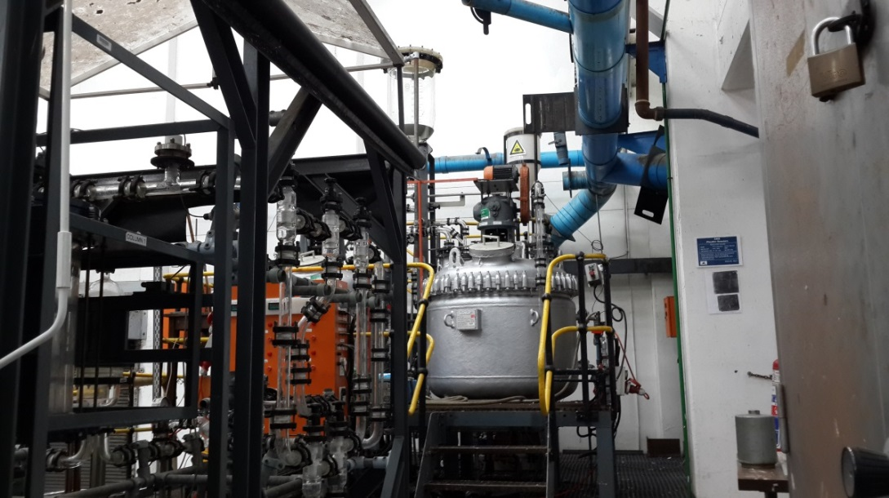
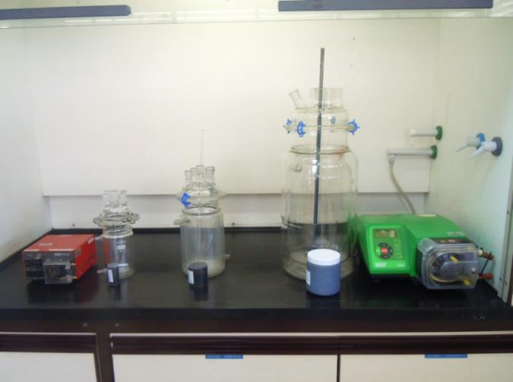
Scale up of Catalyst Production
Commercial Process
(50 kg)
  Full production scale
Pilot Process
(0.5-1kg)
  Mintek’s gold catalyst production facility (hundreds of kg/year)
Lab Scale-up (50g)
Notes:
With the sponsorship of Impala Platinum, HySA Catalysis is scaling up its processes to 1 kg batches in 2015-16. Reproducibility data is encouraging.

Slide 11

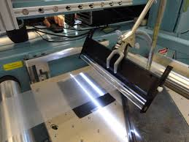

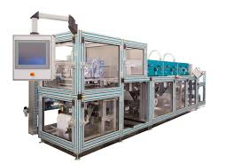
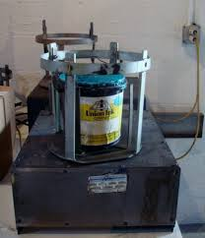
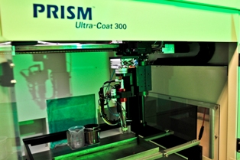
Scale-up of MEA
2017 onwards
>50 000 MEAs/year
2016/17
  10 000 MEAs/year
2015/16
5 000 MEAs /year
Notes:
With the support of TIA, we are making MEAs to customers specifications. Gasketed catalyst coated membrane (3-layer) or 5/7-layer MEAs are being produced.

Slide 12
HySA Highlights: Systems
HySA Systems
Competence Centre Director: Dr Cordelia Sita
Key Programme: 1 (Combined Heat and Power)
3 (Hydrogen Fuelled Vehicles)

Slide 13


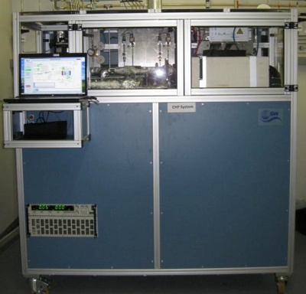
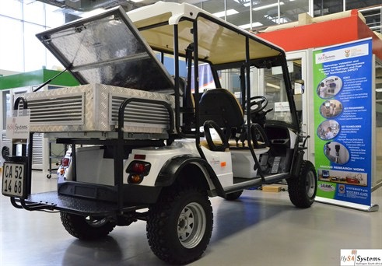











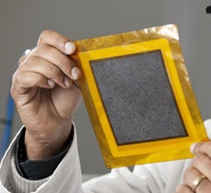
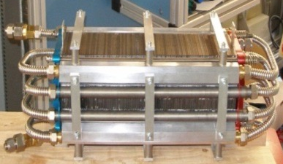



HySA Highlights: Systems
HySA Systems
Combined Heat & Power
Hydrogen Fuelled Vehicles
HT-MEA (>120)
H2 Storage
System Integration
PEMFC Stacks
System Integration
System Validation
System/Stack Modelling
Key Technologies
System Validation
System/Stack Modelling
Key Programme 1- Combined Heat and Power
KP1-S01 Fuel Cell Catalysts and Membrane Electrode Assemblies (HT-MEAs)
KP1-S03 CHP System Integration
and Technology Validation
Key Programme 3 – Hydrogen Fuelled Vehicles
KP3-SO2 On-Board Use of Metal Hydrides for Utility Vehicles
KP3-S03 FCV Systems Integration and Technology Validation
Key Programme 8 – Special Projects
KP8-S03 Pd-nanocomposite membrane Reactors
KP8-SO5 Metal Hydrides for underground Mining Applications (NEW)

Slide 14
HySA Highlights
HySA Infrastructure
Competence Centre Director: Dr Dmitri Bessarabov
Key Programmes: 4 (H2 Fuelling Stations) and
5 (Renewable H2)
Focus areas: Hydrogen Production and Storage, RCS
Projects:
Solar to Hydrogen (generation, compression, storage)
Hydrogen storage on/in porous materials (MOF, CNS)
Chemical Carriers (Ammonia, Formic Acid)
Composite Overwrapped Pressure Vessels

Slide 15
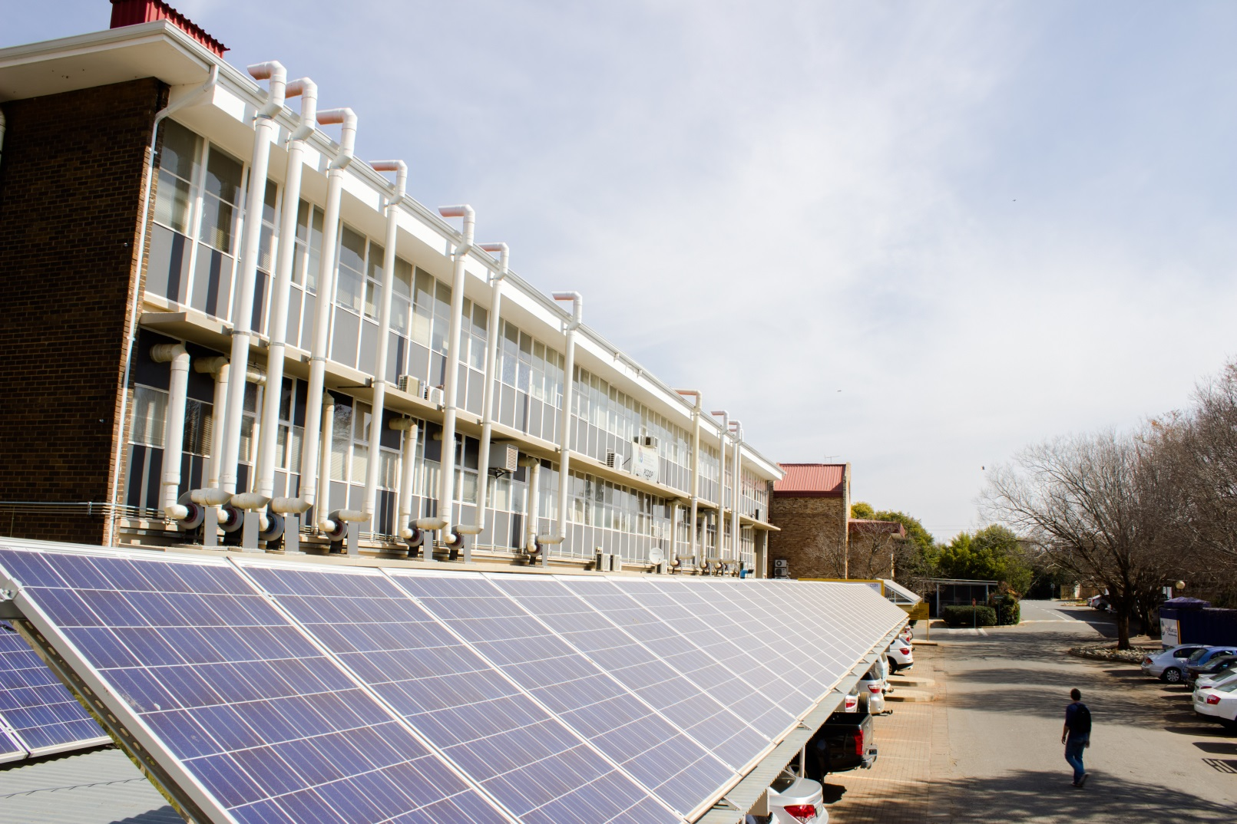
HySA Highlights: Infrastructure
Solar to Hydrogen plant

Slide 16
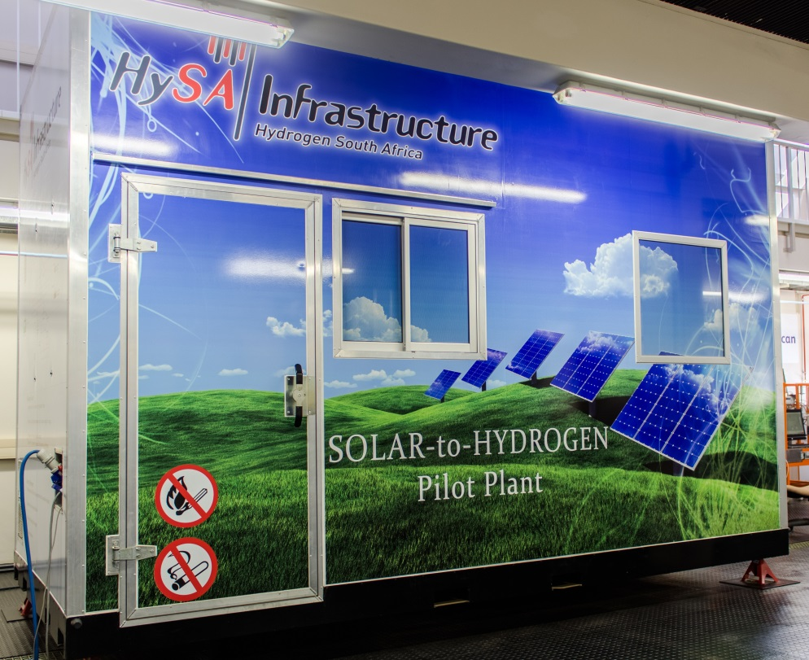
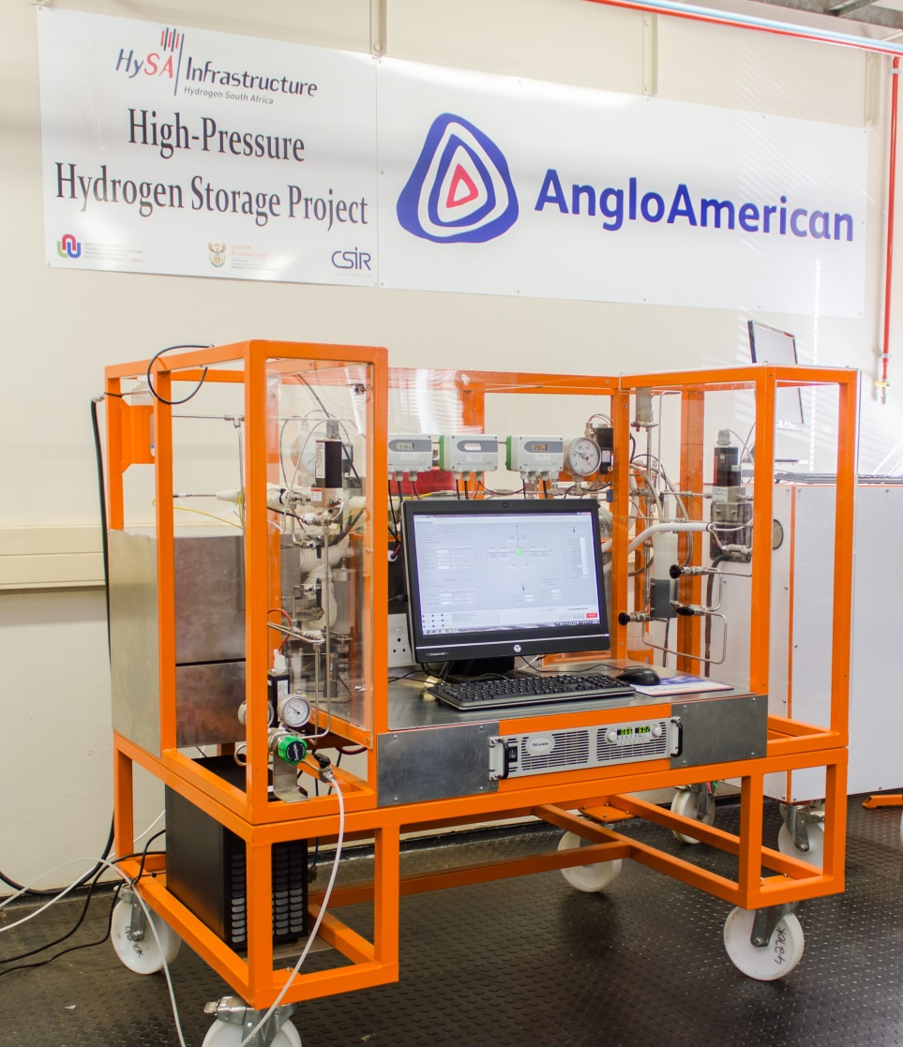
HySA Highlights: Infrastructure
Solar to Hydrogen plant
Cabin containing electrolyser
Electrochemical compressor

Slide 17
HySA Highlights: Infrastructure
Successful synthesis and characterisation of Metal Organic Frameworks
XRD patterns, and (b-d) SEM images of core-shell MOF (MIL-101(Cr)@UiO-66(Zr) grown for 3, 6 and 12 h, respectively (insert, TEM images).

Slide 18
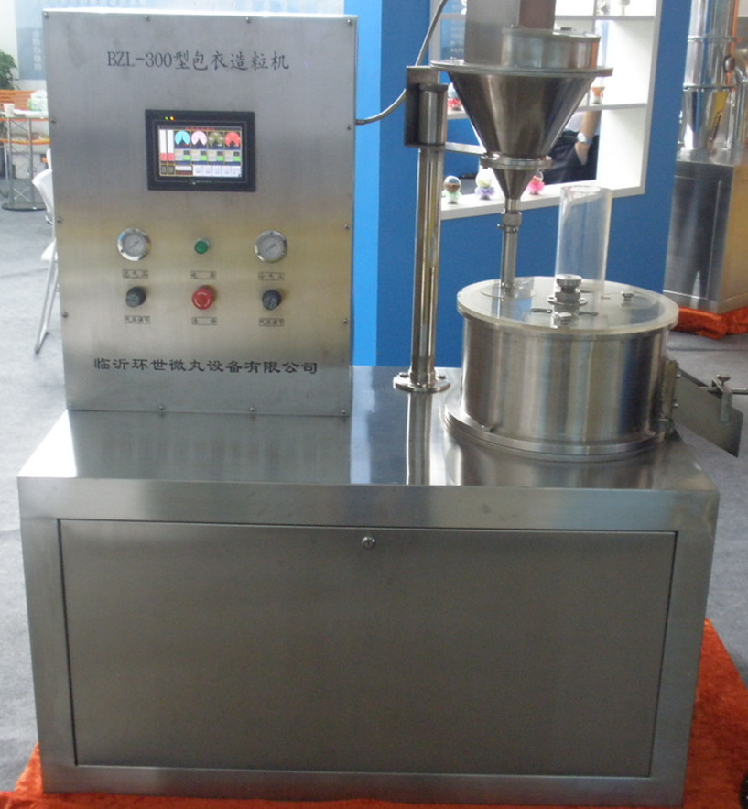
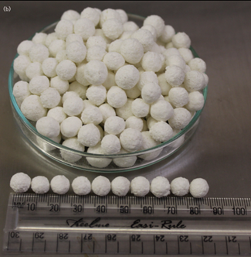
HySA Highlights: Infrastructure
Granulator and MOF pellets

Slide 19
Hydrogen initiatives in South Africa
HySA Infrastructure
Competence Centre Director: Dr Dmitri Bessarabov
Key Programmes: 4 (H2 Fuelling Stations) and
5 (Renewable H2)
Focus areas: Hydrogen Production and Storage, RCS
Projects:
Solar to Hydrogen (generation, compression, storage)
Hydrogen storage on/in porous materials (MOF, CNS)
Chemical Carriers (Ammonia, Formic Acid)
Composite Overwrapped Pressure Vessels

Slide 20
South African Fuel Cell and Hydrogen RCS
South African Bureau of Standards (SABS) develops voluntary standards
These Standards can be used by regulators such as the National Regulator for Compulsory Standards (NRCS) to regulate industry
Technical Committees and Working Groups are created to facilitate the adaptation and/or adoption of standards (such as ISO)
Selection of which standards to adopt is largely needs based
Other criteria such as impact on social and economic development also considered
H2FCT has lagged, largely due to a lack of need
Adoption of FC standards has accelerated (through formation of International Electrotechnical Commission (IEC) mirror committee) TC105: Fuel Cell Technologies

Slide 21
SANS: Fuel Cells (Source: K Shuda of PowerTech SI)
SANS 62282-1, Fuel cell technologies Part 1: Terminology
SANS 62282-2, Fuel cell technologies Part 2: Fuel cell modules
SANS 62281-3-100, Fuel cell technologies Part 3-100: Stationary fuel cell power systems – Safety
SANS 62282-4-101, Fuel cell technologies - Part 4-101: Fuel cell power systems for propulsion other than road vehicles and auxiliary power units (APU) - Safety of electrically powered industrial trucks
SANS 62282-3-200, Fuel cell technologies Part 3-200: Stationary fuel cell power systems - Performance test methods
SANS 62282-3-201, Fuel cell technologies Part 3-201: Stationary fuel cell power systems - Performance test methods for small fuel cell power systems
SANS 62282-3-300, Fuel cell technologies - Part 3-300: Stationary fuel cell power systems - Installation
SANS 62282-5-1, Fuel cell technologies Part 5-1: Portable fuel cell power systems – Safety
SANS 62282-6-100, Fuel cell technologies Part 6-100: Micro fuel cell power systems - Safety
SANS 62282-6-200, Fuel cell technologies Part 6-300: Micro fuel cell power systems – Performance test methods
SANS 62282-6-300, Fuel cell technologies Part 6-300: Micro fuel cell power systems - Fuel cartridge interchangeability
SANS 62282-7-1, Fuel cell technologies Part 7-1: Single cell test methods for polymer electrolyte fuel cell (PEFC)
SATS 62282-7-2, Fuel cell technologies - Part 7-2: Test methods - Single cell and stack performance tests for solid oxide fuel cells (SOFC)

Slide 22
South African Fuel Cell and Hydrogen RCS
Additional South African National Standards cover aspects such as
Hydrogen embrittlement
Hydrogen detectors
FC Vehicles (measurement of speed and energy consumption)
FC Vehicles (safety and protection against Hydrogen hazards)
SANS 10260-2: Industrial gas pipelines: Distribution of Hydrogen at consumer sites
Limits Hydrogen pressure to 16 bar
Review being conducted by TC 1019. Max pressure to be raised to 50 bar
Area classification covered by SANS 60079-10-1-1:2010 & 10108:2005
Pressure vessel and explosive atmosphere standards also exist.

Slide 23
“Simple” Problem
How to operate a PCT Pro to measure Hydrogen uptake
Cylinders are not allowed in laboratories in most provinces (Western Province and Kwa-Zulu Natal are current exceptions)
In Gauteng (Pretoria), we so far have been unable to get permission to pipe Hydrogen into the laboratory at cylinder pressure – SANS 10260-2 (by default) limits line pressure to 16 bar
Opinion is divided – “common sense”, Rational Design, or Major Hazardous Installation
This is due (in my opinion) to a lack of experience with Hydrogen
We continue to work with The Emergency Services, Building Control Officer and Risk Analysis Consultants to resolve this.

Slide 24
Concluding remarks
South Africa lags behind other countries in terms of Hydrogen Regulations, Codes and Standards
This is largely due to our relatively new Hydrogen programme – there has not been a need for such standards. Hydrogen education required. (SAASTA)
This is changing rapidly, due to the needs of HySA and companies rolling out Fuel Cell solutions (off-grid and back-up power)
In the absence of a South African standard, other codes or standards such as ISO and NFPA can be used to “defend” a design
We value the opportunity to meet and learn from the international Hydrogen RCS community
Thanks to Kennith Shuda (PowerTech SI), Peter Cross (SABS), Gavin Coetser (CEI), Philip Venn (Air Products) Cosmas Chitime (DST), HySA Directors and researchers for information provided.

Slide 25
Thank You
Contact details
www.dst.org.za
www.saasta.ac.za
www.hysasystems.com
www.hysacatalysis.uct.ac.za
www.hysainfrastructure.org
BNorth@csir.co.za
Hydrogen@csir.co.za

