Slide 1
Simulation of thermal radiation from hydrogen under-expanded jet fire
7th International Conference on Hydrogen Safety
11-13 September 2017, Hamburg, Germany
D. Cirrone, D. Makarov and V. Molkov
HySAFER Centre, University of Ulster, Newtownabbey, BT37 0QB, UK
cirrone-dmc@email.ulster.ac.uk, dv.makarov@ulster.ac.uk, v.molkov@ulster.ac.uk

Slide 2
Hydrogen jet fires
Introduction
The onboard automotive storage of gaseous hydrogen requires high-pressure tanks (350-700 bar).
In case of release from a damaged tank or a TPRD, the released hydrogen is likely to ignite producing a jet fire.
The resulting jet flame can cover distances of tens of meters, causing life-threatening conditions.
This work aims to create a contemporary CFD model for hydrogen safety engineering able to reproduce the dynamics of the radiative heat transfer and flame length of a hydrogen jet fire resulting from the high-pressure tank blowdown (900 bar).

Slide 3
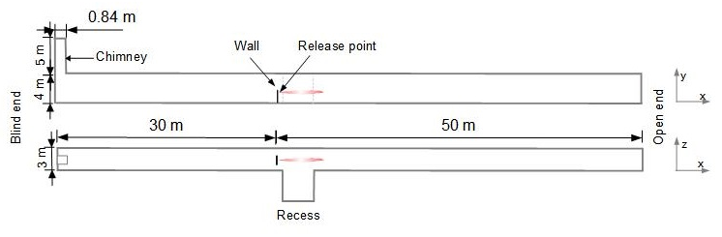
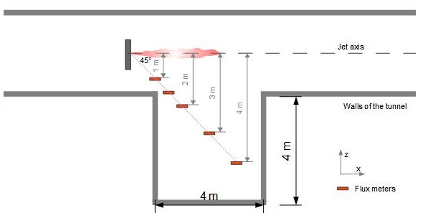
INERIS experiment
Description
Horizontal jet fire experiment at INERIS (Proust et al., 2011).
Release located at 1.5 m above the ground.
Experimental measurements:
Pressure and temperature in tank
Radiative heat flux
Flame length
Storage conditions
Tank volume, L | 25
Pressure, bar | 900
Temperature, K | 315
Release diameter, mm | 2
Geometry of the experimental facility
Detail of recess area and sensors position

Slide 4
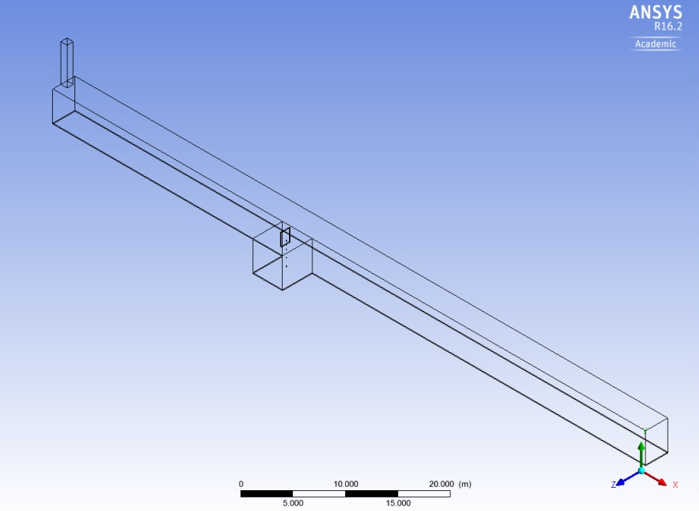
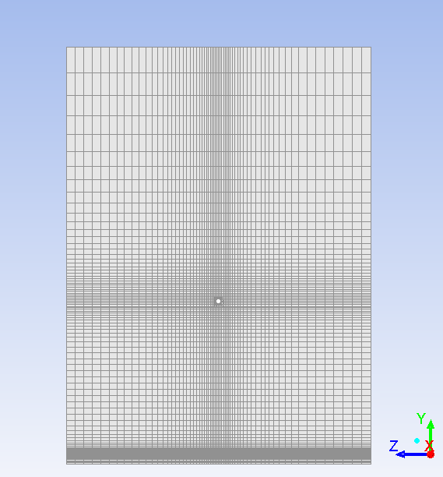
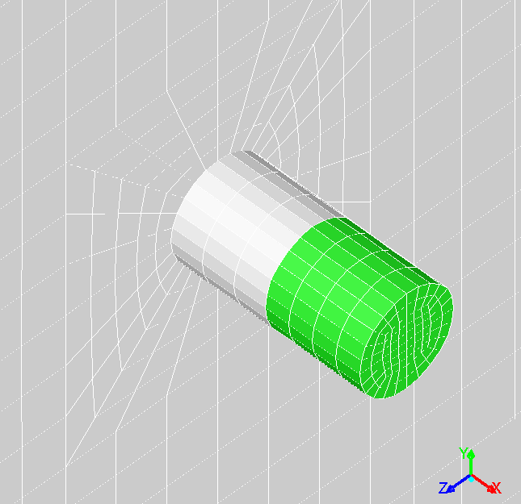
CFD Model
Numerical details
Turbulence | Realizable κ-ε (Shih et al.,1995)
Combustion | Eddy Dissipation Concept (Magnussen, 1981): 9 species and 18-step chemical reactions from Peters and Rogg’s kinetic mechanism (1993)
Radiation | Discrete Ordinates model (Murthy et al., 1998)
Calculation Domain
Cross section numerical grid
Release source numerical grid

Slide 5

Blowdown dynamics
Pressure and temperature dynamics
The Ulster notional nozzle approach is applied to simulate the under-expanded jet properties dynamics during the tank blowdown.
The mass flow rate is evaluated considering discharge coefficient $C_{d}=0.7$.
The adiabatic-to-isothermal (215K) blowdown formulation is selected to model the release.

Slide 6
Blowdown dynamics
Mass flow rate dynamics
The release of hydrogen was reproduced through the volumetric source implementation of the notional nozzle approach.
Range of validity of the volumetric source approach:

Slide 7
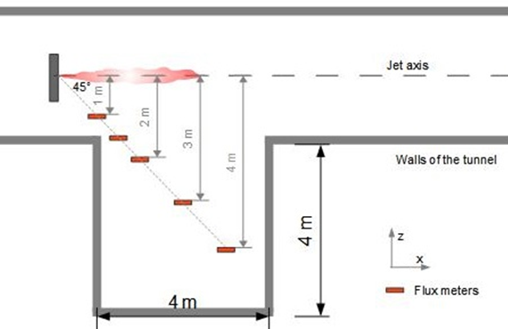
Simulation vs experiment
Radiative heat flux
Zone 1
Zone 2
rd1
rd1.5
rd2
rd3
rd4
radiometers

Slide 8
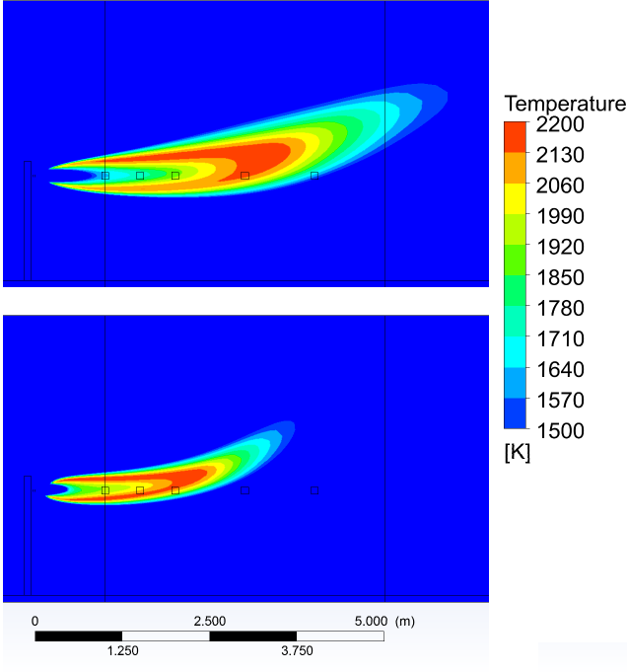
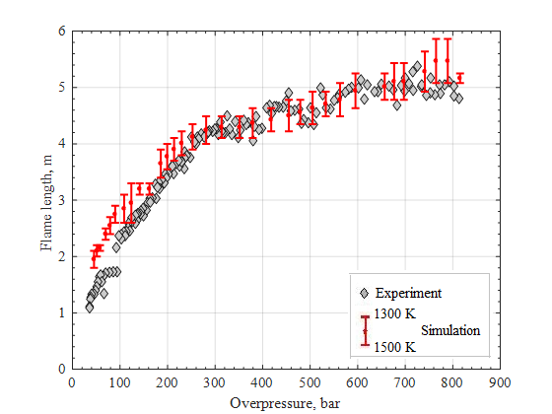
Simulation vs experiment
Flame length
Time = 1 s
Time = 15 s

Slide 9
Simulation results
Sensitivity analysis
Turbulent flow characteristics: turbulent intensity and turbulent length scale in the release source.
  Significant effect on the radiative heat flux in proximity of the release point with variations up to 30%.
  Minor effect on length of the flame (up to 13%).
Water vapour content in air.
  Large effect on the thermal radiation absorbed in the whole surroundings of the flame.
  The effect increases with the distance from the flame.

Slide 10
Concluding remarks
Thermal hazards from an under-expanded (900 bar) hydrogen jet fire have been numerically investigated.
The blowdown from the high-pressure hydrogen storage tank was modelled as first adiabatic and then isothermal process.
Simulation results show excellent CFD model capability to predict flame dynamics during large part of the blowdown process.
Modelling of radiative heat flux shows limited predictive capability during the first stage of hydrogen release (t=0-10 s) and quite a good agreement at later stage (t=10-35 s).
The turbulent flow characteristics have a minor and limited effect compared to the water vapour content in air.
Further studies should be conducted to improve performance of the model in reproduction of radiative properties dynamics during the first stage of the release.

Slide 11
Thank you for your attention!
The authors are grateful to Prof. Proust (INERIS) and Dr. Studer (CEA).
Support of EPSRC through SUPERGEN H2FC Hub and SUPERGEN Challenge, and support of Fuel Cell and Hydrogen 2 Joint Undertaking through NET-Tools project are highly appreciated!

